Slide 1
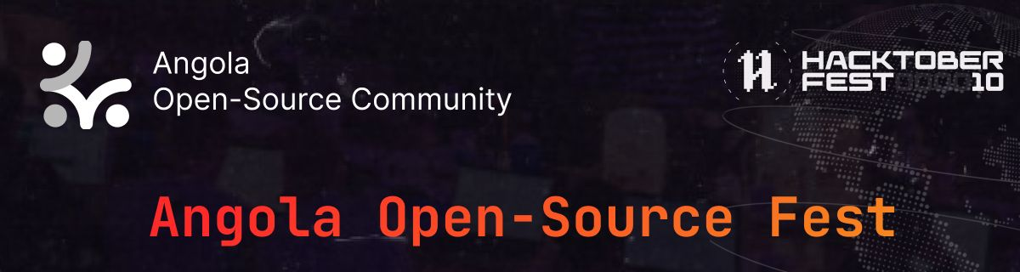
Open Source Program Office (OSPO)
Hackers na Governança e Geração de Negócios com FLOSS.
Marcio Junior Vieira
CEO & Data Scientist, Ambiente Livre
Pesquisador da UNB.

Slide 2
Marcio Junior Vieira – Quem sou eu?
Mini-cv
23 anos de experiência em informática, vivência em desenvolvimento e análise de sistemas de gestão empresarial e ciência de dados.
CEO da Ambiente Livre atuando como Cientista de Dados, Engenheiro de Dados e Arquiteto de Software.
Professor dos MBAs em Big Data & Data Science, Inteligência Artificial e BI da Universidade Positivo.
Professor do MBA Artificial Intelligence e Machine Learning da FIAP.
Trabalhando com Free Software e Open Source desde 2000 com serviços de consultoria e treinamento.
Graduado em Tecnologia em Informática(2004) e pós-graduado em Software Livre(2005) pela UFPR.
Palestrante FLOSS em: FISL, TDC, Latinoware, Campus Party, Pentaho Day, Ticnova, PgDay e FTSL.
Organizador Geral: Pentaho Day 2017, 2015, 2019 e apoio nas ed. 2013 e 2014.
Data Scientist, instrutor e consultor de Big Data e Data Science com tecnologias abertas.
Ajudou a capacitar equipes de Big Data na IBM, Accenture, Tivit, Sonda IT, Serpro, Natura, MP, Netshoes, Embraer entre outras.
Especialista em implantação e customização de Big Data com Hadoop, Spark, Pentaho, Cassandra e MongoDB.
Contribuidor de projetos internacionais, tais como Pentaho, LimeSurvey, SuiteCRM e Camunda.
Certificado (Certified Pentaho Solutions) pela Hitachi Vantara (Pentaho).
Notes:
Pentaho is an end-to-end business analytics and data integration platform. And in particular, a major area of focus for our platform has been helping customers integrate Big Data sources into their architecture and analyze that blend of traditional and emerging data. At the same time, we also provide analytics software that is highly embeddable in that they can fit seamlessly into existing applications and processes. A lot of our success in these areas has been due to both early innovation in Big Data – I believe we’ve been working with Hadoop for 5 to 6 years – as well as the open architecture and standards that our platform is built on.

Slide 3


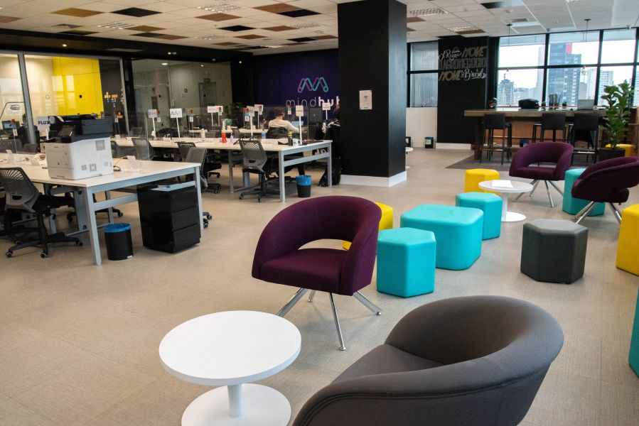

Sobre a Ambiente Livre
Open Software for Business
Fundada em 2004 com foco em consultoria em FLOSS.
Experts em 34 soluções para geração de negócios com Software Livre/Código Aberto.
Atualmente estamos sediados no Hub de Inovação Mindhub em Curitiba.
Notes:
Pentaho is an end-to-end business analytics and data integration platform. And in particular, a major area of focus for our platform has been helping customers integrate Big Data sources into their architecture and analyze that blend of traditional and emerging data. At the same time, we also provide analytics software that is highly embeddable in that they can fit seamlessly into existing applications and processes. A lot of our success in these areas has been due to both early innovation in Big Data – I believe we’ve been working with Hadoop for 5 to 6 years – as well as the open architecture and standards that our platform is built on.

Slide 4














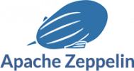

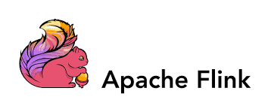
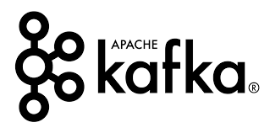




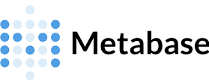
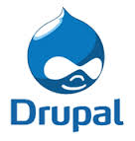



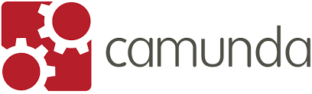
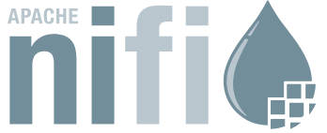




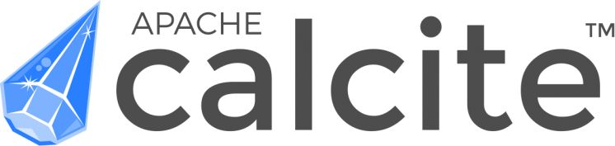
Nosso Ecossistema de Serviços
Notes:
Pentaho is an end-to-end business analytics and data integration platform. And in particular, a major area of focus for our platform has been helping customers integrate Big Data sources into their architecture and analyze that blend of traditional and emerging data. At the same time, we also provide analytics software that is highly embeddable in that they can fit seamlessly into existing applications and processes. A lot of our success in these areas has been due to both early innovation in Big Data – I believe we’ve been working with Hadoop for 5 to 6 years – as well as the open architecture and standards that our platform is built on.

Slide 5

Parceria Acadêmia – Iniciativa Privada
Parceria Ambiente Livre UP
Levar experiência do Mercado para Formação
Profissionais da acadêmia serão os decisores na definição de tecnologias de BI e Big Data em suas companhias e esperamos que esta parceria leve opções Open Source de Machine Learning, Data Mining, Business Intelligence e Big Data como alternativas tecnológica.
Notes:
Pentaho is an end-to-end business analytics and data integration platform. And in particular, a major area of focus for our platform has been helping customers integrate Big Data sources into their architecture and analyze that blend of traditional and emerging data. At the same time, we also provide analytics software that is highly embeddable in that they can fit seamlessly into existing applications and processes. A lot of our success in these areas has been due to both early innovation in Big Data – I believe we’ve been working with Hadoop for 5 to 6 years – as well as the open architecture and standards that our platform is built on.

Slide 6
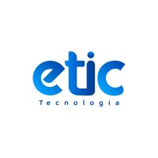
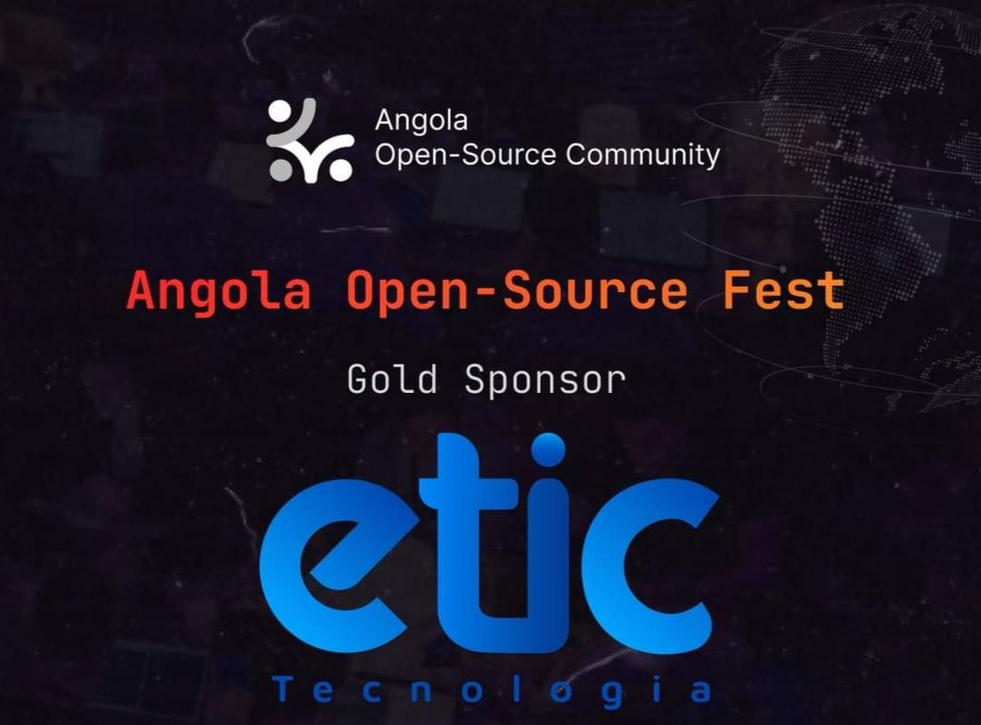
Parceiros em Angola
https://www.etic.co.ao/
Notes:
Pentaho is an end-to-end business analytics and data integration platform. And in particular, a major area of focus for our platform has been helping customers integrate Big Data sources into their architecture and analyze that blend of traditional and emerging data. At the same time, we also provide analytics software that is highly embeddable in that they can fit seamlessly into existing applications and processes. A lot of our success in these areas has been due to both early innovation in Big Data – I believe we’ve been working with Hadoop for 5 to 6 years – as well as the open architecture and standards that our platform is built on.

Slide 7
A 20 anos atrás...
Sonhos
Contato com GNU/Linux e User groups me colocaram no mundo FLOSS.
Eventos de FLOSS nos inspiraram!
O mercado para FLOSS estava se formando no mundo.
Trabalhava com desenvolvimento de Cloused Software.
Criamos um plano de fundamos uma consultoria FLOSS.
O plano inicial não deu certo, mas acertamos no slogan!
Não tínhamos metodologias, referências voltadas para FLOSS , tudo era desbravado! mas códigos sempre eram compartilhados. :)
Nosso Objetivo e ser:
Socialmente Justo, Economicamente Viável, Tecnologicamente Sustentável.
Notes:
Pentaho is an end-to-end business analytics and data integration platform. And in particular, a major area of focus for our platform has been helping customers integrate Big Data sources into their architecture and analyze that blend of traditional and emerging data. At the same time, we also provide analytics software that is highly embeddable in that they can fit seamlessly into existing applications and processes. A lot of our success in these areas has been due to both early innovation in Big Data – I believe we’ve been working with Hadoop for 5 to 6 years – as well as the open architecture and standards that our platform is built on.

Slide 8
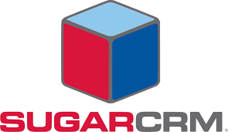


Time line...
2014
2010
2008
2007
2005
Notes:
Pentaho is an end-to-end business analytics and data integration platform. And in particular, a major area of focus for our platform has been helping customers integrate Big Data sources into their architecture and analyze that blend of traditional and emerging data. At the same time, we also provide analytics software that is highly embeddable in that they can fit seamlessly into existing applications and processes. A lot of our success in these areas has been due to both early innovation in Big Data – I believe we’ve been working with Hadoop for 5 to 6 years – as well as the open architecture and standards that our platform is built on.

Slide 9
Nosso Ecossistema de Serviços
Notes:
Pentaho is an end-to-end business analytics and data integration platform. And in particular, a major area of focus for our platform has been helping customers integrate Big Data sources into their architecture and analyze that blend of traditional and emerging data. At the same time, we also provide analytics software that is highly embeddable in that they can fit seamlessly into existing applications and processes. A lot of our success in these areas has been due to both early innovation in Big Data – I believe we’ve been working with Hadoop for 5 to 6 years – as well as the open architecture and standards that our platform is built on.

Slide 10

Ética Hacker
Hackers
Acesso a tecnologia deve ser ilimitado.
O Controle deve ser livre.
Promover a decentralização.
Meritocracia.
Você deve criar arte e beleza ao resolver problemas técnicos.
A tecnologia deve promover a liberdade e bem-estar das pessoas.
Notes:
Pentaho is an end-to-end business analytics and data integration platform. And in particular, a major area of focus for our platform has been helping customers integrate Big Data sources into their architecture and analyze that blend of traditional and emerging data. At the same time, we also provide analytics software that is highly embeddable in that they can fit seamlessly into existing applications and processes. A lot of our success in these areas has been due to both early innovation in Big Data – I believe we’ve been working with Hadoop for 5 to 6 years – as well as the open architecture and standards that our platform is built on.

Slide 11
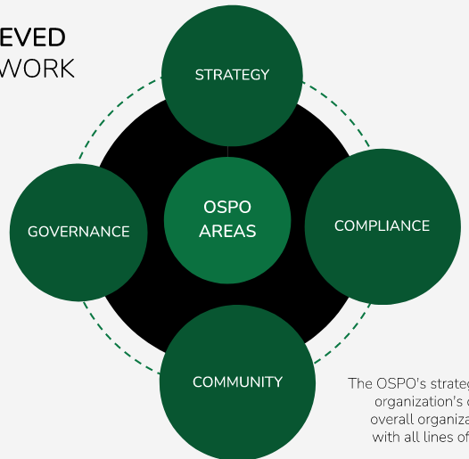
Open Source Program Office (OSPO)
Escritório de programas de código aberto (OSPO)
Centro de competência para operações e estrutura de código aberto de uma organização.
Defini e implementar estratégias e políticas.
Políticas de uso e Distribuição.
Seleção e Auditoria.
Contribuição, educação e treinamento.
Apoiar a eficiência de uma organização no desenvolvimento de software através do incentivo ao uso sustentável de componentes existentes.
Contribuindo com melhorias para esses projetos.
Quando necessário, orientando as equipes.
Garantir a eficácia da engenharia e conformidade legal
Promover e construir o envolvimento da comunidade.
InnerSource faz parte do OSPO.
Notes:
Pentaho is an end-to-end business analytics and data integration platform. And in particular, a major area of focus for our platform has been helping customers integrate Big Data sources into their architecture and analyze that blend of traditional and emerging data. At the same time, we also provide analytics software that is highly embeddable in that they can fit seamlessly into existing applications and processes. A lot of our success in these areas has been due to both early innovation in Big Data – I believe we’ve been working with Hadoop for 5 to 6 years – as well as the open architecture and standards that our platform is built on.

Slide 12
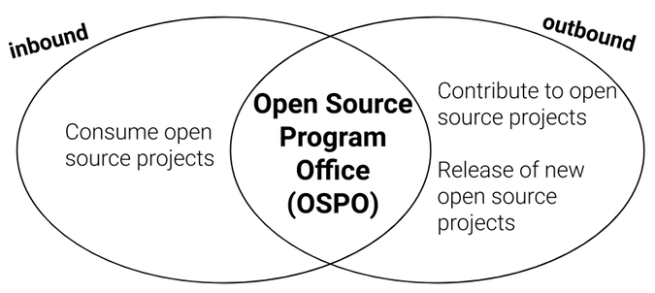
Open Source Program Office (OSPO)
Processos
Inbound: Ponte vital entre uma organização e a comunidade, ajudando a garantir que a organização seja uma boa administradora do software Open Source possa colher os benefícios de adoção.
Outbound: Interface central para atividades relacionadas ao Open Source em toda a organização e para reunir o conhecimento diferentes perspectivas: jurídica, econômica, técnica ou comunitária.
Notes:
Pentaho is an end-to-end business analytics and data integration platform. And in particular, a major area of focus for our platform has been helping customers integrate Big Data sources into their architecture and analyze that blend of traditional and emerging data. At the same time, we also provide analytics software that is highly embeddable in that they can fit seamlessly into existing applications and processes. A lot of our success in these areas has been due to both early innovation in Big Data – I believe we’ve been working with Hadoop for 5 to 6 years – as well as the open architecture and standards that our platform is built on.

Slide 13
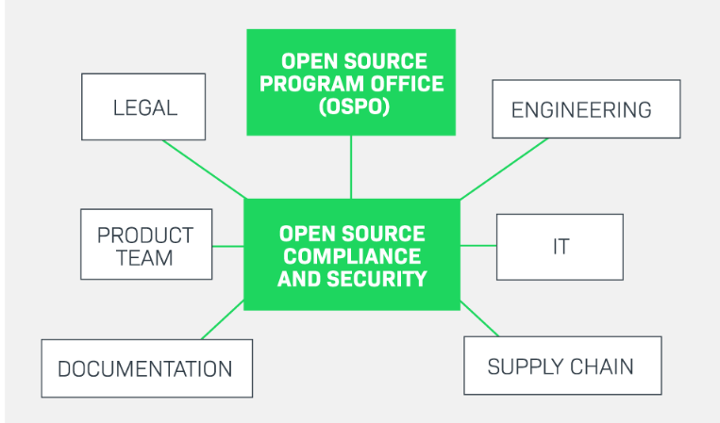
OSPOs são compostos por pessoas.
Notes:
Pentaho is an end-to-end business analytics and data integration platform. And in particular, a major area of focus for our platform has been helping customers integrate Big Data sources into their architecture and analyze that blend of traditional and emerging data. At the same time, we also provide analytics software that is highly embeddable in that they can fit seamlessly into existing applications and processes. A lot of our success in these areas has been due to both early innovation in Big Data – I believe we’ve been working with Hadoop for 5 to 6 years – as well as the open architecture and standards that our platform is built on.

Slide 14
OSPOs são compostos por pessoas.
Especialistas em código aberto com diferentes funções:
Open Source Enabler: Ajudam as organizações a navegar pelas mudanças culturais, de processos e de ferramentas necessárias para se envolverem efetivamente com a comunidade de código aberto.
Open Source Counselor: Fornecer orientação e aconselhamento sobre as últimas tendências de código aberto, tendências de licenciamento e como interagir com projetos, fundações e comunidades de código aberto.
Open Source Advocate: Promovem o uso e/ou contribuição de código aberto e melhores práticas em diferentes unidades organizacionais.
Open Source Environmentalist:Ajudam as organizações a apoiar e sustentar projetos de código aberto no longo prazo, abordando questões como segurança, manutenção e saúde do projeto.
Notes:
Pentaho is an end-to-end business analytics and data integration platform. And in particular, a major area of focus for our platform has been helping customers integrate Big Data sources into their architecture and analyze that blend of traditional and emerging data. At the same time, we also provide analytics software that is highly embeddable in that they can fit seamlessly into existing applications and processes. A lot of our success in these areas has been due to both early innovation in Big Data – I believe we’ve been working with Hadoop for 5 to 6 years – as well as the open architecture and standards that our platform is built on.

Slide 15
OSPO - Aspectos
Aspectos mantidos pelas equipes.
Estratégia.
Governança.
Conformidade e envolvimento da comunidade.
Metas de Open Source da organização com seus objetivos gerais da organização e trabalha com todas as linhas de unidades/grupos organizacionais.
Formado com vários setores, regiões e tamanhos organizacionais, incluindo organizações privadas e públicas, tais como acadêmicos, ONG, fundações, governos e administrações públicas, bem como pequenas, médias e grandes empresas.
Notes:
Pentaho is an end-to-end business analytics and data integration platform. And in particular, a major area of focus for our platform has been helping customers integrate Big Data sources into their architecture and analyze that blend of traditional and emerging data. At the same time, we also provide analytics software that is highly embeddable in that they can fit seamlessly into existing applications and processes. A lot of our success in these areas has been due to both early innovation in Big Data – I believe we’ve been working with Hadoop for 5 to 6 years – as well as the open architecture and standards that our platform is built on.

Slide 16
Tipos de OSPOs
Categorização por tipos de OSPOs.
Business-Oriented: Organizações com fins lucrativos, como empresas, que se concentram principalmente na criação de valor comercial por meio do uso de software de código aberto.
Educational-Oriented: Instituições educacionais, como universidades ou escolas, que se concentram no uso de software de código aberto para apoiar atividades de ensino, pesquisa e aprendizagem.
Business-Educational: Organizações com fins lucrativos que fornecem treinamento e certificação e provavelmente colaboram com educational-oriented.
Social-Gov-Oriented: No âmbito de um governo ou de administradores públicos que se concentram na utilização de software de código aberto para atingir objetivos sociais ou de políticas públicas (por exemplo, servir os cidadãos).
Social-NonGov-Oriented: Organizações não governamentais (ONGs) ou fundações que se dedicam ao uso de software de código aberto para criar mudanças sociais positivas.
Notes:
Pentaho is an end-to-end business analytics and data integration platform. And in particular, a major area of focus for our platform has been helping customers integrate Big Data sources into their architecture and analyze that blend of traditional and emerging data. At the same time, we also provide analytics software that is highly embeddable in that they can fit seamlessly into existing applications and processes. A lot of our success in these areas has been due to both early innovation in Big Data – I believe we’ve been working with Hadoop for 5 to 6 years – as well as the open architecture and standards that our platform is built on.

Slide 17
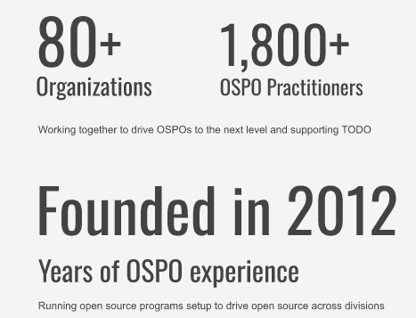
Open Source Program Office (OSPO)
Notes:
Pentaho is an end-to-end business analytics and data integration platform. And in particular, a major area of focus for our platform has been helping customers integrate Big Data sources into their architecture and analyze that blend of traditional and emerging data. At the same time, we also provide analytics software that is highly embeddable in that they can fit seamlessly into existing applications and processes. A lot of our success in these areas has been due to both early innovation in Big Data – I believe we’ve been working with Hadoop for 5 to 6 years – as well as the open architecture and standards that our platform is built on.

Slide 18
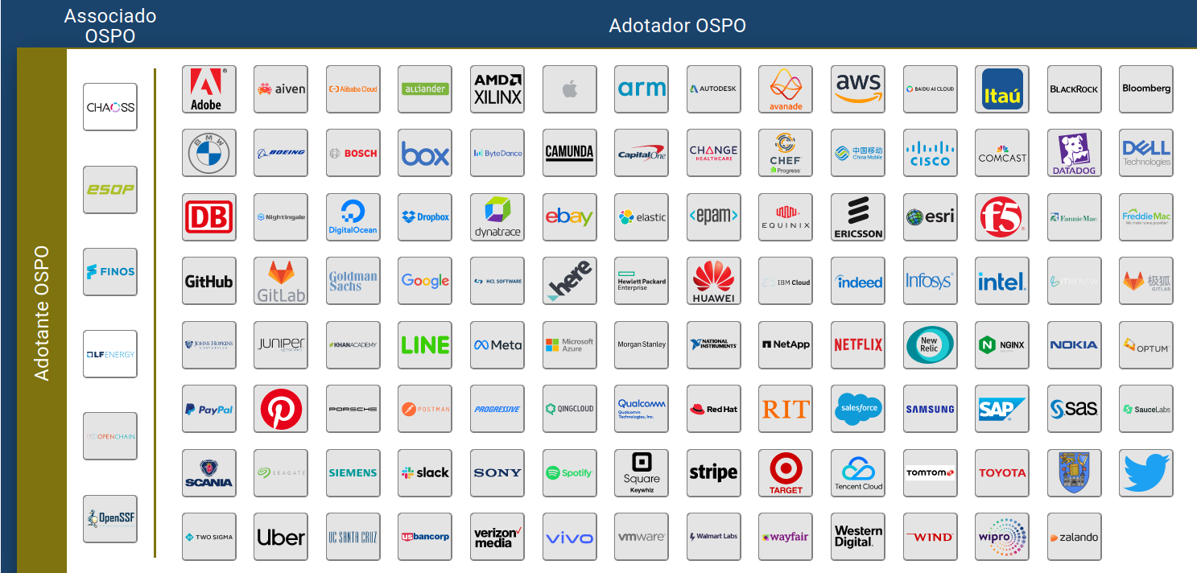
Associados e empresas que adotaram OSPO.
Notes:
Pentaho is an end-to-end business analytics and data integration platform. And in particular, a major area of focus for our platform has been helping customers integrate Big Data sources into their architecture and analyze that blend of traditional and emerging data. At the same time, we also provide analytics software that is highly embeddable in that they can fit seamlessly into existing applications and processes. A lot of our success in these areas has been due to both early innovation in Big Data – I believe we’ve been working with Hadoop for 5 to 6 years – as well as the open architecture and standards that our platform is built on.

Slide 19
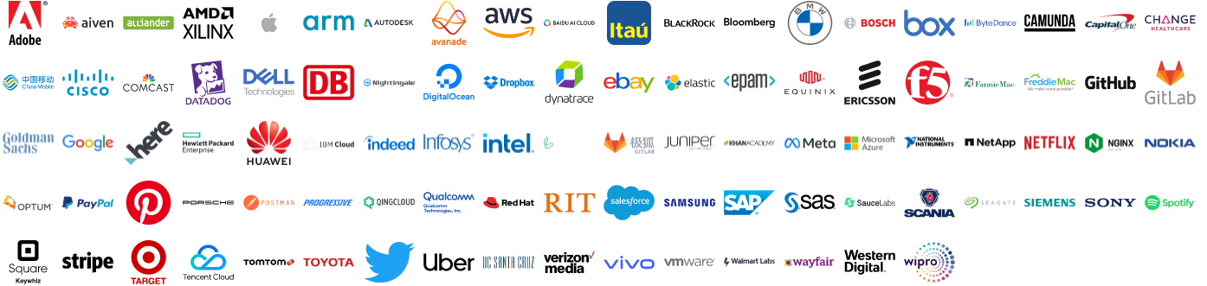
TODO Group Members
Notes:
Pentaho is an end-to-end business analytics and data integration platform. And in particular, a major area of focus for our platform has been helping customers integrate Big Data sources into their architecture and analyze that blend of traditional and emerging data. At the same time, we also provide analytics software that is highly embeddable in that they can fit seamlessly into existing applications and processes. A lot of our success in these areas has been due to both early innovation in Big Data – I believe we’ve been working with Hadoop for 5 to 6 years – as well as the open architecture and standards that our platform is built on.

Slide 20
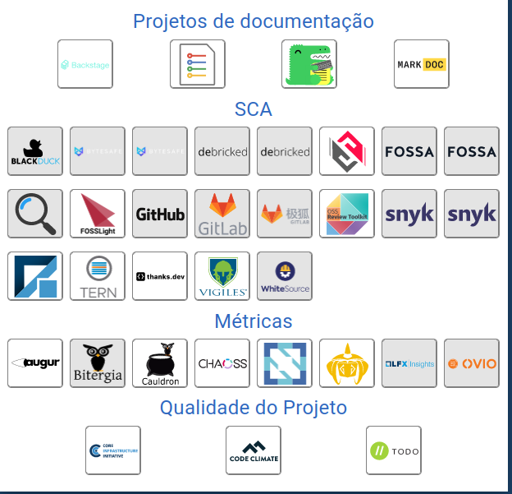
Ferramentas OSPO
Notes:
Pentaho is an end-to-end business analytics and data integration platform. And in particular, a major area of focus for our platform has been helping customers integrate Big Data sources into their architecture and analyze that blend of traditional and emerging data. At the same time, we also provide analytics software that is highly embeddable in that they can fit seamlessly into existing applications and processes. A lot of our success in these areas has been due to both early innovation in Big Data – I believe we’ve been working with Hadoop for 5 to 6 years – as well as the open architecture and standards that our platform is built on.

Slide 21
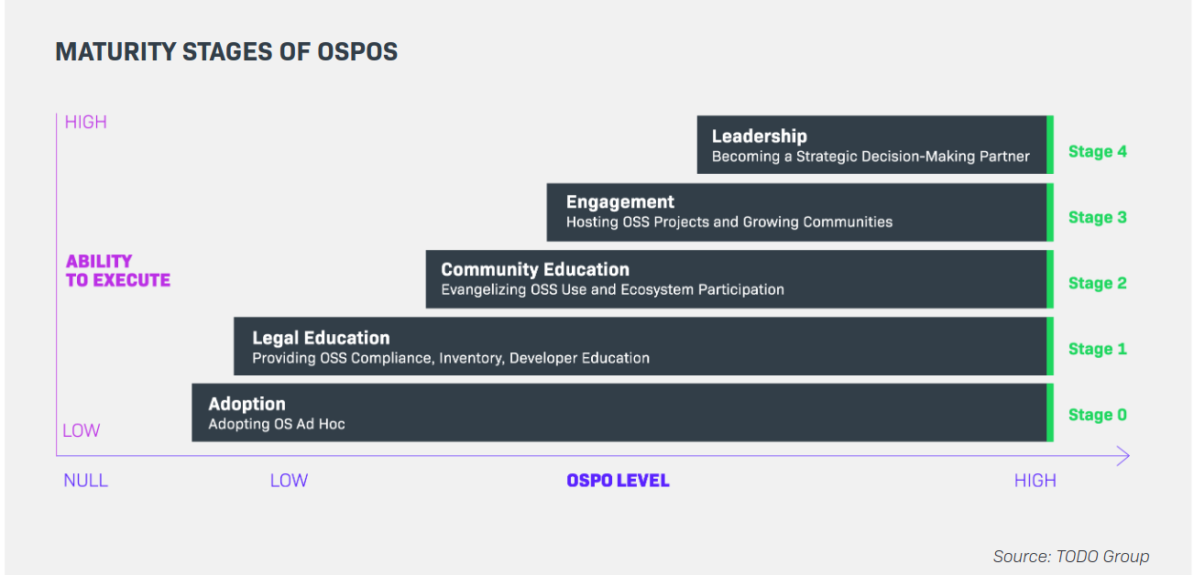
Estágios para Maturidade dos OSPOs
Notes:
Pentaho is an end-to-end business analytics and data integration platform. And in particular, a major area of focus for our platform has been helping customers integrate Big Data sources into their architecture and analyze that blend of traditional and emerging data. At the same time, we also provide analytics software that is highly embeddable in that they can fit seamlessly into existing applications and processes. A lot of our success in these areas has been due to both early innovation in Big Data – I believe we’ve been working with Hadoop for 5 to 6 years – as well as the open architecture and standards that our platform is built on.

Slide 22
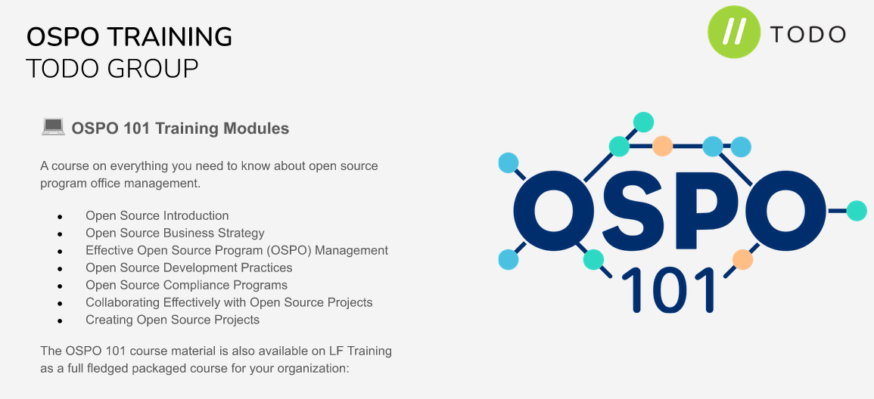
Referências
TODO Group - https://todogroup.org/
OSPO Alliance - https://ospo-alliance.org/
Notes:
Pentaho is an end-to-end business analytics and data integration platform. And in particular, a major area of focus for our platform has been helping customers integrate Big Data sources into their architecture and analyze that blend of traditional and emerging data. At the same time, we also provide analytics software that is highly embeddable in that they can fit seamlessly into existing applications and processes. A lot of our success in these areas has been due to both early innovation in Big Data – I believe we’ve been working with Hadoop for 5 to 6 years – as well as the open architecture and standards that our platform is built on.

Slide 23
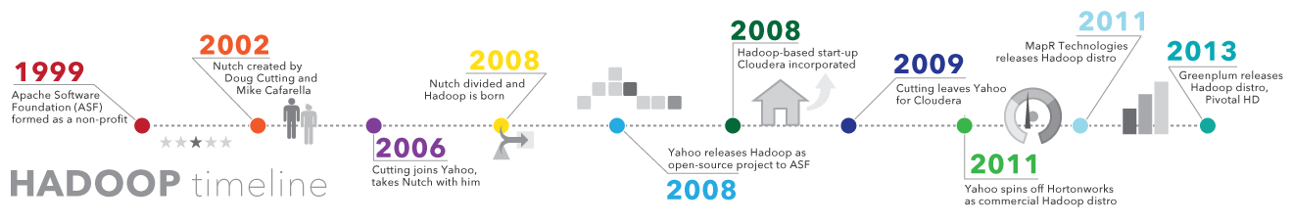
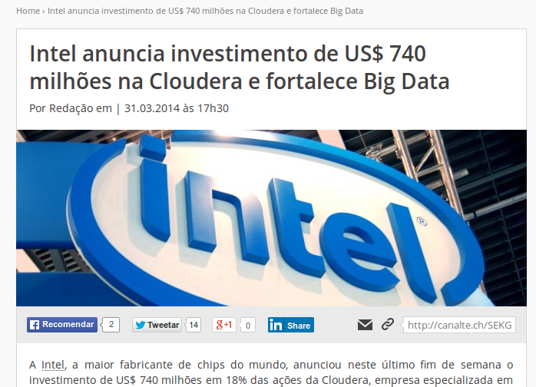
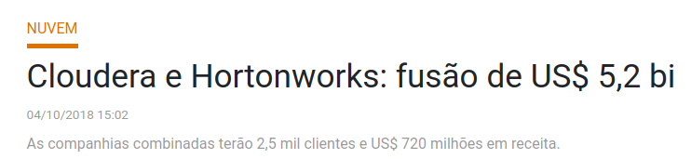
CASE - Open Source Gerando Valor
Startup Cloudera
CASE Hadoop
Cloudera e Hortonworks.
MapR e GreenPlum.
Release MapR
Fonte: https://www.sas.com/pt_br/insights/big-data/hadoop.html
Startup
Greeplum
Startup
Hortonworks
Notes:
Pentaho is an end-to-end business analytics and data integration platform. And in particular, a major area of focus for our platform has been helping customers integrate Big Data sources into their architecture and analyze that blend of traditional and emerging data. At the same time, we also provide analytics software that is highly embeddable in that they can fit seamlessly into existing applications and processes. A lot of our success in these areas has been due to both early innovation in Big Data – I believe we’ve been working with Hadoop for 5 to 6 years – as well as the open architecture and standards that our platform is built on.

Slide 24
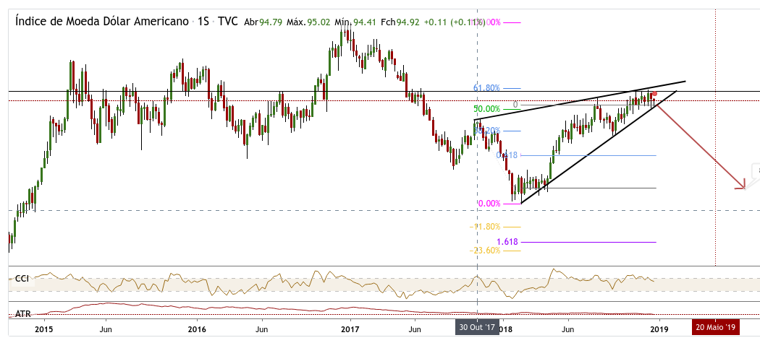
Comportamento do Mercado - Gigantes X Startups
Gigantes
Compram Player de Mercado…
Montamos Cluster na Amazon, Google, Azure, AWS.
Uso o Framework da Nuvem.
O custo sobe... a empresa cresce... a crise vem... o dólar sobe... !
Criam Ambiente de Inovação externo pois internamente não conseguem inovar. (open innovation)
Começo a mesclar usando FLOSS…
Startups
Começam ao Contrário! Open Source sempre primeiro.
Usam sim nuvens, Clouds mas não se aprisionam a itens não mutáveis (lock-in)
Notes:
Pentaho is an end-to-end business analytics and data integration platform. And in particular, a major area of focus for our platform has been helping customers integrate Big Data sources into their architecture and analyze that blend of traditional and emerging data. At the same time, we also provide analytics software that is highly embeddable in that they can fit seamlessly into existing applications and processes. A lot of our success in these areas has been due to both early innovation in Big Data – I believe we’ve been working with Hadoop for 5 to 6 years – as well as the open architecture and standards that our platform is built on.

Slide 25

Diferenciais Reais mas não impeditivos (Oportunidades)
Dificuldades
Interface
Aceleração do Trabalho ( tempo)
BI Self Service , Big Data Self Service! Será mesmo ?
Suporte do Desenvolvedor
Documentação, Livros, Materiais em Português
Documentação extremamente técnica
Oportunidades
Desenvolva UI...
Desenvolva Frameworks de produtividade…
Vende seu serviço para resolver as dificuldades e cria as oportunidades
Notes:
Pentaho is an end-to-end business analytics and data integration platform. And in particular, a major area of focus for our platform has been helping customers integrate Big Data sources into their architecture and analyze that blend of traditional and emerging data. At the same time, we also provide analytics software that is highly embeddable in that they can fit seamlessly into existing applications and processes. A lot of our success in these areas has been due to both early innovation in Big Data – I believe we’ve been working with Hadoop for 5 to 6 years – as well as the open architecture and standards that our platform is built on.

Slide 26
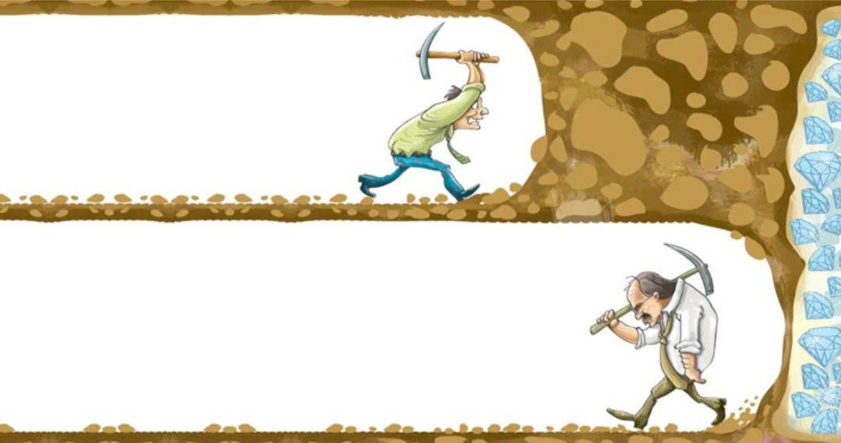

Dificuldades reais ou novamente Oportunidade!
Dificudades
Alto investimento em capital intelectual das pessoas
Encontrar pessoas com perfil “hacker e pesquisador”
Tempo
Persistência
Notes:
Pentaho is an end-to-end business analytics and data integration platform. And in particular, a major area of focus for our platform has been helping customers integrate Big Data sources into their architecture and analyze that blend of traditional and emerging data. At the same time, we also provide analytics software that is highly embeddable in that they can fit seamlessly into existing applications and processes. A lot of our success in these areas has been due to both early innovation in Big Data – I believe we’ve been working with Hadoop for 5 to 6 years – as well as the open architecture and standards that our platform is built on.

Slide 27
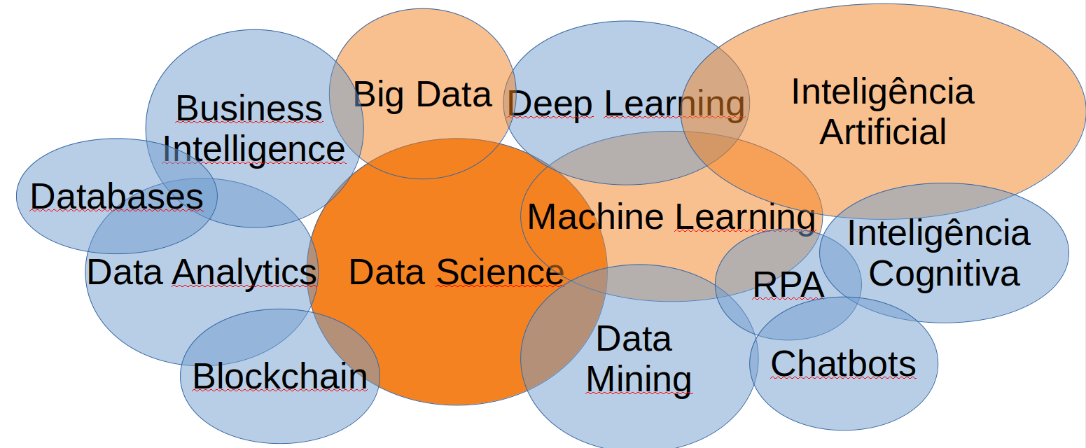
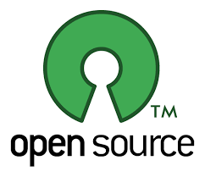

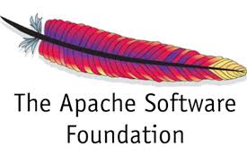
Use FLOSS use Open Source!
E a Base da Pirâmide
da Tecnologia da Informação
FLOSS é Inovação!
Open Source é Inovação!
Notes:
Pentaho is an end-to-end business analytics and data integration platform. And in particular, a major area of focus for our platform has been helping customers integrate Big Data sources into their architecture and analyze that blend of traditional and emerging data. At the same time, we also provide analytics software that is highly embeddable in that they can fit seamlessly into existing applications and processes. A lot of our success in these areas has been due to both early innovation in Big Data – I believe we’ve been working with Hadoop for 5 to 6 years – as well as the open architecture and standards that our platform is built on.

Slide 28

Uma analogia para finalizar!
Tecnologia disponível está no seu pátio
Sejam os pilotos, os mecânicos os tripulantes deste negócio gigantesco que é o Open Source.
Notes:
Pentaho is an end-to-end business analytics and data integration platform. And in particular, a major area of focus for our platform has been helping customers integrate Big Data sources into their architecture and analyze that blend of traditional and emerging data. At the same time, we also provide analytics software that is highly embeddable in that they can fit seamlessly into existing applications and processes. A lot of our success in these areas has been due to both early innovation in Big Data – I believe we’ve been working with Hadoop for 5 to 6 years – as well as the open architecture and standards that our platform is built on.

Slide 29
Obrigado
Marcio Junior Vieira
marcio@ambientelivre.com.br
@marviojvieira @ambientelivre
@ambientelivreopensoftware
https://www.linkedin.com/in/mvieira1/
Blog: http://blogs.ambientelivre.com.br/marcio/

