Slide 1
SolrCloud
Indexação Clusterizada
Marcio Junior Vieira
CEO & Data Scientist, Ambiente Livre
Pesquisador da UNB.

Slide 2
Marcio Junior Vieira
Mini-CV
22 anos de experiência em TI, vivência em desenvolvimento e análise de sistemas de gestão empresarial e ciência de dados.
CEO da Ambiente Livre atuando como Cientista de Dados, Engenheiro de Dados e Arquiteto de Software.
Professor dos MBAs em Big Data & Data Science, Inteligência Artificial e Business Intelligence e Analytics da Universidade Positivo.
Professor do MBA Artificial Intelligence e Machine Learning da FIAP.
Pesquisador do Laboratório de Tecnologias para Tomada de Decisão da Universidade de Brasília (Unb/Latitude).
Trabalhando com Free Software e Open Source desde 2000 com serviços de consultoria e treinamento.
Graduado em Tecnologia em Informática(2004) e pós-graduado em Software Livre(2005) ambos pela UFPR.
Palestrante FLOSS em: FISL, TDC, Latinoware, Campus Party, Pentaho Day, Ticnova, PgDay e FTSL.
Organizador Geral: Pentaho Day 2017, 2015, 2019 e apoio nas ed. 2013 e 2014.
Data Scientist, instrutor e consultor de Big Data e Data Science com tecnologias abertas.
Ajudou a capacitar equipes de Big Data na IBM, Accenture, Tivit, Serpro, Natura, MP, Netshoes, Embraer etc.
Especialista em implantação e customização de Big Data com Hadoop, Spark, Pentaho, Cassandra e MongoDB.
Contribuidor de projetos internacionais, tais como Pentaho, LimeSurvey, SuiteCRM e Camunda.
Especialista em implantação e customização de ECM com Alfresco e BPM com Activiti, Flowable e Camunda.
Certificado (Certified Pentaho Solutions) pela Hitachi Vantara (Pentaho).
Membro da The Order Of de Bee (comunidade Alfresco para desenvolver o ecossistema Alfresco independente)
Notes:
Pentaho is an end-to-end business analytics and data integration platform. And in particular, a major area of focus for our platform has been helping customers integrate Big Data sources into their architecture and analyze that blend of traditional and emerging data. At the same time, we also provide analytics software that is highly embeddable in that they can fit seamlessly into existing applications and processes. A lot of our success in these areas has been due to both early innovation in Big Data – I believe we’ve been working with Hadoop for 5 to 6 years – as well as the open architecture and standards that our platform is built on.

Slide 3




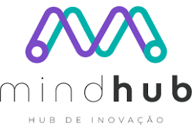
Sobre a Ambiente Livre
Open Software for Business
Fundada em 2004 com foco em consultoria com FLOSS.
Experts em 34 soluções para geração de negócios com Software Livre/Código Aberto.
Atualmente estamos sediados no Hub de Inovação Mindhub em Curitiba (FAE).
Notes:
Pentaho is an end-to-end business analytics and data integration platform. And in particular, a major area of focus for our platform has been helping customers integrate Big Data sources into their architecture and analyze that blend of traditional and emerging data. At the same time, we also provide analytics software that is highly embeddable in that they can fit seamlessly into existing applications and processes. A lot of our success in these areas has been due to both early innovation in Big Data – I believe we’ve been working with Hadoop for 5 to 6 years – as well as the open architecture and standards that our platform is built on.

Slide 4
















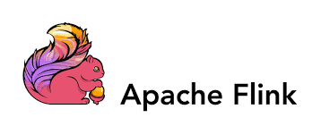















Nosso Ecossistema de Serviços
Notes:
Pentaho is an end-to-end business analytics and data integration platform. And in particular, a major area of focus for our platform has been helping customers integrate Big Data sources into their architecture and analyze that blend of traditional and emerging data. At the same time, we also provide analytics software that is highly embeddable in that they can fit seamlessly into existing applications and processes. A lot of our success in these areas has been due to both early innovation in Big Data – I believe we’ve been working with Hadoop for 5 to 6 years – as well as the open architecture and standards that our platform is built on.

Slide 5
Índices de Pesquisa - Índice Invertido
Conceito
Estrutura de dados de índice que armazena um mapeamento de conteúdo, como palavras ou números, para suas localizações em um documento ou conjunto de documentos.
É um hashmap como uma estrutura de dados que o direciona de uma palavra para um documento ou página da web.
Existem dois tipos de índices invertidos: Um índice invertido em nível de registro contém uma lista de referências a documentos para cada palavra. Um índice invertido em nível de palavra contém adicionalmente as posições de cada palavra em um documento.
Notes:
Pentaho is an end-to-end business analytics and data integration platform. And in particular, a major area of focus for our platform has been helping customers integrate Big Data sources into their architecture and analyze that blend of traditional and emerging data. At the same time, we also provide analytics software that is highly embeddable in that they can fit seamlessly into existing applications and processes. A lot of our success in these areas has been due to both early innovation in Big Data – I believe we’ve been working with Hadoop for 5 to 6 years – as well as the open architecture and standards that our platform is built on.

Slide 6
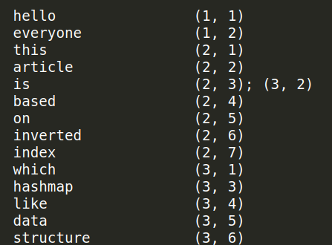
Índices de Pesquisa - Índice Invertido
Índice invertido - Exemplo
Suponha que queremos pesquisar os textos “hello everyone”, “This article is based on inverted index”, “which is a data structure similar to a hashmap”. Se indexarmos por (texto, palavra dentro do texto), o índice com localização no texto é:
A palavra “hello” está no documento 1
(“hello everyone”) começando na palavra 1,
então tem uma entrada (1, 1) e a palavra
“is” está no documento 2 e 3 nas posições
'3ª' e '2ª' respectivamente (aqui a posição
é baseada na palavra).
O índice pode ter pesos, frequências ou
outros indicadores.
Notes:
Pentaho is an end-to-end business analytics and data integration platform. And in particular, a major area of focus for our platform has been helping customers integrate Big Data sources into their architecture and analyze that blend of traditional and emerging data. At the same time, we also provide analytics software that is highly embeddable in that they can fit seamlessly into existing applications and processes. A lot of our success in these areas has been due to both early innovation in Big Data – I believe we’ve been working with Hadoop for 5 to 6 years – as well as the open architecture and standards that our platform is built on.

Slide 7
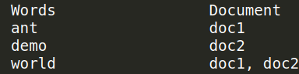
Índices de Pesquisa - Índice Invertido
Passos para construir um índice invertido:
Busque o documento.
Removendo palavras de parada: são as palavras
mais comuns e inúteis em documentos como “eu”, “o”, “nós”, “é”, “um”.
Derivação da palavra raiz.
Sempre que desejo pesquisar “gato”, desejo ver um documento que contém informações sobre ele. Mas a palavra presente no documento é chamada de “gatos” ou “maliciosos” em vez de “gato”. Para relacionar as duas palavras, cortarei alguma parte de cada palavra que leio para que possa obter a “palavra raiz”. Existem ferramentas padrão para fazer isso, como “Porter's Stemmer”.
Registre IDs de documentos.
Se a palavra já estiver presente, adicione a referência do documento para indexar, caso contrário, crie uma nova entrada. Adicione informações adicionais, como frequência da palavra, localização da palavra, etc.
Notes:
Pentaho is an end-to-end business analytics and data integration platform. And in particular, a major area of focus for our platform has been helping customers integrate Big Data sources into their architecture and analyze that blend of traditional and emerging data. At the same time, we also provide analytics software that is highly embeddable in that they can fit seamlessly into existing applications and processes. A lot of our success in these areas has been due to both early innovation in Big Data – I believe we’ve been working with Hadoop for 5 to 6 years – as well as the open architecture and standards that our platform is built on.

Slide 8
Índices de Pesquisa - Índice Invertido
Vantagens
O índice invertido permite pesquisas rápidas de texto completo, a um custo de processamento aumentado quando um documento é adicionado ao banco de dados.
É fácil de desenvolver.
É a estrutura de dados mais popular usada em sistemas de recuperação de documentos, usados ​​em grande escala, por exemplo, em motores de busca.
Desvantagens
Grande sobrecarga de armazenamento e altos custos de manutenção na atualização, exclusão e inserção.
Notes:
Pentaho is an end-to-end business analytics and data integration platform. And in particular, a major area of focus for our platform has been helping customers integrate Big Data sources into their architecture and analyze that blend of traditional and emerging data. At the same time, we also provide analytics software that is highly embeddable in that they can fit seamlessly into existing applications and processes. A lot of our success in these areas has been due to both early innovation in Big Data – I believe we’ve been working with Hadoop for 5 to 6 years – as well as the open architecture and standards that our platform is built on.

Slide 9
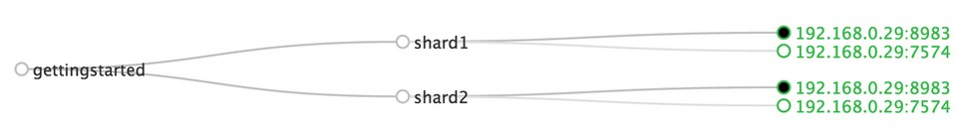
Apache Solr - Funcionalidades
API Open Source
Você coloca documentos nele (chamado de "indexação") via JSON, XML, CSV ou binário sobre HTTP.
Você consulta via HTTP GET e recebe JSON, XML, CSV ou binário
Adiciona novos documentos ao index.
Deleta documentos do index.
Constrói querys.
Busca no index usando querys.
Notes:
Pentaho is an end-to-end business analytics and data integration platform. And in particular, a major area of focus for our platform has been helping customers integrate Big Data sources into their architecture and analyze that blend of traditional and emerging data. At the same time, we also provide analytics software that is highly embeddable in that they can fit seamlessly into existing applications and processes. A lot of our success in these areas has been due to both early innovation in Big Data – I believe we’ve been working with Hadoop for 5 to 6 years – as well as the open architecture and standards that our platform is built on.

Slide 10
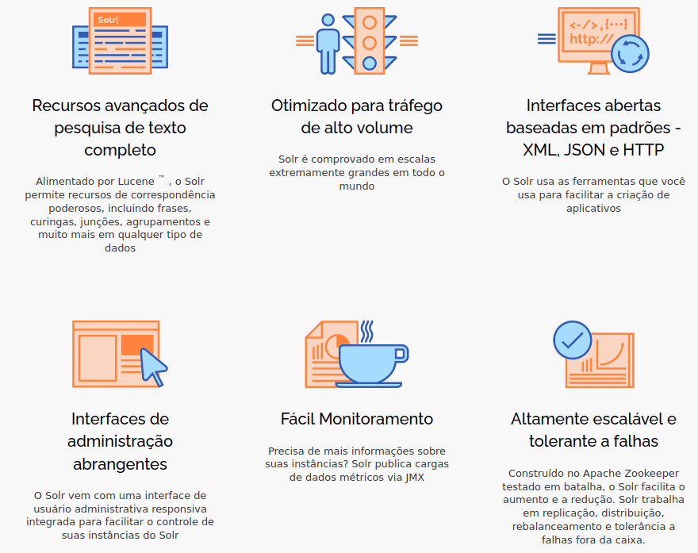
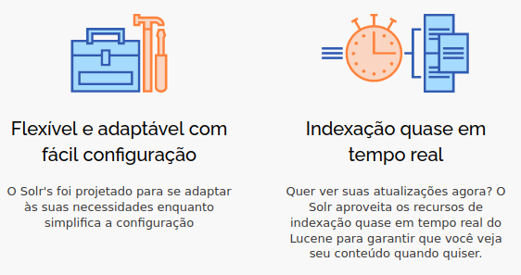
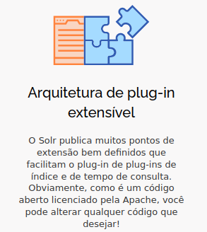
Apache Solr - Funcionalidades
Notes:
Pentaho is an end-to-end business analytics and data integration platform. And in particular, a major area of focus for our platform has been helping customers integrate Big Data sources into their architecture and analyze that blend of traditional and emerging data. At the same time, we also provide analytics software that is highly embeddable in that they can fit seamlessly into existing applications and processes. A lot of our success in these areas has been due to both early innovation in Big Data – I believe we’ve been working with Hadoop for 5 to 6 years – as well as the open architecture and standards that our platform is built on.

Slide 11
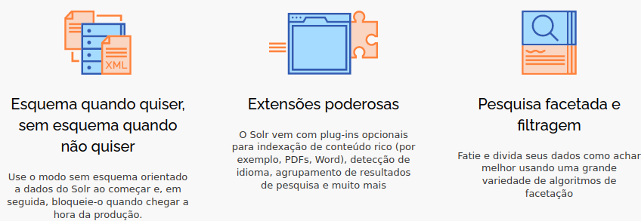
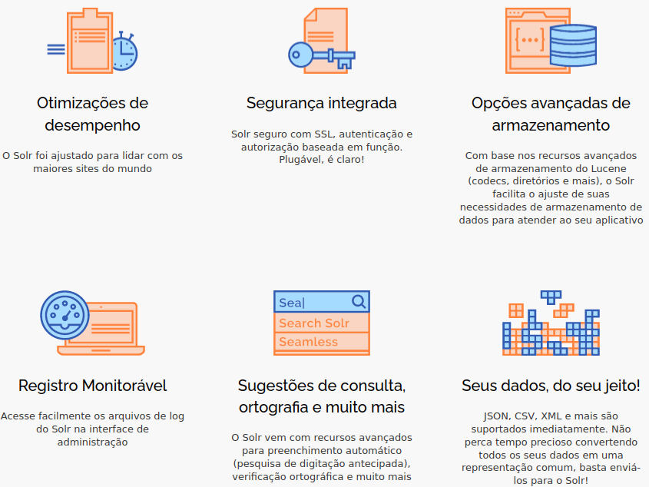
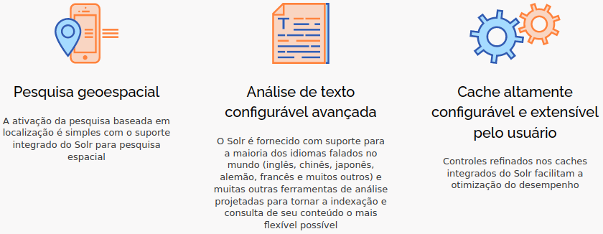
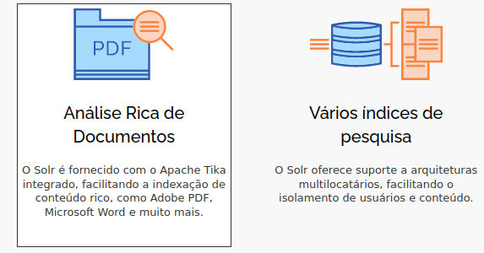
Apache Solr – Funcionalidades Estendidas
Notes:
Pentaho is an end-to-end business analytics and data integration platform. And in particular, a major area of focus for our platform has been helping customers integrate Big Data sources into their architecture and analyze that blend of traditional and emerging data. At the same time, we also provide analytics software that is highly embeddable in that they can fit seamlessly into existing applications and processes. A lot of our success in these areas has been due to both early innovation in Big Data – I believe we’ve been working with Hadoop for 5 to 6 years – as well as the open architecture and standards that our platform is built on.

Slide 12

Apache Lucene
Projeto Apache Lucene™
Desenvolve software de pesquisa de código aberto. O projeto lança uma biblioteca de pesquisa central, denominada Lucene Core™, bem como PyLucene, uma integração de Python com Lucene.
Lucene Core é uma biblioteca Java que oferece recursos avançados de indexação e pesquisa, bem como verificação ortográfica, realce de ocorrências e recursos avançados de análise/tokenização.
O Solr era um subprojeto do Lucene, e se tornou um Projeto de Nível Superior (TLP).
Tecnologia adequada para praticamente qualquer aplicativo que exija pesquisa estruturada, pesquisa de texto completo, facetamento, pesquisa de vizinho mais próximo em vetores de alta dimensionalidade, correção ortográfica ou sugestões de consulta.
Notes:
Pentaho is an end-to-end business analytics and data integration platform. And in particular, a major area of focus for our platform has been helping customers integrate Big Data sources into their architecture and analyze that blend of traditional and emerging data. At the same time, we also provide analytics software that is highly embeddable in that they can fit seamlessly into existing applications and processes. A lot of our success in these areas has been due to both early innovation in Big Data – I believe we’ve been working with Hadoop for 5 to 6 years – as well as the open architecture and standards that our platform is built on.

Slide 13
Apache Lucene - Funcionalidades
Indexação escalável e de alto desempenho
Mais de 800 GB/hora em hardware moderno.
Pequenos requisitos de RAM - apenas 1 MB de heap.
Indexação incremental tão rápida quanto a indexação em lote.
Tamanho do índice aproximadamente 20-30% do tamanho do texto indexado.
Notes:
Pentaho is an end-to-end business analytics and data integration platform. And in particular, a major area of focus for our platform has been helping customers integrate Big Data sources into their architecture and analyze that blend of traditional and emerging data. At the same time, we also provide analytics software that is highly embeddable in that they can fit seamlessly into existing applications and processes. A lot of our success in these areas has been due to both early innovation in Big Data – I believe we’ve been working with Hadoop for 5 to 6 years – as well as the open architecture and standards that our platform is built on.

Slide 14
Apache Lucene - Funcionalidades
Algoritmos de pesquisa poderosos, precisos e eficientes
Pesquisa classificada -- melhores resultados retornados primeiro
Muitos tipos de consulta: consultas de frase, consultas curinga, consultas de proximidade, consultas de intervalo e muito mais.
Pesquisa por campo (por exemplo, título, autor, conteúdo)
Pesquisa de vizinho mais próximo para vetores de alta dimensionalidade
Classificação por qualquer campo.
Pesquisa de índice múltiplo com resultados mesclados.
Permite atualização e busca simultâneas.
Facetamento flexível, realce, junções e agrupamento de resultados
Sugestões rápidas, eficientes em termos de memória e tolerantes a erros de digitação
Modelos de classificação conectáveis, incluindo o Vector Space Model e o Okapi BM25
Mecanismo de armazenamento configurável (codecs)
Notes:
Pentaho is an end-to-end business analytics and data integration platform. And in particular, a major area of focus for our platform has been helping customers integrate Big Data sources into their architecture and analyze that blend of traditional and emerging data. At the same time, we also provide analytics software that is highly embeddable in that they can fit seamlessly into existing applications and processes. A lot of our success in these areas has been due to both early innovation in Big Data – I believe we’ve been working with Hadoop for 5 to 6 years – as well as the open architecture and standards that our platform is built on.

Slide 15











Empresas que Solr – No Mundo
Notes:
Pentaho is an end-to-end business analytics and data integration platform. And in particular, a major area of focus for our platform has been helping customers integrate Big Data sources into their architecture and analyze that blend of traditional and emerging data. At the same time, we also provide analytics software that is highly embeddable in that they can fit seamlessly into existing applications and processes. A lot of our success in these areas has been due to both early innovation in Big Data – I believe we’ve been working with Hadoop for 5 to 6 years – as well as the open architecture and standards that our platform is built on.

Slide 16
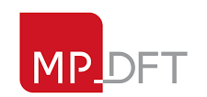







Empresas que Solr – No Brasil
Notes:
Pentaho is an end-to-end business analytics and data integration platform. And in particular, a major area of focus for our platform has been helping customers integrate Big Data sources into their architecture and analyze that blend of traditional and emerging data. At the same time, we also provide analytics software that is highly embeddable in that they can fit seamlessly into existing applications and processes. A lot of our success in these areas has been due to both early innovation in Big Data – I believe we’ve been working with Hadoop for 5 to 6 years – as well as the open architecture and standards that our platform is built on.

Slide 17
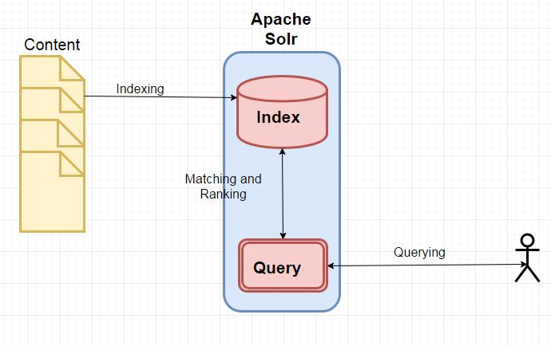
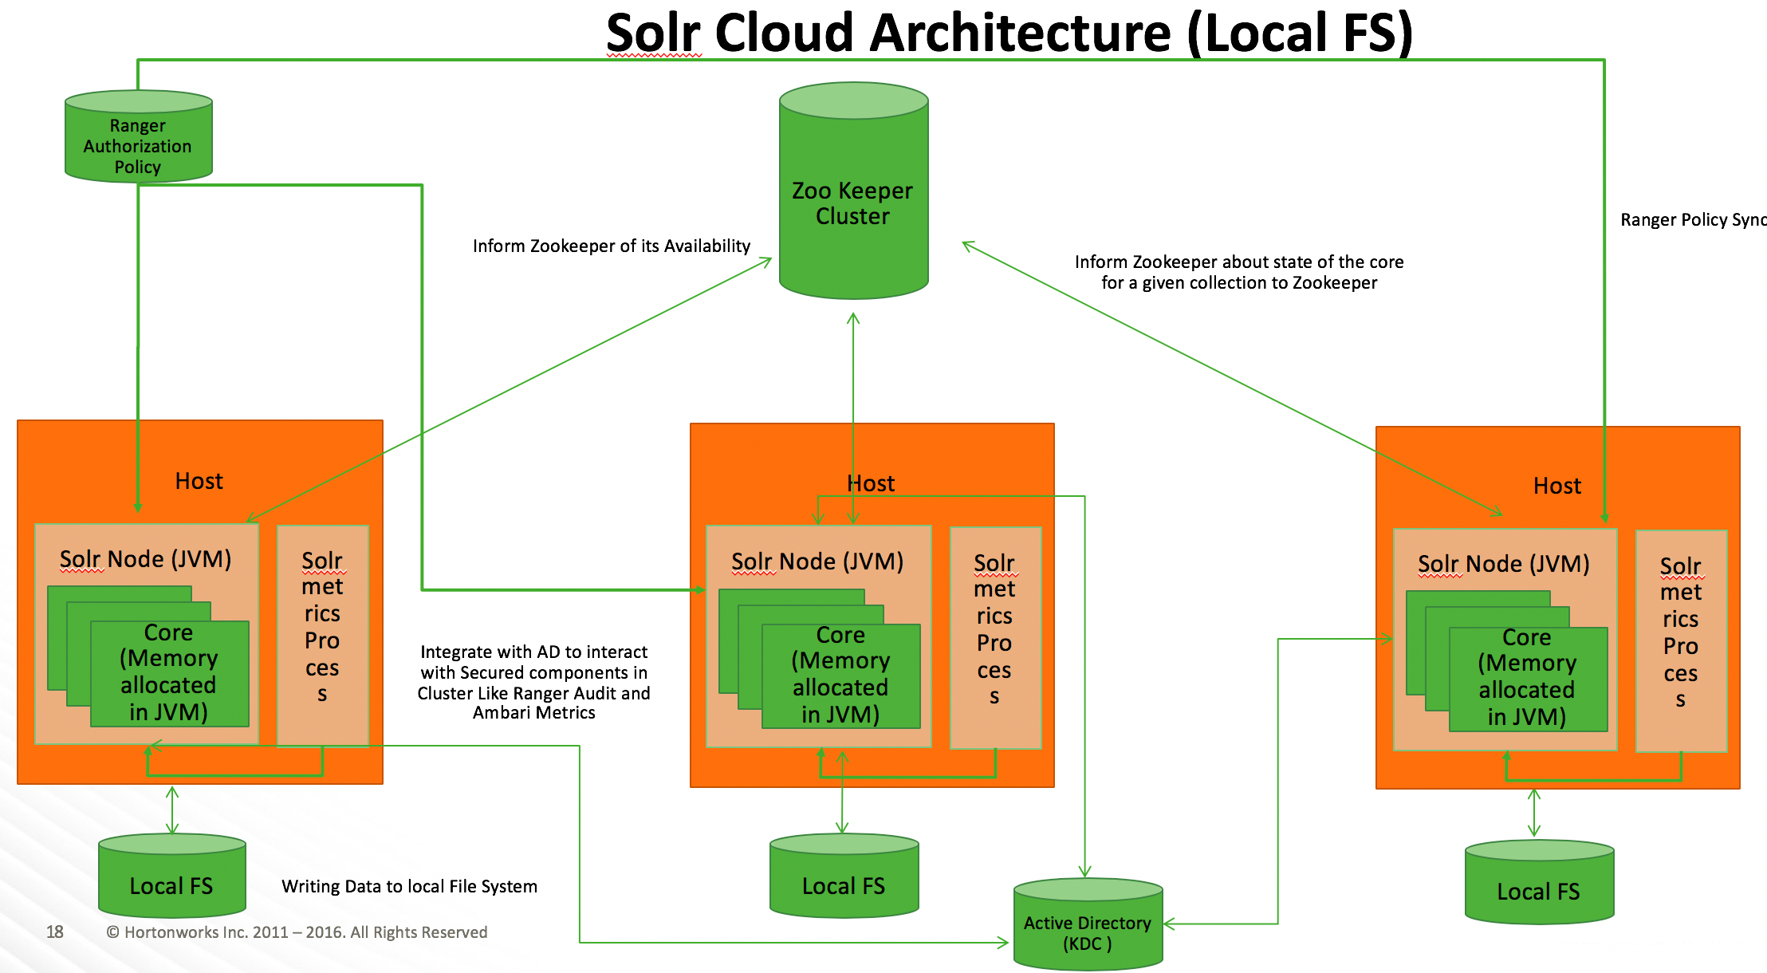
Tipos de Cluster Solr
Tipos
Quando não estamos em cluster chamamos de Solr Standalone mode.
Quando configuramos um cluster chamamos de SolrCloud Mode.
Standalone mode.
Notes:
Pentaho is an end-to-end business analytics and data integration platform. And in particular, a major area of focus for our platform has been helping customers integrate Big Data sources into their architecture and analyze that blend of traditional and emerging data. At the same time, we also provide analytics software that is highly embeddable in that they can fit seamlessly into existing applications and processes. A lot of our success in these areas has been due to both early innovation in Big Data – I believe we’ve been working with Hadoop for 5 to 6 years – as well as the open architecture and standards that our platform is built on.

Slide 18
Tipos de cluster Solr
Tipos de Cluster Modes
Um cluster Solr é um grupo de servidores (nodes) em que cada um executa o Solr.
Existem dois modos gerais de operação de um cluster de nós Solr. Um modo fornece coordenação central dos nós Solr (SolrCloud Mode), enquanto o outro permite operar um cluster sem essa coordenação central (User-Managed Mode).
Ambos os modos compartilham conceitos gerais, mas diferem em última análise na forma como esses conceitos são refletidos na funcionalidade e nos recursos.
Notes:
Pentaho is an end-to-end business analytics and data integration platform. And in particular, a major area of focus for our platform has been helping customers integrate Big Data sources into their architecture and analyze that blend of traditional and emerging data. At the same time, we also provide analytics software that is highly embeddable in that they can fit seamlessly into existing applications and processes. A lot of our success in these areas has been due to both early innovation in Big Data – I believe we’ve been working with Hadoop for 5 to 6 years – as well as the open architecture and standards that our platform is built on.

Slide 19
Shards
Conceito
Em ambos os modos de cluster, um único índice lógico pode ser dividido entre nós como shards. Cada shard contém um subconjunto do índice geral.
O número de shards determina o limite teórico para o número de documentos que podem ser indexados no Solr. Também determina a quantidade de paralelização possível para uma solicitação de pesquisa individual.
Notes:
Pentaho is an end-to-end business analytics and data integration platform. And in particular, a major area of focus for our platform has been helping customers integrate Big Data sources into their architecture and analyze that blend of traditional and emerging data. At the same time, we also provide analytics software that is highly embeddable in that they can fit seamlessly into existing applications and processes. A lot of our success in these areas has been due to both early innovation in Big Data – I believe we’ve been working with Hadoop for 5 to 6 years – as well as the open architecture and standards that our platform is built on.

Slide 20
Replicas
Conceito
Para fornecer algum failover para cada shard, cada shard pode ser copiado como uma réplica. Uma réplica tem a mesma configuração que o shard e quaisquer outras réplicas para o mesmo índice.
É possível ter réplicas sem ter criado shards. Neste caso, cada réplica seria uma cópia completa de todo o índice, em vez de ser apenas uma cópia de parte de todo o índice.
O número de réplicas determina o nível de tolerância a falhas que todo o cluster possui no caso de falha de um node. Também determina o limite teórico do número de solicitações de pesquisa simultâneas que podem ser processadas sob carga pesada.
Notes:
Pentaho is an end-to-end business analytics and data integration platform. And in particular, a major area of focus for our platform has been helping customers integrate Big Data sources into their architecture and analyze that blend of traditional and emerging data. At the same time, we also provide analytics software that is highly embeddable in that they can fit seamlessly into existing applications and processes. A lot of our success in these areas has been due to both early innovation in Big Data – I believe we’ve been working with Hadoop for 5 to 6 years – as well as the open architecture and standards that our platform is built on.

Slide 21
Leaders
Conceito
Depois que as réplicas forem criadas, um líder(Leaders) deverá ser identificado.
A responsabilidade do líder é ser uma fonte de verdade para cada réplica. Quando são feitas atualizações no índice, elas são processadas primeiro pelo líder e depois por cada réplica.
As réplicas que não são leaders são followers.
Notes:
Pentaho is an end-to-end business analytics and data integration platform. And in particular, a major area of focus for our platform has been helping customers integrate Big Data sources into their architecture and analyze that blend of traditional and emerging data. At the same time, we also provide analytics software that is highly embeddable in that they can fit seamlessly into existing applications and processes. A lot of our success in these areas has been due to both early innovation in Big Data – I believe we’ve been working with Hadoop for 5 to 6 years – as well as the open architecture and standards that our platform is built on.

Slide 22
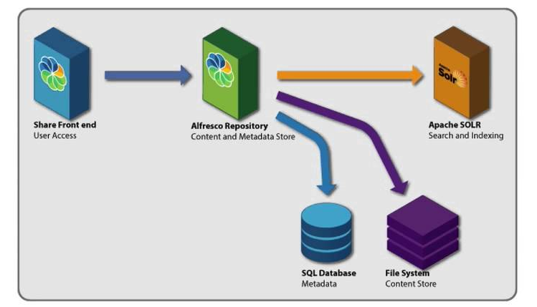
Alfresco Search Services 2.0
Alfresco Search
Um modelo de Configuração do Solr focado para o Alfresco Content Service.
Solr versão 6.x (SolrClod somente Solr 6.6).
Notes:
Pentaho is an end-to-end business analytics and data integration platform. And in particular, a major area of focus for our platform has been helping customers integrate Big Data sources into their architecture and analyze that blend of traditional and emerging data. At the same time, we also provide analytics software that is highly embeddable in that they can fit seamlessly into existing applications and processes. A lot of our success in these areas has been due to both early innovation in Big Data – I believe we’ve been working with Hadoop for 5 to 6 years – as well as the open architecture and standards that our platform is built on.

Slide 23
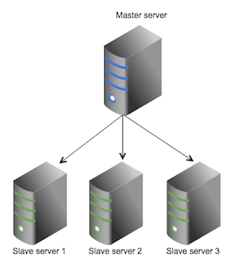
Solr replication
Replicação Solr
Usa o modelo master-worker para distribuir cópias completas de um índice mestre para um ou mais servidores worker.
O mestre recebe todas as atualizações e todas as alterações são feitas. As alterações feitas no mestre são distribuídas a todos os servidores workers que atendem todas as solicitações de consulta dos clientes.
Todos os rastreadores devem ser habilitados nos nós mestres, enquanto apenas o rastreador de modelo e o rastreador de metadados devem ser habilitados nos escravos.
Notes:
Pentaho is an end-to-end business analytics and data integration platform. And in particular, a major area of focus for our platform has been helping customers integrate Big Data sources into their architecture and analyze that blend of traditional and emerging data. At the same time, we also provide analytics software that is highly embeddable in that they can fit seamlessly into existing applications and processes. A lot of our success in these areas has been due to both early innovation in Big Data – I believe we’ve been working with Hadoop for 5 to 6 years – as well as the open architecture and standards that our platform is built on.

Slide 24
Solr Config - Alfresco Content Services - Master
/solrhome/templates/re-rank/conf/solrconfig.xml
<requestHandler name="/replication" class="org.alfresco.solr.handler.AlfrescoReplicationHandler" >
<lst name="master">
<str name="replicateAfter">commit</str>
<str name="replicateAfter">startup</str>
<str name="confFiles">schema.xml,stopwords.txt</str>
</requestHandler>
solrcore.properties
enable.master=false
enable.slave=true
Notes:
Pentaho is an end-to-end business analytics and data integration platform. And in particular, a major area of focus for our platform has been helping customers integrate Big Data sources into their architecture and analyze that blend of traditional and emerging data. At the same time, we also provide analytics software that is highly embeddable in that they can fit seamlessly into existing applications and processes. A lot of our success in these areas has been due to both early innovation in Big Data – I believe we’ve been working with Hadoop for 5 to 6 years – as well as the open architecture and standards that our platform is built on.

Slide 25
Solr Config - Alfresco Content Services - Worker
/solrhome/templates/re-rank/conf/solrconfig.xml
<requestHandler name="/replication" class="org.alfresco.solr.handler.AlfrescoReplicationHandler" >
<lst name="slave">
<str name="masterUrl">http://your-master-hostname:8983/solr</str>
<str name="pollInterval">00:00:60</str>
</lst>
</requestHandler>
solrcore.properties
enable.master=false
enable.slave=true
Notes:
Pentaho is an end-to-end business analytics and data integration platform. And in particular, a major area of focus for our platform has been helping customers integrate Big Data sources into their architecture and analyze that blend of traditional and emerging data. At the same time, we also provide analytics software that is highly embeddable in that they can fit seamlessly into existing applications and processes. A lot of our success in these areas has been due to both early innovation in Big Data – I believe we’ve been working with Hadoop for 5 to 6 years – as well as the open architecture and standards that our platform is built on.

Slide 26
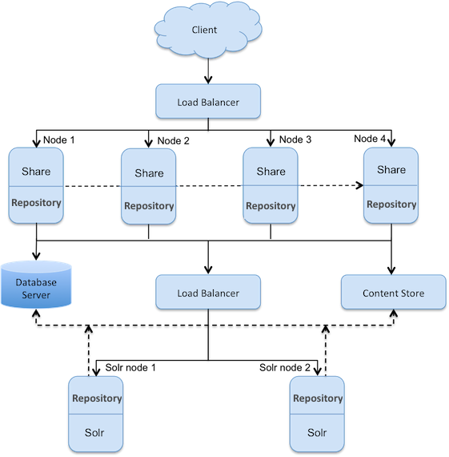
Alfresco em Cluster com Solr - Multi-Master
Replicação Solr
Multi-Master.
Simplicidade de configuração.
Notes:
Pentaho is an end-to-end business analytics and data integration platform. And in particular, a major area of focus for our platform has been helping customers integrate Big Data sources into their architecture and analyze that blend of traditional and emerging data. At the same time, we also provide analytics software that is highly embeddable in that they can fit seamlessly into existing applications and processes. A lot of our success in these areas has been due to both early innovation in Big Data – I believe we’ve been working with Hadoop for 5 to 6 years – as well as the open architecture and standards that our platform is built on.

Slide 27
Obrigado
Marcio Junior Vieira
marcio@ambientelivre.com.br
@marviojvieira @ambientelivre
https://www.linkedin.com/in/mvieira1/
Blog: http://blogs.ambientelivre.com.br/marcio/
Youtube: https://www.youtube.com/c/AmbienteLivreOpenSoftware

