Slide 1
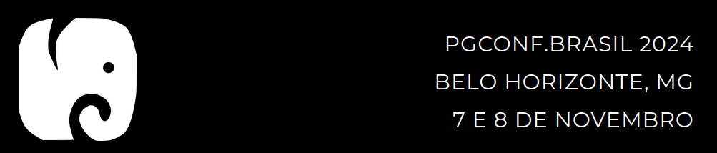
Implementando um Cluster Master-Master no PostgreSQL com Bucardo
PGCONF Brasil 2024
Marcio Junior Vieira
CEO & Data Scientist, Ambiente Livre

Slide 2
Marcio Junior Vieira
Mini-CV
22 anos de experiência em TI, vivência em desenvolvimento e análise de sistemas de gestão empresarial e ciência de dados.
CEO da Ambiente Livre atuando como Cientista de Dados, Engenheiro de Dados e Arquiteto de Software.
Professor dos MBAs em Big Data & Data Science, Inteligência Artificial e Business Intelligence e Analytics da Universidade Positivo.
Professor do MBA Artificial Intelligence e Machine Learning da FIAP.
Pesquisador do Laboratório de Tecnologias para Tomada de Decisão da Universidade de Brasília (Unb/Latitude).
Trabalhando com Free Software e Open Source desde 2000 com serviços de consultoria e treinamento.
Graduado em Tecnologia em Informática(2004) e pós-graduado em Software Livre(2005) ambos pela UFPR.
Palestrante FLOSS em: FISL, TDC, Latinoware, Campus Party, Pentaho Day, Ticnova, PgDay e FTSL.
Organizador Geral: Pentaho Day 2017, 2015, 2019 e apoio nas ed. 2013 e 2014.
Data Scientist, instrutor e consultor de Big Data e Data Science com tecnologias abertas.
Ajudou a capacitar equipes de Big Data na IBM, Accenture, Tivit, Serpro, Natura, MP, Netshoes, Embraer entre outras.
Especialista em implantação e customização de Big Data com Hadoop, Spark, Pentaho, Cassandra e MongoDB.
Contribuidor de projetos internacionais, tais como Pentaho, LimeSurvey, SuiteCRM e Camunda.
Especialista em implantação e customização de ECM com Alfresco e BPM com Activiti, Flowable e Camunda.
Certificado (Certified Pentaho Solutions) pela Hitachi Vantara (Pentaho).
Membro da The Order Of de Bee (comunidade Alfresco para desenvolver o ecossistema Alfresco independente)
Trabalha profissionalmente com PostgreSQL desde 2006.
Notes:
Pentaho is an end-to-end business analytics and data integration platform. And in particular, a major area of focus for our platform has been helping customers integrate Big Data sources into their architecture and analyze that blend of traditional and emerging data. At the same time, we also provide analytics software that is highly embeddable in that they can fit seamlessly into existing applications and processes. A lot of our success in these areas has been due to both early innovation in Big Data – I believe we’ve been working with Hadoop for 5 to 6 years – as well as the open architecture and standards that our platform is built on.

Slide 3


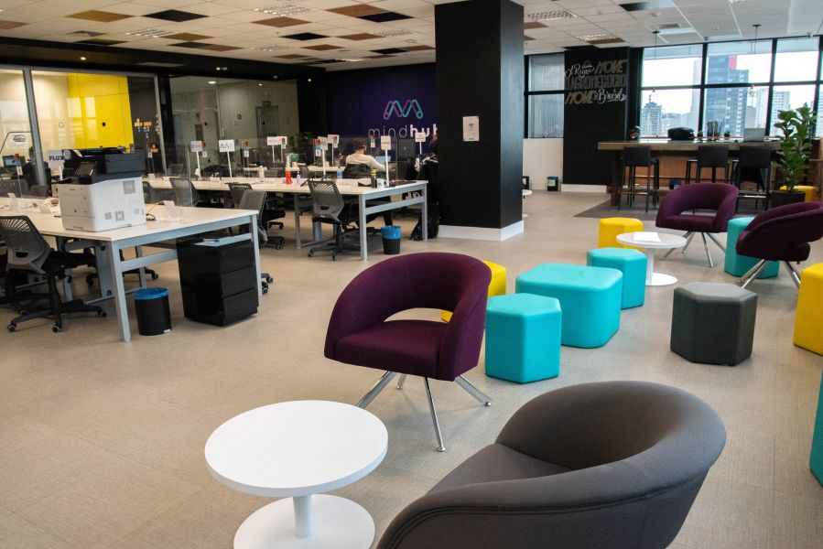

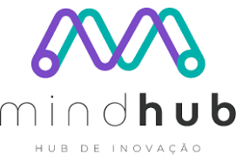
Sobre a Ambiente Livre
Open Software for Business
Fundada em 2004 com foco em consultoria com FLOSS.
Experts em 34 soluções para geração de negócios com Software Livre/Código Aberto.
Atualmente estamos sediados no Hub de Inovação Mindhub em Curitiba (FAE).
Notes:
Pentaho is an end-to-end business analytics and data integration platform. And in particular, a major area of focus for our platform has been helping customers integrate Big Data sources into their architecture and analyze that blend of traditional and emerging data. At the same time, we also provide analytics software that is highly embeddable in that they can fit seamlessly into existing applications and processes. A lot of our success in these areas has been due to both early innovation in Big Data – I believe we’ve been working with Hadoop for 5 to 6 years – as well as the open architecture and standards that our platform is built on.

Slide 4









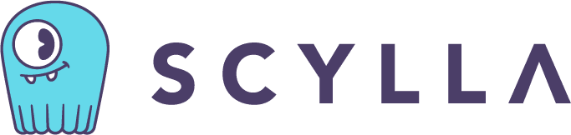
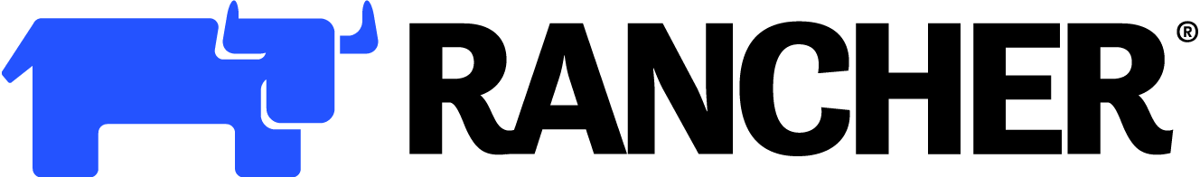

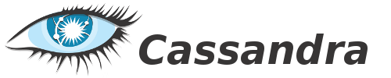

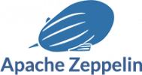

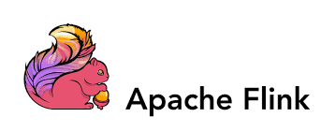





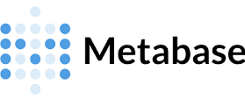
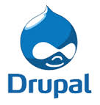
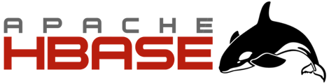


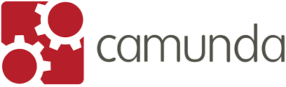
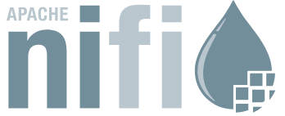
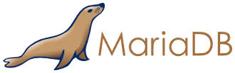


Nosso Ecossistema de Serviços
Notes:
Pentaho is an end-to-end business analytics and data integration platform. And in particular, a major area of focus for our platform has been helping customers integrate Big Data sources into their architecture and analyze that blend of traditional and emerging data. At the same time, we also provide analytics software that is highly embeddable in that they can fit seamlessly into existing applications and processes. A lot of our success in these areas has been due to both early innovation in Big Data – I believe we’ve been working with Hadoop for 5 to 6 years – as well as the open architecture and standards that our platform is built on.

Slide 5
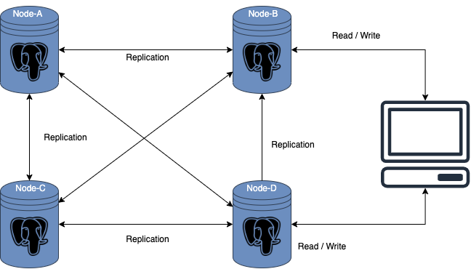
Replicação Multi-Master
Notes:
Pentaho is an end-to-end business analytics and data integration platform. And in particular, a major area of focus for our platform has been helping customers integrate Big Data sources into their architecture and analyze that blend of traditional and emerging data. At the same time, we also provide analytics software that is highly embeddable in that they can fit seamlessly into existing applications and processes. A lot of our success in these areas has been due to both early innovation in Big Data – I believe we’ve been working with Hadoop for 5 to 6 years – as well as the open architecture and standards that our platform is built on.

Slide 6
Replicação Multi-Master
Prós
No caso de um mestre falhar, o outro mestre está lá para servir a atualização e a inserção.
Os nós mestres estão localizados em vários locais diferentes, portanto, as chances de falha de todos os mestres são mínimas.
As atualizações de dados são possíveis em vários servidores.
Não requer rotear o tráfego para apenas um único mestre.
Notes:
Pentaho is an end-to-end business analytics and data integration platform. And in particular, a major area of focus for our platform has been helping customers integrate Big Data sources into their architecture and analyze that blend of traditional and emerging data. At the same time, we also provide analytics software that is highly embeddable in that they can fit seamlessly into existing applications and processes. A lot of our success in these areas has been due to both early innovation in Big Data – I believe we’ve been working with Hadoop for 5 to 6 years – as well as the open architecture and standards that our platform is built on.

Slide 7
Replicação Multi-Master
Contra
A principal desvantagem da replicação multi-master é sua complexidade.
A resolução de conflitos é muito difícil porque gravações simultâneas em vários nós são possíveis.
Às vezes, a intervenção manual é necessária em caso de conflito.
Possibilidade de inconsistência de dados.
Notes:
Pentaho is an end-to-end business analytics and data integration platform. And in particular, a major area of focus for our platform has been helping customers integrate Big Data sources into their architecture and analyze that blend of traditional and emerging data. At the same time, we also provide analytics software that is highly embeddable in that they can fit seamlessly into existing applications and processes. A lot of our success in these areas has been due to both early innovation in Big Data – I believe we’ve been working with Hadoop for 5 to 6 years – as well as the open architecture and standards that our platform is built on.

Slide 8
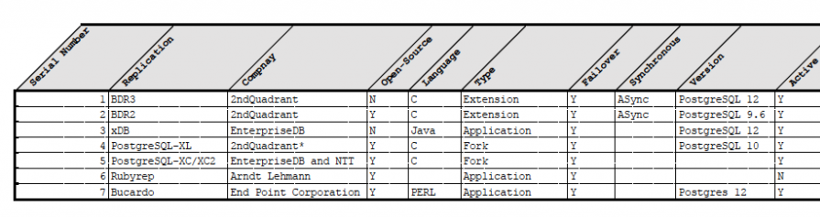
Opções para PostgreSQL
Contra
O PostgreSQL nativo não implementa Master-Master
Tabela de Opções:
Fonte: https://www.percona.com/blog/multi-master-replication-solutions-for-postgresql/
Notes:
Pentaho is an end-to-end business analytics and data integration platform. And in particular, a major area of focus for our platform has been helping customers integrate Big Data sources into their architecture and analyze that blend of traditional and emerging data. At the same time, we also provide analytics software that is highly embeddable in that they can fit seamlessly into existing applications and processes. A lot of our success in these areas has been due to both early innovation in Big Data – I believe we’ve been working with Hadoop for 5 to 6 years – as well as the open architecture and standards that our platform is built on.

Slide 9
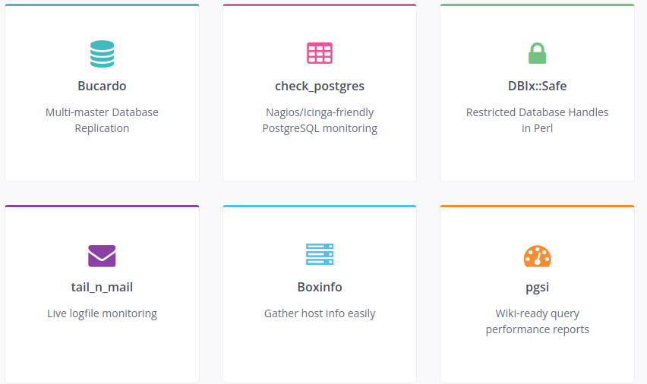
Bucardo
Notes:
Pentaho is an end-to-end business analytics and data integration platform. And in particular, a major area of focus for our platform has been helping customers integrate Big Data sources into their architecture and analyze that blend of traditional and emerging data. At the same time, we also provide analytics software that is highly embeddable in that they can fit seamlessly into existing applications and processes. A lot of our success in these areas has been due to both early innovation in Big Data – I believe we’ve been working with Hadoop for 5 to 6 years – as well as the open architecture and standards that our platform is built on.

Slide 10
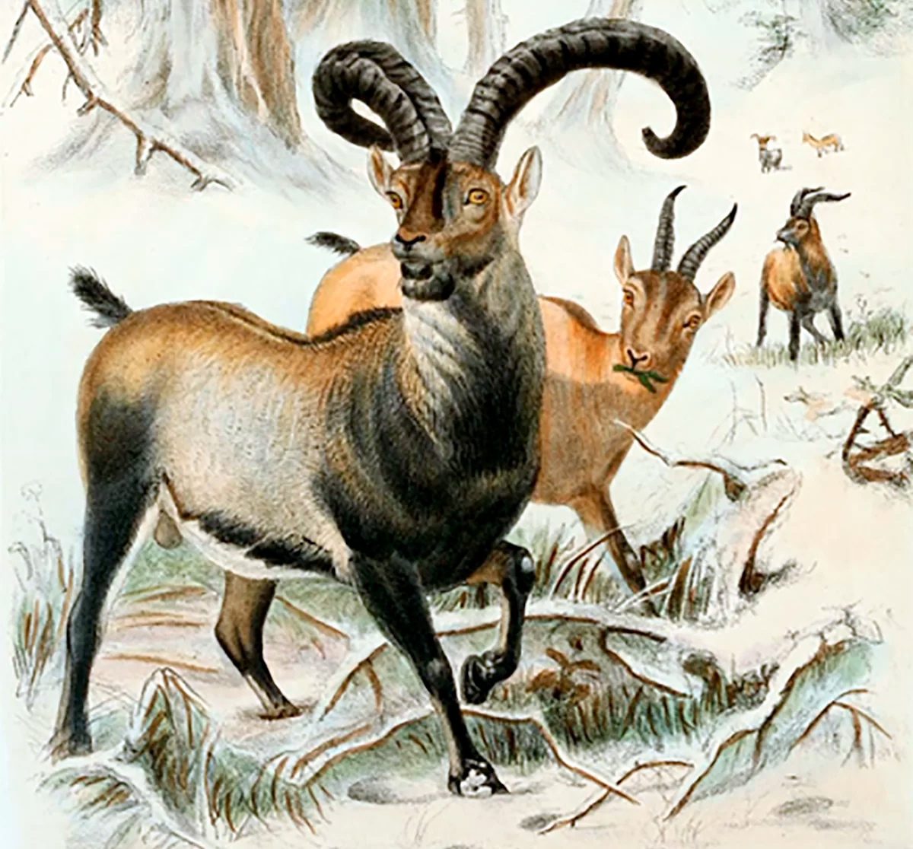
Bucardo
Conceito
Sistema de replicação para o PostgreSQL assíncrono, permitindo operações multi-master e multi-slave.
Desenvolvido no Backcountry.com por Jon Jensen e Greg Sabino Mullane da End Point Corporation.
Software Livre de código aberto lançado sob a licença BSD *.
* 2 clausulas (citar autor e isenção de responsabilidade)
Desenvolvido em Perl.
Versão mais atual 5.6.0.
Notes:
Pentaho is an end-to-end business analytics and data integration platform. And in particular, a major area of focus for our platform has been helping customers integrate Big Data sources into their architecture and analyze that blend of traditional and emerging data. At the same time, we also provide analytics software that is highly embeddable in that they can fit seamlessly into existing applications and processes. A lot of our success in these areas has been due to both early innovation in Big Data – I believe we’ve been working with Hadoop for 5 to 6 years – as well as the open architecture and standards that our platform is built on.

Slide 11
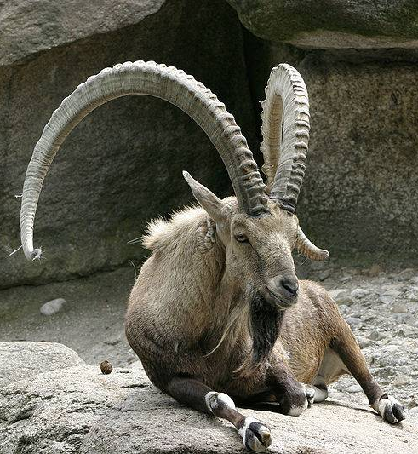
Origem do nome Bucardo
Origem
Referência ao Bucardo, uma subespécie de cabra selvagem que vivia nas montanhas dos Pireneus.
Foi declarado extinto em 2000, mas, em 2003, cientistas tentaram reviver a espécie com técnicas de clonagem.
A experiência teve um sucesso temporário, criando o primeiro animal “desextinto”, mas o clone viveu apenas alguns minutos.
Notes:
Pentaho is an end-to-end business analytics and data integration platform. And in particular, a major area of focus for our platform has been helping customers integrate Big Data sources into their architecture and analyze that blend of traditional and emerging data. At the same time, we also provide analytics software that is highly embeddable in that they can fit seamlessly into existing applications and processes. A lot of our success in these areas has been due to both early innovation in Big Data – I believe we’ve been working with Hadoop for 5 to 6 years – as well as the open architecture and standards that our platform is built on.

Slide 12
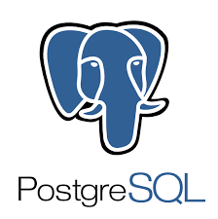
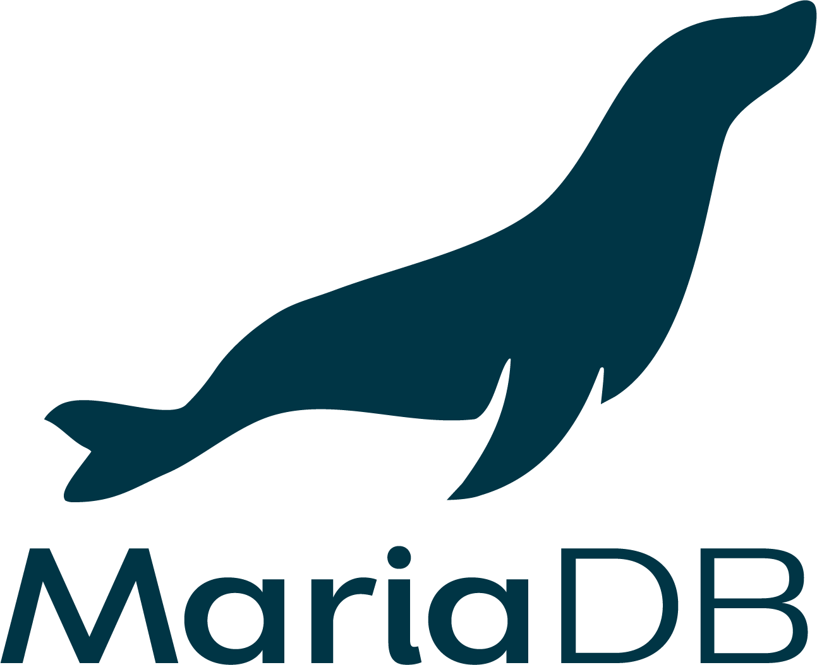
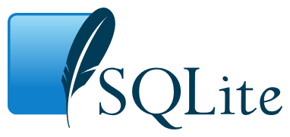
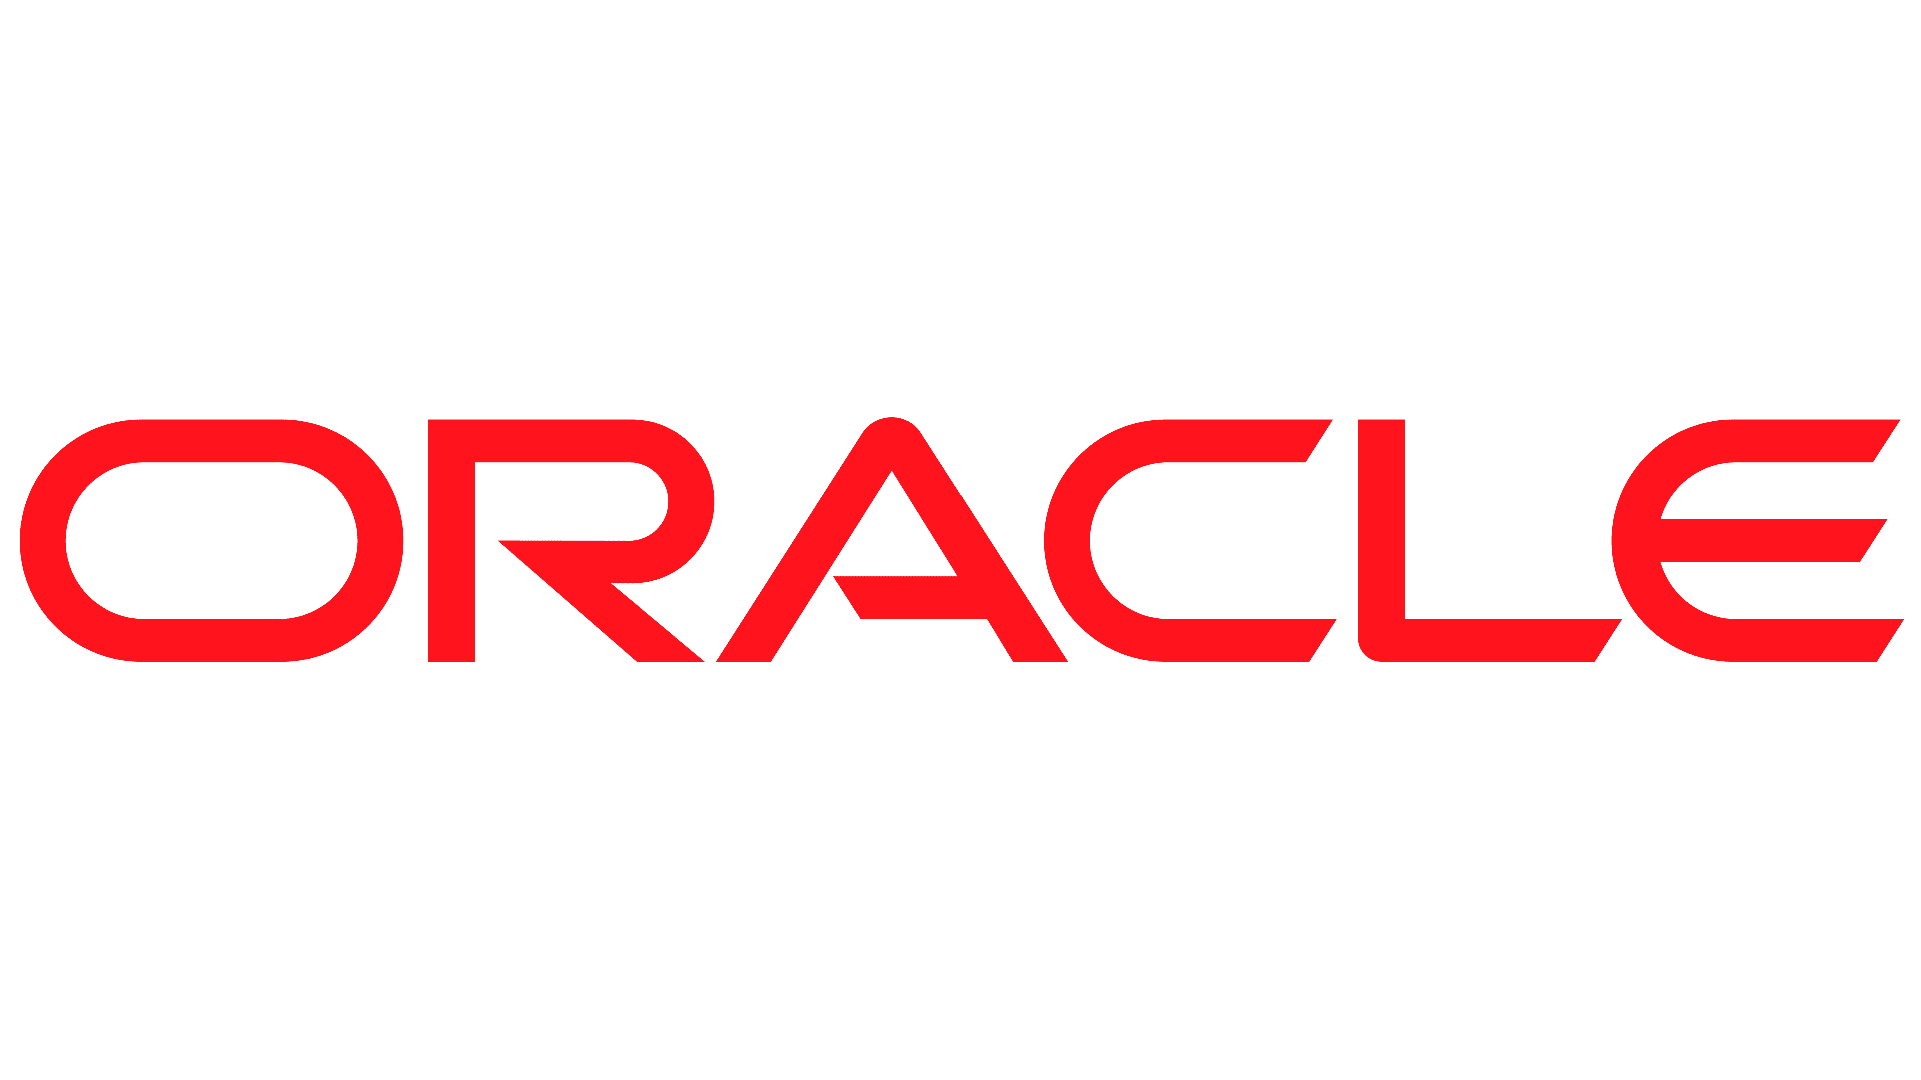
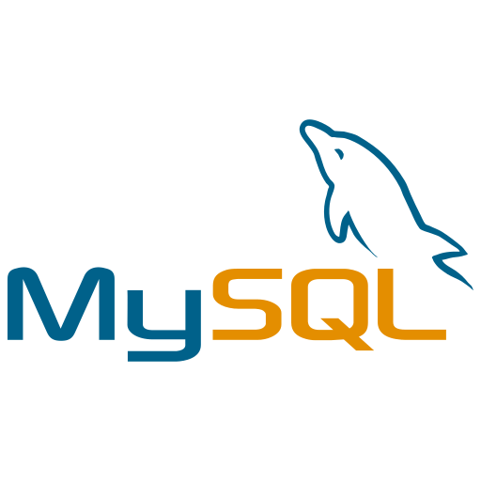
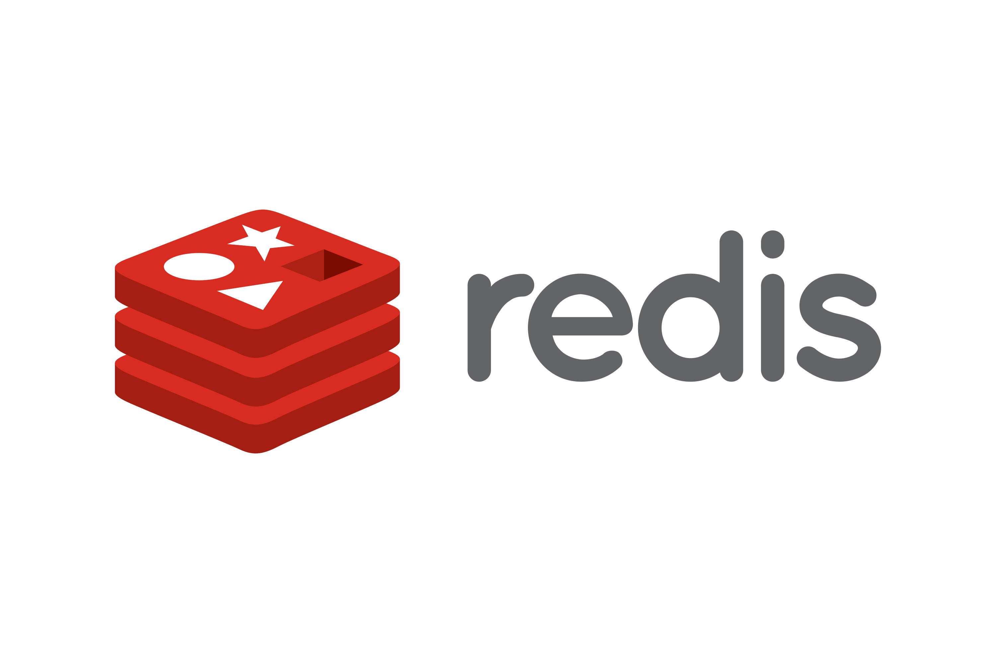

Databases Suportados pelo Bucardo
Conceito
Multi-master suporta PostgreSQL.
Para replicação a origem deve ser PostgreSQL, mas os destinos podem ser PostgreSQL, MySQL, Redis, Oracle, MariaDB, SQLite ou MongoDB.
Notes:
Pentaho is an end-to-end business analytics and data integration platform. And in particular, a major area of focus for our platform has been helping customers integrate Big Data sources into their architecture and analyze that blend of traditional and emerging data. At the same time, we also provide analytics software that is highly embeddable in that they can fit seamlessly into existing applications and processes. A lot of our success in these areas has been due to both early innovation in Big Data – I believe we’ve been working with Hadoop for 5 to 6 years – as well as the open architecture and standards that our platform is built on.

Slide 13
Bucardo - Requisitos
Requisitos
Perl e libs Perl e postgresql-perl.
Requer um banco de dados dedicado e é executado como um daemon Perl que se comunica com esse banco de dados e todos os outros bancos de dados envolvidos na replicação.
Todas as informações específicas que o daemon são armazenadas no banco de dados bucardo principal, incluindo uma lista de todos os bancos de dados envolvidos na replicação e como alcançá-los, todas as tabelas que devem ser replicadas e como cada uma deve ser replicada.
Notes:
Pentaho is an end-to-end business analytics and data integration platform. And in particular, a major area of focus for our platform has been helping customers integrate Big Data sources into their architecture and analyze that blend of traditional and emerging data. At the same time, we also provide analytics software that is highly embeddable in that they can fit seamlessly into existing applications and processes. A lot of our success in these areas has been due to both early innovation in Big Data – I believe we’ve been working with Hadoop for 5 to 6 years – as well as the open architecture and standards that our platform is built on.

Slide 14
Bucardo - Master-Master
Multi-master
A replicação multi-master usa dois ou mais bancos de dados, com resolução de conflitos (opções padrão ou sub-rotinas personalizadas) para lidar com a mesma atualização em ambos os lados.
A replicação mestre-slave envolve uma ou mais origens indo para um ou mais destinos.
Notes:
Pentaho is an end-to-end business analytics and data integration platform. And in particular, a major area of focus for our platform has been helping customers integrate Big Data sources into their architecture and analyze that blend of traditional and emerging data. At the same time, we also provide analytics software that is highly embeddable in that they can fit seamlessly into existing applications and processes. A lot of our success in these areas has been due to both early innovation in Big Data – I believe we’ve been working with Hadoop for 5 to 6 years – as well as the open architecture and standards that our platform is built on.

Slide 15
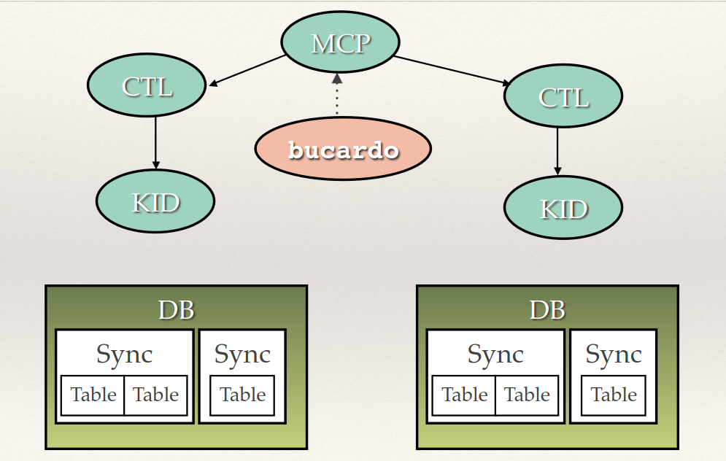
Bucardo - Master-Master
Notes:
Pentaho is an end-to-end business analytics and data integration platform. And in particular, a major area of focus for our platform has been helping customers integrate Big Data sources into their architecture and analyze that blend of traditional and emerging data. At the same time, we also provide analytics software that is highly embeddable in that they can fit seamlessly into existing applications and processes. A lot of our success in these areas has been due to both early innovation in Big Data – I believe we’ve been working with Hadoop for 5 to 6 years – as well as the open architecture and standards that our platform is built on.

Slide 16
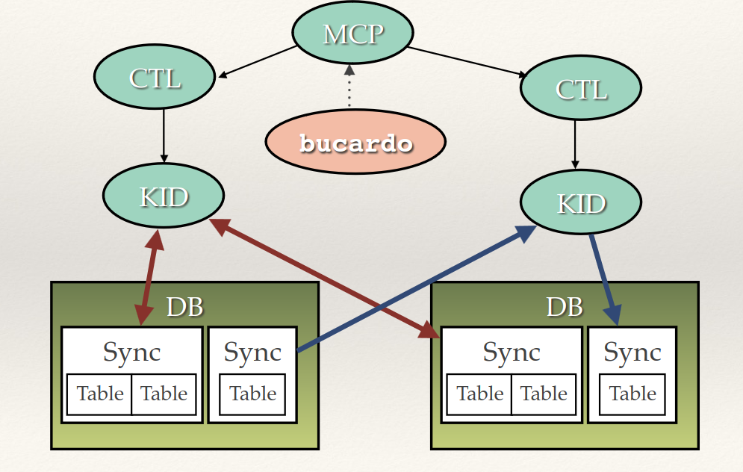
Bucardo - Master-Master
Notes:
Pentaho is an end-to-end business analytics and data integration platform. And in particular, a major area of focus for our platform has been helping customers integrate Big Data sources into their architecture and analyze that blend of traditional and emerging data. At the same time, we also provide analytics software that is highly embeddable in that they can fit seamlessly into existing applications and processes. A lot of our success in these areas has been due to both early innovation in Big Data – I believe we’ve been working with Hadoop for 5 to 6 years – as well as the open architecture and standards that our platform is built on.

Slide 17
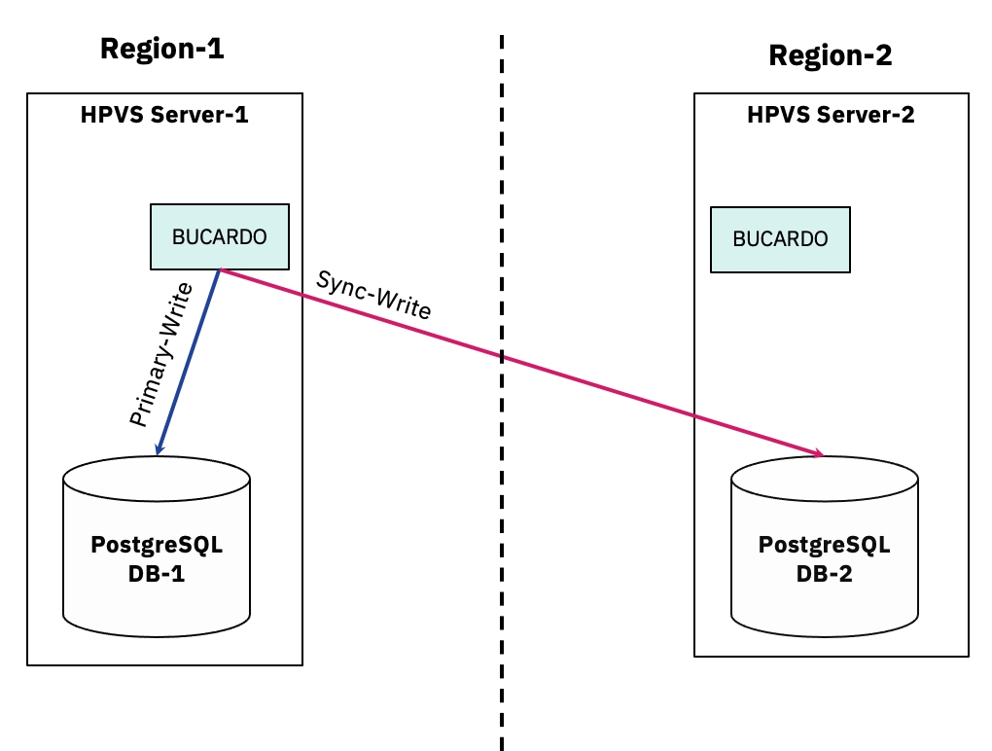
Bucardo - Master-Master
Notes:
Pentaho is an end-to-end business analytics and data integration platform. And in particular, a major area of focus for our platform has been helping customers integrate Big Data sources into their architecture and analyze that blend of traditional and emerging data. At the same time, we also provide analytics software that is highly embeddable in that they can fit seamlessly into existing applications and processes. A lot of our success in these areas has been due to both early innovation in Big Data – I believe we’ve been working with Hadoop for 5 to 6 years – as well as the open architecture and standards that our platform is built on.

Slide 18
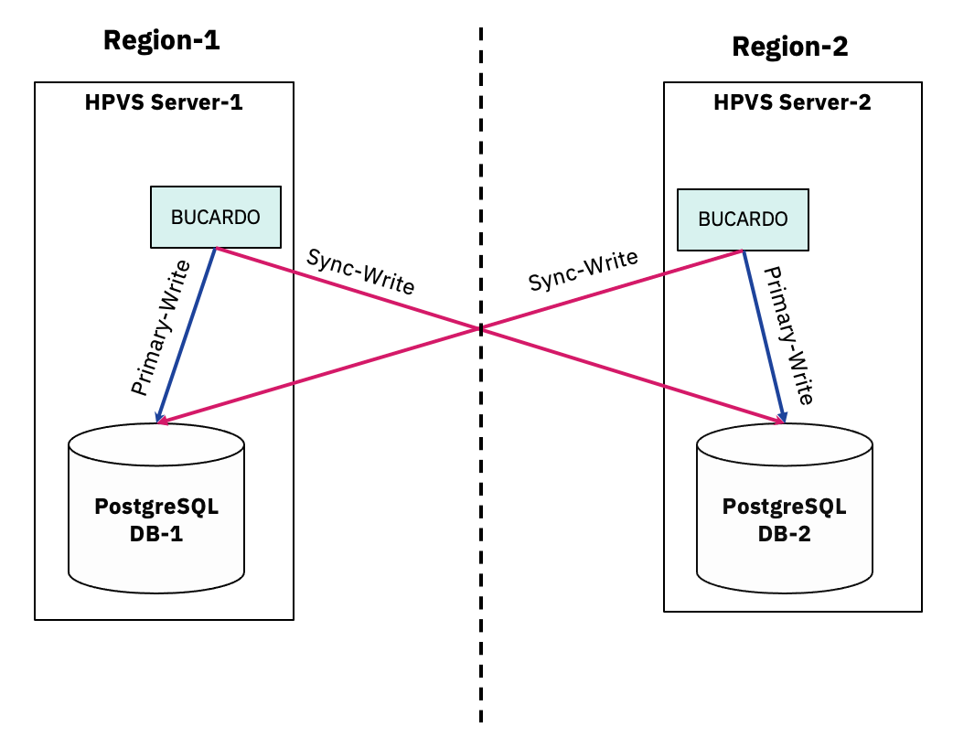
Bucardo - Master-Master
Notes:
Pentaho is an end-to-end business analytics and data integration platform. And in particular, a major area of focus for our platform has been helping customers integrate Big Data sources into their architecture and analyze that blend of traditional and emerging data. At the same time, we also provide analytics software that is highly embeddable in that they can fit seamlessly into existing applications and processes. A lot of our success in these areas has been due to both early innovation in Big Data – I believe we’ve been working with Hadoop for 5 to 6 years – as well as the open architecture and standards that our platform is built on.

Slide 19
Bucardo - Workflow
Workflow
A primeira etapa na execução é adicionar dois ou mais bancos de dados ao banco de dados principal do Bucardo.
Feito isso, são adicionadas informações sobre quais tabelas devem ser replicadas, bem como quaisquer agrupamentos de tabelas.
Em seguida, as sincronizações são adicionadas. As sincronizações são ações de replicação nomeadas, copiando um conjunto específico de tabelas de um servidor para outro servidor ou grupo de servidores.
Uma vez configurado o Bucardo, as triggers começam a armazenar informações sobre quais linhas foram alteradas em todas as tabelas de interesse.
Notes:
Pentaho is an end-to-end business analytics and data integration platform. And in particular, a major area of focus for our platform has been helping customers integrate Big Data sources into their architecture and analyze that blend of traditional and emerging data. At the same time, we also provide analytics software that is highly embeddable in that they can fit seamlessly into existing applications and processes. A lot of our success in these areas has been due to both early innovation in Big Data – I believe we’ve been working with Hadoop for 5 to 6 years – as well as the open architecture and standards that our platform is built on.

Slide 20
Bucardo - Workflow
Sincronização de troca (multi-master)
Uma alteração é feita na tabela e registrada na tabela bucardo_delta.
Um aviso é enviado ao daemon principal, informando alteração.
O daemon notifica o controlador para essa sincronização e volta a escutar.
O controlador cria um “kid” para lidar com a replicação.
O kid inicia uma nova transação e desabilita triggers e regras nas tabelas.
Em seguida, reúne uma lista de quais linhas foram alteradas desde a última replicação e compara as duas para descobrir o que deve ser feito.
Se houver um conflito, o manipulador de conflitos padrão ou personalizado, definido por tabela, será executado para resolver as coisas.
Triggers e regras são reativados e a transação é confirmada.
Se a transação falhar, todos os manipuladores de exceção personalizados serão executados.
O kid sinaliza para o controlador que terminou.
Notes:
Pentaho is an end-to-end business analytics and data integration platform. And in particular, a major area of focus for our platform has been helping customers integrate Big Data sources into their architecture and analyze that blend of traditional and emerging data. At the same time, we also provide analytics software that is highly embeddable in that they can fit seamlessly into existing applications and processes. A lot of our success in these areas has been due to both early innovation in Big Data – I believe we’ve been working with Hadoop for 5 to 6 years – as well as the open architecture and standards that our platform is built on.

Slide 21
Bucardo Client
Cli commands
bucardo install
bucardo add
bucardo status
bucardo kick
bucardo help
Notes:
Pentaho is an end-to-end business analytics and data integration platform. And in particular, a major area of focus for our platform has been helping customers integrate Big Data sources into their architecture and analyze that blend of traditional and emerging data. At the same time, we also provide analytics software that is highly embeddable in that they can fit seamlessly into existing applications and processes. A lot of our success in these areas has been due to both early innovation in Big Data – I believe we’ve been working with Hadoop for 5 to 6 years – as well as the open architecture and standards that our platform is built on.

Slide 22
Limitações Bucardo
Limitações
Sem manipulação automática de DDL
Requer PKs
Notes:
Pentaho is an end-to-end business analytics and data integration platform. And in particular, a major area of focus for our platform has been helping customers integrate Big Data sources into their architecture and analyze that blend of traditional and emerging data. At the same time, we also provide analytics software that is highly embeddable in that they can fit seamlessly into existing applications and processes. A lot of our success in these areas has been due to both early innovation in Big Data – I believe we’ve been working with Hadoop for 5 to 6 years – as well as the open architecture and standards that our platform is built on.

Slide 23
Demo
O que faremos
Instalar o Bucardo.
Criar dois databases (no mesmo server para teste)
Apresentar Replicações.
Database:test1
Table: t1
Database:test2
Table: t2
insert/delete
insert/delete
Notes:
Pentaho is an end-to-end business analytics and data integration platform. And in particular, a major area of focus for our platform has been helping customers integrate Big Data sources into their architecture and analyze that blend of traditional and emerging data. At the same time, we also provide analytics software that is highly embeddable in that they can fit seamlessly into existing applications and processes. A lot of our success in these areas has been due to both early innovation in Big Data – I believe we’ve been working with Hadoop for 5 to 6 years – as well as the open architecture and standards that our platform is built on.

Slide 24
Obrigado
Marcio Junior Vieira
marcio@ambientelivre.com.br
@marviojvieira @ambientelivre
https://www.linkedin.com/in/mvieira1/

