Slide 1

Automação de Fluxo de Dados em Cluster com Apache NiFi
Marcio Junior Vieira
CEO & Data Scientist, Ambiente Livre
Pesquisador da UNB.

Slide 2
Marcio Junior Vieira
Mini-CV
22 anos de experiência em TI, vivência em desenvolvimento e análise de sistemas de gestão empresarial e ciência de dados.
CEO da Ambiente Livre atuando como Cientista de Dados, Engenheiro de Dados e Arquiteto de Software.
Professor dos MBAs em Big Data & Data Science, Inteligência Artificial e Business Intelligence e Analytics da Universidade Positivo.
Professor do MBA Artificial Intelligence e Machine Learning da FIAP.
Pesquisador do Laboratório de Tecnologias para Tomada de Decisão da Universidade de Brasília (Unb/Latitude).
Trabalhando com Free Software e Open Source desde 2000 com serviços de consultoria e treinamento.
Graduado em Tecnologia em Informática(2004) e pós-graduado em Software Livre(2005) ambos pela UFPR.
Palestrante FLOSS em: FISL, TDC, Latinoware, Campus Party, Pentaho Day, Ticnova, PgDay e FTSL.
Organizador Geral: Pentaho Day 2017, 2015, 2019 e apoio nas ed. 2013 e 2014.
Data Scientist, instrutor e consultor de Big Data e Data Science com tecnologias abertas.
Ajudou a capacitar equipes de Big Data na IBM, Accenture, Tivit, Serpro, Natura, MP, Netshoes, Embraer entre outras.
Especialista em implantação e customização de Big Data com Hadoop, Spark, Pentaho, Cassandra e MongoDB.
Contribuidor de projetos internacionais, tais como Pentaho, LimeSurvey, SuiteCRM e Camunda.
Especialista em implantação e customização de ECM com Alfresco e BPM com Activiti, Flowable e Camunda.
Certificado (Certified Pentaho Solutions) pela Hitachi Vantara (Pentaho).
Membro da The Order Of de Bee (comunidade Alfresco para desenvolver o ecossistema Alfresco independente)
Trabalha profissionalmente com NiFi desde 2019.
Notes:
Pentaho is an end-to-end business analytics and data integration platform. And in particular, a major area of focus for our platform has been helping customers integrate Big Data sources into their architecture and analyze that blend of traditional and emerging data. At the same time, we also provide analytics software that is highly embeddable in that they can fit seamlessly into existing applications and processes. A lot of our success in these areas has been due to both early innovation in Big Data – I believe we’ve been working with Hadoop for 5 to 6 years – as well as the open architecture and standards that our platform is built on.

Slide 3


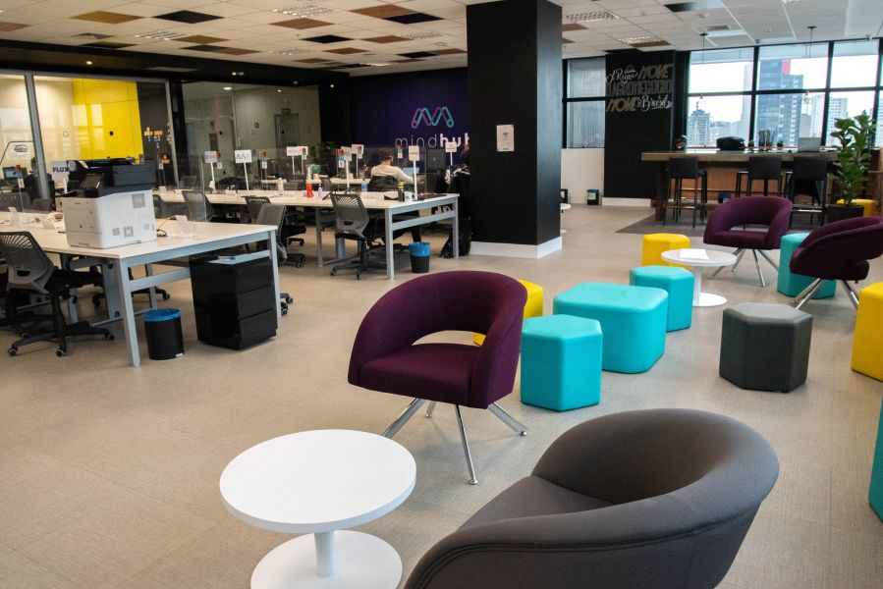

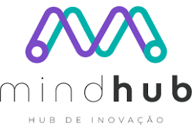
Sobre a Ambiente Livre
Open Software for Business
Fundada em 2004 com foco em consultoria com FLOSS.
Experts em 34 soluções para geração de negócios com Software Livre/Código Aberto.
Atualmente estamos sediados no Hub de Inovação Mindhub em Curitiba (FAE).
Notes:
Pentaho is an end-to-end business analytics and data integration platform. And in particular, a major area of focus for our platform has been helping customers integrate Big Data sources into their architecture and analyze that blend of traditional and emerging data. At the same time, we also provide analytics software that is highly embeddable in that they can fit seamlessly into existing applications and processes. A lot of our success in these areas has been due to both early innovation in Big Data – I believe we’ve been working with Hadoop for 5 to 6 years – as well as the open architecture and standards that our platform is built on.

Slide 4










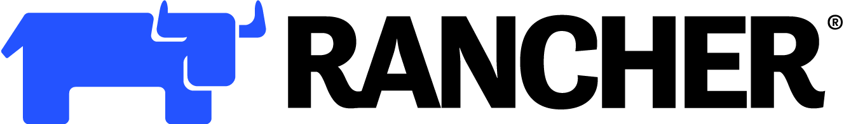



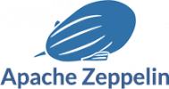

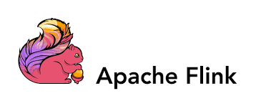





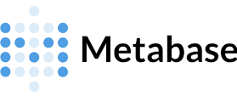
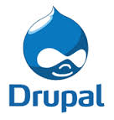



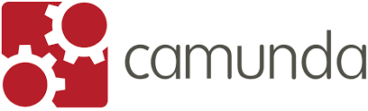
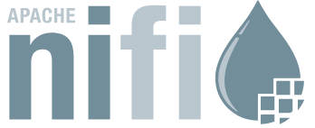



Nosso Ecossistema de Serviços
Notes:
Pentaho is an end-to-end business analytics and data integration platform. And in particular, a major area of focus for our platform has been helping customers integrate Big Data sources into their architecture and analyze that blend of traditional and emerging data. At the same time, we also provide analytics software that is highly embeddable in that they can fit seamlessly into existing applications and processes. A lot of our success in these areas has been due to both early innovation in Big Data – I believe we’ve been working with Hadoop for 5 to 6 years – as well as the open architecture and standards that our platform is built on.

Slide 5
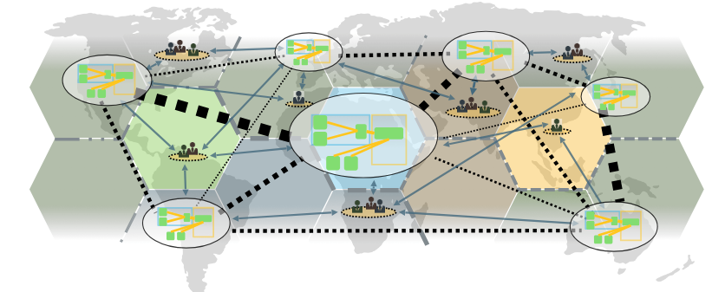
Um problema: Transporte de dados!
Notes:
Pentaho is an end-to-end business analytics and data integration platform. And in particular, a major area of focus for our platform has been helping customers integrate Big Data sources into their architecture and analyze that blend of traditional and emerging data. At the same time, we also provide analytics software that is highly embeddable in that they can fit seamlessly into existing applications and processes. A lot of our success in these areas has been due to both early innovation in Big Data – I believe we’ve been working with Hadoop for 5 to 6 years – as well as the open architecture and standards that our platform is built on.

Slide 6
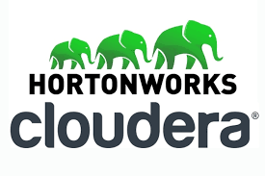
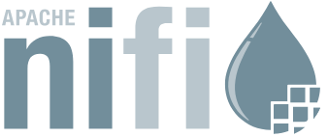
O Projeto Apache NiFi.
Apache NiFi.
É um projeto de software da Apache Software Foundation projetado para automatizar o fluxo de dados entre sistemas de software.
O design do software é baseado no modelo de programação baseado em fluxo e oferece recursos que incluem a capacidade de operar em laptops como ou dentro de clusters.
Segurança usando criptografia TLS.
Extensibilidade.
Suportar fluxos de dados altamente escaláveis e flexíveis.
Recursos de usabilidade aprimorados como um portal que pode ser usado para visualizar e modificar o comportamento visualmente.
Tem atualmente como principal desenvolvedora e suporte comercial a empresa
Hortonworks (agora incorporada à Cloudera).
Notes:
Pentaho is an end-to-end business analytics and data integration platform. And in particular, a major area of focus for our platform has been helping customers integrate Big Data sources into their architecture and analyze that blend of traditional and emerging data. At the same time, we also provide analytics software that is highly embeddable in that they can fit seamlessly into existing applications and processes. A lot of our success in these areas has been due to both early innovation in Big Data – I believe we’ve been working with Hadoop for 5 to 6 years – as well as the open architecture and standards that our platform is built on.

Slide 7

Apache NiFi.
Visão de negócio.
Automatiza a movimentação de dados entre diferentes fontes e
sistemas de dados.
Plataforma de logística de dados integrada para automatizar a
movimentação de dados entre sistemas distintos.
Fornece controle em tempo real que facilita o gerenciamento da movimentação de dados entre qualquer origem e qualquer destino.
É agnóstico quanto à fonte de dados, suportando fontes díspares e distribuídas de diferentes formatos, esquemas, protocolos, velocidades e tamanhos, como máquinas, dispositivos de localização geográfica, fluxos de cliques, arquivos, feeds sociais, arquivos de log e vídeos, etc.
Configurável para movimentação de dados, semelhante a como a Fedex, UPS ou outros serviços de entrega de correio transportam pacotes.
E, assim como esses serviços, permite que você rastreie seus dados em tempo real, da mesma forma que rastreia uma entrega.
Notes:
Pentaho is an end-to-end business analytics and data integration platform. And in particular, a major area of focus for our platform has been helping customers integrate Big Data sources into their architecture and analyze that blend of traditional and emerging data. At the same time, we also provide analytics software that is highly embeddable in that they can fit seamlessly into existing applications and processes. A lot of our success in these areas has been due to both early innovation in Big Data – I believe we’ve been working with Hadoop for 5 to 6 years – as well as the open architecture and standards that our platform is built on.

Slide 8
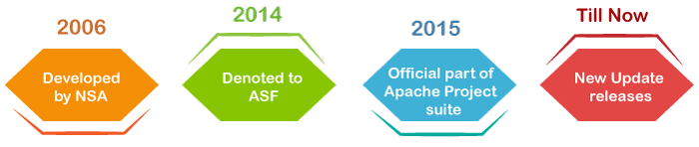




Histórico do Apache NiFi.
Apache NiFi.
Baseia-se no software "NiagaraFiles" anteriormente desenvolvido pela NSA, que também dá origem a uma parte do seu nome atual – NiFi.
Transformou-se em código aberto como parte do programa de transferência de tecnologia da NSA em 2014.
A empresa criadora inicialmente do Software foi a Onyara Inc que foi adquirida pela Hortonworks em 2015. (*1) e hoje incorporada a Cloudera.
Fontes:
https://www.convergedigest.com/2015/08/hortonworks-to-acquire-onyara-for.html
Notes:
Pentaho is an end-to-end business analytics and data integration platform. And in particular, a major area of focus for our platform has been helping customers integrate Big Data sources into their architecture and analyze that blend of traditional and emerging data. At the same time, we also provide analytics software that is highly embeddable in that they can fit seamlessly into existing applications and processes. A lot of our success in these areas has been due to both early innovation in Big Data – I believe we’ve been working with Hadoop for 5 to 6 years – as well as the open architecture and standards that our platform is built on.

Slide 9
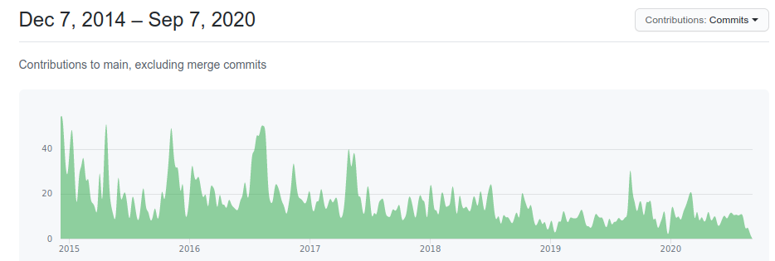
Versões do Apache NiFi.
Apache NiFi.
A última versão estável é a 1.15 lançada em 07/11/2021 (nifi-1.15.0)
Aproximadamente uma versão a cada 3 meses.
Mais de 370 desenvolvedores contribuidores do projeto.
Notes:
Pentaho is an end-to-end business analytics and data integration platform. And in particular, a major area of focus for our platform has been helping customers integrate Big Data sources into their architecture and analyze that blend of traditional and emerging data. At the same time, we also provide analytics software that is highly embeddable in that they can fit seamlessly into existing applications and processes. A lot of our success in these areas has been due to both early innovation in Big Data – I believe we’ve been working with Hadoop for 5 to 6 years – as well as the open architecture and standards that our platform is built on.

Slide 10
Apache Software Foundation
Definição
491 Projetos Open Source.
+7000 Committers, e com uma média de 50 novos mensais… Seja um!
Data Science = Apache = Open Source
Apache é lider em Big Data e Data Science!
~49 projetos da linha “Big Data” incluindo “Apache Hadoop” e “Spark”
~25 projetos de database incluindo “Apache Cassandra”
Notes:
Pentaho is an end-to-end business analytics and data integration platform. And in particular, a major area of focus for our platform has been helping customers integrate Big Data sources into their architecture and analyze that blend of traditional and emerging data. At the same time, we also provide analytics software that is highly embeddable in that they can fit seamlessly into existing applications and processes. A lot of our success in these areas has been due to both early innovation in Big Data – I believe we’ve been working with Hadoop for 5 to 6 years – as well as the open architecture and standards that our platform is built on.

Slide 11
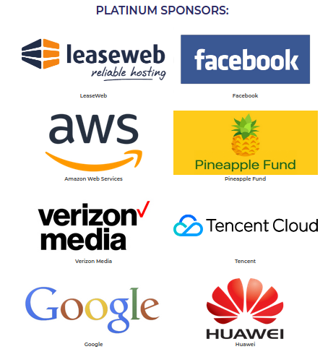
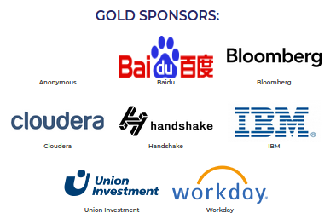
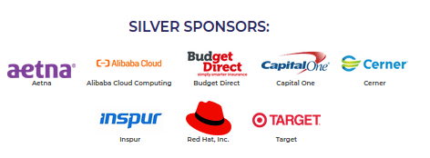
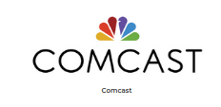
Patrocinadores da Apache Software Foundation.
Notes:
Pentaho is an end-to-end business analytics and data integration platform. And in particular, a major area of focus for our platform has been helping customers integrate Big Data sources into their architecture and analyze that blend of traditional and emerging data. At the same time, we also provide analytics software that is highly embeddable in that they can fit seamlessly into existing applications and processes. A lot of our success in these areas has been due to both early innovation in Big Data – I believe we’ve been working with Hadoop for 5 to 6 years – as well as the open architecture and standards that our platform is built on.

Slide 12
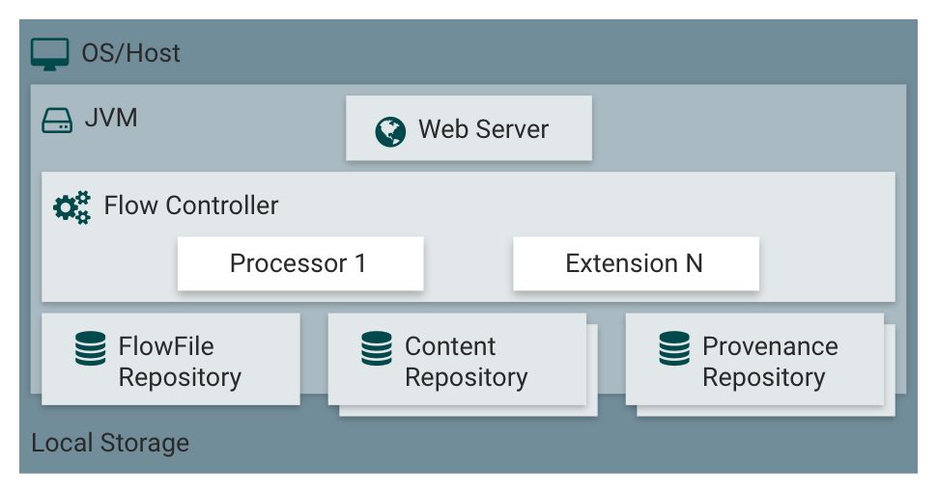
Arquitetura do Apache NiFi.
Arquitetura.
Notes:
Pentaho is an end-to-end business analytics and data integration platform. And in particular, a major area of focus for our platform has been helping customers integrate Big Data sources into their architecture and analyze that blend of traditional and emerging data. At the same time, we also provide analytics software that is highly embeddable in that they can fit seamlessly into existing applications and processes. A lot of our success in these areas has been due to both early innovation in Big Data – I believe we’ve been working with Hadoop for 5 to 6 years – as well as the open architecture and standards that our platform is built on.

Slide 13
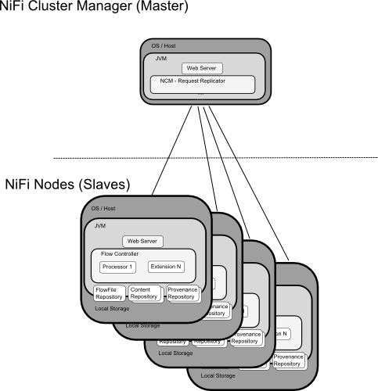
Arquitetura do Apache NiFi. - Cluster
Arquitetura.
Notes:
Pentaho is an end-to-end business analytics and data integration platform. And in particular, a major area of focus for our platform has been helping customers integrate Big Data sources into their architecture and analyze that blend of traditional and emerging data. At the same time, we also provide analytics software that is highly embeddable in that they can fit seamlessly into existing applications and processes. A lot of our success in these areas has been due to both early innovation in Big Data – I believe we’ve been working with Hadoop for 5 to 6 years – as well as the open architecture and standards that our platform is built on.

Slide 14

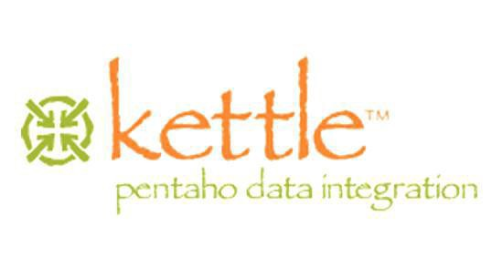
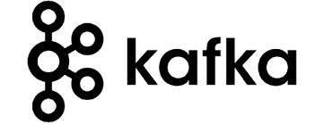
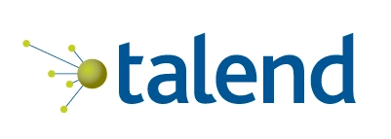
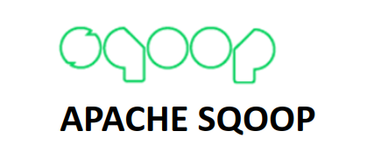
NiFi x PDI x HOP x Talend x Sqoop.
Opções Open Source para Data Flow ou ETL ou Stream de dados!
Notes:
Pentaho is an end-to-end business analytics and data integration platform. And in particular, a major area of focus for our platform has been helping customers integrate Big Data sources into their architecture and analyze that blend of traditional and emerging data. At the same time, we also provide analytics software that is highly embeddable in that they can fit seamlessly into existing applications and processes. A lot of our success in these areas has been due to both early innovation in Big Data – I believe we’ve been working with Hadoop for 5 to 6 years – as well as the open architecture and standards that our platform is built on.

Slide 15
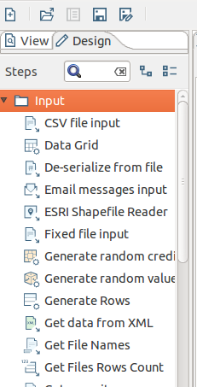
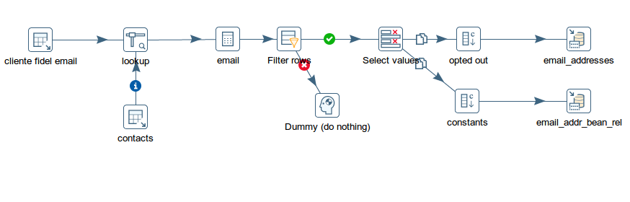
Pentaho Data Integration ( PDI )
Processa em Paralelo ( Também roda em Cluster Spark)
Acessar dados diretamente (se necessário sem DW )
Permite publicar dados diretamente em Reports, Ad-Hoc Reports e Dashboards.
“Programação e Fluxo Visual” com aproximadamente 350 steps diferentes
Notes:
Pentaho is an end-to-end business analytics and data integration platform. And in particular, a major area of focus for our platform has been helping customers integrate Big Data sources into their architecture and analyze that blend of traditional and emerging data. At the same time, we also provide analytics software that is highly embeddable in that they can fit seamlessly into existing applications and processes. A lot of our success in these areas has been due to both early innovation in Big Data – I believe we’ve been working with Hadoop for 5 to 6 years – as well as the open architecture and standards that our platform is built on.

Slide 16
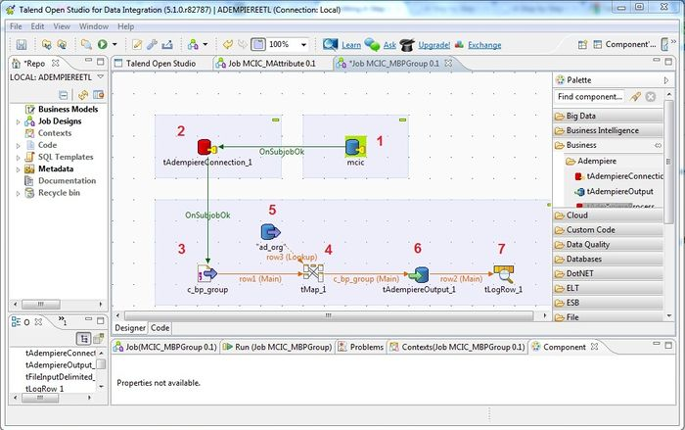
Talend
Muito Similar ao Pentaho Data Integration.
Funcionalidades interessantes como detecção
de registros duplicado, governança de data
quality não existem na versão Community.
Algumas funcionalidades que só existem na
EE podem ser supridas por integrações porém recriando a funcionalidade.
Abaixo a lista completa (na visão da Talend) das comparações , alguns recursos que não existem na community podem ser suprimidos por ferramentas acessórios open source.
Recentemente comprado pela Qlik e Descontinuando a CE
https://www.talend.com/products/mdm/mdm-compare-all/
Notes:
Pentaho is an end-to-end business analytics and data integration platform. And in particular, a major area of focus for our platform has been helping customers integrate Big Data sources into their architecture and analyze that blend of traditional and emerging data. At the same time, we also provide analytics software that is highly embeddable in that they can fit seamlessly into existing applications and processes. A lot of our success in these areas has been due to both early innovation in Big Data – I believe we’ve been working with Hadoop for 5 to 6 years – as well as the open architecture and standards that our platform is built on.

Slide 17
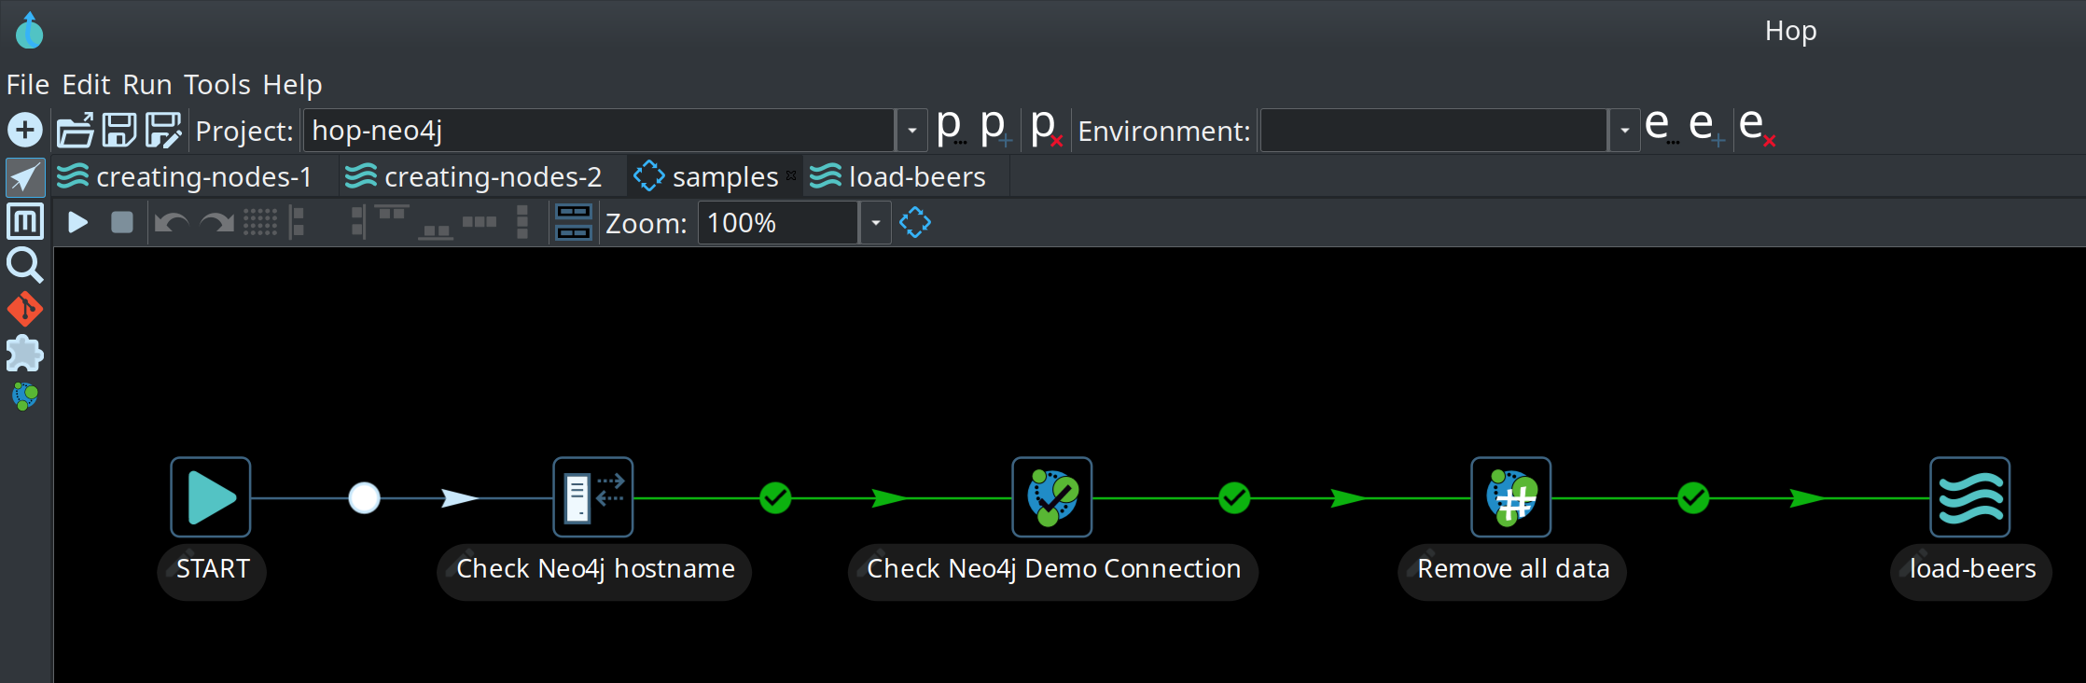
Apache Hop
Acronimo de: Hop Orquestration Plataform
Orquestração
- Dados – Pipelines e Workflows.
- Metadata – Edição, Manuseio e gerenciamento.
- Insights: Execução e tratamento de dados, log do processo.
- Configurações: Manuseio de ecossistemas complexos.
Notes:
Pentaho is an end-to-end business analytics and data integration platform. And in particular, a major area of focus for our platform has been helping customers integrate Big Data sources into their architecture and analyze that blend of traditional and emerging data. At the same time, we also provide analytics software that is highly embeddable in that they can fit seamlessly into existing applications and processes. A lot of our success in these areas has been due to both early innovation in Big Data – I believe we’ve been working with Hadoop for 5 to 6 years – as well as the open architecture and standards that our platform is built on.

Slide 18
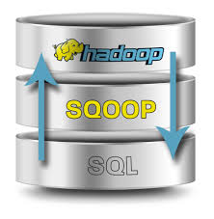
Apache Sqoop
Apache Sqoop – Uma abordagem prática para a unificação de dados.
Abreviação de “SQL para Hadoop”
Objetivo
executar a transferência eficiente e bidirecional de dados entre o
Hadoop e diversos serviços de armazenamento externo de dados estruturados
Notes:
Pentaho is an end-to-end business analytics and data integration platform. And in particular, a major area of focus for our platform has been helping customers integrate Big Data sources into their architecture and analyze that blend of traditional and emerging data. At the same time, we also provide analytics software that is highly embeddable in that they can fit seamlessly into existing applications and processes. A lot of our success in these areas has been due to both early innovation in Big Data – I believe we’ve been working with Hadoop for 5 to 6 years – as well as the open architecture and standards that our platform is built on.

Slide 19




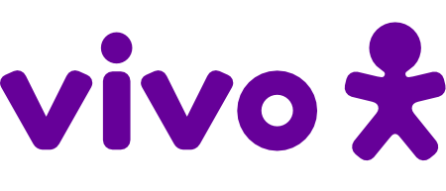






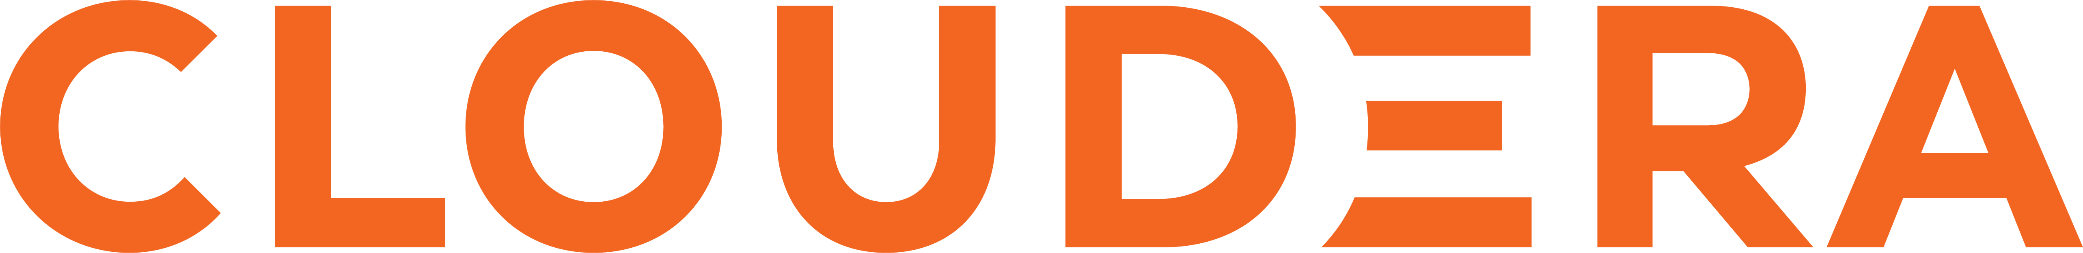
Usuários Apache Nifi no Brasil
3.262 no Mundo
Confidêncial
Todos Usuários
Notes:
Pentaho is an end-to-end business analytics and data integration platform. And in particular, a major area of focus for our platform has been helping customers integrate Big Data sources into their architecture and analyze that blend of traditional and emerging data. At the same time, we also provide analytics software that is highly embeddable in that they can fit seamlessly into existing applications and processes. A lot of our success in these areas has been due to both early innovation in Big Data – I believe we’ve been working with Hadoop for 5 to 6 years – as well as the open architecture and standards that our platform is built on.

Slide 20
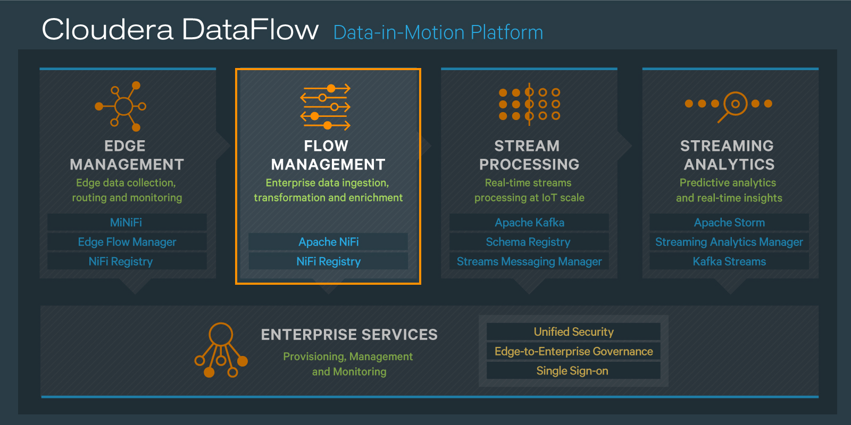
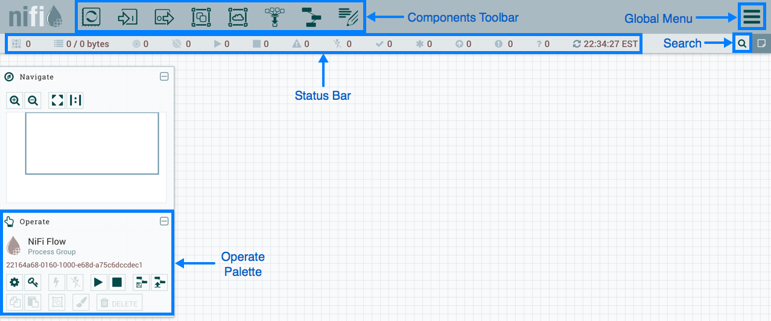
Terminologias.
DataFlow Manager
Um DataFlow Manager (DFM) é um usuário NiFi que tem permissão para adicionar, remover e modificar componentes de um fluxo de dados NiFi.
Notes:
Pentaho is an end-to-end business analytics and data integration platform. And in particular, a major area of focus for our platform has been helping customers integrate Big Data sources into their architecture and analyze that blend of traditional and emerging data. At the same time, we also provide analytics software that is highly embeddable in that they can fit seamlessly into existing applications and processes. A lot of our success in these areas has been due to both early innovation in Big Data – I believe we’ve been working with Hadoop for 5 to 6 years – as well as the open architecture and standards that our platform is built on.

Slide 21
Interface gráfica do NiFi.
Notes:
Pentaho is an end-to-end business analytics and data integration platform. And in particular, a major area of focus for our platform has been helping customers integrate Big Data sources into their architecture and analyze that blend of traditional and emerging data. At the same time, we also provide analytics software that is highly embeddable in that they can fit seamlessly into existing applications and processes. A lot of our success in these areas has been due to both early innovation in Big Data – I believe we’ve been working with Hadoop for 5 to 6 years – as well as the open architecture and standards that our platform is built on.

Slide 22
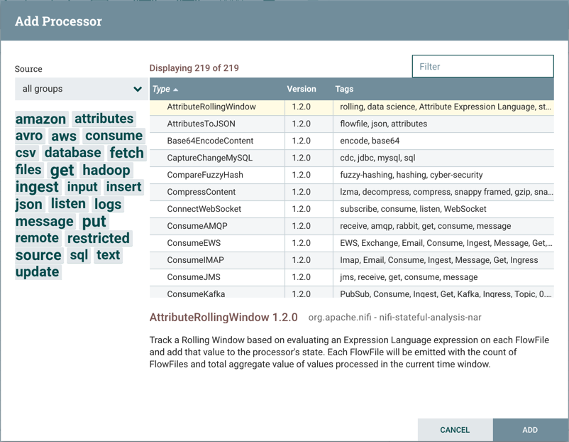
Processor
Processador.
São os componentes responsáveis por processar os dados.
Existem diversos tipos de processor.
Existem algumas tags para agrupá-los
São 288 processadores nativos (ver.1.12)
Notes:
Pentaho is an end-to-end business analytics and data integration platform. And in particular, a major area of focus for our platform has been helping customers integrate Big Data sources into their architecture and analyze that blend of traditional and emerging data. At the same time, we also provide analytics software that is highly embeddable in that they can fit seamlessly into existing applications and processes. A lot of our success in these areas has been due to both early innovation in Big Data – I believe we’ve been working with Hadoop for 5 to 6 years – as well as the open architecture and standards that our platform is built on.

Slide 23
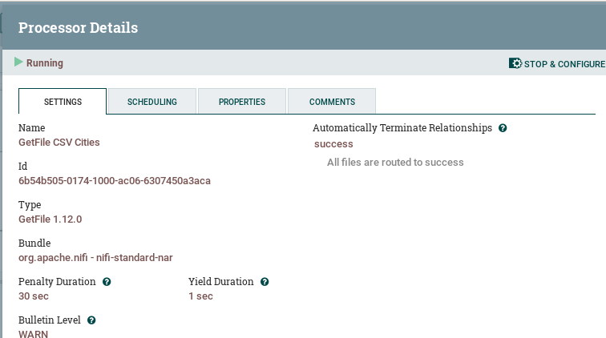
Processor - Configuration
Configuração do Processador
Cada processador tem propriedades
especificas.
Podem ser agendadas as formas de execução.
Podem ser adicionados comentários.
Os processor podem ficar em execução ou parados.
Notes:
Pentaho is an end-to-end business analytics and data integration platform. And in particular, a major area of focus for our platform has been helping customers integrate Big Data sources into their architecture and analyze that blend of traditional and emerging data. At the same time, we also provide analytics software that is highly embeddable in that they can fit seamlessly into existing applications and processes. A lot of our success in these areas has been due to both early innovation in Big Data – I believe we’ve been working with Hadoop for 5 to 6 years – as well as the open architecture and standards that our platform is built on.

Slide 24
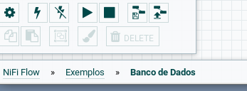
Processor Groups
Grupos de Processador.
Os grupos de processadores são formas de organizar seus processadores.
É uma divisão lógica do Apache NiFi.
O primeiro acesso ao NiFi e aberto o Process Group principal.
Notes:
Pentaho is an end-to-end business analytics and data integration platform. And in particular, a major area of focus for our platform has been helping customers integrate Big Data sources into their architecture and analyze that blend of traditional and emerging data. At the same time, we also provide analytics software that is highly embeddable in that they can fit seamlessly into existing applications and processes. A lot of our success in these areas has been due to both early innovation in Big Data – I believe we’ve been working with Hadoop for 5 to 6 years – as well as the open architecture and standards that our platform is built on.

Slide 25
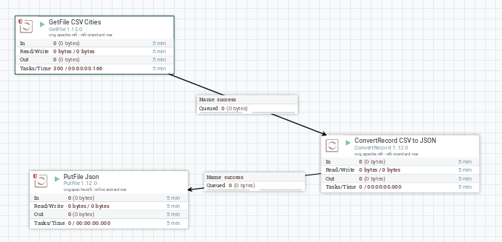
Connections
Conexões
São responsáveis pelo direcionamento do fluxo do dados.
São relacionados por possíveis caminhos como a serem seguidos:
* Sucesso.
* Falha.
* Outros dependendo
do Processor.
Notes:
Pentaho is an end-to-end business analytics and data integration platform. And in particular, a major area of focus for our platform has been helping customers integrate Big Data sources into their architecture and analyze that blend of traditional and emerging data. At the same time, we also provide analytics software that is highly embeddable in that they can fit seamlessly into existing applications and processes. A lot of our success in these areas has been due to both early innovation in Big Data – I believe we’ve been working with Hadoop for 5 to 6 years – as well as the open architecture and standards that our platform is built on.

Slide 26
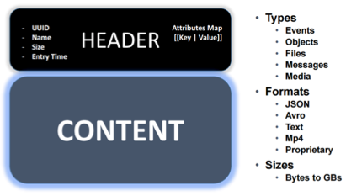
FlowFiles
Configuração do Processador
Processados ​​pelo Nifi e são mantidos em um mapa hash na memória da JVM.
Isso o torna muito eficiente para processá-los.
O mesmo pode gravar cache em disco.
O Repositório FlowFile é um "Log Write-Ahead" (ou registro de dados) dos metadados de cada um dos FlowFiles que existem atualmente no sistema.
Um FlowFile pode ter diversos formatos.
O Tamanho pode ser configurado
O Número de linhas pode ser configurado.
O conteúdo pode ser criptografado.
Notes:
Pentaho is an end-to-end business analytics and data integration platform. And in particular, a major area of focus for our platform has been helping customers integrate Big Data sources into their architecture and analyze that blend of traditional and emerging data. At the same time, we also provide analytics software that is highly embeddable in that they can fit seamlessly into existing applications and processes. A lot of our success in these areas has been due to both early innovation in Big Data – I believe we’ve been working with Hadoop for 5 to 6 years – as well as the open architecture and standards that our platform is built on.

Slide 27
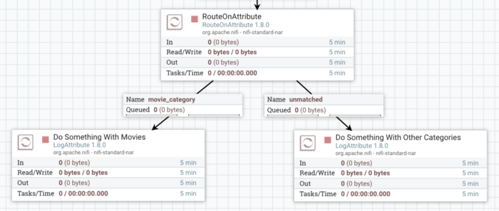
Condicional Processor
Processador de Condição.
Permite verificar o dado e tomar decisão do roteamento do fluxo.
Utiliza da NiFi Expression Language.
${category:equals('movies')}
https://medium.com/mpharma-tech-blog/dealing-with-conditionals-in-apache-nifi-e24fbc01037b
Notes:
Pentaho is an end-to-end business analytics and data integration platform. And in particular, a major area of focus for our platform has been helping customers integrate Big Data sources into their architecture and analyze that blend of traditional and emerging data. At the same time, we also provide analytics software that is highly embeddable in that they can fit seamlessly into existing applications and processes. A lot of our success in these areas has been due to both early innovation in Big Data – I believe we’ve been working with Hadoop for 5 to 6 years – as well as the open architecture and standards that our platform is built on.

Slide 28
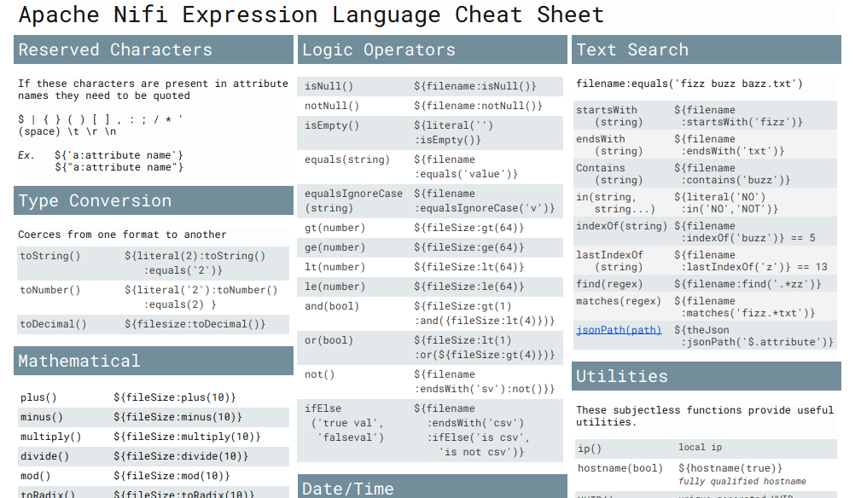
NiFi Expression Language.
Processador de Condição.
Quando processamos os FlowFiles eles gera atributos.
O atributos gerados podem ser acessados pela NiFi EL.
Exemplos:
${category:equals('movies')}
/opt/hacks/${filename}
${filename:toUpper()}
${"my attribute"}
Notes:
Pentaho is an end-to-end business analytics and data integration platform. And in particular, a major area of focus for our platform has been helping customers integrate Big Data sources into their architecture and analyze that blend of traditional and emerging data. At the same time, we also provide analytics software that is highly embeddable in that they can fit seamlessly into existing applications and processes. A lot of our success in these areas has been due to both early innovation in Big Data – I believe we’ve been working with Hadoop for 5 to 6 years – as well as the open architecture and standards that our platform is built on.

Slide 29
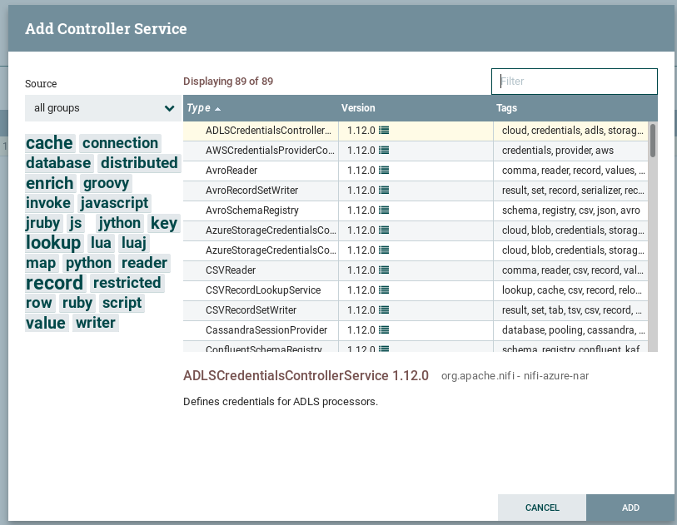
Controller Services
Services
Os controlllers services são divididos por grupos.
Atualmente são mais de 80 Controllers Services.
Notes:
Pentaho is an end-to-end business analytics and data integration platform. And in particular, a major area of focus for our platform has been helping customers integrate Big Data sources into their architecture and analyze that blend of traditional and emerging data. At the same time, we also provide analytics software that is highly embeddable in that they can fit seamlessly into existing applications and processes. A lot of our success in these areas has been due to both early innovation in Big Data – I believe we’ve been working with Hadoop for 5 to 6 years – as well as the open architecture and standards that our platform is built on.

Slide 30

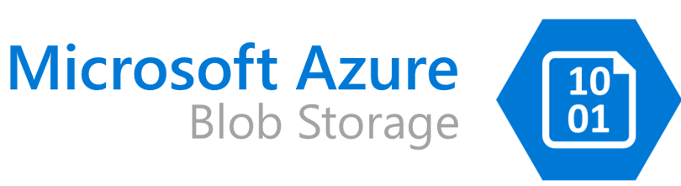



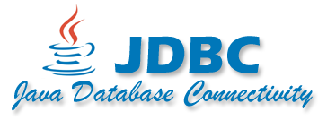
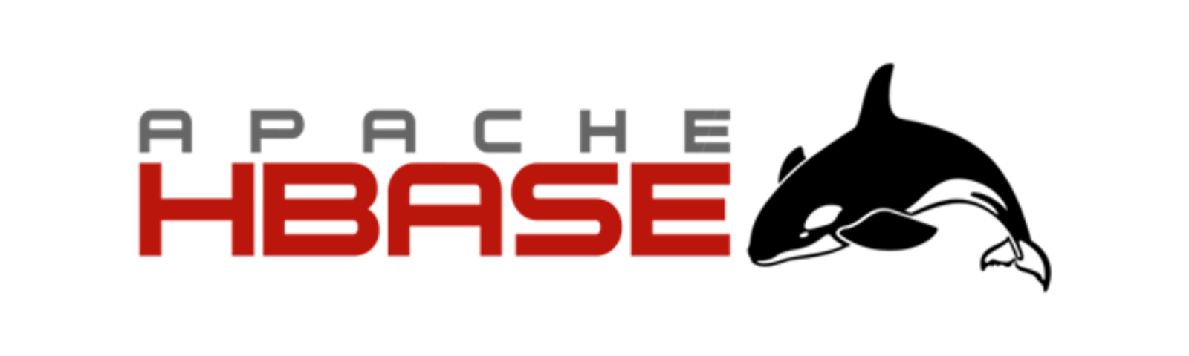
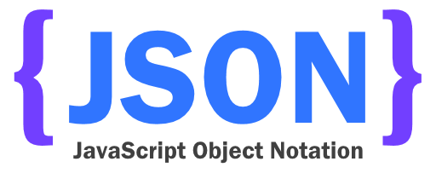


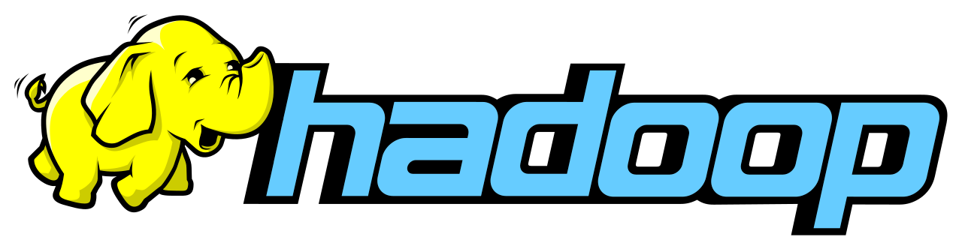
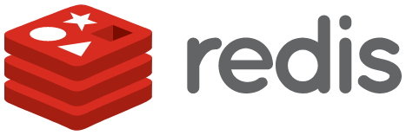
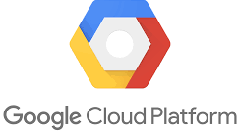
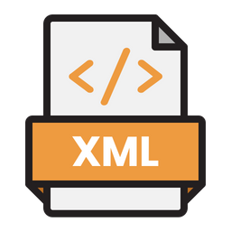



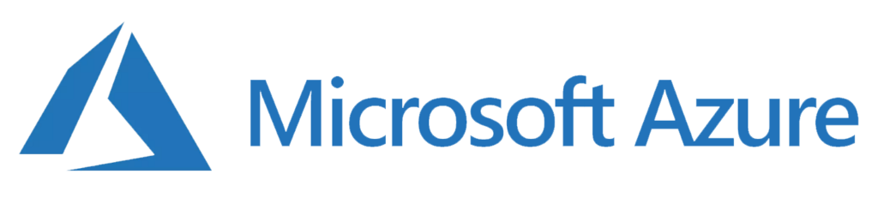










Apache NiFi - Controller Services Types
Notes:
Pentaho is an end-to-end business analytics and data integration platform. And in particular, a major area of focus for our platform has been helping customers integrate Big Data sources into their architecture and analyze that blend of traditional and emerging data. At the same time, we also provide analytics software that is highly embeddable in that they can fit seamlessly into existing applications and processes. A lot of our success in these areas has been due to both early innovation in Big Data – I believe we’ve been working with Hadoop for 5 to 6 years – as well as the open architecture and standards that our platform is built on.

Slide 31

Nifi Cluster
Notes:
Pentaho is an end-to-end business analytics and data integration platform. And in particular, a major area of focus for our platform has been helping customers integrate Big Data sources into their architecture and analyze that blend of traditional and emerging data. At the same time, we also provide analytics software that is highly embeddable in that they can fit seamlessly into existing applications and processes. A lot of our success in these areas has been due to both early innovation in Big Data – I believe we’ve been working with Hadoop for 5 to 6 years – as well as the open architecture and standards that our platform is built on.

Slide 32

Nifi Registry e Flow Life Cyclo
Notes:
Pentaho is an end-to-end business analytics and data integration platform. And in particular, a major area of focus for our platform has been helping customers integrate Big Data sources into their architecture and analyze that blend of traditional and emerging data. At the same time, we also provide analytics software that is highly embeddable in that they can fit seamlessly into existing applications and processes. A lot of our success in these areas has been due to both early innovation in Big Data – I believe we’ve been working with Hadoop for 5 to 6 years – as well as the open architecture and standards that our platform is built on.

Slide 33


Minifi
Conceito
Versão leve do Apache NiFi, projetada para coleta eficiente de dados em dispositivos de borda ou ambientes com recursos limitados.
Permite a transmissão segura e em tempo real de dados para um servidor NiFi centralizado.
Suporte Flexível: Oferece configuração em Java, C++, Python, etc, adaptando-se a diferentes casos de uso.
Ideal para IoT.
Notes:
Pentaho is an end-to-end business analytics and data integration platform. And in particular, a major area of focus for our platform has been helping customers integrate Big Data sources into their architecture and analyze that blend of traditional and emerging data. At the same time, we also provide analytics software that is highly embeddable in that they can fit seamlessly into existing applications and processes. A lot of our success in these areas has been due to both early innovation in Big Data – I believe we’ve been working with Hadoop for 5 to 6 years – as well as the open architecture and standards that our platform is built on.

Slide 34

Minifi e Case
Notes:
Pentaho is an end-to-end business analytics and data integration platform. And in particular, a major area of focus for our platform has been helping customers integrate Big Data sources into their architecture and analyze that blend of traditional and emerging data. At the same time, we also provide analytics software that is highly embeddable in that they can fit seamlessly into existing applications and processes. A lot of our success in these areas has been due to both early innovation in Big Data – I believe we’ve been working with Hadoop for 5 to 6 years – as well as the open architecture and standards that our platform is built on.

Slide 35
Obrigado
Marcio Junior Vieira
marcio@ambientelivre.com.br
@marviojvieira @ambientelivre
https://www.linkedin.com/in/mvieira1/
Blog: http://blogs.ambientelivre.com.br/marcio/
Slides:
https://github.com/ambientelivre/labs

