Slide 1

PostgreSQL
Implementando um Cluster Master-Master no PostgreSQL com Bucardo
CONFLOSS 2023
Marcio Junior Vieira
CEO & Data Scientist, Ambiente Livre

Slide 2
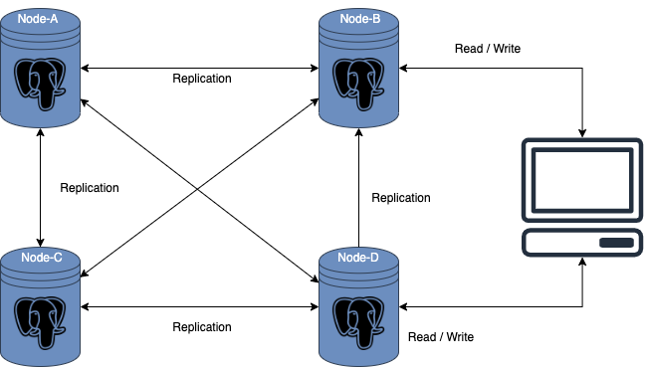
Replicação Multi-Master
Notes:
Pentaho is an end-to-end business analytics and data integration platform. And in particular, a major area of focus for our platform has been helping customers integrate Big Data sources into their architecture and analyze that blend of traditional and emerging data. At the same time, we also provide analytics software that is highly embeddable in that they can fit seamlessly into existing applications and processes. A lot of our success in these areas has been due to both early innovation in Big Data – I believe we’ve been working with Hadoop for 5 to 6 years – as well as the open architecture and standards that our platform is built on.

Slide 3
Replicação Multi-Master
Prós
No caso de um mestre falhar, o outro mestre está lá para servir a atualização e a inserção.
Os nós mestres estão localizados em vários locais diferentes, portanto, as chances de falha de todos os mestres são mínimas.
As atualizações de dados são possíveis em vários servidores.
O aplicativo não requer rotear o tráfego para apenas um único mestre.
Notes:
Pentaho is an end-to-end business analytics and data integration platform. And in particular, a major area of focus for our platform has been helping customers integrate Big Data sources into their architecture and analyze that blend of traditional and emerging data. At the same time, we also provide analytics software that is highly embeddable in that they can fit seamlessly into existing applications and processes. A lot of our success in these areas has been due to both early innovation in Big Data – I believe we’ve been working with Hadoop for 5 to 6 years – as well as the open architecture and standards that our platform is built on.

Slide 4
Replicação Multi-Master
Contra
A principal desvantagem da replicação multi-master é sua complexidade.
A resolução de conflitos é muito difícil porque gravações simultâneas em vários nós são possíveis.
Às vezes, a intervenção manual é necessária em caso de conflito .
Possibilidade de inconsistência de dados.
Notes:
Pentaho is an end-to-end business analytics and data integration platform. And in particular, a major area of focus for our platform has been helping customers integrate Big Data sources into their architecture and analyze that blend of traditional and emerging data. At the same time, we also provide analytics software that is highly embeddable in that they can fit seamlessly into existing applications and processes. A lot of our success in these areas has been due to both early innovation in Big Data – I believe we’ve been working with Hadoop for 5 to 6 years – as well as the open architecture and standards that our platform is built on.

Slide 5
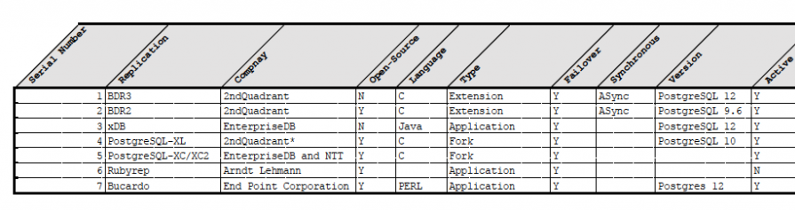
Opções para PostgreSQL
Contra
O PostgreSQL nativo não implementa Master-Master
Tabela de Opções ?
Fonte: https://www.percona.com/blog/multi-master-replication-solutions-for-postgresql/
Notes:
Pentaho is an end-to-end business analytics and data integration platform. And in particular, a major area of focus for our platform has been helping customers integrate Big Data sources into their architecture and analyze that blend of traditional and emerging data. At the same time, we also provide analytics software that is highly embeddable in that they can fit seamlessly into existing applications and processes. A lot of our success in these areas has been due to both early innovation in Big Data – I believe we’ve been working with Hadoop for 5 to 6 years – as well as the open architecture and standards that our platform is built on.

Slide 6
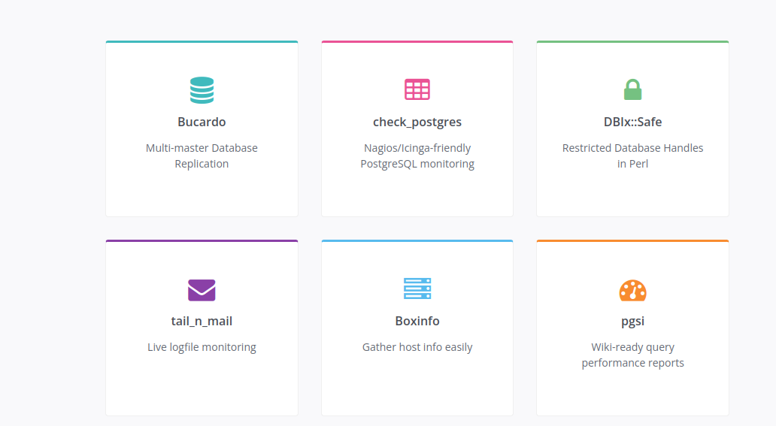
Bucardo
Notes:
Pentaho is an end-to-end business analytics and data integration platform. And in particular, a major area of focus for our platform has been helping customers integrate Big Data sources into their architecture and analyze that blend of traditional and emerging data. At the same time, we also provide analytics software that is highly embeddable in that they can fit seamlessly into existing applications and processes. A lot of our success in these areas has been due to both early innovation in Big Data – I believe we’ve been working with Hadoop for 5 to 6 years – as well as the open architecture and standards that our platform is built on.

Slide 7
Bucardo
Conceito
Sistema de replicação PostgreSQL assíncrono, permitindo operações multi-master e multi-slave.
Replica dados entre bancos de dados PostgreSQL, MySQL, Redis, Oracle, MariaDB, SQLite ou MongoDB.
Desenvolvido no Backcountry.com por Jon Jensen e Greg Sabino Mullane da End Point Corporation.
Software Livre e de código aberto lançado sob a licença BSD.
Desenvolvido em Perl.
Notes:
Pentaho is an end-to-end business analytics and data integration platform. And in particular, a major area of focus for our platform has been helping customers integrate Big Data sources into their architecture and analyze that blend of traditional and emerging data. At the same time, we also provide analytics software that is highly embeddable in that they can fit seamlessly into existing applications and processes. A lot of our success in these areas has been due to both early innovation in Big Data – I believe we’ve been working with Hadoop for 5 to 6 years – as well as the open architecture and standards that our platform is built on.

Slide 8
Bucardo - Requisitos
Requisitos
Perl e libs Perl e postgresql-perl.
Requer um banco de dados dedicado e é executado como um daemon Perl que se comunica com esse banco de dados e todos os outros bancos de dados envolvidos na replicação.
Todas as informações específicas que o daemon precisa são armazenadas no banco de dados bucardo principal, incluindo uma lista de todos os bancos de dados envolvidos na replicação e como alcançá-los, todas as tabelas que devem ser replicadas e como cada uma deve ser replicada.
Notes:
Pentaho is an end-to-end business analytics and data integration platform. And in particular, a major area of focus for our platform has been helping customers integrate Big Data sources into their architecture and analyze that blend of traditional and emerging data. At the same time, we also provide analytics software that is highly embeddable in that they can fit seamlessly into existing applications and processes. A lot of our success in these areas has been due to both early innovation in Big Data – I believe we’ve been working with Hadoop for 5 to 6 years – as well as the open architecture and standards that our platform is built on.

Slide 9
Bucardo - Master-Master
Multi-master
A replicação multi-master usa dois ou mais bancos de dados, com resolução de conflitos (opções padrão ou sub-rotinas personalizadas) para lidar com a mesma atualização em ambos os lados.
A replicação mestre-slave envolve uma ou mais origens indo para um ou mais destinos.
A origem deve ser PostgreSQL, mas os destinos podem ser PostgreSQL, MySQL, Redis, Oracle, MariaDB, SQLite ou MongoDB.
Notes:
Pentaho is an end-to-end business analytics and data integration platform. And in particular, a major area of focus for our platform has been helping customers integrate Big Data sources into their architecture and analyze that blend of traditional and emerging data. At the same time, we also provide analytics software that is highly embeddable in that they can fit seamlessly into existing applications and processes. A lot of our success in these areas has been due to both early innovation in Big Data – I believe we’ve been working with Hadoop for 5 to 6 years – as well as the open architecture and standards that our platform is built on.

Slide 10
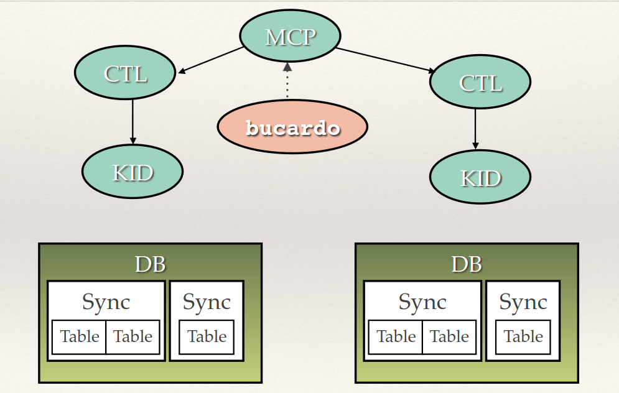
Bucardo - Master-Master
Notes:
Pentaho is an end-to-end business analytics and data integration platform. And in particular, a major area of focus for our platform has been helping customers integrate Big Data sources into their architecture and analyze that blend of traditional and emerging data. At the same time, we also provide analytics software that is highly embeddable in that they can fit seamlessly into existing applications and processes. A lot of our success in these areas has been due to both early innovation in Big Data – I believe we’ve been working with Hadoop for 5 to 6 years – as well as the open architecture and standards that our platform is built on.

Slide 11
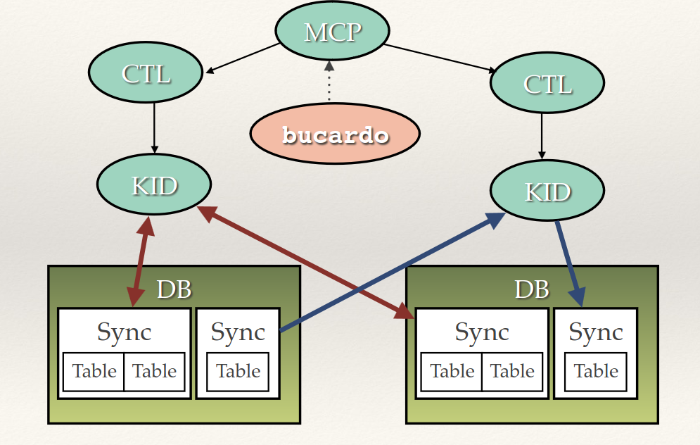
Bucardo - Master-Master
Notes:
Pentaho is an end-to-end business analytics and data integration platform. And in particular, a major area of focus for our platform has been helping customers integrate Big Data sources into their architecture and analyze that blend of traditional and emerging data. At the same time, we also provide analytics software that is highly embeddable in that they can fit seamlessly into existing applications and processes. A lot of our success in these areas has been due to both early innovation in Big Data – I believe we’ve been working with Hadoop for 5 to 6 years – as well as the open architecture and standards that our platform is built on.

Slide 12
Bucardo - Workflow
Workflow
A primeira etapa na execução é adicionar dois ou mais bancos de dados ao banco de dados principal do Bucardo.
Feito isso, são adicionadas informações sobre quais tabelas devem ser replicadas, bem como quaisquer agrupamentos de tabelas.
Em seguida, as sincronizações são adicionadas. As sincronizações são ações de replicação nomeadas, copiando um conjunto específico de tabelas de um servidor para outro servidor ou grupo de servidores.
Uma vez configurado o Bucardo, as triggers começam a armazenar informações sobre quais linhas foram alteradas em todas as tabelas de interesse.
Notes:
Pentaho is an end-to-end business analytics and data integration platform. And in particular, a major area of focus for our platform has been helping customers integrate Big Data sources into their architecture and analyze that blend of traditional and emerging data. At the same time, we also provide analytics software that is highly embeddable in that they can fit seamlessly into existing applications and processes. A lot of our success in these areas has been due to both early innovation in Big Data – I believe we’ve been working with Hadoop for 5 to 6 years – as well as the open architecture and standards that our platform is built on.

Slide 13
Bucardo - Workflow
Sincronização de troca (multi-master)
Uma alteração é feita na tabela e registrada na tabela bucardo_delta.
Um aviso é enviado ao daemon principal, informando alteração.
O daemon notifica o controlador para essa sincronização e volta a escutar.
O controlador cria um “kid” para lidar com a replicação.
O kid inicia uma nova transação e desabilita triggers e regras nas tabelas.
Em seguida, reúne uma lista de quais linhas foram alteradas desde a última replicação e compara as duas para descobrir o que deve ser feito.
Se houver um conflito, o manipulador de conflitos padrão ou personalizado, definido por tabela, será executado para resolver as coisas.
Triggers e regras são reativados e a transação é confirmada.
Se a transação falhar, todos os manipuladores de exceção personalizados serão executados.
O kid sinaliza para o controlador que terminou.
Notes:
Pentaho is an end-to-end business analytics and data integration platform. And in particular, a major area of focus for our platform has been helping customers integrate Big Data sources into their architecture and analyze that blend of traditional and emerging data. At the same time, we also provide analytics software that is highly embeddable in that they can fit seamlessly into existing applications and processes. A lot of our success in these areas has been due to both early innovation in Big Data – I believe we’ve been working with Hadoop for 5 to 6 years – as well as the open architecture and standards that our platform is built on.

Slide 14
Bucardo Client
Cli commands
bucardo install
bucardo add
bucardo status
bucardo kick
bucardo help
Notes:
Pentaho is an end-to-end business analytics and data integration platform. And in particular, a major area of focus for our platform has been helping customers integrate Big Data sources into their architecture and analyze that blend of traditional and emerging data. At the same time, we also provide analytics software that is highly embeddable in that they can fit seamlessly into existing applications and processes. A lot of our success in these areas has been due to both early innovation in Big Data – I believe we’ve been working with Hadoop for 5 to 6 years – as well as the open architecture and standards that our platform is built on.

Slide 15
Limitações Bucardo
Limitações
Sem manipulação automática de DDL
Requer PKs
Notes:
Pentaho is an end-to-end business analytics and data integration platform. And in particular, a major area of focus for our platform has been helping customers integrate Big Data sources into their architecture and analyze that blend of traditional and emerging data. At the same time, we also provide analytics software that is highly embeddable in that they can fit seamlessly into existing applications and processes. A lot of our success in these areas has been due to both early innovation in Big Data – I believe we’ve been working with Hadoop for 5 to 6 years – as well as the open architecture and standards that our platform is built on.

Slide 16
Obrigado
Marcio Junior Vieira
marcio@ambientelivre.com.br
@marviojvieira @ambientelivre
https://www.linkedin.com/in/mvieira1/

