Slide 1
Alfresco: Digital Business Platform Overview (ECM)
Williane Delfino
Desenvolvedora de Software, Ambiente Livre

Slide 2

Williane Delfino Pinheiro
Mini-cv
Graduada em Pedagogia pela Universidade Federal do Oeste do Pará - UFOPA.
Acadêmica de Análise e Desenvolvimento de Sistemas na Universidade da Amazônia - UNAMA.
Experiência como Gestora Pedagógica em ambientes não-escolares.
Atuei como assistente de apoio à aprendizagem na AIESEC Argentina.
Integrei o time de desenvolvedores Back-end Compass.uol e Everymind, especializado em integrações Mulesoft.
Especialista em customização de ECM com Alfresco e BPM com Camunda.
Instrutora da Ambiente Livre em treinamentos para equipes de gestão empresarial com Alfresco Digital Business Platform.
Contribuidora de projetos Open Source como Camunda.

Slide 3
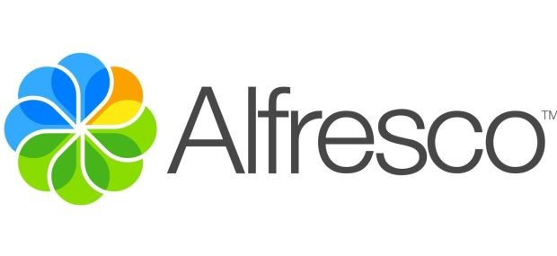
Agenda
ECM ou GED ?
Alfresco Primeiras Impressões
Arquitetura
Interfaces
Pilares de um ECM
Vantagens
Funcionalidades
Conceitos básicos da gestão de documentos
Modelos de Conteúdo
Segurança
Integração e Autenticação
Curiosidades Alfresco

Slide 4
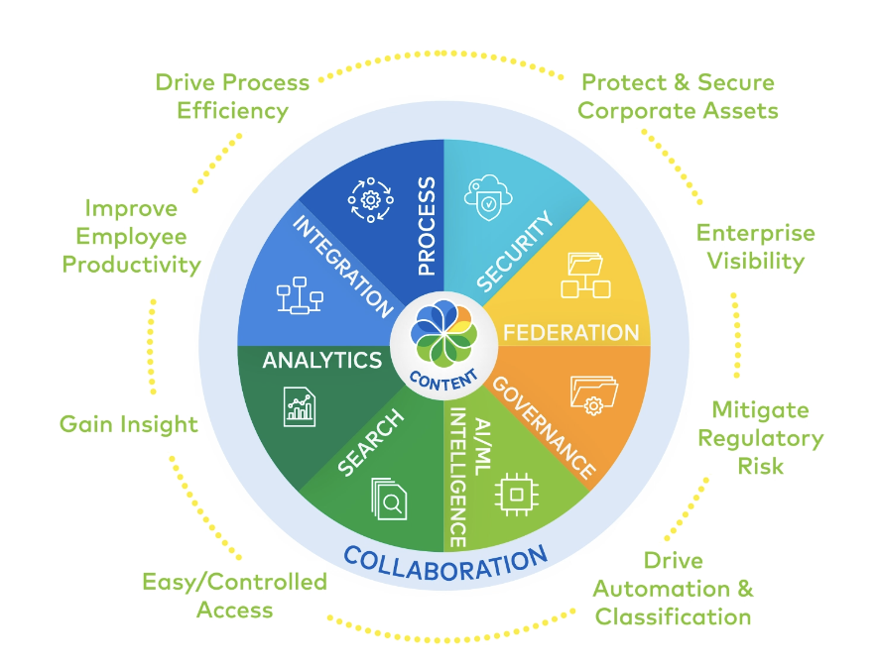
ECM ou GED ?
GED – Gestão Eletrônica de Documentos (guardar documentos)
ECM – Gestão de Conteúdo Empresarial (conta com todo esse conjunto de funcionalidades para conteúdo empresarial variado)

Slide 5

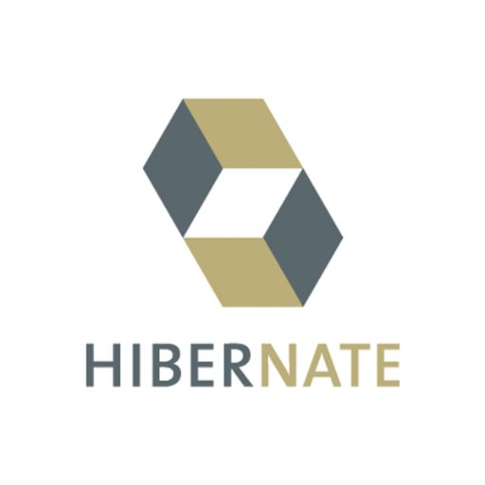
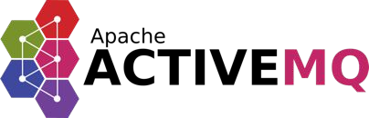


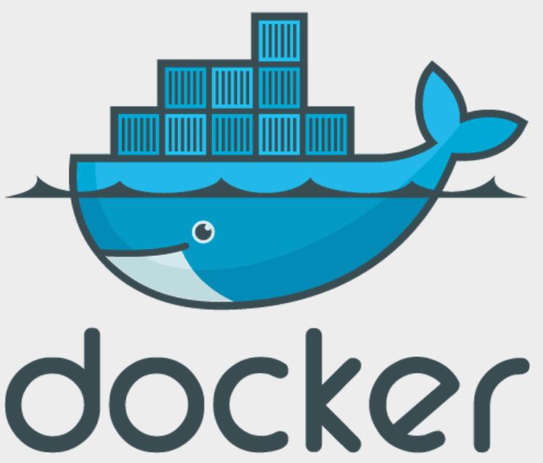

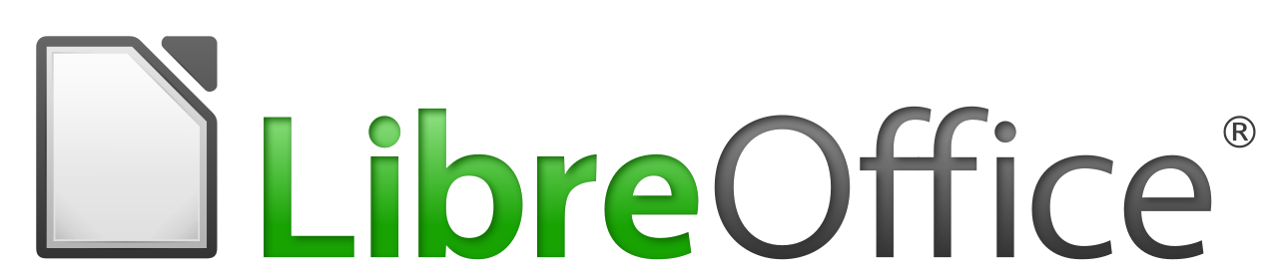
Alfresco Primeiras Impressões
Características
Uma Alternativa ao Microsoft Share Point, Open Text e Documentum.
Baseado em padrões: Java Specification Request (JSR) JSR-128, JSR-170, Level 2 Web Services , Java Server Faces.
Desenvolvido com tecnologias open source:
Notes:
Pentaho is an end-to-end business analytics and data integration platform. And in particular, a major area of focus for our platform has been helping customers integrate Big Data sources into their architecture and analyze that blend of traditional and emerging data. At the same time, we also provide analytics software that is highly embeddable in that they can fit seamlessly into existing applications and processes. A lot of our success in these areas has been due to both early innovation in Big Data – I believe we’ve been working with Hadoop for 5 to 6 years – as well as the open architecture and standards that our platform is built on.

Slide 6
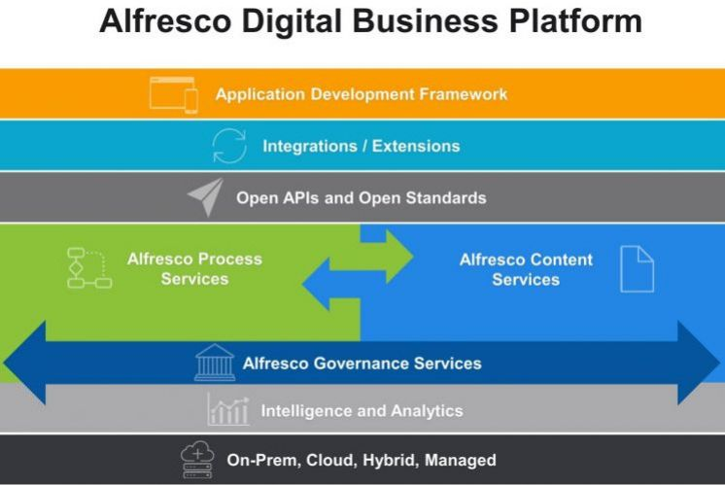
Alfresco - Arquitetura
EE/CE
EE/CE
EE/CE
EE/CE
EE
EE/CE
Notes:
Pentaho is an end-to-end business analytics and data integration platform. And in particular, a major area of focus for our platform has been helping customers integrate Big Data sources into their architecture and analyze that blend of traditional and emerging data. At the same time, we also provide analytics software that is highly embeddable in that they can fit seamlessly into existing applications and processes. A lot of our success in these areas has been due to both early innovation in Big Data – I believe we’ve been working with Hadoop for 5 to 6 years – as well as the open architecture and standards that our platform is built on.

Slide 7
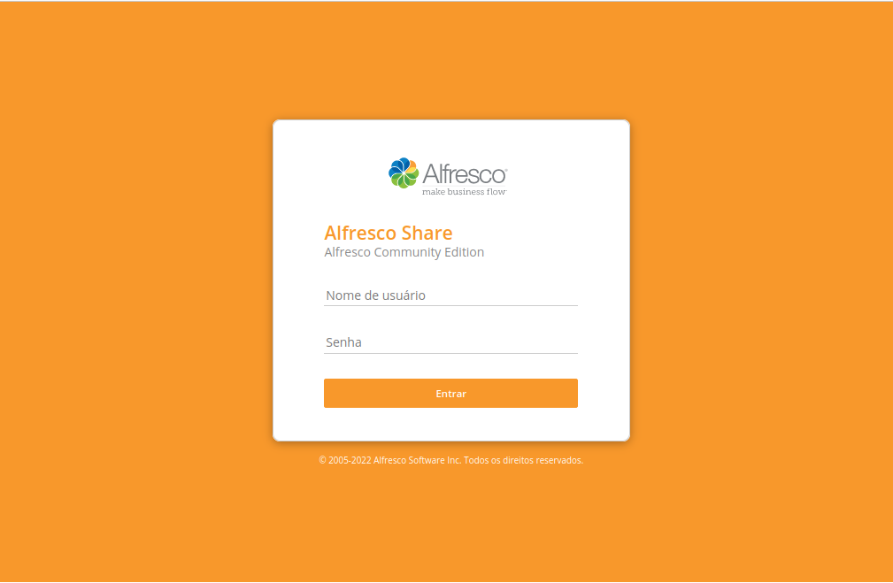
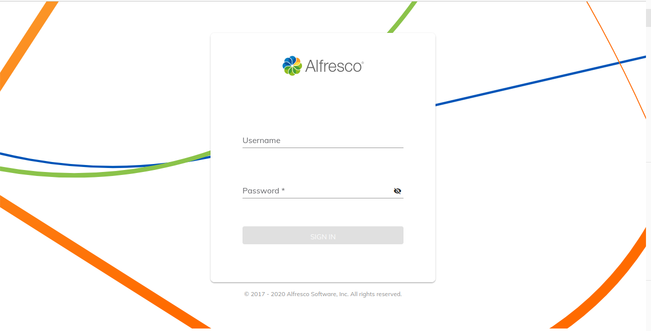
Alfresco – Plataforma de Conteúdo
Colaboração (Share)
Content App (Basic Interface)
WebDav (Explorer)
Notes:
Pentaho is an end-to-end business analytics and data integration platform. And in particular, a major area of focus for our platform has been helping customers integrate Big Data sources into their architecture and analyze that blend of traditional and emerging data. At the same time, we also provide analytics software that is highly embeddable in that they can fit seamlessly into existing applications and processes. A lot of our success in these areas has been due to both early innovation in Big Data – I believe we’ve been working with Hadoop for 5 to 6 years – as well as the open architecture and standards that our platform is built on.

Slide 8
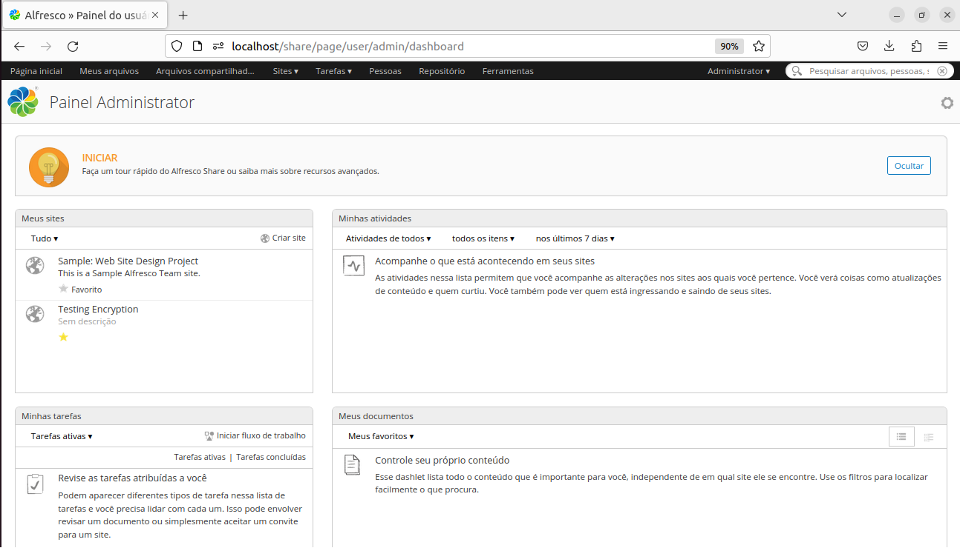
Alfresco - Share
Interface simples
de colaboração
Telas e menus para
buscar e/ou navegar
em Conteúdos
Dashlets personalizáveis
Thumbnails (frame
inicial de cada conteúdo)
Preview e edição de
documentos
Possibilidade de integrar
Wikis, Blogs e Fóruns de
Discussões
Personalização de layout
Notes:
Pentaho is an end-to-end business analytics and data integration platform. And in particular, a major area of focus for our platform has been helping customers integrate Big Data sources into their architecture and analyze that blend of traditional and emerging data. At the same time, we also provide analytics software that is highly embeddable in that they can fit seamlessly into existing applications and processes. A lot of our success in these areas has been due to both early innovation in Big Data – I believe we’ve been working with Hadoop for 5 to 6 years – as well as the open architecture and standards that our platform is built on.

Slide 9
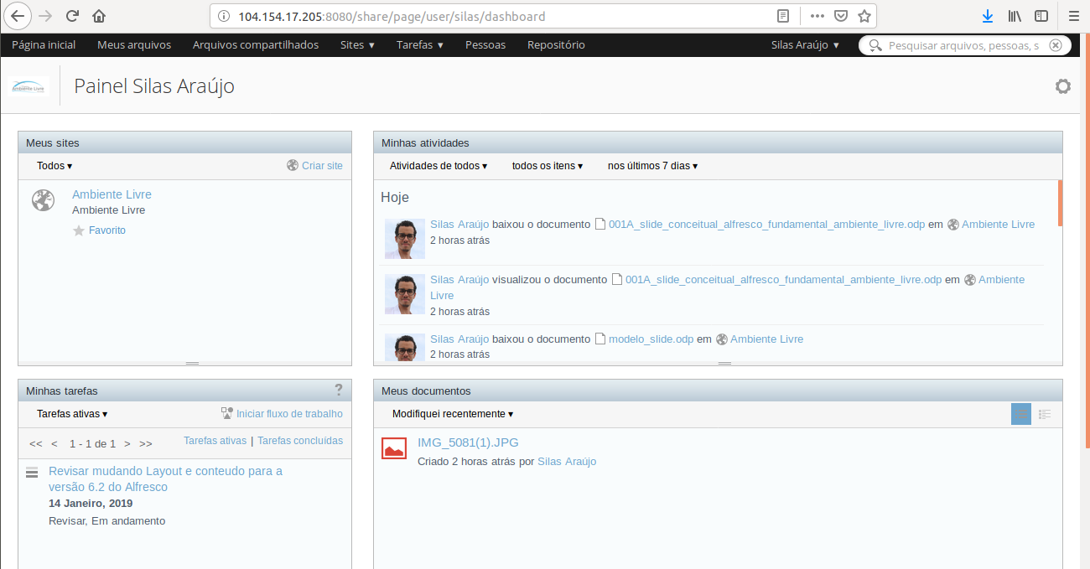
Alfresco - Share
1
2
3
4
5
6
Notes:
Pentaho is an end-to-end business analytics and data integration platform. And in particular, a major area of focus for our platform has been helping customers integrate Big Data sources into their architecture and analyze that blend of traditional and emerging data. At the same time, we also provide analytics software that is highly embeddable in that they can fit seamlessly into existing applications and processes. A lot of our success in these areas has been due to both early innovation in Big Data – I believe we’ve been working with Hadoop for 5 to 6 years – as well as the open architecture and standards that our platform is built on.

Slide 10
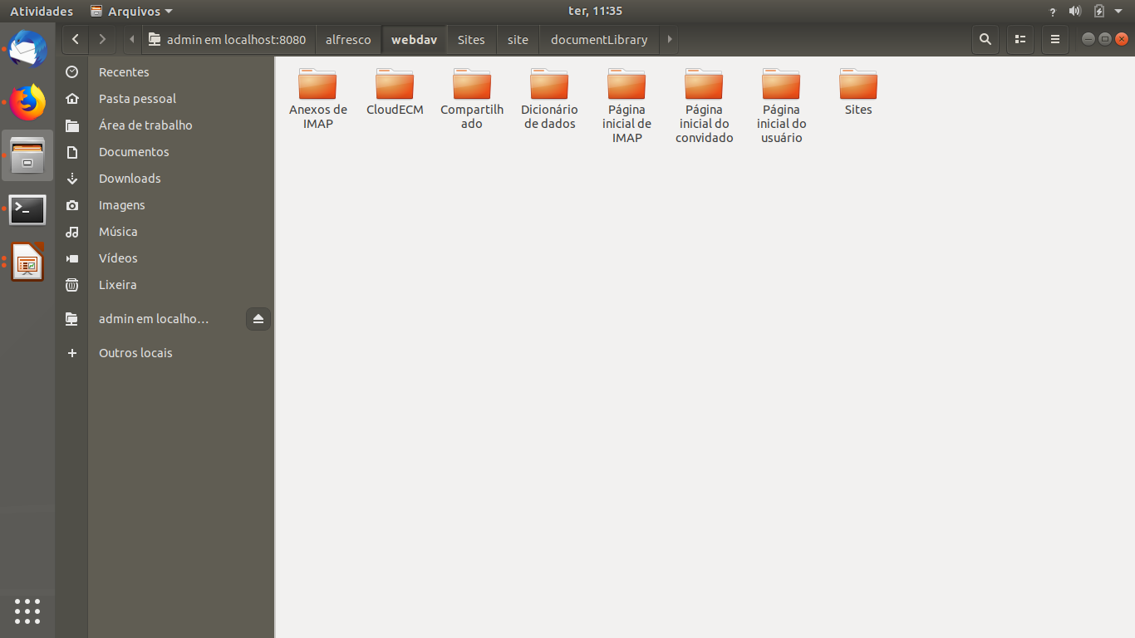
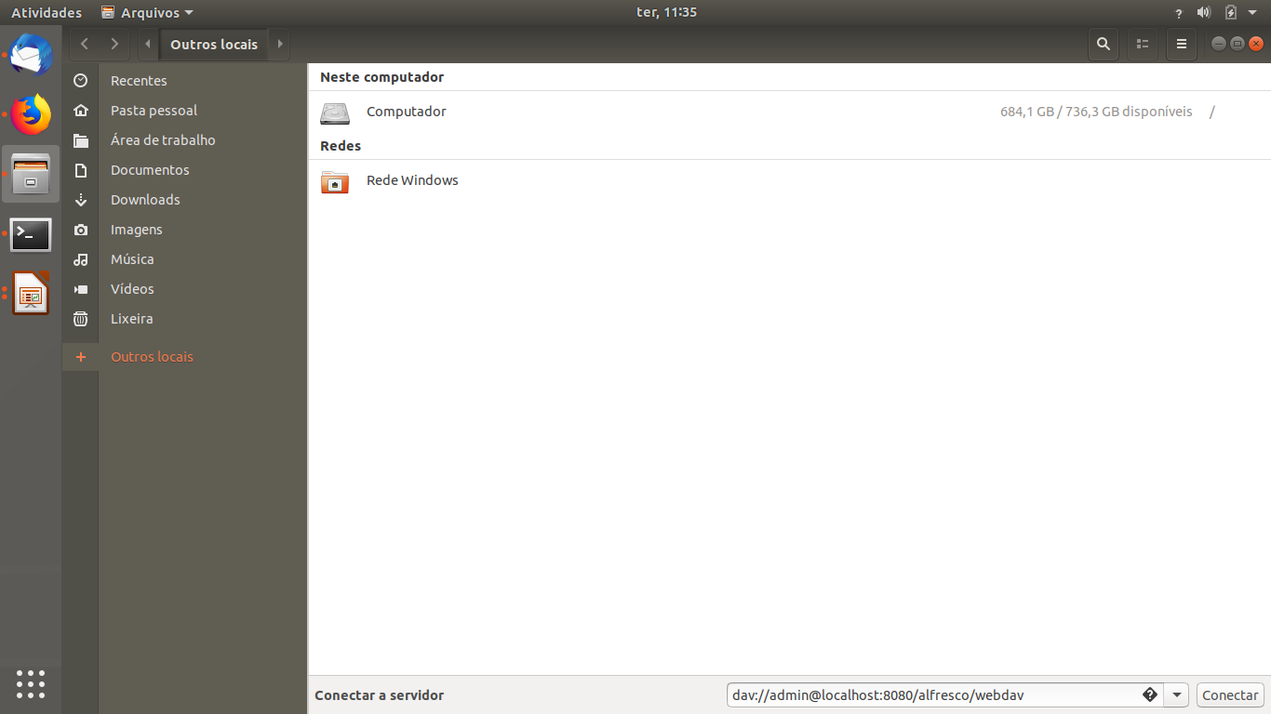
Interface SO (Explorer)
É como um explorer externo onde os documentos podem ser acessados e editados
Algumas funções são limitadas nessa interface
Regras de permissão e automatizações feitas no Alfresco valem para esse ambiente
Vantagem: migração de dados
Notes:
Pentaho is an end-to-end business analytics and data integration platform. And in particular, a major area of focus for our platform has been helping customers integrate Big Data sources into their architecture and analyze that blend of traditional and emerging data. At the same time, we also provide analytics software that is highly embeddable in that they can fit seamlessly into existing applications and processes. A lot of our success in these areas has been due to both early innovation in Big Data – I believe we’ve been working with Hadoop for 5 to 6 years – as well as the open architecture and standards that our platform is built on.

Slide 11
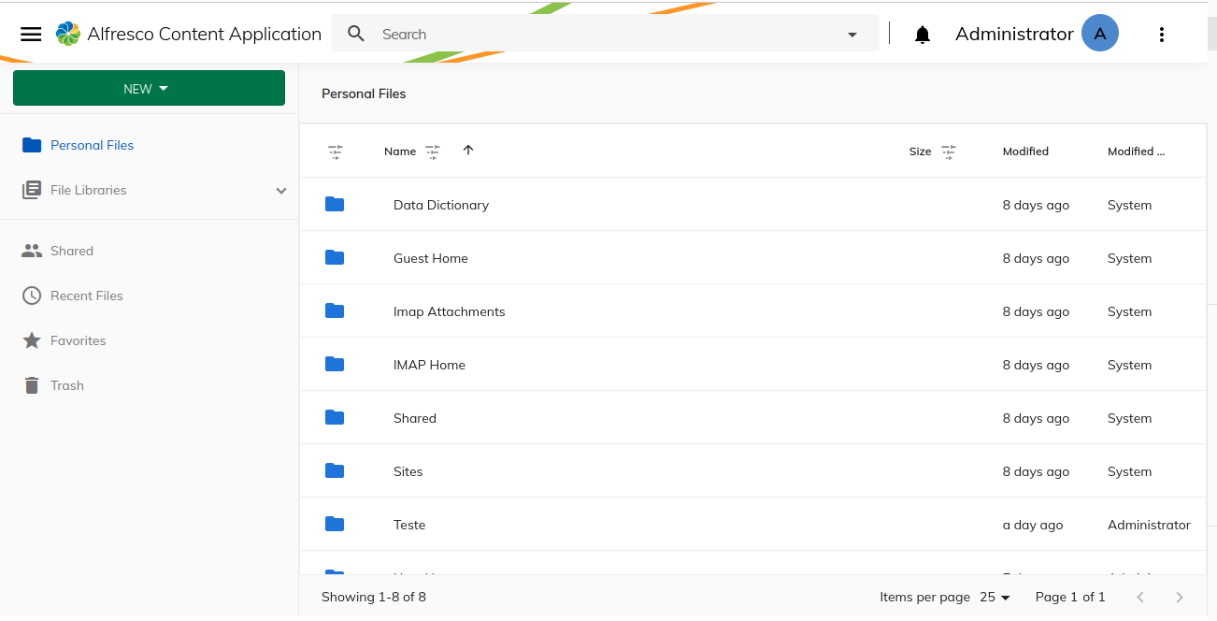
Content Application
Notes:
Pentaho is an end-to-end business analytics and data integration platform. And in particular, a major area of focus for our platform has been helping customers integrate Big Data sources into their architecture and analyze that blend of traditional and emerging data. At the same time, we also provide analytics software that is highly embeddable in that they can fit seamlessly into existing applications and processes. A lot of our success in these areas has been due to both early innovation in Big Data – I believe we’ve been working with Hadoop for 5 to 6 years – as well as the open architecture and standards that our platform is built on.

Slide 12
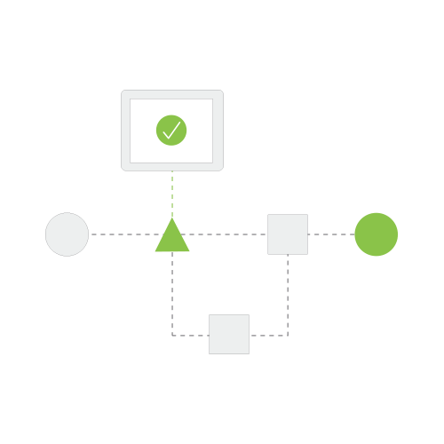
3 pilares das ferramentas de ECM
Workflow (poder processar com
fluxos as informações).
Metadados (possibilidade de criar
metadados, catalogar documentos
com propriedades diferentes).
Rastreabilidade (rastreabilidade,
quem fez, onde fez, o que fez,
onde está o doc.).
Notes:
Pentaho is an end-to-end business analytics and data integration platform. And in particular, a major area of focus for our platform has been helping customers integrate Big Data sources into their architecture and analyze that blend of traditional and emerging data. At the same time, we also provide analytics software that is highly embeddable in that they can fit seamlessly into existing applications and processes. A lot of our success in these areas has been due to both early innovation in Big Data – I believe we’ve been working with Hadoop for 5 to 6 years – as well as the open architecture and standards that our platform is built on.

Slide 13
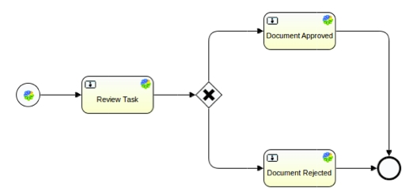
Workflow
BPMN 2.0 é o padrão de modelagem atual usado para mapear processos de negócios em um modelo de processo de negócios.
Tasks e componentes do workflow
EXEMPLOS:
Reembolso de despesas.
Processo de Solicitação de
Férias
Gestão de reclamações.
Solicitação de demissão.
Processo de seleção e
contratação de candidatos.
Notes:
Pentaho is an end-to-end business analytics and data integration platform. And in particular, a major area of focus for our platform has been helping customers integrate Big Data sources into their architecture and analyze that blend of traditional and emerging data. At the same time, we also provide analytics software that is highly embeddable in that they can fit seamlessly into existing applications and processes. A lot of our success in these areas has been due to both early innovation in Big Data – I believe we’ve been working with Hadoop for 5 to 6 years – as well as the open architecture and standards that our platform is built on.

Slide 14
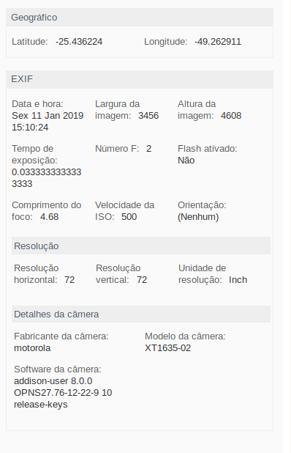
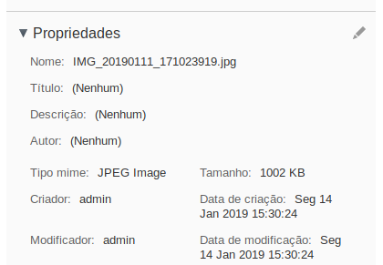
Metadados
Informações relevantes do documento,
que descrevem o conteúdo que está
sendo armazenado.
Autor, Título, Descrição, Datas de criação
e atualização.
É possível usá-los ainda para automações.
Notes:
Pentaho is an end-to-end business analytics and data integration platform. And in particular, a major area of focus for our platform has been helping customers integrate Big Data sources into their architecture and analyze that blend of traditional and emerging data. At the same time, we also provide analytics software that is highly embeddable in that they can fit seamlessly into existing applications and processes. A lot of our success in these areas has been due to both early innovation in Big Data – I believe we’ve been working with Hadoop for 5 to 6 years – as well as the open architecture and standards that our platform is built on.

Slide 15
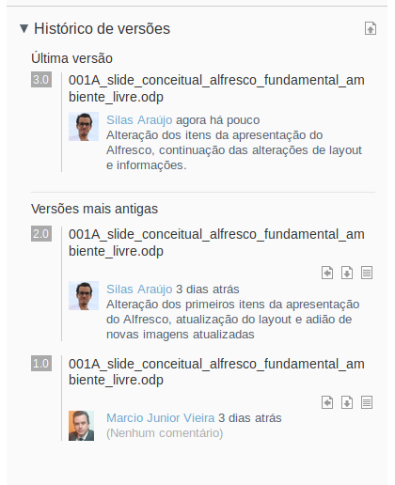
Rastreabilidade
Histórico do documento.
Controle de versão.
Estado da tarefa (status).
Quem fez a alteração.
Descrição da alteração.
Possibilidade de reverter para
uma versão anterior.
Notes:
Pentaho is an end-to-end business analytics and data integration platform. And in particular, a major area of focus for our platform has been helping customers integrate Big Data sources into their architecture and analyze that blend of traditional and emerging data. At the same time, we also provide analytics software that is highly embeddable in that they can fit seamlessly into existing applications and processes. A lot of our success in these areas has been due to both early innovation in Big Data – I believe we’ve been working with Hadoop for 5 to 6 years – as well as the open architecture and standards that our platform is built on.

Slide 16
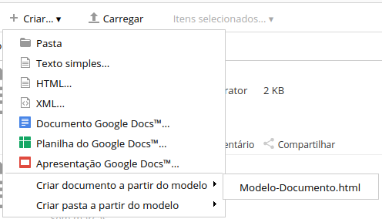
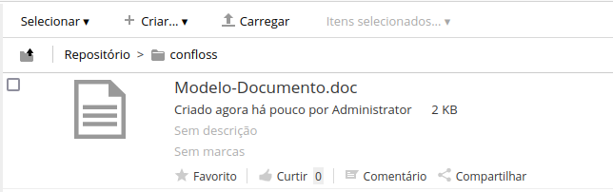
Vantagens do Alfresco
Normalização de documentos (Templates).
Garantem seguir um padrão (certificados, propostas Comerciais, etc).
Notes:
Pentaho is an end-to-end business analytics and data integration platform. And in particular, a major area of focus for our platform has been helping customers integrate Big Data sources into their architecture and analyze that blend of traditional and emerging data. At the same time, we also provide analytics software that is highly embeddable in that they can fit seamlessly into existing applications and processes. A lot of our success in these areas has been due to both early innovation in Big Data – I believe we’ve been working with Hadoop for 5 to 6 years – as well as the open architecture and standards that our platform is built on.

Slide 17
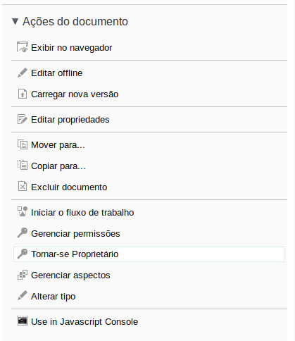
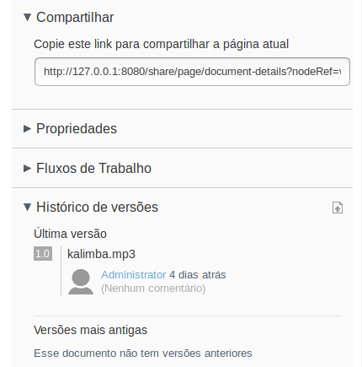
Vantagens do Alfresco
Normalização de documentos.
Controle de versões (atendendo o pilar da rastreabilidade).
Classificação e organização (tags, categorias, pastas).
Compartilhamento (Link).
Workflow Nativo (Activiti) e Externo (Bonita BPM, Flowable, Camunda).
Notes:
Pentaho is an end-to-end business analytics and data integration platform. And in particular, a major area of focus for our platform has been helping customers integrate Big Data sources into their architecture and analyze that blend of traditional and emerging data. At the same time, we also provide analytics software that is highly embeddable in that they can fit seamlessly into existing applications and processes. A lot of our success in these areas has been due to both early innovation in Big Data – I believe we’ve been working with Hadoop for 5 to 6 years – as well as the open architecture and standards that our platform is built on.

Slide 18
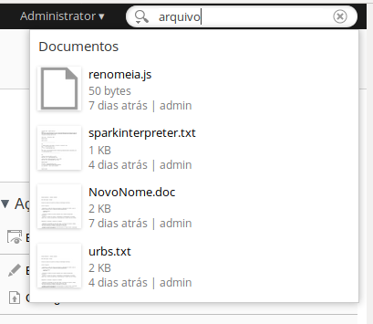
Funcionalidades
Temos uma pesquisa simples e duas avançadas. Aí o alfresco faz buscas no nome do documento, nos metadados, e no conteúdo do documento (se for de texto)
Requisição e devolução de documentos ( check in / check out )
Conversão de formatos.
Envio de e-mails e notificação.
Ações personalizadas.
Notes:
Pentaho is an end-to-end business analytics and data integration platform. And in particular, a major area of focus for our platform has been helping customers integrate Big Data sources into their architecture and analyze that blend of traditional and emerging data. At the same time, we also provide analytics software that is highly embeddable in that they can fit seamlessly into existing applications and processes. A lot of our success in these areas has been due to both early innovation in Big Data – I believe we’ve been working with Hadoop for 5 to 6 years – as well as the open architecture and standards that our platform is built on.

Slide 19
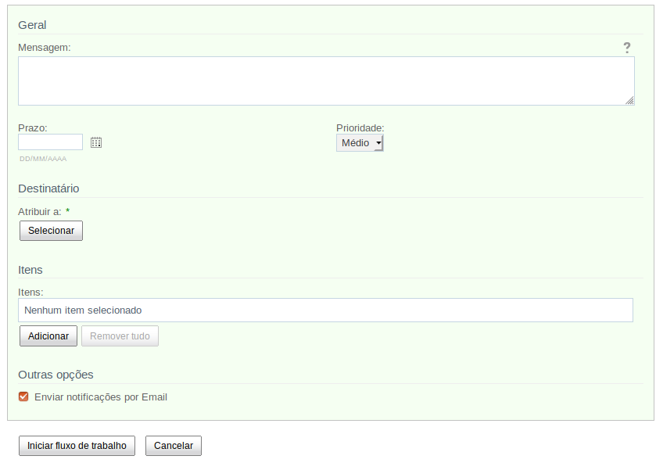
Funcionalidades
Configuração de regras workflow
(por interface)
Podem ser integrados ao workflow:
    Documentos a processos
    Emissão de relatórios
    Templates
Notes:
Pentaho is an end-to-end business analytics and data integration platform. And in particular, a major area of focus for our platform has been helping customers integrate Big Data sources into their architecture and analyze that blend of traditional and emerging data. At the same time, we also provide analytics software that is highly embeddable in that they can fit seamlessly into existing applications and processes. A lot of our success in these areas has been due to both early innovation in Big Data – I believe we’ve been working with Hadoop for 5 to 6 years – as well as the open architecture and standards that our platform is built on.

Slide 20
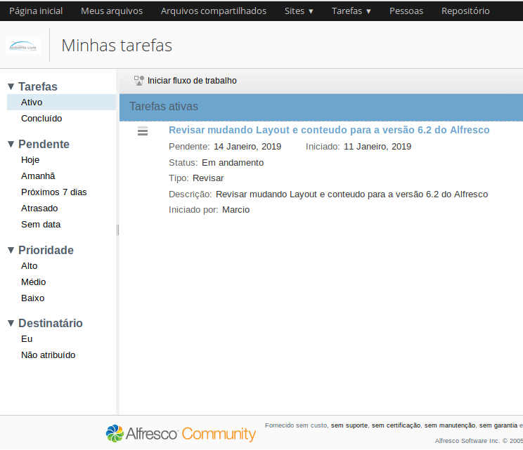
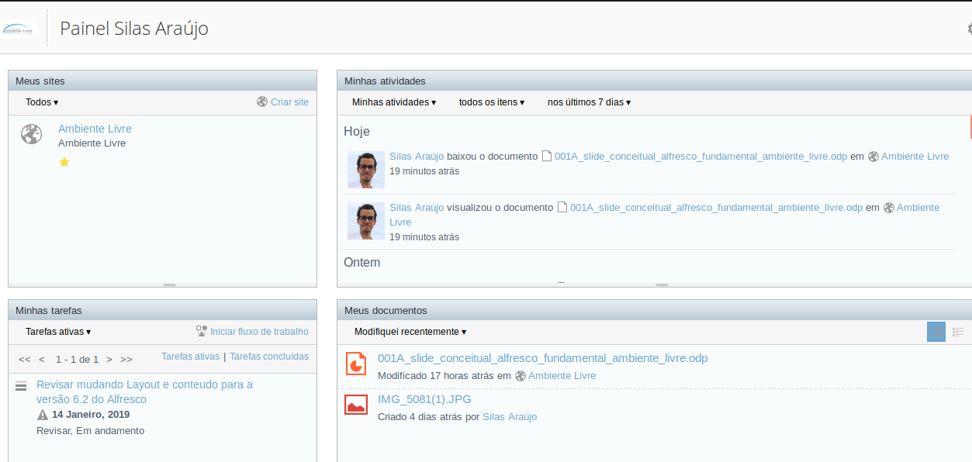
Gestão de Tarefas – BPM / Workflow
Notes:
Pentaho is an end-to-end business analytics and data integration platform. And in particular, a major area of focus for our platform has been helping customers integrate Big Data sources into their architecture and analyze that blend of traditional and emerging data. At the same time, we also provide analytics software that is highly embeddable in that they can fit seamlessly into existing applications and processes. A lot of our success in these areas has been due to both early innovation in Big Data – I believe we’ve been working with Hadoop for 5 to 6 years – as well as the open architecture and standards that our platform is built on.

Slide 21
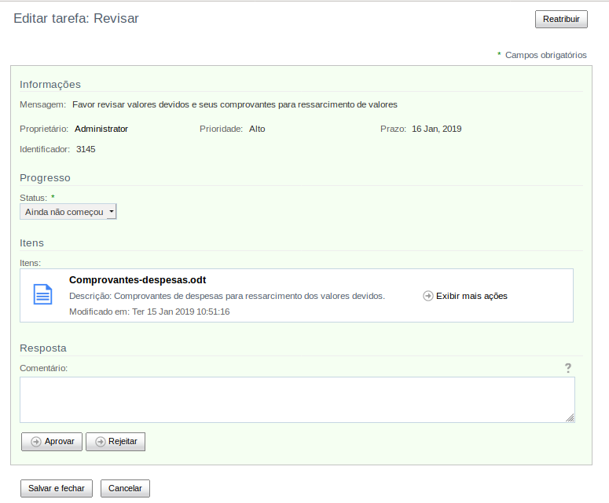
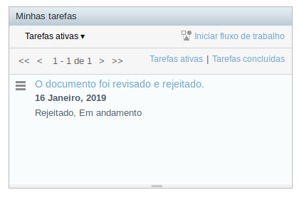
Aprovação e rejeição de tarefas
Notes:
Pentaho is an end-to-end business analytics and data integration platform. And in particular, a major area of focus for our platform has been helping customers integrate Big Data sources into their architecture and analyze that blend of traditional and emerging data. At the same time, we also provide analytics software that is highly embeddable in that they can fit seamlessly into existing applications and processes. A lot of our success in these areas has been due to both early innovation in Big Data – I believe we’ve been working with Hadoop for 5 to 6 years – as well as the open architecture and standards that our platform is built on.

Slide 22
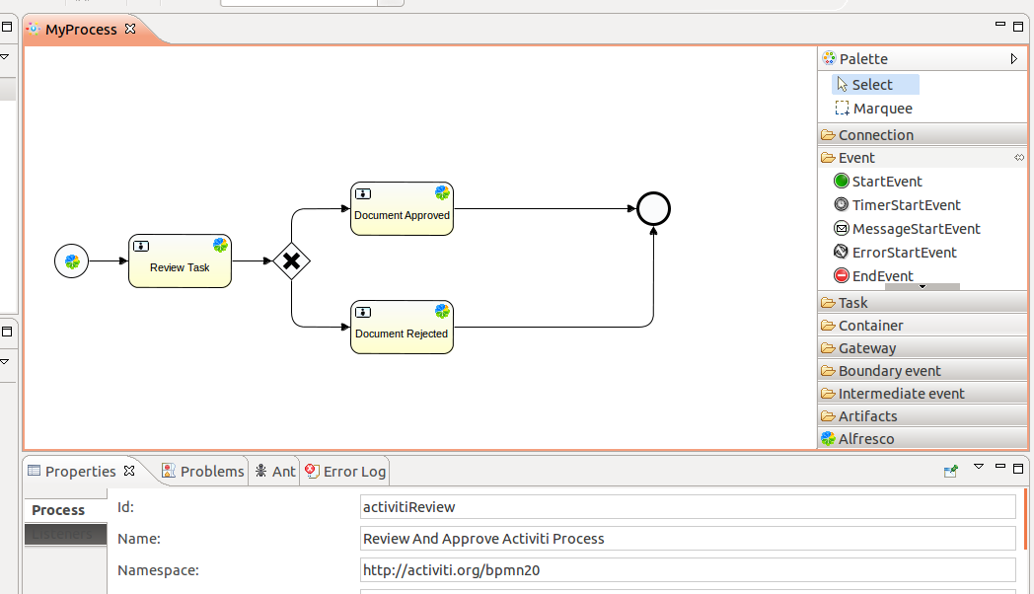
Workflow de BPMN 2.0
Workflow em
ambiente de
desenvolvimento
(Eclipse) ou Web.
Precisa ser instalado na máquina de quem vai desenvolver o bpmn.
Notes:
Pentaho is an end-to-end business analytics and data integration platform. And in particular, a major area of focus for our platform has been helping customers integrate Big Data sources into their architecture and analyze that blend of traditional and emerging data. At the same time, we also provide analytics software that is highly embeddable in that they can fit seamlessly into existing applications and processes. A lot of our success in these areas has been due to both early innovation in Big Data – I believe we’ve been working with Hadoop for 5 to 6 years – as well as the open architecture and standards that our platform is built on.

Slide 23
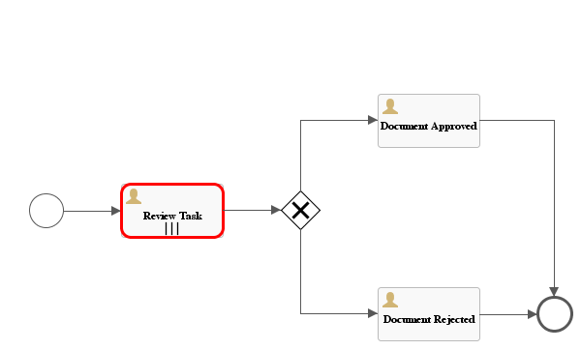
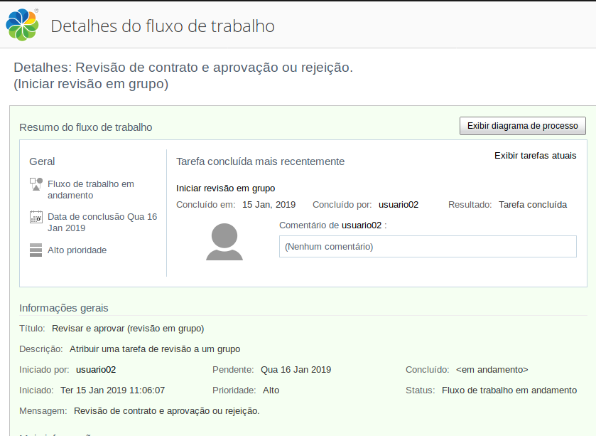
BPMs, embutidos na Plataforma.
Workflow em ambiente interno (Alfresco/Share), posso ver em qual tarefa o fluxo está parado.
Notes:
Pentaho is an end-to-end business analytics and data integration platform. And in particular, a major area of focus for our platform has been helping customers integrate Big Data sources into their architecture and analyze that blend of traditional and emerging data. At the same time, we also provide analytics software that is highly embeddable in that they can fit seamlessly into existing applications and processes. A lot of our success in these areas has been due to both early innovation in Big Data – I believe we’ve been working with Hadoop for 5 to 6 years – as well as the open architecture and standards that our platform is built on.

Slide 24
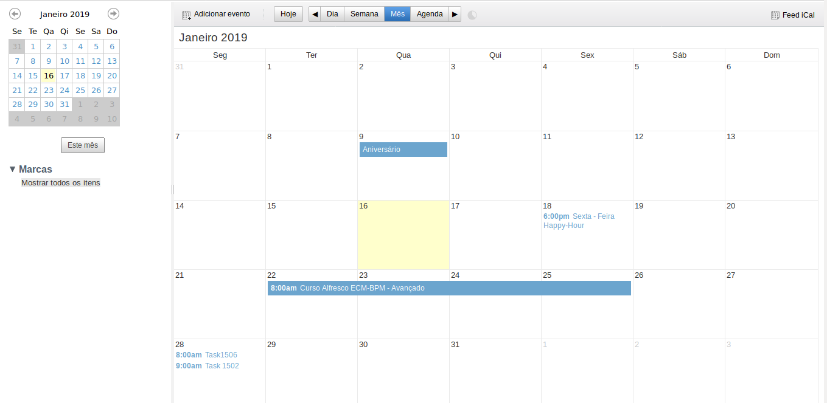
Calendário
Notes:
Pentaho is an end-to-end business analytics and data integration platform. And in particular, a major area of focus for our platform has been helping customers integrate Big Data sources into their architecture and analyze that blend of traditional and emerging data. At the same time, we also provide analytics software that is highly embeddable in that they can fit seamlessly into existing applications and processes. A lot of our success in these areas has been due to both early innovation in Big Data – I believe we’ve been working with Hadoop for 5 to 6 years – as well as the open architecture and standards that our platform is built on.

Slide 25
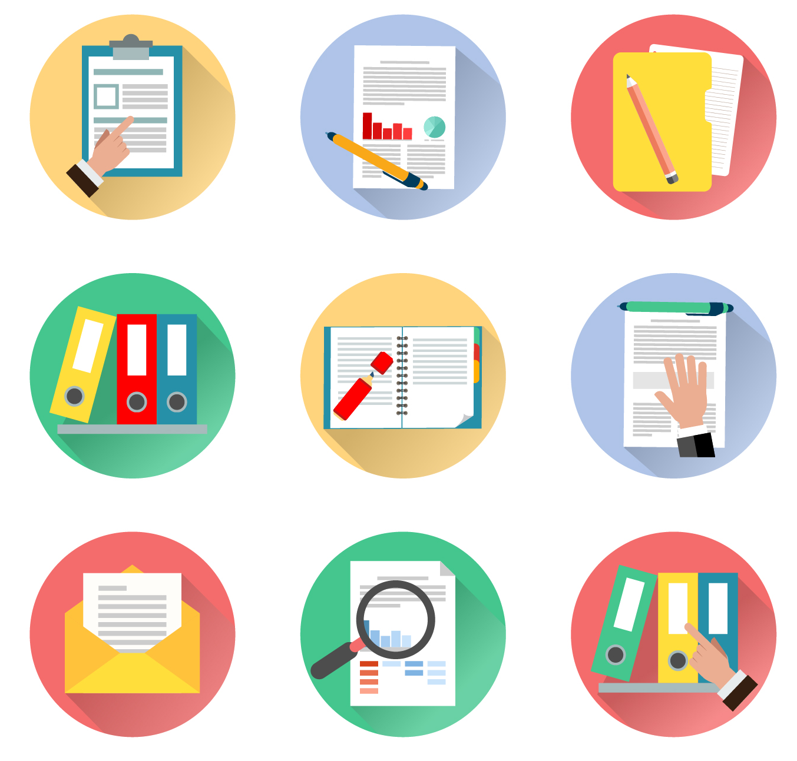
Gestão de documentos
Camada de Digitalização
(há softwares especializados para scanners
e plugins de OCR para o Alfresco)
Armazenar.
Pesquisar.
Gerir.
Maior segurança no acesso.
Redução de custos.
Tempo.
Papel.
Cópias.
Armazenamento físico.
Notes:
Pentaho is an end-to-end business analytics and data integration platform. And in particular, a major area of focus for our platform has been helping customers integrate Big Data sources into their architecture and analyze that blend of traditional and emerging data. At the same time, we also provide analytics software that is highly embeddable in that they can fit seamlessly into existing applications and processes. A lot of our success in these areas has been due to both early innovation in Big Data – I believe we’ve been working with Hadoop for 5 to 6 years – as well as the open architecture and standards that our platform is built on.

Slide 26
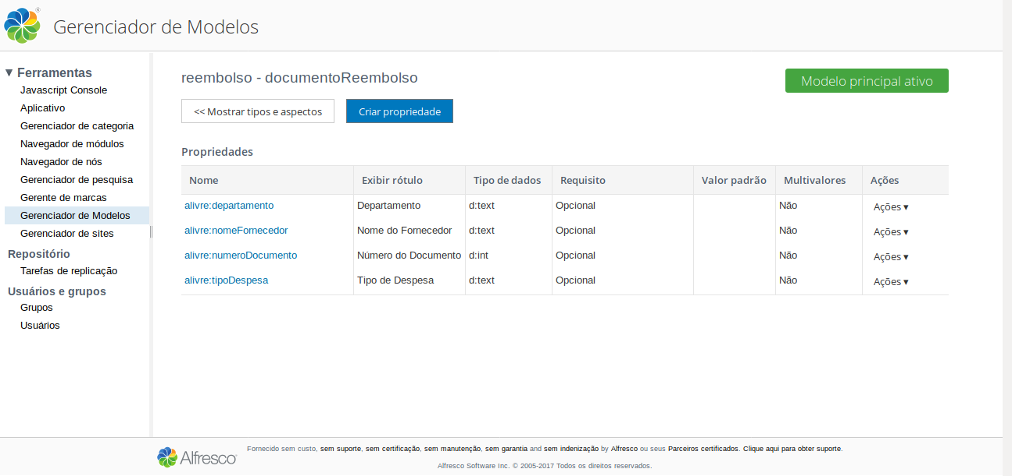
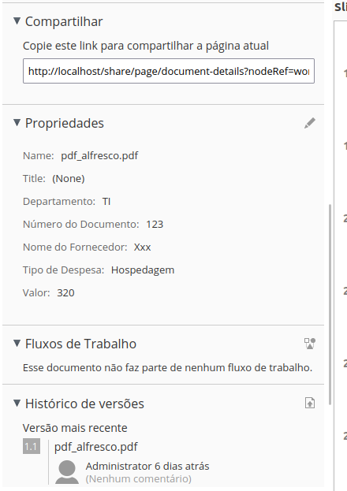
Modelos de Documentos Personalizáveis
Notes:
Pentaho is an end-to-end business analytics and data integration platform. And in particular, a major area of focus for our platform has been helping customers integrate Big Data sources into their architecture and analyze that blend of traditional and emerging data. At the same time, we also provide analytics software that is highly embeddable in that they can fit seamlessly into existing applications and processes. A lot of our success in these areas has been due to both early innovation in Big Data – I believe we’ve been working with Hadoop for 5 to 6 years – as well as the open architecture and standards that our platform is built on.

Slide 27
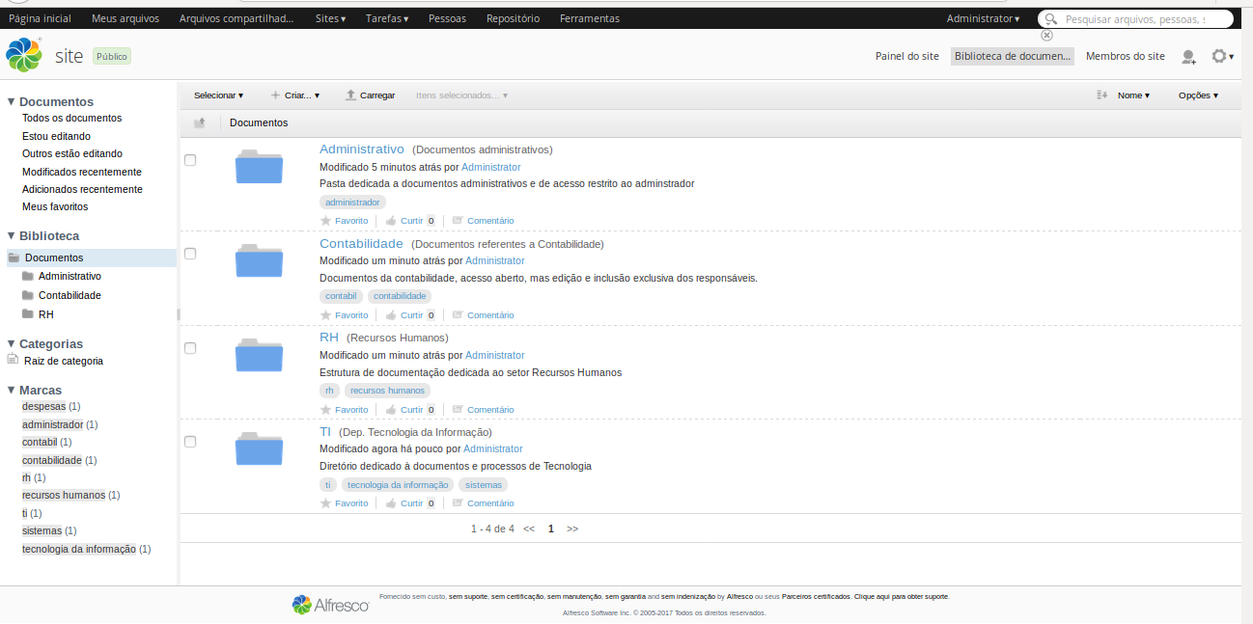
Organização por Departamentos
Notes:
Pentaho is an end-to-end business analytics and data integration platform. And in particular, a major area of focus for our platform has been helping customers integrate Big Data sources into their architecture and analyze that blend of traditional and emerging data. At the same time, we also provide analytics software that is highly embeddable in that they can fit seamlessly into existing applications and processes. A lot of our success in these areas has been due to both early innovation in Big Data – I believe we’ve been working with Hadoop for 5 to 6 years – as well as the open architecture and standards that our platform is built on.

Slide 28
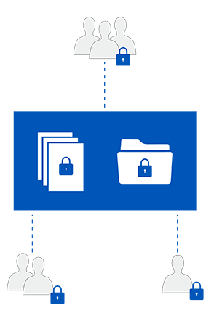
Segurança
Existem níveis de acesso no alfresco (Gerente,
Contribuidor, Colaborador, Consumidor)
Gerencie a permissão de usuários individualmente
para determinados arquivos ou diretórios
Ou crie seus próprios grupos com permissões
específicas para sua organização

Slide 29
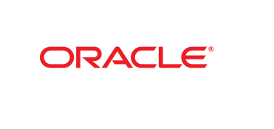
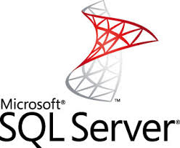
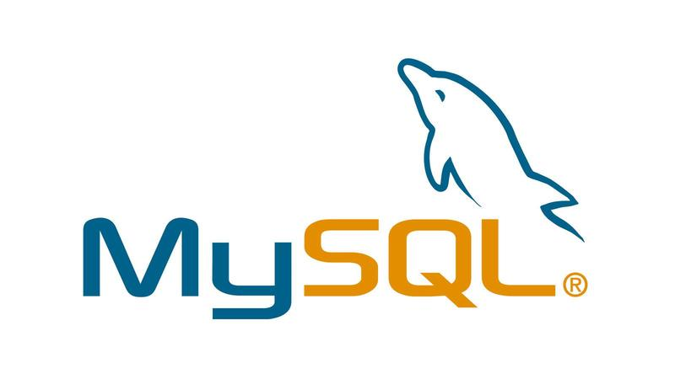
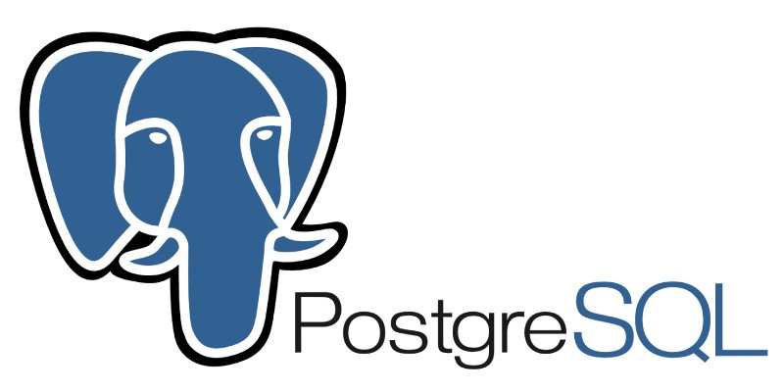
Alfresco – Estrutura de Banco de Dados
Banco de Dados
O Hibernate é um Object Relational Mapping ( ORM ),
que faz interligação entre o conceito de Orientação a Objetos
e o conceito relacional de banco de dados.
Com isso o Alfresco pode se conectar às tradicionais bases : MySQL, PostgreSQL, Oracle, MS SQL Server.
Notes:
Pentaho is an end-to-end business analytics and data integration platform. And in particular, a major area of focus for our platform has been helping customers integrate Big Data sources into their architecture and analyze that blend of traditional and emerging data. At the same time, we also provide analytics software that is highly embeddable in that they can fit seamlessly into existing applications and processes. A lot of our success in these areas has been due to both early innovation in Big Data – I believe we’ve been working with Hadoop for 5 to 6 years – as well as the open architecture and standards that our platform is built on.

Slide 30
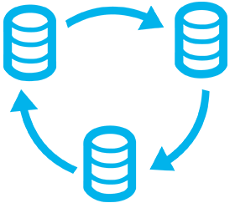
Integração e Autenticação
As integrações podem ser feitas com qualquer ferramenta, banco de dados ou APIs externas.
O Alfresco fornece um Identity Manager para controle de usuários internos, criados dentro do Alfresco.
Também é possível integrar usuários de LDAP ou AD.
Podemos integrar e usar os dois métodos de autenticação (default alfresco ou cadastrados no AD/LDAP).
Ainda é possível fazer regras internas configuráveis para autenticação (mesmo usuário de um software ou sistema externo).
Notes:
Pentaho is an end-to-end business analytics and data integration platform. And in particular, a major area of focus for our platform has been helping customers integrate Big Data sources into their architecture and analyze that blend of traditional and emerging data. At the same time, we also provide analytics software that is highly embeddable in that they can fit seamlessly into existing applications and processes. A lot of our success in these areas has been due to both early innovation in Big Data – I believe we’ve been working with Hadoop for 5 to 6 years – as well as the open architecture and standards that our platform is built on.

Slide 31
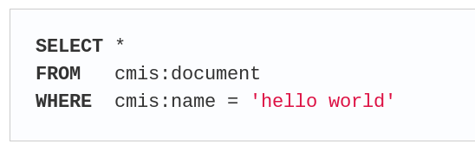
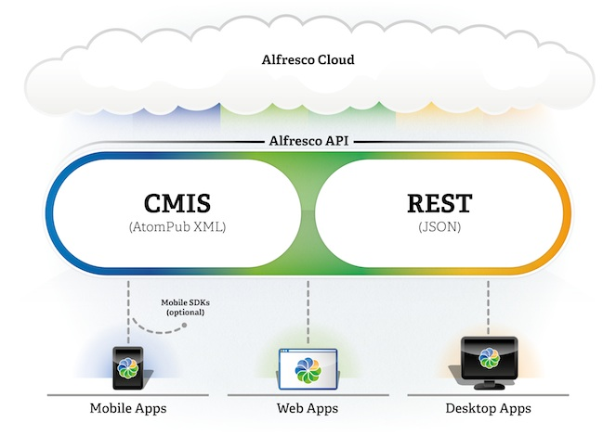
CMIS e Rest
CMIS é um protocolo de comunicação que
permite a interoperabilidade entre sistemas
Enterprise Content Management (ECM).
A versão 1.0 da API Alfresco REST é
uma interface de aplicativo completa
que fornece acesso a todos os recursos
do Repositório Alfresco. Ao criar
extensões remotas, a API Alfresco REST
é a interface preferida.
A documentação de referência para a API Alfresco REST está disponível no aplicativo API Explorer.
Notes:
Pentaho is an end-to-end business analytics and data integration platform. And in particular, a major area of focus for our platform has been helping customers integrate Big Data sources into their architecture and analyze that blend of traditional and emerging data. At the same time, we also provide analytics software that is highly embeddable in that they can fit seamlessly into existing applications and processes. A lot of our success in these areas has been due to both early innovation in Big Data – I believe we’ve been working with Hadoop for 5 to 6 years – as well as the open architecture and standards that our platform is built on.

Slide 32
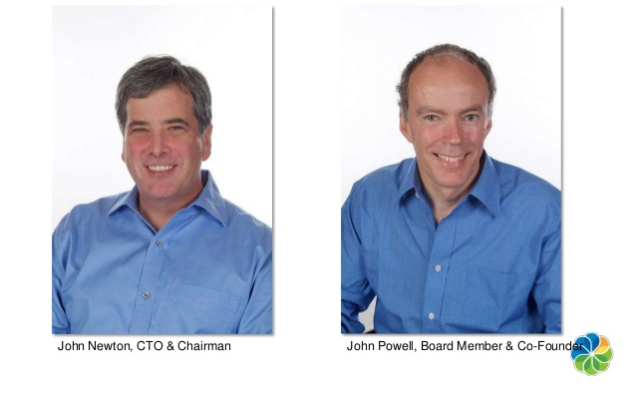
Curiosidades Alfresco
John Newton foi um dos Fundadores da Documentum
John Powell COO (Chief Operating Officer) – BO
Notes:
Pentaho is an end-to-end business analytics and data integration platform. And in particular, a major area of focus for our platform has been helping customers integrate Big Data sources into their architecture and analyze that blend of traditional and emerging data. At the same time, we also provide analytics software that is highly embeddable in that they can fit seamlessly into existing applications and processes. A lot of our success in these areas has been due to both early innovation in Big Data – I believe we’ve been working with Hadoop for 5 to 6 years – as well as the open architecture and standards that our platform is built on.

Slide 33
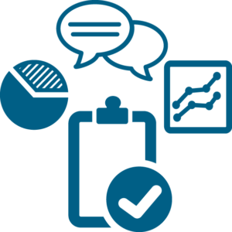
Números Alfresco
400 Funcionários da Alfresco + 3500 Hyland.
28 Milhões de Usuários em mais de 190 países.
+ de 1300 Empresas referências em suas áreas.
+ de 6000 Empresas usando elementos Alfresco.
Tradução Oficial em 20 idiomas diferentes.
+ de 80 Bilhões de documentos.
Notes:
Pentaho is an end-to-end business analytics and data integration platform. And in particular, a major area of focus for our platform has been helping customers integrate Big Data sources into their architecture and analyze that blend of traditional and emerging data. At the same time, we also provide analytics software that is highly embeddable in that they can fit seamlessly into existing applications and processes. A lot of our success in these areas has been due to both early innovation in Big Data – I believe we’ve been working with Hadoop for 5 to 6 years – as well as the open architecture and standards that our platform is built on.

Slide 34
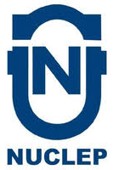




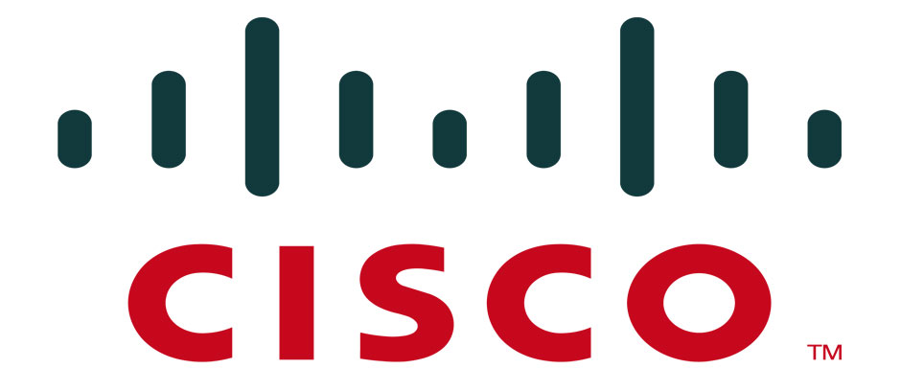
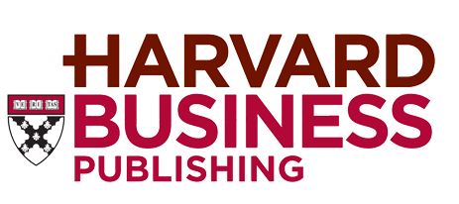
































Usando Alfresco
Notes:
Pentaho is an end-to-end business analytics and data integration platform. And in particular, a major area of focus for our platform has been helping customers integrate Big Data sources into their architecture and analyze that blend of traditional and emerging data. At the same time, we also provide analytics software that is highly embeddable in that they can fit seamlessly into existing applications and processes. A lot of our success in these areas has been due to both early innovation in Big Data – I believe we’ve been working with Hadoop for 5 to 6 years – as well as the open architecture and standards that our platform is built on.

Slide 35
Obrigada
Williane Delfino Pinheiro
williane@ambientelivre.com.br
Linkedin: https://www.linkedin.com/in/williane-pinheiro/
https://confloss.com.br/speakers/williane-delfino-pinheiro/
https://www.ambientelivre.com.br/tutoriais-alfresco/requisitos-de-infraestrutura-para-instalacao-do-alfresco-ecm.html

