Slide 1
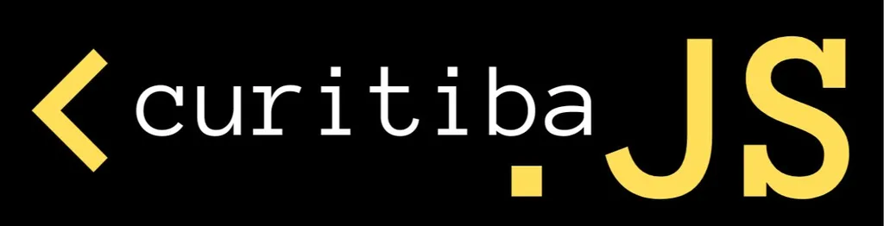
BPMN.IO
Renderizando Workflows BPMN com BPMN-JS
Marcio Junior Vieira
CEO & Data Scientist, Ambiente Livre
Pesquisador da UNB.

Slide 2
Marcio Junior Vieira – Quem sou eu?
Mini-cv
23 anos de experiência em informática, vivência em desenvolvimento e análise de sistemas de gestão empresarial e ciência de dados.
CEO da Ambiente Livre atuando como Cientista de Dados, Engenheiro de Dados e Arquiteto de Software.
Professor dos MBAs em Big Data & Data Science, Inteligência Artificial e BI da Universidade Positivo.
Professor do MBA Artificial Intelligence e Machine Learning da FIAP.
Trabalhando com Free Software e Open Source desde 2000 com serviços de consultoria e treinamento.
Graduado em Tecnologia em Informática(2004) e pós-graduado em Software Livre(2005) pela UFPR.
Palestrante FLOSS em: FISL, TDC, Latinoware, Campus Party, Pentaho Day, Ticnova, PgDay e FTSL.
Organizador Geral: Pentaho Day 2017, 2015, 2019 e apoio nas ed. 2013 e 2014.
Data Scientist, instrutor e consultor de Big Data e Data Science com tecnologias abertas.
Ajudou a capacitar equipes de Big Data na IBM, Accenture, Tivit, Sonda IT, Serpro, Natura, MP, Netshoes, Embraer entre outras.
Especialista em implantação e customização de Big Data com Hadoop, Spark, Pentaho, Cassandra e MongoDB.
Contribuidor de projetos internacionais, tais como Pentaho, LimeSurvey, SuiteCRM e Camunda.
Certificado (Certified Pentaho Solutions) pela Hitachi Vantara (Pentaho).
Notes:
Pentaho is an end-to-end business analytics and data integration platform. And in particular, a major area of focus for our platform has been helping customers integrate Big Data sources into their architecture and analyze that blend of traditional and emerging data. At the same time, we also provide analytics software that is highly embeddable in that they can fit seamlessly into existing applications and processes. A lot of our success in these areas has been due to both early innovation in Big Data – I believe we’ve been working with Hadoop for 5 to 6 years – as well as the open architecture and standards that our platform is built on.

Slide 3




Sobre a Ambiente Livre
Open Software for Business
Fundada em 2004 com foco em consultoria em FLOSS.
Experts em 34 soluções para geração de negócios com Software Livre/Código Aberto.
Atualmente estamos sediados no Hub de Inovação Mindhub em Curitiba.
Notes:
Pentaho is an end-to-end business analytics and data integration platform. And in particular, a major area of focus for our platform has been helping customers integrate Big Data sources into their architecture and analyze that blend of traditional and emerging data. At the same time, we also provide analytics software that is highly embeddable in that they can fit seamlessly into existing applications and processes. A lot of our success in these areas has been due to both early innovation in Big Data – I believe we’ve been working with Hadoop for 5 to 6 years – as well as the open architecture and standards that our platform is built on.

Slide 4

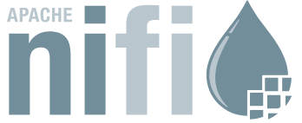
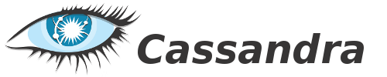











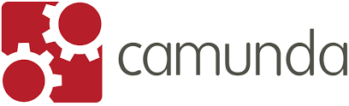

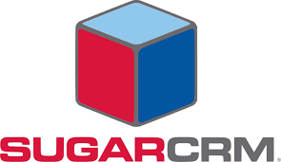






Timeline
2014
2010
2008
2007
2005
2004
Notes:
Pentaho is an end-to-end business analytics and data integration platform. And in particular, a major area of focus for our platform has been helping customers integrate Big Data sources into their architecture and analyze that blend of traditional and emerging data. At the same time, we also provide analytics software that is highly embeddable in that they can fit seamlessly into existing applications and processes. A lot of our success in these areas has been due to both early innovation in Big Data – I believe we’ve been working with Hadoop for 5 to 6 years – as well as the open architecture and standards that our platform is built on.

Slide 5







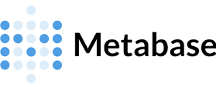





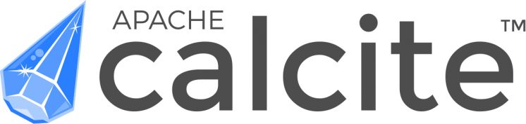
Nosso Ecossistema de Serviços
Notes:
Pentaho is an end-to-end business analytics and data integration platform. And in particular, a major area of focus for our platform has been helping customers integrate Big Data sources into their architecture and analyze that blend of traditional and emerging data. At the same time, we also provide analytics software that is highly embeddable in that they can fit seamlessly into existing applications and processes. A lot of our success in these areas has been due to both early innovation in Big Data – I believe we’ve been working with Hadoop for 5 to 6 years – as well as the open architecture and standards that our platform is built on.

Slide 6
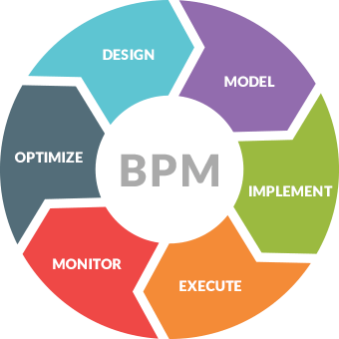
Workflow e BPM – Definições
Workflow
É a sequência de passos necessários para que se possa atingir a automação de processos de negócio, de acordo com um conjunto de regras definidas, envolvendo a noção de processos, permitindo que estes possam ser transmitidos de uma pessoa para outra de acordo com algumas regras.
BPM
BPM é a abreviação de Business Process Management, que traduzido para o português significa Gerenciamento de Processos de Negócio. BPM é uma abordagem de gerenciamento adaptável, desenvolvido com a finalidade de sistematizar e facilitar processos organizacionais individuais
Notes:
Pentaho is an end-to-end business analytics and data integration platform. And in particular, a major area of focus for our platform has been helping customers integrate Big Data sources into their architecture and analyze that blend of traditional and emerging data. At the same time, we also provide analytics software that is highly embeddable in that they can fit seamlessly into existing applications and processes. A lot of our success in these areas has been due to both early innovation in Big Data – I believe we’ve been working with Hadoop for 5 to 6 years – as well as the open architecture and standards that our platform is built on.

Slide 7
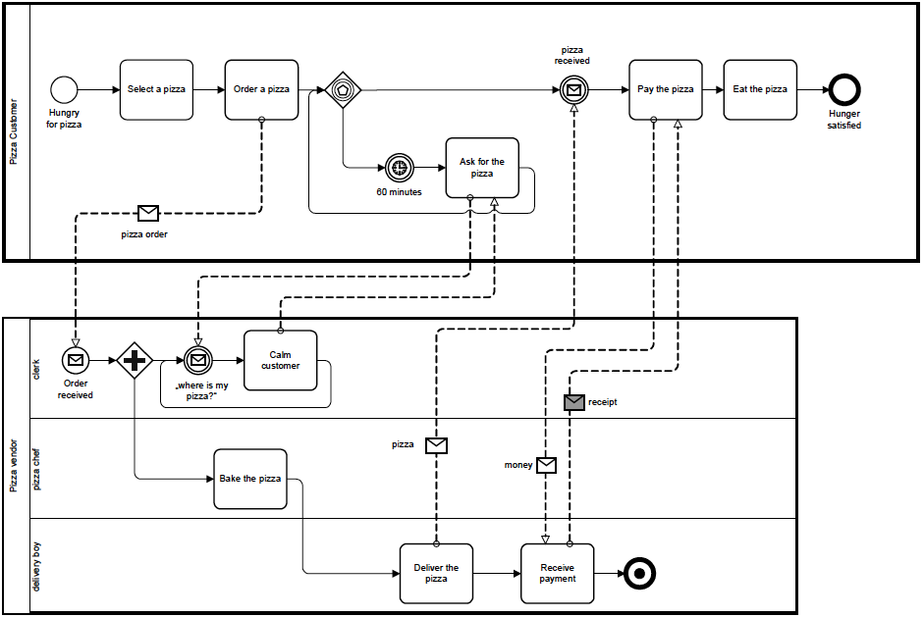
The Pizza Collaboration
Notes:
Pentaho is an end-to-end business analytics and data integration platform. And in particular, a major area of focus for our platform has been helping customers integrate Big Data sources into their architecture and analyze that blend of traditional and emerging data. At the same time, we also provide analytics software that is highly embeddable in that they can fit seamlessly into existing applications and processes. A lot of our success in these areas has been due to both early innovation in Big Data – I believe we’ve been working with Hadoop for 5 to 6 years – as well as the open architecture and standards that our platform is built on.

Slide 8
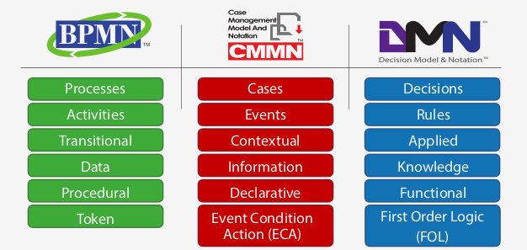
Diferenças , termos, semântica e conceitos.
Notes:
Pentaho is an end-to-end business analytics and data integration platform. And in particular, a major area of focus for our platform has been helping customers integrate Big Data sources into their architecture and analyze that blend of traditional and emerging data. At the same time, we also provide analytics software that is highly embeddable in that they can fit seamlessly into existing applications and processes. A lot of our success in these areas has been due to both early innovation in Big Data – I believe we’ve been working with Hadoop for 5 to 6 years – as well as the open architecture and standards that our platform is built on.

Slide 9


O Projeto Camunda
Camunda é software open source desenvolvido em Java para BPM.
Atualmente são dois software Camunda Modeler e Camunda Plataform.
Existe uma versão EE (Enterprise Edition) e uma CE (Community Edition)
Executado em um Container Java EE (Tomcat, jBoss, etc)
Atualmente o Camunda utiliza da notação BPMN, DMN e CMMN.
O Camunda é um Fork do Activiti da Alfresco.
O primeiro desenvolvedor do software foi Tom Baeyens que criou o do jBPM na Jboos.
Camunda tem licença Apache.
Hoje o Líder do projeto Camunda é Bernd Rücker.
Tom Baeyens
Bernd Rücker,
Chief Technologist and Co-Founder
Conheça mais sobre o Tom Baeyens https://www.infoq.com/news/2013/03/baeyens-activiti
Notes:
Pentaho is an end-to-end business analytics and data integration platform. And in particular, a major area of focus for our platform has been helping customers integrate Big Data sources into their architecture and analyze that blend of traditional and emerging data. At the same time, we also provide analytics software that is highly embeddable in that they can fit seamlessly into existing applications and processes. A lot of our success in these areas has been due to both early innovation in Big Data – I believe we’ve been working with Hadoop for 5 to 6 years – as well as the open architecture and standards that our platform is built on.

Slide 10
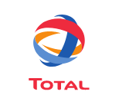









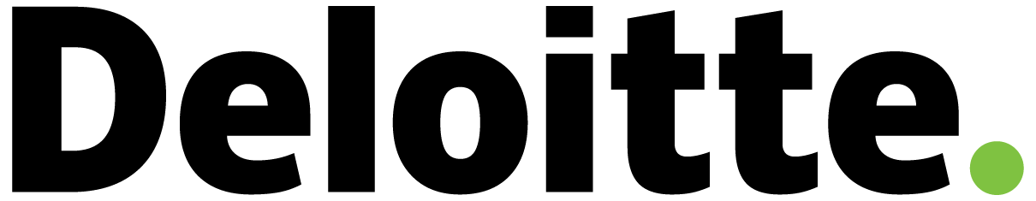
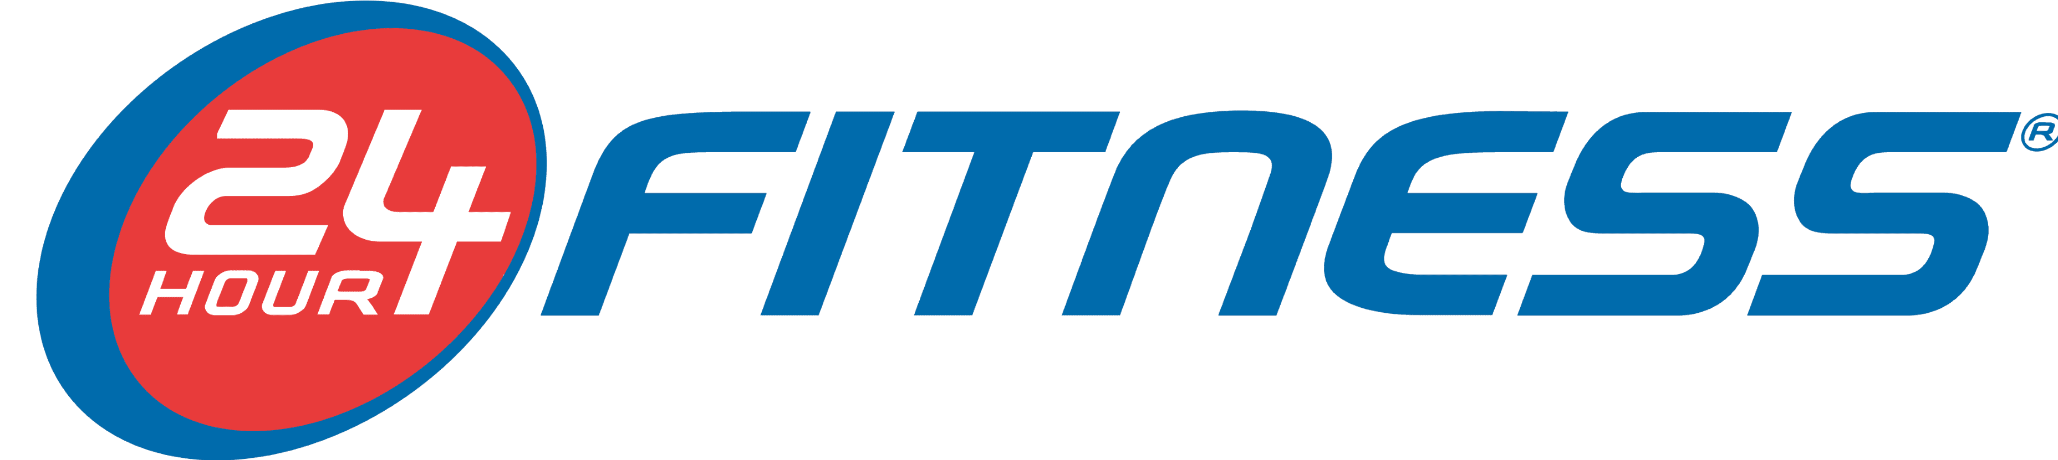





Empresas que usam Camunda
Notes:
Pentaho is an end-to-end business analytics and data integration platform. And in particular, a major area of focus for our platform has been helping customers integrate Big Data sources into their architecture and analyze that blend of traditional and emerging data. At the same time, we also provide analytics software that is highly embeddable in that they can fit seamlessly into existing applications and processes. A lot of our success in these areas has been due to both early innovation in Big Data – I believe we’ve been working with Hadoop for 5 to 6 years – as well as the open architecture and standards that our platform is built on.

Slide 11





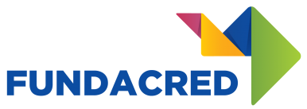




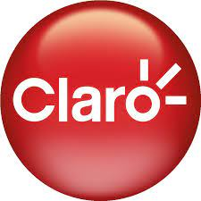




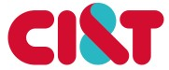
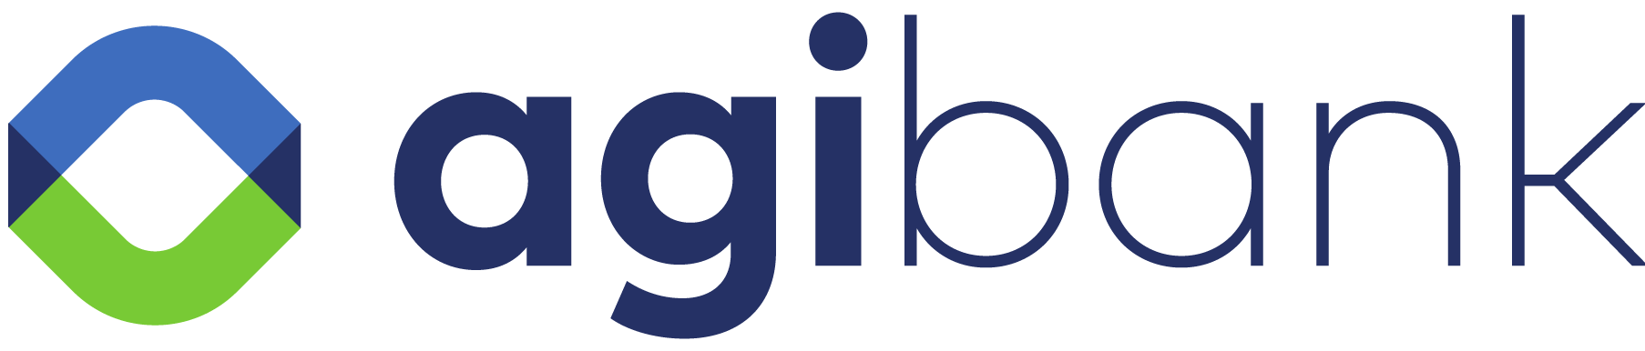

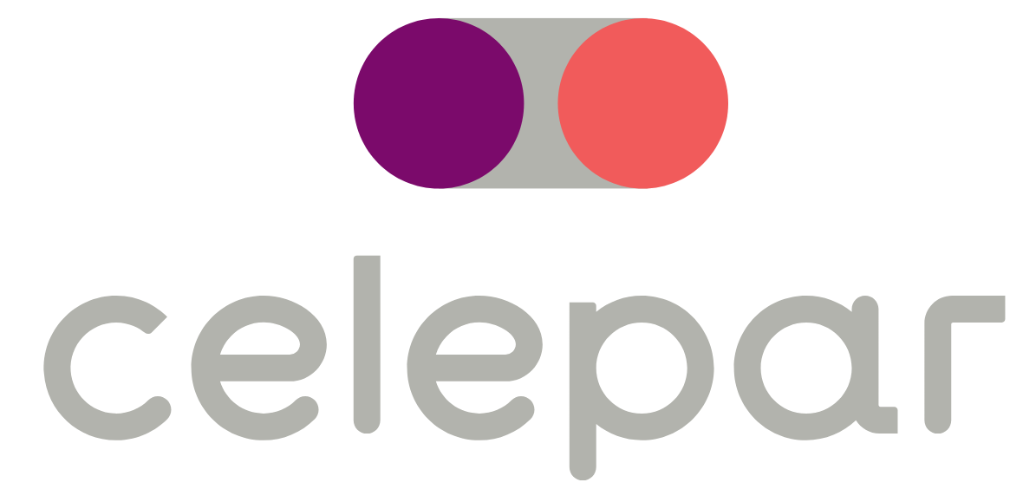

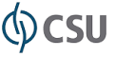

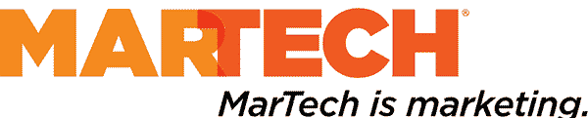
Empresas que usam Camunda no Brasil
Notes:
Pentaho is an end-to-end business analytics and data integration platform. And in particular, a major area of focus for our platform has been helping customers integrate Big Data sources into their architecture and analyze that blend of traditional and emerging data. At the same time, we also provide analytics software that is highly embeddable in that they can fit seamlessly into existing applications and processes. A lot of our success in these areas has been due to both early innovation in Big Data – I believe we’ve been working with Hadoop for 5 to 6 years – as well as the open architecture and standards that our platform is built on.

Slide 12
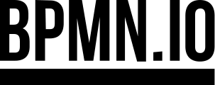
BPMN.IO
Ferramentas baseadas na Web para BPMN, DMN e Formulários.
Iniciamos o bpmn.io como um esforço para fornecer as melhores ferramentas BPMN possíveis: código aberto e de uso gratuito para todos que mudam pessoas e organizações por meio do BPMN.
O BPMN.IO compõe 4 módulos.
bpmn-js
dmn-js
cmmn-js
form-js
Notes:
Pentaho is an end-to-end business analytics and data integration platform. And in particular, a major area of focus for our platform has been helping customers integrate Big Data sources into their architecture and analyze that blend of traditional and emerging data. At the same time, we also provide analytics software that is highly embeddable in that they can fit seamlessly into existing applications and processes. A lot of our success in these areas has been due to both early innovation in Big Data – I believe we’ve been working with Hadoop for 5 to 6 years – as well as the open architecture and standards that our platform is built on.

Slide 13
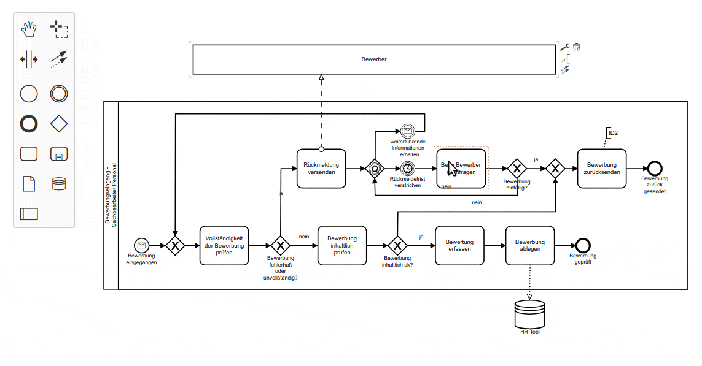
BPMN-JS
Visualizador e Editor BPMN
Use bpmn-js para exibir diagramas BPMN 2.0 em seu site.
Incorpore-o como um modelador web BPMN 2.0 em suas aplicações e personalize-o para atender às suas necessidades.
Notes:
Pentaho is an end-to-end business analytics and data integration platform. And in particular, a major area of focus for our platform has been helping customers integrate Big Data sources into their architecture and analyze that blend of traditional and emerging data. At the same time, we also provide analytics software that is highly embeddable in that they can fit seamlessly into existing applications and processes. A lot of our success in these areas has been due to both early innovation in Big Data – I believe we’ve been working with Hadoop for 5 to 6 years – as well as the open architecture and standards that our platform is built on.

Slide 14
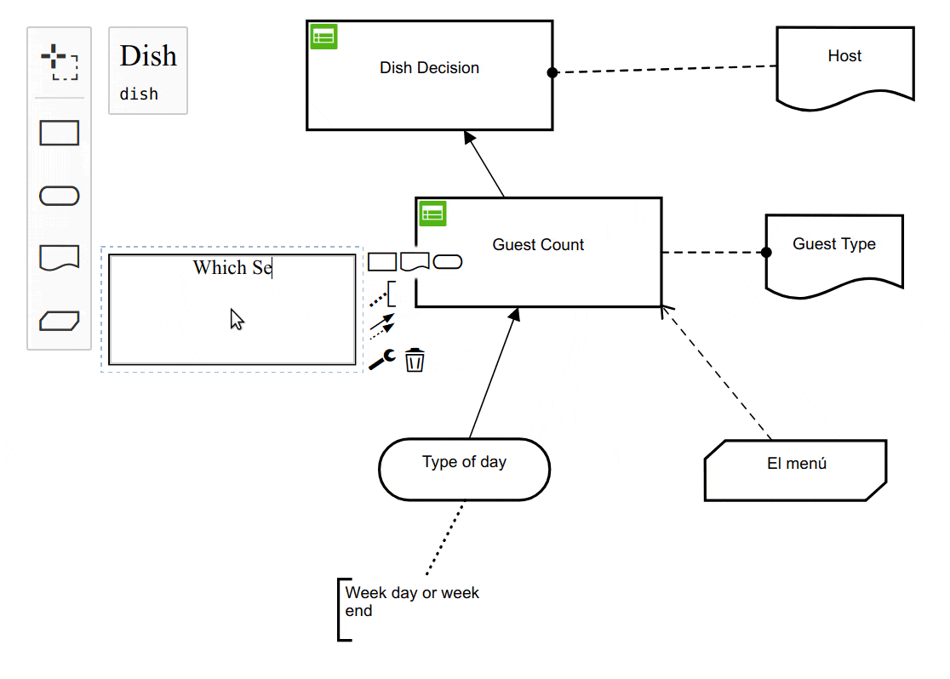
DMN-JS
Tabelas de Decisão - DMN
Use dmn-js para exibir diagramas de requisitos de decisão DMN 1.3, tabelas de decisão e expressões literais no navegador.
Incorpore-o como um editor DMN em seu aplicativo web.
Notes:
Pentaho is an end-to-end business analytics and data integration platform. And in particular, a major area of focus for our platform has been helping customers integrate Big Data sources into their architecture and analyze that blend of traditional and emerging data. At the same time, we also provide analytics software that is highly embeddable in that they can fit seamlessly into existing applications and processes. A lot of our success in these areas has been due to both early innovation in Big Data – I believe we’ve been working with Hadoop for 5 to 6 years – as well as the open architecture and standards that our platform is built on.

Slide 15
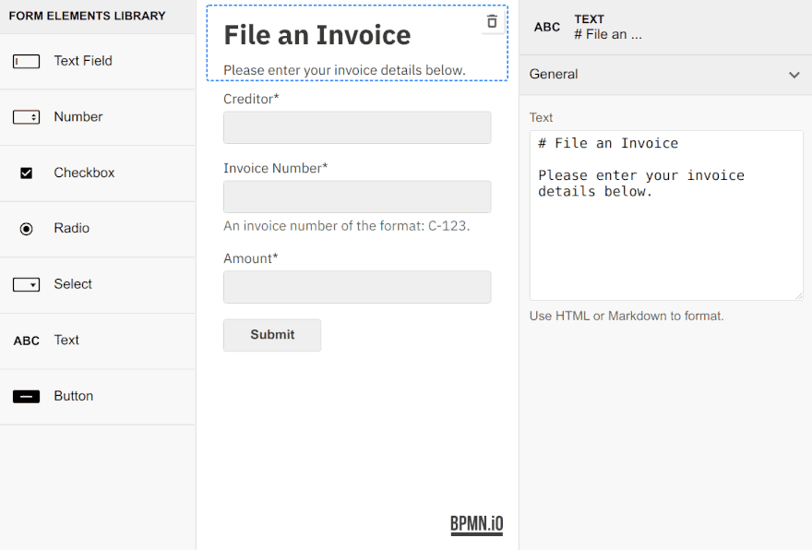
FORM-JS
Formulários
Use form-js para construir formulários de maneira visual.
Salve os formulários e incorpore-os em qualquer página usando um renderizador de formulários leve.
Notes:
Pentaho is an end-to-end business analytics and data integration platform. And in particular, a major area of focus for our platform has been helping customers integrate Big Data sources into their architecture and analyze that blend of traditional and emerging data. At the same time, we also provide analytics software that is highly embeddable in that they can fit seamlessly into existing applications and processes. A lot of our success in these areas has been due to both early innovation in Big Data – I believe we’ve been working with Hadoop for 5 to 6 years – as well as the open architecture and standards that our platform is built on.

Slide 16
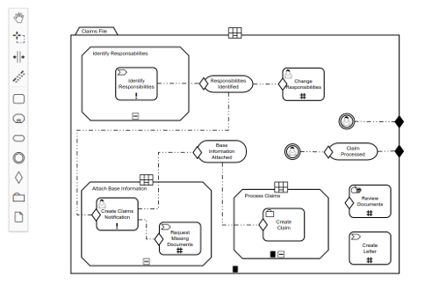
CMMN-JS
Casos de Decisão - CMMN
Use cmmn-js para exibir diagramas CMMN 1.1 em seu site.
Incorpore-o como um modelador web CMMN 1.1 em seus aplicativos e personalize-o para atender às suas necessidades.
Notes:
Pentaho is an end-to-end business analytics and data integration platform. And in particular, a major area of focus for our platform has been helping customers integrate Big Data sources into their architecture and analyze that blend of traditional and emerging data. At the same time, we also provide analytics software that is highly embeddable in that they can fit seamlessly into existing applications and processes. A lot of our success in these areas has been due to both early innovation in Big Data – I believe we’ve been working with Hadoop for 5 to 6 years – as well as the open architecture and standards that our platform is built on.

Slide 17
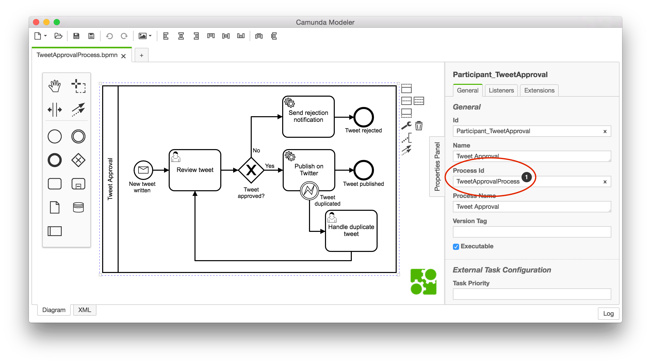
Camunda Modeler
Modelagem
Ferramenta para usuários de negócio desenhar seus workflows em BPMN 2.0
Notes:
Pentaho is an end-to-end business analytics and data integration platform. And in particular, a major area of focus for our platform has been helping customers integrate Big Data sources into their architecture and analyze that blend of traditional and emerging data. At the same time, we also provide analytics software that is highly embeddable in that they can fit seamlessly into existing applications and processes. A lot of our success in these areas has been due to both early innovation in Big Data – I believe we’ve been working with Hadoop for 5 to 6 years – as well as the open architecture and standards that our platform is built on.

Slide 18

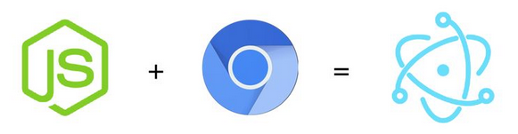
Electron
Node.js para Desktop
Pacote desenvolvido pelo github inicialmente para o Atom.
Crie aplicativos de desktop multiplataforma com JavaScript, HTML e CSS e Node.js
Permite acessar funções nativas do sistema operacional
Permite Iniciar um serviço local.
Multiplataforma.
Notes:
Pentaho is an end-to-end business analytics and data integration platform. And in particular, a major area of focus for our platform has been helping customers integrate Big Data sources into their architecture and analyze that blend of traditional and emerging data. At the same time, we also provide analytics software that is highly embeddable in that they can fit seamlessly into existing applications and processes. A lot of our success in these areas has been due to both early innovation in Big Data – I believe we’ve been working with Hadoop for 5 to 6 years – as well as the open architecture and standards that our platform is built on.

Slide 19
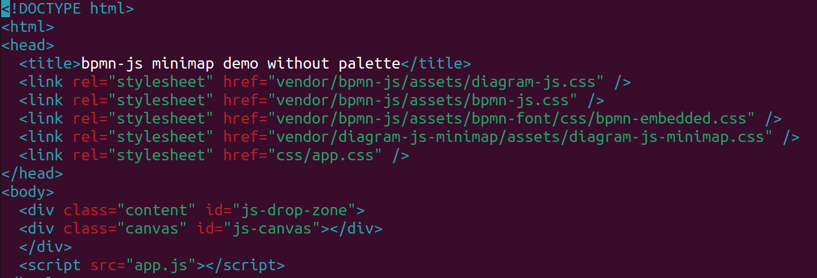
Show me your code! HTML
Designer do bpmn
Precisa de uma div para renderizar o bpmn
Notes:
Pentaho is an end-to-end business analytics and data integration platform. And in particular, a major area of focus for our platform has been helping customers integrate Big Data sources into their architecture and analyze that blend of traditional and emerging data. At the same time, we also provide analytics software that is highly embeddable in that they can fit seamlessly into existing applications and processes. A lot of our success in these areas has been due to both early innovation in Big Data – I believe we’ve been working with Hadoop for 5 to 6 years – as well as the open architecture and standards that our platform is built on.

Slide 20
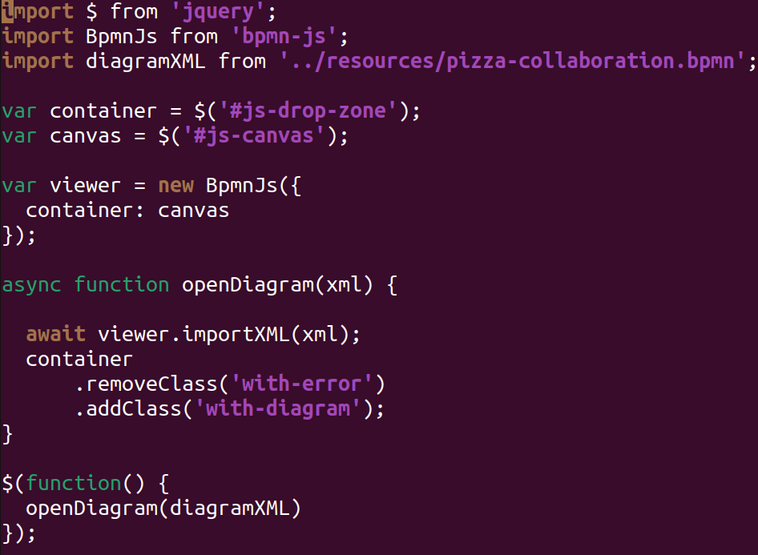
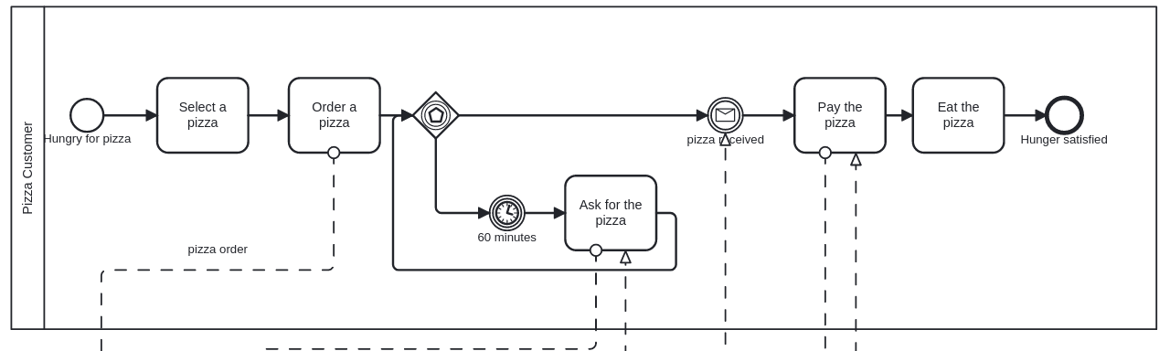
Show me your code! HTML
Importe o módulo bpmn-js
Importe seu diagrama bpmn/XML
Crie seu objeto viewer (default in BpmnJS)
Resultado:
Importe o BPMN/xml para o BPMN-JS
Personalize styles
Notes:
Pentaho is an end-to-end business analytics and data integration platform. And in particular, a major area of focus for our platform has been helping customers integrate Big Data sources into their architecture and analyze that blend of traditional and emerging data. At the same time, we also provide analytics software that is highly embeddable in that they can fit seamlessly into existing applications and processes. A lot of our success in these areas has been due to both early innovation in Big Data – I believe we’ve been working with Hadoop for 5 to 6 years – as well as the open architecture and standards that our platform is built on.

Slide 21
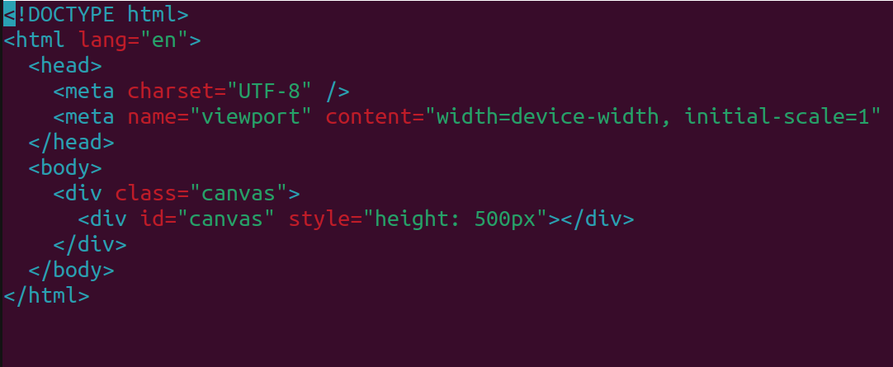
Show me your code! In NODE
Precisa de uma div para renderizar o bpmn
Notes:
Pentaho is an end-to-end business analytics and data integration platform. And in particular, a major area of focus for our platform has been helping customers integrate Big Data sources into their architecture and analyze that blend of traditional and emerging data. At the same time, we also provide analytics software that is highly embeddable in that they can fit seamlessly into existing applications and processes. A lot of our success in these areas has been due to both early innovation in Big Data – I believe we’ve been working with Hadoop for 5 to 6 years – as well as the open architecture and standards that our platform is built on.

Slide 22
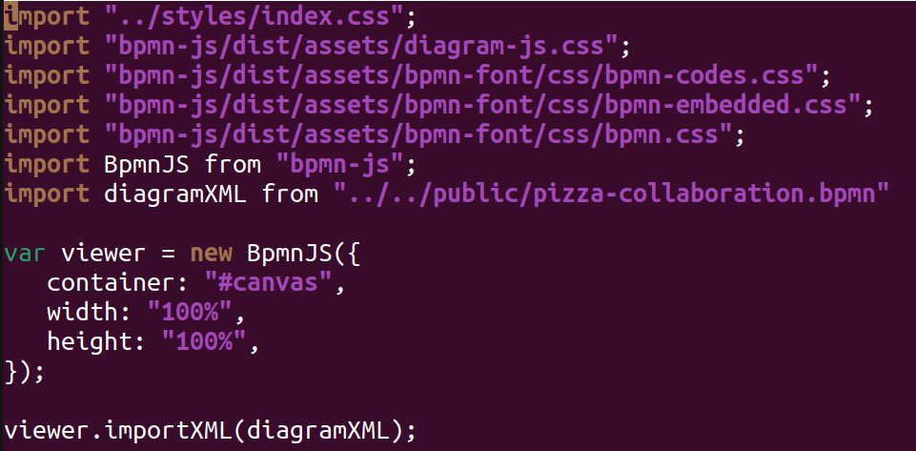
Show me your code! In NODE
Designer do bpmn
Importe o módulo bpmn-js
Importe seu diagrama bpmn/XML (API ou local)
Crie seu objeto viewer (default in BpmnJS)
Resultado:
Personalize styles
Importe o BPMN/xml para o BPMN-JS
Notes:
Pentaho is an end-to-end business analytics and data integration platform. And in particular, a major area of focus for our platform has been helping customers integrate Big Data sources into their architecture and analyze that blend of traditional and emerging data. At the same time, we also provide analytics software that is highly embeddable in that they can fit seamlessly into existing applications and processes. A lot of our success in these areas has been due to both early innovation in Big Data – I believe we’ve been working with Hadoop for 5 to 6 years – as well as the open architecture and standards that our platform is built on.

Slide 23
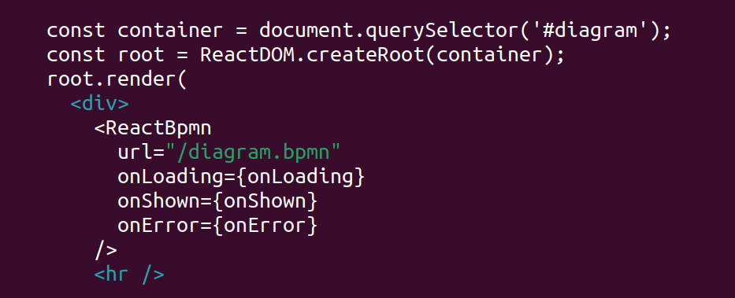
Frameworks?
Frameworks suportados!
React (React-bpmn)
Vue (vue-bpmn)
FEEL expressions
bpmn-js-i18n
Notes:
Pentaho is an end-to-end business analytics and data integration platform. And in particular, a major area of focus for our platform has been helping customers integrate Big Data sources into their architecture and analyze that blend of traditional and emerging data. At the same time, we also provide analytics software that is highly embeddable in that they can fit seamlessly into existing applications and processes. A lot of our success in these areas has been due to both early innovation in Big Data – I believe we’ve been working with Hadoop for 5 to 6 years – as well as the open architecture and standards that our platform is built on.

Slide 24
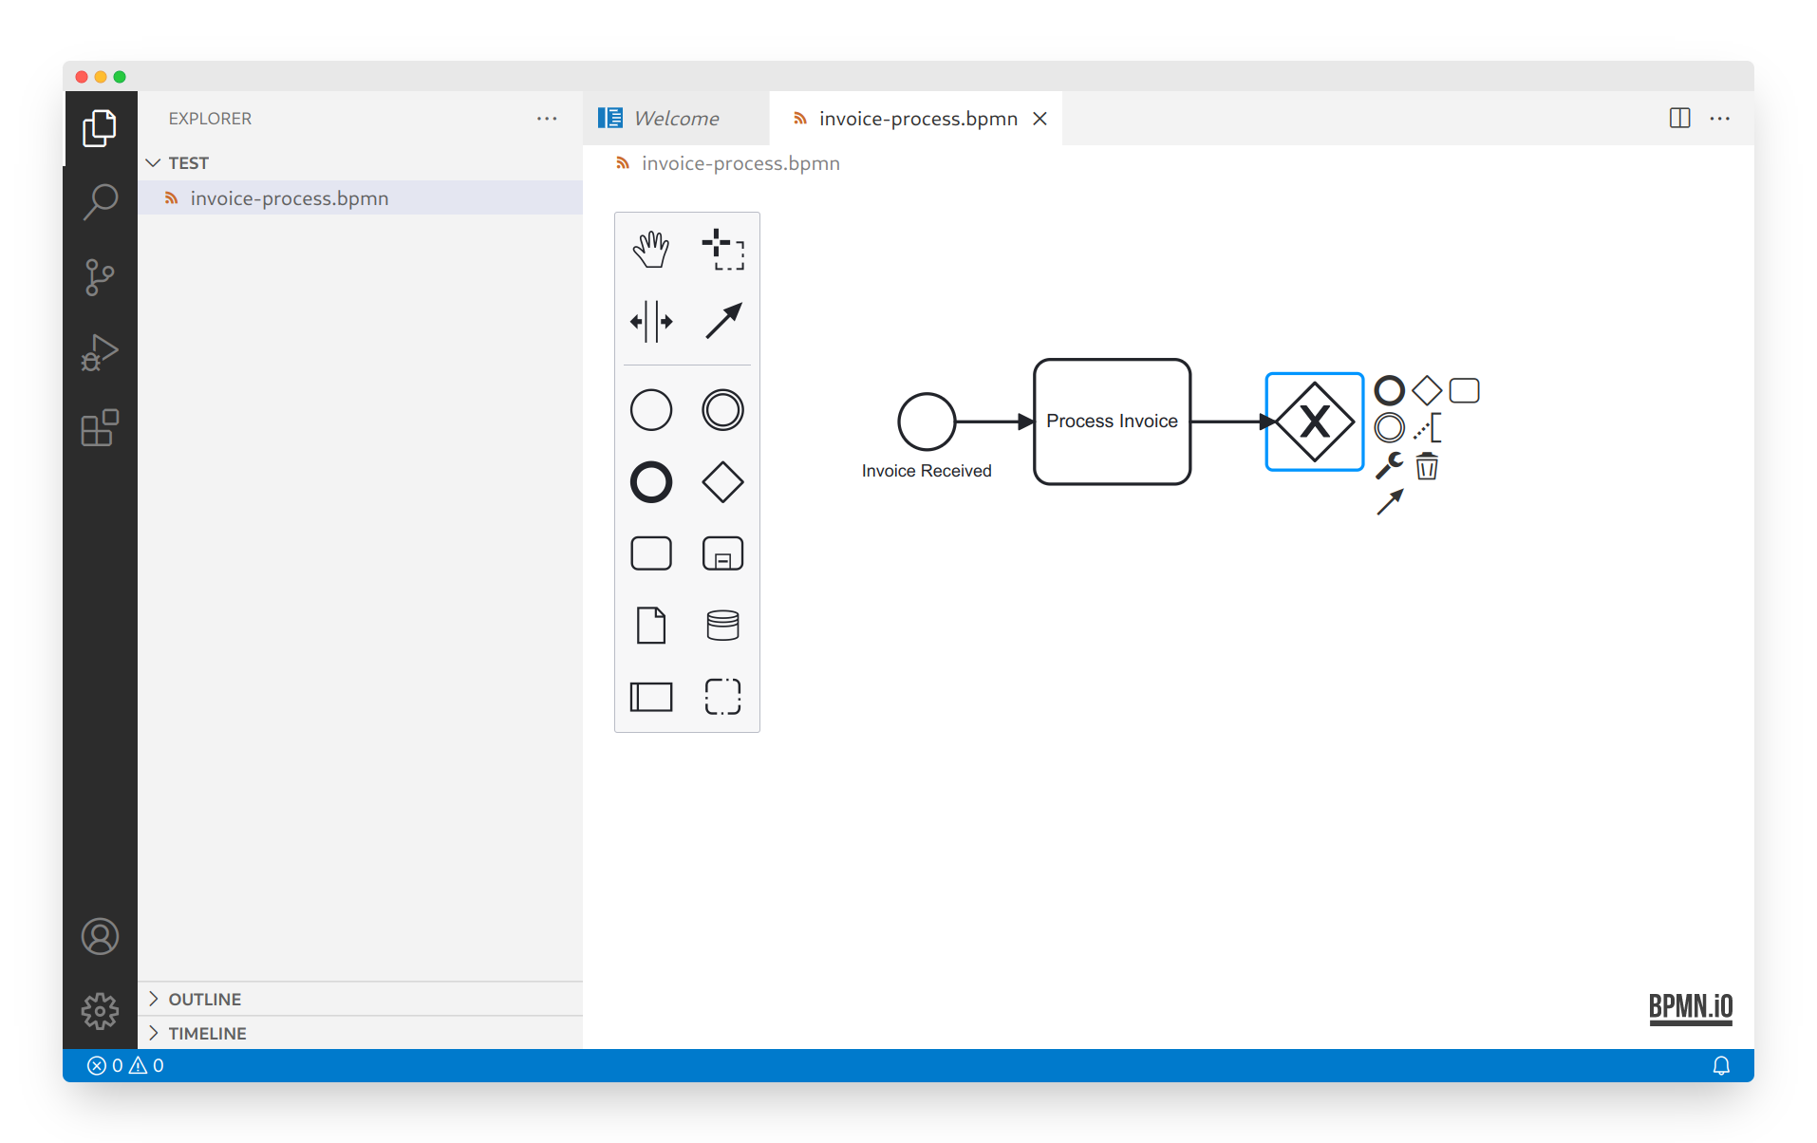
BPMN diagrams in VSCode. (vs-code-bpmn-io )
Notes:
Pentaho is an end-to-end business analytics and data integration platform. And in particular, a major area of focus for our platform has been helping customers integrate Big Data sources into their architecture and analyze that blend of traditional and emerging data. At the same time, we also provide analytics software that is highly embeddable in that they can fit seamlessly into existing applications and processes. A lot of our success in these areas has been due to both early innovation in Big Data – I believe we’ve been working with Hadoop for 5 to 6 years – as well as the open architecture and standards that our platform is built on.

Slide 25
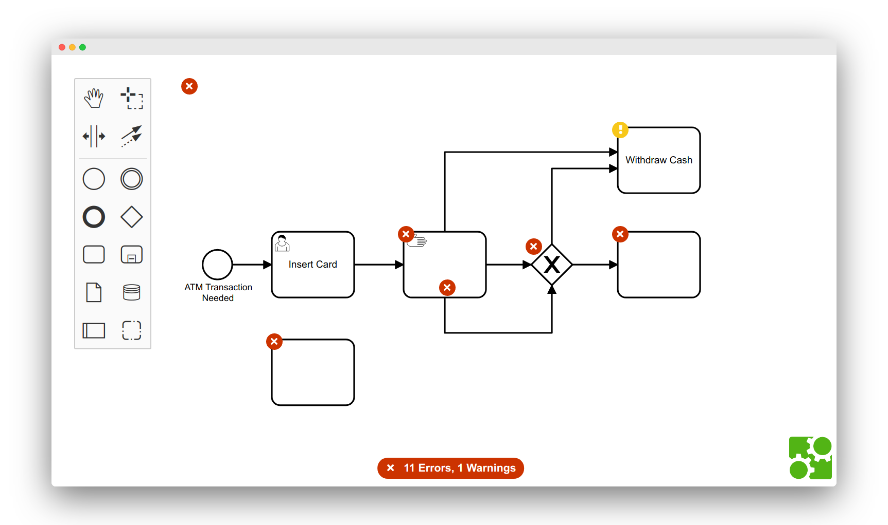
Integrates bpmnlint into bpmn-js.
Notes:
Pentaho is an end-to-end business analytics and data integration platform. And in particular, a major area of focus for our platform has been helping customers integrate Big Data sources into their architecture and analyze that blend of traditional and emerging data. At the same time, we also provide analytics software that is highly embeddable in that they can fit seamlessly into existing applications and processes. A lot of our success in these areas has been due to both early innovation in Big Data – I believe we’ve been working with Hadoop for 5 to 6 years – as well as the open architecture and standards that our platform is built on.

Slide 26
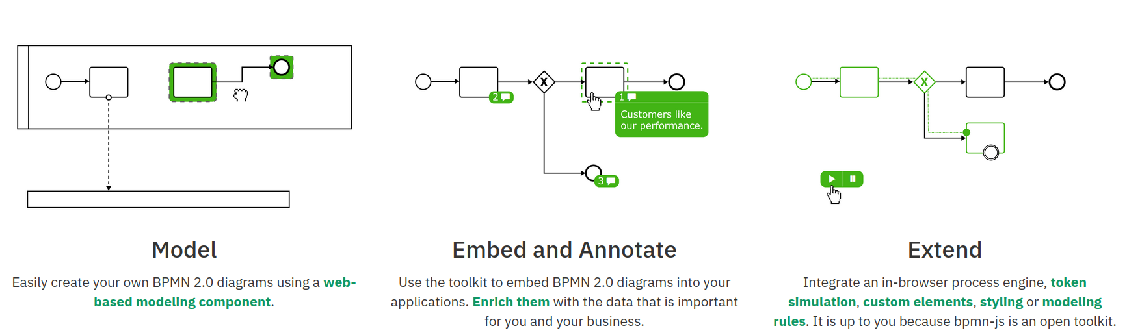
Casos de Uso
Notes:
Pentaho is an end-to-end business analytics and data integration platform. And in particular, a major area of focus for our platform has been helping customers integrate Big Data sources into their architecture and analyze that blend of traditional and emerging data. At the same time, we also provide analytics software that is highly embeddable in that they can fit seamlessly into existing applications and processes. A lot of our success in these areas has been due to both early innovation in Big Data – I believe we’ve been working with Hadoop for 5 to 6 years – as well as the open architecture and standards that our platform is built on.

Slide 27
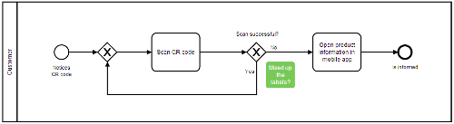
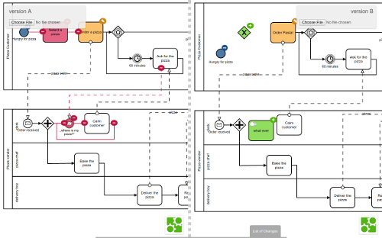
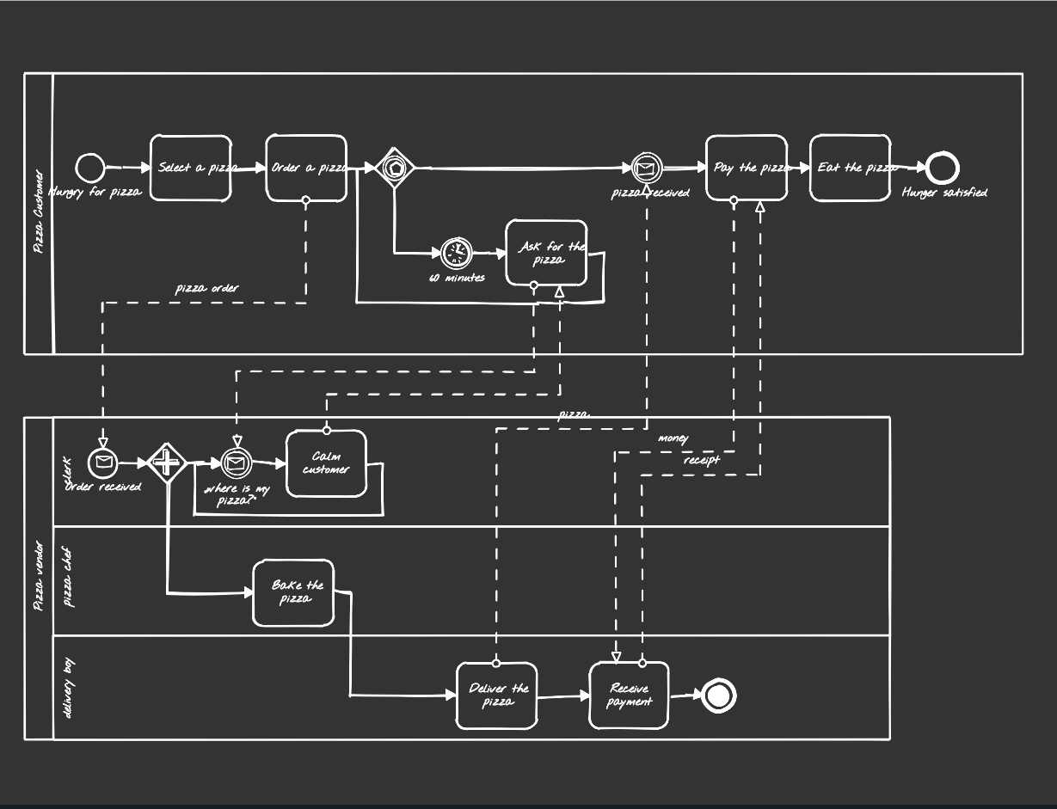
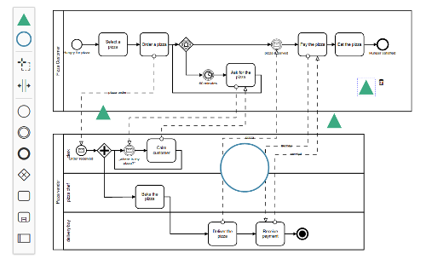
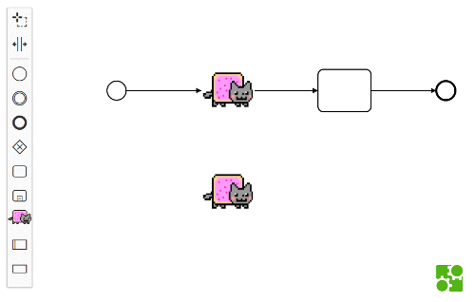
Exemplos
Notes:
Pentaho is an end-to-end business analytics and data integration platform. And in particular, a major area of focus for our platform has been helping customers integrate Big Data sources into their architecture and analyze that blend of traditional and emerging data. At the same time, we also provide analytics software that is highly embeddable in that they can fit seamlessly into existing applications and processes. A lot of our success in these areas has been due to both early innovation in Big Data – I believe we’ve been working with Hadoop for 5 to 6 years – as well as the open architecture and standards that our platform is built on.

Slide 28
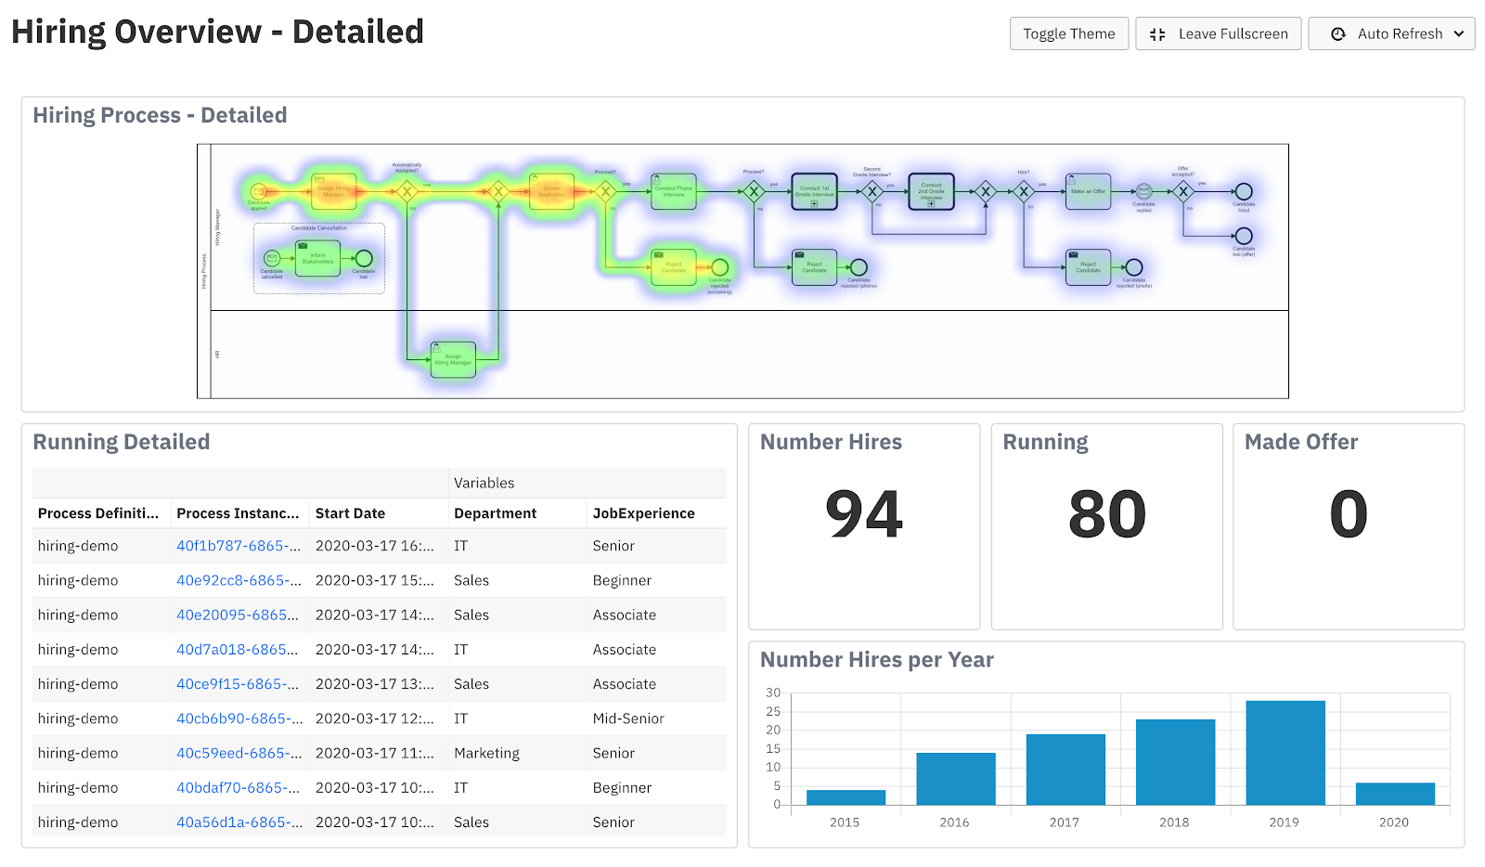
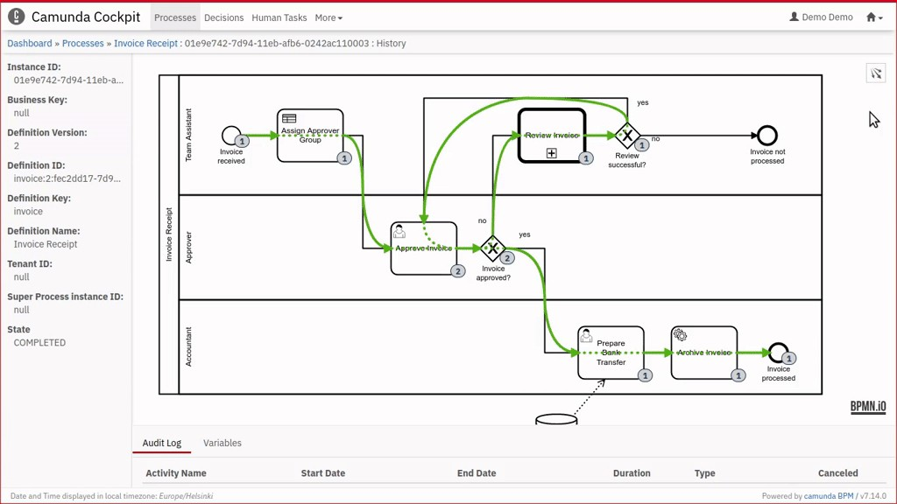
Plugins para Camunda
Notes:
Pentaho is an end-to-end business analytics and data integration platform. And in particular, a major area of focus for our platform has been helping customers integrate Big Data sources into their architecture and analyze that blend of traditional and emerging data. At the same time, we also provide analytics software that is highly embeddable in that they can fit seamlessly into existing applications and processes. A lot of our success in these areas has been due to both early innovation in Big Data – I believe we’ve been working with Hadoop for 5 to 6 years – as well as the open architecture and standards that our platform is built on.

Slide 29
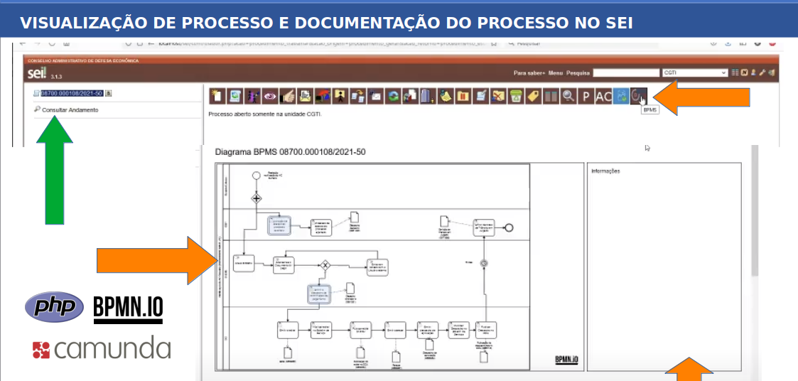
Casos de Uso – Ferramentas de Processos em PHP
Notes:
Pentaho is an end-to-end business analytics and data integration platform. And in particular, a major area of focus for our platform has been helping customers integrate Big Data sources into their architecture and analyze that blend of traditional and emerging data. At the same time, we also provide analytics software that is highly embeddable in that they can fit seamlessly into existing applications and processes. A lot of our success in these areas has been due to both early innovation in Big Data – I believe we’ve been working with Hadoop for 5 to 6 years – as well as the open architecture and standards that our platform is built on.

Slide 30
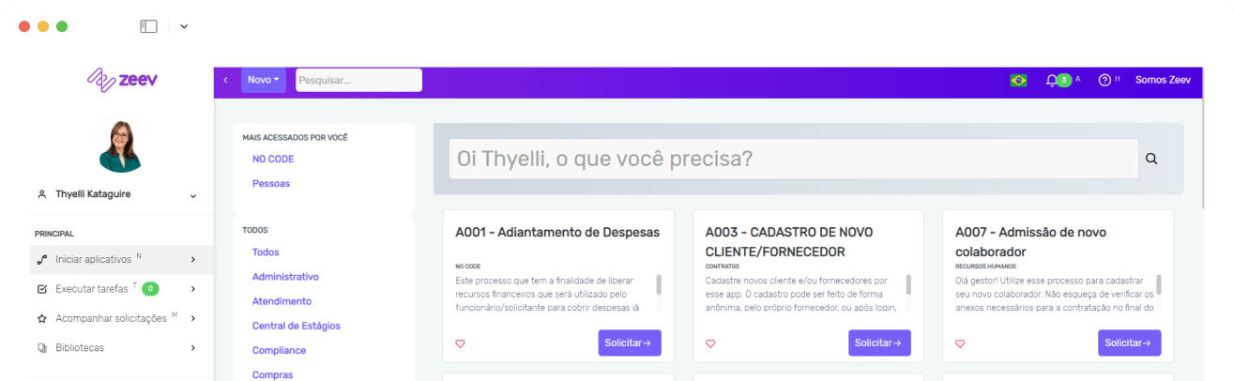

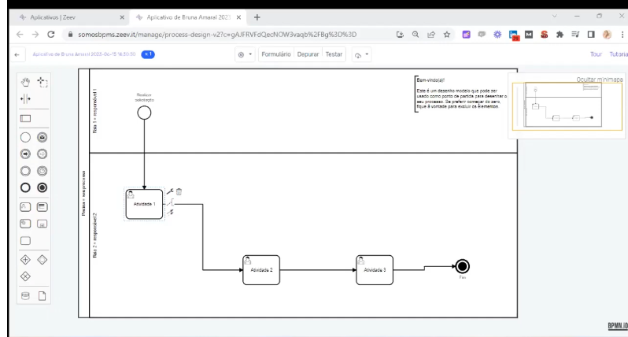
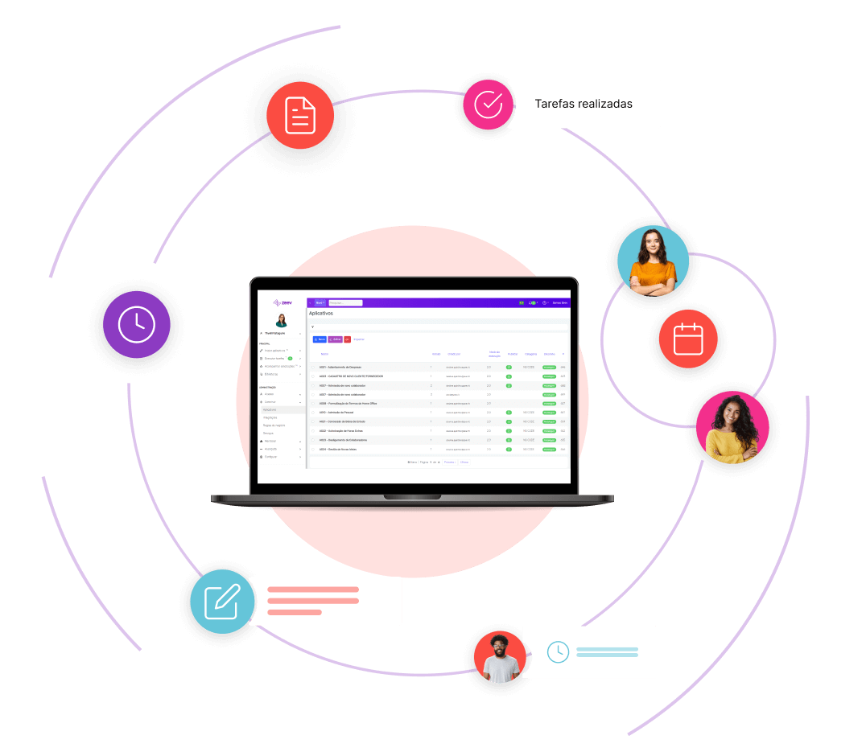
Casos de Uso – Ferramentas SaaS de BPMs
Notes:
Pentaho is an end-to-end business analytics and data integration platform. And in particular, a major area of focus for our platform has been helping customers integrate Big Data sources into their architecture and analyze that blend of traditional and emerging data. At the same time, we also provide analytics software that is highly embeddable in that they can fit seamlessly into existing applications and processes. A lot of our success in these areas has been due to both early innovation in Big Data – I believe we’ve been working with Hadoop for 5 to 6 years – as well as the open architecture and standards that our platform is built on.

Slide 31
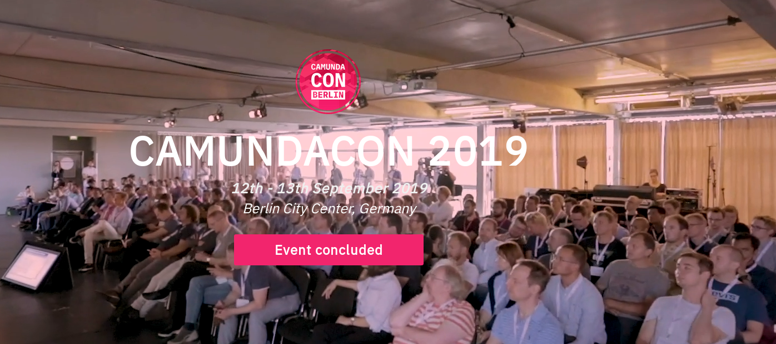

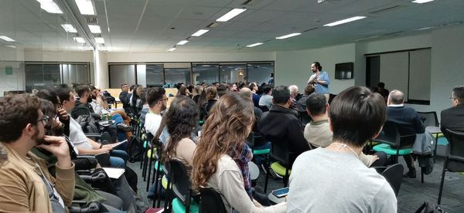
Comunidade Camunda no Brasil e no Mundo
Fontes
Site Oficial BPMN.IO https://bpmn.io/
Github do projeto Camunda https://github.com/camunda
Eventos
Camunda Con - Camunda Conference
https://www.camundacon.com
Meetup - Camunda User Group Brazil https://www.meetup.com/pt-BR/Camunda-User-Group-Brazil
Site oficial do Projeto Activiti Community
Site do Camunda https://camunda.com/
Camunda Community https://camunda.com/learn/community/
Forum: https://forum.camunda.org/
Documentação: https://docs.camunda.org
Notes:
Pentaho is an end-to-end business analytics and data integration platform. And in particular, a major area of focus for our platform has been helping customers integrate Big Data sources into their architecture and analyze that blend of traditional and emerging data. At the same time, we also provide analytics software that is highly embeddable in that they can fit seamlessly into existing applications and processes. A lot of our success in these areas has been due to both early innovation in Big Data – I believe we’ve been working with Hadoop for 5 to 6 years – as well as the open architecture and standards that our platform is built on.

Slide 32
Obrigado
Marcio Junior Vieira
marcio@ambientelivre.com.br
@marviojvieira @ambientelivre
@ambientelivreopensoftware
https://www.linkedin.com/in/mvieira1/
Blog: http://blogs.ambientelivre.com.br/marcio/

