Slide 1

Basic Details of the Team and Problem Statement
Ministry : Ministry of Home Affairs
PS Code : SIH1412
Problem Statement Title : Data Compression for Backbone Network
Team Name : Asterisks
Team Leader Name : Vyoam Yadav
Institute Code (AISHE) : C-29359
Institute Name : CCET sector 26
Theme Name : BLOCKCHAIN & CYBERSECURITY

Slide 2
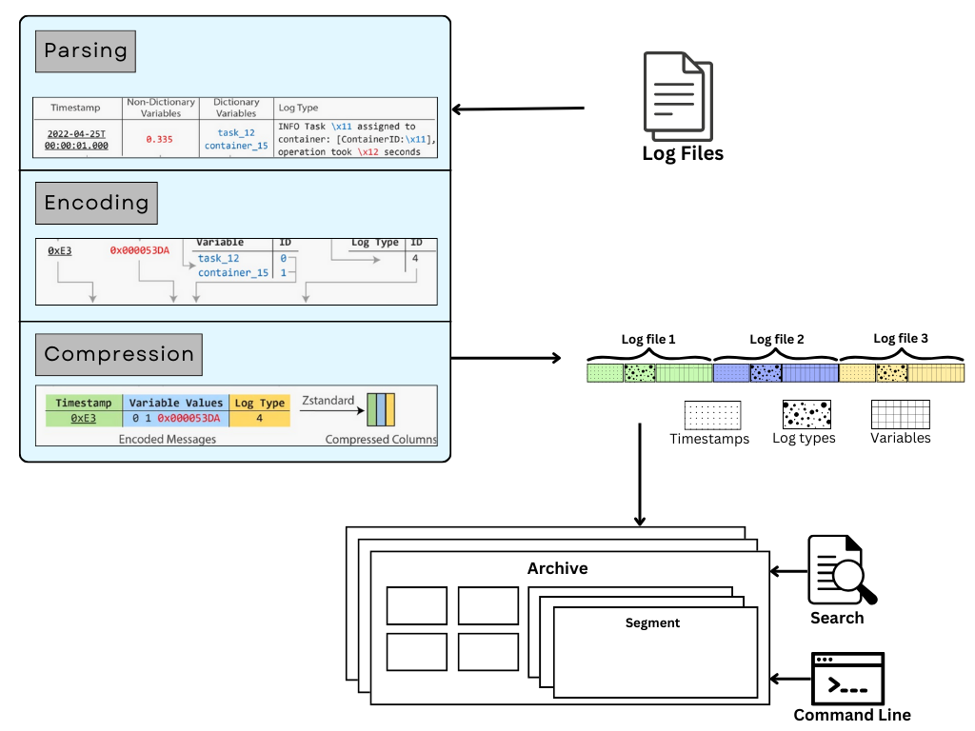





Approach Details
Basic Idea about the Solution :
A data compression reducing system for a network with high speed and traffic.
Ensuring scalability with very low latency and overhead.
Identification and Removal of redundant data using efficient encoding schemes.
Recognising specific network’s resource requirements.
Optimising the performance of the system by reducing the bandwidth required for transmission of data packets.
Integration of compression for various data types like images, videos, text with different formats and sizes.
Ensuring reliablity and security of system.
Tech Stack Used:
Compression System : Go, C
Website / Network interface for performance testings : Django, ReactJs.
Data storge : Sqlite

Slide 3
Approach Details
Use Cases
Dependencies
Reduced transmission times for large data files between differnt nodes in the network.
Reducing bandwidth requirements ensuring performance during periods of high network traffic.
Effective and efficient compression will allow storage of larger volumes of data.
Improving efficiency of distributed computing.
Technologies like IOTs where power resource are limited could be more effectively used due reduced packet sizes.
Optimising network performance considering specific requirements of the network.
Duplicate copies of same data could be eliminated.
Choice of compression techniques like lossless and lossy compression.
Level of compression : Like providing Protocall Level Compression via “Accept Encoding” or “Content Encoding”.
Transformation of data into different domains like Fourier and Discrete Cosine Transforms.
Recognition of patterns and different data types for elimination of redundancies.
Level of information to store about data quality of images, videos or audios to be maintained.
Infrastructure and Resources available to the network like bandwitdth, storage, transmission protocalls.

Slide 4
Team Member Details
Team Leader Name : Vyoam Yadav
Branch : BE Stream : CSE Year : IV
Team Member 1 Name : Shivam Jain
Branch : BE Stream : CSE Year : IV
Team Member 2 Name : Smriti Kumari
Branch : BE Stream : CSE Year : IV
Team Member 3 Name : Shivam Kumar
Branch : BE Stream : CSE Year : IV
Team Member 4 Name : Rishika
Branch : BE Stream : ECE Year : IV
Team Member 5 Name : Aditya Motla
Branch : BE Stream : MECH Year : IV

