Slide 1


Slide 2
Backtracking and Branch and bound
BT and BB used to solve the combinatorial problems
Based on construction of state space tree
Is used to solve problems for which a sequence of objects is to be selected from a set such that the sequence satisfies some constraint
Traverses the state space using a depth-first search with pruning
Backtracking and branch and bound are based on state space tree whose node reflect specific choices made for a solutions components

Slide 3
State space tree
Constructing a tree of choices being made called state space tree.
Root represents an initial state before the search for a solution begins
Nodes of the first level in the tree represent the choices made for the first component of a solution, the nodes of the second level represent the choices for second component and so on.
Promising – if it corresponds to a partially constructed solution that may still lead to a complete solution
Non promising- if not.

Slide 4
Backtracking
Performs a depth-first traversal of a tree
Search for Promising or non promising
Continues until it reaches a node that is non-viable or non-promising
If the current node is non promising, the alg backtracks to the node parent to consider the next possible option for the last component
If alg reaches the complete solution to the problem it either stops or backtracks to continue searching for other possible solutions

Slide 5
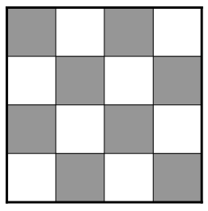
Example: N-Queens Problem
Given an N x N sized chess board
Objective: Place N queens on the board so that no queens are in danger
Place n queens on n by n chessboard so that no two queens attack each other by being in the same row or in the same column or in the same diagonal

Slide 6
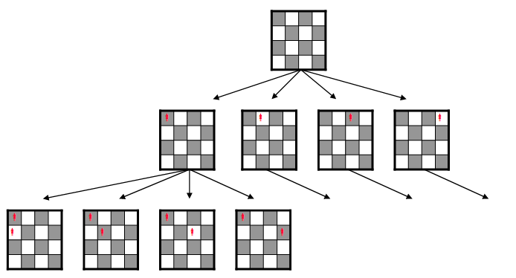
One option would be to generate a tree of every possible board layout
This would be an expensive way to find a solution

Slide 7
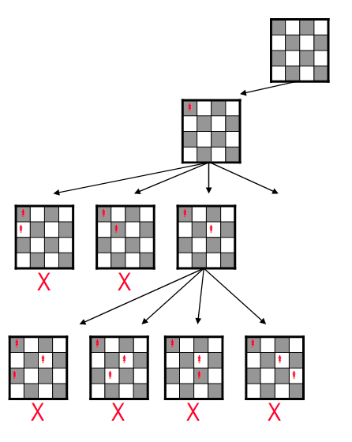
Backtracking
Backtracking prunes entire sub trees if their root node is not a viable solution
The algorithm will “backtrack” up the tree to search for other possible solutions

Slide 8
Efficiency of Backtracking
Worst case: Algorithm tries every path, traversing the entire search space as in an exhaustive search

Slide 9
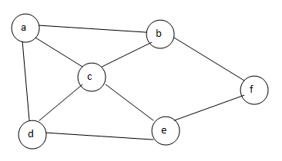
Hamiltonian Circuit
Complete path which consists of all the nodes in the given graph, starting and end vertex of the complete path is same

Slide 10
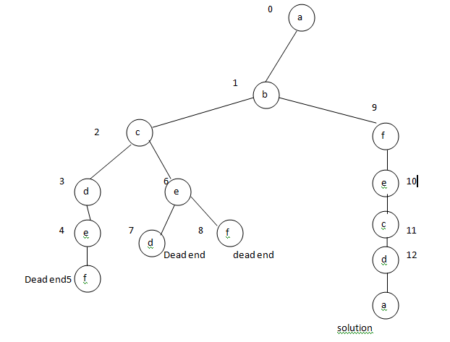

Slide 11
Start at vertex a, Using the alphabet order to break the 3 way tie among the adjacency vertex to a, we select the vertex b from b to c and f, from c we have d and e from d to e from e to f(dead end), from c to e and e to d and f(dead end), from f to e to c to d to a(source) solution
Hamiltonian circuit : a,b,f,e,c,d,a
We want to find another hamiltonian circuit, we could continue this process by backtracking from the leaf of the solution found.

Slide 12
Subset sum problem
Finding a subset of the given set S={s1,….sn} of n positive integers whose sum is equal to a given positive integer d.
Ex : S={1,2,5,6,8} and d=9, there are 2 solutions {1,2,6} and {1,8}, some instances may have no solutions
Sort the elements in increasing order s1<=s2<=…<=sn
State space tree can be constructed as a binary tree for the instance S={3,5,6,7}and d=15
Root of the tree represents the starting point, its left and right represented by the inclusion and exclusion of the instance
On each level we have to check the level whether it reaches the solution, record the value s’ sum of those numbers

Slide 13
If s’ is equal to d we have the solution, if not need to backtrack to the node’s parent
Two inequalities or non promising
  S’+Si+1 >d (the sum s’ is too large)
  S’+ j=i+1 to n sum(Sj) <d ( the sum s’ is too small)
  Example diagram

Slide 14
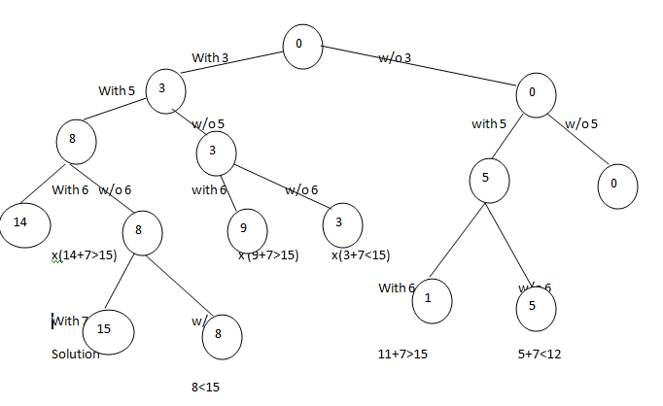

Slide 15
Branch and Bound
Where backtracking uses a depth-first search with pruning, the branch and bound algorithm uses a breadth-first search with pruning
Branch and bound uses a queue as an auxiliary data structure
Feasible solution – is a point in the problem’s state space that satisfies all the problem’s constraints
Optimal solution – is a feasible solution with the best value of the objective function

Slide 16
The Branch and Bound Algorithm
Starting by considering the root node and applying a lower-bounding and upper-bounding procedure to it
If the bounds match, then an optimal solution has been found and the algorithm is finished
If they do not match, then algorithm runs on the child nodes
Examples – Assignment problem, Knapsack problem, TSP

Slide 17
Assignment Problem
Assigning n people to n jobs so that total cost of the assignment is as small as possible. Seen in exhaustive search. Instance of this pblm is specified by n*n matrix cost matrix C. least cost – finding lower bound value
Select one element in each row of the matrix so that no two selected elements are in the same column and their sum is smallest possible
Apply branch and bound technique : consider smaller element in each row to calculate the lower bound
  Job1 job2 job3 job4
  9 2 7 8 person a
  6 4 3 7 person b = C
  5 8 1 8 person c
  7 6 9 4 person d

Slide 18
Knapsack
Finding most valuable subset to fit in to the bag – Upper bound value
Given n items of known weights Wi and values Vi, i=1,2…..n and knapsack capacity W, find the most valuable subset of the items that fit in to the knapsack
Formula to calculate upper bound value
Ub = v+(W-w)(vi+1/wi+1)
Ex : item weight value value/weight
    1 4 $40 10
    2 7 $42 6
    3 5 $25 5
    4 3 $12 4 W=10
    Ub = 40+(10-4)*6=$76

Slide 19
knapsack Problem
Product of remaining capacity of the knapsack W-w
The best payoff among the remaining items vi+1/wi+1

Slide 20
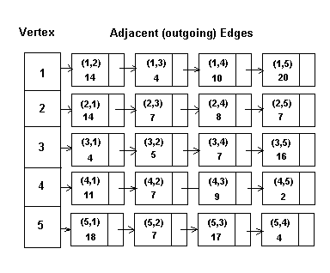
Example:
The Traveling Salesman Problem
Branch and bound can be used to solve the TSP using a priority queue as an auxiliary data structure
An example is the problem with a directed graph given by this adjacency matrix:

Slide 21
Traveling Salesman Problem
The problem starts at vertex 1
The initial bound for the minimum tour is the sum of the minimum outgoing edges from each vertex
Vertex 1 min (14, 4, 10, 20) = 4
Vertex 2 min (14, 7, 8, 7) = 7
Vertex 3 min (4, 5, 7, 16) = 4
Vertex 4 min (11, 7, 9, 2) = 2
Vertex 5 min (18, 7, 17, 4) = 4
Bound = 21

Slide 22
Traveling Salesman Problem
Next, the bound for the node for the partial tour from 1 to 2 is calculated using the formula:
  Bound = Length from 1 to 2 + sum of min outgoing edges for vertices 2 to 5 = 14 + (7 + 4 + 2 + 4) = 31

Slide 23
Traveling Salesman Problem
The node is added to the priority queue
The node with the lowest bound is then removed
This calculation for the bound for the node of the partial tours is repeated on this node
The process ends when the priority queue is empty

Slide 24
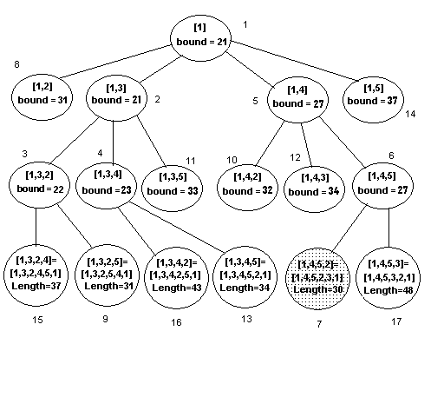
Traveling Salesman Problem
The final results of this example are in this tree:
The accompanying number for each node is the order it was removed in

Slide 25
Efficiency of Branch and Bound
In many types of problems, branch and bound is faster than branching, due to the use of a breadth-first search instead of a depth-first search
The worst case scenario is the same, as it will still visit every node in the tree

