Slide 1
Chapter 3
Brute Force

Slide 2
Brute Force
A straightforward approach, usually based directly on the problem’s statement and definitions of the concepts involved
Examples:
Computing a^{n} (a > 0, n a nonnegative integer)
Computing n!
Multiplying two matrices
Searching for a key of a given value in a list

Slide 3
Brute-Force Sorting Algorithm
Selection Sort Scan the array to find its smallest element and swap it with the first element. Then, starting with the second element, scan the elements to the right of it to find the smallest among them and swap it with the second elements. Generally, on pass i (0 ≤ i ≤ n-2), find the smallest element in A[i..n-1] and swap it with A[i]:
A[0] ≤ . . . ≤ A[i-1] | A[i], . . . , A[min], . . ., A[n-1]
in their final positions
Example: 7 3 2 5

Slide 4
Process
Scan the entire list and find the smallest value
Exchange that value with the value in the first position of the list
Scan the list, omitting the first value, and find the smallest value
Exchange that value with the value in the second position of the list
Scan the list, omitting the first two values, and find the smallest value
Exchange that value with the value in the third position of the list
Continue this process for all but the last position in the list, which will contain the largest value

Slide 5
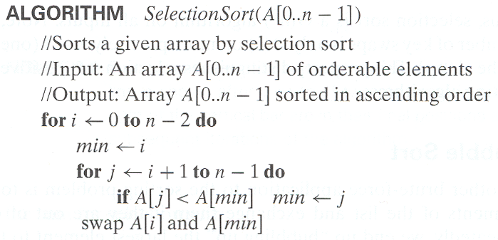
Analysis of Selection Sort
Time efficiency:
Θ(n^2)

Slide 6
Advantages : Simple and easy to implement
Disadv: Inefficient for large lists
Analysis:
Worst case : 1. occurs if the array is already sorted in descending order
2. Spends most of its time trying to find the minimum element in the unsorted part of the array.
3.Swapping it in to first position, finding the next lowest element requires scanning the remaining n-1 elements ……
4. For (n-1)+(n-2)+(n-3)+……+3+2+1 =n(n-1)/2 ε Θ(n^2)

Slide 7
Bubble Sort
Works by comparing each item in the list with the item next to it and swapping them if required
It repeats the process until it makes a pass all the way through the list without swapping any items(or all items are in the correct order)
It causes larger values to bubble to the end of the list and smaller values sink towards the beginning of the list
Advant: simple and easy to implement
Dis: inefficient for larger lists

Slide 8
Pass 1
29 10 14 37 13
10 29 14 37 13
10 14 29 37 13
10 14 29 37 13
10 14 29 13 37 (n-1)
Pass 2
10 14 29 13 37
10 14 29 13 37
10 14 29 13 37
10 14 13 29 37 (n-2) ……
Complexity :
1+2+….+(n-1) = n(n-1)/2 = O(n^2)

Slide 9
Algorithm
For i← 0 to n-2 do
  For j← 0 to n-2-i do
    If a[j+1]<a[j] swap a[j] and a[j+1]

Slide 10
Sequential Search
Compare the successive elements of a given list with a given search key until either a match is encountered(successful search) or list is exhausted with out finding a match(unsuccessful search)
i/p: array of n elements
Search key k
o/p:position of the array whose value is equal to k

Slide 11
Algorithm
A[n]← k
i← 0
While A[i] = k do
i← i+1
if i<n return i
else return -1

Slide 12
Brute-Force String Matching
pattern: a string of m characters to search for
text: a (longer) string of n characters to search in
problem: find a substring in the text that matches the pattern
Brute-force algorithm(Naïve Algorithm)
Step 1 Align pattern at beginning of text
Step 2 Moving from left to right, compare each character of
pattern to the corresponding character in text until
    all characters are found to match (successful search); or
    a mismatch is detected
Step 3 While pattern is not found and the text is not yet
exhausted, realign pattern one position to the right and
repeat Step 2

Slide 13
Examples of Brute-Force String Matching
Pattern: 001011 Text: 10010101101001100101111010
Pattern: happy Text: It is never too late to have a happy childhood.

Slide 14
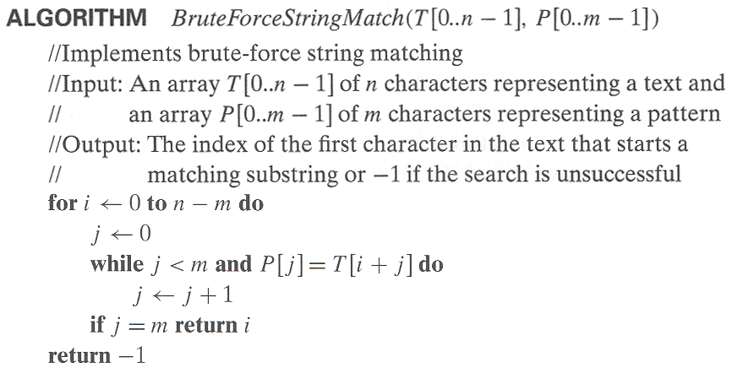
Pseudocode and Efficiency

Slide 15
Referring to implementation of naïve matcher, we see that the for-loop is executed at most n - m +1 times, and the while-loop is executed at most m times. Therefore, the running time of the algorithm is O((n - m +1)m), which is clearly O(nm). Hence, in the worst case, when the length of the pattern, m are roughly equal, this algorithm runs in the quadratic time.
Time efficiency: Θ(mn) comparisons (in the worst case)

Slide 16
Boyer Moore algorithm
Most efficient alg for string matching
Implemented in most of the text editors to search and replace the text
Alg scans the chars of the pattern from right to left beginning from the rightmost
For mismatch it uses 2 pre computed functions
Good suffix shift
Bad suffix shift

Slide 17
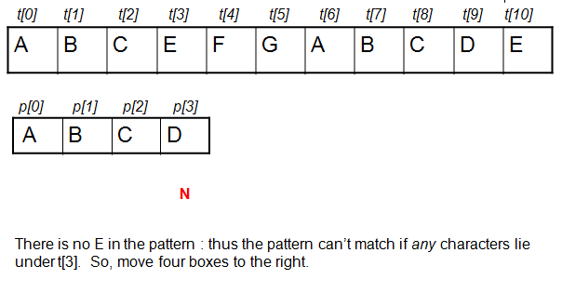
Example

Slide 18
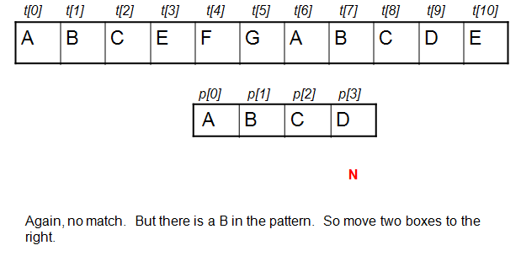
Step 2 since there is a and b in the pattern move 2 positions next

Slide 19
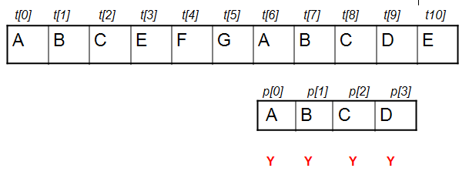
Step 3

Slide 20
Closest-Pair Problem
Find the two closest points in a set of n points (in the two-dimensional Cartesian plane).
Brute-force algorithm
Compute the distance between every pair of distinct points and return the indexes of the points for which the distance is the smallest.
Points(x,y), distance between two points P_{i =} (x_{i} ,y_{i}), P_{j}=(x_{j},y_{j}) is the standard Euclidean distance
d(P_{i},P_{j})= Sqrt((x_{i}-x_{j}) ^2 + (y_{i}-y_{j}) ^2)
We need to compute distance between 2 points only once. To do that we consider only the pair of points (P_{i},P_{j}) for which i<j
Notes:
Draw example.

Slide 21
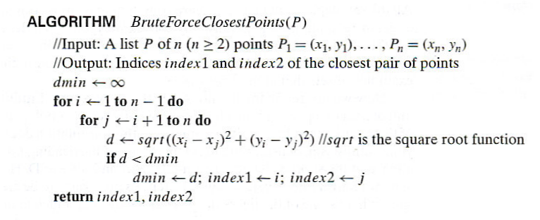
Closest-Pair Brute-Force Algorithm (cont.)
Efficiency:
How to make it faster?
Θ(n^2) multiplications (or sqrt)
Using divide-and-conquer!
Notes:
The basic operation of the algorithm is computing the Euclidean distance between two points.
The square root is a complex operation who’s result is often irrational, therefore the results
can be found only approximately. Computing such operations are not trivial. One can avoid
computing square roots by comparing distance squares instead.

Slide 22
Basic operation: computing the euclidean distance between two points
computing square roots : an operation – addition or multiplication
After finding the distance need to be squared . So the eq
d← Sqrt((x_{i}-x_{j}) ^2 + (y_{i}-y_{j}) ^2) will be replaced
Sqr(d)←(x_{i}-x_{j}) ^2 + (y_{i}-y_{j}) ^2
It means just squaring a number (1+1) = 2(Θ(n^2) multiplications (or sqrt ) )

Slide 23
Convex Hull
Convex : A set of points(finite or infinite) on the plane is called convex
Imagine that the points are represented by nails driven in to large sheet of plywood representing the plane
Take a rubber band and stretch it to include all the nails then let it snap into place
Convex hull is the area bounded by the snapped rubber band
Formal definition : convex hull that is applicable to arbitrary sets, including sets of points that happen to lie on the same line
Convex hull problem is the problem of constructing the convex hull for a given set of S of n points
To solve that we need to find points that will serve as the vertices of the polygon

Slide 24
Vertices are called as extreme points
Extreme points – a point that is not a middle point of any line segment but end points of the given set
If it is a triangle : 3 vertices are the extreme points
Circle : all the points of its circumference
Given n points, we need to know which pairs of points need to be connected to form the boundary of the convex hull.

Slide 25
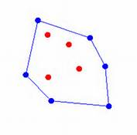
example

Slide 26
Applications
Computer Visualization, Ray Tracing, Video Games, Replacement of Bounding Boxes
Path Finding - Embedded AI of Mars mission Rovers
Geographical Information Systems (GIS) - Computing Accessibility Maps
Visual Pattern Matching - Detecting Car License Plates
http://www.tcs.fudan.edu.cn/rudolf/Courses/Algorithms/Alg_ss_07w/Webprojects/Chen_hull/applications.htm

Slide 27
Repeat the above for every pair of points yields a list of line segments that make up the convex hull
Few facts from analytical geometry are needed to implement alg
A straight line through two points(x₁,y₁) and (x₂,y₂) in the plane can be defined by the eq;
    ax+by=c
    a=y₂-y₁, b=x₁-x₂, c=x₁y₂-y₁x₂
    Second, such line divides the plane in to 2 halfs for all points in one of them ax+by>c, in the other ax+by<c
    Points on the line ax+by=c

Slide 28
Brute-Force Strengths and Weaknesses
Strengths
  wide applicability
  simplicity
  yields reasonable algorithms for some important problems
  (e.g., matrix multiplication, sorting, searching, string matching)
Weaknesses
  rarely yields efficient algorithms
  some brute-force algorithms are unacceptably slow
  not as constructive as some other design techniques

Slide 29
Exhaustive Search
A brute force solution to a problem involving search for an element with a special property, usually among combinatorial objects such as permutations, combinations, or subsets of a set.
Method:
  generate a list of all potential solutions to the problem in a systematic manner
  evaluate potential solutions one by one, disqualifying infeasible ones and, for an optimization problem, keeping track of the best one found so far
  when search ends, announce the solution(s) found

Slide 30
Example 1: Traveling Salesman Problem
Given n cities with known distances between each pair, find the shortest tour that passes through all the cities exactly once before returning to the starting city
Alternatively: Find shortest Hamiltonian circuit in a weighted connected graph
Example:
2
a
b
5
3
8
4
c
d
7
How do we represent a solution (Hamiltonian circuit)?

Slide 31
TSP by Exhaustive Search
Tour Cost
a→b→c→d→a 2+3+7+5 = 17
a→b→d→c→a 2+4+7+8 = 21
a→c→b→d→a 8+3+4+5 = 20
a→c→d→b→a 8+7+4+2 = 21
a→d→b→c→a 5+4+3+8 = 20
a→d→c→b→a 5+7+3+2 = 17
Hamiltonian circuit defined as a sequence of n+1 adjacent vertices. First and last vertices are same remaining n-1 vertices are distinct
Efficiency:
Θ((n-1)!)

Slide 32
Example 2: Knapsack Problem
Given n items:
  weights: w₁ w₂ … w_{n}
  values: v₁ v₂ … v_{n}
  a knapsack of capacity W
Find most valuable subset of the items that fit into the knapsack
Example: Knapsack capacity W=16
item weight value
2 $20
5 $30
10 $50
5 $10

Slide 33
Knapsack Problem by Exhaustive Search
Subset Total weight Total value
{null} 0 $0
{1} 2 $20
{2} 5 $30
{3} 10 $50
{4} 5 $10
{1,2} 7 $50
{1,3} 12 $70
{1,4} 7 $30
{2,3} 15 $80
{2,4} 10 $40
{3,4} 15 $60
{1,2,3} 17 not feasible
{1,2,4} 12 $60
{1,3,4} 17 not feasible
{2,3,4} 20 not feasible
{1,2,3,4} 22 not feasible
Efficiency:
Θ(2^n)

Slide 34
Example 3: The Assignment Problem
There are n people who need to be assigned to n jobs, one person per job. The cost of assigning person i to job j is C[i,j]. Find an assignment that minimizes the total cost.
Job 0 Job 1 Job 2 Job 3
Person 0 9 2 7 8
Person 1 6 4 3 7
Person 2 5 8 1 8
Person 3 7 6 9 4
Algorithmic Plan: Generate all legitimate assignments, compute
their costs, and select the cheapest one.
How many assignments are there?
n!

Slide 35
Assignment Problem by Exhaustive Search
9 2 7 8
6 4 3 7
5 8 1 8
7 6 9 4
Assignment (col.#s) Total Cost
1, 2, 3, 4 9+4+1+4=18
1, 2, 4, 3 9+4+8+9=30
1, 3, 2, 4 9+3+8+4=24
1, 3, 4, 2 9+3+8+6=26
1, 4, 2, 3 9+7+8+9=33
1, 4, 3, 2 9+7+1+6=23
etc.
(For this particular instance, the optimal assignment can be found by exploiting the specific features of the number given. It is: )
C =
2,1,3,4

Slide 36
Final Comments on Exhaustive Search
Exhaustive-search algorithms run in a realistic amount of time only on very small instances
In some cases, there are much better alternatives!
  Euler circuits
  shortest paths
  minimum spanning tree
  assignment problem best method
The Hungarian method runs in O(n^3) time.

