Slide 1
Decrease-and-Conquer

Slide 2
Decrease-and-Conquer
Reduce problem instance to smaller instance of the same problem
Solve smaller instance
Extend solution of smaller instance to obtain solution to original instance
Can be implemented either top-down or bottom-up
Also referred to as inductive or incremental approach

Slide 3
3 Types of Decrease and Conquer
Decrease by a constant (usually by 1): ( pblm with a ^{n} = a ^{n-1}.a)
insertion sort
  graph traversal algorithms (DFS and BFS)
  algorithms for generating permutations, subsets
Decrease by a constant factor (usually by half = usually equal to 2)
  binary search and bisection method
  Instance of n to compute a^{n} , half to compute is a^{n/2}
  exponentiation by squaring
  a ^{n}=(a ^{n/2} ) ²
Variable-size decrease
  Euclid’s algorithm
  Size reduction varies from one iteration from the other
  selection by partition
  This usually results in a recursive algorithm.

Slide 4
Formula
Decrease-by-a constant :
f(n) = f(n-1).a , if n>1
a , if n=1
Decrease by a constant factor :
a ^{n} = (a ^{n/2} ) ² , if n is even and positive
(a ^{n-1/2} ) ² . a , if n is odd and greater thn 1
a , if n=1
Decrease by variable size decrease :
Ex : euclid: gcd (m , n) = gcd ( n , m mod n)
Args on right hand side is smaller than left hand side

Slide 5
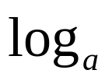
What’s the difference?
Consider the problem of exponentiation: Compute x^{n}
Brute Force:
Divide and conquer:
Decrease by one:
Multiplying a by n-1 times = n-1
Decrease by constant factor:
n-1 multiplications
T(n) = 2*T(n/2) + 1
= n-1
T(n) = T(n-1) + 1 = n-1
T(n) = T(n/a) + a-1
= (a-1) n
Notes:
Try to get the students involved in coming up with these:
Brute Force:
a^{n}= a*a*a*a*...*a
n
Divide and conquer:
a^{n}= a^{n/2} * a^{n/2} (more accurately, a^{n}= a^{⎣n/2⎦} * a ^{⎡n/2│})
Decrease by one:
a^{n}= a^{n-1}* a (one hopes a student will ask what is the difference with brute force here:
there is none in the resulting algorithm, of course, but you can arrive
at it in two different ways)
Decrease by constant factor:
a^{n}= (a^{n/2})² (again, if no student asks about it, be sure to point out the difference
with divide and conquer. Here there is a significant difference that leads to a
much more efficient algorithm – in divide and conquer we recompute a^{n/2}

Slide 6
Insertion Sort
To sort array A[0..n-1], sort A[0..n-2] recursively and then insert A[n-1] in its proper place among the sorted A[0..n-2]
Usually implemented bottom up (nonrecursively)
Example: Sort 6, 4, 1, 8, 5
6 | 4 1 8 5
4 6 | 1 8 5
1 4 6 | 8 5
1 4 6 8 | 5
1 4 5 6 8

Slide 7
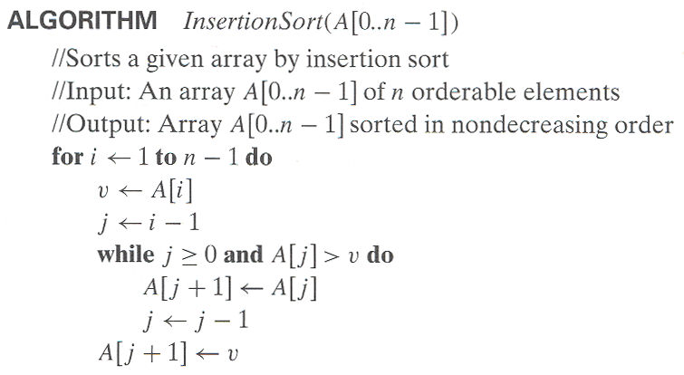
Pseudocode of Insertion Sort

Slide 8
Analysis of Insertion Sort
i=1……n-1 j=i-1…….0
Time efficiency
C_{worst}(n) = n(n-1)/2 ∈ Θ(n²)
C_{best}(n) = n - 1 ∈ Θ(n) (also fast on almost sorted arrays)
Space efficiency: in-place
Stability: yes

Slide 9
Graph Traversal
Many problems require processing all graph vertices (and edges) in systematic fashion
Graph traversal algorithms:
  Depth-first search (DFS)
  Breadth-first search (BFS)

Slide 10
Depth-First Search (DFS)
Visits graph’s vertices by always moving away from last
visited vertex to an unvisited one, backtracks if no adjacent
unvisited vertex is available.
Recursive or it uses a stack
  a vertex is pushed onto the stack when it’s reached for the first time
  a vertex is popped off the stack when it becomes a dead end, i.e., when there is no adjacent unvisited vertex
Tree edge : whenever a new unvisited vertex reached for the first time, it is attached as a child to the vertex from which it is being reached. Tree edges forms forest.
Back edge : an edge leading to the previously visited vertex other than its immediate predecessor is called back edge.

Slide 11
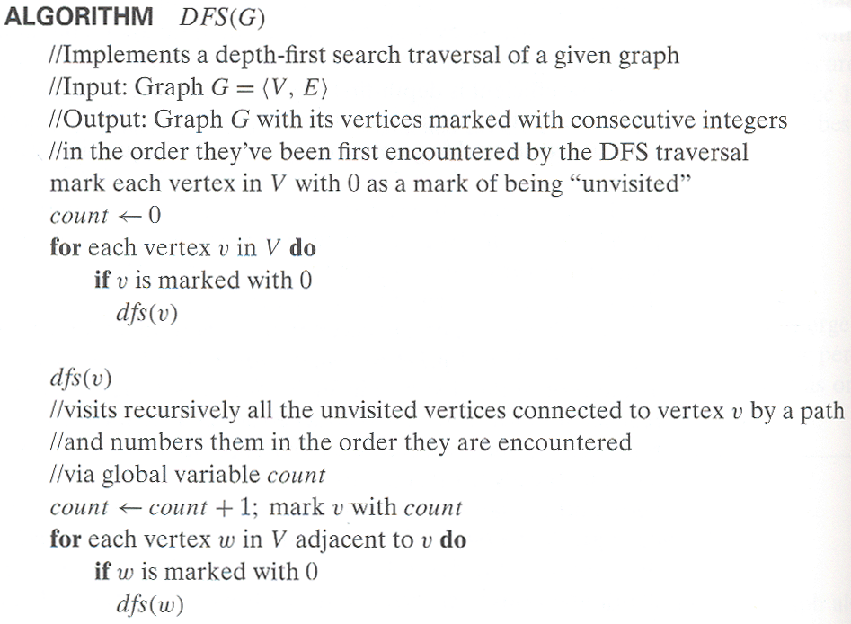
Pseudocode of DFS

Slide 12
Example: DFS traversal of undirected graph
a
b
c
d
a
ab
abf
abfe
abf
ab
abg
abgc
abgcd
abgcdh
abgcd
…
e
f
g
h
DFS traversal stack:
DFS tree:
1
2
6
7
a
b
c
d
e
f
g
h
4
3
5
8
Red edges are tree edges and white edges are back edges.
Notes:
Traversal using alphabetical order of vertices. Work through this example in detail,
showing the traversal by highlighting edges on the graph and showing how the stack
evolves:
8 h 3
7 d 4 stack shown growing upwards
4 e 1 6 c 5 number on left is order that vertex was pushed onto stack
3 f 2 5 g 6 number on right is order that vertex was popped from stack
2 b 7 overlap is because after e, f are popped off stack, g and c
1 a 8 are pushed onto stack in their former locations.
order pushed onto stack: a b f e g c d h
order popped from stack: e f h d c g b a
* show dfs tree as it gets constructed, back edges

Slide 13
DFS
Time efficiency depends on the size of data structure used for representing the graph
  adjacency matrices: Θ(|V|²).
  adjacency lists: Θ(|V|+|E|). No of vertices and edges used
Yields two distinct ordering of vertices:
  order in which vertices are first encountered (pushed onto stack)
  order in which vertices become dead-ends (popped off stack)
Applications:
  checking connectivity, finding connected components
  checking acyclicity (if no back edges)
  searching the state-space of problems for solutions (in AI)

Slide 14
Breadth-first search (BFS)
Visits graph vertices by moving across to all the neighbors of the last visited vertex
Instead of a stack, BFS uses a queue
Similar to level-by-level tree traversal

Slide 15
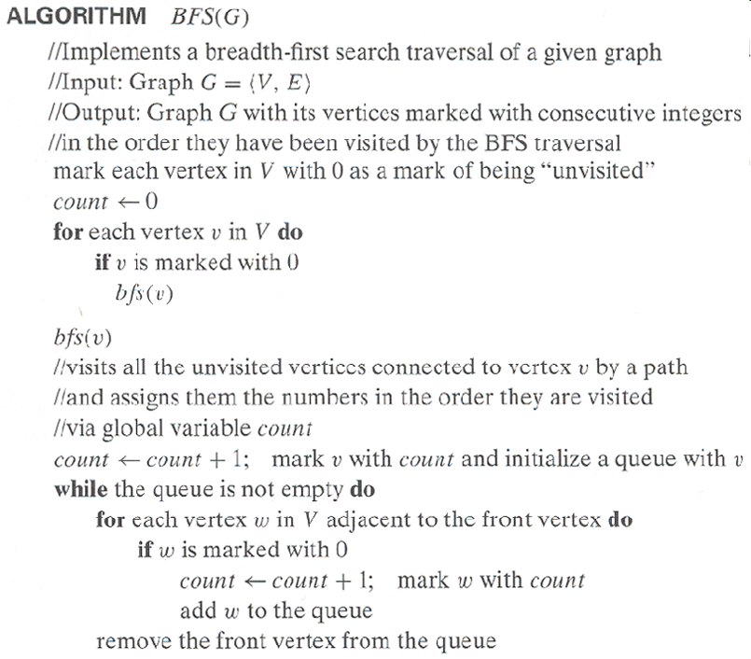
Pseudocode of BFS

Slide 16
Example of BFS traversal of undirected graph
a
b
c
d
a
bef
efg
fg
g
ch
hd
d
e
f
g
h
BFS traversal queue:
BFS tree:
1
2
6
8
a
b
c
d
e
f
g
h
3
4
5
7
Red edges are tree edges and white edges are cross edges.

Slide 17
Notes on BFS
BFS has same efficiency as DFS and can be implemented with graphs represented as:
  adjacency matrices: Θ(|V|²).
  adjacency lists: Θ(|V|+|E|).
Yields single ordering of vertices (order added/deleted from queue is the same)
Applications: same as DFS, but can also find paths from a vertex to all other vertices with the smallest number of edges

Slide 18
DAGs and Topological Sorting
A dag: a directed acyclic graph, i.e. a directed graph with no (directed) cycles
Arise in modeling many problems that involve prerequisite
constraints (construction projects, document version control)
Vertices of a dag can be linearly ordered so that for every edge its starting vertex is listed before its ending vertex (topological sorting). Being a dag is also a necessary condition for topological sorting to be possible.
Tree edge, back edge, forward edge – vertices to their descendents.
a
b
a
b
a dag
not a dag
c
d
c
d

Slide 19
Topological Sorting Example
Order the following items in a food chain
tiger
human
fish
sheep
shrimp
plankton
wheat

Slide 20
DFS-based Algorithm
DFS-based algorithm for topological sorting
  Perform DFS traversal, noting the order in which vertices become dead ends or vertices are popped off the traversal stack
  Reversing the order solves topological sorting problem
  Back edges encountered?→ NOT a dag! (topological sorting is impossible)
Example:
  C5 – 1
  C4 – 2
  C3 – 3
  C1 – 4 C2 – 5
  Popping order C5,C4,C3,C1,C2
  Topological order : C2 C1 -> C3->C4->C5
Efficiency: The same as that of DFS.
C1
C4
C3
C2
C5

Slide 21
Source Removal Algorithm implementation Decrease and conquer
Source removal algorithm
  Repeatedly identify in a remaining graph digraph a source which is a vertex with no incoming edges, and delete it along with all the edges outgoing from it. If there is none stop it. The order in which the vertices are deleted is the solution to the topological sorting
  Example:
  delete C1, Delete C2, C3,C4,C5
  Topological order : C1,C2,C3,C4,C5
Efficiency: same as efficiency of the DFS-based algorithm
C1
C4
C3
C2
C6

Slide 22
Decrease-by-Constant-Factor Algorithms
In this variation of decrease-and-conquer, instance size is reduced by the same factor (typically, 2)
Examples:
Binary search and the method of bisection
Exponentiation by squaring
Multiplication à la russe (Russian peasant method)
Fake-coin puzzle
Josephus problem

Slide 23
Exponentiation by Squaring
The problem: Compute a^{n} where n is a nonnegative integer
The problem can be solved by applying recursively the formulas:
For even values of n
a ^{n} = (a ^{n/2} )² if n > 0 and a ⁰ = 1
For odd values of n
a ^{n} = (a ^{(n-1)/2} )² a
Recurrence: M(n) = M( ⎣n/2⎦ ) + f(n), where f(n) = 1 or 2,
M(0) = 0
Master Theorem: M(n) ∈ Θ(log n) = Θ(b) where b = ⎡log₂(n+1)⎤

Slide 24
Russian Peasant Multiplication
The problem: Compute the product of two positive integers
Can be solved by a decrease-by-half algorithm based on the following formulas.
For even values of n:
n 2
n * m = * 2m
For odd values of n:
n – 1
2
n * m = * 2m + m if n > 1 and m if n = 1

Slide 25
Example of Russian Peasant Multiplication
Compute 20 * 26
n m
20 26
10 52
5 104 104
2 208 +
1 416 416
520
Note: Method reduces to adding m’s values corresponding to
odd n’s.

Slide 26
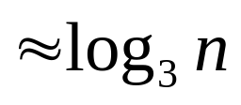
Fake-Coin Puzzle (simpler version)
There are n identically looking coins one of which is fake.
There is a balance scale but there are no weights; the scale can tell whether two sets of coins weigh the same and, if not, which of the two sets is heavier (but not by how much, i.e. 3-way comparison). Design an efficient algorithm for detecting the fake coin. Assume that the fake coin is known to be lighter than the genuine ones.
Decrease by factor 2 algorithm
Decrease by factor 3 algorithm (Q3 on page 187 of Levitin)
T(n) = log n
T(n)

Slide 27
Variable-Size-Decrease Algorithms
In the variable-size-decrease variation of decrease-and-conquer,
instance size reduction varies from one iteration to another
Examples:
Euclid’s algorithm for greatest common divisor
Partition-based algorithm for selection problem
Interpolation search
Some algorithms on binary search trees
Nim and Nim-like games

Slide 28
Euclid’s Algorithm
Euclid’s algorithm is based on repeated application of equality
gcd(m, n) = gcd(n, m mod n)
Ex.: gcd(80,44) = gcd(44,36) = gcd(36, 8) = gcd(8,4) = gcd(4,0) = 4
One can prove that the size, measured by the first number,
decreases at least by half after two consecutive iterations.
Hence, T(n) ∈ O(log n)
Proof. Assume m > n, and consider m and m mod n.
Case 1: n <= m/2. m mod n < n <= m/2.
Case 2: n > m/2. m mod n = m-n < m/2.

Slide 29
Selection Problem
Find the k-th smallest element in a list of n numbers
k = 1 or k = n
median: k = ⎡n/2⎤
Example: 4, 1, 10, 9, 7, 12, 8, 2, 15 median = ?
The median is used in statistics as a measure of an average
value of a sample. In fact, it is a better (more robust) indicator
than the mean, which is used for the same purpose.

Slide 30
Digression: Post Office Location Problem
Given n village locations along a straight highway, where should a new post office be located to minimize the average distance from the villages to the post office?
The average!
In two dimensions with Manhattan distance?
Linear programming!

Slide 31
Algorithms for the Selection Problem
The sorting-based algorithm: Sort and return the k-th element
Efficiency (if sorted by mergesort): Θ(nlog n)
A faster algorithm is based on using the quicksort-like partition of the list. Let s be a split position obtained by a partition (using some pivot):
Assuming that the list is indexed from 1 to n:
If s = k, the problem is solved;
if s > k, look for the k-th smallest element in the left part;
if s < k, look for the (k-s)-th smallest element in the right part.
Note: The algorithm can simply continue until s = k.
all are ≤ A[s]
all are ≥ A[s]
s

Slide 32
Tracing the Median / Selection Algorithm
Example: 4 1 10 9 7 12 8 2 15 Here: n = 9, k = ⎡9/2⎤ = 5
array index 1 2 3 4 5 6 7 8 9
4 1 10 9 7 12 8 2 15
4 1 2 9 7 12 8 10 15
2 1 4 9 7 12 8 10 15 --- s=3 < k=5
9 7 12 8 10 15
9 7 8 12 10 15
8 7 9 12 10 15 --- s=6 > k=5
8 7
7 8 --- s=k=5
Solution: median is 8

Slide 33
Efficiency of the Partition-based Algorithm
Average case (average split in the middle):
C(n) = C(n/2)+(n+1) C(n) ∈ Θ(n)
Worst case (degenerate split): C(n) ∈ Θ(n²)
A more sophisticated choice of the pivot leads to a complicated algorithm with Θ(n) worst-case efficiency. Details can be found in CLRS, Ch 9.3.

Slide 34
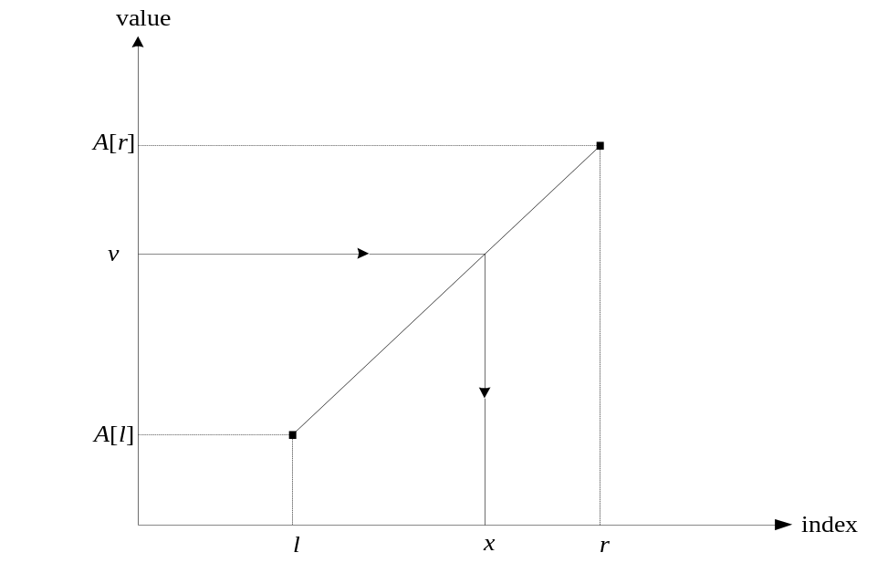
Interpolation Search
Searches a sorted array similar to binary search but estimates location of the search key in A[l..r] by using its value v. Specifically, the values of the array’s elements are assumed to grow linearly from A[l] to A[r] and the location of v is estimated as the x-coordinate of the point on the straight line through (l, A[l]) and (r, A[r]) whose y-coordinate is v:
x = l + ⎣(v - A[l])(r - l)/(A[r] – A[l] )⎦

Slide 35
Analysis of Interpolation Search
Efficiency
average case: C(n) < log₂ log₂ n + 1 (from “rounding errors”)
worst case: C(n) = n
Preferable to binary search only for VERY large arrays and/or expensive comparisons
Has a counterpart, the method of false position (regula falsi), for solving equations in one unknown (Sec. 12.4)

Slide 36
Binary Search Tree Algorithms
Several algorithms on BST requires recursive processing of just one of its subtrees, e.g.,
Searching
Insertion of a new key
Finding the smallest (or the largest) key
k
<k
>k

Slide 37
Searching in Binary Search Tree
Algorithm BST(x, v)
//Searches for node with key equal to v in BST rooted at node x
if x = NIL return -1
else if v = K(x) return x
else if v < K(x) return BST(left(x), v)
else return BST(right(x), v)
Efficiency
worst case: C(n) = n
average case: C(n) ≈ 2ln n ≈ 1.39log₂ n, if the BST was built from n random keys and v is chosen randomly.

Slide 38
One-Pile Nim
There is a pile of n chips. Two players take turn by removing from the pile at least 1 and at most m chips. (The number of chips taken can vary from move to move.) The winner is the player that takes the last chip. Who wins the game – the player moving first or second, if both player make the best moves possible?
It’s a good idea to analyze this and similar games “backwards”, i.e., starting with n = 0, 1, 2, …

Slide 39
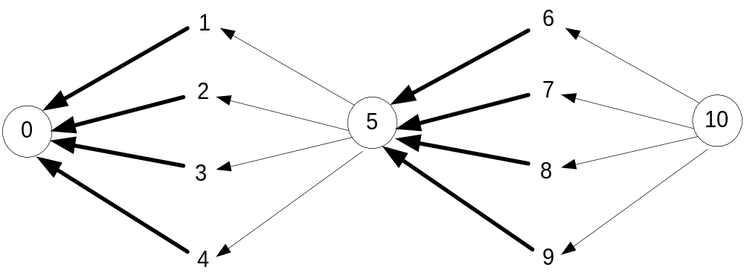
Partial Graph of One-Pile Nim with m = 4
Vertex numbers indicate n, the number of chips in the pile. The losing positions for the player to move are circled. Only winning moves from a winning position are shown (in bold).
Generalization: The player moving first wins iff n is not a
multiple of 5 (more generally, m+1); the
winning move is to take n mod 5 (n mod (m+1))
chips on every move.

