Slide 1
Dynamic Programming

Slide 2
Dynamic Programming
Dynamic Programming is a general algorithm design technique
for solving problems with overlapping sub problems.
Invented by American mathematician Richard Bellman in the 1950s to solve optimization problems
Main idea:
    set up a recurrence relating a solution to a given problem with solutions to its smaller sub problems of same type
    - solve smaller instances once
    record solutions in a table
    extract solution to the initial instance from that table

Slide 3
Example: Fibonacci numbers
Recall definition of Fibonacci numbers:
  F(n) = F(n-1) + F(n-2)
  F(0) = 0
  F(1) = 1
Computing the n^{th} Fibonacci number recursively (top-down):
F(n)
F(n-1) + F(n-2)
F(n-2) + F(n-3) F(n-3) + F(n-4)
...

Slide 4
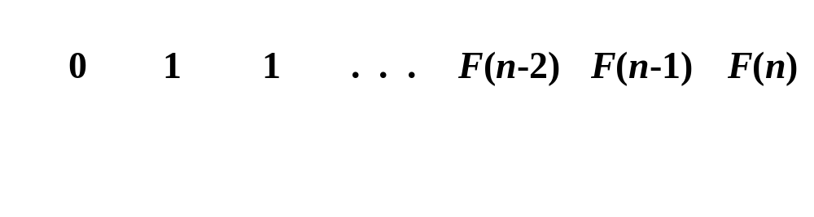
Example: Fibonacci numbers (cont.)
  Computing the n^{th} Fibonacci number using bottom-up iteration and recording results:
F(0) = 0
F(1) = 1
F(2) = 1+0 = 1
…
F(n-2) =
F(n-1) =
F(n) = F(n-1) + F(n-2)
Efficiency:
- time
- space
n
n

Slide 5
Examples of DP algorithms
Computing a binomial coefficient
Warshall’s algorithm for transitive closure
Floyd’s algorithm for all-pairs shortest paths
Constructing an optimal binary search tree
Some instances of difficult discrete optimization problems:
  - traveling salesman
  - knapsack

Slide 6
Computing a binomial coefficient by DP
  Binomial coefficients or coefficients of the binomial formula:
  (a + b)^{n} = C(n,0)a^{n}b⁰ + . . . + C(n,k)a^{n-k}b^{k} + . . . + C(n,n)a⁰b^{n}
  Recurrence: C(n,k) = C(n-1,k) + C(n-1,k-1) for n > k > 0
  and initial condition C(n,0) = 1, C(n,n) = 1 for n ≥ 0
  Value of C(n,k) can be computed by filling a table:
  0 1 2 . . . k-1 k
  0 1
  1 1 1
  .
  .
  .
  n-1 C(n-1,k-1) C(n-1,k)
  n C(n,k)

Slide 7

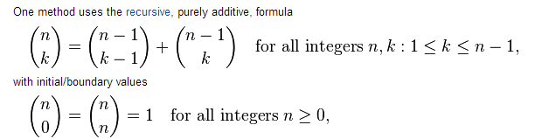

Slide 8
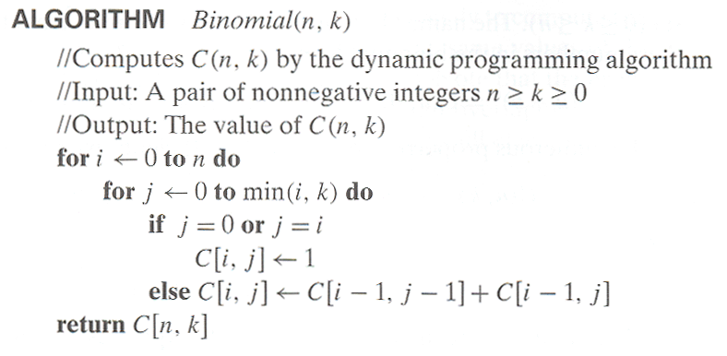
Computing C(n,k): pseudocode and analysis
A(n,k) = i=1…k j=1….i-1(1) + i=k+1….n j=1….k(1)
i=1…k(i-1) + i=k+1….n(k) = k(k-1)/2+k(n-k) = Θ(nk)
Time efficiency: Θ(nk)

Slide 9
Knapsack Problem by DP
Given n items of
  integer weights: w₁ w₂ … w_{n}
  values: v₁ v₂ … v_{n}
a knapsack of integer capacity W
find most valuable subset of the items that fit into the knapsack
Consider instance defined by first i items and capacity j (j ≤ W).
Let V[i,j] be optimal value of such an instance. Then
max {V[i-1,j], v_{i} + V[i-1,j- w_{i}]} if j- w_{i} ≥ 0
V[i,j] =
V[i-1,j] if j- w_{i} < 0
Initial conditions: V[0,j] = 0 and V[i,0] = 0
{

Slide 10
Knapsack Problem by DP (example)
Example: Knapsack of capacity W = 5
item weight value
1 2 $12
2 1 $10
3 3 $20
4 2 $15 capacity j
0 1 2 3 4 5
0
w₁ = 2, v₁= 12 1
w₂ = 1, v₂= 10 2
w₃ = 3, v₃= 20 3
w₄ = 2, v₄= 15 4 ?
0 0 0
0 0 12
0 10 12
22 22 22
0 10 12 22 30 32
0 10 15 25 30 37
Backtracing finds the actual optimal subset, i.e. solution.

Slide 11
Knapsack Problem by DP (pseudocode)
Algorithm DPKnapsack(w[1..n], v[1..n], W)
var V[0..n,0..W], P[1..n,1..W]: int
for j := 0 to W do
V[0,j] := 0
for i := 0 to n do
V[i,0] := 0
for i := 0 to n do
for j := 0 to W do
if w[i] ≤ j and v[i] + V[i-1,j-w[i]] > V[i-1,j] then
V[i,j] := v[i] + V[i-1,j-w[i]]; P[i,j] := j-w[i]
else
V[i,j] := V[i-1,j]; P[i,j] := j
return V[n,W] and the optimal subset by backtracking
Running time O(nW).

Slide 12
Time Efficiency
I = 0 to n and j=0 to m from this
F(n,m) = ∑i=0ton ∑j=0 to m (1) → bop (i.e) V[i,j]
i=0ton∑m-0+1 = i=0to n ∑ (m+1)
(m+1) i=0 to n∑ 1
(m+1)(n-0+1)
(m+1)(n+1) = mn+m+n+1 for large value of m and n we will get Ө(mn)

Slide 13
Warshall’s Algorithm: Transitive Closure
Computes the transitive closure of a directed graph
Alternatively: existence of all nontrivial paths in a digraph
Example of transitive closure:
3
3
1
1
4
4
0 0 1 0
1 1 1 1
0 0 0 0
1 1 1 1
2
0 0 1 0
1 0 0 1
0 0 0 0
0 1 0 0
2

Slide 14
Transitive closure : it is a n by n boolean matrix T={t_{ij}}, in which element in the ith row and jth column id 1 if there is exist a nontrivial(directed path of a positive length) directed path from ith vertex to the jth vertex otherwise 0.
Constructs transitive closure T as the last matrix in the sequence of n-by-n matrices R⁽⁰⁾, … , R^{(k)}, … , R^{(n)} where
R^{(k)}[i,j] = 1 iff there is nontrivial path from i to j with only the first k vertices allowed as intermediate
Note that R⁽⁰⁾ = A (adjacency matrix), R^{(n)} = T (transitive closure)

Slide 15
Warshall’s Algorithm (matrix generation)
Recurrence relating elements R^{(k)} to elements of R^{(k-1)} is:
      R^{(k)}[i,j] = R^{(k-1)}[i,j] or (R^{(k-1)}[i,k] and R^{(k-1)}[k,j])
It implies the following rules for generating R^{(k)} from R^{(k-1)}:
Rule 1 If an element in row i and column j is 1 in R^{(k-1)},
it remains 1 in R^{(k)}
Rule 2 If an element in row i and column j is 0 in R^{(k-1)},
it has to be changed to 1 in R^{(k)} if and only if
the element in its row i and column k and the element
in its column j and row k are both 1’s in R^{(k-1)}

Slide 16
Warshall’s Algorithm (example)
3
0 0 1 0
1 0 0 1
0 0 0 0
0 1 0 0
0 0 1 0
1 0 1 1
0 0 0 0
0 1 0 0
1
R⁽⁰⁾ ⁼
R⁽¹⁾ ⁼
2
4
0 0 1 0
1 0 1 1
0 0 0 0
1 1 1 1
0 0 1 0
1 0 1 1
0 0 0 0
1 1 1 1
0 0 1 0
1 1 1 1
0 0 0 0
1 1 1 1
R⁽²⁾ ⁼
R⁽³⁾ ⁼
R⁽⁴⁾ ⁼

Slide 17
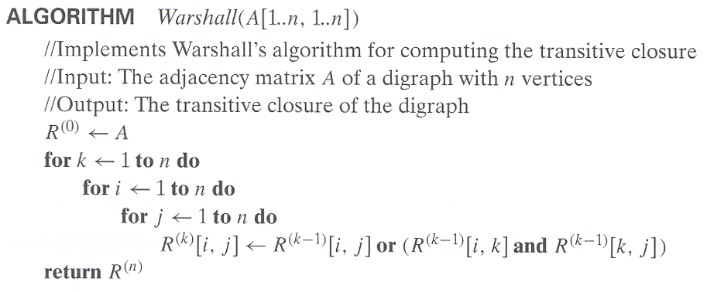
Warshall’s Algorithm (pseudocode and analysis)
Time efficiency: Θ(n³)

Slide 18
Floyd’s Algorithm: All pairs shortest paths
Problem: In a weighted (di)graph, find shortest paths between
every pair of vertices
Same idea: construct solution through series of matrices D⁽⁰⁾, …,
D ^{(n)} using increasing subsets of the vertices allowed
as intermediate
Example:
4
3
1
0 ∞ 4 ∞
1 0 4 3 ∞ ∞ 0 ∞
6 5 1 0
1
6
1
5
4
2
3

Slide 19
Floyd’s Algorithm (matrix generation)
Distance Matrix : it is a n by n matrix to record the lengths of shortest paths. The element d_{ij} in the i_{th} row and j_{th} column of this matrix indicates the length of the shortest path from the i_{th} vertex to the j_{th} vertex.
On the k-th iteration, the algorithm determines shortest paths between every pair of vertices i, j that use only vertices among 1,…,k as intermediate
D^{(k)}[i,j] = min {D^{(k-1)}[i,j], D^{(k-1)}[i,k] + D^{(k-1)}[k,j]}

Slide 20
Floyd’s Algorithm (example)
2
1
2
0 ∞ 3 ∞ 2 0 ∞ ∞
∞ 7 0 1
6 ∞ ∞ 0
0 ∞ 3 ∞
2 0 5 ∞
∞ 7 0 1
6 ∞ 9 0
3
6
7
D⁽⁰⁾ ⁼
D⁽¹⁾ ⁼
3
1
4
0 ∞ 3 ∞
2 0 5 ∞
9 7 0 1
6 ∞ 9 0
0 10 3 4
2 0 5 6
9 7 0 1
6 16 9 0
0 10 3 4
2 0 5 6
7 7 0 1
6 16 9 0
D⁽²⁾ ⁼
D⁽³⁾ ⁼
D⁽⁴⁾ ⁼

Slide 21
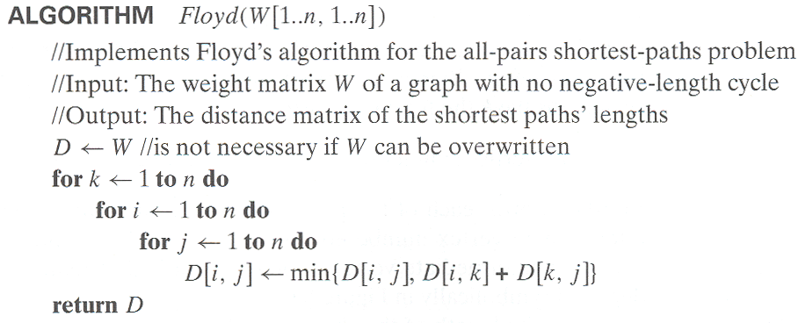
Floyd’s Algorithm (pseudocode and analysis)
Time efficiency: Θ(n³)

Slide 22
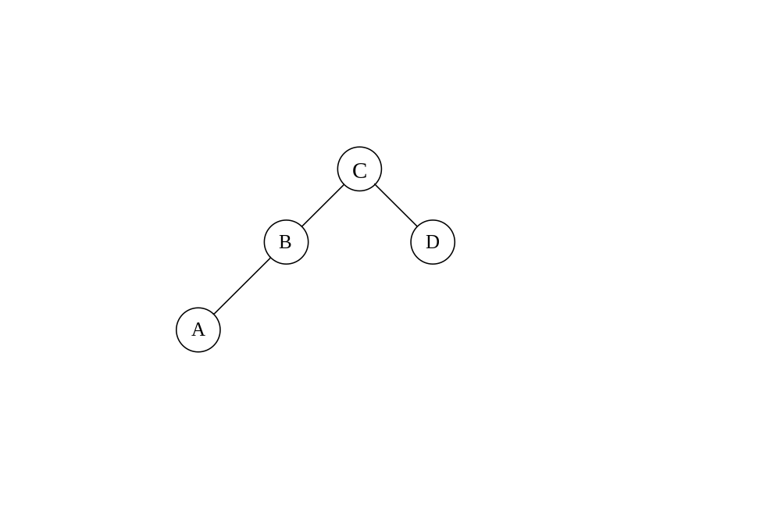
Optimal Binary Search Trees
Problem: Given n keys a₁ < …< a_{n} and probabilities p₁, …, p_{n}
searching for them, find a BST with a minimum
average number of comparisons in successful search.
Example: What is an optimal BST for keys A, B, C, and D with
search probabilities 0.1, 0.2, 0.4, and 0.3, respectively?

Slide 23
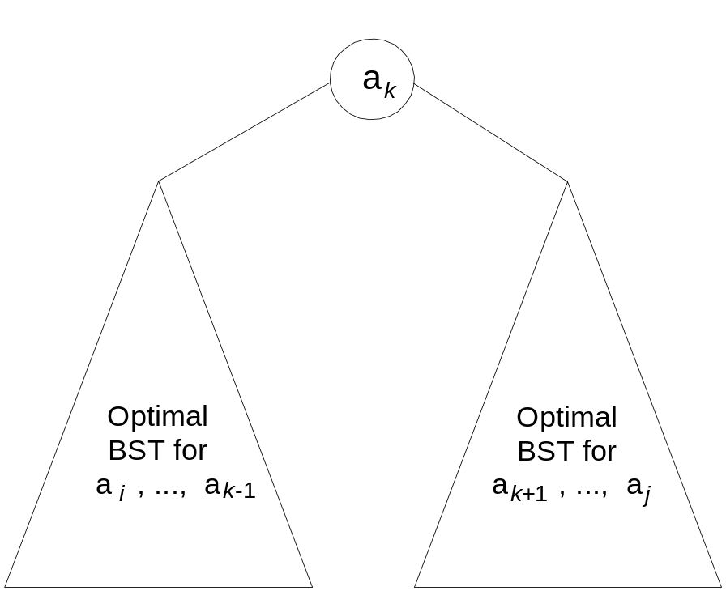
DP for Optimal BST Problem
Let C[i,j] be minimum average number of comparisons made in T[i,j], optimal BST for keys a_{i} < …< a_{j} , where 1 ≤ i ≤ j ≤ n. Consider optimal BST among all BSTs with some a_{k} (i ≤ k ≤ j ) as their root; T[i,j] is the best among them.
C[i,j] =
min {
∑ p_{s} (level a_{s} in T[i,k-1] +1) +
∑ p_{s} (level a_{s} in T[k+1,j] +1)}
i ≤ k ≤ j
k-1
s = i
j
s =k+1

Slide 24
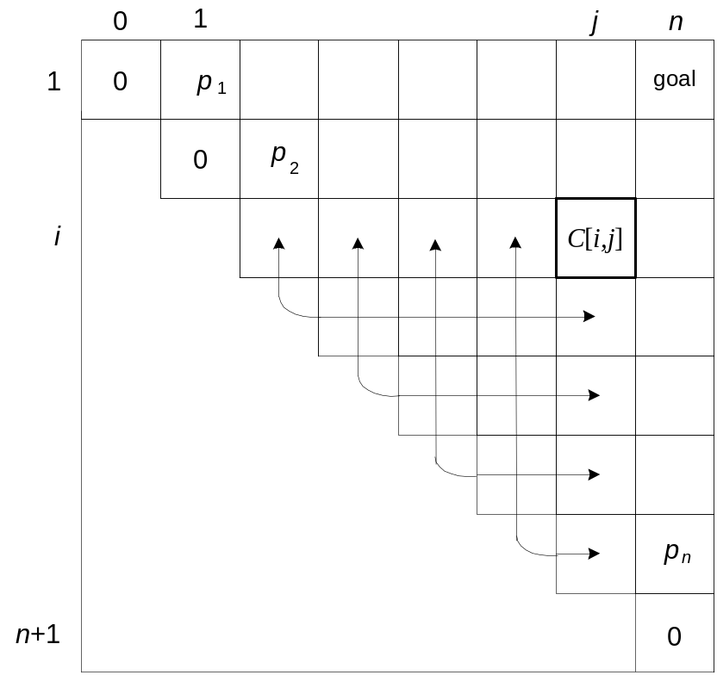
DP for Optimal BST Problem (cont.)
After simplifications, we obtain the recurrence for C[i,j]:
C[i,j] = min {C[i,k-1] + C[k+1,j]} + ∑ p_{s} for 1 ≤ i ≤ j ≤ n
C[i,i] = p_{i} for 1 ≤ i ≤ j ≤ n
j
i ≤ k ≤ j
s = i

Slide 25
Example: key A B C D
probability 0.1 0.2 0.4 0.3
The tables below are filled diagonal by diagonal: the left one is filled using the recurrence
C[i,j] = min {C[i,k-1] + C[k+1,j]} + ∑ p_{s ,} C[i,i] = p_{i} ;
the right one, for trees’ roots, records k’s values giving the minima
j
i ≤ k ≤ j
s = i
_{i} ^{j}
 | 0 | 1 | 2 | 3 | 4
1 | 0 | .1 | .4 | 1.1 | 1.7
2 |  | 0 | .2 | .8 | 1.4
3 |  |  | 0 | .4 | 1.0
4 |  |  |  | 0 | .3
5 |  |  |  |  | 0
_{i} ^{j}
 | 0 | 1 | 2 | 3 | 4
1 |  | 1 | 2 | 3 | 3
2 |  |  | 2 | 3 | 3
3 |  |  |  | 3 | 3
4 |  |  |  |  | 4
5
C
B
D
A
optimal BST

Slide 26
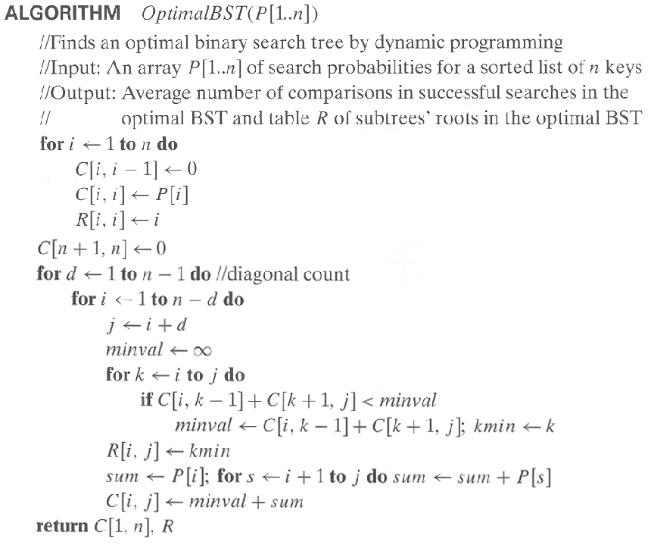
Optimal Binary Search Trees

Slide 27
Analysis DP for Optimal BST Problem
Time efficiency: Θ(n³)

