Slide 1
Technical Session III Python-Mysql Connectivity

Slide 2
Database Connectivity
Python Database API supports a wide range of database servers: –
mySQL
PostgreSQL
Microsoft SQL Server 2000
Informix
Interbase
Oracle
Sybase

Slide 3
Step 1 – database import
error
Import modules for database in your python program.
Mysql
import MySQLdb
Traceback (most recent call last): File "test.py", line 3, in import MySQLdb ImportError: No module named MySQLdb

Slide 4
Basic requirements
XAMPP (For Mysql)
Mysql Connector –
https://anaconda.org/bioconda/mysqlclient
Mysql workbench (Optional****)
conda install -c bioconda mysqlclient

Slide 5
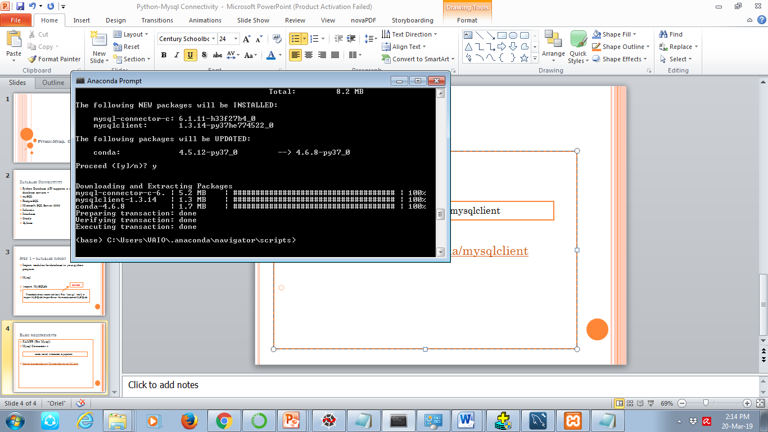

Slide 6
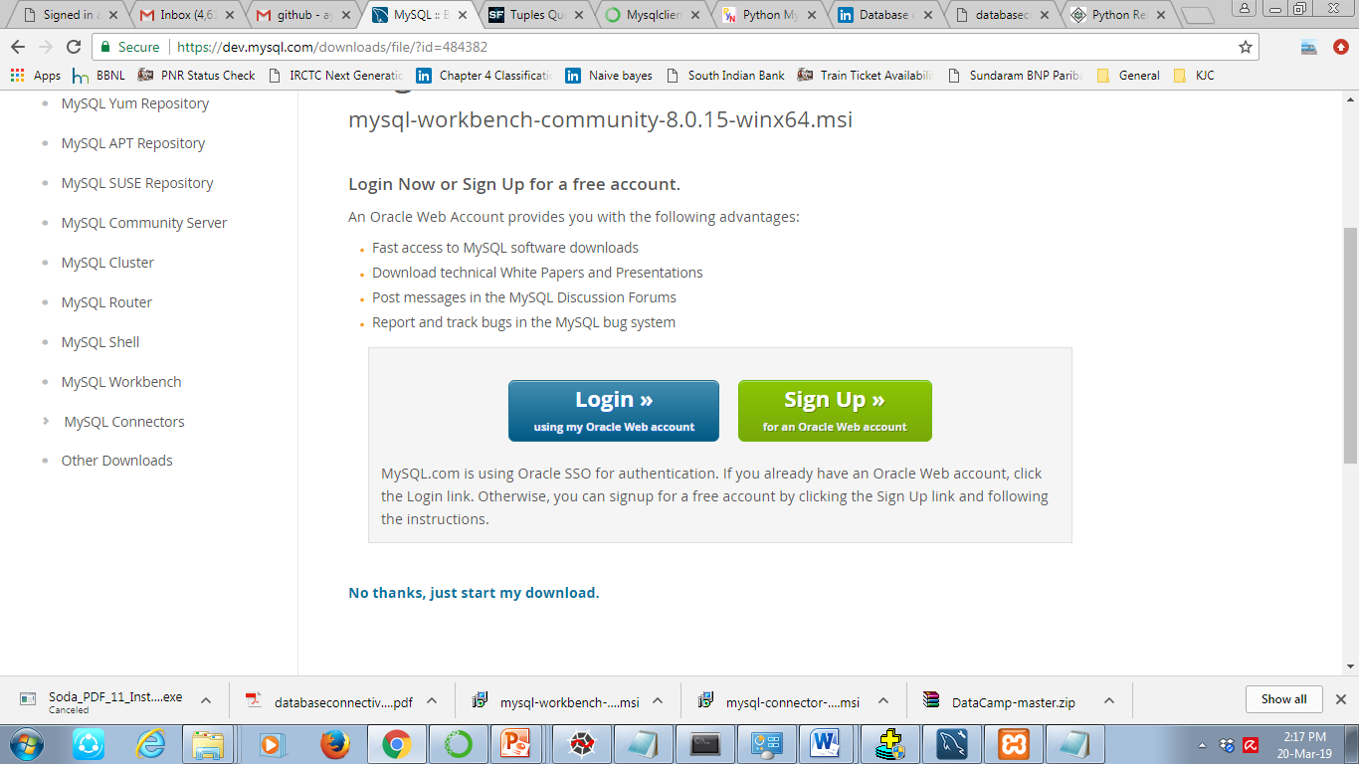

Slide 7
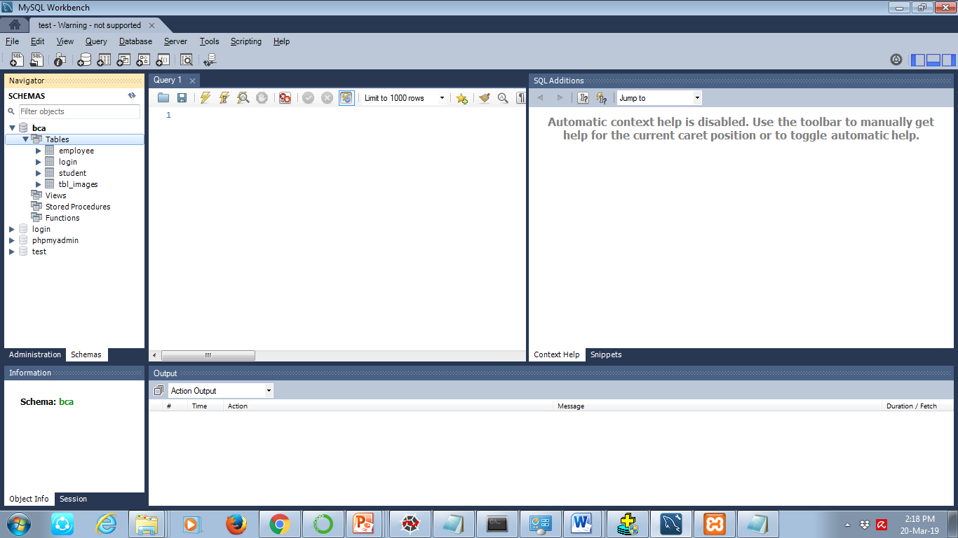

Slide 8
Step 2 – Establishing connection
Open a database connection with your program using connect()
------Mysql
db = MySQLdb.connect(user=‘root', password=‘root', host=‘localhost', database=‘test' )
db = MySQLdb.connect(user=‘root', password=‘ ', host=‘localhost', database=‘bca' )

Slide 9
Step 3 – Creating cursor object
We need to create the object of a class called cursor that allows Python code to execute database command in a database session.
Cursors are created by the connection.cursor() method
They are bound to the connection for the entire lifetime.
cursor = db.cursor()

Slide 10
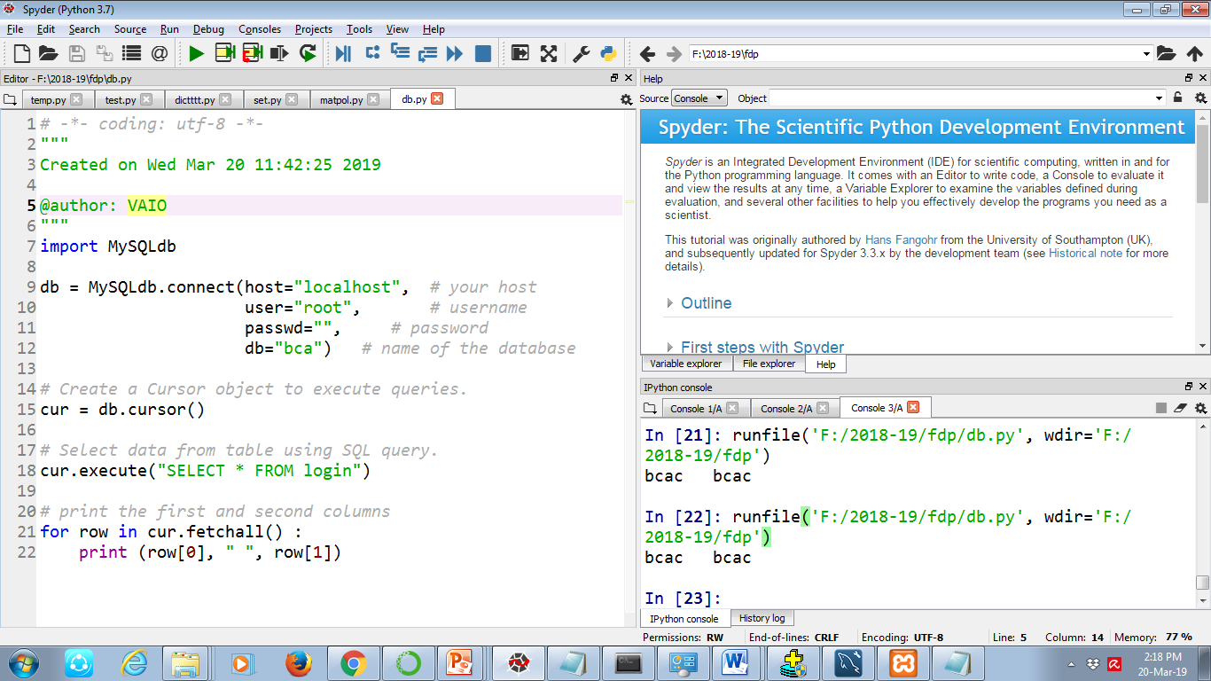

Slide 11
Step 4 -Execute SQL query
We can execute the sql queries from python program using execute() method associated with cursor object .
Examples –
cursor.execute("SELECT * from tbl_student“)

Slide 12
Step 5 – Fetch data from database
MySQLdb provides multiple ways to retrieve data such as:
fetchall()
.fetchmany(size)
fetchone()

Slide 13
Python - Functions

Slide 14
definition
A function is a block of organized, reusable code that is used to perform a single, related action.
Built-in Function
User-defined Function

Slide 15
def functionname( parameters ): "function_docstring“
function_suite
return [expression]
def printme( str ):
#"This prints a passed string into this function" print str
return

Slide 16
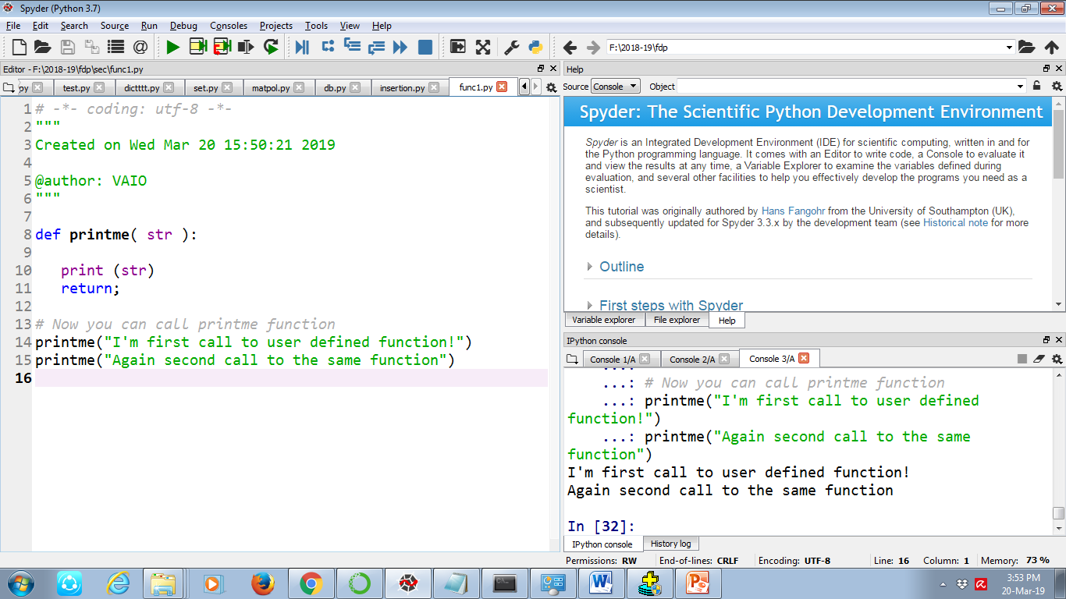

Slide 17
Function Arguments
We can call a function by using the following types of formal arguments −
Required arguments
Keyword arguments
Default arguments
Variable-length arguments

Slide 18
Required arguments
They are the arguments passed to a function in correct positional order.

Slide 19
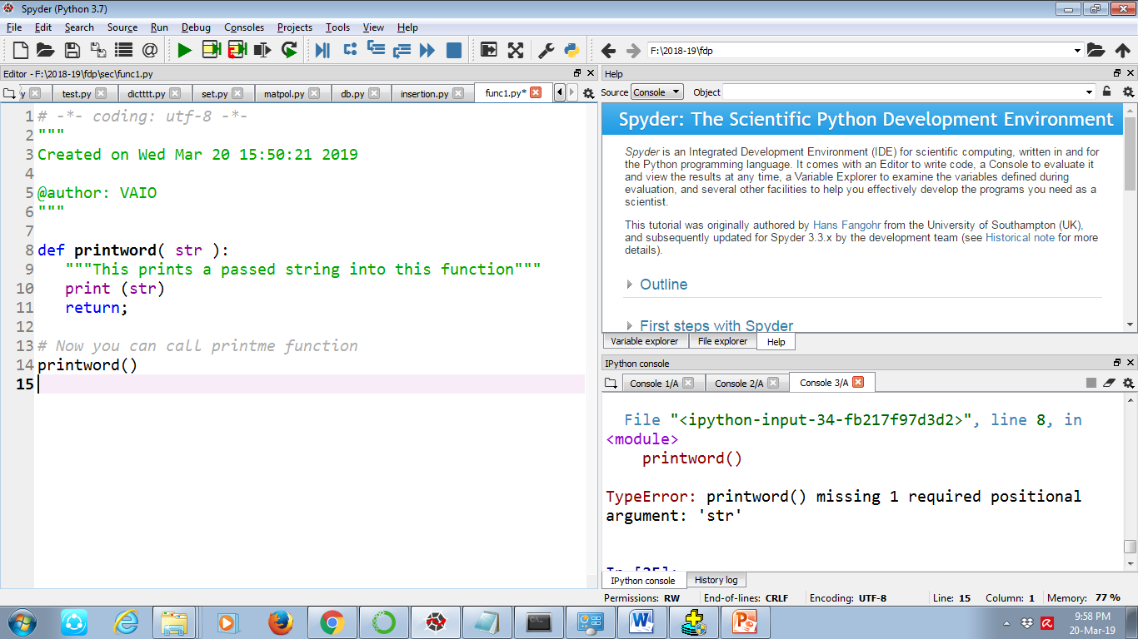

Slide 20
Keyword arguments
Keyword arguments are related to the function calls.
When we use keyword arguments in a function call, the caller identifies the arguments by the parameter name.

Slide 21
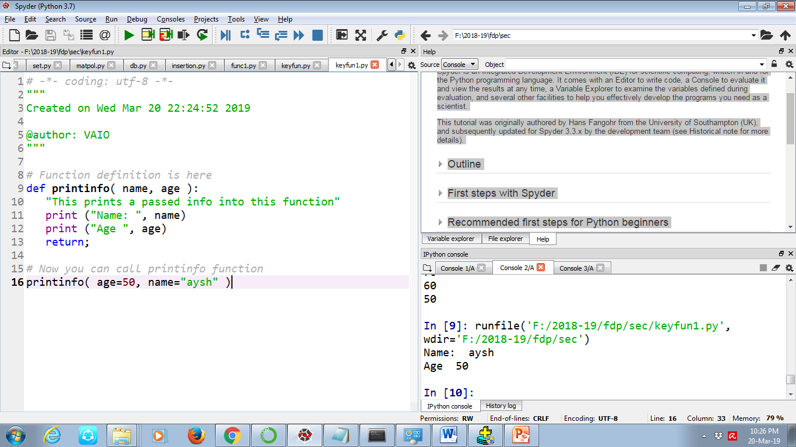

Slide 22
Default arguments
A default argument is an argument that assumes a default value if a value is not provided in the function call for that argument.

Slide 23
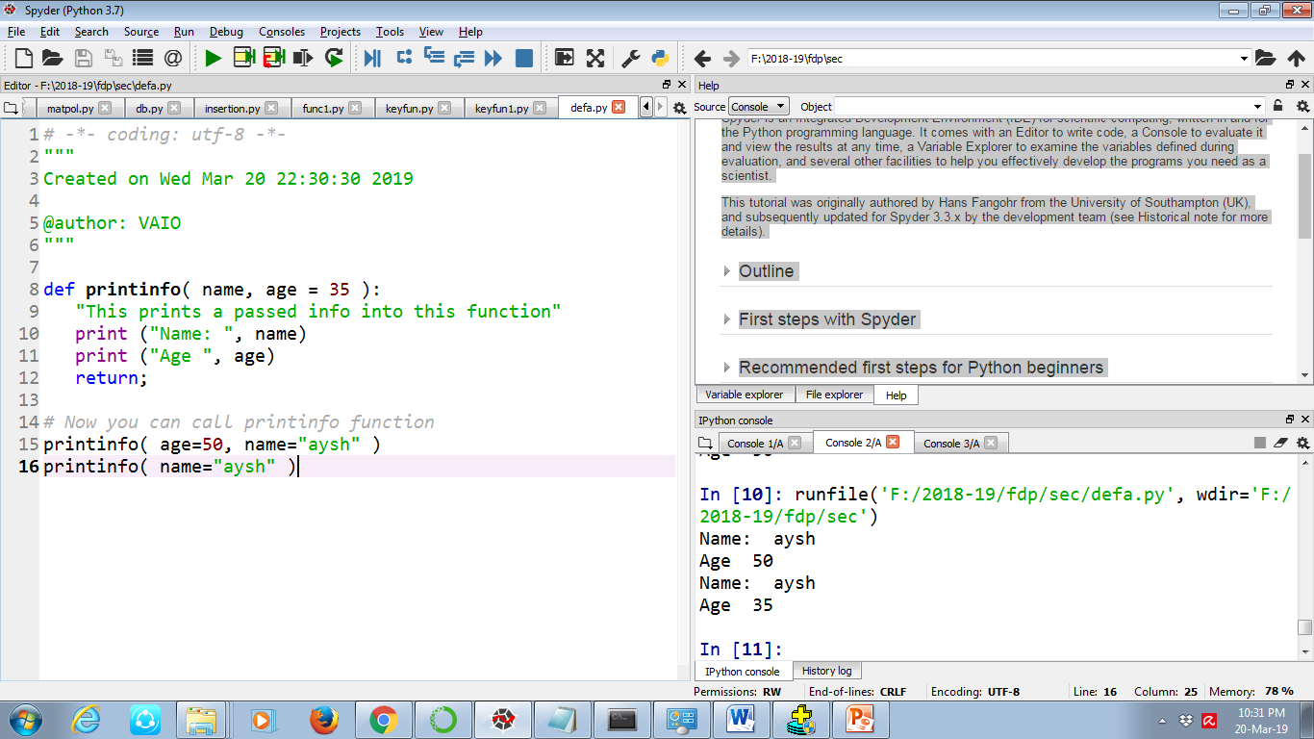

Slide 24
Variable-length arguments
You may need to process a function for more arguments than you specified while defining the function. These arguments are called variable-length arguments

Slide 25
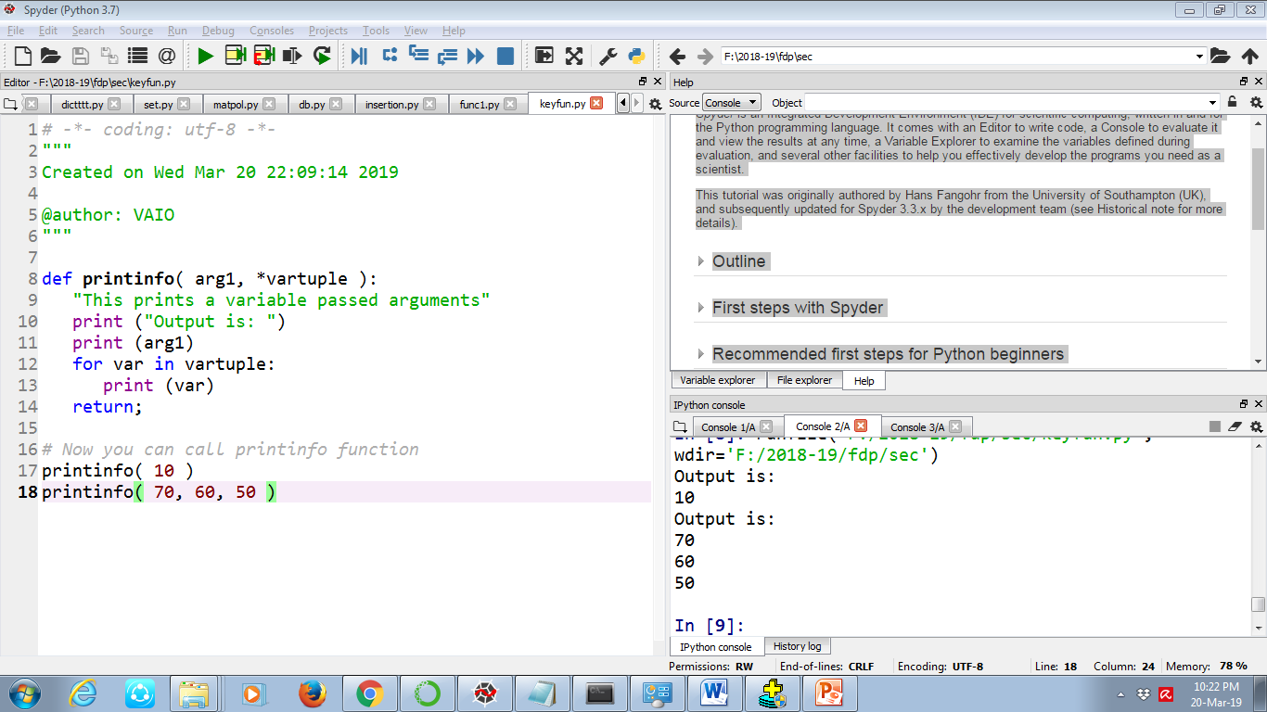

Slide 26
The Anonymous Functions
These functions are called anonymous because they are not declared in the standard manner by using the def keyword.
we can use the lambda keyword to create small anonymous functions.
lambda function can take any number of arguments, but can only have one expression.
lambda arguments : expression
x = lambda a : a + 10
print(x(5))

Slide 27
Example use with filter()
The filter() function in Python takes in a function and a list as arguments.
The function is called with all the items in the list and a new list is returned which contains items for which the function evaluates to True.

Slide 28
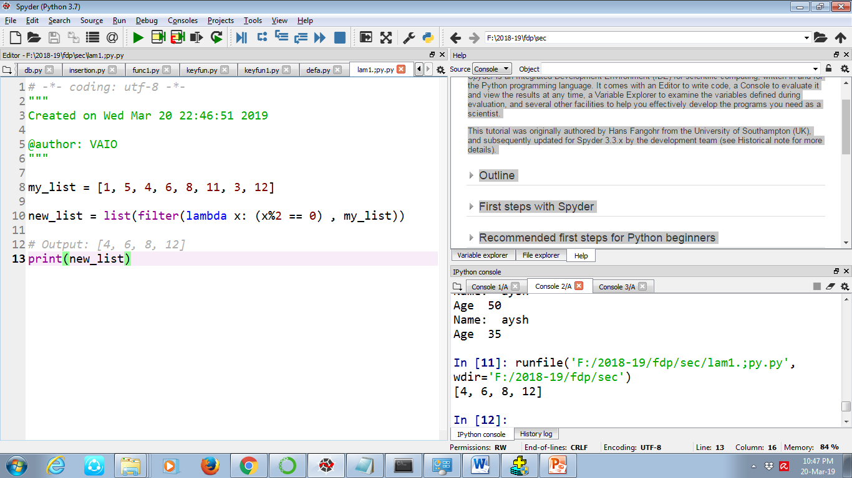

Slide 29
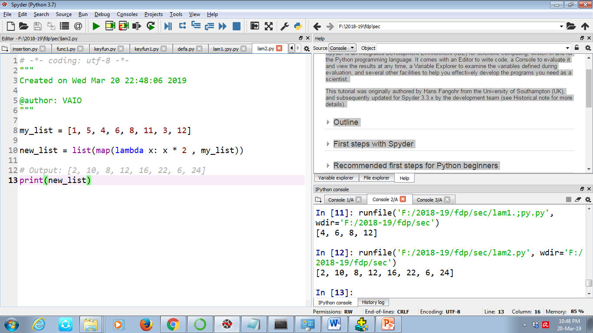

Slide 30
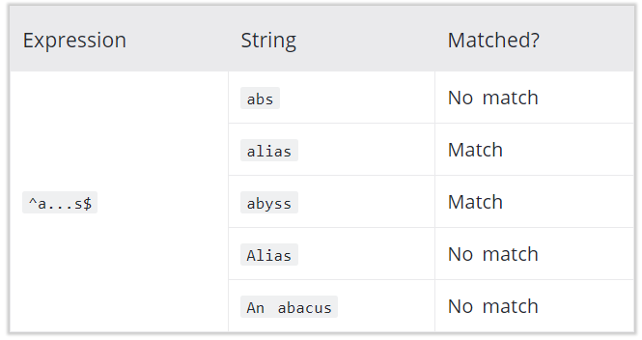
Regular Expressions
A Regular Expression (RegEx) is a sequence of characters that defines a search pattern.
pattern is: any five letter string starting with a and ending with s.
^a...s$
A pattern defined using RegEx can be used to match against a string
Metacharacters:
To specify regular expressions, metacharacters are used. In the above example, ^ and $ are metacharacters.
] . ^ $ * + ? {} () \ | are list of metacharacters
re.match() function to search pattern within the test_string.
The method returns a match object if the search is successful. If not, it returns None.

Slide 31
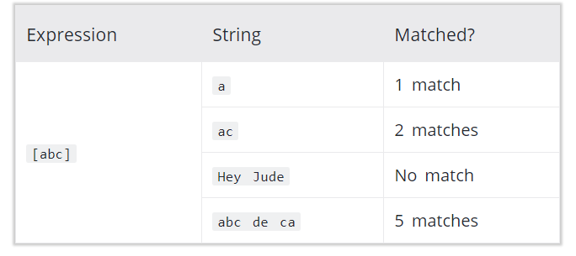
[] - Square brackets
We can also specify range of characters
[a-e] is the same as [abcde].
[1-4] is the same as [1234].
[0-39] is the same as [01239]
Complement (invert) the character set by using caret ^ symbol at the start of a square-bracket.
[^abc] means any character except a or b or c.
[^0-9] means any non-digit character.
specifies a set of characters you wish to match.

Slide 32
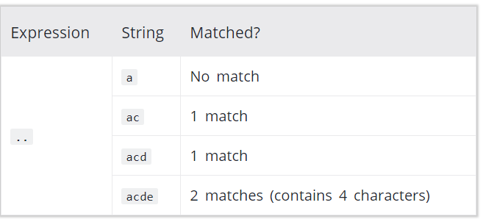
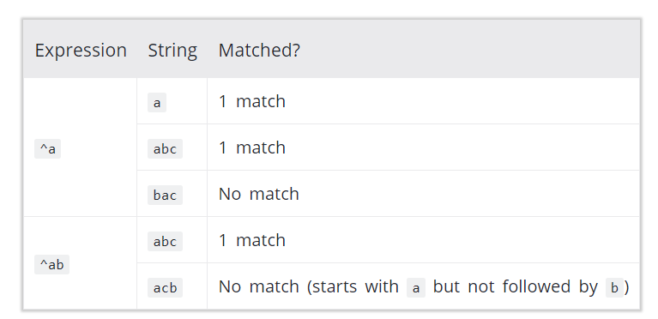
^ Caret
.
. period
A period matches any single character (except newline '\n').
The caret symbol ^ is used to check if a string starts with a certain character.

Slide 33
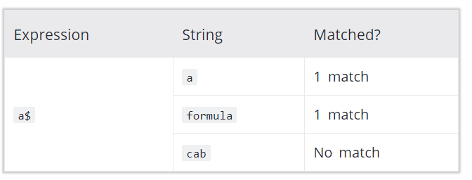
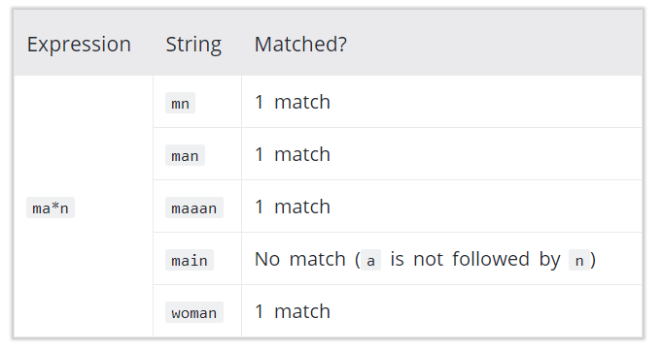
$ Dollar
* Star
The dollar symbol $ is used to check if a string ends with a certain character.
star symbol * matches zero or more occurrences of the pattern left to it.

Slide 34
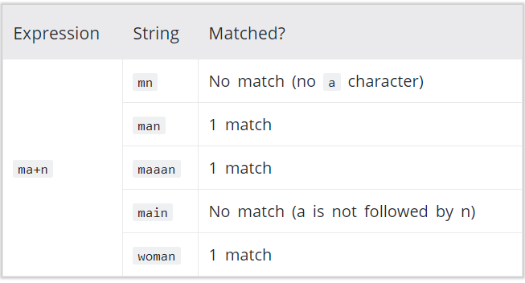
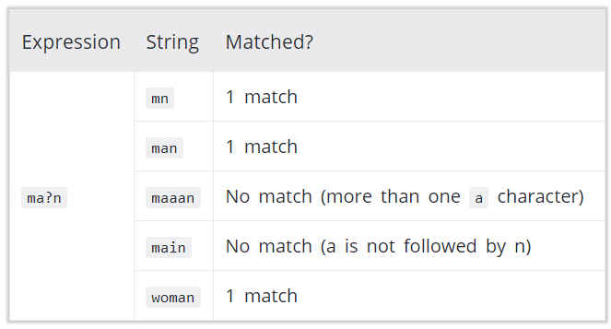
+ Plus
? Question mark
The plus symbol + matches one or more
occurrences of the pattern left to it
The question mark symbol ? matches zero or one
occurrence of the pattern left to it.

Slide 35
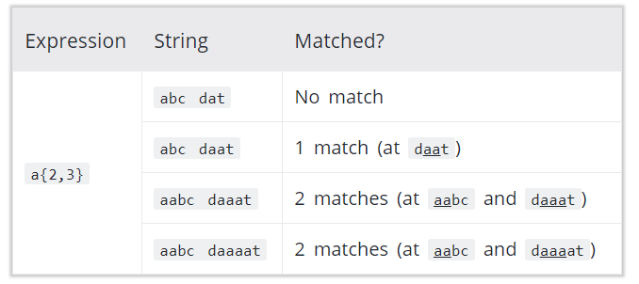
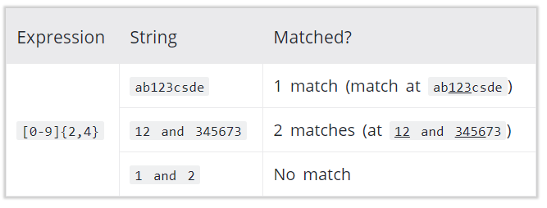
{}- Braces
Example : RegEx [0-9]{2, 4} matches at least 2
digits but not more than 4 digits
Consider this code: {n,m}. This means at least n, and at most m repetitions of the pattern left to it.

Slide 36
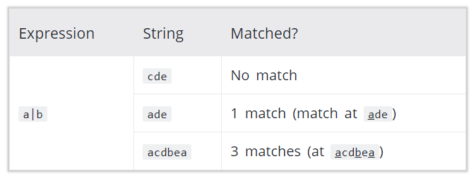
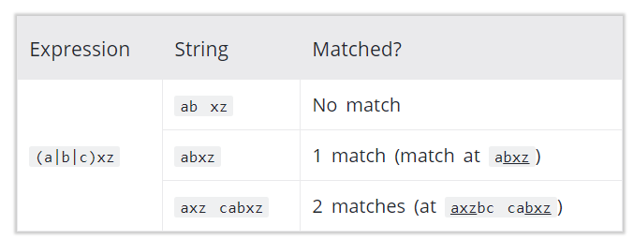
() - Group
| - Alternation
Vertical bar | is used for alternation (or operator)
Here, a|b match any string that contains either a or b
Example : RegEx [0-9]{2, 4} matches at least 2
digits but not more than 4 digits

Slide 37
\ - Backslash
Vertical bar | is used for alternation (or operator)
Here, a|b match any string that contains either a or b

Slide 38
Backlash \
Backlash \ is used to escape various characters
including all metacharacters.
For example,
\$a match if a string contains $ followed by a.
Here, $ is not interpreted by a RegEx engine in a special way.
If you are unsure if a character has special meaning or not,
you can put \ in front of it.
This makes sure the character is not treated in a special way.

Slide 39
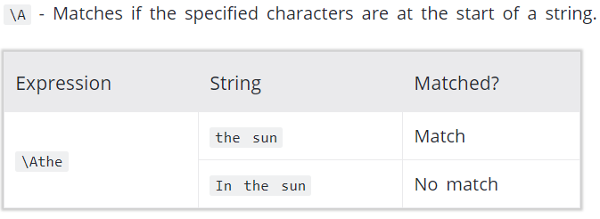
Special Sequences
Special sequences make commonly used patterns easier to write.
List of special sequences:
\A, \b,\B,\d,\D, \s,\S,\w,\W,\Z

Slide 40
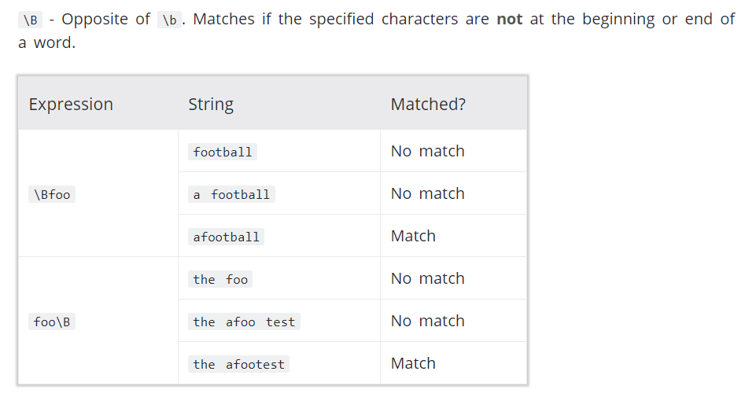
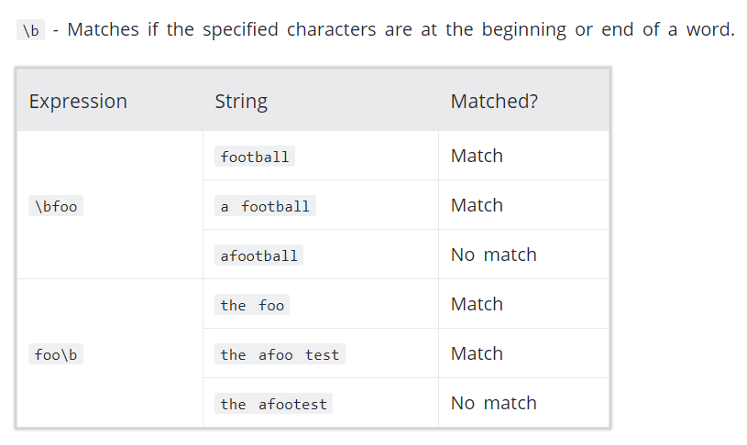
Special Sequences Cont..

Slide 41
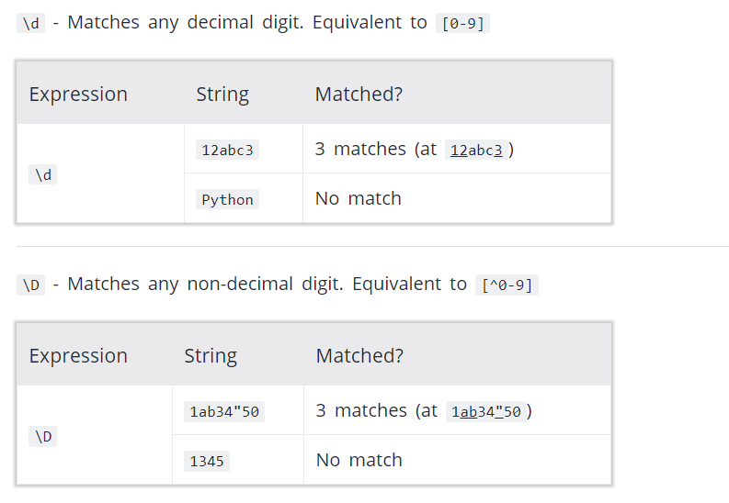
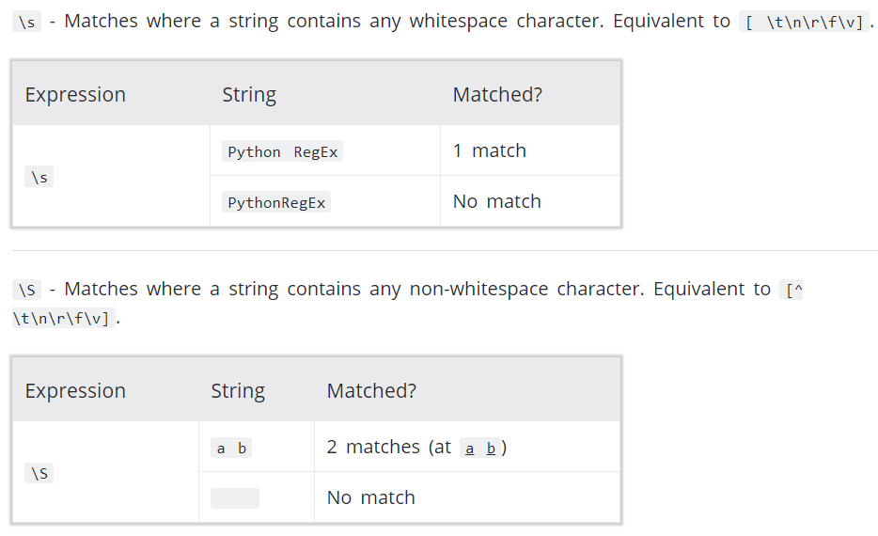
Special Sequences Cont..

Slide 42
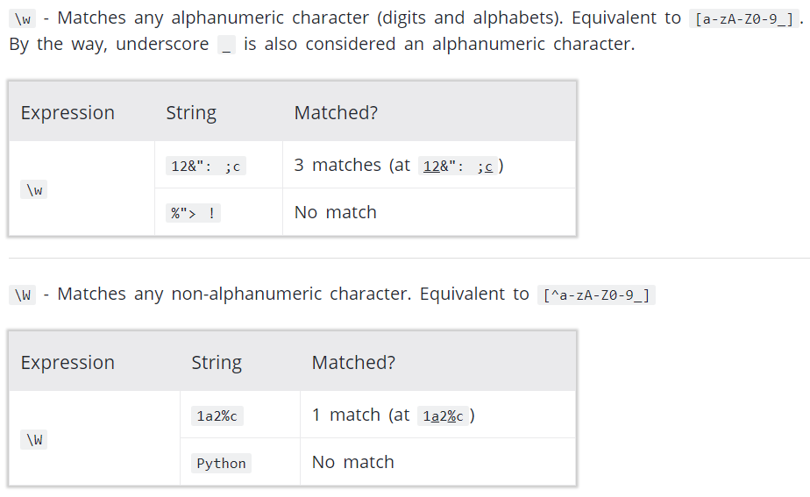
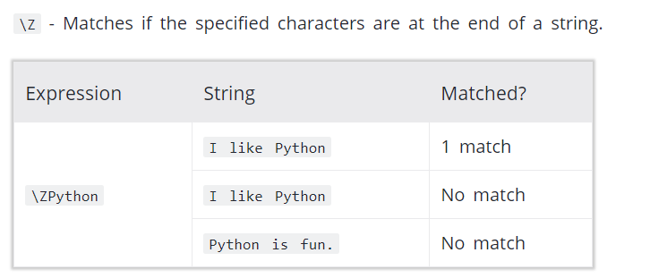
Special Sequences Cont..

Slide 43
RE
Python has a module named re to work with regular expressions
Import re
re.findall()-re.findall() method returns a list of strings containing all matches.
if the pattern is not found,
re.findall() returns an empty list.
re.split()
The re.split method splits the string where there is a match and returns a list of strings where the splits have occurred.
If the pattern is no found, re.split() returns a list containing an empty string.
You can pass maxsplit argument to the re.split() method. It's the maximum number of splits that will occur.

Slide 44
re.sub()
re.sub(pattern, replace, string)
The method returns a string where matched occurrences are replaced with the content of replace variable.
If the pattern is no found, re.sub() returns the original string.
You can pass count as a fourth parameter to the re.sub() method. If omited, it results to 0. This will replace all occurrences.
re.subn()
The re.subn() is similar to re.sub() expect it returns a tuple of 2 items containing the new string and the number of substitutions made.

Slide 45
re.search()
The re.search() method takes two arguments: a pattern and a string.
The method looks for the first location where the RegEx pattern produces a match with the string.
If the search is successful, re.search() returns a match object; if not, it returns None.
match = re.search(pattern, str)

Slide 46
Match object
You can get methods and attributes of a match object using dir() function.
Some of the commonly used methods and attributes of match objects are:
import restring = '39801 356, 2102 1111’
# Three digit number followed by space followed by two digit number
pattern = '(\d{3}) (\d{2})’
# match variable contains a Match object.
match = re.search(pattern, string)
if match:
print(match.group())
else: print("pattern not found")

Slide 47
Match Group
match.group()
The group() method returns the part of the string where there is a match.
Here, match variable contains a match object.
Our pattern (\d{3}) (\d{2}) has two subgroups (\d{3}) and (\d{2}).
You can get the part of the string of these parenthesized subgroups. Here's how:
>>> match.group(1)'801’ >>> match.group(2)'35’
>>> match.group(1, 2)('801', '35’)
>>> match.groups()('801', '35')

Slide 48
>>> match.start()2
>>> match.end()8
match.start(), match.end() and match.span()
The start() function returns the index of the start of the matched substring.
Similarly, end() returns the end index of the matched substring.

Slide 49
The span()
function returns a tuple containing start and end index of the matched part.
Example : >>> match.span()(2, 8)
match.re and match.string
The re attribute of a matched object returns a regular expression object. Similarly, stringattribute returns the passed string.
>>> match.rere.compile('(\\d{3}) (\\d{2})’)
>>> match.string'39801 356, 2102 1111'
Using r prefix before RegEx
When r or R prefix is used before a regular expression, it means raw string.
For example, '\n' is a new line whereas
r'\n' means two characters: a backslash \ followed by n -
Backlash \ is used to escape various characters including all metacharacters. However, using r prefix makes \ treat as a normal character.

