Slide 1
Outline of Genome Project
1
Divide the Genome into the chunks of 500 nucleotides
2
Analyze each chunks and see if there are any 9-mers being repeated more than 3 times
3
For example: There are four 9-mer in a chunk of 500 genome and two of those are reverse complement of each other, then it further increases the chance of ORI in that chunk
If so, that chunk can have probable ORI region

Slide 2
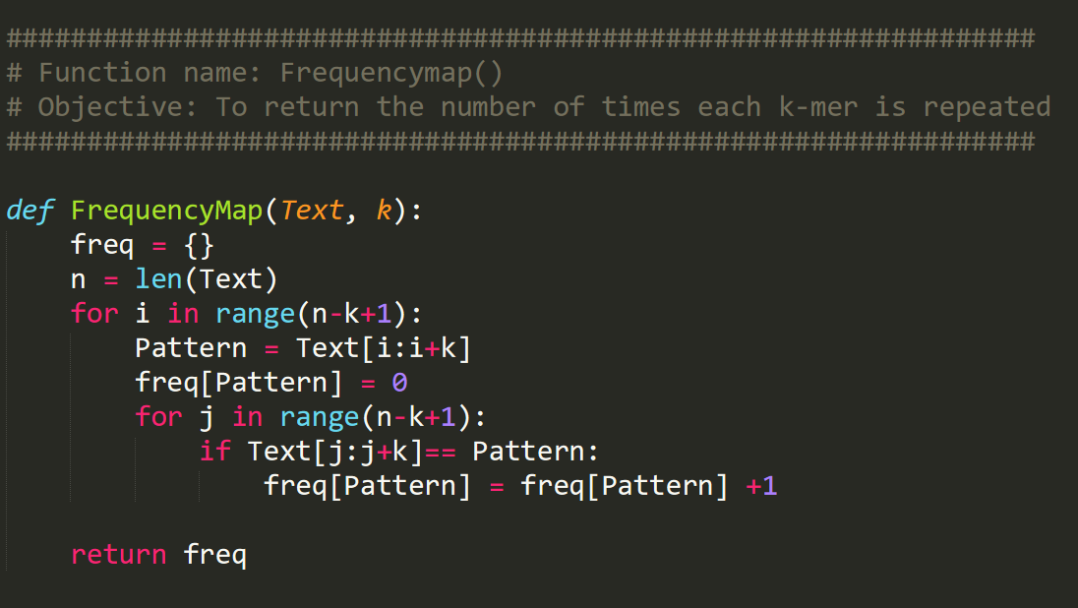
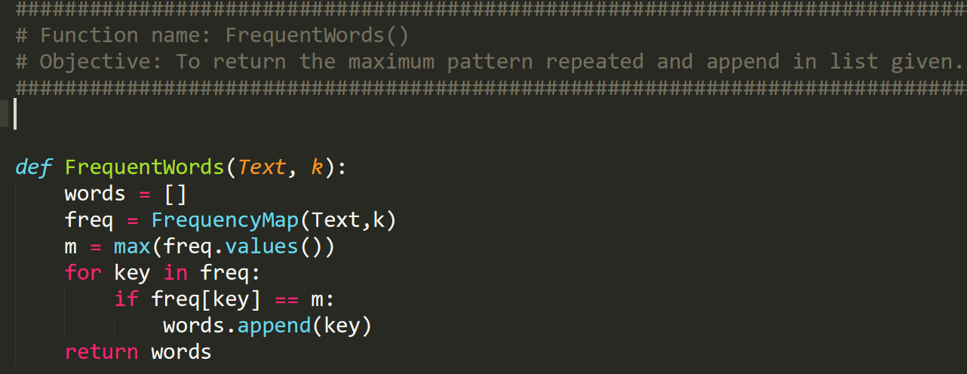
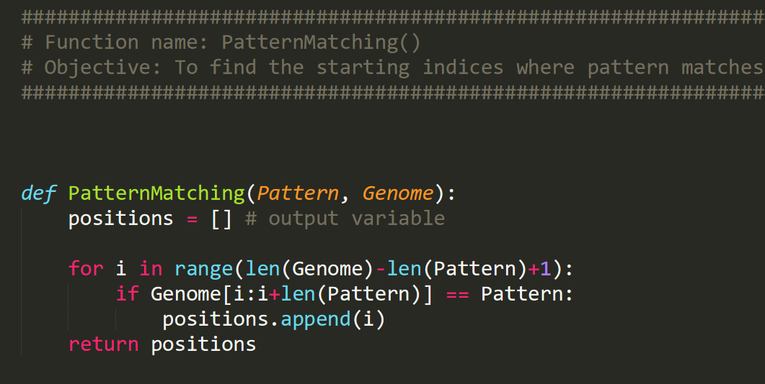
Genome file
Convert Genome to String
FrequencyMap
Walks through Genome string and lists the Patterns with its Frequency Value
FrequentWords
Catches the Max Freq & Returns the list of Patterns with Max Freq Value
PatternMatching
the list of indices where the ORI can be present in Genome string
Split_genome
Pattern Analyzation
Split the string in the genome chunks of particular length and create a list
Genome String
List of Chunks of Genome String
Loop through each chunk of Genome
Dictionary of Patterns with its Frequency (repetition) Values
List of Patterns which has Max Freq Value
Indices where patterns are present

Slide 3
Thank you !

