Slide 1

SMART PLACEMENT PREPARATION PORTAL
Project Team
Tirumanadham Murali krishna
Prasad Kapileswarapu
Uddisapu Ram Charan
Sunkara Ambika Naga Srivalli
5.Kurasala Sri Naga Lakshmi Parvathi
6.Purnima sai Lakshmi Chavvakula
7.Devaguptapu Pavani

Slide 2

Why Do Students Struggle in Placements?
Despite access to countless resources, most students fail to crack placements due to fragmented preparation, lack of structured guidance, and no unified platform to track progress.
Too Many Platforms
Unorganised Preparation
No Interview Practice
Students juggle 5+ websites for aptitude, coding, resumes, and interview prep — losing focus and momentum.
No structured roadmap means students study randomly, missing critical topics and company-specific patterns.
Real interview simulation is rare. Students enter actual interviews without adequate mock exposure.
Resume Building Gap
No Centralised Platform
Most students lack guidance on crafting ATS-friendly, recruiter-ready resumes that stand out.
There is no single destination combining learning, practice, assessment, and placement updates.

Slide 3
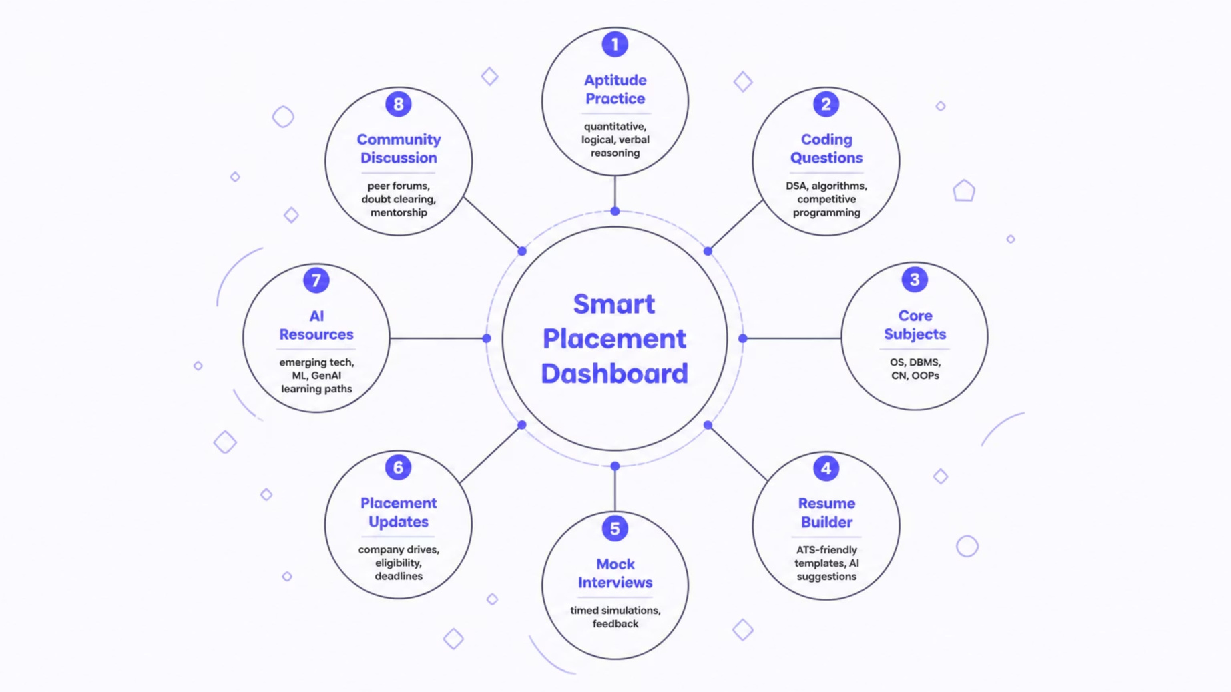
Our Solution: One Platform. Everything You Need.
The Smart Placement Preparation Portal is a unified, cloud-hosted ecosystem that eliminates preparation fragmentation. Every module — from aptitude to AI resources — is seamlessly connected through a single intelligent dashboard.
"Everything required for placements — in one intelligent, cloud-powered platform."

Slide 4





Key Features at a Glance
Every feature is designed with student success in mind — from structured learning paths to real-time placement tracking. Here is what sets our platform apart.
Aptitude & Reasoning
Coding & DSA Practice
AI Resume Builder
Mock Interviews & Tests
Thousands of curated questions across quantitative, logical, and verbal reasoning — with difficulty levels and timed practice modes.
Structured problem sets covering Data Structures, Algorithms, and competitive programming with instant feedback.
Generate ATS-optimised resumes with AI-powered suggestions, multiple templates, and real-time scoring.
Simulated interview rounds with timer, peer review, and performance analytics to build confidence before the real day.
Community & Placement Updates
Live placement notifications, company eligibility criteria, and a peer discussion forum for collaborative learning.

Slide 5
Technology Stack
Built with modern, industry-standard technologies chosen for performance, scalability, and developer experience — ensuring the platform is production-ready and future-proof.
Frontend
Backend & Database
React.js — Component-based UI with fast rendering
Vite — Lightning-fast build tool and dev server
Spring Boot — Enterprise-grade Java REST API framework with built-in security
PostgreSQL — Robust relational database with advanced query capabilities
HTML5 / CSS3 / JavaScript — Core web standards
Cloud & Infrastructure
Version Control
Git & GitHub — Collaborative development, CI/CD pipelines, and code review workflows.
AWS EC2 — Scalable virtual servers on Amazon Web Services
Nginx — High-performance reverse proxy and load balancer

Slide 6
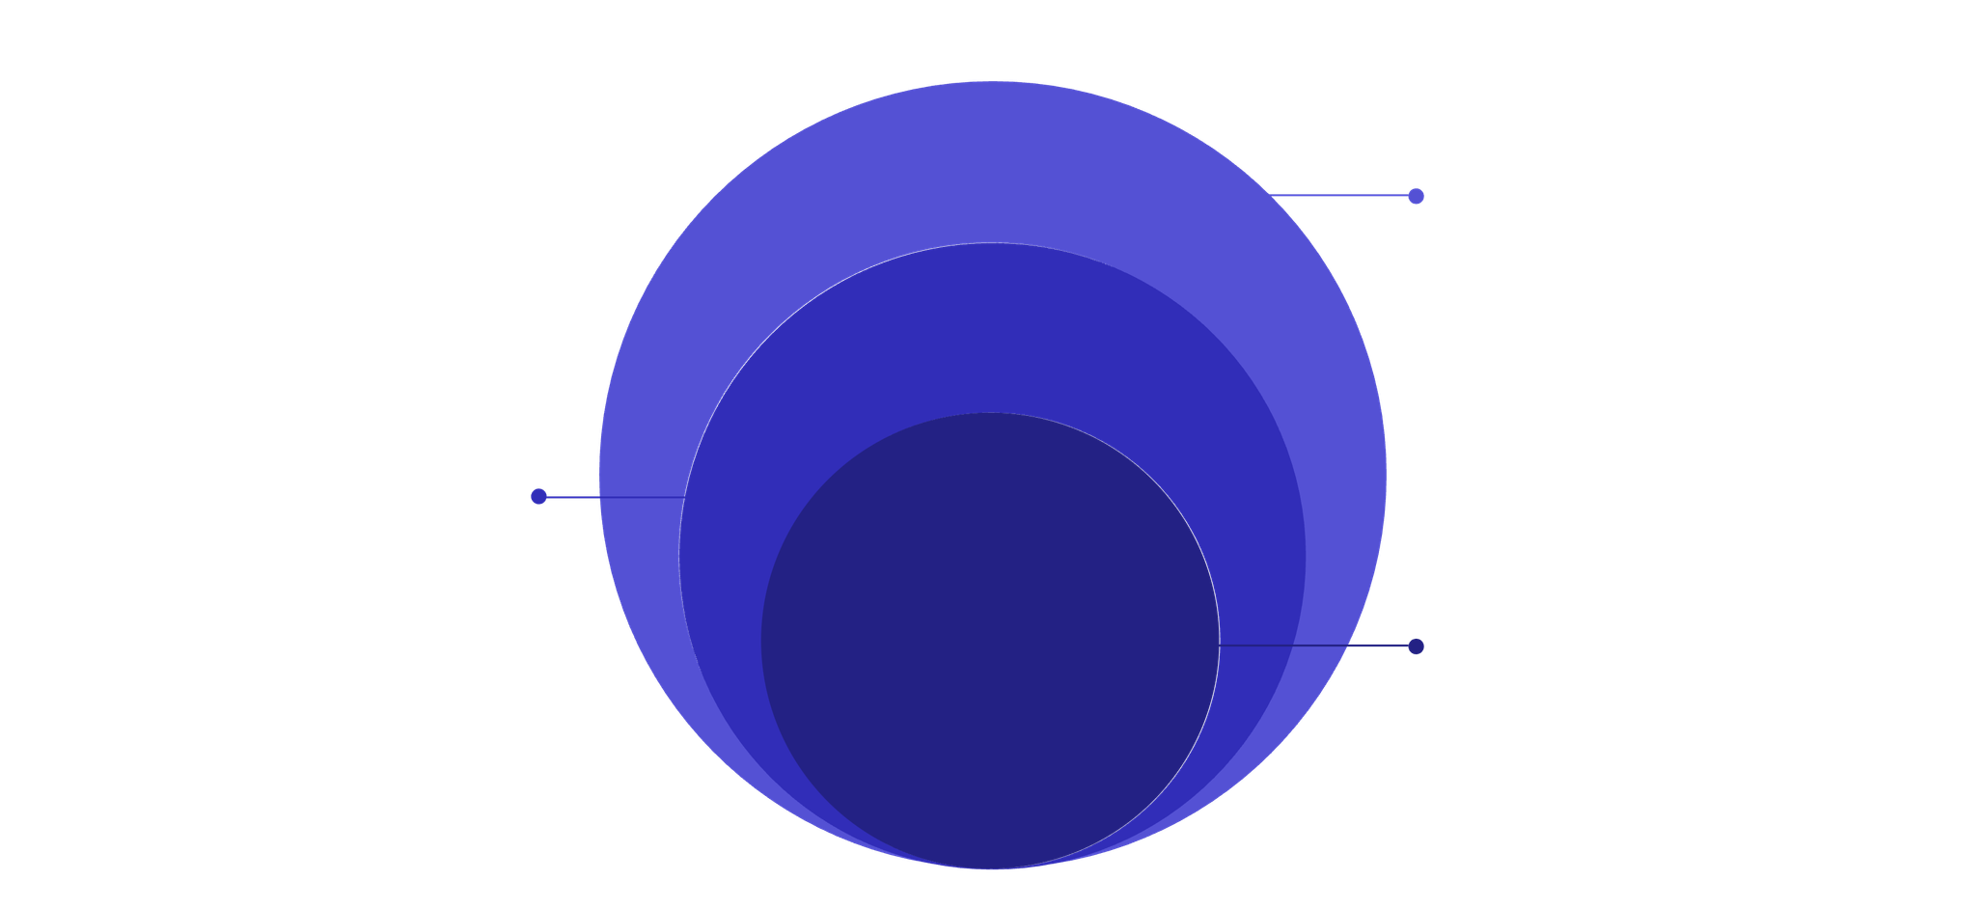
System Architecture
A clean, layered architecture ensures separation of concerns, security, and high availability. Every request flows through a protected pipeline from the student's browser to the cloud-hosted database.
API & DB
Spring Boot API, VPC, Postgres encrypted
Frontend
React on EC2 behind Nginx
Student Client
Browser or mobile over HTTPS
The architecture leverages AWS VPC for network isolation, Security Groups as firewalls, and Nginx as a reverse proxy — ensuring every student interaction is fast, secure, and reliable.
🔒 VPC Security
🛡️ Security Groups
☁️ Elastic IP
⚡ Nginx Proxy
Isolated network environment
Rule-based traffic filtering
Static public address for EC2
High-performance request routing

Slide 7

Development Methodology
We followed a structured Agile-inspired waterfall approach — ensuring each phase was validated before moving forward, with continuous feedback loops for quality assurance.
Requirements
1
Gathered user stories, defined scope, and documented functional and non-functional requirements.
2
Design
Created wireframes, UI/UX mockups, database schema, and API contract specifications.
Development
3
Built frontend with React.js and backend with Spring Boot in iterative sprints.
4
Database
Designed and normalised PostgreSQL schema with optimised indexes and foreign key relationships.
Testing
5
Conducted unit, integration, and end-to-end testing with bug fixes and performance tuning.
6
Deployment
Deployed to AWS EC2 with Nginx configuration, SSL setup, and environment hardening.
Continuous Improvement
7
Monitored logs, gathered user feedback, and iterated on features and performance.

Slide 8
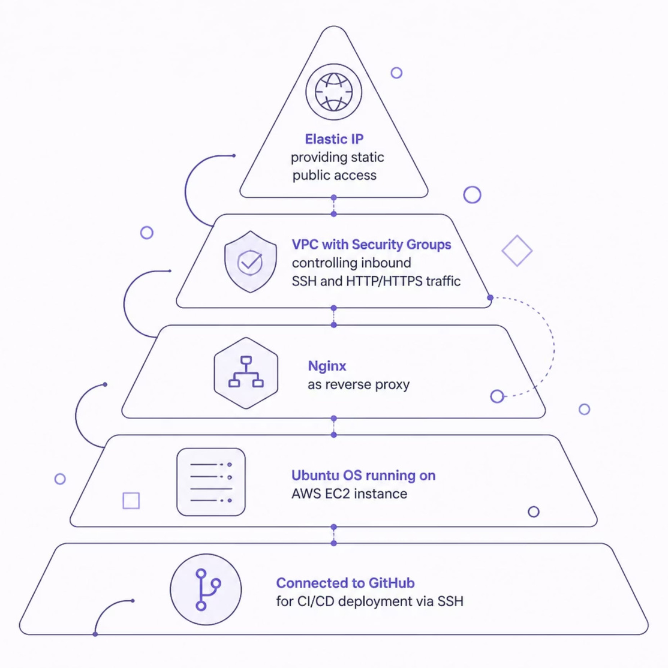
AWS Cloud Deployment
The platform is deployed on Amazon Web Services using a production-grade infrastructure setup — ensuring high availability, security, and the ability to scale with growing student traffic.
Infrastructure Highlights
Ubuntu LTS on EC2 — Stable, secure OS environment
Elastic IP — Persistent public address for zero-downtime updates
VPC + Security Groups — Network-level isolation and firewall rules
SSH Access — Secure remote management and deployment
GitHub Integration — Version-controlled, auditable deployments

Slide 9







Student Journey: From Login to Placement Ready
A seamless, guided workflow takes students from their first login all the way to being fully placement-ready — with every step tracked, measured, and optimised for success.
Student Login
Dashboard
Select Module
Secure authentication and personalised onboarding
Overview of progress, pending modules, and placement alerts
Choose from Aptitude, Coding, Core Subjects, or Resume
Practice
Mock Test
Interview Prep
Timed exercises with instant feedback and explanations
Full-length simulated assessments with performance analytics
Mock interviews, HR questions, and technical round practice
Placement Ready
Confident, prepared, and ready to crack any campus drive

Slide 10
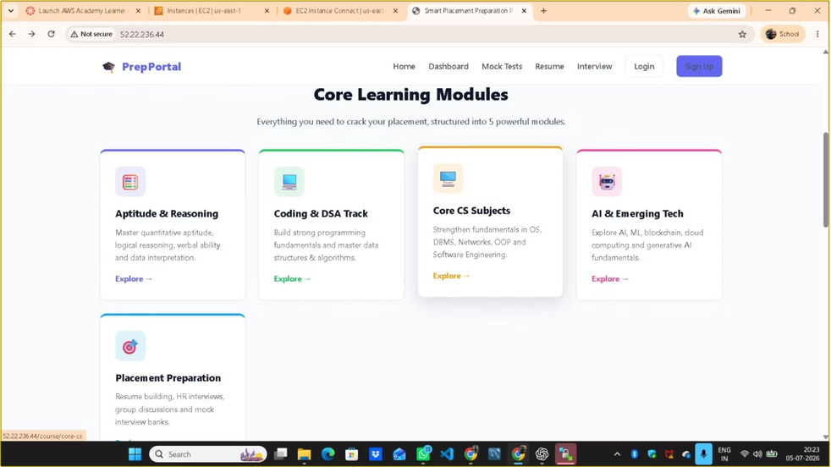
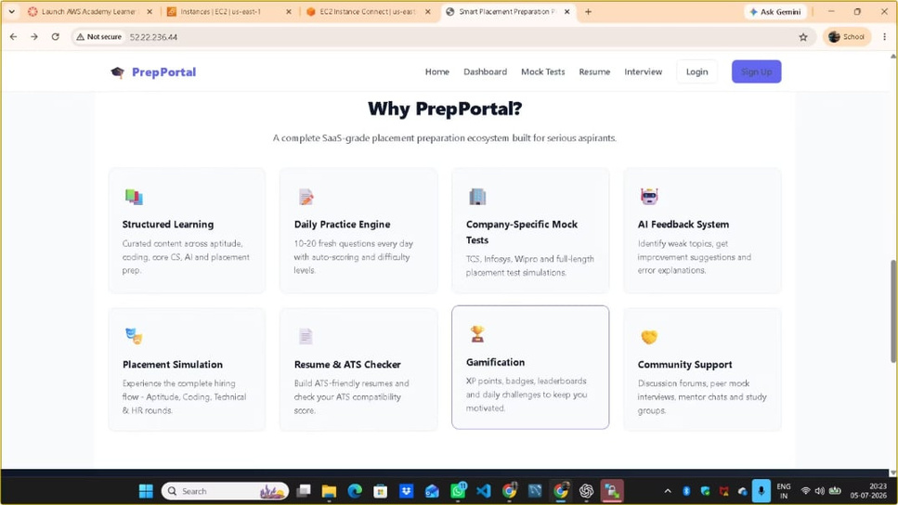
Results, Roadmap & Conclusion
🚀 Future Enhancements
🤖 AI Career Guidance
💬 Chatbot Assistant
📊 Analytics Dashboard
📱 Mobile App
Personalised roadmaps powered by ML
24/7 doubt resolution and mentorship
Student performance insights for colleges
Native iOS and Android experience
Thank You
Questions? We welcome your feedback, suggestions, and curiosity. Let us build the future of placement preparation together.

