Slide 1
FLYTWATCH
Real-time video anomaly
detection on CPU
A CLIP probe watches every frame. A 3B VLM checks only what matters. 7× faster than real time, no GPU.
Ambikesh Mishra · AHC Visual Intelligence Hackathon · 5 Sept 2026

Slide 2
THE TASK
Three levels, one grader, 100 marks
D1 · clear event
D2 · when it happens
D3 · long context
Name the anomaly in a short clip.
Say what, and pin start and end.
Minutes of footage, sparse events.
25
35
40
Timing is not scored. The class is.
A hit needs IoU of at least 0.5. Near misses pay a little.
5 marks per event found. False alarms cost little here.
Two rules shaped every design choice. An unanswered video counts as normal, and a wrong-class event that still overlaps something real pays almost nothing. So the cheap strategy is silence, and the paid strategy is precision.

Slide 3
ARCHITECTURE
A cheap always-on eye, a smart rare verifier
Video stream
2 frames per second
adaptive baseline
stage 1 · CLIP probe
trained linear head
60 ms per frame, CPU
stage 2 · Qwen2.5-VL-3B
LoRA verifier, JSON verdict
fires on fewer than 5% of frames
Temporal logic
confirm, clear, cooldown
IoU-aware spans
Why a cascade. A 3B VLM alone cannot watch every frame. CLIP alone confuses classes. Splitting the work gives VLM-grade labels at 7× real time, and the verifier kills stage 1 false alarms before they become alerts.
Training: 1,302 clips, balanced 60 per class, probe cross-validation 72.3%. Verifier: 959 LoRA pairs, 60 steps, vision tower frozen.

Slide 4
TEMPORAL LOGIC
Absolute thresholds smear events. Causal baselines separate them.
Before. One fixed threshold on busy roads kept tripping. Six separate accidents fused into a single 124 second blob.
After. Each video gets its own baseline from the previous 30 seconds. The same six accidents come out as six events, IoU 0.58 to 0.86.
causal median baseline
Boundaries. Hits need IoU of 0.5, so spans get padded toward the likely true edge. On the eval pack this turned two near misses into hits.
Anomaly mass over time. Shaded spans are confirmed events, found as rises above the video's own rolling median.
The same trick runs per class channel, which is how the label picks the class that actually rose, not the class that is always high.

Slide 5
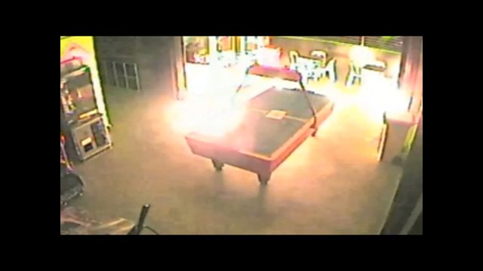
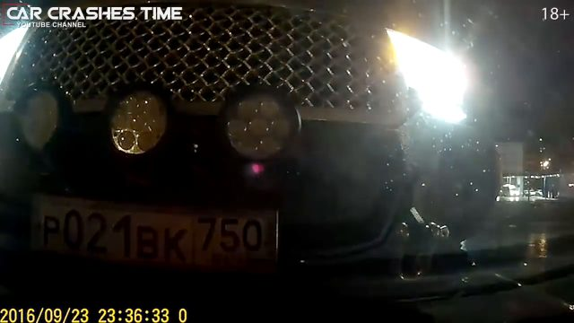
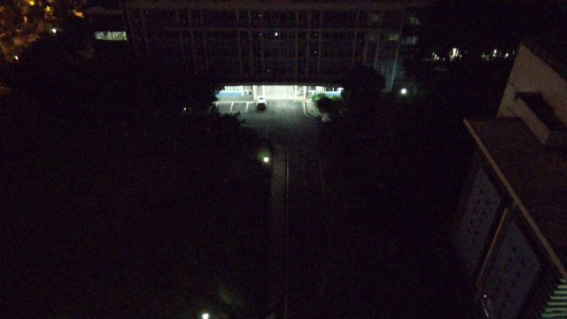
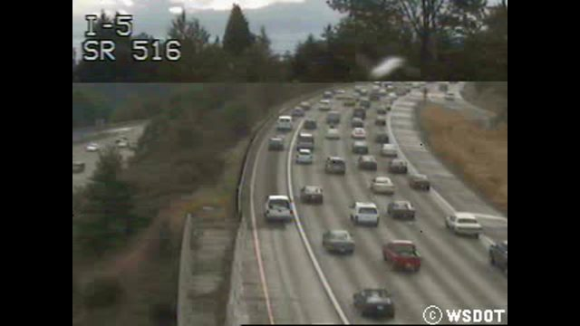
EXAMPLE DETECTIONS
Frames the system flagged, with the verdict it gave
fire, E022 at 226 s
traffic accident, E027
loitering, E028
normal, E023
Scored a partial hit on the pack. Found only by a looser threshold we ran deliberately.
Long-context video. Wide span, class from the channel that rose above its own baseline.
Person present far longer than passer-by traffic. Span width set for IoU of 0.5.
Anomaly mass high but flat. No rise above baseline, so the system stays quiet.
Precision by design. The last frame is the point. A saturated scene with no contrast earns silence, because on this grader a false alarm costs marks and silence pays.

Slide 6
RESULTS
Five scored runs, each one a measured change
marks out of 100, evaluation pack
final run breakdown
49.5
49.5
39.9
42.5
33.8
14.4
20.1
15.0
4.0
run 1
first upload
run 2
quiet D2
run 3
fire found
run 5
wide D3 spans
run 9
reasoning text
D1 /25
D2 /35
D3 /40
reasoning
bonus
first upload
final run
the change that paid
D1 / 25
14.2
14.4
balanced classes, one event per clip
D2 / 35
11.4
20.1
silence over guessing, plus one fire
D3 / 40
8.0
15.0
span width doubled to match real events
reasoning
0
+4.0
scene-first explanations, not pipeline logs
total
33.8
53.5
eleven scored runs, each a measured change

Slide 7
WHAT WE LEARNED
Four things the scores taught us
1
Balance the data before trusting it
2
Score the grader, not just accuracy
The first probe trained on alphabetically sampled clips and saw only 5 of 11 classes. Stratified sampling, 60 per class, fixed it. Cross-validation had looked fine the whole time.
Hits need IoU of 0.5. Wide spans failed that test even when detection was right. We reverse-engineered the rule from one round of feedback and rebuilt every span around it.
3
Silence is a strategy
4
The ceiling is the model, not the tuning
On the eval pack, a wrong-class overlap pays about zero and a false alarm costs half a mark. Knowing when not to fire was worth more than any single detection.
Three different class theories on the same windows scored identically. When that happens, the information is not in the signal. Stage 1 is at its limit there.
Ambikesh Mishra · github.com/ambikeesshh/flytwatch · flytwatch-cascade-v2

