Slide 1
^{Buddha Institute of Technology} ^{Gida , Gorakhpur} ^{Project Title:-} ^{Air Pollution Monitoring} ^{System} ^{By:- Ambikesh Prajapati}
Department of Electronics and Communication Engineering

Slide 2
Contents
1- Introduction
2- Literature Review
3- Components Required
4- Circuit Diagram
5- Working
6- Applications
7- Advantages
8- Conclusion

Slide 3

INTRODUCTION
Air pollution is the biggest problem of every nation, Whether it is developed or developing.
This Problems have been growing at faster rate especially In urban areas of developing countries .
It leads to release lot of gaseous pollutants and affect

Slide 4
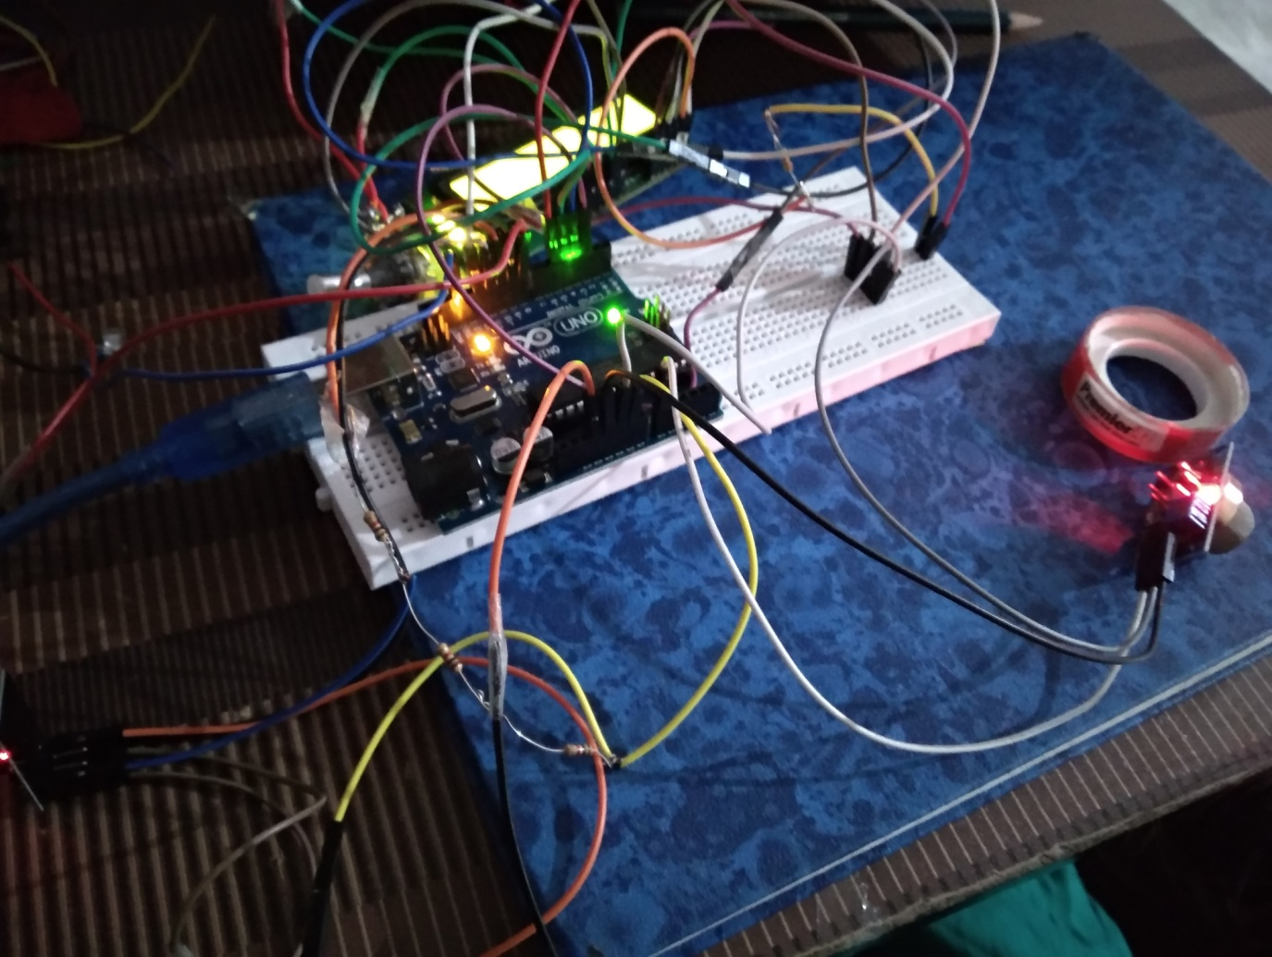
This poject is about an IOT Based Air Pollution Monitoring System in which we can monitor the Air Quality and trigger an alarm if it is harmful.
It detects different types of harmful gases which are present in the air like CO2, smoke, alcohol, benzene and NH3.
It will show the air quality in PPM on the LCD .

Slide 5
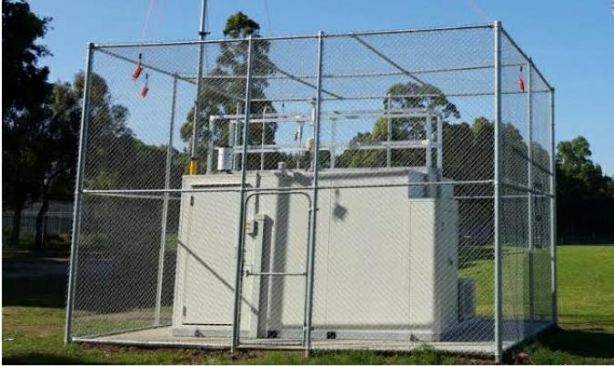
Literature Review
The drawbacks of the conventional monitoring instruments are –
Their large size, heavy weight and
extraordinary expensiveness.
These lead to sparse deployment of the monitoring stations.
The locations of the monitoring stations need careful placement .

Slide 6
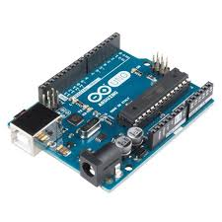
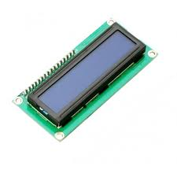
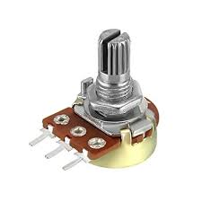
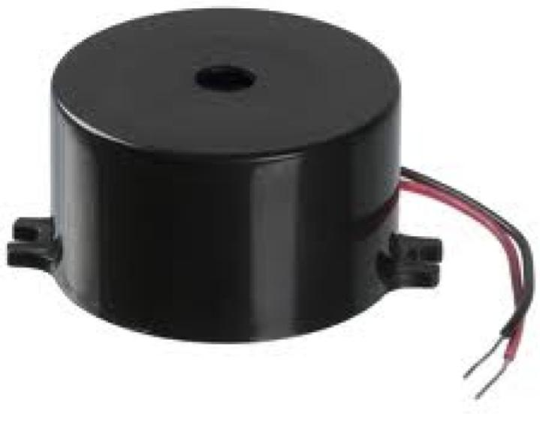
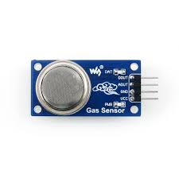
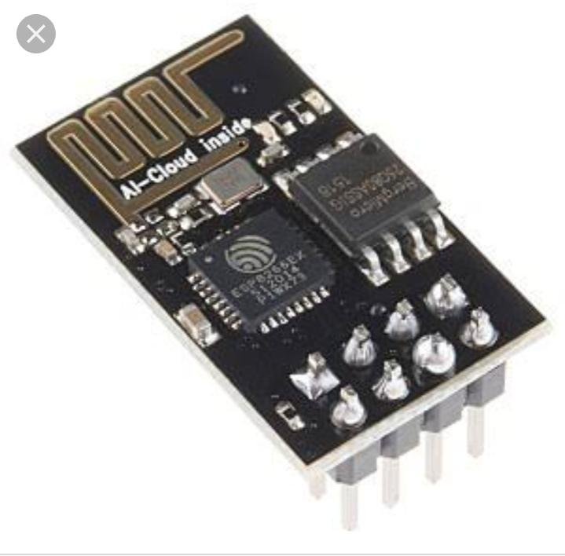
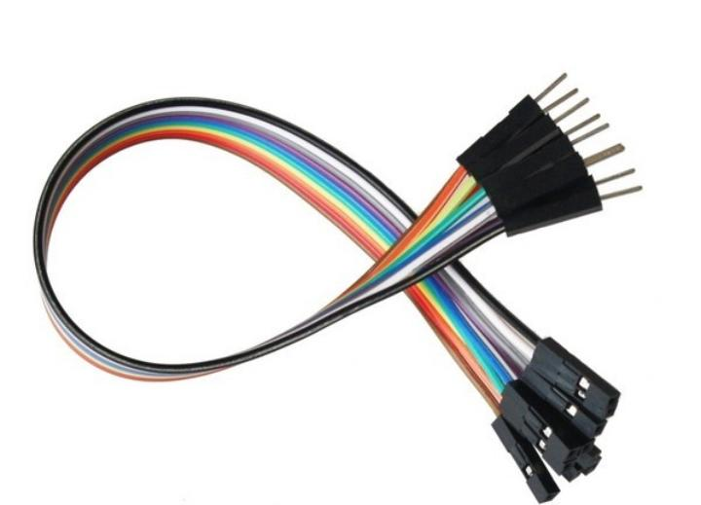

Components Required
Arduino Uno
16*2 LCD display
Potentiometer
Buzzer
MQ135 gas sensor
ESP8266 module
Resistors
Connecting wires

Slide 7
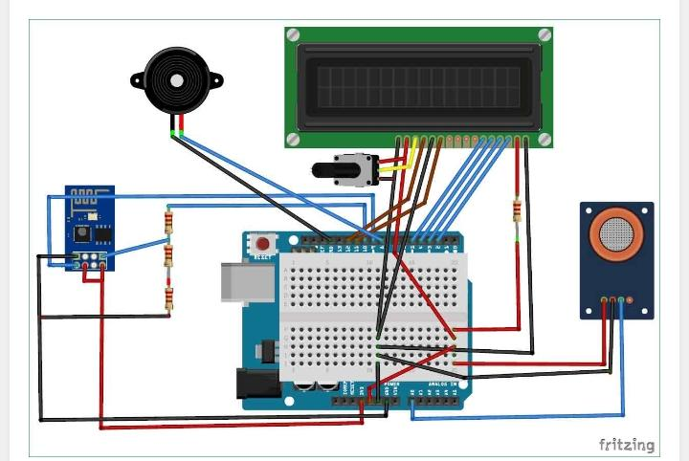
Circuit Diagram

Slide 8
Working
When we connect it MQ135 gas sensor to Arduino then it will sense the gases, and we will get the Pollution level in PPM .
MQ135 gas sensor gives the output in form of voltage levels and we need to convert it into PPM .
When there is no gas near the sensor it will give the value “90 PPM”.
The safe level of air quality is “150 PPM” and it should not exceed “250 PPM”.

Slide 9

Applications
Industrial perimeter monitoring

Slide 10
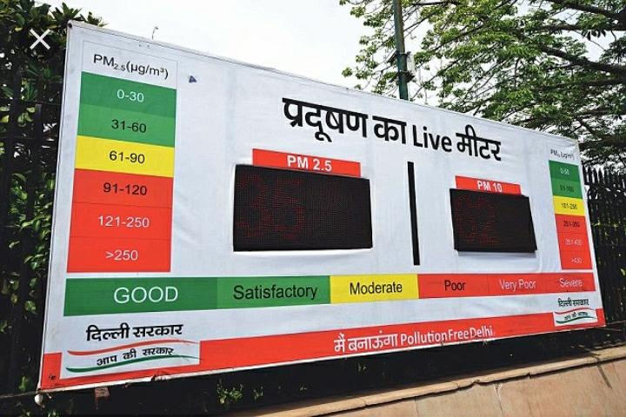
2) Make data available to user.

Slide 11
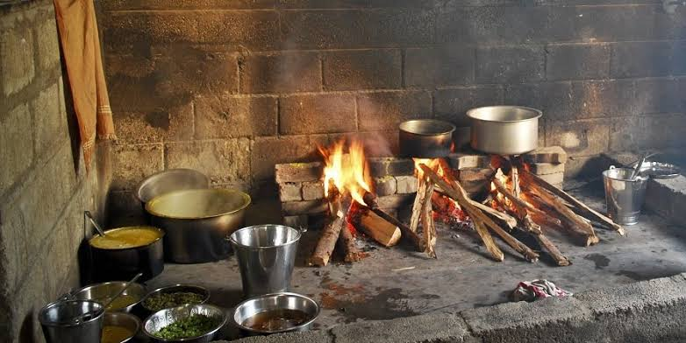
Indoor air quality monitoring.
Roadside pollution monitoring.

Slide 12
Advantages
Easy to Install.
2) Updates On mobile phone directly.
3) Accurate Pollution monitoring .
4) Remote location monitoring.

Slide 13
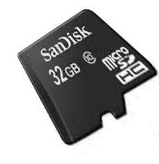
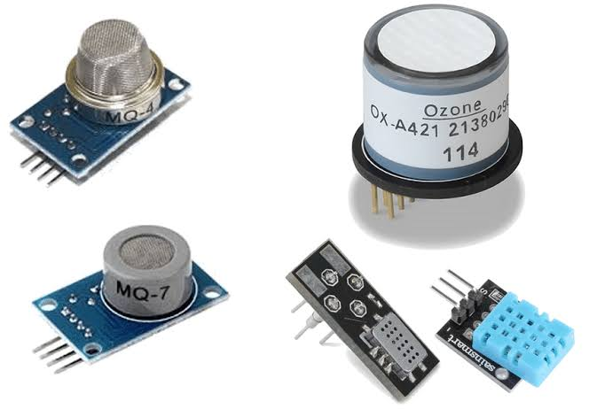
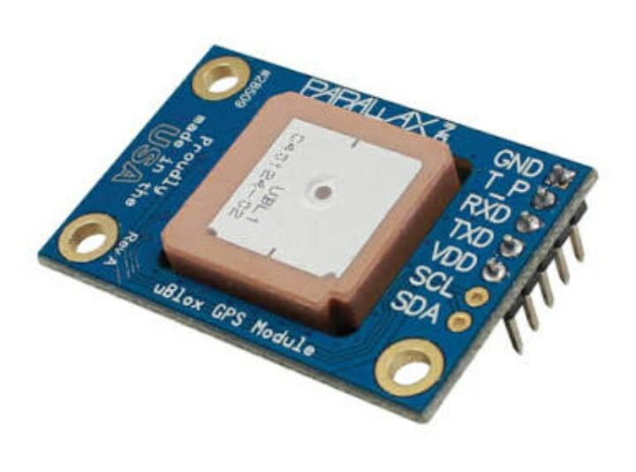
Future use
Interface SD card to store data.
Interface number of sensors to know the details content of all gases present in air.
Interface GPS module to monitor the pollution at exact location and upload on webpage for citizens.

Slide 14
Conclusion
The system to monitor the air of environment using Arduino microcontroller, IOT Technology is proposed to improve quality of air.
Here, using the MQ135 gas sensor gives the sense of different type of dangerous gas.
Arduino is the heart of this project , Which control the entire process. Wi-Fi module connects the whole process to internet and LCD is used for the visual Output.

Slide 15
References
Google-https://circuitdigest.com/microcontroller-projects/iot-air-pollution-monitoring-using-arduino
Youtube -https://youtu.be/EXU5hEPHKy0

Slide 16
Thank You

