Slide 1

Presentation on THE LIFE SAVING VENTILATOR (TLSV)
Presented by :
Ambikesh Prajapati
Under the Guidance of Mr. Ghanshyam Mishra (Assistant Professor)
Department of Electronics and Communication Engineering
Buddha Institute of Technology, Gida, Gorakhpur

Slide 2
CONTENT:
1. Introduction
2. Components
3. Circuit Diagram
4. Working of The Life Saving Ventilator (TLSV)
5. Block Diagram
6. Applications
7. Objectives
8. Future Scope
9. Conclusion
10. Reference

Slide 3
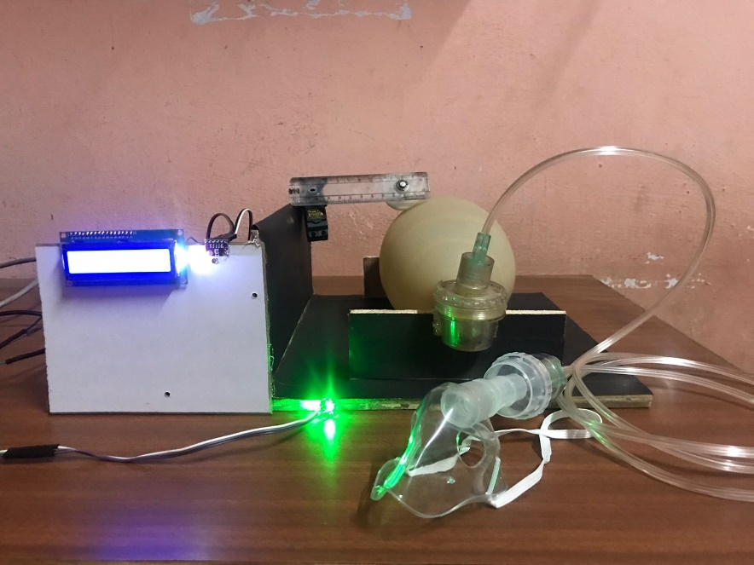
INTRODUCTION:
A ventilator is a machine that provides mechanical ventilation by moving breathable air into and out of the lungs, to deliver breaths to a patient who is physically unable to breathe, or breathing insufficiently.
Ventilators are computerized microprocessor-controlled machines, but patients can also be ventilated with a simple, hand-operated bag valve mask.
Ventilators are chiefly used in intensive-care medicine.
Ventilators are sometimes called "respirators", a term commonly used for them in the 1950s.

Slide 4

COMPONENTS:
1. Atmega Processor
2. Blood Oxygen Sensor
3. Pressure Sensor
4. Servo Motor
5. Breather Mask
6. Air Breather Bag
7. Push Rods
8. LCD Display IC (16*4)
9. Vtg Regulator IC
10. Cables and Connectors
11. Transformer/ Adapter
12. Buzzer
13. Push Buttons
14. LED
15. Gear Mechanism

Slide 5
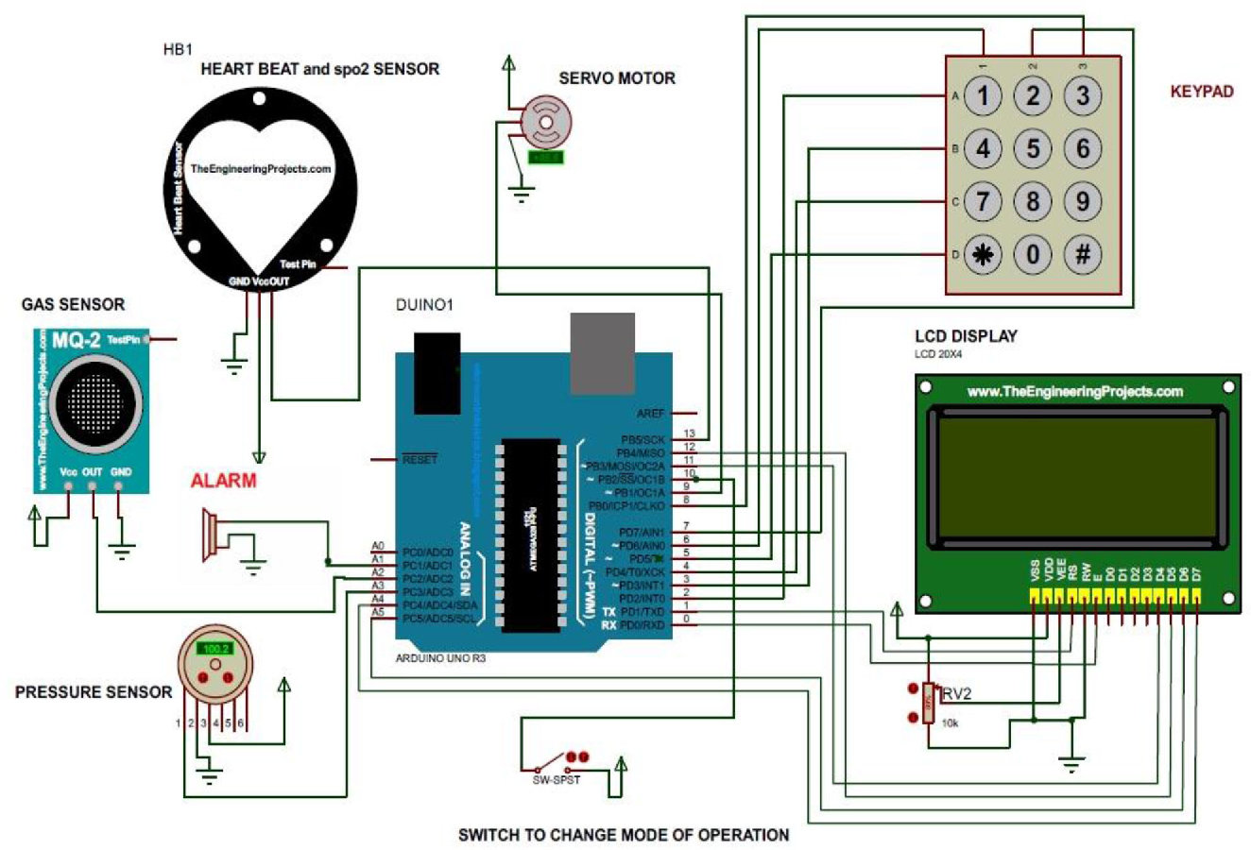
CIRCUIT DIAGRAM:

Slide 6
WORKING:
In this project we will be explaining and demonstrating the development of a pneumatic-type ventilator.
The Human lungs use the reverse pressure generated by contraction motion of the diaphragm to suck in air for breathing.
A contradictory motion is used by a ventilator to inflate the lungs by pumping type motion.
The air reservoir is pneumatically compressed several times a minute to deliver room-air, or in most cases, an air/oxygen mixture to the patient.

Slide 7
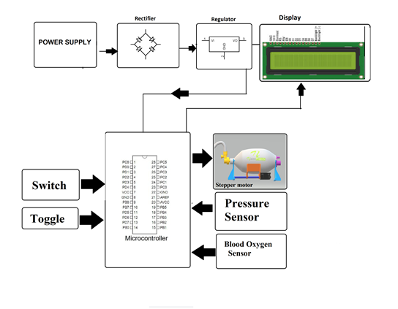
BLOCK DIAGRAM:

Slide 8
APPLICATIONS:
The patient can breathe easily till their respiratory muscles rest.
The patient's allowed time to recover makes breathing normal again.
Helps the patient get adequate oxygen and clears carbon dioxide.
Preserves a stable airway and preventing injury from aspiration.
Features :-
Easy to use
Easy to setup
Low price
Can be used in small projects

Slide 9
OBJECTIVES:
Overall, the goal of mechanical ventilation is to support gas exchange and sustain life until the cause of respiratory failure is resolved. As Hippocrates stated, an important goal of medical practice is to “do no harm”, and this is a crucial aspect to consider when setting the goals during mechanical ventilation.
The aims of mechanical ventilation according to the initiating indications include:
Achieve adequate ventilation - CO₂ elimination
Improve oxygenation
Relieve respiratory distress – off-load respiratory muscles

Slide 10
FUTURE SCOPE:
In the near future, more advanced function and compact sizes of the modern ventilators.
It will enable them to effectively ventilate all patients in all settings, invasively or non-invasively.
To ensure optimum respiratory care, smart ventilators will better adapt to each different individual’s situation and a patient’s changing condition.
This will not only reduce complications and sedation but also greatly increase patient comfort and wean patients earlier.

Slide 11
CONCLUSION:
The low-cost, easy-to-build non-invasive ventilator performs similarly to a high-quality commercial device, with its open-source hardware description, which will allow for free replication, facilitating application of this life-saving therapy to patients who otherwise could not be treated.
Thus, the functionality of the entire system has been tested thoroughly and it is said to function successfully.

Slide 12
REFERENCE:
https://www.webmd.com/lung/coronavirus-ventilators [6]
https://journals.lww.com/ccejournal/fulltext/2020/12000/a_novel_low_cost_ventilator_for_use_in_a_worldwide.13.aspx [7]
https://erj.ersjournals.com/content/55/6/2000846 [8]

Slide 13
THANK YOU!

