Slide 1

Sandhi
- IIT Bombay
Conversion from LabView/Scilab to Sandhi

Slide 2
A novel flow graph editor which generates code in the backend when the blocks are connected in the GUI.
Based on GNU Radio, which was originally designed and developed for software radios.
Currently under testing: we are trying to achieve various control schemes for real plants.
About Sandhi

Slide 3
Motivation to develop Sandhi:
FOSS is defined as software, the source code of which is available to all users.
FOSS stands for free and open source software.
Free refers to the freedom to copy and re-use the software, rather than to the price of the software.
The project Sandhi is being developed to serve as an open-source alternative poprietary data acquisition and control applications.
<number>

Slide 4
Features differentiate Sandhi from GNURadio
Sandhi uses GRAS for feedback solution
Interactive and user friendly GUI
Customised blocks can be designed using Python, C++
It supports connection to external hardware devices through serial port
Uses Scilab and python for scientific calculations
Ability to generate control system data-flowgraph
Auto-checks if connections are correct
Outputs are shown in the form of graph/calculated values
Inputs can be dynamically changed with the help of sliders
<number>

Slide 5
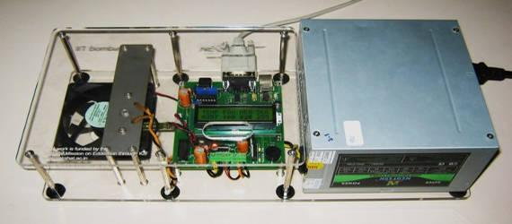
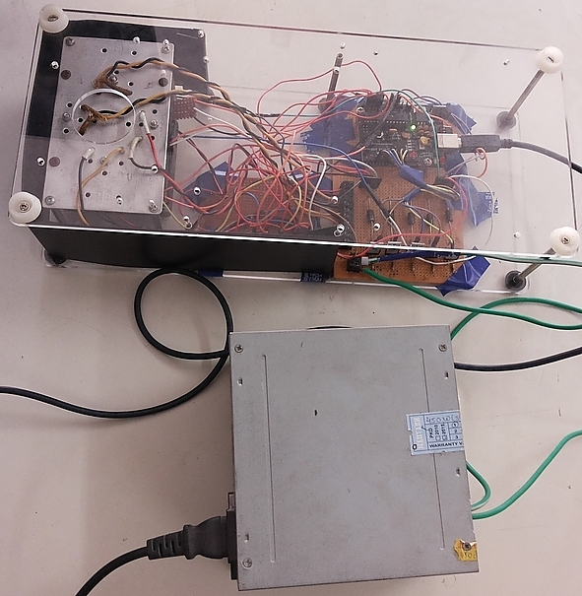
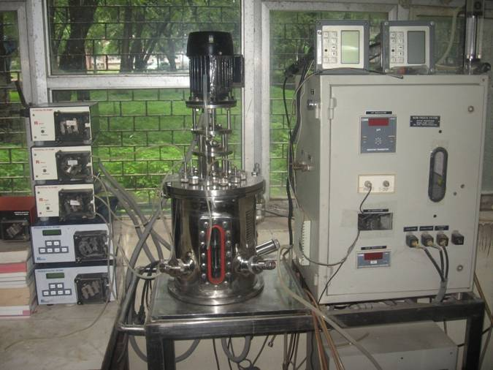
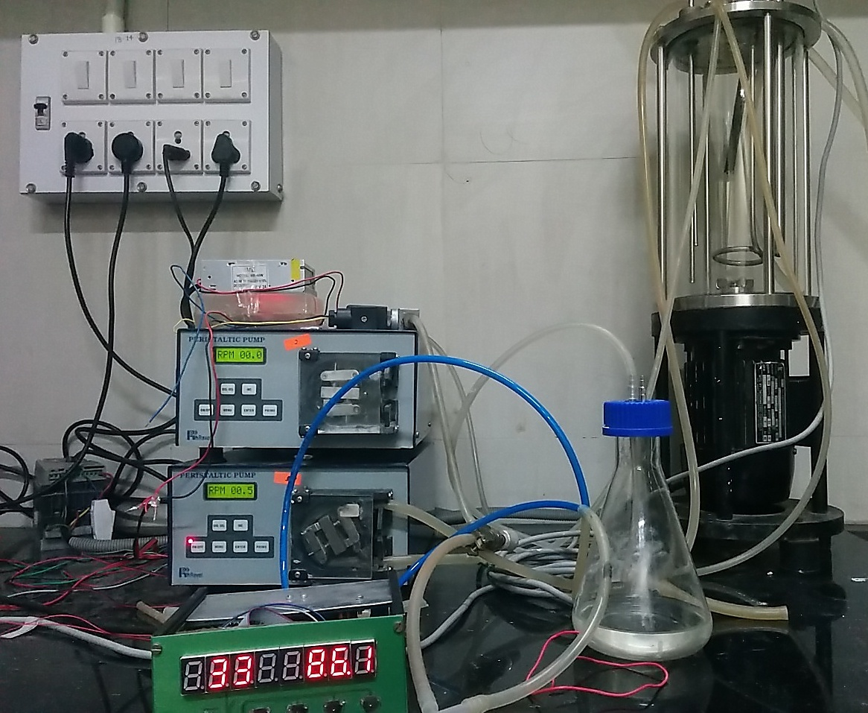
RTLabs on Sandhi
1.SBHS
3.SBHS+
2.Reactor
4.Bioreactor
and
5.OpenPLC
<number>

Slide 6
References:
Sandhi_Docs
GNURadio
<number>

