Slide 1

CREDIT CARD PAYMENT DEFAULTERS
This Photo by Unknown Author is licensed under CC BY-ND

Slide 2


DAB 103:
ANALYTICS TOOLS & DECISION MAKING
Section: 004, Group: 01
Team Members
1. Ambily Treesa Varghese
2. Dileep Sathyan
3. Jibina Francis
4. Satya Akhil Govvala
5. Srilakshmi Gummadidala

Slide 3
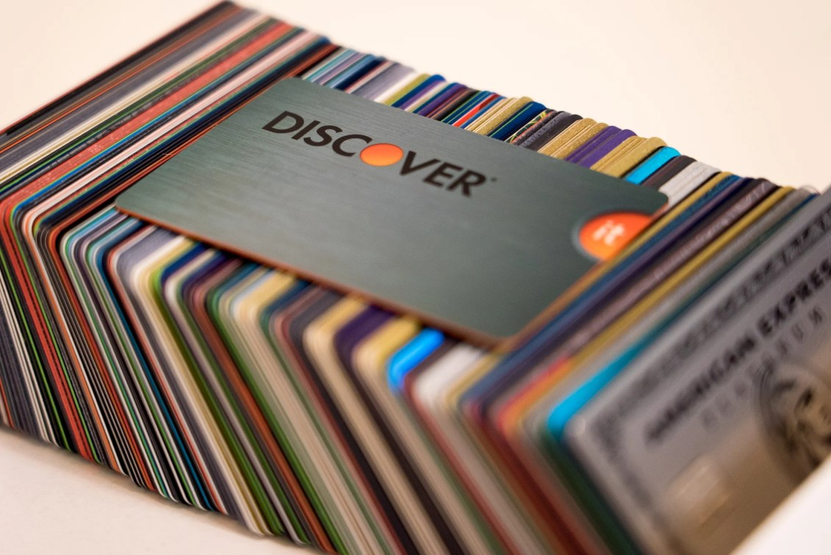
BACKGROUND / MOTIVATION
A Bank gets 100s of new Credit Card applications every single day from their users.
Although the bank might give their users a Credit Card with a minimum line to increase their customer acquisition, it is one of the biggest challenges any financial institution faces when it comes to payment collection.
Around 22% of the credit card users of the financial institution are found to default on their repayment which results in huge losses.
Identifying the potential defaulters within the first 6 months of their repayment will mitigate the risks with credit lending.
This Photo by Unknown Author is licensed under CC BY-NC-ND

Slide 4
PROBLEM STATEMENT
Can the Financial institution limit their credit risks by at least 10% by identifying the potential payment defaulters within the 7th month of their credit card usage?
This Photo by Unknown Author is licensed under CC BY-ND

Slide 5
PROJECT PROPOSAL
Our project team will create a machine-learning model to predict the potential payment defaulters with maximum accuracy using the available features.
The financial institution can thus take necessary measures to control the credit consumption of such users.
This Photo by Unknown Author is licensed under CC BY-NC-ND

Slide 6
ANALYSIS QUESTIONS
Which variables in the dataset have a stronger correlation with the users going default?
Find the distribution of categorical variables and their association with the payment defaulters.
Create insightful data visualizations of the available features using Python.
Build a Machine Learning model to predict the users with a higher probability of default.
Finally, estimate the accuracy of the model using a Confusion Matrix.
This Photo by Unknown Author is licensed under CC BY-ND

Slide 7
DATASET DESCRIPTION
The dataset contains the credit card usage and repayment history of 6 months (April to September 2005) of a Financial Institution in Taiwan.
Our analysis will be based on the repayment Default of Credit Card Clients Data Set obtained from the UCI Machine Learning Repository.
The description of certain values in some fields in the dataset is unavailable, although the dataset doesn’t have incomplete or missing data.
Dataset Source: https://archive.ics.uci.edu/ml/machine-learning-databases/00350/
Source: https://archive.ics.uci.edu/ml/datasets/default+of+credit+card+clients
This Photo by Unknown Author is licensed under CC BY-NC-ND

Slide 8
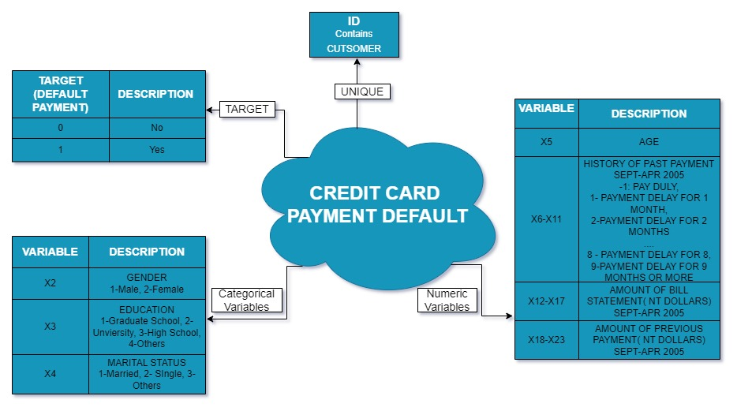
DATASET ATTRIBUTE DESCRIPTION
Created using: https://app.diagrams.net/
This Photo by Unknown Author is licensed under CC BY-ND

Slide 9
EXPLORATORY DATA ANALYSIS

Slide 10
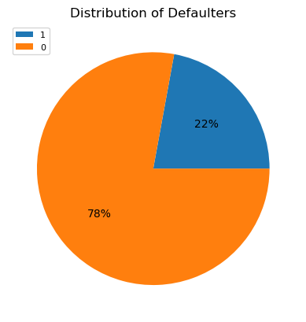
DEFAULTER DISTRIBUTION
The dataset contains 22% of records labeled as DEFAULTERS while the rest as Happy-Paying-Customers.
The Financial Institution requires measures to identify the defaulters as early as possible to control credit risks.
As per the data description,
flag 1 represents ‘Defaulter’ and
flag 0 represents ‘Happy-Paying-Customer’

Slide 11
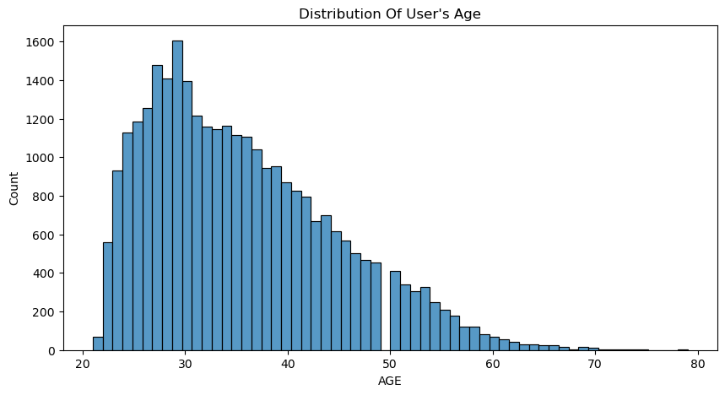
AGE DISTRIBUTION
Most of the credit card users are in their early-twenties to late-forties.
The average age of the users is currently 30 years.

Slide 12
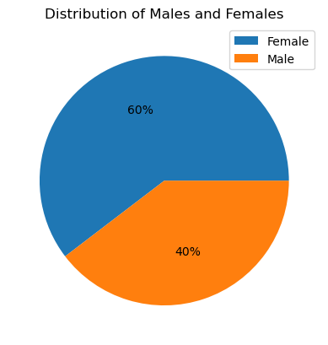
GENDER DISTRIBUTION
The dataset under analysis has a 3:2 Female to Male client ratio.

Slide 13
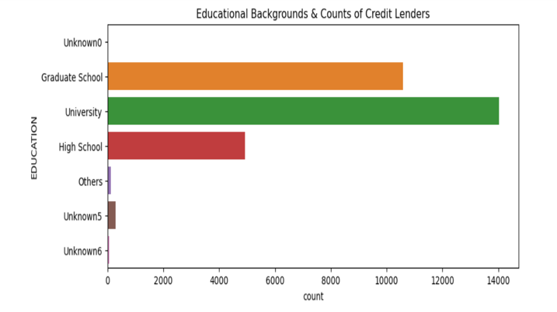
CREDIT LENDER COUNT BY EDUCATIONAL BACKGROUND
The institution seemingly considers the Educational Background as one of the major parameters for issuing a credit card.
The count of credit card users are directly proportional to the Educational qualification that they have.

Slide 14
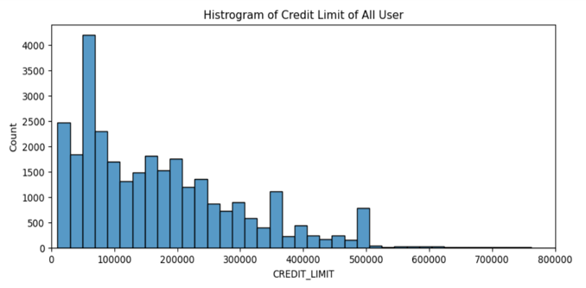
USER CREDIT LIMIT
Credit limits issued by the Institution to its users are Normally distributed with a right skew.
Majority of the users are given a credit limit of less than NT$ 250,000 (New Taiwan Dollar)

Slide 15
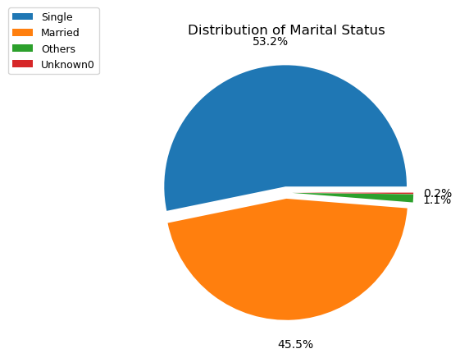
DISTRIBUTION OF MARITAL STATUS
53% of the users in the dataset are Single, followed by 46% Married users.
A very few proportions of users belong to Others and Unspecified groups

Slide 16
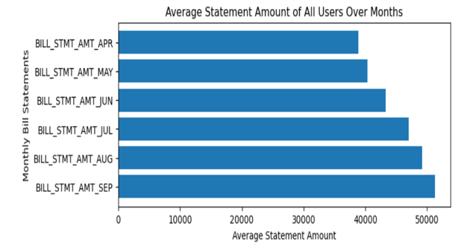
BILL STATEMENT AMOUNTS
On an average, the Financial Institution raises Bill Statements which amounts to NT$ 40k to 50k to their users in a month.
The statement amount grow over the months either because of the usage or the accumulation of credit due to repayment default.

Slide 17
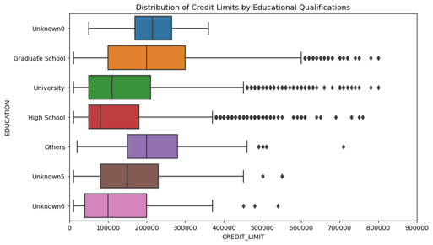
CREDIT LENDER COUNT BY EDUCATIONAL QUALIFICATIONS
The median credit limit varies with the Educational Qualification of users.
Although there are more University graduates who own a credit card, the users with Graduate School qualifications seem to have a better Median score.
Category wise outliers are visible in the figure, except for "Unknown0".

Slide 18
CREDIT LENDER COUNT BY EDUCATIONAL QUALIFICATION
The median credit limit varies with the Educational Qualification of users.
Although there are more University graduates who own a credit card, the users with Graduate School qualifications seem to have a better Median score.
Category-wise outliers are visible in the figure, except for "Unknown0".

Slide 19
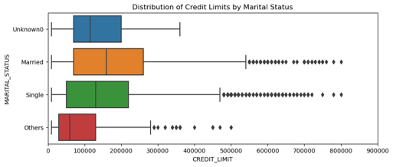
CREDIT LIMIT BY MARITAL STATUS
The plot distribution describes that Credit Limit of each Marital Status category such as Married, Single, Others and Unknown0.
The highest credit lenders are Married Individuals followed by Single and Unknown0 category users.
Here, Married, Single and Others type of Marital Status categories have the outliers as per their Credit Limit.

Slide 20
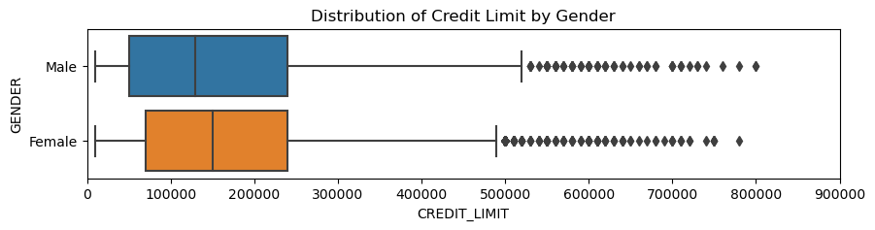
CREDIT LIMIT BY GENDER
Females, the category having more credit cards in our dataset, possess a slightly higher median Credit Limit than Males.
The Outliers are present in both Female and Male categories ranges from NT $500000 to above as per their Credit Limit.

Slide 21
THANK YOU...!
This Photo by Unknown Author is licensed under CC BY-NC-ND

