Slide 1
LSTM Model

Slide 2
import math
import pandas_datareader as web
import numpy as np
import matplotlib.pyplot as plt
import pandas as pd
from sklearn.preprocessing import MinMaxScaler
from keras.models import Sequential
from keras.layers import Dense,LSTM
plt.style.use('fivethirtyeight’)
from pandas.io.parsers.readers import read_csv
df=read_csv('SBI.csv')
df

Slide 3
df.shape
plt.figure(figsize=(16,8))
plt.title('Close Price History')
plt.plot(df['Close'])
plt.xlabel('Date',fontsize=18)
plt.ylabel('Close Price USD ($)',fontsize=18)
plt.show()
data=df.filter(['Close'])
#convert dataframe to numpy array
dataset=data.values
#get number of rows to train model on
training_data_len=math.ceil(len(dataset)* 0.8)
training_data_len

Slide 4
#scale data
scaler=MinMaxScaler(feature_range=(0,1))
scaled_data=scaler.fit_transform(dataset)
scaled_data
#create training data set
#create the scaled training data set
train_data=scaled_data[0:training_data_len,:]
#split data into x_train and y_train data sets
x_train=[]
y_train=[]
for i in range(60,len(train_data)):
x_train.append(train_data[i-60:i,0])
y_train.append(train_data[i,0])
if i<=61:
print(x_train)
print(y_train)
print()

Slide 5
#convert x_train and y_train to numpy arrays
x_train , y_train =np.array(x_train),np.array(y_train)
#reshape the data
x_train=np.reshape(x_train,(x_train.shape[0],x_train.shape[1],1))
x_train.shape

Slide 6
#build the LSTM model
model=Sequential()
model.add(LSTM(50,return_sequences=True,input_shape=(x_train.shape[1],1)))
model.add(LSTM(50,return_sequences=False))
model.add(Dense(25))
model.add(Dense(1))
#compile the model
model.compile(optimizer='adam',loss='mean_squared_error')

Slide 7
#train the model
model.fit(x_train,y_train,batch_size=1,epochs=10)
#create testing data set
#create a new array containing scaled values from remaining index values
test_data=scaled_data[training_data_len-60:,:]
#create data sets x_test and y_test
x_test=[]
y_test=dataset[training_data_len:,:]
for i in range(60,len(test_data)):
x_test.append(test_data[i-60:i,0])

Slide 8
#convert data into numpy array
x_test=np.array(x_test)
#reshape the data
x_test=np.reshape(x_test,(x_test.shape[0],x_test.shape[1],1))
#get models predicted price values
predictions=model.predict(x_test)
predictions=scaler.inverse_transform(predictions)

Slide 9
#get root mean squared error
rmse=np.sqrt(np.mean(predictions-y_test)**2)
rmse
#plot the data
train=data[:training_data_len]
valid=data[training_data_len:]
valid['predictions']=predictions
#visualize the data
plt.figure(figsize=(16,8))
plt.title('Model')
plt.xlabel('Date',fontsize=18)
plt.ylabel('Close price USD($)',fontsize=18)
plt.plot(train['Close'])
plt.plot(valid[['Close','predictions']])
plt.legend(['train','val','predictions'],loc='lower right')
plt.show()

Slide 10
#show valid and predicted prices
valid
#get the quote
sbi_quote=df
#create new data frame
new_df=sbi_quote.filter(['Close'])
#get the last 60 closing prices values and convert dataframe to an array
last_60_days=new_df[-60:].values
#scale data to be values between 0 and 1
last_60_days_scaled=scaler.transform(last_60_days)
#create an empty list
X_test=[]
#Append the past 60 days
X_test.append(last_60_days_scaled)
#convert the X_test data set to numpy array
X_test=np.array(X_test)

Slide 11
#reshape data
X_test=np.reshape(X_test,(X_test.shape[0],X_test.shape[1],1))
#get the predicted scaled price
pred_price=model.predict(X_test)
#undo the scaling
pred_price=scaler.inverse_transform(pred_price)
print(pred_price)

Slide 12
Linear regression

Slide 13
import pandas as pd
import yfinance as yf
import numpy as np
import matplotlib.pyplot as plt
from sklearn.linear_model import LinearRegression
data = yf.download(‘SBI')
plt.figure(figsize=(10, 5))
data['Close'].plot()

Slide 14
data = data.reset_index()
x = np.array(data.index).reshape(-1, 1)
y = data['Close’]
linreg = LinearRegression().fit(x, y)
linreg.score(x, y)
predictions = linreg.predict(x)
plt.figure(figsize=(15,5))
plt.plot(data['Close'])
plt.plot(data.index, predictions)

Slide 15
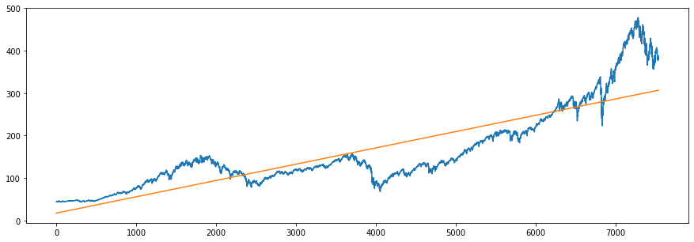
print('R^2:', linreg.score(x, y))

Slide 16
ARIMA Model

Slide 17
import pandas as pd
import numpy as np
import matplotlib.pyplot as plt
import seaborn as sns

Slide 18
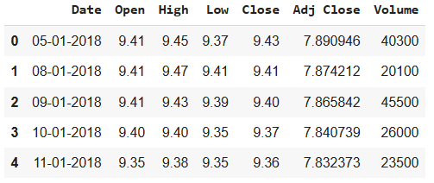
df = pd.read_csv("SBI.csv")
df.head()

Slide 19
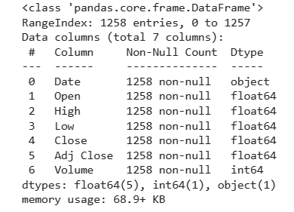
df.info()

Slide 20
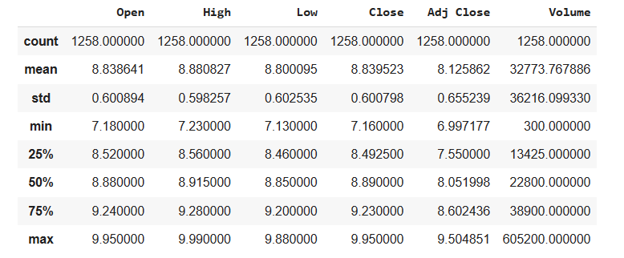
df.describe()

Slide 21
df.Date= pd.to_datetime(df.Date)
df2 =df.set_index('Date’)
plt.figure(figsize=(20,12))
plt.subplot(2, 1, 1)
plt.title('Google Stock Price')
plt.plot(df2.Close,label='Close price')
plt.legend()
plt.subplot(2, 1, 2)
plt.title('Volume Traded')
plt.bar(x=df2.index,height=df2['Volume'])
plt.show()

Slide 22
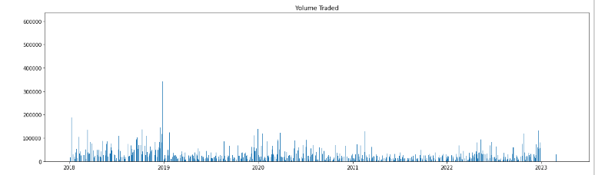

Slide 23
data = list(df2["Close"])
from statsmodels.tsa.stattools import adfuller
result = adfuller(data)
print("1. ADF : ",result[0])
print("2. P-Value : ", result[1])
print("3. Num Of Lags : ", result[2])
print("4. Num Of Observations Used For ADF Regression:", result[3])
print("5. Critical Values :")
for key, val in result[4].items():
print("\t",key, ": ", val)

Slide 24
1. ADF : -1.413699724158521
2. P-Value : 0.5756909623821345
3. Num Of Lags : 18
4. Num Of Observations Used For ADF Regression: 1239
5. Critical Values :
1% : -3.435638861796935
5% : -2.863875547501718
10% : -2.5680134763122906

Slide 25
from pmdarima.arima.utils import ndiffs
d_value = ndiffs(data,test = "adf")
print("d value:", d_value)
d value: 1
from statsmodels.tsa.arima.model import ARIMA
from pmdarima import auto_arima

Slide 26
x_train= data[:-100]
x_test = data[-100:]
print(len(x_train),len(x_test))
1158 100
stepwise_fit = auto_arima(data,trace=True,suppress_warnings=True)
print(stepwise_fit.summary())

Slide 27
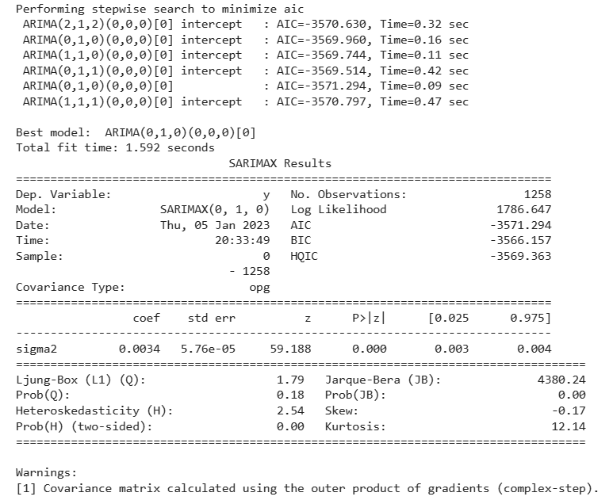

Slide 28
import statsmodels.api as sm
model = sm.tsa.arima.ARIMA(data, order=(5,2,0))

Slide 29
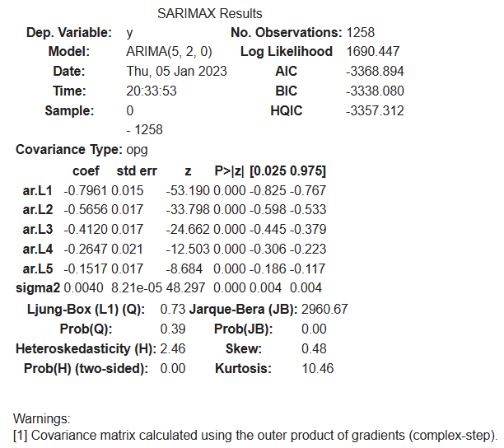
model = model.fit()
model.summary()

Slide 30
start=len(x_train)
end=len(x_train)+len(x_test)-1
pred = model.predict(start=start,end=end)
pred

Slide 31
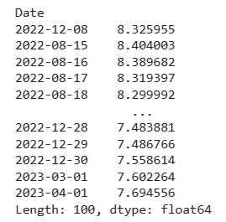
s = pd.Series(pred, index =df2.index[-100:])
S

Slide 32
plt.figure(figsize=(10,6), dpi=100)
df2['Close'][-100:].plot(label='Actual Stock Price', legend=True)
s.plot(label='Predicted Price', legend=True,)

Slide 33
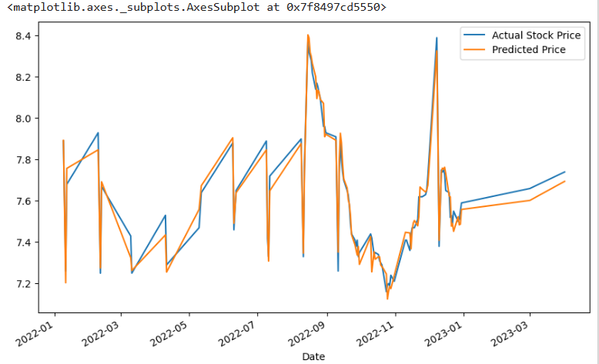

Slide 34
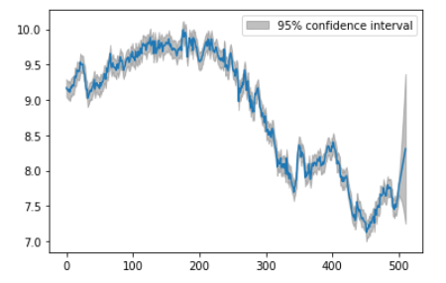
from statsmodels.graphics.tsaplots import plot_predict
plot_predict(model, start = len(data)-500, end = len(data)+10, dynamic = False);

Slide 35
from sklearn.metrics import mean_squared_error
np.sqrt(mean_squared_error(x_test,pred))
0.05102278110077639
from sklearn.metrics import r2_score
r2_score(x_test,pred)
0.9707465368655863

Slide 36
Predicting Future 10 values:
pred_future = model.predict(start=end,end=end+10)
pred_future
array([7.69455591, 7.77802822, 7.82690308, 7.87881952, 7.93227561, 7.98791148, 8.04318253, 8.09442635, 8.14731551, 8.20051232, 8.25395891])

Slide 37
import datetime
start_date = datetime.datetime(2023,4,4)
dates = [start_date + datetime.timedelta(days=idx) for idx in range(11)]

Slide 38
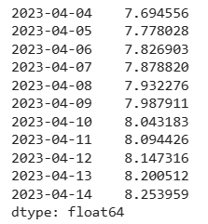
pred_future2 = pd.Series(pred_future, index = dates)
pred_future2

Slide 39
plt.figure(figsize=(10,6), dpi=100)
df2['Close'][-200:].plot(label='Actual Stock Price', legend=True)
pred_future2.plot(label='Future Predicted Price', legend=True)

Slide 40
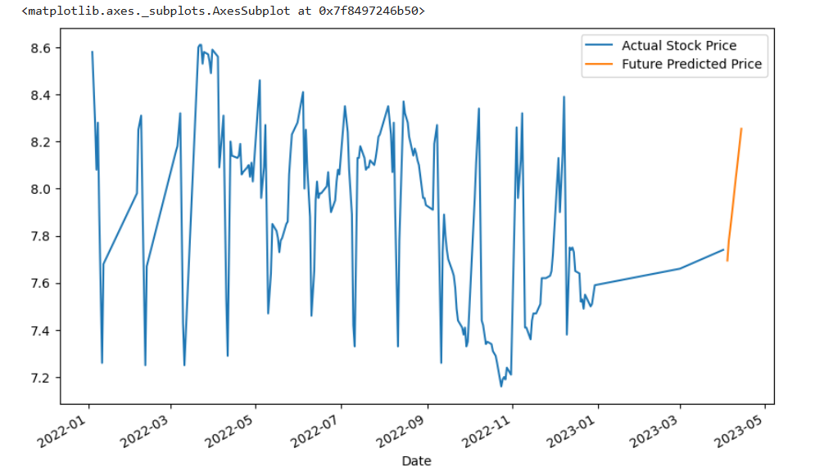

Slide 41
Comparing predicted prices with real prices
check_df = pd.read_csv("SBI.csv")
check_df.Date= pd.to_datetime(check_df.Date)
check_df2 =check_df.set_index('Date')

Slide 42
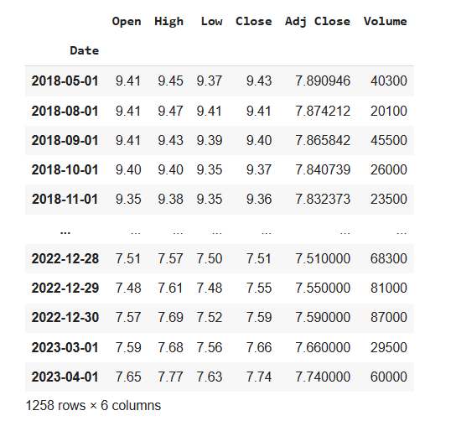
check_df2

Slide 43
plt.figure(figsize=(9,5), dpi=100)
plt.subplot(1, 2, 1)
pred_future2.plot(label='Future Predicted Price', legend=True, color='orange')
plt.subplot(1, 2, 2)
check_df2['Close'].plot(label='Actual Stock Price', legend=True)
plt.show()

Slide 44
