Slide 1
Minimizing Django Growing Pains in a Fast Paced Startup
Wes Kendall, Micah Hausler,
Rob deCarvalho, Jeff McRiffey

Slide 2
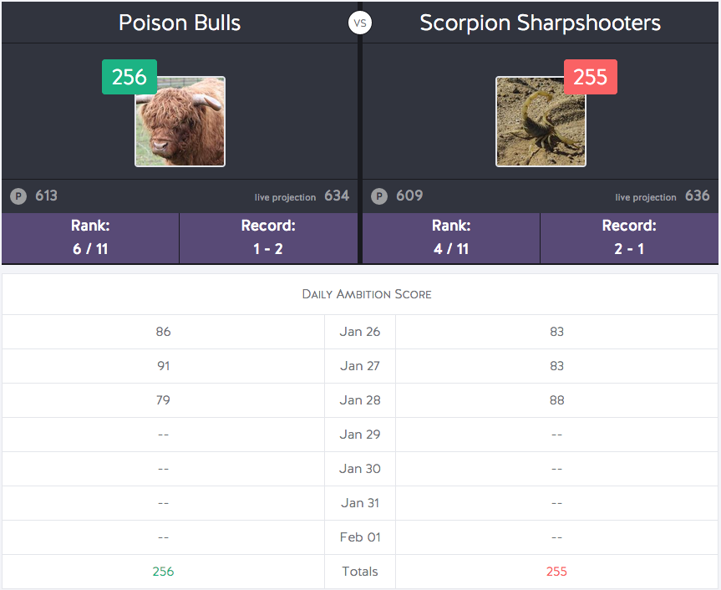
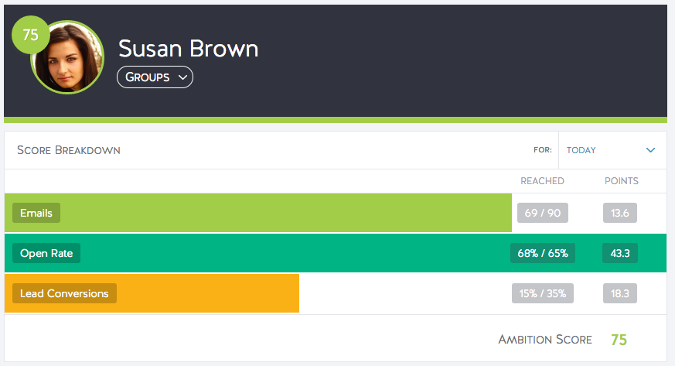
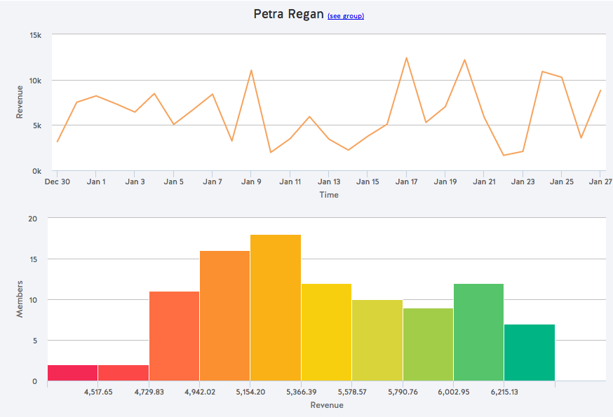
What is Ambition?
Ambition is an engagement platform for businesses
Achievement
Accountability
Awareness
Competition, Leaderboard,
Highlights
Dashboard
Reporting

Slide 3


Over The Past Two Years...
Scaled to 8 engineers
Scaled to over 50+ apps and 5 projects
Over 1M lines of Python code
All while going through YCombinator and scaling up customer base with product pivots

Slide 4
Minimizing Growing Pains
While growing, we have been able to:
Automate code reliability, quality, and standards
Minimize product pivot overhead by architecting key software abstractions
Apply same principles in UI / Javascript design

Slide 5
Automating Best Development Practices
Micah Hausler

Slide 6
Code Quality

Slide 7
100% Test Coverage
But not all bugs are caught with 100% coverage!
That last 1% of coverage are often edge cases: here be dragons
High degree of confidence that a PR is not introducing a new regression
Broken window theory

Slide 8
Static Analysis
Flake8/pylint are your friends
Reduce unused code statements
Reduce complexity
Increase standardization

Slide 9
Continuous Integration
This ties it all together
You should be running your tests/static analysis on every commit
You will always know the state of the code

Slide 10
Documentation

Slide 11
Documentation
Zero examples = no one using your code
The more complicated something becomes, the more likely you are to forget it
Written documentation distributes knowledge within your organization

Slide 12
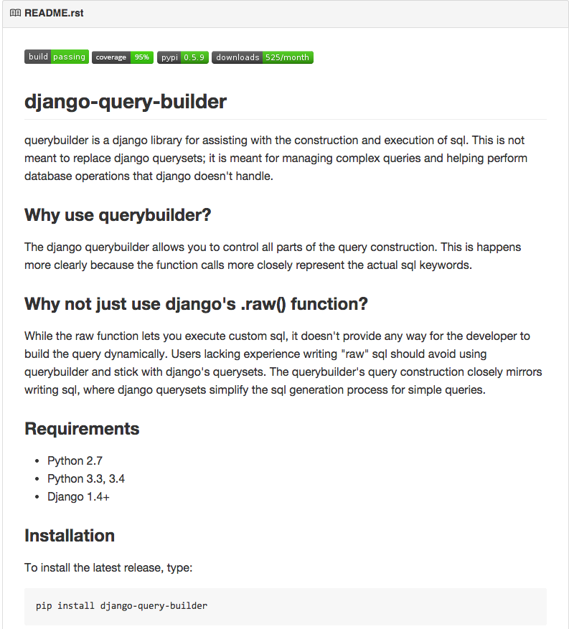
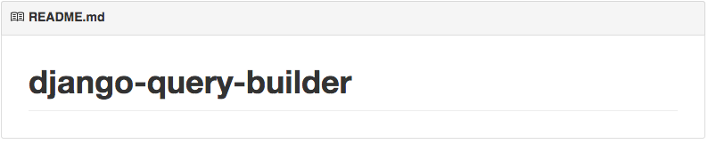
README
Original
Current

Slide 13
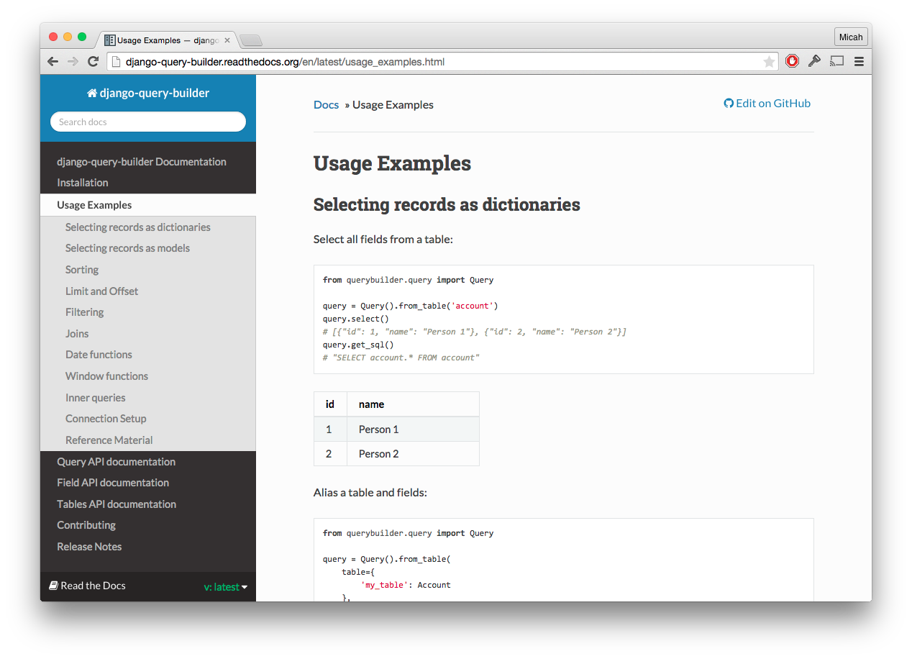
rtfd.org

Slide 14
Code Cleanup

Slide 15
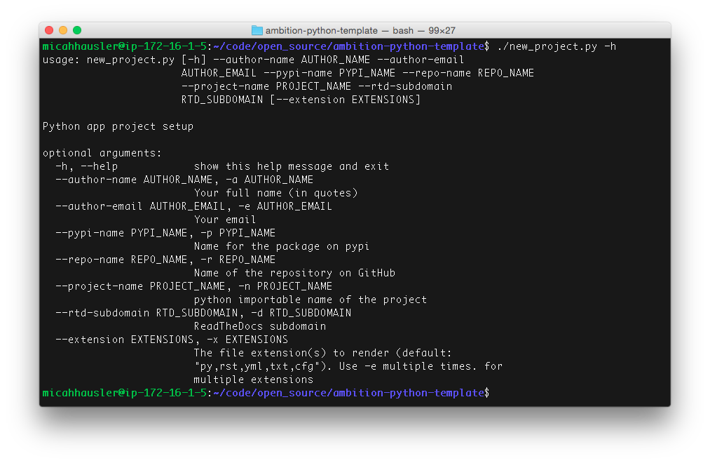
Splitting Up Code
Lots of apps in one project → lots of external apps
Made possible by templating python and django apps and projects

Slide 16
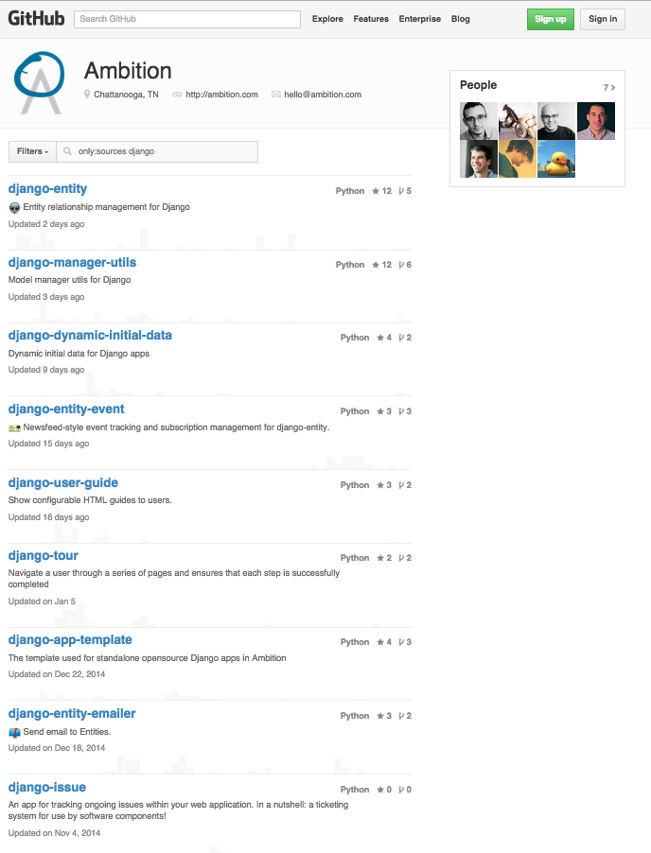
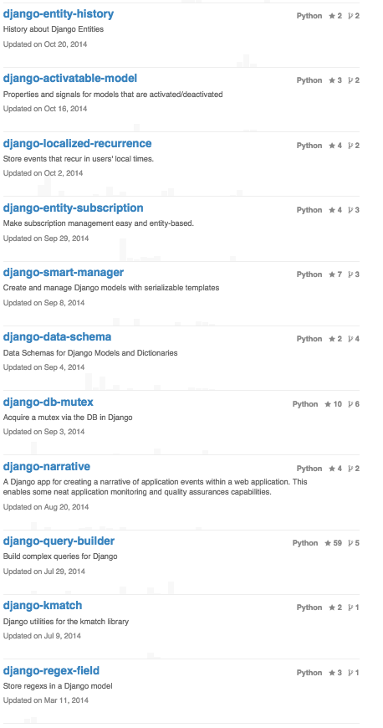
Django Apps

Slide 17
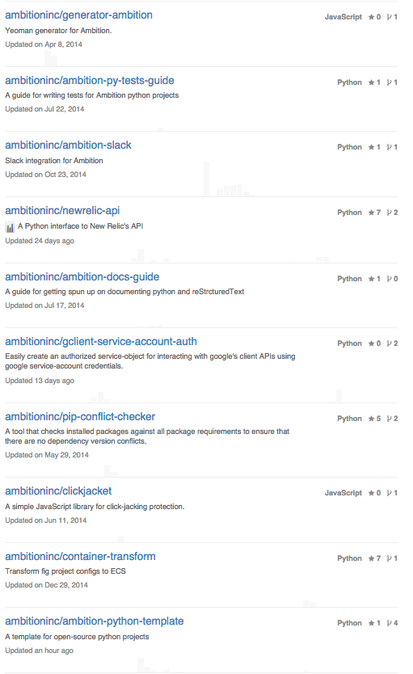
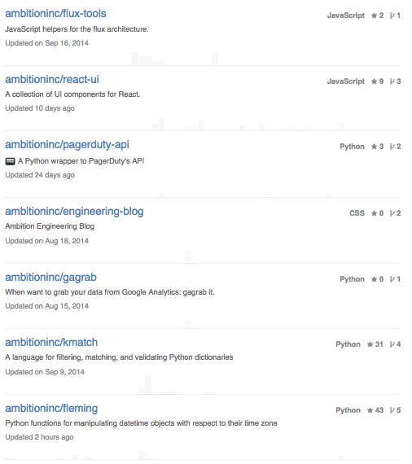

Slide 18
Architecting Useful Abstractions
Rob deCarvalho

Slide 19
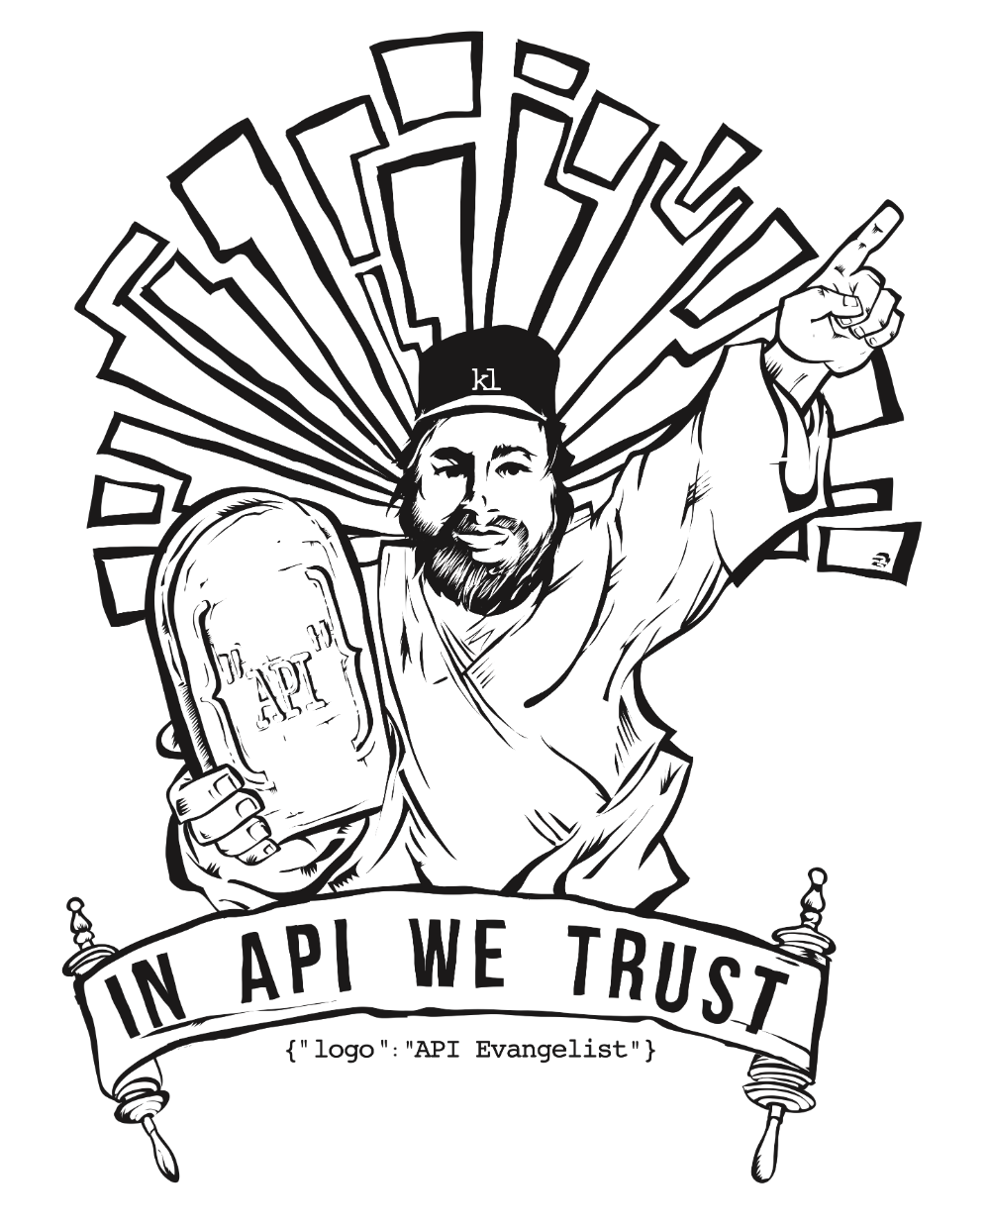




The Principles of Good Abstractions
Common Things Easy
Simplify the common
Stable Interfaces / APIs
Strive for uniformity
Follow expectations
Loose Coupling
Independent components
Connected through well-defined interfaces

Slide 20
Abstractions for Loose Coupling
Loose coupling: Independent blocks of code that interact through well-defined interfaces
Python: packages, modules, functions, classes
Django: apps … BUT!
Giant mutable shared state-machine: database
Changes to database structure often lead to painful code refactoring

Slide 21
Abstractions for Loose Coupling
Loose coupling: Independent blocks of code that interact through well-defined interfaces
Python: packages, modules, functions, classes
Django: apps … BUT!
Giant mutable shared state-machine: database
Changes to database structure often lead to painful code refactoring
Examine case-study that helps with this problem

Slide 22
How Ambition Works
Data Sources
Salesforce
Dropbox
Google Docs
API
Custom
Core System
Metric Processor
Convert data to “metrics”
Benchmark metrics
Create composite “Ambition Score”
Hierarchical Grouper
Aggregate into groups
Company hierarchy
Teams, roles, etc
Apps
Leaderboard
Ranked performance
Competition
Fantasy or Head-to-head
Reports
Tabular or visualized
Event System
Send events to email, TV, feed

Slide 23
How Ambition Works
Data Sources
Salesforce
Dropbox
Google Docs
API
Custom
Core System
Metric Processor
Convert data to “metrics”
Benchmark metrics
Create composite “Ambition Score”
Hierarchical Grouper
Aggregate into groups
Company hierarchy
Teams, roles, etc
Case study - Django entity
Apps
Leaderboard
Ranked performance
Competition
Fantasy or Head-to-head
Reports
Tabular or visualized
Event System
Send events to email, TV, feed

Slide 24
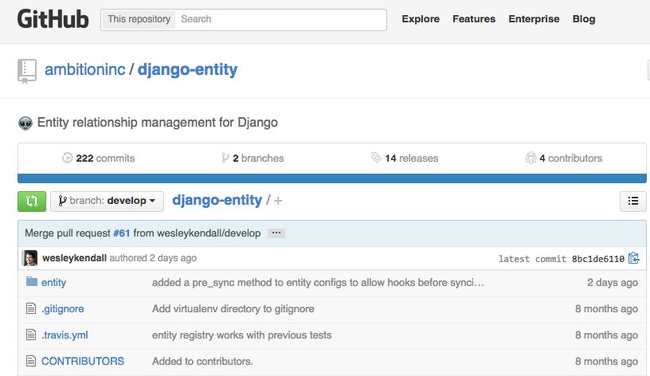
Django Entity
Github app from Ambition
github.com/ambitioninc/django-entity
Model-agnostic hierarchical abstraction
Solves common use case
Interface has semantics for hierarchies
Enables more effective decoupling between apps and the database

Slide 25
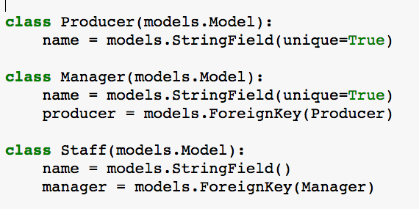
Concrete Example - Music Studio
Producer
Berry
Manager
Brian
Manager
Andrew
Staff
John
Staff
Paul
Staff
George
Staff
Ringo
Staff
Charlie
Staff
Mick
Staff
Keith
Staff
Darryl

Slide 26
Entity Mirroring
Producer
Berry
Manager
Brian
Manager
Andrew
Staff
John
Staff
Paul
Staff
George
Staff
Ringo
Staff
Charlie
Staff
Mick
Staff
Keith
Staff
Darryl
Entity Table
entity_type: Class of mirrored entity
entity_id: pk of mirrored entity
(other stuff)
Entity Relationships Table
super_entity
sub_entity
(other stuff)
Configured with registration process similar to django-admin

Slide 27
Entity Mirroring
Producer
Berry
Manager
Brian
Manager
Andrew
Staff
John
Staff
Paul
Staff
George
Staff
Ringo
Staff
Charlie
Staff
Mick
Staff
Kieth
Staff
Darryl
Entity Table
entity_type: Class of mirrored entity
entity_id: pk of mirrored entity
(other stuff)
Entity Relationships Table
super_entity
sub_entity
(other stuff)
Configured with registration process similar to django-admin

Slide 28
Entity Mirroring
Producer
Berry
Manager
Brian
Manager
Andrew
Staff
John
Staff
Paul
Staff
George
Staff
Ringo
Staff
Charlie
Staff
Mick
Staff
Kieth
Staff
Darryl
Entity Table
entity_type: Class of mirrored entity
entity_id: pk of mirrored entity
(other stuff)
Entity Relationships Table
super_entity
sub_entity
(other stuff)
Configured with registration process similar to django-admin

Slide 29
Entity Mirroring
Producer
Berry
Manager
Brian
Manager
Andrew
Staff
John
Staff
Paul
Staff
George
Staff
Ringo
Staff
Charlie
Staff
Mick
Staff
Kieth
Staff
Darryl
Entity Table
entity_type: Class of mirrored entity
entity_id: pk of mirrored entity
(other stuff)
Entity Relationships Table
super_entity
sub_entity
(other stuff)
Configured with registration process similar to django-admin

Slide 30
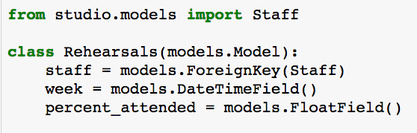
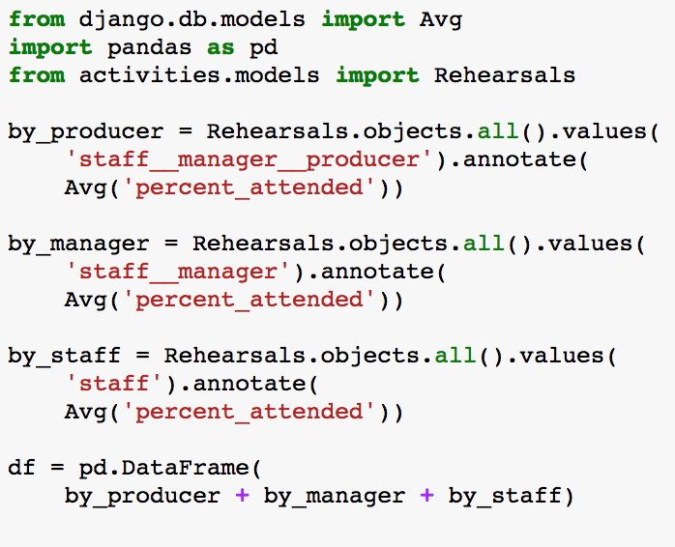
Adding an Analytics App to Project
models.py
stats.py

Slide 31
Adding an Analytics App to Project
models.py
Dependencies
Explicit dependency on studio app
Changing any studio model means code changes in stats module
stats.py

Slide 32
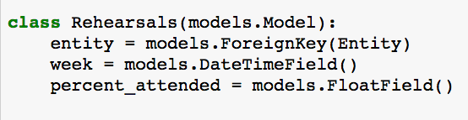
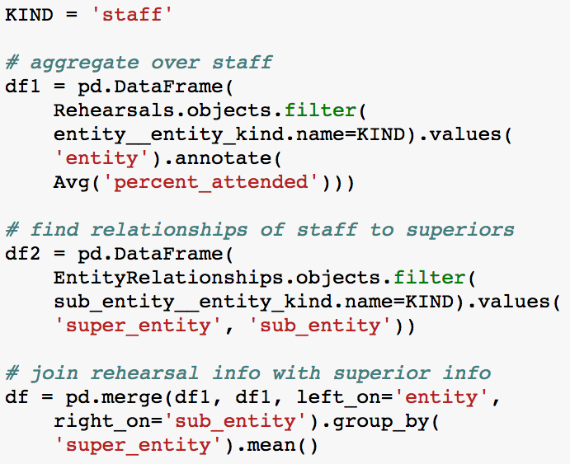
Adding an Analytics App to Project
Entity decouples apps!

Slide 33
Django Entity Helped Ambition Scale
Over 25 Ambition apps use Django Entity
account_management, ambition-business-calendar, ambition-competition, ambition-headlines, ambition-integration, ambition-notification, ambition-onboarding, ambition-trigger, calendar_management, collection_management, django-animal, django-entity-emailer, django-entity-event, django-entity-history, django-entity-subscription, django-lucy, fantasy, fantasy_management, insights, leaderboard, transport, trigger, tv, tv_management, ...
Django Entity is just an example.
We employ similar strategies for various levels of abstraction.

Slide 34
Huge Refactor Just Deployed
Competition-Based Design
Org
League
League
Team
Team
Team
Team
Account
Account
Account
Account
Account
Account
Account
Account
Generic Design
Org
Collection
Collection
Account
Account
Account
Account

Slide 35
Summary
Three properties of good abstractions
Loose coupling is hard for database apps
Django entity helps us decouple our apps
The proof is in the pudding! Our enormous refactor went very smoothly

Slide 36
Front End Architecture
Jeff McRiffey

Slide 37
Front End Practices
Back end practices make much life easier
Useful abstractions => stable APIs
Stable APIs => Predictable UI
Applies to front end too
Code quality (coverage + static analysis)
Loose coupling in JS/CSS (es6 + stylus)
Good abstractions (React + Flux)

Slide 38
React
Components
Declarative view layer
We distinguish views and controller-views
State
Mutable - managed by component
Props
Immutable - managed by parent

Slide 39
React
UserProfileApp (Controller-View)
State
photo, name, email, messages
Photo (View)
Props
photo
Contact (View)
Props
name, email
Messages (View)
Props
messages

Slide 40
Flux
Data flow
Unidirectional, reliable source of truth
Dispatcher
Coordinates communication
Stores
Holds state
Actions
Changes state

Slide 41
Flux
Dispatcher
Store
View
Action

Slide 42
Flux
Action
Store
View
Action
Dispatcher
Store
View
Action

Slide 43
React + Flux App Example
UserProfileApp (Controller-View)
UserProfileStore (Store)
Contact (View)
Photo (View)
Messages (View)
UserProfileDispatcher (Dispatcher)
updateEmail (Action)
updateName (Action)
updatePhoto (Action)
sendMessage (Action)

Slide 44
DEMO

Slide 45
Conclusion
Don’t ever degrade coding practices just to ship code.
Automate best practices. Reduces energy barriers to do the right thing.
When seeing patterns, develop an abstraction.
Maintain these practices on the UI and treat it as a first-class citizen. We did this with React and Flux.

Slide 46
Resources
Slides/Examples - https://github.com/ambitioninc/ambition-pytennessee
Our open source apps:
Django Entity - http://github.com/ambitoninc/django-entity
React UI - http://github.com/ambitioninc/react-ui
All of them - http://github.com/ambitioninc/
Static Analysis
Flake8 - http://flake8.readthedocs.org/en/latest/
Pylint - http://www.pylint.org/
Continuous Integration
TravisCI http://travisci.org/
CircleCI https://circleci.com/
Documentation
RTD - https://readthedocs.org/
MkDocs - http://www.mkdocs.org/
Sphinx - http://sphinx-doc.org/index.html
Google Python Style Guide - https://google-styleguide.googlecode.com/svn/trunk/pyguide.html
Ambition Project Templates (MIT Licensed)
https://github.com/ambitioninc/ambition-python-template
https://github.com/ambitioninc/django-app-template

