Slide 1
YADE: a diagram editor to mechanise categorical proofs
Ambroise Lafont
Chambery, 24 October 2024
Notes:
Bonjour, je vais vous presenter mon porfil autour des langages et preuves mécanisées pour un poste de charche de recherche de classe normale au CNRS
Je suis actuellement en postdoctorat depuis 2022 a l’universite de Cambridge. Apres un premier doctorat a l’universi entre 2020 et 2022, suivant ma these
A quoi ca sert de verifier un compilateur
Precedemment, j’etais
Pas assez articule
Je parle trop vite
Variable binding and substitution for (nameless) dummies

Slide 2

What is YADE?
Yet Another Diagram Editor
Not to be confused with Yet Another Dynamical Engine!
Full name:
YAYADE
Yet Another YADE
or
YA²DE

Slide 3
Packaging
Web app
Check it out if you get bored¹
✖ Not user-friendly
✓ Runs locally in your browser (js)
✓ Can join an online session with other users
✓ LaTeX integration
VSCode extension
coreact-yade
✓ Server for running an online session
(over LiveShare)
✓ Mechanisation features for the Coq proof assistant
¹
https://amblafont.github.io/graph-editor/index.html

Slide 4
Technology
a functional language that compiles to javascript
(last Elm compiler release: December 2019)
Mainly implemented in Elm (12k LoC)
“[My favorite thing] is the feeling of joy and relaxation when writing Elm code.”
Luca Mugnaini, Software Engineer, Rakuten
+ some bits of TypeScript / JS (vscode extension, server, …)

Slide 5
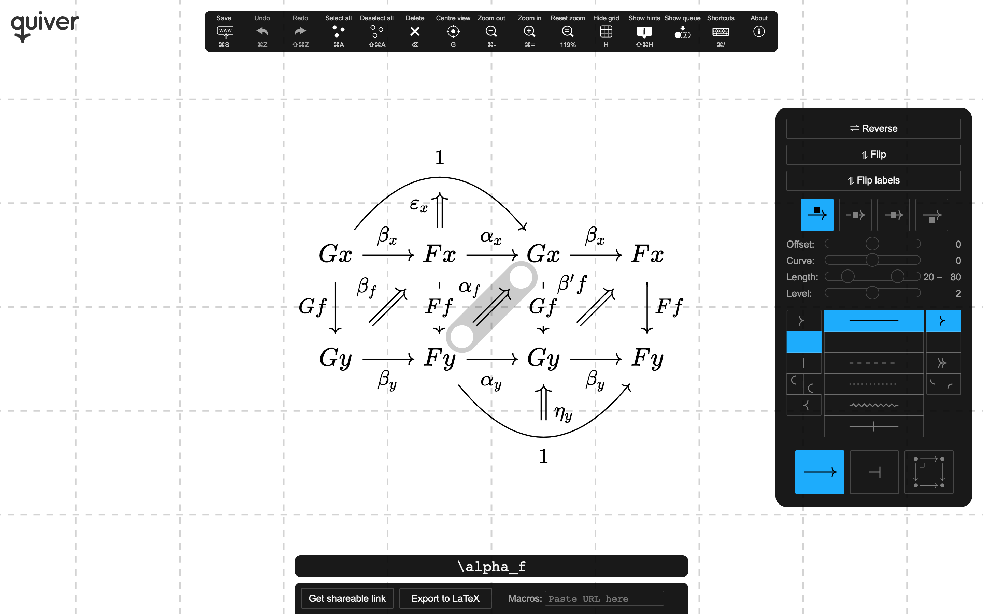
An other diagram editor: Quiver
“a modern, graphical editor for commutative and pasting diagrams, capable of rendering high-quality diagrams for screen viewing, and exporting to LaTeX via tikz-cd.”
Implemented by Nathaniel Arkhor
Implemented in Javascript
More user-friendly
Widely used
Much more styling options, but currently lacks useful features such as copy & paste

Slide 6
Mechanisation features

Slide 7
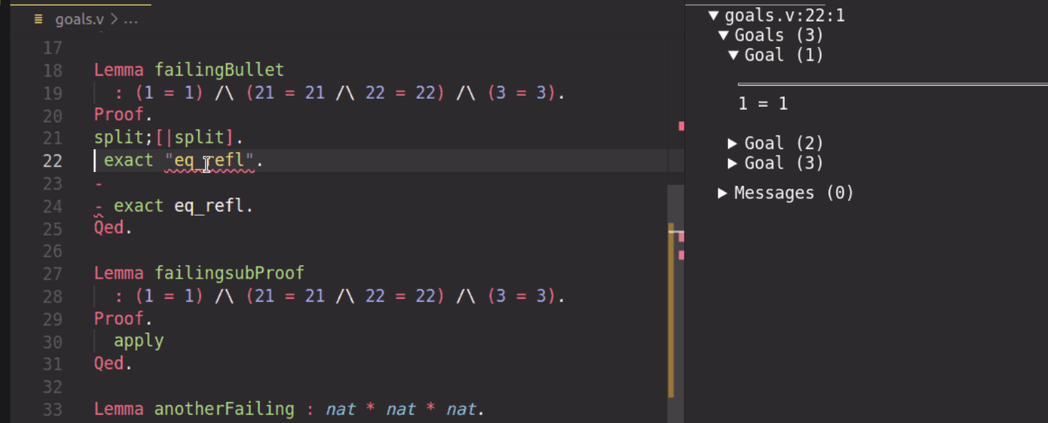



The Coq proof assistant
A software to write formal proofs interactively
VS Code editor
Edited file
Feedback from the Coq proof assistant

Slide 8
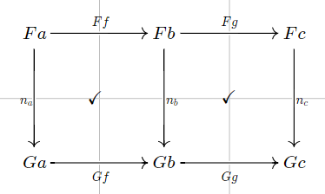
Architecture of YADE
Diagram editor
(standalone version)
Show diagram
under cursor
Custom vscode extension
Visual Studio Code
(+ Coq library for custom notations)

Slide 9
Architecture of YADE
Diagram editor
(standalone version)
Show diagram
under cursor
Custom vscode extension
Visual Studio Code
Proof generation
(+ Coq library for custom notations)

Slide 10




























Proof generation: an example
Automatic generation?
Diagrammatic proof
Computer-friendly proof
$$α_{c_{1}}$$
$$β_{c_{1}}$$
$$Fc_{1}$$
$$Gc_{1}$$
$$Hc_{1}$$
YADE
?
$$Ff$$
$$Hf∘β_{c_{1}}∘α_{c_{1}}=β_{c_{2}}∘α_{c_{2}}∘Ff$$
$$Hf$$
$$Hf∘β_{c_{1}}∘α_{c_{1}}$$
$$=β_{c_{2}}∘Gf∘α_{c_{1}}$$
$=β_{c_{2}}∘α_{c_{2}}∘Ff$
$$Fc_{2}$$
$${Gc}_{2}$$
$${Hc}_{2}$$
$$α_{c_{2}}$$
$$β_{c_{2}}$$
$$α_{c_{1}}$$
$$β_{c_{1}}$$
$$Fc_{1}$$
$$Gc_{1}$$
$$Hc_{1}$$
$$Ff$$
=
$$Gf$$
=
$$Hf$$
$$Fc_{2}$$
$${Gc}_{2}$$
$${Hc}_{2}$$
$$α_{c_{2}}$$
$$β_{c_{2}}$$

Slide 11
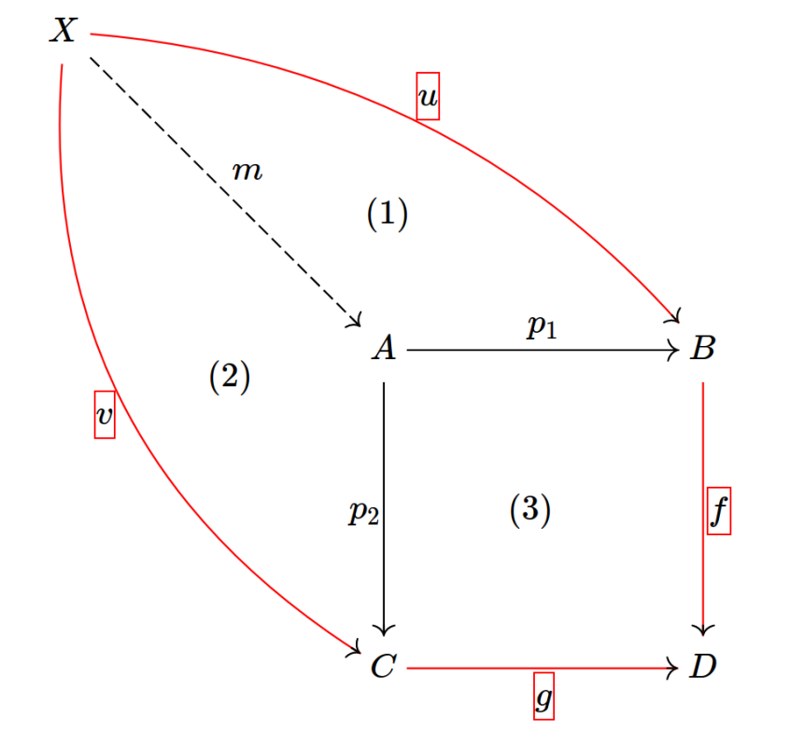

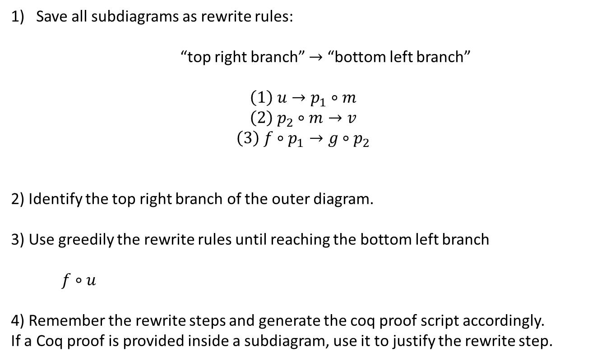










Proof generation: sketch of the algorithm
Save all subdiagrams as rewrite rules:
“top right branch” $→$ “bottom left branch”
$$\left(1\right) u→p_{1}∘m$$
$$\left(2\right) p_{2}∘m→v$$
$$\left(3\right) f∘p_{1}→g∘p_{2}$$
2) Identify the top right branch of the outer diagram.
3) Use greedily the rewrite rules until reaching the bottom left branch
$f∘u$
4) Remember the rewrite steps and generate the coq proof script accordingly.
If a Coq proof is provided inside a subdiagram, use it to justify the rewrite step.
$$→^{\left(1\right)}f∘p_{1}∘m$$
$$→^{\left(3\right)}g∘p_{2}∘m$$
$$→^{\left(2\right)} g∘v$$

Slide 12
Architecture of YADE
Diagram editor
(standalone version)
Show diagram
under cursor
Custom vscode extension
Visual Studio Code
Proof generation
(+ Coq library for custom notations)

Slide 13
Architecture of YADE
Diagram editor
(standalone version)
Show diagram
under cursor
Custom vscode extension
Visual Studio Code
Proof generation
Interactive diagrammatic proof
(+ Coq library for custom notations)

Slide 14
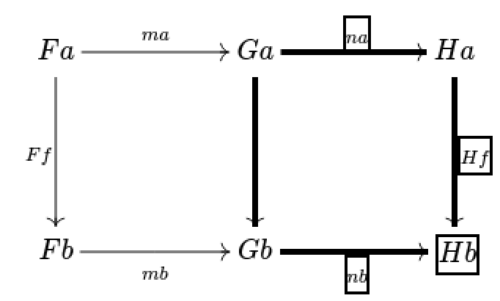
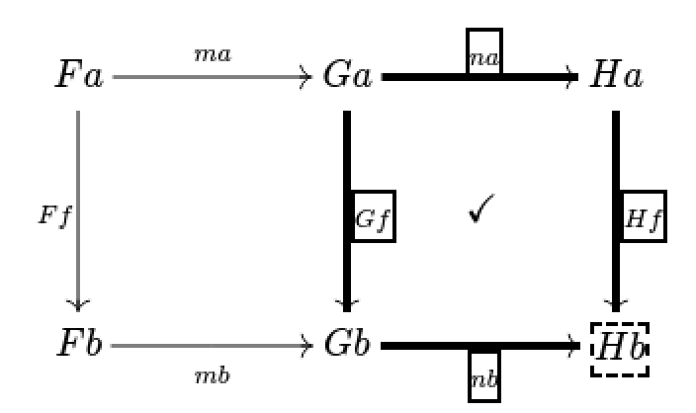

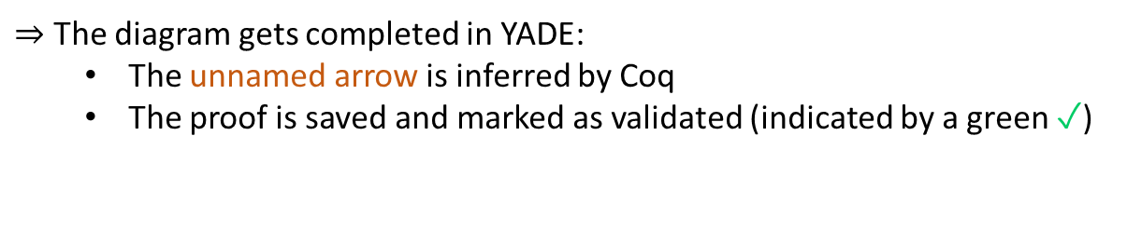

Building the diagrammatic proof interactively
1) Select a subdiagram
2) Create a proof node, labelled with the Coq tactic naturality.
unnamed morphism
(to be inferred)
$⇒$ Coq checks that it solves the goal:
$$Hf∘n_{a}=nb∘_$$
$⇒$ The diagram gets completed in YADE:
The unnamed arrow is inferred by Coq
The proof is saved and marked as validated (indicated by a green ✓)
✓

Slide 15
Demo¹
(Based on the category theory library of Hierarchy Builder)
A distributive law $δ:TS⇒ST$ between two monads $S$ and $T$ induces a monad structure on $ST$.
Let us show that the induced multiplication $STST\overset{SδT}{→}SSTT\overset{μ^{S}μ^{T}}{→}ST$ is associative.
¹ https://github.com/amblafont/vscode-yade-example

Slide 16
Coq tactics and notations (yade.v)

Slide 17
The tactic norm_graph
$$f·g=h \text{·} k$$
Coq goal
norm_graph.
a -- f -> b -- g -> c = a -- h -> d -- k -> c
Objects are explicit in the final goal.
YADE can parse directly the output string.
norm_graph is (silently) called by the vscode extension before sending data to YADE.
(the user should not need to call this tactic yourself)

Slide 18
Categorical notations
Declaration of two “notation scopes”, for morphisms and objects
Declare Custom Entry obj.
Declare Custom Entry mor.
“Space” is functor application and is right associative:
“T T x” means “T (T x)”
“|x|” is the identity morphism on “x”

Slide 19
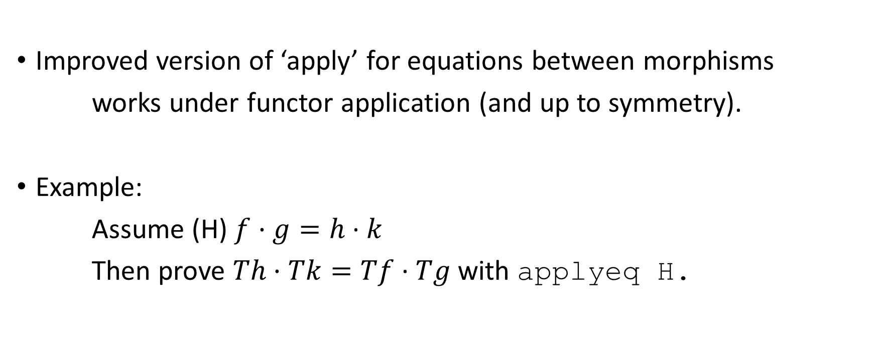
The tactic applyeq
Improved version of ‘apply’ for equations between morphisms
works under functor application (and up to symmetry).
Example:
Assume (H) $f·g=h \text{· }k$
Then prove $Th·Tk=Tf \text{· }Tg$ with applyeq H.

Slide 20
The underlying category theory library (definition of categories, functors, …)
Originally, based on the (big) UniMath library
The demo is based on Hierarchy Builder’s (small) library
Adaptation was easy: just redefine some lemmas / notations on top of your favourite library (see yade.v)

Slide 21
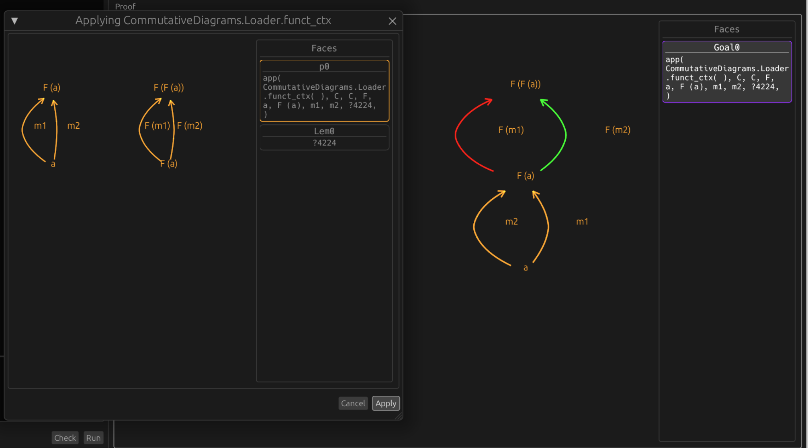
Another related software for mechanisation:
Luc Chabassier’s interface for diagrammatic proofs¹
Goal, assumptions, lemmas
Graphical interface
(standalone program,
implemented in Rust)
Coq plugin
(ocaml)
Lemma …
Proof.
…
diagram server.
Coq proof term
(implicit)
Automatic layout (limited manual editing)
Proof tactics (including invoking a lemma)
Integrated search for lemmas
¹ https://github.com/dwarfmaster/commutative-diagrams

Slide 22
How to try YADE
Requirements for the full example available on github¹
Package manager for ocaml softwares / libraries
opam
Coq-lsp runtime
Handles communication between vscode and Coq
Hierarchy builder
A coq library to help building algebraic hierarchies
(e.g. categories)
Coreact-yade extension
Coq
Visual Studio Code
¹ https://github.com/amblafont/vscode-yade-example

