Slide 1
A diagram editor to mechanise categorical proofs
Ambroise Lafont
CoqPL, 20 January 2024
Notes:
Bonjour, je vais vous presenter mon porfil autour des langages et preuves mécanisées pour un poste de charche de recherche de classe normale au CNRS
Je suis actuellement en postdoctorat depuis 2022 a l’universite de Cambridge. Apres un premier doctorat a l’universi entre 2020 et 2022, suivant ma these
A quoi ca sert de verifier un compilateur
Precedemment, j’etais
Pas assez articule
Je parle trop vite
Variable binding and substitution for (nameless) dummies

Slide 2
Naming convention
Yet Another Diagram Editor
I will refer to my editor as YADE, or Coreact-YADE.
ANR Project¹ (2023 - 2027): Coq-based Rewriting: Towards Executable Applied Category Theory
¹ https://coreact.wiki/

Slide 3
How to test the editor
A web app that runs locally in your browser
A standalone desktop program
Embeds the web app using electron
Additional features (mechanisation)
https://amblafont.github.io/graph-editor/index.html

Slide 4
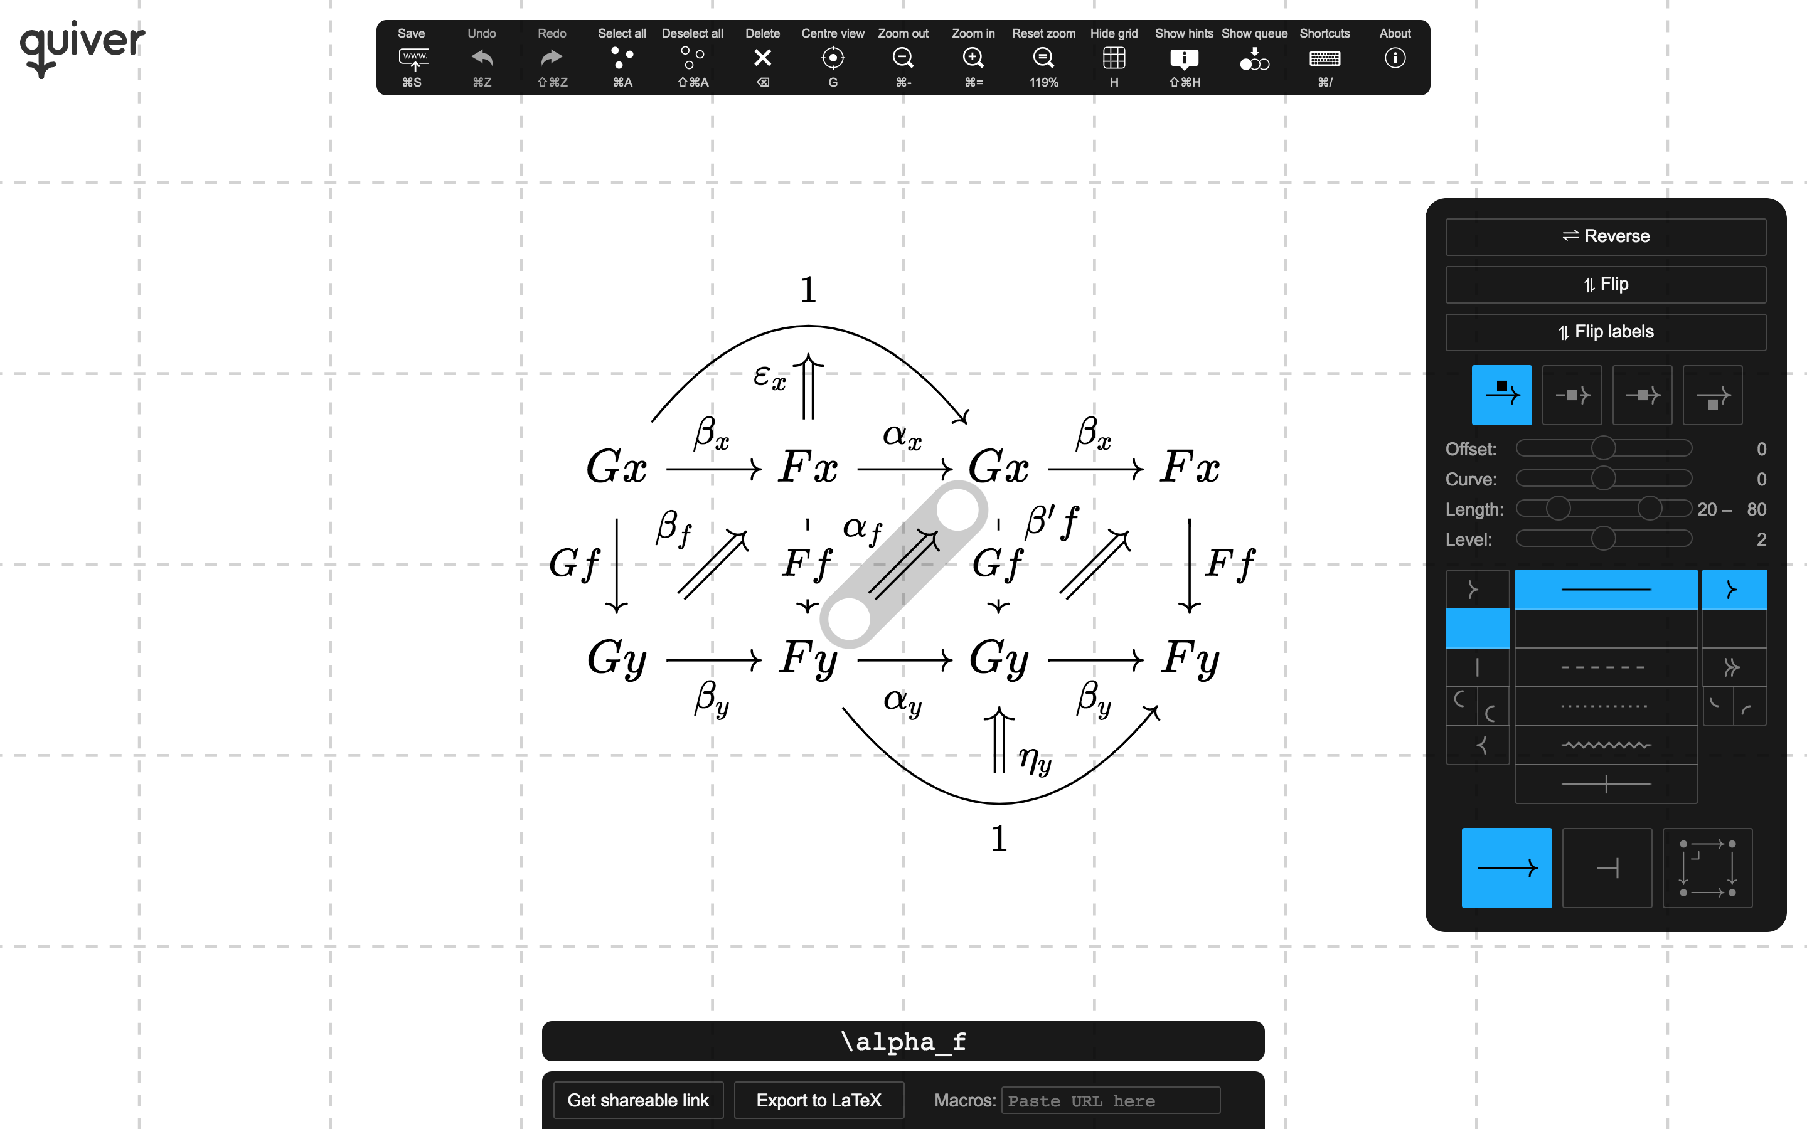
Related software: Quiver
“a modern, graphical editor for commutative and pasting diagrams, capable of rendering high-quality diagrams for screen viewing, and exporting to LaTeX via tikz-cd.”

Slide 5
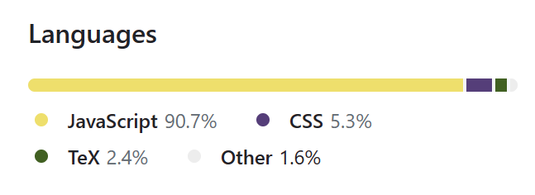
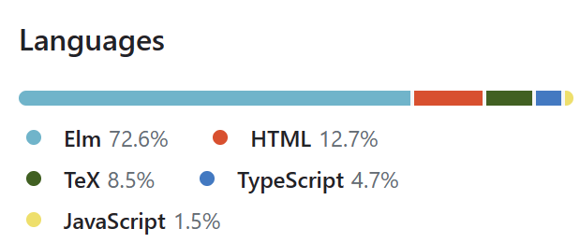
Comparison with quiver
About the same size (around 10k of LoC)
 | Quiver | YADE
Programming Languages | JavaScript + React
Styling options | + | -
User-friendly | + | -
Editing features | - | + Tabs, copy & paste, find & replace, expand selection to connected components, …
LaTeX export | yes | yes¹
¹ Implemented by Tom Hirschowitz

Slide 6
Comparison with quiver
About the same size (around 10k of LoC)
 | Quiver | YADE
Programming Languages | JavaScript + React
Styling options | + | -
User-friendly | + | -
Editing features | - | + Tabs, copy & paste, find & replace, expand selection to connected components, …
LaTeX export | yes | yes¹
Mechanisation features | - | +
¹ Implemented by Tom Hirschowitz

Slide 7

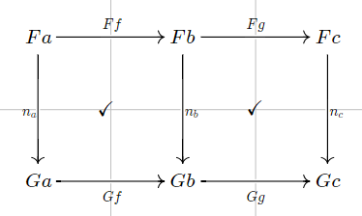
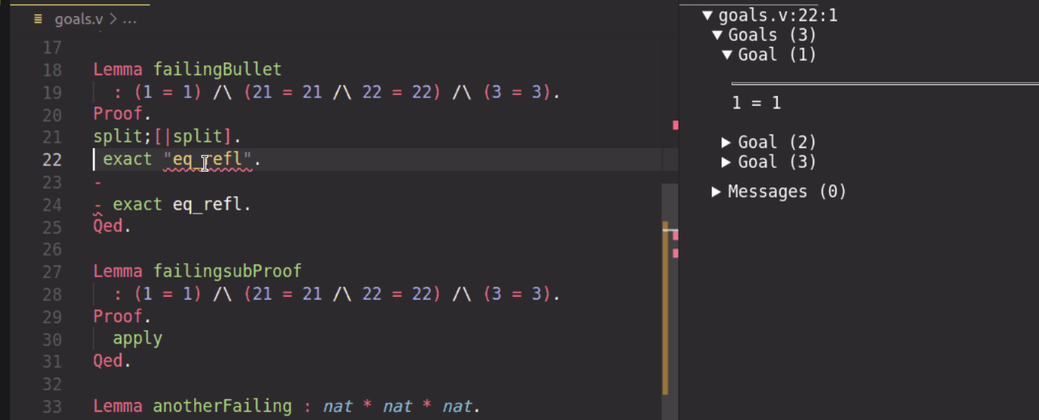
Architecture
Diagram editor
(standalone version)
Custom vscode extension
(building upon coq-lsp)
Visual Studio Code
Show diagram
under cursor
Generate proofs
(+ Coq library for custom notations)

Slide 8




























Natural transformations compose:
If $α:F⇒G$ and $β:G⇒H$ are natural, then so is ${\left(β_{c}∘α_{c}:Fc→Hc\right)}_{c}$
Automatic generation?
Diagrammatic proof
Computer-friendly proof
$$α_{c_{1}}$$
$$β_{c_{1}}$$
$$Fc_{1}$$
$$Gc_{1}$$
$$Hc_{1}$$
YADE
?
$$Ff$$
$$Hf∘β_{c_{1}}∘α_{c_{1}}=β_{c_{2}}∘α_{c_{2}}∘Ff$$
$$Hf$$
$$Hf∘β_{c_{1}}∘α_{c_{1}}$$
$$=β_{c_{2}}∘Gf∘α_{c_{1}}$$
$=β_{c_{2}}∘α_{c_{2}}∘Ff$
$$Fc_{2}$$
$${Gc}_{2}$$
$${Hc}_{2}$$
$$α_{c_{2}}$$
$$β_{c_{2}}$$
$$α_{c_{1}}$$
$$β_{c_{1}}$$
$$Fc_{1}$$
$$Gc_{1}$$
$$Hc_{1}$$
$$Ff$$
=
$$Gf$$
=
$$Hf$$
$$Fc_{2}$$
$${Gc}_{2}$$
$${Hc}_{2}$$
$$α_{c_{2}}$$
$$β_{c_{2}}$$

Slide 9
Architecture
Diagram editor
(standalone version)
Custom vscode extension
(building upon coq-lsp)
Visual Studio Code
Show diagram
under cursor
Generate proofs
Construct diagrams step by step
(+ Coq library for custom notations)

Slide 10
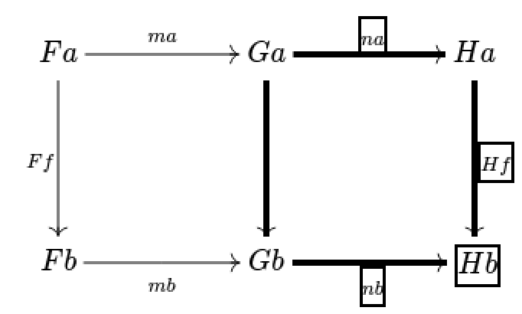
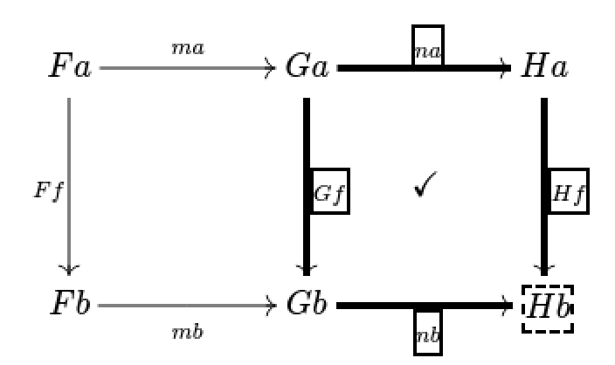

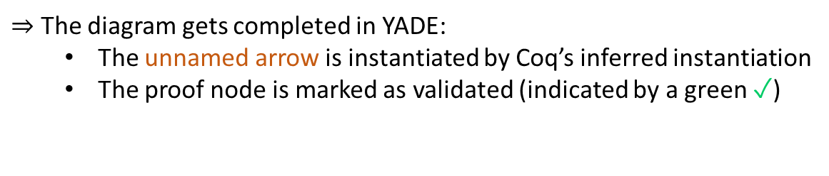

Building the diagrammatic proof interactively
1) Select a subdiagram
2) Create a proof node, labelled with the Coq tactic naturality.
unnamed arrow
$⇒$ Coq (in vscode) checks that this tactic solves the goal:
$$Hf∘n_{a}=nb∘_$$
$⇒$ The diagram gets completed in YADE:
The unnamed arrow is instantiated by Coq’s inferred instantiation
The proof node is marked as validated (indicated by a green ✓)
✓

Slide 11

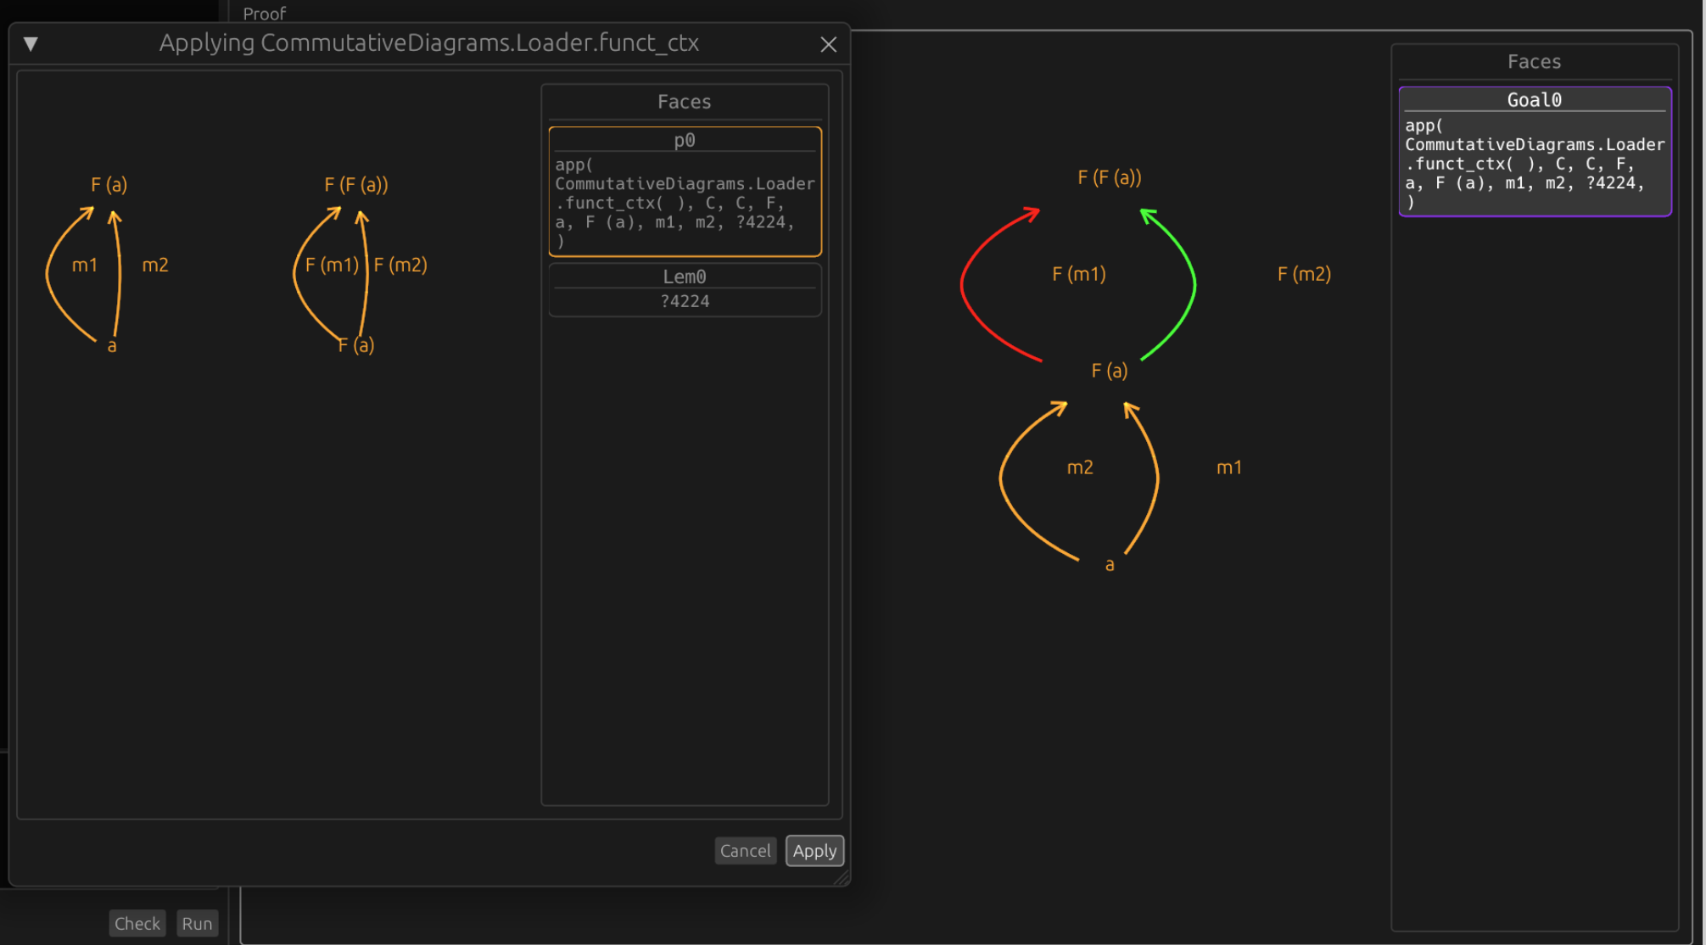
Another related software for mechanisation:
Luc Chabassier’s interface¹ for diagrammatic proofs
Goal, assumptions, lemmas
Graphical interface
(standalone program,
implemented in Rust)
Coq plugin
(ocaml)
Lemma …
Proof.
…
diagram server.
Coq proof term
(implicit)
Automatic layout (limited manual editing)
Proof tactics (including invoking a lemma)
¹https://github.com/dwarfmaster/commutative-diagrams

Slide 12
Demo¹ of YADE
(Based on the category theory library of Hierarchy Builder + custom tactics & notations)
A distributive law $δ:TS⇒ST$ between two monads $S$ and $T$ induces a monad structure on $ST$.
Let us show that the induced multiplication $STST\overset{SδT}{→}SSTT\overset{μ^{S}μ^{T}}{→}ST$ is associative.
¹ https://github.com/amblafont/vscode-yade-example

Slide 13
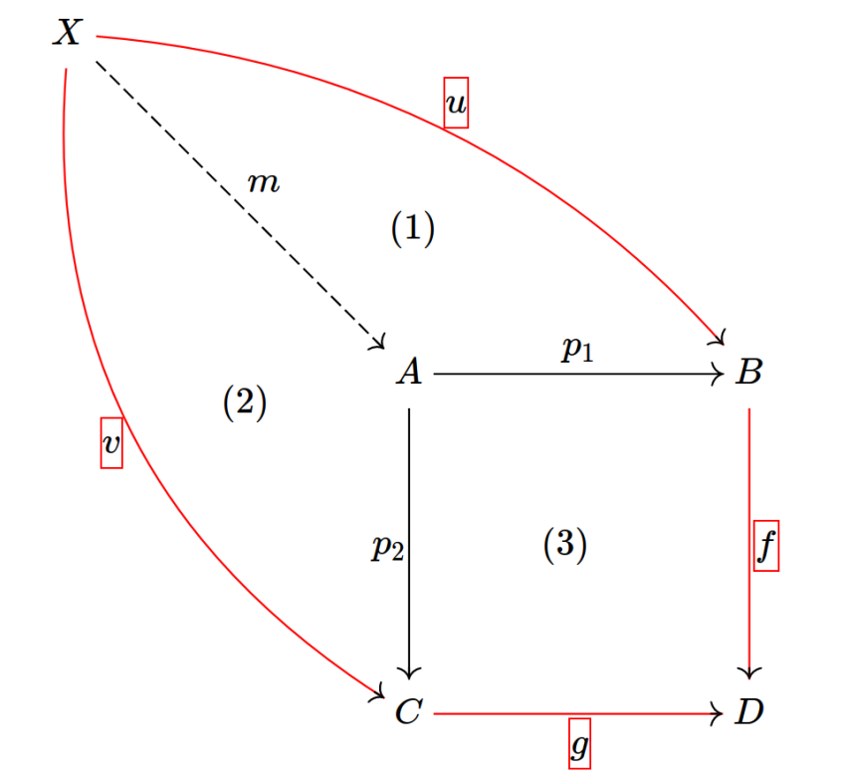
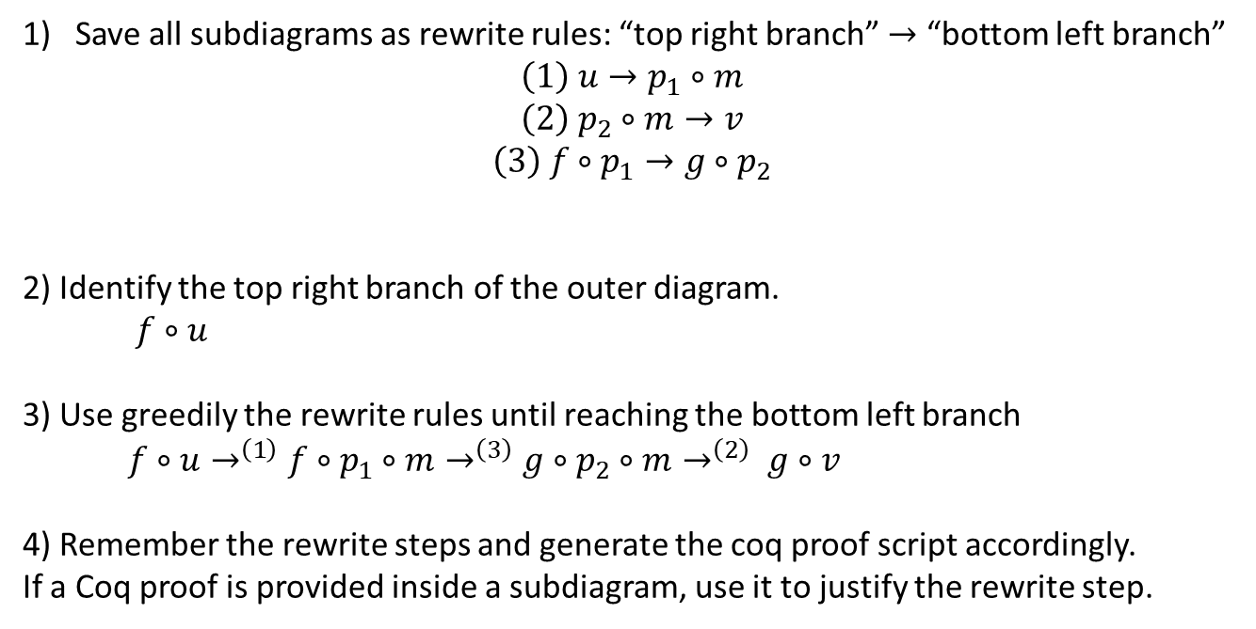
Proof generation: sketch of the algorithm
Save all subdiagrams as rewrite rules: “top right branch” $→$ “bottom left branch”
$$\left(1\right) u→p_{1}∘m$$
$$\left(2\right) p_{2}∘m→v$$
$$\left(3\right) f∘p_{1}→g∘p_{2}$$
2) Identify the top right branch of the outer diagram.
$f∘u$
3) Use greedily the rewrite rules until reaching the bottom left branch
$f∘u→^{\left(1\right)}f∘p_{1}∘m→^{\left(3\right)}g∘p_{2}∘m→^{\left(2\right)} g∘v$
4) Remember the rewrite steps and generate the coq proof script accordingly.
If a Coq proof is provided inside a subdiagram, use it to justify the rewrite step.

