Slide 1
YA²DE: a diagram editor to mechanise categorical proofs
Ambroise Lafont
Chambery, 24 October 2024
Notes:
Bonjour, je vais vous presenter mon porfil autour des langages et preuves mécanisées pour un poste de charche de recherche de classe normale au CNRS
Je suis actuellement en postdoctorat depuis 2022 a l’universite de Cambridge. Apres un premier doctorat a l’universi entre 2020 et 2022, suivant ma these
A quoi ca sert de verifier un compilateur
Precedemment, j’etais
Pas assez articule
Je parle trop vite
Variable binding and substitution for (nameless) dummies

Slide 2

What is YA²DE?
Yet Another Diagram Editor
Not to be confused with Yet Another Dynamical Engine!
YA²DE =
YAYADE
Yet Another YADE

Slide 3
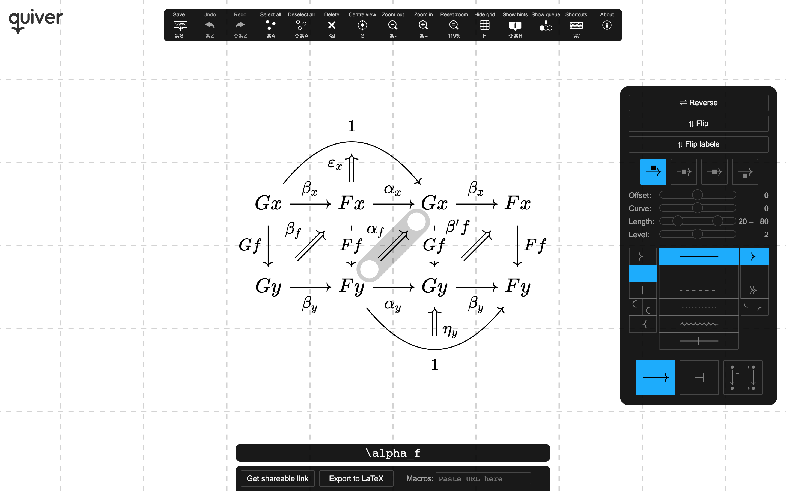
An other diagram editor: Quiver
“a modern, graphical editor for commutative and pasting diagrams, capable of rendering high-quality diagrams for screen viewing, and exporting to LaTeX via tikz-cd.”
Implemented by Nathaniel Arkhor
Implemented in Javascript
More user-friendly
Widely used
Much more styling options
Lacks useful features such as copy & paste
No mechanisation features

Slide 4
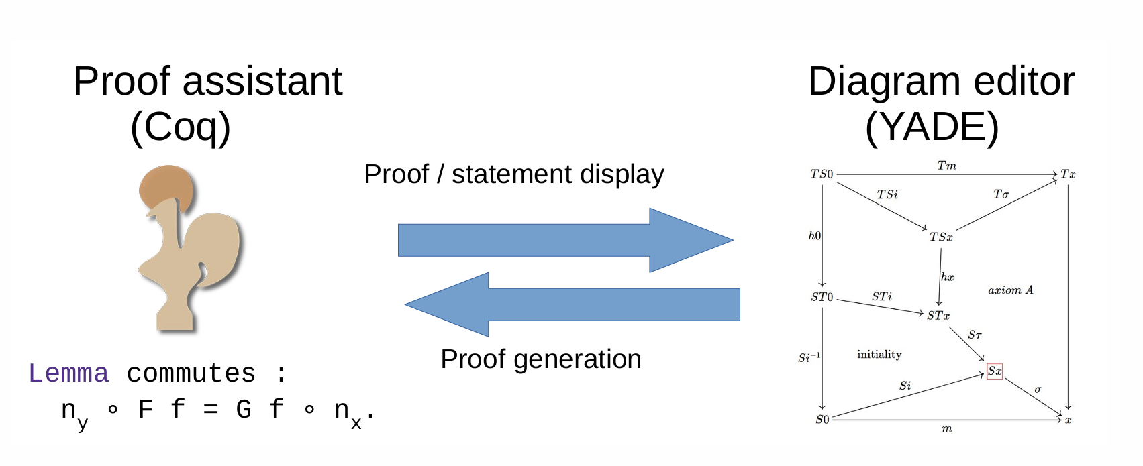
Mechanisation features of YADE

Slide 5

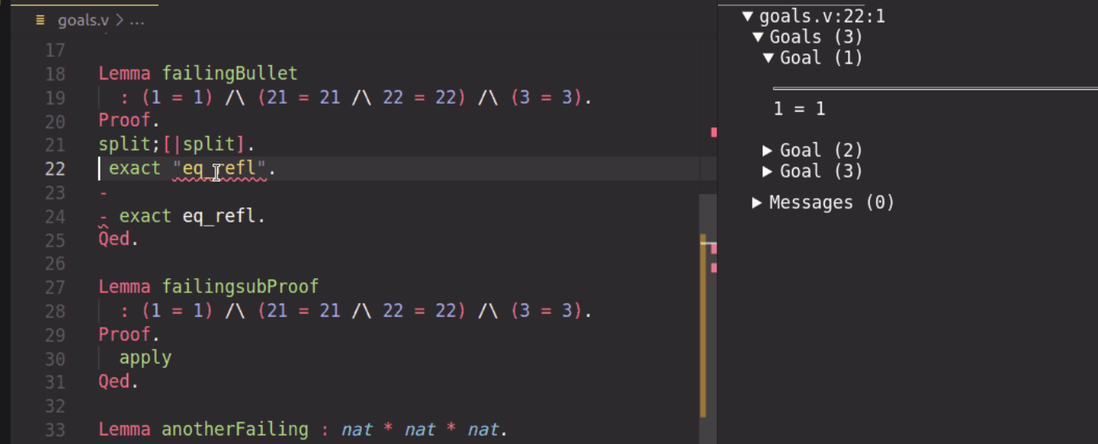


The Coq proof assistant
A software to write formal proofs interactively
VS Code editor
Edited file
Feedback from the Coq proof assistant

Slide 6
Packaging of YADE
Web app
Check it out if you get bored
✖ Not user-friendly
✓ Runs locally in your browser (js)
✓ Can join collaborative session
✓ LaTeX integration
VSCode extension
coreact-yade
✓ Server for running collaborative session
(over LiveShare)
✓ Mechanisation features for the Coq proof assistant
https://amblafont.github.io/graph-editor/index.html

Slide 7
Technology
Some bits of TypeScript / JS (vscode extension)
Otherwise, mainly implemented in Elm (12k LoC)
a functional language that compiles to javascript
“[My favorite thing] is the feeling of joy and relaxation when writing Elm code.”
Luca Mugnaini, Software Engineer, Rakuten
last Elm compiler release: December 2019

Slide 8
Mechanisation of commutation proofs with YADE
?
(of “commutation statements”)
?

Slide 9
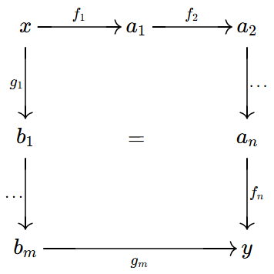
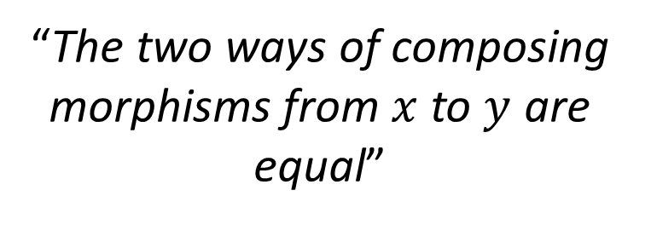
What is a commutation statement?
$$f_{1}∘f_{2}∘…∘f_{n}=g_{1}∘…∘g_{m}$$
More explicitly,
Equivalently,
“The two ways of composing morphisms from $x$ to $y$ are equal”
Notes:
x -- f_1 -> a_1 -- f_2 -> a_2 -- \dots -> a_{n} -- f_n -> y = x -- g_1 -> b_1 -- \dots -> b_{m} -- g_m -> y
{"graph":{"activeTabId":0,"latexPreamble":"\\newcommand{\\coqproof}[1]{\\checkmark}","nextTabId":1,"tabs":[{"edges":[{"from":0,"id":10,"label":{"kind":"normal","label":"f_1","style":{"alignment":"left","bend":0,"color":"black","dashed":false,"head":"default","kind":"normal","position":0.5,"tail":"none"},"zindex":0},"to":3},{"from":3,"id":11,"label":{"kind":"normal","label":"f_2","style":{"alignment":"left","bend":0,"color":"black","dashed":false,"head":"default","kind":"normal","position":0.5,"tail":"none"},"zindex":0},"to":2},{"from":2,"id":12,"label":{"kind":"normal","label":"\\dots","style":{"alignment":"left","bend":0,"color":"black","dashed":false,"head":"default","kind":"normal","position":0.5,"tail":"none"},"zindex":0},"to":4},{"from":4,"id":13,"label":{"kind":"normal","label":"f_n","style":{"alignment":"left","bend":0,"color":"black","dashed":false,"head":"default","kind":"normal","position":0.5,"tail":"none"},"zindex":0},"to":1},{"from":7,"id":14,"label":{"kind":"normal","label":"\\dots","style":{"alignment":"left","bend":0,"color":"black","dashed":false,"head":"default","kind":"normal","position":0.5,"tail":"none"},"zindex":0},"to":6},{"from":6,"id":15,"label":{"kind":"normal","label":"g_m","style":{"alignment":"left","bend":0,"color":"black","dashed":false,"head":"default","kind":"normal","position":0.5,"tail":"none"},"zindex":0},"to":8},{"from":9,"id":16,"label":{"kind":"normal","label":"g_1","style":{"alignment":"left","bend":0,"color":"black","dashed":false,"head":"default","kind":"normal","position":0.5,"tail":"none"},"zindex":0},"to":7}],"id":0,"nextGraphId":17,"nodes":[{"id":0,"label":{"isCoqValidated":false,"isMath":true,"label":"x","pos":[48,48],"zindex":0}},{"id":1,"label":{"isCoqValidated":false,"isMath":true,"label":"y","pos":[432,48],"zindex":0}},{"id":2,"label":{"isCoqValidated":false,"isMath":true,"label":"a_2","pos":[240,48],"zindex":0}},{"id":3,"label":{"isCoqValidated":false,"isMath":true,"label":"a_1","pos":[144,48],"zindex":0}},{"id":4,"label":{"isCoqValidated":false,"isMath":true,"label":"a_{n}","pos":[336,48],"zindex":0}},{"id":5,"label":{"isCoqValidated":false,"isMath":true,"label":"=","pos":[479.14286041259766,48],"zindex":0}},{"id":6,"label":{"isCoqValidated":false,"isMath":true,"label":"b_{m}","pos":[719.1428604125977,48],"zindex":0}},{"id":7,"label":{"isCoqValidated":false,"isMath":true,"label":"b_1","pos":[623.1428604125977,48],"zindex":0}},{"id":8,"label":{"isCoqValidated":false,"isMath":true,"label":"y","pos":[815.1428604125977,48],"zindex":0}},{"id":9,"label":{"isCoqValidated":false,"isMath":true,"label":"x","pos":[527.1428604125977,48],"zindex":0}}],"sizeGrid":96,"title":"2"}]},"version":14}

Slide 10
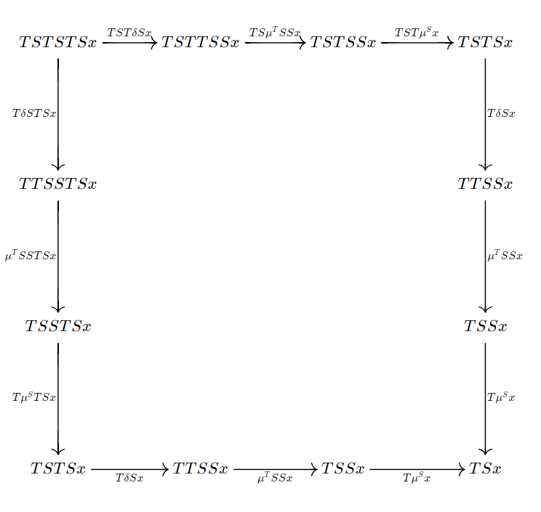
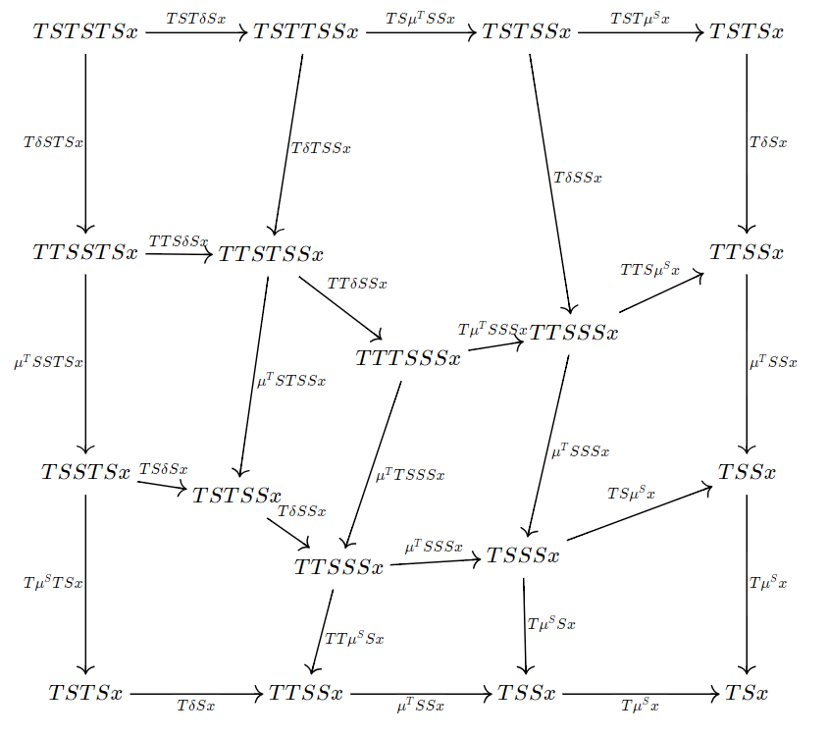
How to prove a commutation statement?
“split” the diagram into subfaces
justify equality of each subface
This is enough to reconstruct the proof that the original equality holds
=
=
=
?
=
=
=
=
=
=
=
=
Notes:
x -- f_1 -> a_1 -- f_2 -> a_2 -- \dots -> a_{n} -- f_n -> y = x -- g_1 -> b_1 -- \dots -> b_{m} -- g_m -> y
{"graph":{"activeTabId":0,"latexPreamble":"\\newcommand{\\coqproof}[1]{\\checkmark}","nextTabId":1,"tabs":[{"edges":[{"from":0,"id":10,"label":{"kind":"normal","label":"f_1","style":{"alignment":"left","bend":0,"color":"black","dashed":false,"head":"default","kind":"normal","position":0.5,"tail":"none"},"zindex":0},"to":3},{"from":3,"id":11,"label":{"kind":"normal","label":"f_2","style":{"alignment":"left","bend":0,"color":"black","dashed":false,"head":"default","kind":"normal","position":0.5,"tail":"none"},"zindex":0},"to":2},{"from":2,"id":12,"label":{"kind":"normal","label":"\\dots","style":{"alignment":"left","bend":0,"color":"black","dashed":false,"head":"default","kind":"normal","position":0.5,"tail":"none"},"zindex":0},"to":4},{"from":4,"id":13,"label":{"kind":"normal","label":"f_n","style":{"alignment":"left","bend":0,"color":"black","dashed":false,"head":"default","kind":"normal","position":0.5,"tail":"none"},"zindex":0},"to":1},{"from":7,"id":14,"label":{"kind":"normal","label":"\\dots","style":{"alignment":"left","bend":0,"color":"black","dashed":false,"head":"default","kind":"normal","position":0.5,"tail":"none"},"zindex":0},"to":6},{"from":6,"id":15,"label":{"kind":"normal","label":"g_m","style":{"alignment":"left","bend":0,"color":"black","dashed":false,"head":"default","kind":"normal","position":0.5,"tail":"none"},"zindex":0},"to":8},{"from":9,"id":16,"label":{"kind":"normal","label":"g_1","style":{"alignment":"left","bend":0,"color":"black","dashed":false,"head":"default","kind":"normal","position":0.5,"tail":"none"},"zindex":0},"to":7}],"id":0,"nextGraphId":17,"nodes":[{"id":0,"label":{"isCoqValidated":false,"isMath":true,"label":"x","pos":[48,48],"zindex":0}},{"id":1,"label":{"isCoqValidated":false,"isMath":true,"label":"y","pos":[432,48],"zindex":0}},{"id":2,"label":{"isCoqValidated":false,"isMath":true,"label":"a_2","pos":[240,48],"zindex":0}},{"id":3,"label":{"isCoqValidated":false,"isMath":true,"label":"a_1","pos":[144,48],"zindex":0}},{"id":4,"label":{"isCoqValidated":false,"isMath":true,"label":"a_{n}","pos":[336,48],"zindex":0}},{"id":5,"label":{"isCoqValidated":false,"isMath":true,"label":"=","pos":[479.14286041259766,48],"zindex":0}},{"id":6,"label":{"isCoqValidated":false,"isMath":true,"label":"b_{m}","pos":[719.1428604125977,48],"zindex":0}},{"id":7,"label":{"isCoqValidated":false,"isMath":true,"label":"b_1","pos":[623.1428604125977,48],"zindex":0}},{"id":8,"label":{"isCoqValidated":false,"isMath":true,"label":"y","pos":[815.1428604125977,48],"zindex":0}},{"id":9,"label":{"isCoqValidated":false,"isMath":true,"label":"x","pos":[527.1428604125977,48],"zindex":0}}],"sizeGrid":96,"title":"2"}]},"version":14}

Slide 11
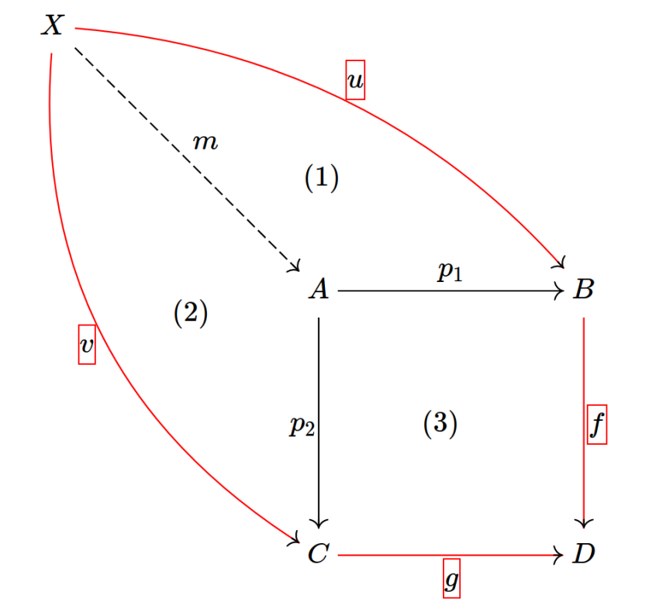





















How to reconstruct the full proof?
Save all subfaces as rewrite rules:
“top right branch” $→$ “bottom left branch”
$$\left(1\right) u→p_{1}∘m$$
$$\left(2\right) p_{2}∘m→v$$
$$\left(3\right) f∘p_{1}→g∘p_{2}$$
2) Identify the top right branch of the outer diagram.
3) Use greedily the rewrite rules until reaching the bottom left branch
4) Reconstruct the proof from the history of rewrite steps:
YADE
$$f∘u$$
$$→^{\left(1\right)}f∘p_{1}∘m$$
$$→^{\left(3\right)}g∘p_{2}∘m$$
$$→^{\left(2\right)} g∘v$$
$$By \left(1\right)$$
$$By \left(3\right)$$
$$By \left(2\right)$$
$$f∘u$$
$$=^{}f∘p_{1}∘m$$
$$=^{}g∘p_{2}∘m$$
$$=^{} g∘v$$

Slide 12
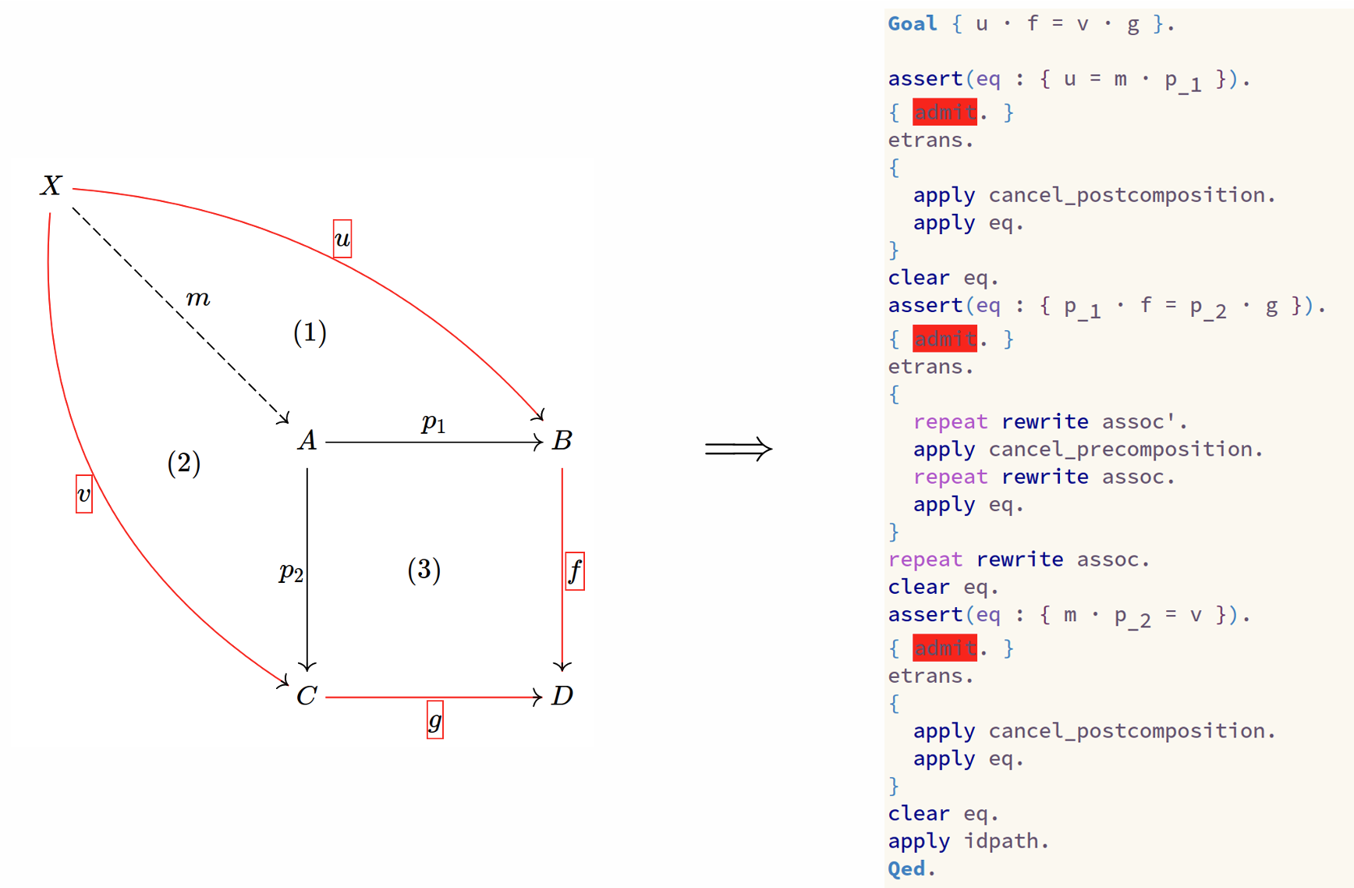
proof of (1) provided by the user
proof of (3) provided by the user
(YADE)
generatedCoq proof
proof of (2) provided by the user

Slide 13
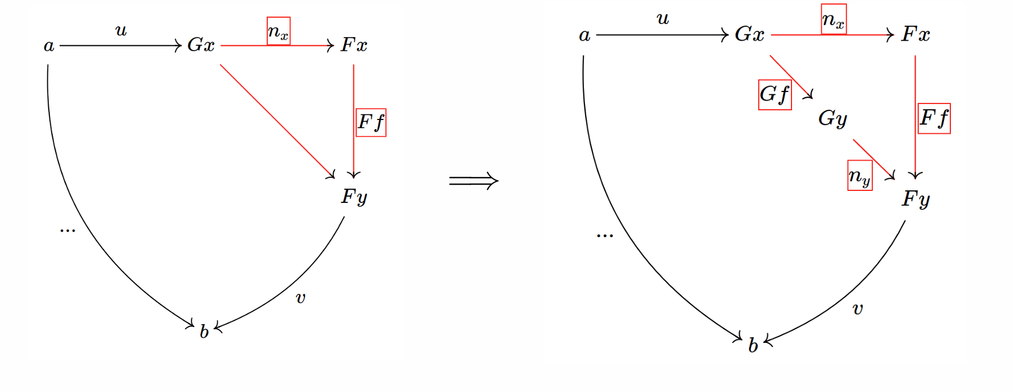
Interactive splitting of the diagram
Provided by the user (any Coq tactic)
=
“By naturality.”
Inferred by Coq

Slide 14
The underlying category theory library (definition of categories, functors, …)
Originally, based on the (big) UniMath library
The demo is based on Hierarchy Builder’s (small) library
Adaptation was straightforward: just redefine some lemmas / notations on top of your favourite library.
I plan to make this easier in the future.

Slide 15
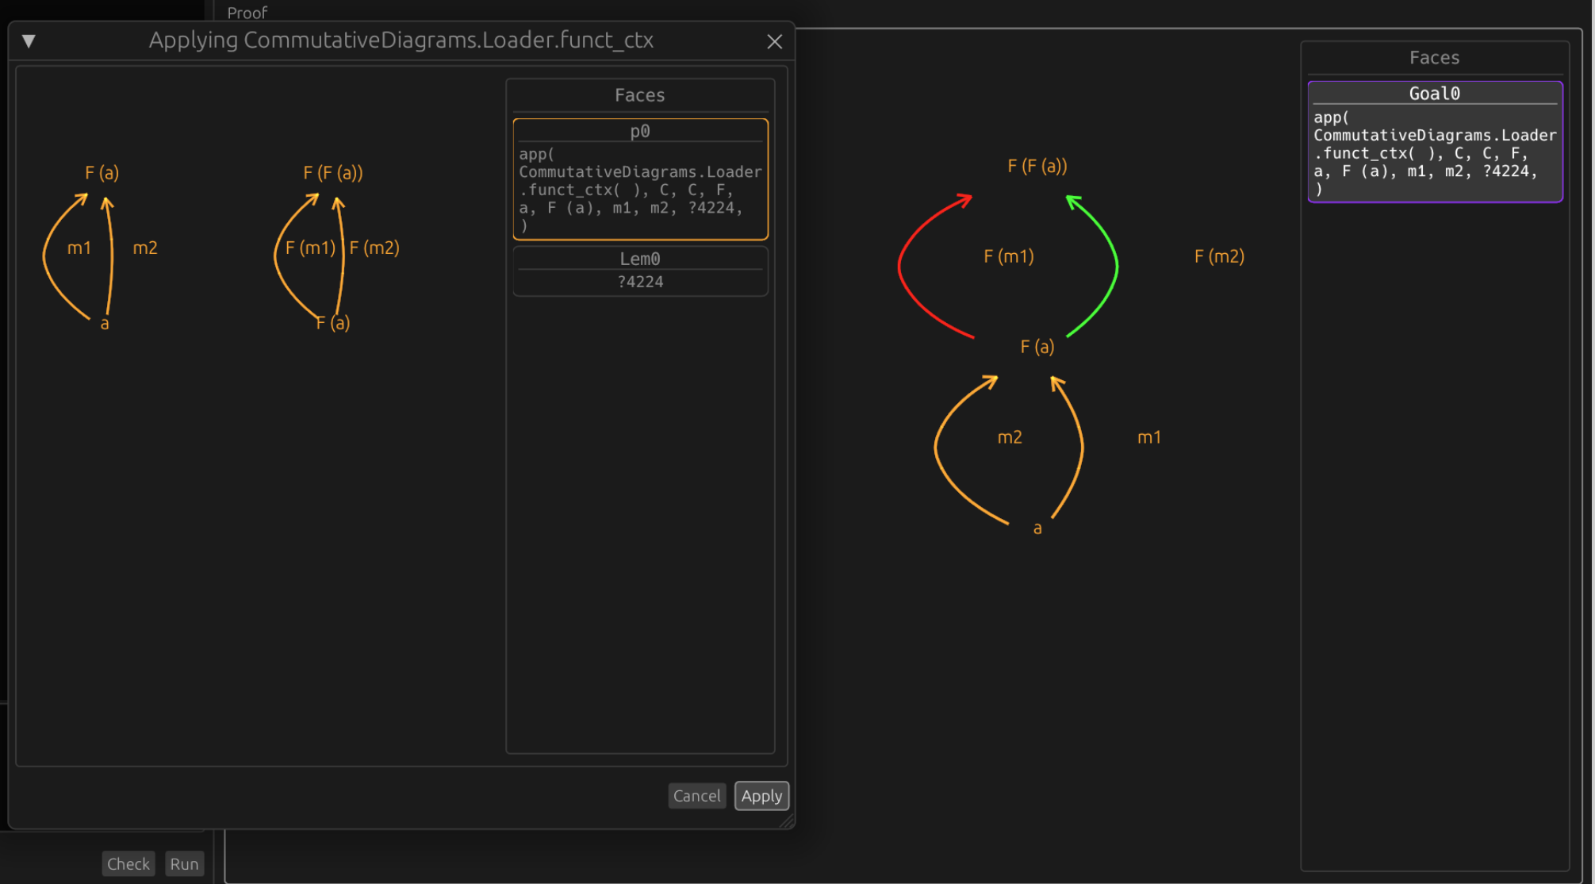
Luc Chabassier’s interface for diagrammatic proofs¹
Goal, assumptions, lemmas
Graphical interface
(standalone program,
implemented in Rust)
Coq plugin
(ocaml)
Lemma …
Proof.
…
diagram server.
Coq proof term
(implicit)
Automatic layout (limited manual editing)
Proof tactics (including invoking a lemma)
Integrated search for lemmas
¹ https://github.com/dwarfmaster/commutative-diagrams

Slide 16
Life is not all about commutative diagrams.
Last part of this talk:
Towards a proof assistant for diagrammatic reasoning

Slide 17
I have a dream…
… of an interactive proof assistant
with a graphical interface (no text),
to prove that some statement holds in any model;
where the notion of model is specified by the user
Examples: a category with pullbacks, a 2-category …
No built-in notion of models: the user must define what a category is
How to specify a model graphically?

Slide 18
How to specify a model?
1. Sorts
For graphs:
vertex and edge
For categories:
same + composition witness
For categories with monomorphisms:
… + monomorphic tag
Rewriting rules
Operations (e.g. composition)
Equations

Slide 19
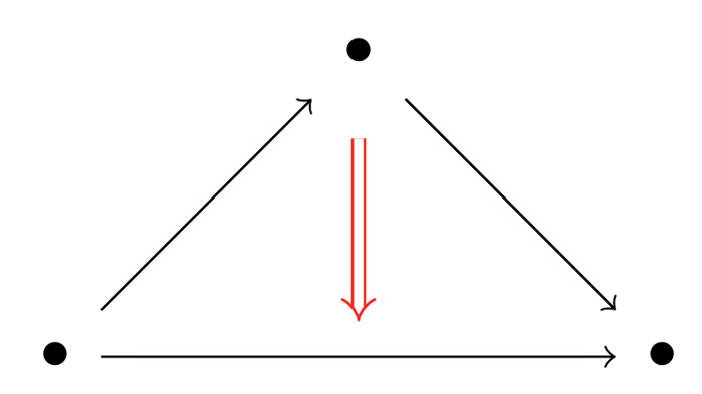

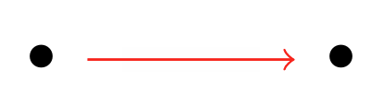
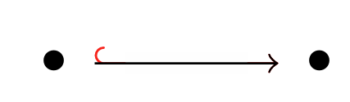
Sort Specification
Each user-drawn diagram above
specifies a sort as below:
Dependencies (in black) | (none) | 2 vertices | 1 edge | A triangle of edges
Graphical representation | Dot | Arrow | Hook | Double arrow

Slide 20
Specification of models
1. Sorts
Rewriting rules
First example: composition of morphisms

Slide 21
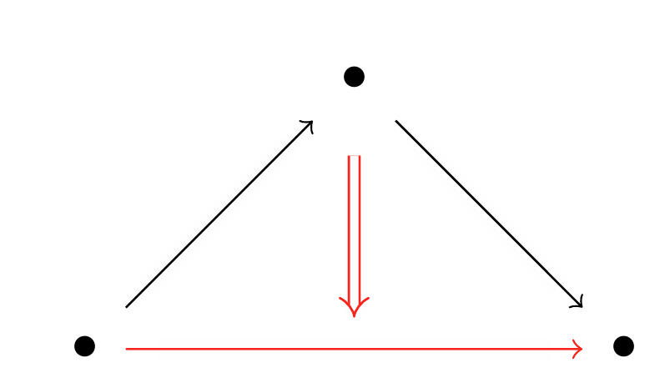


Rewriting rule for composition
“Each time I see the black stuff,
I can add the red stuff”
The user-drawn diagram above
specifies a rewriting rule as below:
$$→$$
f
g
$$⇒$$
g
f
$$h=g∘f$$
h

Slide 22
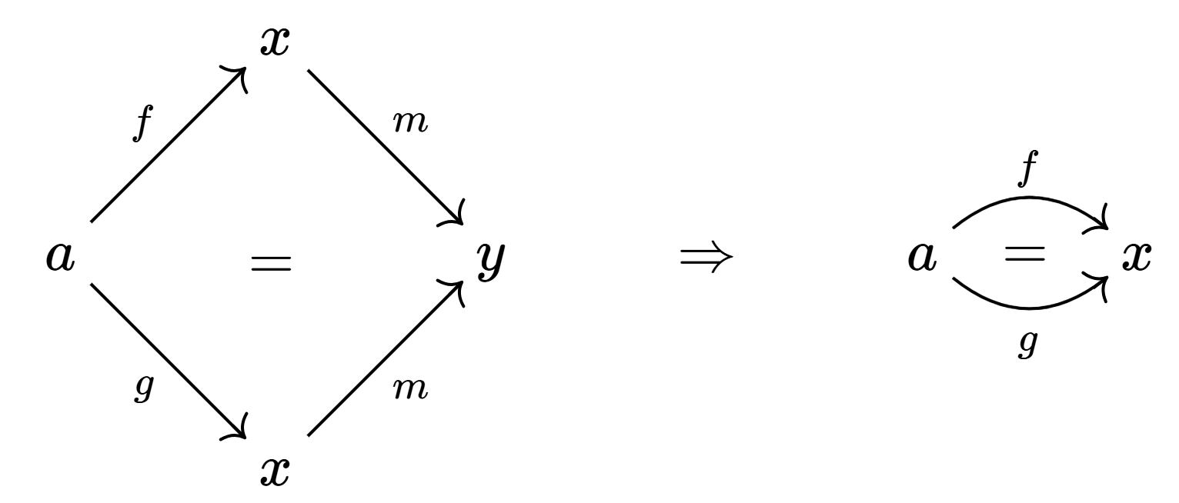




A more advanced example: monomorphisms
Definition: $x\underset{→}{m}y$ is mono means:
$$∀f,g:a→x,$$
$m∘f=m∘g ⇒ f=g$
Notation: $m:x↪y$ means that m is mono
Notes:
{"graph":{"activeTabId":0,"latexPreamble":"\\newcommand{\\coqproof}[1]{\\checkmark}","nextTabId":1,"tabs":[{"edges":[{"from":0,"id":10,"label":{"kind":"normal","label":"f","style":{"alignment":"left","bend":0,"color":"black","dashed":false,"head":"default","kind":"normal","position":0.5,"tail":"none"},"zindex":0},"to":1},{"from":1,"id":11,"label":{"kind":"normal","label":"m","style":{"alignment":"left","bend":0,"color":"black","dashed":false,"head":"default","kind":"normal","position":0.5,"tail":"none"},"zindex":0},"to":2},{"from":0,"id":12,"label":{"kind":"normal","label":"g","style":{"alignment":"right","bend":0,"color":"black","dashed":false,"head":"default","kind":"normal","position":0.5,"tail":"none"},"zindex":0},"to":3},{"from":3,"id":13,"label":{"kind":"normal","label":"m","style":{"alignment":"right","bend":0,"color":"black","dashed":false,"head":"default","kind":"normal","position":0.5,"tail":"none"},"zindex":0},"to":2},{"from":6,"id":14,"label":{"kind":"normal","label":"f","style":{"alignment":"left","bend":-0.4,"color":"black","dashed":false,"head":"default","kind":"normal","position":0.5,"tail":"none"},"zindex":0},"to":7},{"from":6,"id":15,"label":{"kind":"normal","label":"g","style":{"alignment":"right","bend":0.4,"color":"black","dashed":false,"head":"default","kind":"normal","position":0.5,"tail":"none"},"zindex":0},"to":7}],"id":0,"nextGraphId":16,"nodes":[{"id":0,"label":{"isCoqValidated":false,"isMath":true,"label":"a","pos":[105,105],"zindex":0}},{"id":1,"label":{"isCoqValidated":false,"isMath":true,"label":"x","pos":[175,35],"zindex":0}},{"id":2,"label":{"isCoqValidated":false,"isMath":true,"label":"y","pos":[245,105],"zindex":0}},{"id":3,"label":{"isCoqValidated":false,"isMath":true,"label":"x","pos":[175,175],"zindex":0}},{"id":4,"label":{"isCoqValidated":false,"isMath":true,"label":"=","pos":[173.6,107.35520833333334],"zindex":0}},{"id":5,"label":{"isCoqValidated":false,"isMath":true,"label":"\\Rightarrow","pos":[315,105],"zindex":0}},{"id":6,"label":{"isCoqValidated":false,"isMath":true,"label":"a","pos":[385,105],"zindex":0}},{"id":7,"label":{"isCoqValidated":false,"isMath":true,"label":"x","pos":[455,105],"zindex":0}},{"id":8,"label":{"isCoqValidated":false,"isMath":true,"label":"=","pos":[418.5,104.046875],"zindex":0}},{"id":9,"label":{"isCoqValidated":false,"isMath":true,"label":"","pos":[462.5,264.046875],"zindex":0}}],"sizeGrid":70,"title":"1"}]},"version":14}

Slide 23
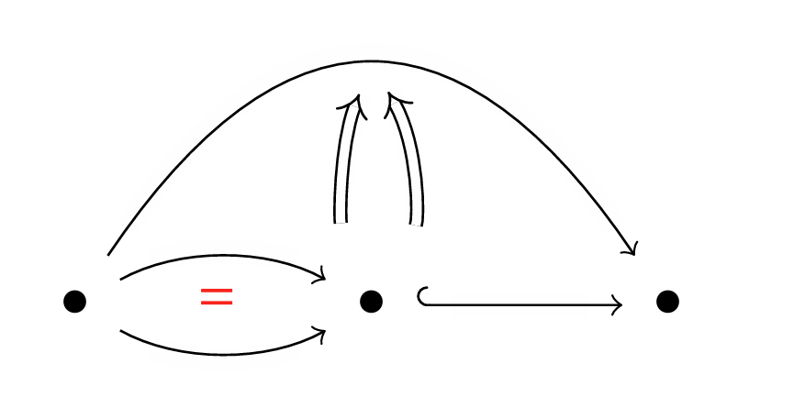
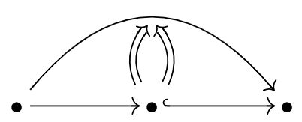




Rule for the monomorphic property
h
$$h=m∘g$$
$$h=m∘f$$
f
“$m∘f=m∘g ⇒ f=g$ ”
m
g
Each time I see the black stuff, I can “add” red stuff…
…which here means I can merge stuff marked as equal
$$→$$
Notes:
{"graph":{"activeTabId":0,"latexPreamble":"\\newcommand{\\coqproof}[1]{\\checkmark}","nextTabId":1,"tabs":[{"edges":[{"from":0,"id":3,"label":{"kind":"normal","label":"","style":{"alignment":"left","bend":0,"color":"black","dashed":false,"head":"default","kind":"normal","position":0.5,"tail":"hook"},"zindex":0},"to":1},{"from":2,"id":4,"label":{"kind":"normal","label":"","style":{"alignment":"left","bend":0,"color":"black","dashed":false,"head":"default","kind":"normal","position":0.5,"tail":"none"},"zindex":0},"to":0},{"from":2,"id":5,"label":{"kind":"normal","label":"","style":{"alignment":"left","bend":-0.6,"color":"black","dashed":false,"head":"default","kind":"normal","position":0.5,"tail":"none"},"zindex":0},"to":1},{"from":0,"id":6,"label":{"kind":"normal","label":"","style":{"alignment":"left","bend":-0.30000000000000004,"color":"black","dashed":false,"head":"default","kind":"double","position":0.5,"tail":"none"},"zindex":0},"to":5},{"from":0,"id":7,"label":{"kind":"normal","label":"","style":{"alignment":"left","bend":0.30000000000000004,"color":"black","dashed":false,"head":"default","kind":"double","position":0.5,"tail":"none"},"zindex":0},"to":5}],"id":0,"nextGraphId":8,"nodes":[{"id":0,"label":{"isCoqValidated":false,"isMath":true,"label":"","pos":[444.0052080154419,124.67465209960938],"zindex":0}},{"id":1,"label":{"isCoqValidated":false,"isMath":true,"label":"","pos":[544.0052080154419,124.67465209960938],"zindex":0}},{"id":2,"label":{"isCoqValidated":false,"isMath":true,"label":"","pos":[344.0052080154419,124.67465209960938],"zindex":0}}],"sizeGrid":150,"title":"1"}]},"version":14}

Slide 24
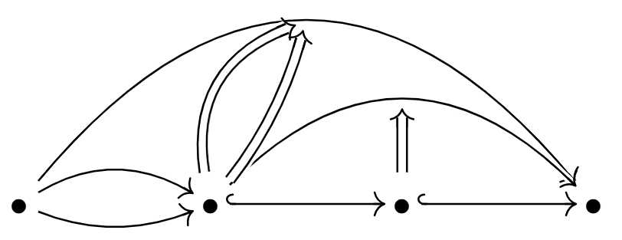
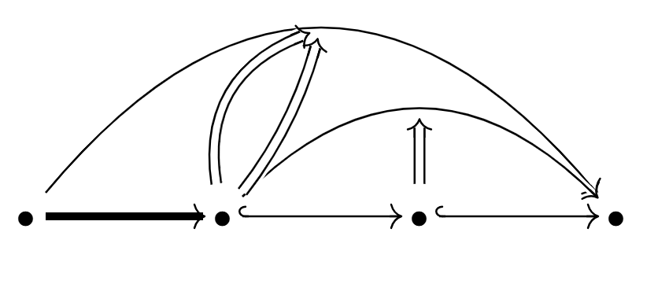
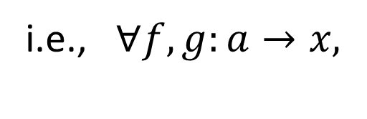

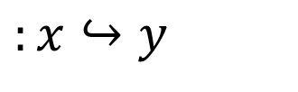
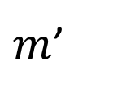






A proof that monomorphisms compose
$$m$$
$$:x↪y$$
mono $⇒ m^{′}∘m$ mono
$m$’
$:y↪z$
i.e., $∀f,g:a→x,$
$m^{′}∘m∘f=m^{′}∘m∘g ⇒ f=g$
Proof:
$$m^{′}∘m∘f=m^{′}∘m∘g$$
$$m^{′}∘m$$
$$→$$
$$...$$
$$→$$
f
m
m’
g
Notes:
{"graph":{"activeTabId":0,"latexPreamble":"\\newcommand{\\coqproof}[1]{\\checkmark}","nextTabId":1,"tabs":[{"edges":[{"from":0,"id":4,"label":{"kind":"normal","label":"","style":{"alignment":"left","bend":0,"color":"black","dashed":false,"head":"default","kind":"normal","position":0.5,"tail":"hook"},"zindex":0},"to":1},{"from":1,"id":5,"label":{"kind":"normal","label":"","style":{"alignment":"left","bend":0,"color":"black","dashed":false,"head":"default","kind":"normal","position":0.5,"tail":"hook"},"zindex":0},"to":2},{"from":3,"id":6,"label":{"kind":"normal","label":"","style":{"alignment":"left","bend":0.2,"color":"black","dashed":false,"head":"default","kind":"normal","position":0.5,"tail":"none"},"zindex":0},"to":0},{"from":3,"id":7,"label":{"kind":"normal","label":"","style":{"alignment":"left","bend":-0.30000000000000004,"color":"black","dashed":false,"head":"default","kind":"normal","position":0.5,"tail":"none"},"zindex":0},"to":0},{"from":3,"id":8,"label":{"kind":"normal","label":"","style":{"alignment":"left","bend":-0.6,"color":"black","dashed":false,"head":"default","kind":"normal","position":0.5,"tail":"none"},"zindex":0},"to":2},{"from":0,"id":9,"label":{"kind":"normal","label":"","style":{"alignment":"left","bend":-0.5,"color":"black","dashed":false,"head":"default","kind":"normal","position":0.5,"tail":"none"},"zindex":0},"to":2},{"from":1,"id":10,"label":{"kind":"normal","label":"","style":{"alignment":"left","bend":0,"color":"black","dashed":false,"head":"default","kind":"double","position":0.5,"tail":"none"},"zindex":0},"to":9},{"from":0,"id":11,"label":{"kind":"normal","label":"","style":{"alignment":"left","bend":-0.4,"color":"black","dashed":false,"head":"default","kind":"double","position":0.5,"tail":"none"},"zindex":0},"to":8},{"from":0,"id":12,"label":{"kind":"normal","label":"","style":{"alignment":"left","bend":0.1,"color":"black","dashed":false,"head":"default","kind":"double","position":0.5,"tail":"none"},"zindex":0},"to":8}],"id":0,"nextGraphId":13,"nodes":[{"id":0,"label":{"isCoqValidated":false,"isMath":true,"label":"\\textcolor{black}{\\bullet}","pos":[250,150],"zindex":0}},{"id":1,"label":{"isCoqValidated":false,"isMath":true,"label":"\\textcolor{black}{\\bullet}","pos":[350,150],"zindex":0}},{"id":2,"label":{"isCoqValidated":false,"isMath":true,"label":"\\textcolor{black}{\\bullet}","pos":[450,150],"zindex":0}},{"id":3,"label":{"isCoqValidated":false,"isMath":true,"label":"","pos":[150,150],"zindex":0}}],"sizeGrid":150,"title":"1"}]},"version":14}

Slide 25
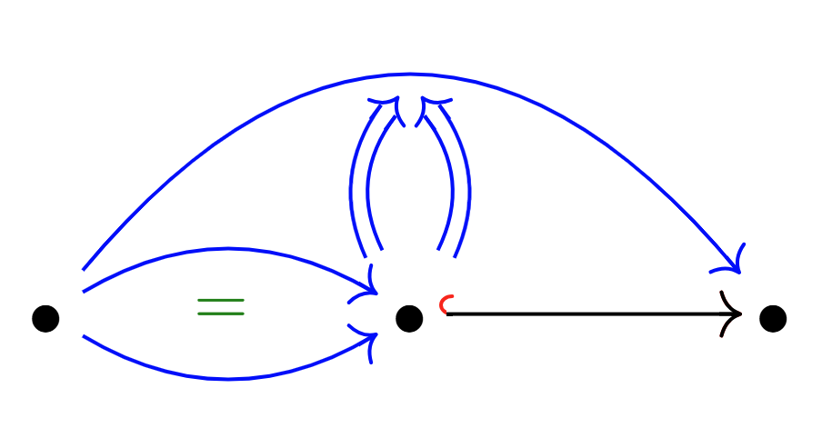
Rewriting rule for tagging a morphism as mono
“Each time I see the black stuff,
if, by adding the blue stuff,
I am able to add the green stuff,
then I can add the red stuff”
The meaning is more complex than that of the previous examples.
Thesis: This notion of (second-order) rule is enough to capture any model specification. (prove me wrong!)
Notes:
{"graph":{"activeTabId":0,"latexPreamble":"\\newcommand{\\coqproof}[1]{\\checkmark}","nextTabId":1,"tabs":[{"edges":[{"from":0,"id":4,"label":{"kind":"normal","label":"","style":{"alignment":"left","bend":0,"color":"red","dashed":false,"head":"default","kind":"normal","position":0.5,"tail":"hook"},"zindex":0},"to":1},{"from":2,"id":5,"label":{"kind":"normal","label":"","style":{"alignment":"left","bend":-0.30000000000000004,"color":"blue","dashed":false,"head":"default","kind":"normal","position":0.5,"tail":"none"},"zindex":0},"to":0},{"from":2,"id":6,"label":{"kind":"normal","label":"","style":{"alignment":"left","bend":0.30000000000000004,"color":"blue","dashed":false,"head":"default","kind":"normal","position":0.5,"tail":"none"},"zindex":0},"to":0},{"from":2,"id":7,"label":{"kind":"normal","label":"","style":{"alignment":"left","bend":-0.6,"color":"blue","dashed":false,"head":"default","kind":"normal","position":0.5,"tail":"none"},"zindex":0},"to":1},{"from":0,"id":8,"label":{"kind":"normal","label":"","style":{"alignment":"left","bend":0,"color":"black","dashed":false,"head":"default","kind":"normal","position":0.5,"tail":"none"},"zindex":0},"to":1},{"from":0,"id":9,"label":{"kind":"normal","label":"","style":{"alignment":"left","bend":-0.30000000000000004,"color":"blue","dashed":false,"head":"default","kind":"double","position":0.5,"tail":"none"},"zindex":0},"to":7},{"from":0,"id":10,"label":{"kind":"normal","label":"","style":{"alignment":"left","bend":0.30000000000000004,"color":"blue","dashed":false,"head":"default","kind":"double","position":0.5,"tail":"none"},"zindex":0},"to":7}],"id":0,"nextGraphId":11,"nodes":[{"id":0,"label":{"isCoqValidated":false,"isMath":true,"label":"","pos":[602.0052080154419,232.89686584472656],"zindex":0}},{"id":1,"label":{"isCoqValidated":false,"isMath":true,"label":"","pos":[702.0052080154419,232.89686584472656],"zindex":0}},{"id":2,"label":{"isCoqValidated":false,"isMath":true,"label":"","pos":[502.0052080154419,232.89686584472656],"zindex":0}},{"id":3,"label":{"isCoqValidated":false,"isMath":true,"label":"\\textcolor{green}{=}","pos":[550.0052080154419,229.6968536376953],"zindex":0}}],"sizeGrid":150,"title":"1"}]},"version":14}

Slide 26
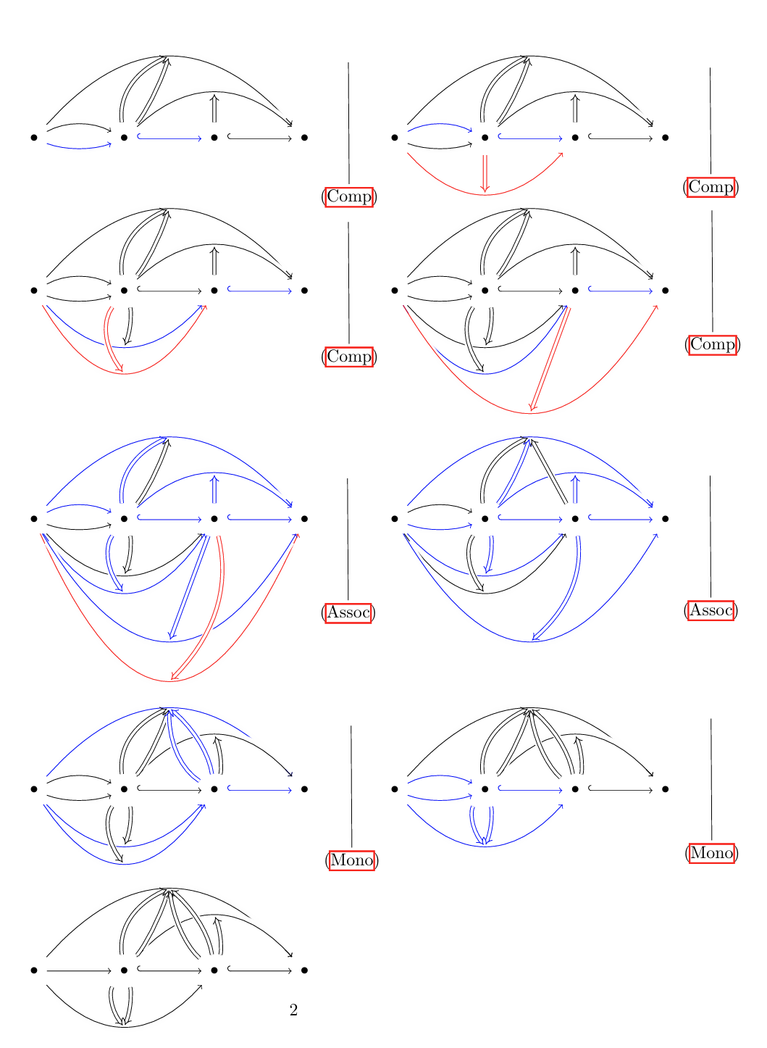
Engineering challenges
proof that monomorphisms compose
Implement a catalogue of graphical artefacts
Automatic layout
How to make the context easier to manipulate?

Slide 27
More details are available in the pdf draft¹ (WIP)
If you have any idea of application, or improvement, let me know! I have been recently looking at diagram chasing.
¹ http://github.com/amblafont/diagrammatic-resoning-spec

