Slide 1
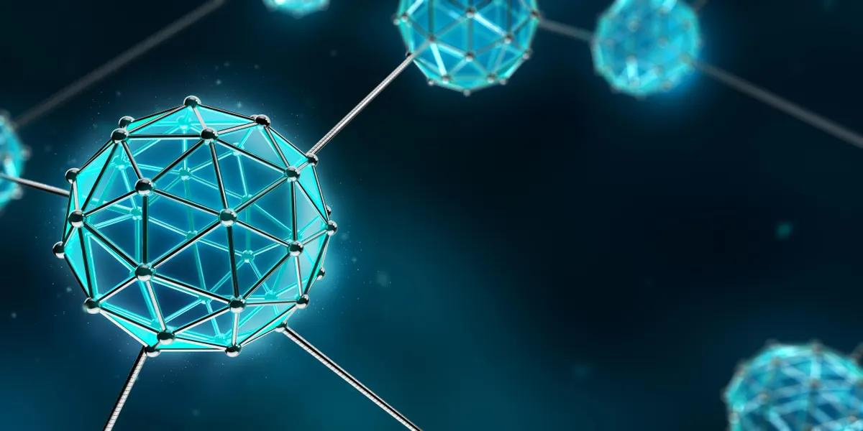
NANOTECHNOLOGY
NANOTECHNOLOGY

Slide 2
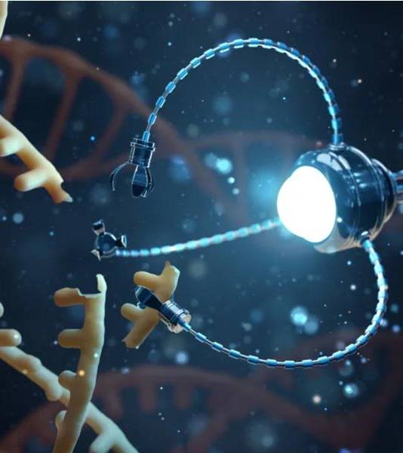
NANOTECHNOLOGY
NANOTECHNOLOGY
Nanotechnology involves manipulating and controlling matter at the nanoscale, ranging from 1 to 100 nanometers.
Its impact on the Information Technology (IT) field is profound, revolutionizing various aspects of technology and innovation.

Slide 3
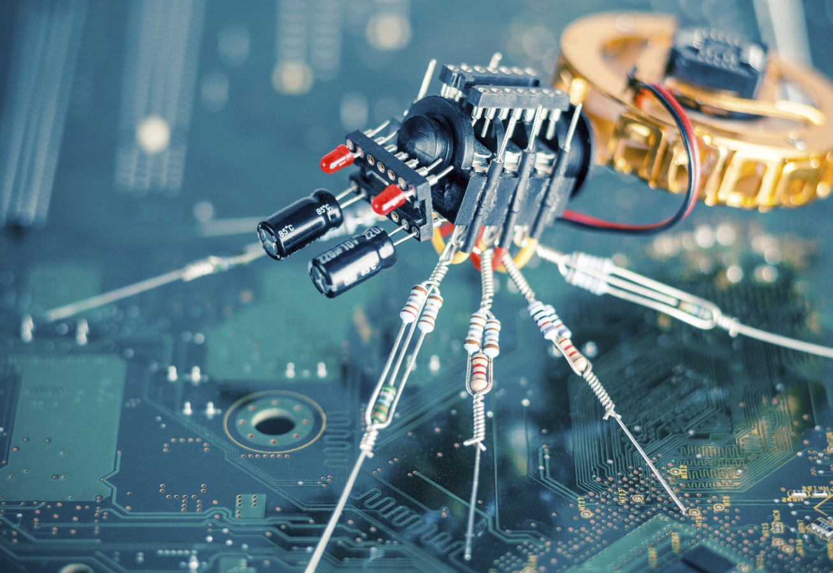
WHAT IS
NANOTECHNOLOGY?
Nanotechnology is the science, engineering, and application of materials and devices at the nanoscale.
At this scale, materials exhibit unique properties and behaviors, enabling novel applications in diverse fields.

Slide 4
IMPORTANCE OF
NANOTECHNOLOGY
Nanotechnology drives IT innovations by offering capabilities beyond traditional technology limits.
It enables the development of smaller, faster, and more energy-efficient devices, transforming computing and communication.

Slide 5
IMPORTANCE OF
NANOTECHNOLOGY
Nanoscale components enhance processor speed, data storage capacity, and sensor sensitivity, revolutionizing data processing and analysis.

Slide 6
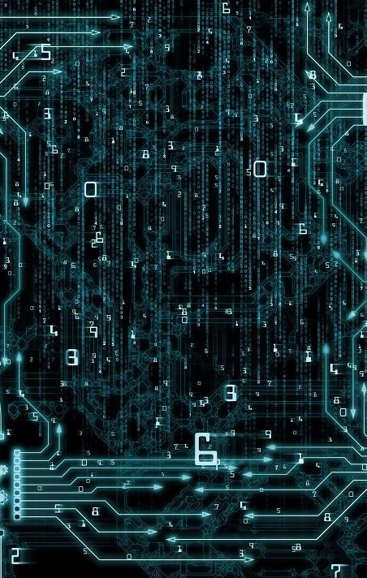
NANO
NANO
The nanoscale is incredibly small, where 1 nanometer equals 1 billionth of a meter.
To put this into perspective:
A human hair is about 80,000 - 100,000 nanometers wide.
A virus typically ranges from 20 to 400 nanometers in size.

Slide 7
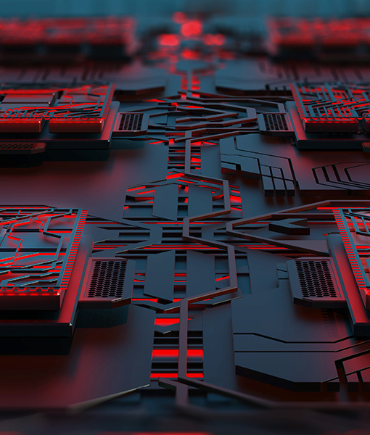
VISUALIZING THE NANOSCALE
VISUALIZING THE NANOSCALE
Challenges in Nanoscale Visualization
Traditional microscopes have limitations in visualizing nanoscale structures due to their resolution constraints.
The nanoscale's small size and intricacy pose difficulties for conventional imaging methods.
Advanced Imaging Techniques
Advanced techniques have revolutionized nanoscale imaging:
Scanning Tunneling Microscopy (STM): Measures surface topography using quantum tunneling of electrons.
Atomic Force Microscopy (AFM): Uses a fine probe to map surfaces at atomic resolution.

Slide 8
VISUALIZING THE NANOSCALE
VISUALIZING THE NANOSCALE
Nanoscale Structures
Carbon Nanotubes: Ultrathin, strong, and conductive, used in nanoelectronics and data storage.
Nanoparticles: Small particles with unique properties used in displays, sensors, and drug delivery.
Applications
Carbon nanotubes: Transistor components in processors for faster and more energy-efficient computing.
Nanoparticles: Enhance display quality and enable more accurate sensors, contributing to immersive experiences and advanced data analysis.

Slide 9
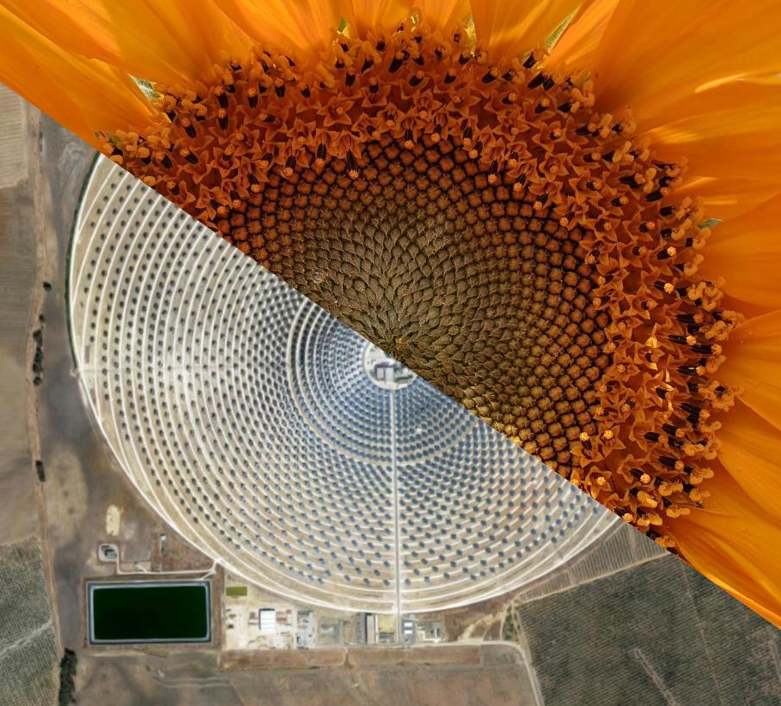
Biomimicry: Nature as a Blueprint
Biomimicry involves drawing inspiration from nature's designs and processes to solve complex challenges.
Nature's solutions, refined over billions of years, serve as a valuable resource for innovation.
BIOMIMICRY
BIOMIMICRY
Creating Nanomaterials with Inspired Properties
Nanotechnology enables us to replicate natural structures' properties:
Lotus Leaves: Hydrophobic surfaces inspire self-cleaning materials.
Gecko Feet: Microstructures inspire adhesives for versatile applications.

Slide 10
THANK YOU
THANK YOU

