Slide 1
Food Concepts Training Report
Comprehensive Training Analytics
Generated: October 30, 2025

Slide 2
Executive Summary
Report Year: 2025
📊 Total Trainings: 1090
👥 Total Staff: 8423
✅ Staff Trained: 841
🏪 Stores Trained: 313
⏰ Pending Trainings: 7293

Slide 3
Training Frequency
Training Title | Times Held | Date Range
Food Safety | 306 | 2025-02-13 to 2025-09-30
Occupational Health And Safety | 224 | 2025-02-05 to 2025-10-23
First Aid | 201 | 2025-02-04 to 2025-10-15
Pest Control | 127 | 2025-02-18 to 2025-09-18
Fires Safety | 108 | 2025-01-30 to 2025-09-09
Water Treatment | 99 | 2025-02-19 to 2025-04-29
Food Handlers Workshop | 11 | 2025-03-21 to 2025-03-21
Frozen Pie Handling And Baking Process | 9 | 2025-06-16 to 2025-06-16
Energy Conservation | 3 | 2025-06-16 to 2025-06-16
Preventive Maintenance Workshop | 1 | 2025-06-16 to 2025-06-16
Effective Restaurant Management Workshop | 1 | 2025-06-16 to 2025-06-16

Slide 4
Stores Training Coverage
Total Stores: 612
✅ Stores Trained: 313 (51.1%)
⏳ Stores Pending: 299 (48.9%)

Slide 5
Staff Participation Analysis
Total Eligible Staff: 7293
Participated: 841 (11.5%)
Not Participated: 6452

Slide 6
Food Safety Compliance
Food Handlers / Food Safety Training Status
Required to be Tested: 7293
Already Tested: 313 (4.3%)
Never Tested: 6980
Due for Testing: 6980

Slide 7
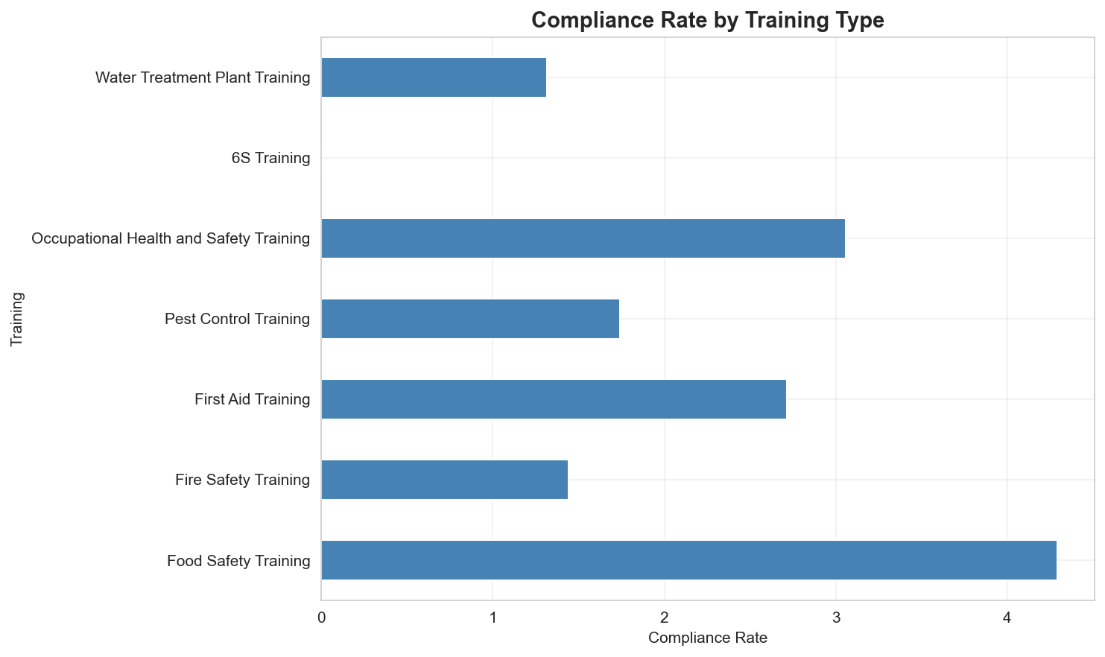
Compliance Dashboard - All Required Trainings

Slide 8
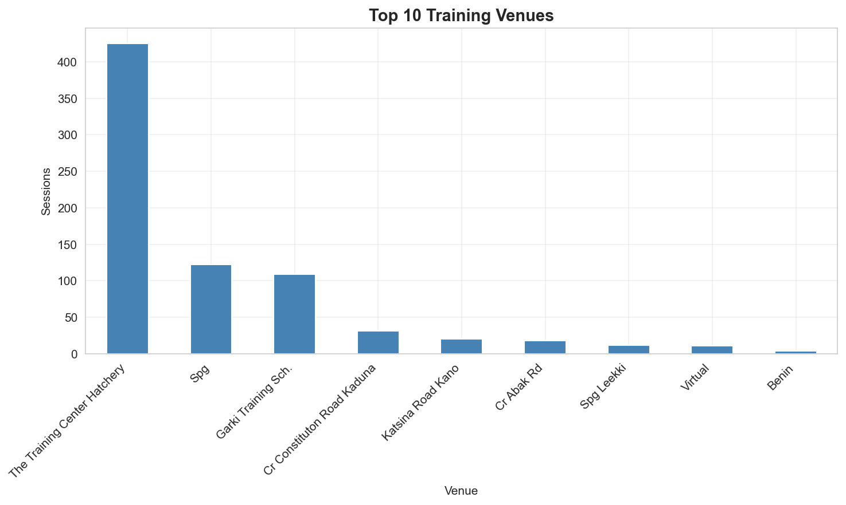
Training by Venue

Slide 9
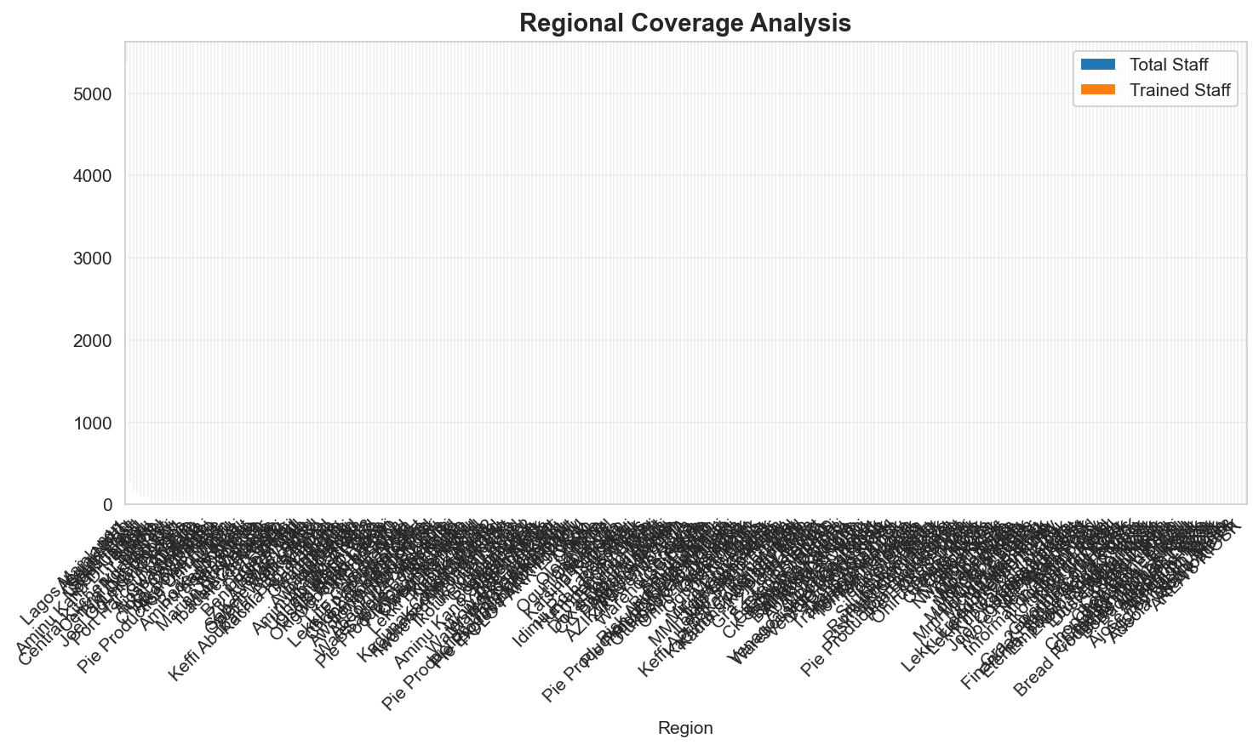
Regional Training Coverage

Slide 10
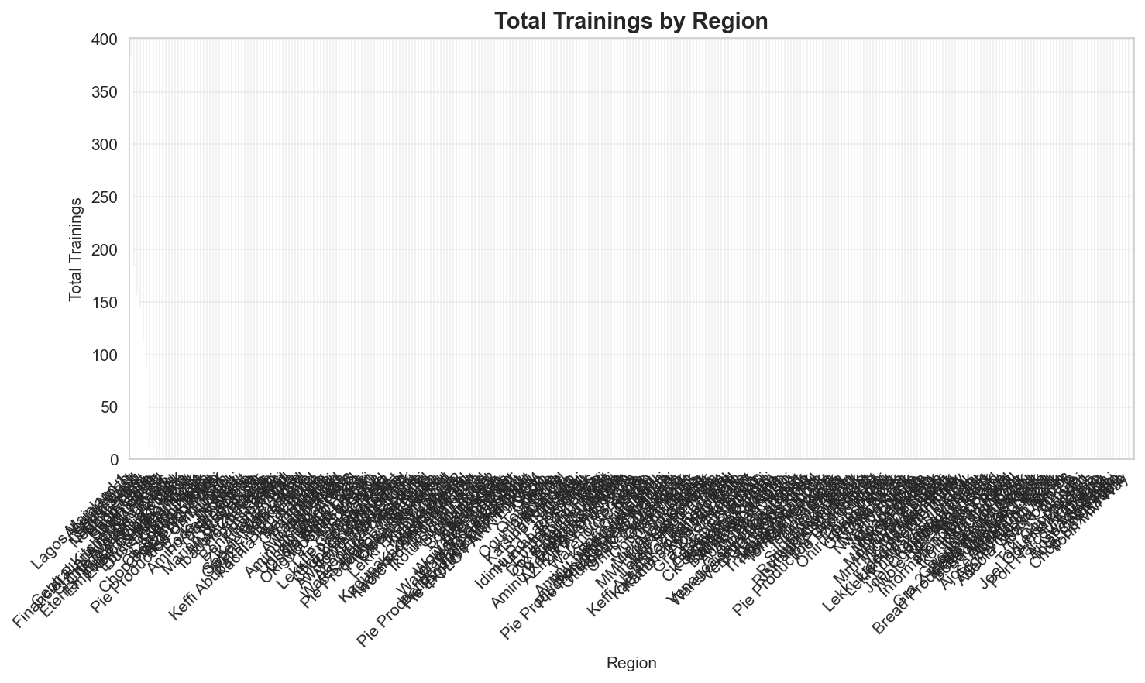
Trainings by Region

Slide 11
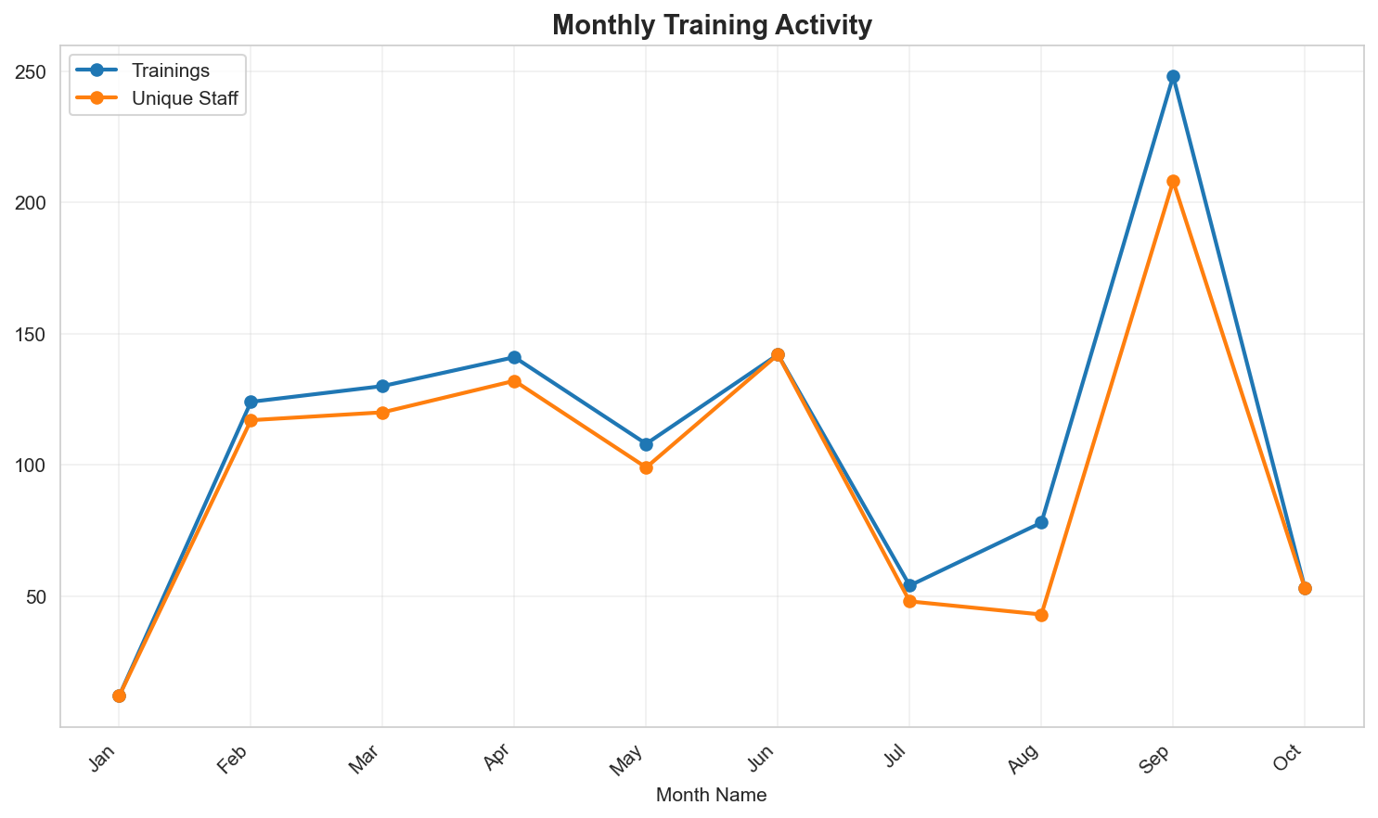
Monthly Training Trends (2025)

Slide 12
Staff Yet to be Trained
Total Staff Needing Training: 7293
These staff members are missing required trainings and are not on probation.
Top Departments:
  • OPERATIONS: 5830 staff
  • CR STORES: 384 staff
  • Operations: 335 staff
  • SCD Operations: 116 staff
  • Human Resources: 88 staff

