Slide 1
Food Concepts Training Report
Comprehensive Training Analytics
Generated: October 29, 2025

Slide 2
Executive Summary
Report Year: 2025
📊 Total Trainings: 1370
👥 Total Staff: 8561
✅ Staff Trained: 883
🏪 Stores Trained: 314
⏰ Pending Trainings: 6349

Slide 3
Training Frequency
Training Title | Times Held | Date Range
 | 431 | 2025-02-19 to 2025-10-23
Food Safety | 279 | 2025-02-13 to 2025-09-30
Occupational Health And Safety | 211 | 2025-02-05 to 2025-09-26
FIRST AID | 125 | 2025-02-04 to 2025-09-25
Fires Safety | 108 | 2025-01-30 to 2025-09-09
Water Treatment | 98 | 2025-03-25 to 2025-04-29
PEST CONTROL | 93 | 2025-02-18 to 2025-09-12
Food Handlers Workshop | 11 | 2025-03-21 to 2025-03-21
Frozen Pie Handling and Baking Process | 9 | 2025-06-16 to 2025-06-16
Energy conservation | 3 | 2025-06-16 to 2025-06-16
Preventive Maintenance Workshop | 1 | 2025-06-16 to 2025-06-16
Effective Restaurant Management Workshop | 1 | 2025-06-16 to 2025-06-16

Slide 4
Stores Training Coverage
Total Stores: 605
✅ Stores Trained: 314 (51.9%)
⏳ Stores Pending: 291 (48.1%)

Slide 5
Staff Participation Analysis
Total Eligible Staff: 7359
Participated: 883 (12.0%)
Not Participated: 6476

Slide 6
Food Safety Compliance
Food Handlers / Food Safety Training Status
Required to be Tested: 7359
Already Tested: 285 (3.9%)
Never Tested: 7074
Due for Testing: 7074

Slide 7
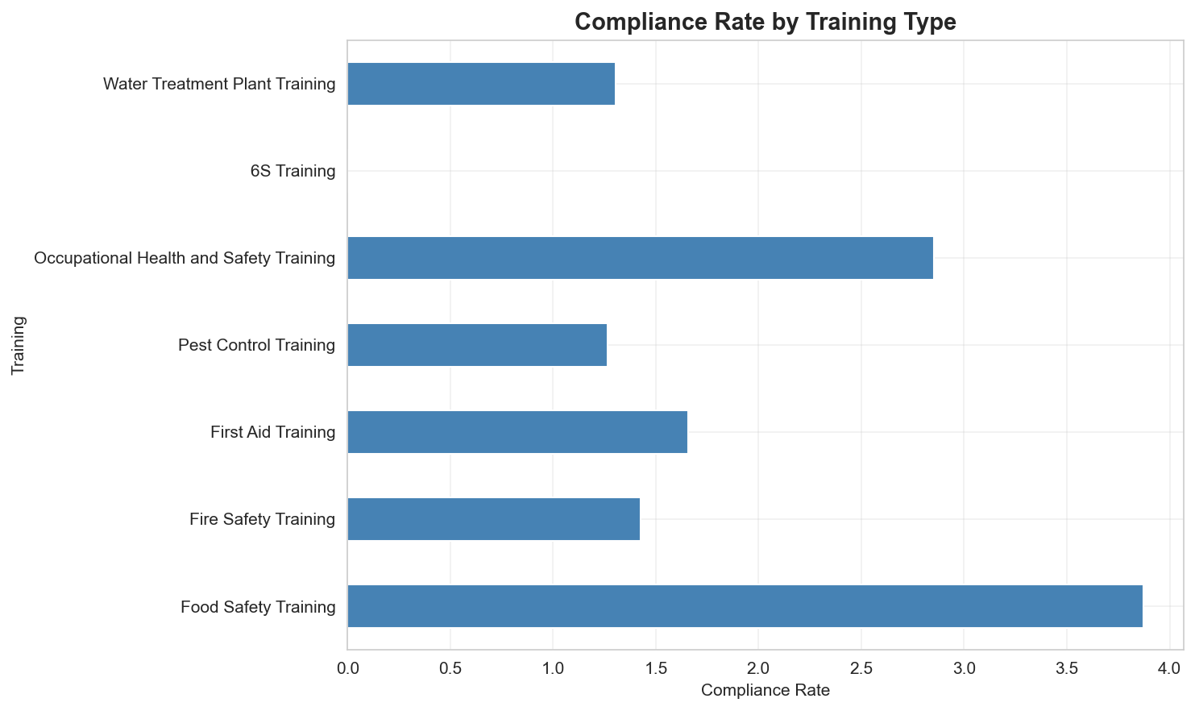
Compliance Dashboard - All Required Trainings

Slide 8
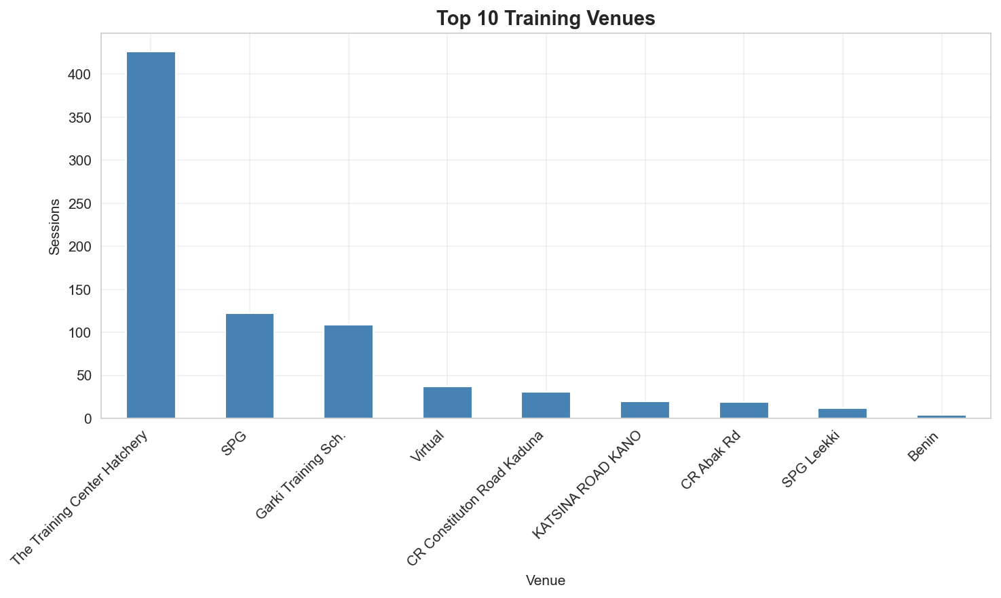
Training by Venue

Slide 9
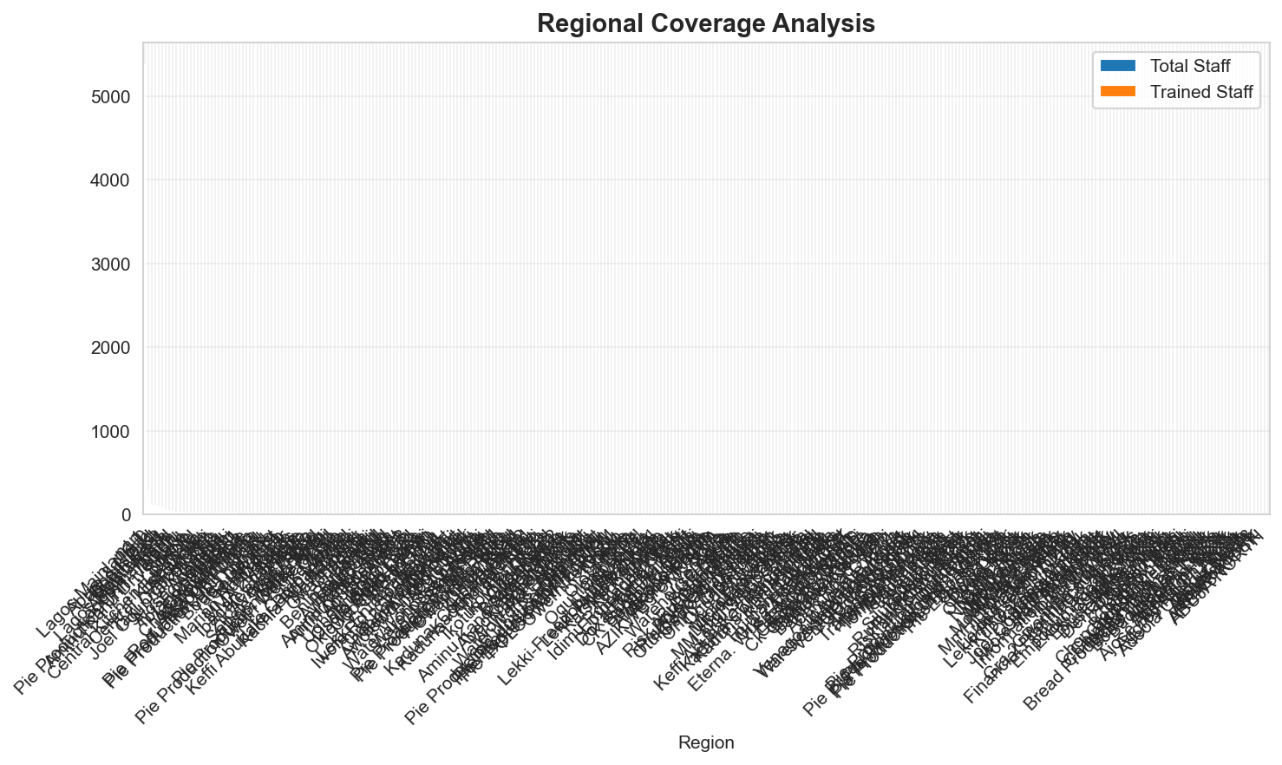
Regional Training Coverage

Slide 10
Trainings by Region

Slide 11
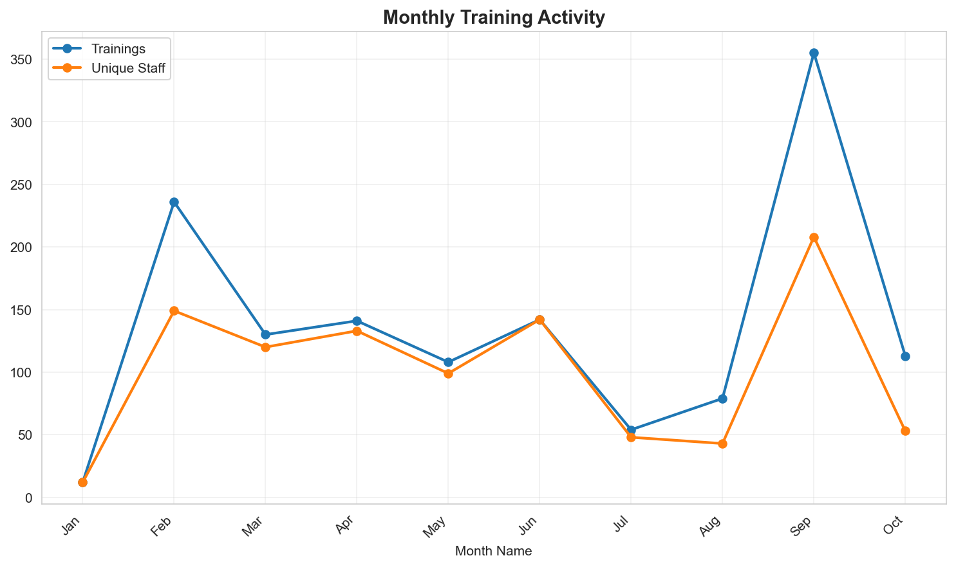
Monthly Training Trends (2025)

Slide 12
Staff Yet to be Trained
Total Staff Needing Training: 6349
These staff members are missing required trainings and are not on probation.
Top Departments:
  • OPERATIONS: 5617 staff
  • Operations: 333 staff
  • SCD Operations: 116 staff
  • Shared-Service Division: 109 staff
  • Human Resources: 88 staff

