Slide 1
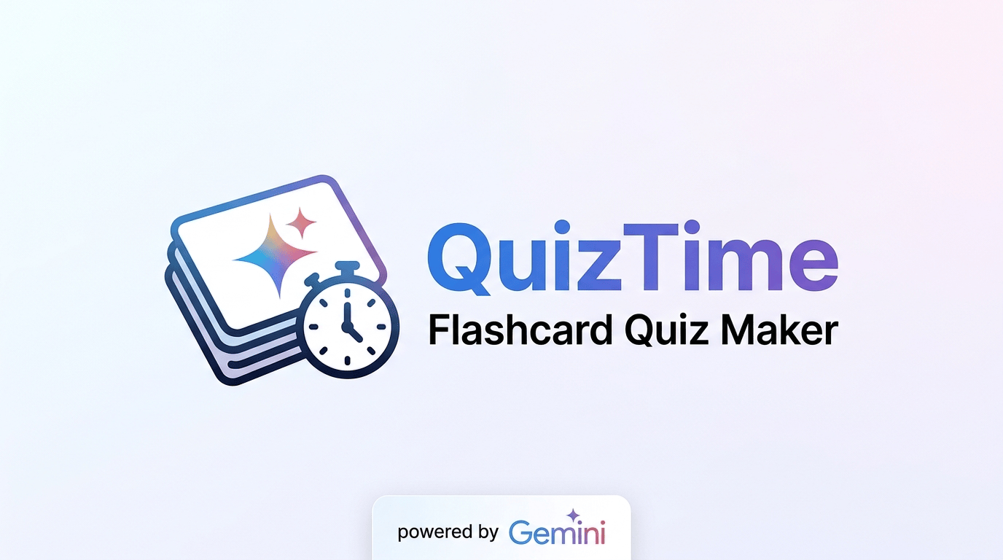

An AI-Assisted Flashcard and Quiz Generator for Active Recall and Spaced Repetition Study
A Concept Paper
Presented by the QuizTime Project Team
September 2026
AI-generated decks
Four study modes
Spaced repetition
Works offline
Notes:
OPENING (about 30 seconds)
Good day. Our concept paper is titled "An AI-Assisted Flashcard and Quiz Generator for Active Recall and Spaced Repetition Study" — the system is called QuizTime.
One sentence to hold on to: QuizTime turns the documents a student already has into flashcards, and then decides what that student should review today.

Slide 2
The problem
Students have the material. They lack the time to turn it into practice.
1
2
3
Rereading feels productive
Testing beats restudying
Spacing is the hard part
Re-reading and highlighting rank among the least effective study techniques, yet they are the ones students use most.
Learners who self-test retain far more a week later than learners who reread for the same amount of time — but almost nobody does it.
Reviewing each card exactly when it is about to be forgotten is what makes recall permanent, and it is impossible to do by hand.
In short:
Students already hold thousands of pages of digital material, but nothing turns it into retrieval practice — or tells them what to review today.
QuizTime · Concept Paper
2
Notes:
THE PROBLEM (about 1 minute)
Start with what students actually do. They reread, they highlight — and the learning-science evidence says those are among the weakest techniques available, even though they feel productive.
The two techniques that clearly work are practice testing and distributed practice. Both have one practical obstacle: they take time. Writing cards by hand and scheduling reviews by hand is tedious, so learners skip it.
Say the punchline on the slide: students already hold thousands of pages of material; nothing turns it into retrieval practice.

Slide 3
The opportunity
Two technologies matured at the right moment.
Generative AI can read your material
Web apps can now work offline
A 40-page lecture can be summarised into key concepts, definitions and enumerations in seconds.
A browser-installed app can cache itself, its data and its logic.
That is exactly the tedious part of building flashcards — and the part learners skip.
Study sessions no longer have to depend on a stable connection.
The gap this project fills
Existing flashcard apps make you type every card by hand. AI study tools generate cards but rarely schedule them properly, and many assume a constant connection.
QuizTime joins all three: AI generation, evidence-based scheduling, and offline study — from the learner's own documents.
QuizTime · Concept Paper
3
Notes:
THE OPPORTUNITY (about 1 minute)
Two things matured at the same time.
First, generative AI can read a lecture and pull out its key concepts, definitions and enumerations in seconds. That is exactly the tedious part of making flashcards.
Second, web apps can now install themselves on a phone and keep working with no connection, so studying no longer has to depend on a stable signal.
The gap: existing flashcard apps make you type everything; AI study tools generate cards but rarely schedule them well; most assume you are always online. QuizTime joins all three.

Slide 4
Objectives of the study
General objective, then seven specific objectives.
General objective: to design and develop QuizTime — an AI-assisted, offline-capable flashcard and quiz generator that turns a learner's own documents into active-recall practice — and to evaluate its functionality, reliability and acceptability.
1
Build the generation pipeline
2
Implement four study modes
8 files or 100k characters → 8–20 cards with hint and difficulty
Study · Exam · Identification · Enumeration, with scoring
3
Implement spaced repetition
4
Record progress analytics
Grade Again / Hard / Good / Easy → a daily review queue
Accuracy, mastery, streaks and review health per deck
5
Make it work offline
6
Keep it reliable and private
Service worker, snapshots, queued answers that sync later
AI failover, rate limits, per-account data isolation
7
Validate the system
156 automated checks plus an acceptability evaluation
QuizTime · Concept Paper
4
Notes:
OBJECTIVES (about 1 minute)
State the general objective, then group the specific ones rather than reading all seven: build the generation pipeline; implement the four study modes; implement the scheduler; record progress; make it work offline; keep it reliable and private; and validate it.
Note that the last objective matters for the defense panel — we commit to a documented evaluation, not just a working demo.

Slide 5
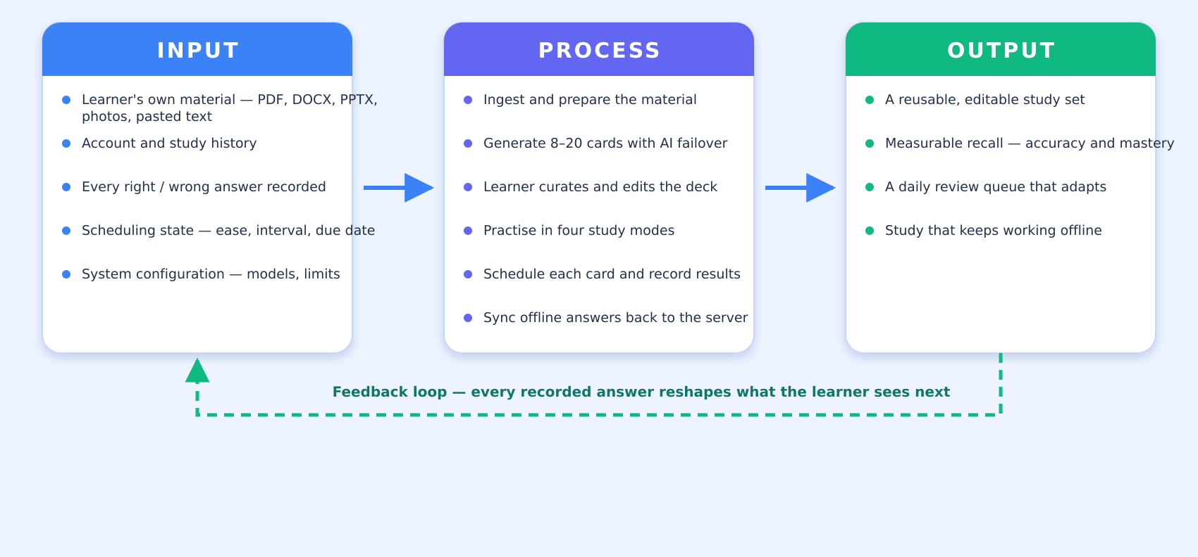
Conceptual framework
Inputs are the learner's own material; the process turns study into a feedback loop.
QuizTime · Concept Paper
5
Notes:
CONCEPTUAL FRAMEWORK (about 1 minute)
Use the diagram, left to right. Inputs are the learner's own material plus everything the system records. The process is: ingest, generate, let the learner curate, practise, schedule, and sync.
The important part is the dashed loop at the bottom: recorded outcomes are not just reported, they decide what comes back next. Correct recalls push a card further out; a lapse pulls it back in.

Slide 6
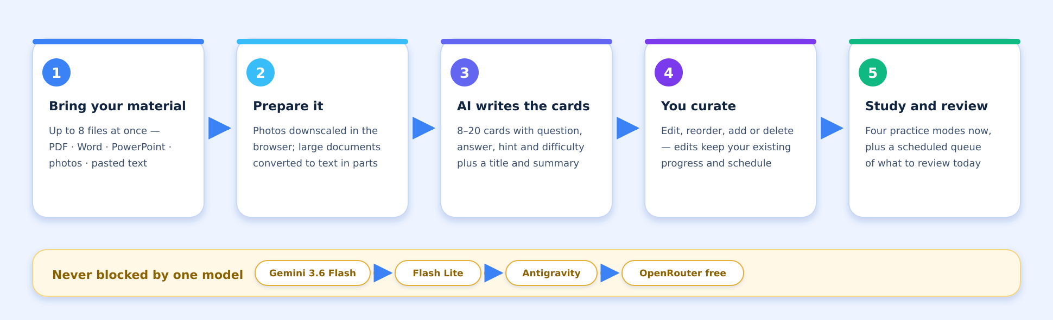
How it works
From an uploaded file to a scheduled study habit.
Upload
Generate
Curate
PDF · Word · PowerPoint · photos · pasted text — up to 8 files at once
8–20 cards with question, answer, hint and difficulty
Edit, reorder or delete — progress survives every edit
QuizTime · Concept Paper
6
Notes:
HOW IT WORKS (about 1 minute)
Walk the five steps quickly. Then point at the amber strip: the chain of models. If the primary model is rate-limited or unavailable, generation moves to the next one instead of failing, the model that was skipped is remembered for a cooldown, and the learner is told which model produced the cards.
If a panelist asks "what if the AI is wrong?" — this is the right moment: generated cards are editable precisely because the learner must verify content.

Slide 7
Four ways to be tested
Each mode exercises recall differently and feeds the same progress record.
Study
Exam
Identification
Enumeration
Flashcards
Multiple choice
Type the answer
List them all
Read, flip, reveal the answer and an optional hint.
Four options per question with instant feedback.
Recall from memory, no options to lean on.
Type every item of a list answer, in any order.
Self-check: “Got it” or “Still learning”.
10 points a card, +5 medium, +10 hard.
Forgives case, punctuation and small typos.
Per-item feedback as you go.
Missed cards come back in the same session.
Streak bonus +2, capped at +10.
Supports “/”-separated alternative answers.
Complete only when every item is named.
Every completed session ends with a results screen: accuracy, letter grade, points against the maximum, best streak, elapsed time, and the questions that were missed — which can be sent straight into Study Mode.
QuizTime · Concept Paper
7
Notes:
FOUR MODES (about 1 minute)
Each mode tests recall differently. Study Mode is the classic flip card with self-checking. Exam Mode is four-option multiple choice with points and streak bonuses. Identification Mode makes you type the answer and forgives case, punctuation and small typos. Enumeration Mode asks for a whole list and gives per-item feedback.
Every finished session ends with a results screen: accuracy, grade, points, best streak, time, and the questions that were missed — which can be sent straight into Study Mode.

Slide 8
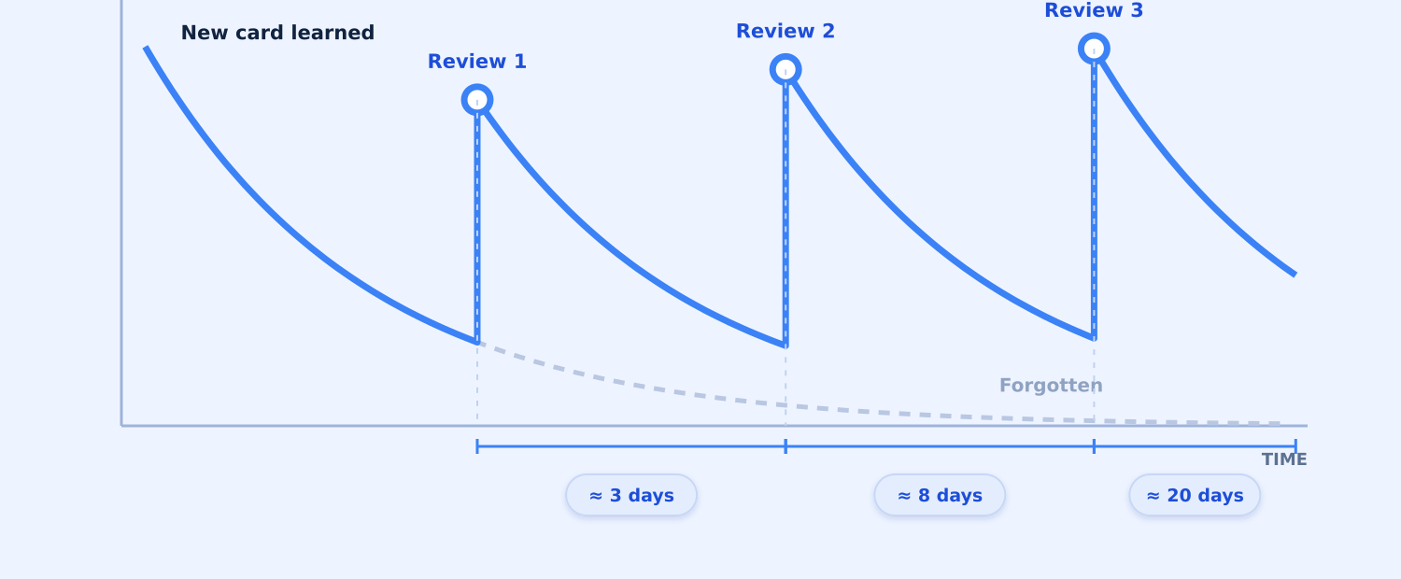
Spaced repetition
The app decides what you should study today — an SM-2 descendant with four grades.
How each grade reschedules a card
Again
back in 10 minutes, ease −0.20
Hard
interval × 1.2, ease −0.15
Good
interval × the ease factor
Easy
interval × ease × 1.3, ease +0.15
Each button previews its own result (“Good · 3 days”): the client and the server run the same scheduler.
What the scheduler guarantees
Where it shows up in the app
New cards start in minute-long learning steps; Easy skips to 4 days
A Review tab with today's queue, split into due and new
A forgotten card relearns from 10 minutes and returns sooner
A due badge on every deck and on the navigation item
Intervals are clamped to 1–365 days, ease to 1.3–2.8
A banner on Home when something is waiting
At most 20 new cards a day — what you owe comes first
Due-now, learning and mature tiles on the Stats tab
QuizTime · Concept Paper
8
Notes:
SPACED REPETITION (about 1 to 1.5 minutes)
This is the heart of the system. Point at the curve: one review lands before the memory fades, and each review lifts the curve higher.
Each card is graded Again, Hard, Good or Easy, and that grade sets the next interval using an SM-2 descendant — the four-button variant used by modern flashcard apps. Again brings the card back in ten minutes and lowers its ease; Good multiplies the interval by the ease factor; Easy adds a bonus.
Two details worth saying: the buttons print what they will do before you press them, because the client and server run the same scheduler; and new cards are capped at twenty a day, so what you owe comes first.

Slide 9
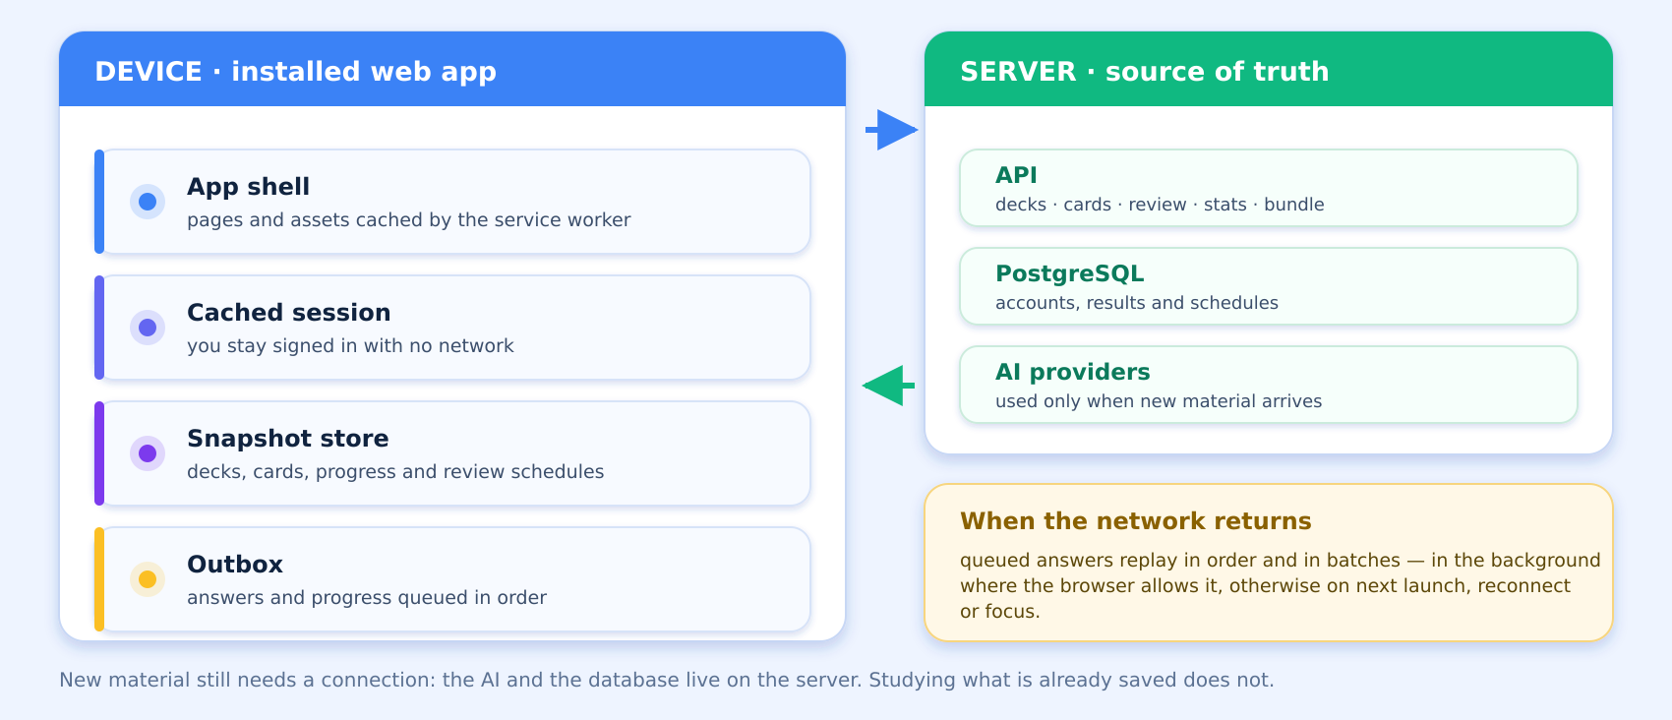
Works with no signal
Offline-first design: the review queue lives on the device, not just online.
QuizTime · Concept Paper
9
Notes:
OFFLINE (about 1 minute)
Many learners study on a commute or on unreliable Wi-Fi, so the app is offline-first.
The device keeps its own copy: the app shell, a cached session so you stay signed in, a snapshot of decks, cards and schedules, and an outbox. All four study modes, progress, and the review queue keep working with no signal, and answers replay when the connection returns.
Be honest about the limitation: new material still needs the network — the AI and the database live on the server.

Slide 10
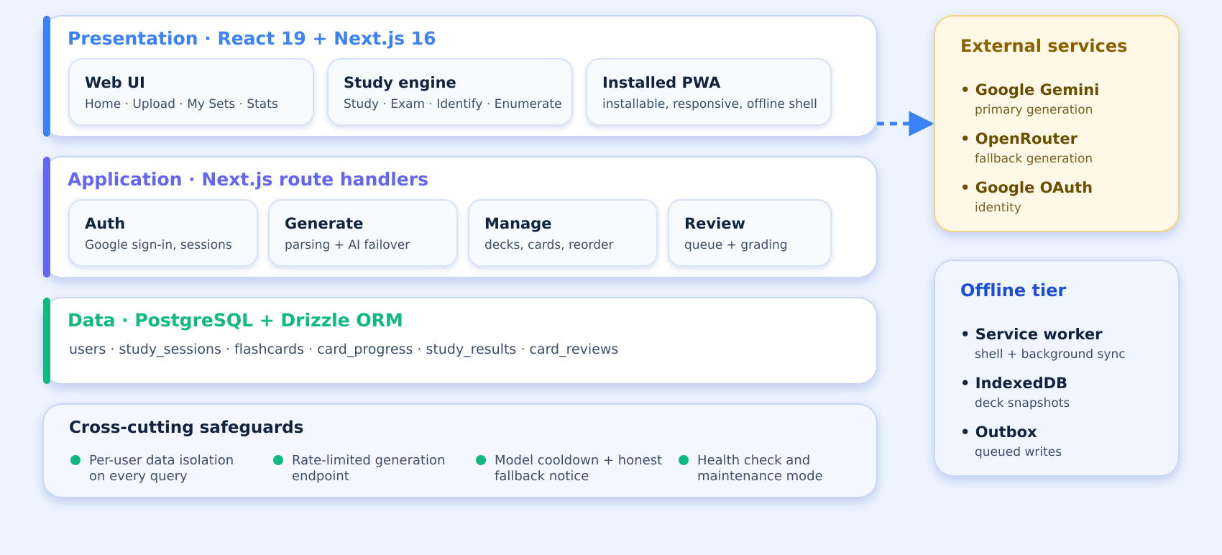
System architecture
Three tiers, plus an offline tier that lives inside the browser.
QuizTime · Concept Paper
10
Notes:
ARCHITECTURE (about 45 seconds)
Three tiers — the React and Next.js interface, the route handlers, and PostgreSQL — plus an offline tier that lives inside the browser.
Do not read every box. Highlight the safeguards instead: every query is scoped to the signed-in user, generation is rate-limited, models cool down after a limit, and there is a health check and a maintenance mode.

Slide 11
Scope and delimitation
What the project covers — and what it deliberately does not.
IN SCOPE
OUT OF SCOPE
Uploads: 8 files — PDF, DOCX, PPTX, JPG, PNG, WEBP, HEIC — or 100k characters of text
No LMS features — rosters, gradebooks or teacher dashboards
AI generation with automatic failover across models and providers
No sharing, public decks, comments or leaderboards
Four study modes with scoring, grades and session review
No handwriting or image-only OCR; scanned PDFs without text are rejected
SM-2 descendant scheduling with a daily review queue
No semantic grading of essay or free-form answers
Deck management: manual decks, rename, card CRUD and reorder
AI output is a draft — the learner verifies the content
Progress analytics: accuracy, mastery, streak, review health
No native app, payments or institutional single sign-on
Offline study with queued answers that sync automatically
Google sign-in with strict per-account data isolation
Everything in the left column is implemented and covered by automated tests; the right column defines the honest boundary of the claim.
QuizTime · Concept Paper
11
Notes:
SCOPE AND DELIMITATION (about 1 minute)
This slide usually draws questions, so be deliberate. The left column is what the system does, and every item there is covered by automated tests. The right column is what we deliberately did not build: no LMS features, no gradebook or teacher dashboard, no public decks, no handwriting recognition, no semantic grading of essay answers, no native app or payments.
The strongest statement here: AI output is a draft, and the learner remains responsible for verifying it.

Slide 12
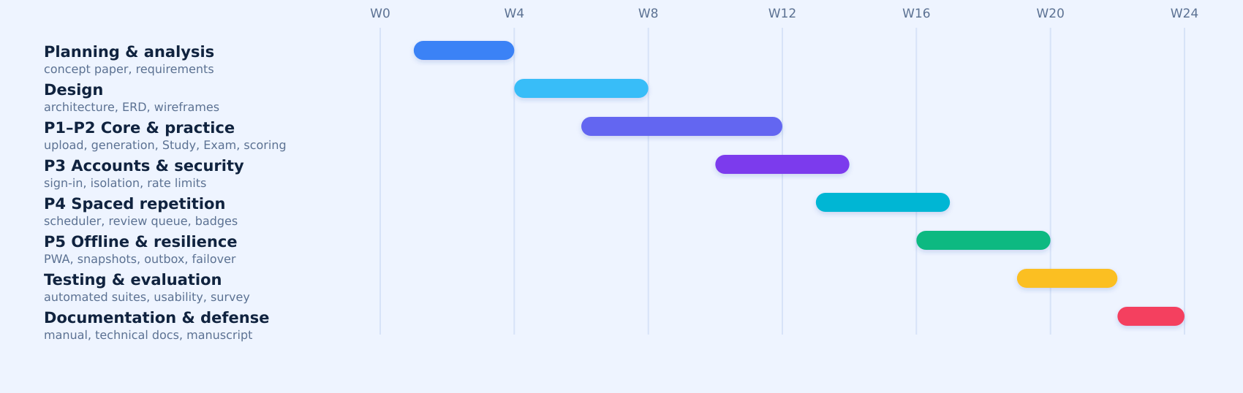
Methodology and work plan
Design-and-development research, delivered in five incremental releases over 24 weeks.
Approach
Releases
Design and development research (Richey & Klein).
P1
Upload, parsing, generation, Study Mode
Four phases: analysis, design, development, evaluation.
P2
Exam Mode, scoring, statistics
Requirements from a learner survey, the literature, course material.
P3
Sign-in, data isolation, rate limits
Each increment ships only when its automated tests pass.
P4
Scheduler, Review queue, offline grading
P5
Service worker, snapshots, AI failover
QuizTime · Concept Paper
12
Notes:
METHODOLOGY (about 1 minute)
We use design-and-development research: building the artifact and studying that process are equally important. Requirements came from a learner survey, the literature, and real course material.
Development is iterative in five releases, from upload and generation, through scoring and accounts, to the scheduler and finally offline capability. The timeline shows the eight phases across 24 weeks, ending with evaluation, documentation and this defense.

Slide 13
Testing and evaluation
Verification by automated suites, validation by users.
194
146
9
8
automated checks in total
re-run for this paper — all passing
test files across 8 npm suites
cross-account isolation checks
What is verified automatically
How users will evaluate it
AI failover engine under simulated rate limits and outages
Scripted usability walkthrough of all primary tasks
Spaced-repetition steps, graduations, lapses and interval clamping
ISO/IEC 25010-based acceptability questionnaire
Offline round trip against a real server and database
Student respondents, 5-point Likert scale
One account cannot read, grade or delete another's data
Deck edits preserve card identity, progress and schedules
Descriptive statistics with an adjectival rating scale
Preferences, health endpoint and service-worker contract
Debrief interview on study-habit change
QuizTime · Concept Paper
13
Notes:
TESTING AND EVALUATION (about 1 minute)
Verification is automated: 194 checks across nine test files. For this paper we re-ran the 146 that need no database or API key — all passed. Eight of them deliberately try to read and grade another account's data; they are rejected, as they should be. There is also an offline round trip that checks the database after answers were recorded with the network switched off.
Validation is with users: a scripted usability walkthrough and an acceptability questionnaire based on ISO/IEC 25010, answered on a five-point Likert scale and interpreted with descriptive statistics.

Slide 14
Significance and cost
Who benefits, and what the project actually costs to run.
Students
Teachers
Cost to run
Deck-building and scheduling stop being the reason they don't self-test.
Course material becomes practice material with almost no preparation.
Domain
₱700 / year
Hosting
free tier
Board reviewees
Low-connectivity learners
Database
free tier
Eight sources merge into one deck, and the scheduler decides what is urgent.
Spaced repetition keeps working on a phone with no signal.
AI quota
free + ₱600
Printing
₱1,200
Expected outcomes
A deployed, installable study app that turns a learner's own files into editable flashcards.
₱2,500 – ₱10,000
A working spaced-repetition scheduler with a daily queue and visible progress analytics.
for the whole semester, mostly optional upgrades
Offline study that keeps working without a connection and syncs afterwards.
Generation that survives a model or provider going down — and says so honestly.
Verified quality, documented patterns, and a foundation other researchers can extend.
QuizTime · Concept Paper
14
Notes:
SIGNIFICANCE AND COST (about 45 seconds)
The beneficiaries are students, teachers converting existing material, board reviewees consolidating many sources, and learners with poor connectivity.
On cost: the system is designed to run on free tiers, with the fallback chain as the safety net when a free quota runs out. We estimate 2,500 to 10,000 pesos for the semester, most of it optional upgrades.

Slide 15

Learners remember what they retrieve.
QuizTime removes the labour of applying that — by using AI to prepare the material a learner already has, and a scheduler to decide when each card should return.
Thank you — questions and suggestions are welcome.
QuizTime · Flashcard Quiz Maker · Concept Paper Presentation
Notes:
CLOSING (about 30 seconds)
Close on the claim: learners remember what they retrieve, and the barrier has never been the science but the labour of applying it. QuizTime removes that labour.
Thank the panel and invite questions.

