Slide 1

CLMVS – lab4 ROV with 3 dofs
x
Ɵ
y
<body>
$$\begin{aligned}m\ddot{x}=−α\dot{x}+F_{X} \\ m\ddot{y}=−β\dot{y}+F_{Y} \\ J\dot{w}=−γw+N_{Z}\end{aligned}$$
$$\left\{\begin{aligned}\dot{x}=Ax+Bu \\ y=Cx \end{aligned}\right.$$
$$\frac{d}{dt}x=\left(\begin{matrix}\begin{matrix}0 & 0 & 0 \\ 0 & 0 & 0 \\ 0 & 0 & 0\end{matrix} & \begin{matrix}1 & 0 & 0 \\ 0 & 1 & 0 \\ 0 & 0 & 1\end{matrix} \\ \begin{matrix}0 & 0 & 0 \\ 0 & 0 & 0 \\ 0 & 0 & 0\end{matrix} & \begin{matrix}−α/m & 0 & 0 \\ 0 & −β/m & 0 \\ 0 & 0 & −γ/J\end{matrix}\end{matrix}\right)\left[\begin{matrix}r_{x} \\ r_{y} \\ \begin{matrix}θ \\ \dot{r_{x}} \\ \begin{aligned}\dot{r_{y}} \\ w\end{aligned}\end{matrix}\end{matrix}\right]+ \left(\begin{matrix}\begin{matrix}0 & 0 & 0 \\ 0 & 0 & 0 \\ 0 & 0 & 0\end{matrix} \\ \begin{matrix}1/m & 0 & 0 \\ 0 & 1/m & 0 \\ 0 & 0 & 1/J\end{matrix}\end{matrix}\right)\left[\begin{matrix}F_{x} \\ F_{y} \\ N_{z}\end{matrix}\right]$$
x
y
<world>

Slide 2
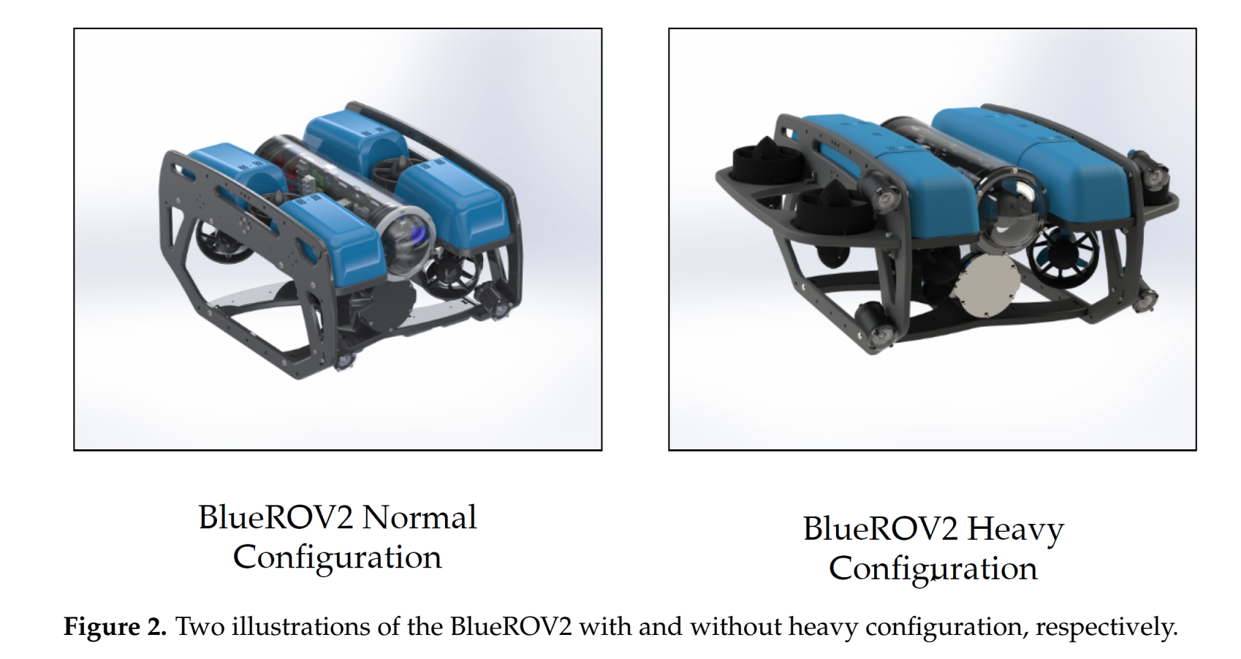
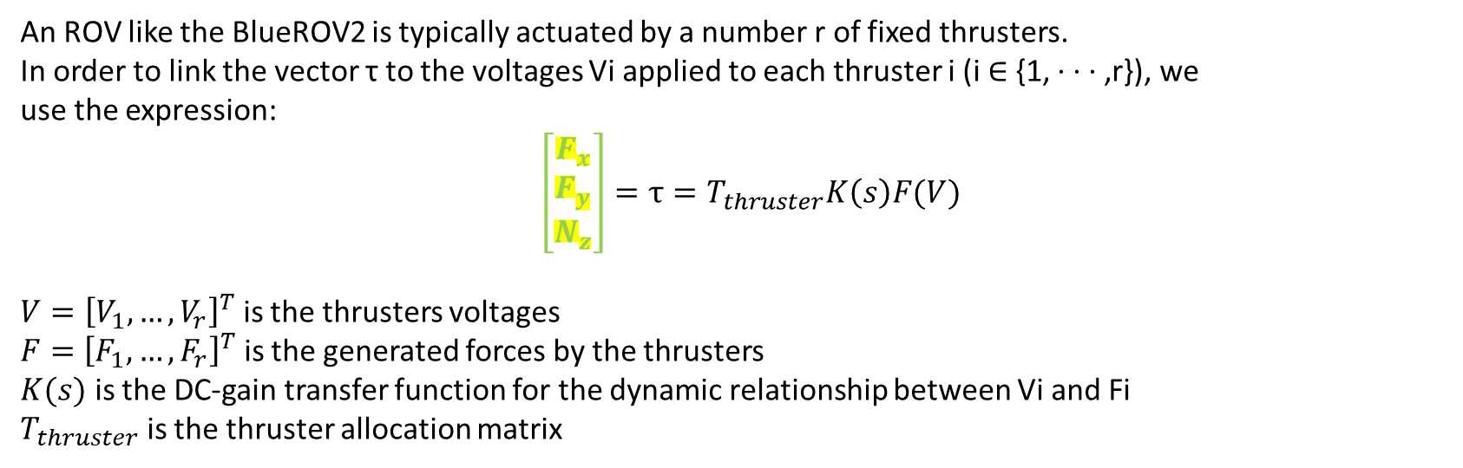
ROV
Modelling
An ROV like the BlueROV2 is typically actuated by a number r of fixed thrusters.
In order to link the vector τ to the voltages Vi applied to each thruster i (i ∈ {1, · · · ,r}), we
use the expression:
$\left[\begin{matrix}F_{x} \\ F_{y} \\ N_{z}\end{matrix}\right]=τ=T_{thruster}K\left(s\right)F(V)$
$V={\left[V_{1}, …, V_{r}\right]}^{T}$ is the thrusters voltages
$F={\left[F_{1}, …, F_{r}\right]}^{T}$ is the generated forces by the thrusters
$K(s)$ is the DC-gain transfer function for the dynamic relationship between Vi and Fi
$T_{thruster}$ is the thruster allocation matrix

Slide 3

BlueROV2
Equation of forces
$τ=T_{thruster}K\left(s\right)F(V)$
$V={\left[V_{1}, …, V_{r}\right]}^{T}$ is the thrusters’ voltages
$F={\left[F_{1}, …, F_{r}\right]}^{T}$ is the generated forces by the thrusters
$$F_{i}\left(V_{i}\right)=30{ V}_{i}$$
$K(s)$ is diagonal transfer function $K\left(s\right)=diag(K_{1}\left(s\right), …, K_{r}\left(s\right))$
The diagonal elements are equal and obtained from system identification on experimental data.
$$K_{i}\left(s\right)=\frac{6136s+108700}{s^{3}+89s^{2}+9258s+108700}$$
$K_{i}\left(s\right)$ is the third order transfer function with unity steady state gain.

Slide 4
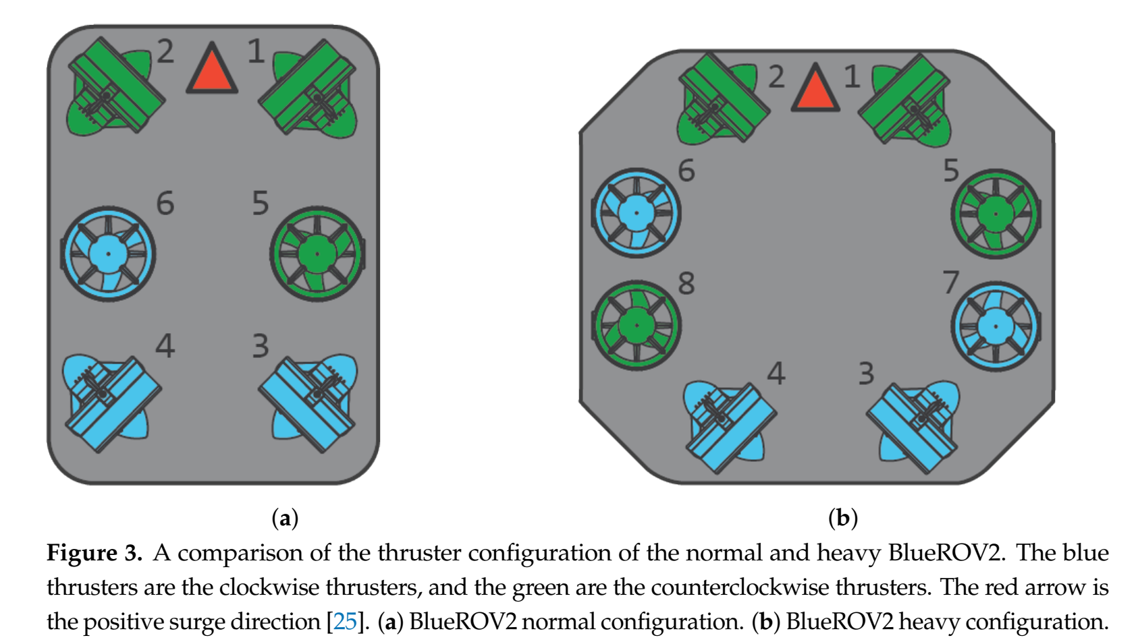
BlueROV2
Thrusters allocation

Slide 5
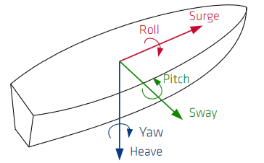
Thruster allocation matrix
Thruster allocation matrix (TAM)
 | T1 | T2 | T3 | T4 | T5 | T6
Surge | 0.7071 | 0.7071 | -0.7071 | -0.7071 | 0 | 0
Sway | -0.7071 | 0.7071 | -0.7071 | 0.7071 | 0 | 0
Heave | 0 | 0 | 0 | 0 | -1 | 1
Roll | 0 | 0 | 0 | 0 | 0.218 | 0.218
Pitch | 0 | 0 | 0 | 0 | 0.12 | -0.12
Yaw | -0.1888 | 0.1888 | 0.1888 | -0.1888 | 0 | 0
Notes:
K is the thrust coefficient, which is a scaling factor mapping
from the control input to the thrust force
The thruster dynamics is described by the diagonal transfer function matrix K(s) the following third order transfer function with unity DC-gain was identified

Slide 6
Simplifications
Thruster allocation matrix (TAM): In our example, we study the motion of ROV on surge, sway and yaw. (3dofs)

Slide 7
Thruster allocation matrix
Thruster allocation matrix (TAM) for 3 degree of motion
 | T1 | T2 | T3 | T4 | T5 | T6
Surge | 0.7071 | 0.7071 | -0.7071 | -0.7071 | 0 | 0
Sway | -0.7071 | 0.7071 | -0.7071 | 0.7071 | 0 | 0
Heave | 0 | 0 | 0 | 0 | -1 | 1
Roll | 0 | 0 | 0 | 0 | 0.218 | 0.218
Pitch | 0 | 0 | 0 | 0 | 0.12 | -0.12
Yaw | -0.1888 | 0.1888 | 0.1888 | -0.1888 | 0 | 0
Notes:
K is the thrust coefficient, which is a scaling factor mapping
from the control input to the thrust force
The thruster dynamics is described by the diagonal transfer function matrix K(s) the following third order transfer function with unity DC-gain was identified

Slide 8
Thruster allocation matrix
Thruster allocation matrix (TAM) for 3 degree of motion
 | T1 | T2 | T3 | T4 | T5 | T6
Surge | 0.7071 | 0.7071 | -0.7071 | -0.7071 | 0 | 0
Sway | -0.7071 | 0.7071 | -0.7071 | 0.7071 | 0 | 0
Heave | 0 | 0 | 0 | 0 | -1 | 1
Roll | 0 | 0 | 0 | 0 | 0.218 | 0.218
Pitch | 0 | 0 | 0 | 0 | 0.12 | -0.12
Yaw | -0.1888 | 0.1888 | 0.1888 | -0.1888 | 0 | 0
Notes:
K is the thrust coefficient, which is a scaling factor mapping
from the control input to the thrust force
The thruster dynamics is described by the diagonal transfer function matrix K(s) the following third order transfer function with unity DC-gain was identified

Slide 9
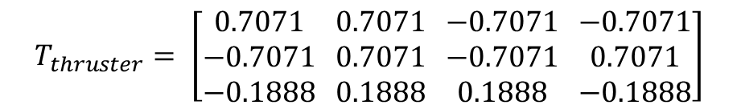
Thruster allocation matrix
Thruster allocation matrix (TAM) for 3 degree of motion
 | T1 | T2 | T3 | T4
Surge | 0.7071 | 0.7071 | -0.7071 | -0.7071
Sway | -0.7071 | 0.7071 | -0.7071 | 0.7071
Yaw | -0.1888 | 0.1888 | 0.1888 | -0.1888
$$T_{thruster}= \left[\begin{matrix}0.7071 \\ −0.7071 \\ −0.1888\end{matrix} \begin{matrix}0.7071 \\ 0.7071 \\ 0.1888\end{matrix} \begin{matrix}−0.7071 \\ −0.7071 \\ 0.1888\end{matrix} \begin{matrix}−0.7071 \\ 0.7071 \\ −0.1888\end{matrix}\right]$$
Notes:
K is the thrust coefficient, which is a scaling factor mapping
from the control input to the thrust force
The thruster dynamics is described by the diagonal transfer function matrix K(s) the following third order transfer function with unity DC-gain was identified

Slide 10
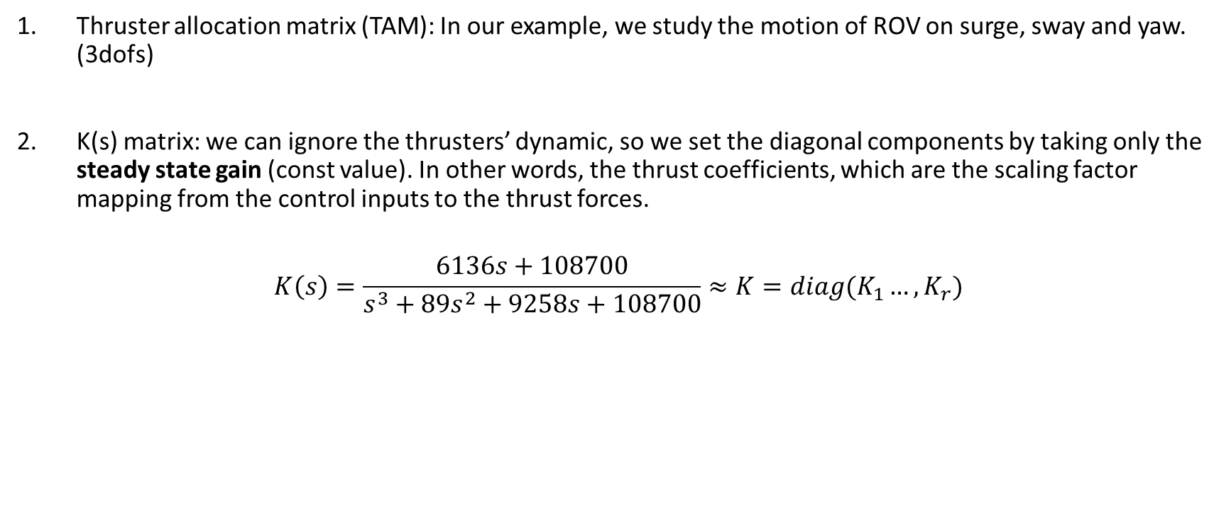
Simplifications
Thruster allocation matrix (TAM): In our example, we study the motion of ROV on surge, sway and yaw. (3dofs)
K(s) matrix: we can ignore the thrusters’ dynamic, so we set the diagonal components by taking only the steady state gain (const value). In other words, the thrust coefficients, which are the scaling factor mapping from the control inputs to the thrust forces.
$$K\left(s\right)=\frac{6136s+108700}{s^{3}+89s^{2}+9258s+108700}≈K=diag(K_{1}…, K_{r})$$

Slide 11
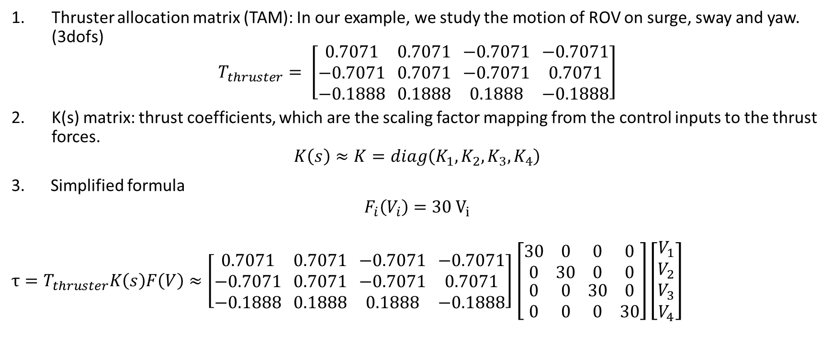
Simplifications
Thruster allocation matrix (TAM): In our example, we study the motion of ROV on surge, sway and yaw. (3dofs)
$$T_{thruster}= \left[\begin{matrix}0.7071 \\ −0.7071 \\ −0.1888\end{matrix} \begin{matrix}0.7071 \\ 0.7071 \\ 0.1888\end{matrix} \begin{matrix}−0.7071 \\ −0.7071 \\ 0.1888\end{matrix} \begin{matrix}−0.7071 \\ 0.7071 \\ −0.1888\end{matrix}\right]$$
K(s) matrix: thrust coefficients, which are the scaling factor mapping from the control inputs to the thrust forces.
$$K\left(s\right)≈K=diag\left(K_{1},K_{2},K_{3},K_{4}\right)$$
Simplified formula
$$F_{i}\left(V_{i}\right)=30{ V}_{i}$$
$τ=T_{thruster}K\left(s\right)F\left(V\right)≈\left[\begin{matrix}0.7071 \\ −0.7071 \\ −0.1888\end{matrix} \begin{matrix}0.7071 \\ 0.7071 \\ 0.1888\end{matrix} \begin{matrix}−0.7071 \\ −0.7071 \\ 0.1888\end{matrix} \begin{matrix}−0.7071 \\ 0.7071 \\ −0.1888\end{matrix}\right]$ $\left[\begin{matrix}30 \\ 0 \\ \begin{aligned}0 \\ 0\end{aligned}\end{matrix} \begin{matrix}0 \\ 30 \\ \begin{aligned}0 \\ 0\end{aligned}\end{matrix} \begin{matrix}0 \\ 0 \\ \begin{aligned}30 \\ 0\end{aligned}\end{matrix} \begin{matrix}0 \\ 0 \\ \begin{aligned}0 \\ 30\end{aligned}\end{matrix}\right]\left[\begin{aligned}V_{1} \\ V_{2} \\ V_{3} \\ V_{4}\end{aligned}\right]$

Slide 12
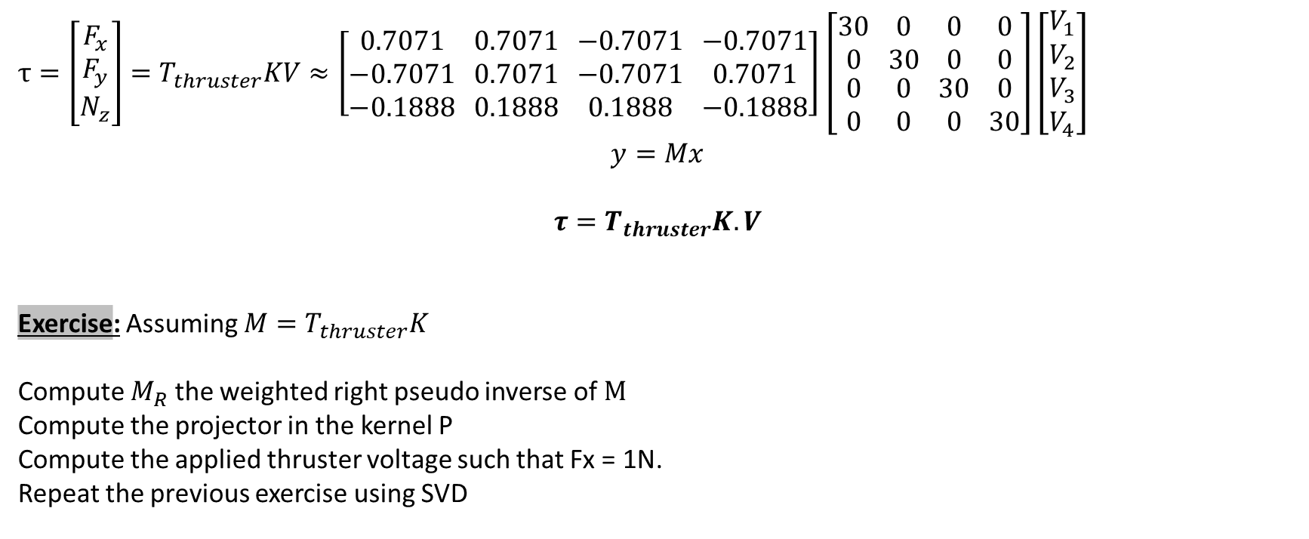
Control Allocation Problem
$τ=\left[\begin{aligned}F_{x} \\ F_{y} \\ N_{z}\end{aligned}\right]=T_{thruster}KV≈\left[\begin{matrix}0.7071 \\ −0.7071 \\ −0.1888\end{matrix} \begin{matrix}0.7071 \\ 0.7071 \\ 0.1888\end{matrix} \begin{matrix}−0.7071 \\ −0.7071 \\ 0.1888\end{matrix} \begin{matrix}−0.7071 \\ 0.7071 \\ −0.1888\end{matrix}\right]$ $\left[\begin{matrix}30 \\ 0 \\ \begin{aligned}0 \\ 0\end{aligned}\end{matrix} \begin{matrix}0 \\ 30 \\ \begin{aligned}0 \\ 0\end{aligned}\end{matrix} \begin{matrix}0 \\ 0 \\ \begin{aligned}30 \\ 0\end{aligned}\end{matrix} \begin{matrix}0 \\ 0 \\ \begin{aligned}0 \\ 30\end{aligned}\end{matrix}\right]\left[\begin{aligned}V_{1} \\ V_{2} \\ V_{3} \\ V_{4}\end{aligned}\right]$
$$y=Mx$$
$$τ=T_{thruster}K.V$$
Exercise: Assuming $M=T_{thruster}K$
Compute $M_{R}$the weighted right pseudo inverse of $M$
Compute the projector in the kernel P
Compute the applied thruster voltage such that Fx = 1N.
Repeat the previous exercise using SVD

