Slide 1

CLMVS – lab3 ROV with 3 dofs
x
Ɵ
y
<body>
$$\begin{aligned}m\ddot{x}=−α\dot{x}+F_{X} \\ m\ddot{y}=−β\dot{y}+F_{Y} \\ J\dot{w}=−γw+N_{Z}\end{aligned}$$
$$\left\{\begin{aligned}\dot{x}=Ax+Bu \\ y=Cx \end{aligned}\right.$$
$$\frac{d}{dt}x=\left(\begin{matrix}\begin{matrix}0 & 0 & 0 \\ 0 & 0 & 0 \\ 0 & 0 & 0\end{matrix} & \begin{matrix}1 & 0 & 0 \\ 0 & 1 & 0 \\ 0 & 0 & 1\end{matrix} \\ \begin{matrix}0 & 0 & 0 \\ 0 & 0 & 0 \\ 0 & 0 & 0\end{matrix} & \begin{matrix}−α/m & 0 & 0 \\ 0 & −β/m & 0 \\ 0 & 0 & −γ/J\end{matrix}\end{matrix}\right)\left[\begin{matrix}r_{x} \\ r_{y} \\ \begin{matrix}θ \\ \dot{r_{x}} \\ \begin{aligned}\dot{r_{y}} \\ w\end{aligned}\end{matrix}\end{matrix}\right]+ \left(\begin{matrix}\begin{matrix}0 & 0 & 0 \\ 0 & 0 & 0 \\ 0 & 0 & 0\end{matrix} \\ \begin{matrix}1/m & 0 & 0 \\ 0 & 1/m & 0 \\ 0 & 0 & 1/J\end{matrix}\end{matrix}\right)\left[\begin{matrix}F_{x} \\ F_{y} \\ N_{z}\end{matrix}\right]$$
x
y
<world>

Slide 2

Space state model – output
$Y= \left[\begin{matrix}r_{x} \\ r_{y} \\ θ\end{matrix}\right], Y=C ∗x$ , $x$ = $\left[\begin{matrix}r_{x} \\ r_{y} \\ \begin{matrix}θ \\ \dot{r_{x}} \\ \begin{aligned}\dot{r_{y}} \\ w\end{aligned}\end{matrix}\end{matrix}\right]$
$C= \left(\begin{matrix}\begin{matrix}1 & 0 & 0 \\ 0 & 1 & 0 \\ 0 & 0 & 1\end{matrix} & \begin{matrix}0 & 0 & 0 \\ 0 & 0 & 0 \\ 0 & 0 & 0\end{matrix}\end{matrix}\right), D=0$

Slide 3
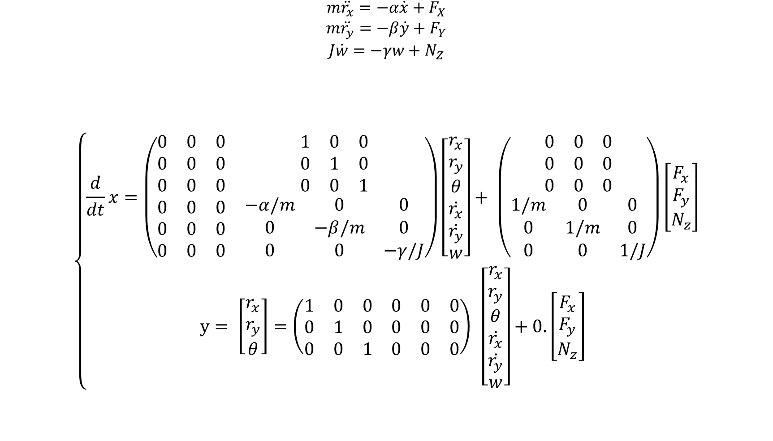
$$\begin{aligned}m\ddot{r_{x}}=−α\dot{x}+F_{X} \\ m\ddot{r_{y}}=−β\dot{y}+F_{Y} \\ J\dot{w}=−γw+N_{Z}\end{aligned}$$
$$\left\{\begin{aligned}\frac{d}{dt}x=\left(\begin{matrix}\begin{matrix}0 & 0 & 0 \\ 0 & 0 & 0 \\ 0 & 0 & 0\end{matrix} & \begin{matrix}1 & 0 & 0 \\ 0 & 1 & 0 \\ 0 & 0 & 1\end{matrix} \\ \begin{matrix}0 & 0 & 0 \\ 0 & 0 & 0 \\ 0 & 0 & 0\end{matrix} & \begin{matrix}−α/m & 0 & 0 \\ 0 & −β/m & 0 \\ 0 & 0 & −γ/J\end{matrix}\end{matrix}\right)\left[\begin{matrix}r_{x} \\ r_{y} \\ \begin{matrix}θ \\ \dot{r_{x}} \\ \begin{aligned}\dot{r_{y}} \\ w\end{aligned}\end{matrix}\end{matrix}\right]+ \left(\begin{matrix}\begin{matrix}0 & 0 & 0 \\ 0 & 0 & 0 \\ 0 & 0 & 0\end{matrix} \\ \begin{matrix}1/m & 0 & 0 \\ 0 & 1/m & 0 \\ 0 & 0 & 1/J\end{matrix}\end{matrix}\right)\left[\begin{matrix}F_{x} \\ F_{y} \\ N_{z}\end{matrix}\right] \\ y= \left[\begin{matrix}r_{x} \\ r_{y} \\ θ\end{matrix}\right]=\left(\begin{matrix}\begin{matrix}1 & 0 & 0 \\ 0 & 1 & 0 \\ 0 & 0 & 1\end{matrix} & \begin{matrix}0 & 0 & 0 \\ 0 & 0 & 0 \\ 0 & 0 & 0\end{matrix}\end{matrix}\right) \left[\begin{matrix}r_{x} \\ r_{y} \\ \begin{matrix}θ \\ \dot{r_{x}} \\ \begin{aligned}\dot{r_{y}} \\ w\end{aligned}\end{matrix}\end{matrix}\right]+0.\left[\begin{matrix}F_{x} \\ F_{y} \\ N_{z}\end{matrix}\right]\end{aligned}\right.$$

Slide 4
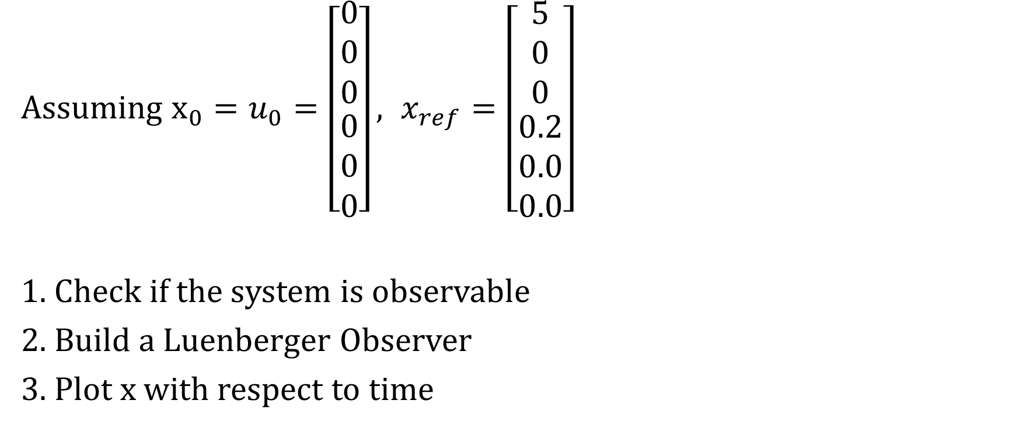
Exercise
x
x
Assuming $x_{0}=u_{0}=\left[\begin{matrix}\begin{matrix}0 \\ 0 \\ 0\end{matrix} \\ \begin{matrix}0 \\ 0 \\ 0\end{matrix}\end{matrix}\right], x_{ref}=\left[\begin{matrix}\begin{matrix}5 \\ 0 \\ 0\end{matrix} \\ \begin{matrix}0.2 \\ 0.0 \\ 0.0\end{matrix}\end{matrix}\right]$
1. Check if the system is observable
2. Build a Luenberger Observer
3. Plot x with respect to time
Ɵ
y
<body>
y
x
y
<world>

Slide 5

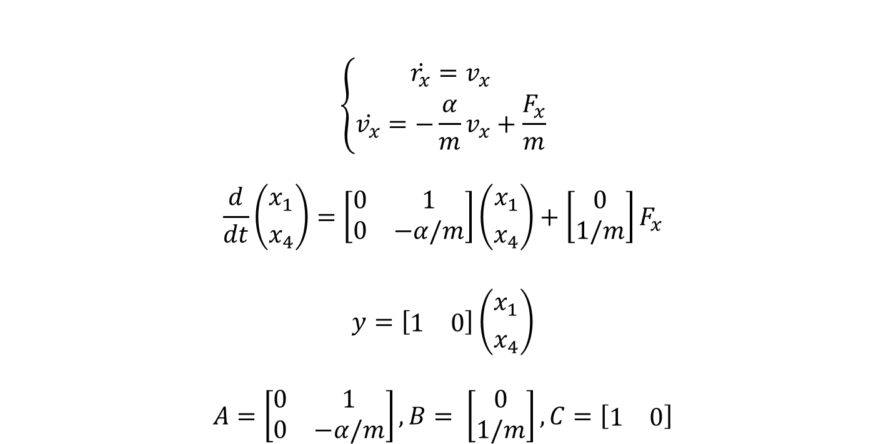
Computing Kc
We can study the subsystem (position and velocity), which are coupled (velocity is the derivative of the position) as one independent system.
$$\left\{\begin{aligned}\dot{r_{x}}=v_{x} \\ \dot{v_{x}}=−\frac{α}{m}v_{x}+\frac{F_{x}}{m}\end{aligned}\right.$$
$$\frac{d}{dt}\left({x_{1} \atop x_{4}}\right)=\left[\begin{matrix}0 & 1 \\ 0 & −α/m\end{matrix}\right]\left({x_{1} \atop x_{4}}\right)+\left[\begin{matrix}0 \\ 1/m\end{matrix}\right]F_{x}$$
$$y=\left[\begin{matrix}1 & 0\end{matrix}\right]\left({x_{1} \atop x_{4}}\right)$$
$$A=\left[\begin{matrix}0 & 1 \\ 0 & −α/m\end{matrix}\right], B= \left[\begin{matrix}0 \\ 1/m\end{matrix}\right],C=\left[\begin{matrix}1 & 0\end{matrix}\right]$$
New state definition:
$$x≜\left({r_{x} \atop v_{x}}\right)=\left({x_{1} \atop x_{4}}\right)$$

Slide 6

Computing Kc
We should choose $Kc_{surge}$such that $\left(A+BKc_{surge}\right)$ is assymptotically stable.
$$A+BK_{surge}=\left(\begin{matrix}0 & 1 \\ 0 & −\frac{α}{m}\end{matrix}\right)+\left(\begin{matrix}0 & 0 \\ \frac{k_{c_{1}}}{m} & \frac{k_{c_{4}}}{m}\end{matrix}\right)=\left(\begin{matrix}0 & 1 \\ \frac{k_{c_{1}}}{m} & −\frac{α}{m}+\frac{k_{c_{4}}}{m}\end{matrix}\right)$$
$$\det\left(λI−\left[A+BK_{surge}\right]\right)=\left|\begin{matrix}λ & −1 \\ −\frac{k_{c_{1}}}{m} & λ+\frac{α}{m}−\frac{k_{c_{4}}}{m}\end{matrix}\right|$$
$$=λ\left(λ+\frac{α−k_{c_{4}}}{m}\right)−\frac{k_{c_{1}}}{m}$$
$$=λ^{2}+\left(\frac{α−k_{c_{4}}}{m}\right)λ+\left(−\frac{k_{c_{1}}}{m}\right)=0$$

Slide 7

Computing Kc
We should choose ${K_{C}}_{surge}$such that $\left(A+BKc_{surge}\right)$ is assymptotically stable.
$$\det\left(λI−\left[A+B{K_{C}}_{surge}\right]\right) =λ^{2}+\left(\frac{α−k_{x_{c4}}}{m}\right)λ+\left(−\frac{k_{x_{c1}}}{m}\right)=0$$
$$\left\{\begin{aligned}−\frac{k_{c_{1}}}{m}=w_{n}^{2} \\ \frac{α−k_{c_{4}}}{m}=2ζw_{n}\end{aligned}\right.$$
For our exercise we can choose $ζ=1,w_{n}=3 rad/s$
$$k_{c_{1}}=−mw_{n}^{2}$$
$$k_{c_{4}}=α−2mζw_{n}$$

Slide 8
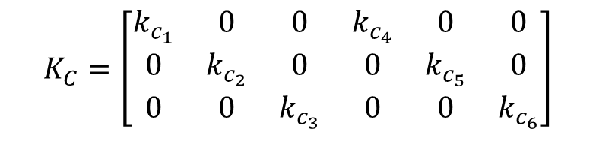

Computing Kc
We repeat the same method for the other 2 components y and theta.
$surge: \left\{\begin{aligned}k_{c_{1}}=−mw_{n}^{2} \\ k_{c_{4}}=α−2mζw_{n}\end{aligned}\right.$
$sway: \left\{\begin{aligned}k_{c_{2}}=−mw_{n}^{2} \\ k_{c_{5}}=β−2mζw_{n}\end{aligned}\right.$
$yaw: \left\{\begin{aligned}k_{c_{3}}=−J_{w}w_{n}^{2} \\ k_{c_{6}}=γ−2J_{w}ζw_{n}\end{aligned}\right.$
$$K_{C}=\left[\begin{matrix}\begin{matrix}k_{c_{1}} & 0 & 0 \\ 0 & k_{c_{2}} & 0 \\ 0 & 0 & k_{c_{3}}\end{matrix} & \begin{matrix}k_{c_{4}} & 0 & 0 \\ 0 & k_{c_{5}} & 0 \\ 0 & 0 & k_{c_{6}}\end{matrix}\end{matrix}\right]$$

Slide 9
Computing Ko
Since the observer is the positions and the orientation, which are coupled with their derivatives (the velocities), again we can deal with each two equation (position, velocity) as one independent system.
$$\left\{\begin{aligned}\dot{r_{x}}=v_{x} \\ \dot{v_{x}}=−\frac{α}{m}v_{x}+\frac{F_{x}}{m}\end{aligned}\right.$$
$$\frac{d}{dt}\left({x_{1} \atop x_{4}}\right)=\left[\begin{matrix}0 & 1 \\ 0 & −α/m\end{matrix}\right]\left({x_{1} \atop x_{4}}\right)+\left[\begin{matrix}0 \\ 1/m\end{matrix}\right]F_{x}$$
$$y=\left[\begin{matrix}1 & 0\end{matrix}\right]\left({x_{1} \atop x_{4}}\right)$$
$$A=\left[\begin{matrix}0 & 1 \\ 0 & −α/m\end{matrix}\right], B= \left[\begin{matrix}0 \\ 1/m\end{matrix}\right],C=\left[\begin{matrix}1 & 0\end{matrix}\right]$$
New state definition:
$$x≜\left({r_{x} \atop v_{x}}\right)=\left({x_{1} \atop x_{4}}\right)$$

Slide 10

Computing Ko
$$\dot{\hat{x}}=A\hat{x}+Bu_{1}+K_{o_{surge}}\left(y−\hat{y}\right);K_{o_{surge}}=\left[\begin{matrix}k_{x_{1}} \\ k_{x_{4}}\end{matrix}\right]$$
$$\dot{x}=Ax+Bu_{1}$$
$$\tilde{x}=x−\hat{x};$$
$$\dot{\tilde{x}}=\dot{x}−\dot{\hat{x}}=Ax+Bu_{1}−A\hat{x}−Bu_{1}−K_{o_{surge}}\left(y−\hat{y}\right)$$
$$\dot{\tilde{x}}=A\tilde{x}−K_{o_{surge}}C\tilde{x}=(A−K_{o_{surge}}C)\tilde{x}$$
We should choose $K$such that $\left(A−K_{o_{surge}}C\right)$ is assymptotically stable.
$$A−K_{o_{surge}}C=\left(\begin{matrix}0 & 1 \\ 0 & −\frac{α}{m}\end{matrix}\right)−\left(\begin{matrix}k_{x_{1}} & 0 \\ k_{x_{4}} & 0\end{matrix}\right)=\left(\begin{matrix}−k_{x_{1}} & 1 \\ −k_{x_{4}} & −\frac{α}{m}\end{matrix}\right)$$

Slide 11

Computing Ko
$$\det\left(λI−\left[A−K_{o_{surge}}C\right]\right)=\left|\begin{matrix}λ+k_{x_{1}} & −1 \\ k_{x_{4}} & λ+\frac{α}{m}\end{matrix}\right|$$
$$=\left(λ+\frac{α}{m}\right)\left(λ+k_{x_{1}}\right)+k_{x_{4}}$$
$$=λ^{2}+\left(\frac{α}{m}+k_{x_{1}}\right)λ+\left(k_{x_{1}}\frac{α}{m}+k_{x_{4}}\right)=0$$
$$\left\{\begin{aligned}k_{x_{1}}\frac{α}{m}+k_{x_{4}}=w_{n}^{2} \\ \frac{α}{m}+k_{x_{1}}=2ζw_{n}\end{aligned}\right.$$
For our exercise we can choose $ζ=1,w_{n}=1 rad/s$
$$K_{o_{surge}}$$

Slide 12
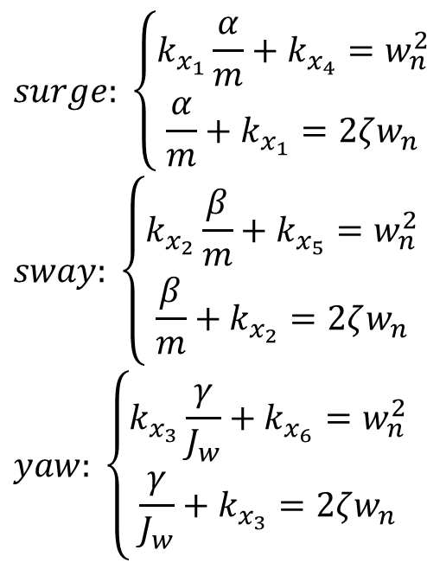
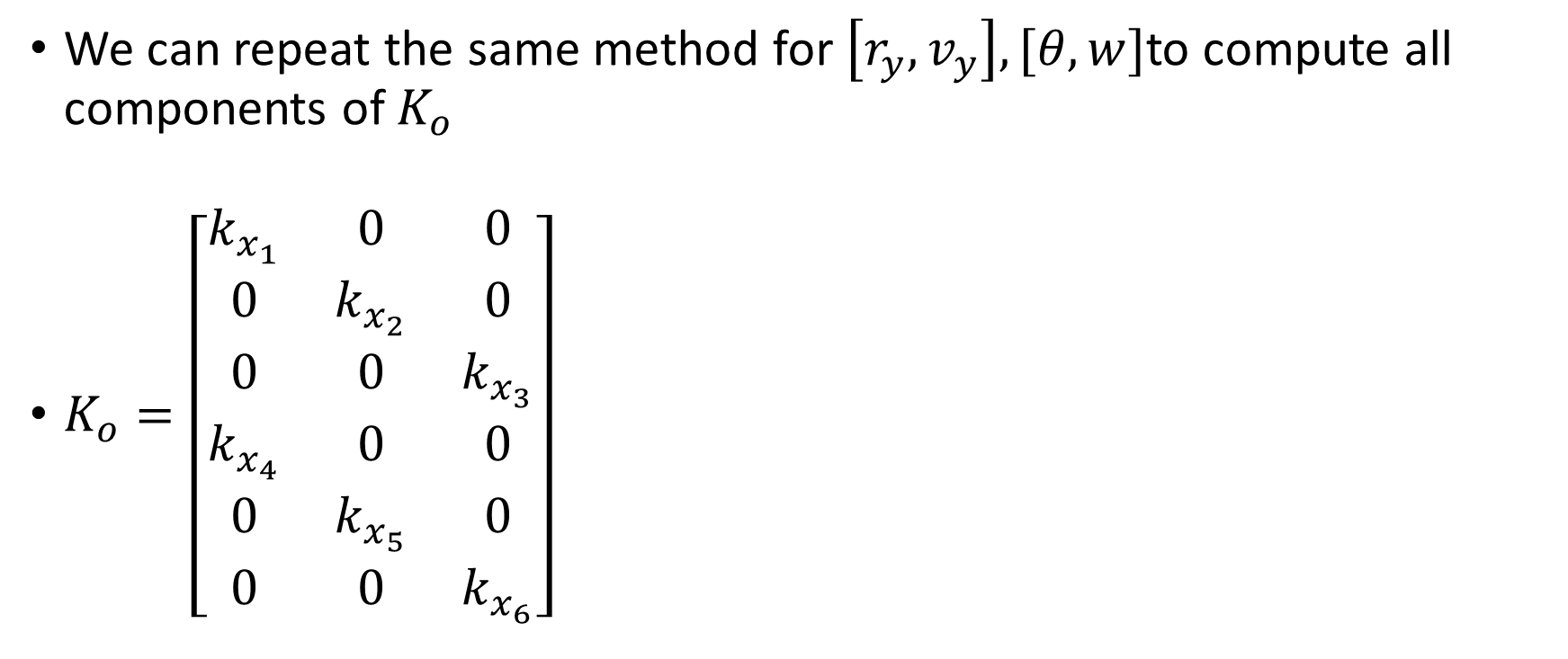

Computing Ko
We can repeat the same method for $\left[r_{y}, v_{y}\right], [θ,w]$to compute all components of $K_{o}$
$K_{o}=\left[\begin{matrix}\begin{matrix}k_{x_{1}} & 0 & 0 \\ 0 & k_{x_{2}} & 0 \\ 0 & 0 & k_{x_{3}}\end{matrix} \\ \begin{matrix}k_{x_{4}} & 0 & 0 \\ 0 & k_{x_{5}} & 0 \\ 0 & 0 & k_{x_{6}}\end{matrix}\end{matrix}\right]$
$$surge: \left\{\begin{aligned}k_{x_{1}}\frac{α}{m}+k_{x_{4}}=w_{n}^{2} \\ \frac{α}{m}+k_{x_{1}}=2ζw_{n}\end{aligned}\right.$$
$$sway: \left\{\begin{aligned}k_{x_{2}}\frac{β}{m}+k_{x_{5}}=w_{n}^{2} \\ \frac{β}{m}+k_{x_{2}}=2ζw_{n}\end{aligned}\right.$$
$$yaw: \left\{\begin{aligned}k_{x_{3}}\frac{γ}{J_{w}}+k_{x_{6}}=w_{n}^{2} \\ \frac{γ}{J_{w}}+k_{x_{3}}=2ζw_{n}\end{aligned}\right.$$
$$w_{n}=1;ζ=1;$$

