Slide 1
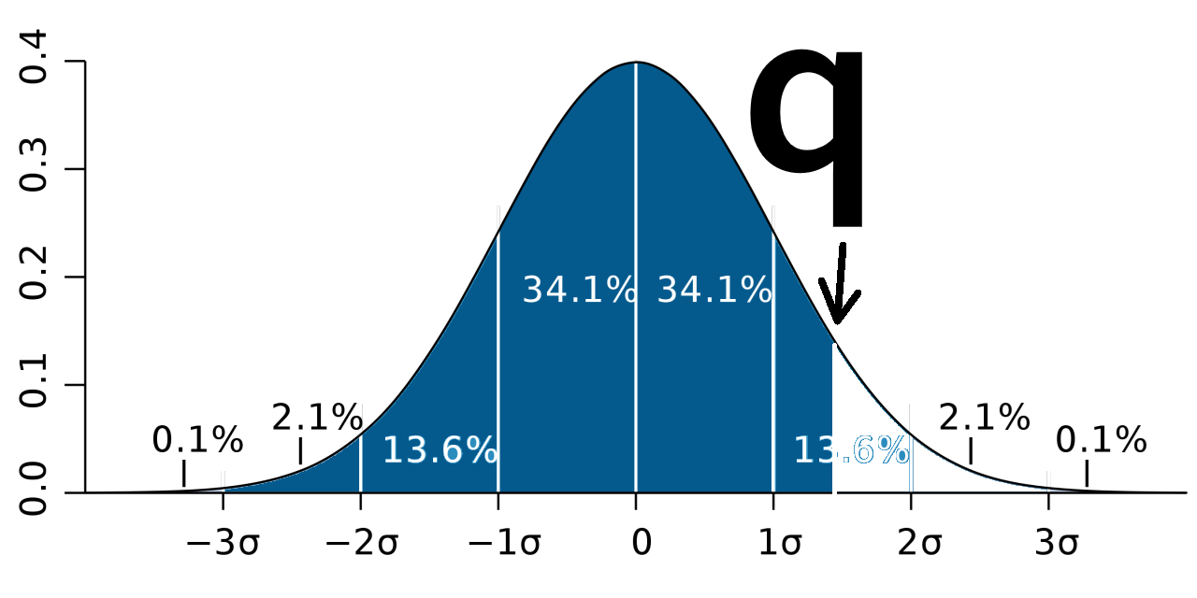

Input
function “pnorm”
Output
q = 1.42
0.9221962
Input
function “mean”
Output
x =
c(0.4, 1.2,
9.1, 7.6,
2.3)
$$\frac{\begin{aligned}\text{(}\text{0.4} \text{+} \text{1.2} \text{+} \\ \text{9.1} \text{+} \text{7.6} \text{+} \text{2.3}\text{)}\end{aligned}}{\text{5}}$$
4.12

