Slide 1
GIT
Git is software for tracking changes in any set of files, usually used for coordinating work among programmers collaboratively developing source code during software development. Its goals include speed, data integrity, and support for distributed, non-linear workflows.

Slide 2
Configuring GIT
Settings:
Name
Email
Default Editor
Line Ending

Slide 3
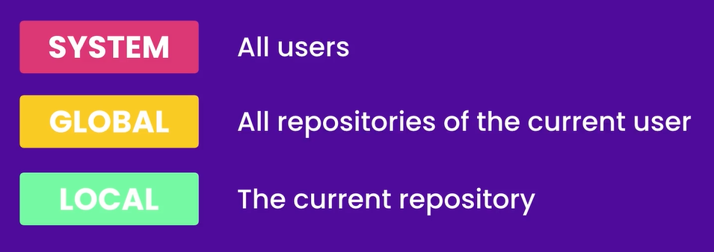
Setting Level

Slide 4
Setting
$ git config --global user.name“alqama shuja”
$ git config --global user.email alqamashuja313@gmail.com
$ git config --global core.editor “code --wait”
$ git config --global –e
$ git config --global core.autocrlf true (Skip)

Slide 5
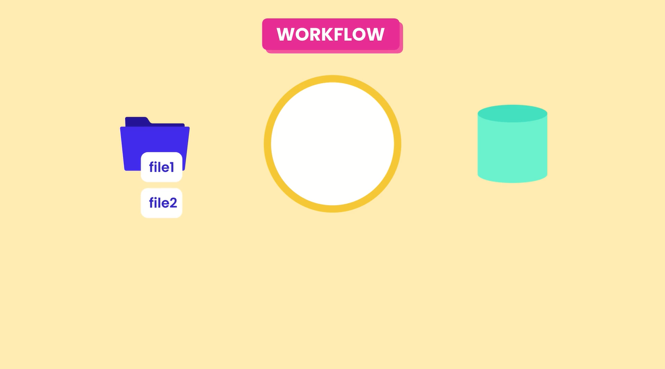

Slide 6
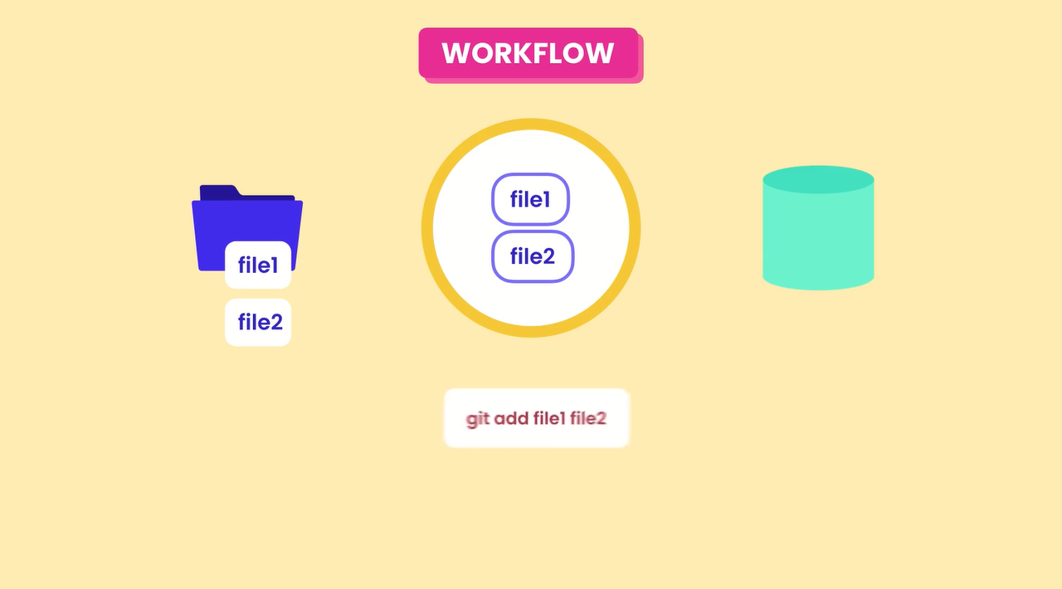

Slide 7
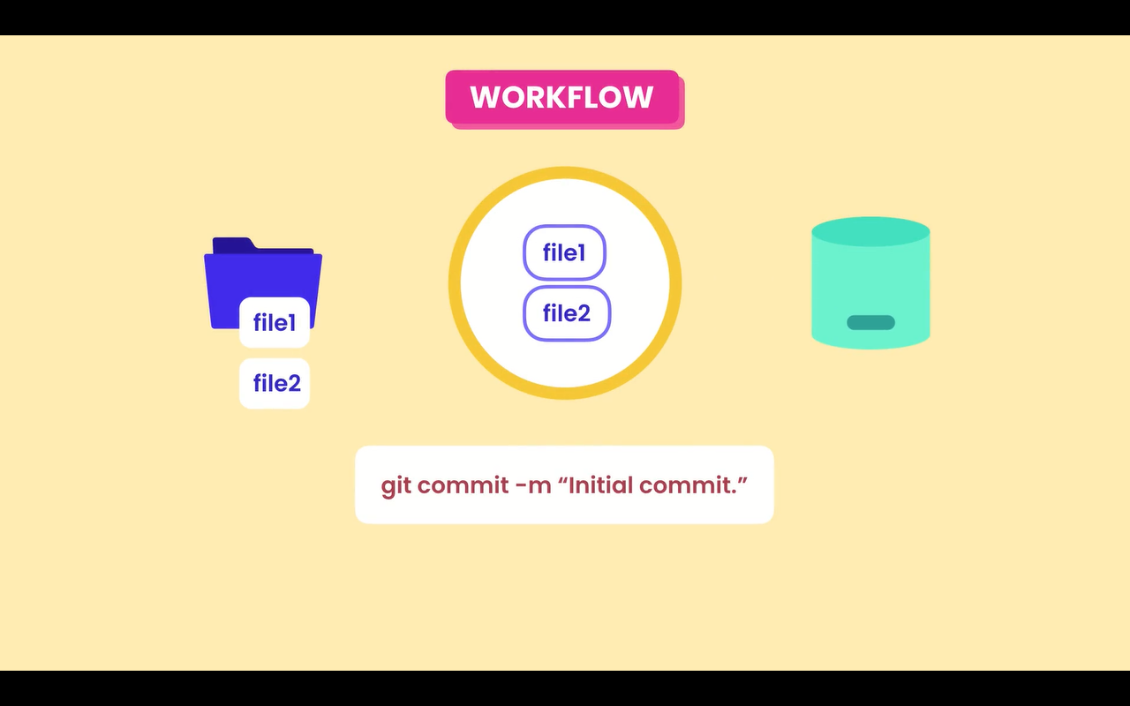

Slide 8
Git Status -s

Slide 9
Before Commit check the Staging area git diff - - staged
Viewing the Staged & Unstaged Changes

Slide 10
git config --global difftool.vscode.cmd "code --wait --diff $LOCAL $REMOTE"
Setting to Check the difference between two files
Check the difference between two files in directory
Git difftool
Check the difference between two files in Stagging area
Git difftool --staged

Slide 11
Git log
Check the commit history in details
Check th commit history
Git log - - oneline
Check th commit history with changes in files
Git log - - oneline - - stat
Check th commit history
Git log - - oneline - - reverse

Slide 12
git restore - - staged <filename>
Unstaging Files
Discarding Local Changes
git clean -fd
Restoring a File to an earlier Version
git restore - - source = HEAD ~1 <filename>

Slide 13
Git log - - oneline -3 (Last 3 commit)
Filtering the History
Discarding Local Changes
Git log - - oneline --author=“Alqama” (Last 3 commit)
Restoring a File to an earlier Version
git restore - - source = HEAD ~1 <filename>

