Slide 1

HARCOURT BUTTLER TECHNOLOGICAL INSTITUTE KANPUR DEPARTMENT OF COMPUTER SCIENCE AND ENGINEERING
GALAXIAN SHOOTING
COMPUTER GRAPHICS PROJECT USING OPENGL
SUBMITTED TO: SUBMITTED BY:
DR. NARENDRA KOHALI AMBRISH AWASTHI(86/13)
H.O.D CSE AMIT GAUTAM(87/13)
HBTI KANPUR DEEPAK KUMAR(93/13)
GAURAV SHARMA(526/14)

Slide 2
ABSTRACT
Galaxy Shooting is an Open-GL based 2D game.
This project was done as a part of Computer Graphics Course,
6th Semester (B.Tech), Computer Science and Engineering Department, Harcourt Butler Technological Institute, kanpur.
The project was made with an objective of learning 2D Animations and basic transformations.

Slide 3
CONTENTS
Inroduction to opengl
Computer Graphics
About Galaxian Shooting
Design & Implementation
Conclusion & future scope

Slide 4
INTRODUCTION TO OPENGL
The Open Graphics Library (OpenGL) is used for visualizing 2D and 3D data. It is a multipurpose open-standard graphics library that supports applications for 2D and 3D digital content creation, mechanical and architectural design, virtual prototyping, flight simulation, video games, and more. You use OpenGL to configure a 3D graphics pipeline and submit data to it. Vertices are transformed and lit, assembled into primitives, and rasterize to create a 2D image. OpenGL is designed to translate function calls into graphics commands that can be sent to underlying graphics hardware. Because this underlying hardware is dedicated to processing graphics commands, OpenGL drawing is typically very fast.

Slide 5
COMPUTER GRAPHICS

Slide 6
DESIGN & IMPLEMENTATION
MAIN SHIP
START MENU
PAUSE MENU
THANK YOU
EXIT MENU

Slide 7
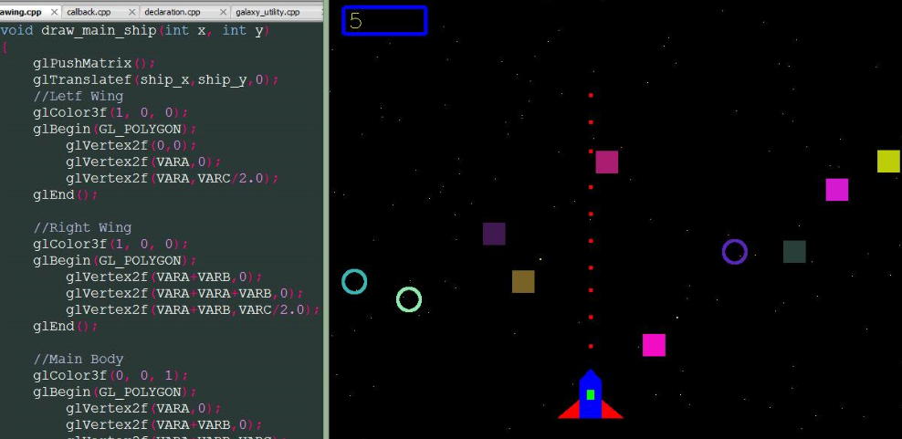
MAIN SHIP

Slide 8
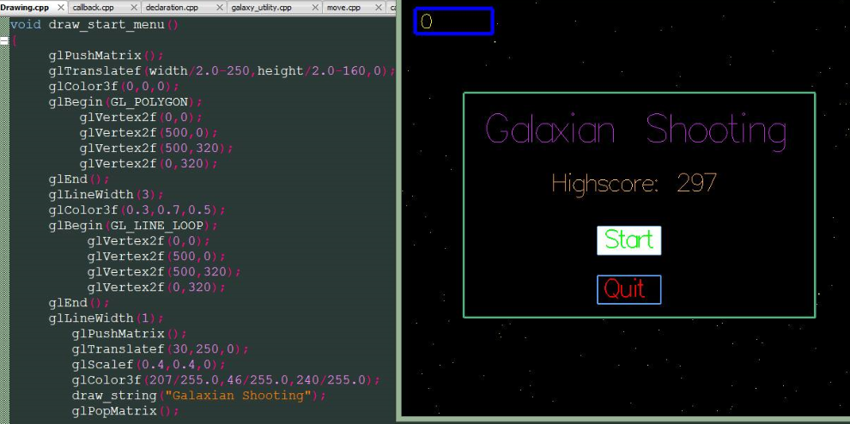
START MENU

Slide 9
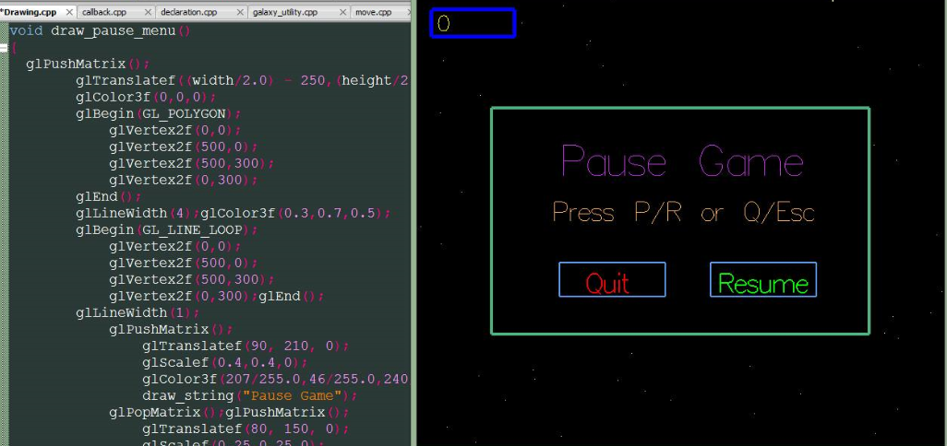
PAUSE MENU

Slide 10
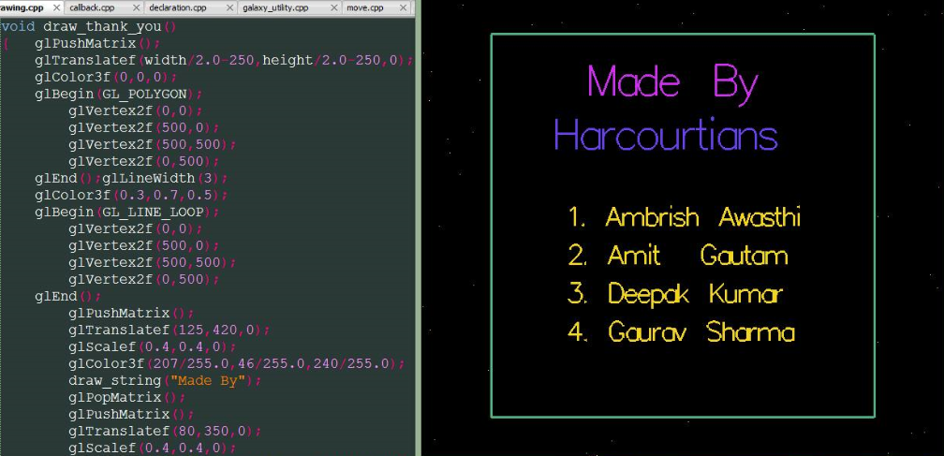
THANK YOU

Slide 11
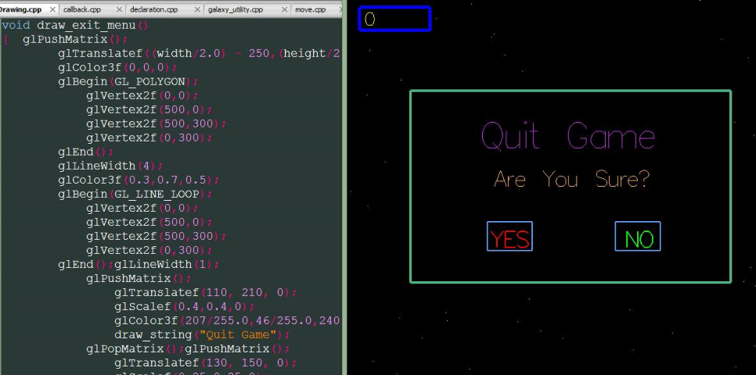
EXIT MENU

Slide 12
FUNCTIONS
Some Opengl Standard Functions Used
glPushMatrix();
glPopMatrix();
glColor3f(float r,float g,float b);
glBegin();
glVertex2f(float x,float y);
glEnd();
GL_POLYGON
GL_LINE_LOOP
GL_MODEL_VIEW

Slide 13
glutInitDisplayMode (GLUT_DOUBLE | GLUT_RGBA | GLUT_DEPTH);
glutKeyboardFunc(normal_key);
glutKeyboardUpFunc(normal_key_up);
glutSpecialFunc(keyboard_func);
glutSpecialUpFunc(keyboard_up_func);
glutPassiveMotionFunc(mouse_motion);
glutMouseFunc(mouse_func);
glutTimerFunc(100,timer_function,0);
glutPostRedisplay();

Slide 14
Some User defined Functions Used
Drawing.cpp
draw_background()
draw_main_ship(ship_x,ship_y);
draw_bombs();
draw_bullets();
darw_score_board();
draw_start_menu();
draw_pause_menu();
draw_quit_menu();
draw_thank_you_menu();

Slide 15
move.cpp
main_ship_move();
bomb_move();
bullet_move();
detect_collisions();
collision_bomb_ship();
collision_bomb_bullet();

Slide 16
Utility.cpp
cirsetpix()
dispcir()
add_bullet()
Callback.cpp
normal_key()
normal_key_up();
keyboard_func();
keyboard_up_func();
mouse_motion()

Slide 17
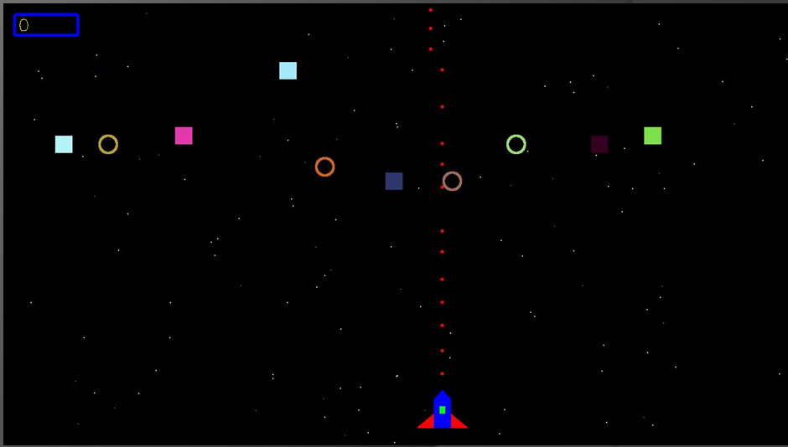
RESULT

Slide 18
CONCLUSION
The GALAXIAN SHOOTING game has been improvised with graphical approach.
The demo is made more iterative with mouse interaction module in the program.

Slide 19
FUTURE SCOPE
The game designed is two dimensional demo. In future, it can be redesigned with 3D animation and sound effects.
Future scope of computer graphics
Animation
Game Industries
Multimedia
Entertainment
Business

Slide 20
THANK YOU

