Slide 1
Entity Framework
Code-First (Domain Driven Design)

Slide 2
Why Code First
Focus on domain design and start creating classes.
CF APIs will create DB on the fly.

Slide 3
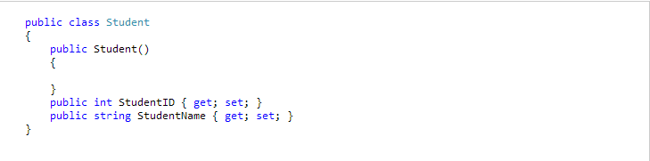
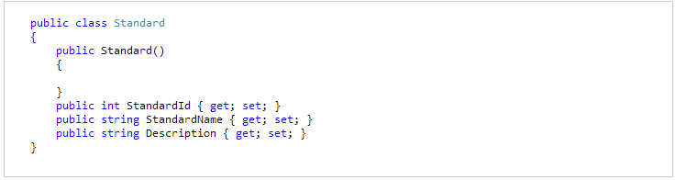
Simple Example

Slide 4
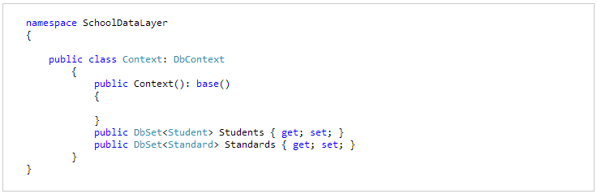
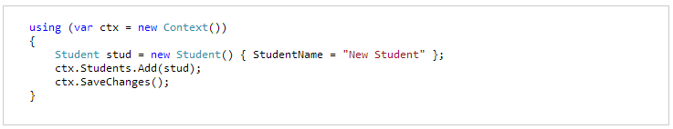
Simple Example Contd…

Slide 5
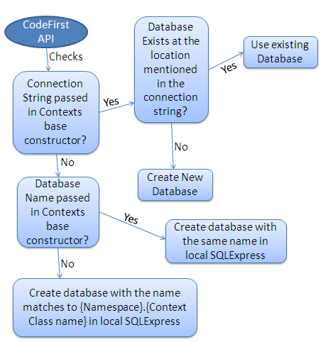
DB initialization

Slide 6
DB Initialization Strategy
Database initialization strategy is used to handle DB creation strategy.
CreateDatabaseIfNotExists
DropCreateDatabaseIfModelChanges
DropCreateDatabaseAlways
Custom DB initializer

Slide 7
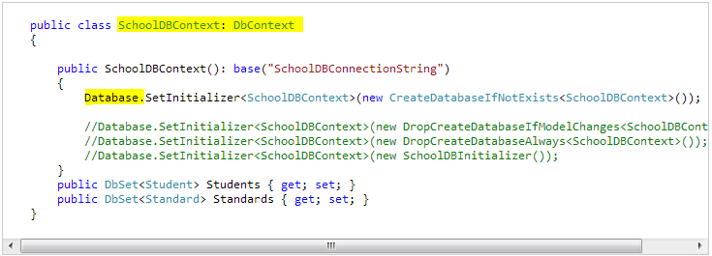
DB initialization strategy

Slide 8
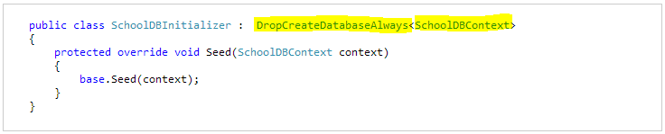
Custom DB initializer
Create custom DB initializer by inheriting one of the initializer.
Custom DB initializer can also be set in App.config

Slide 9
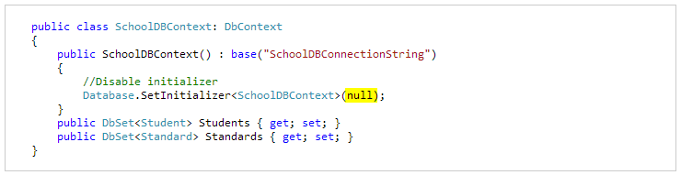
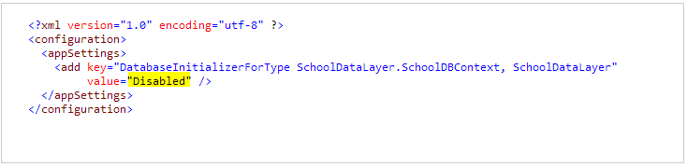
Turn off DB initializer

Slide 10
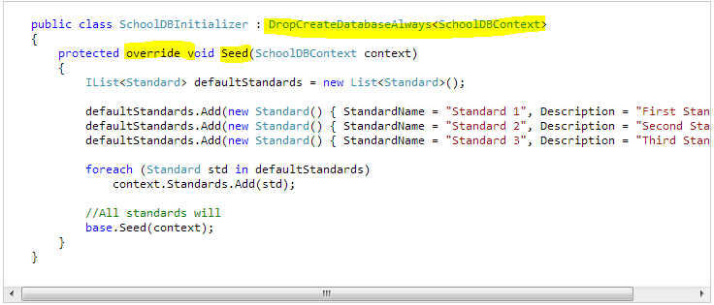
Seed your database
You have to create custom DB initializer.
Override Seed method.

Slide 11
Configure Domain Classes
Code first suggests certain conventions to follow by your domain classes so that EF can understand it and build the model out of it. If your domain classes are not following conventions still you can configure them using below methods.
Data Annotations
Fluent API

Slide 12
Configure Domain Classes
Data annotation
Is simple attribute based configuration.
Fluent API
This configuration is applied while creating model.
Inject configurations by overriding DbContext’s OnModelCreating.

Slide 13
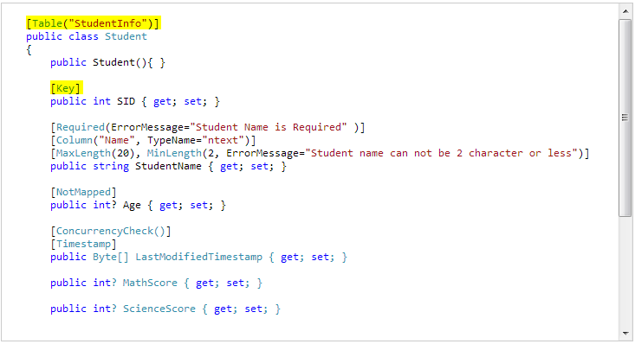
Data Annotations

Slide 14
Data Annotations
Validation attributes
DB schema attributes

Slide 15
Fluent API
You can configure your domain classes (Using FAPI) by overriding OnModelCreating method of DBContext in your context class.
DbModelBuilder is main class by which you can configure domain classes.

Slide 16
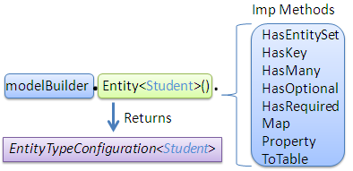
EntityTypeConfiguration Class
Allows configuration to be performed for an entity type in a model.
It can be obtained by calling Entity method of DbModelBuilder class

Slide 17
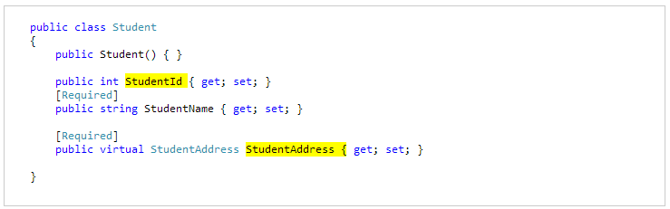
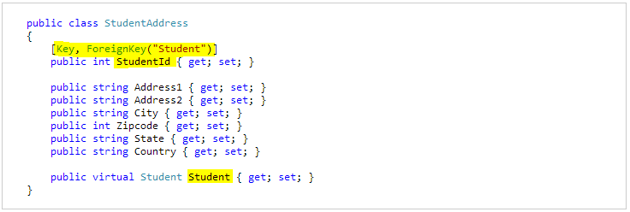
One-to-One Relationship
Using DataAnnotation

Slide 18
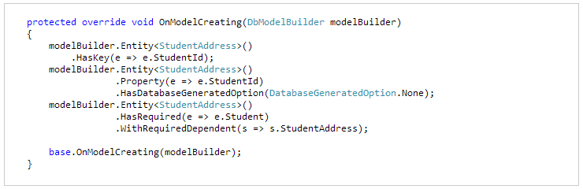
One-to-One Relationship
Using Fluent API

Slide 19
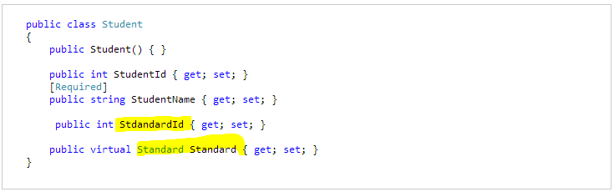
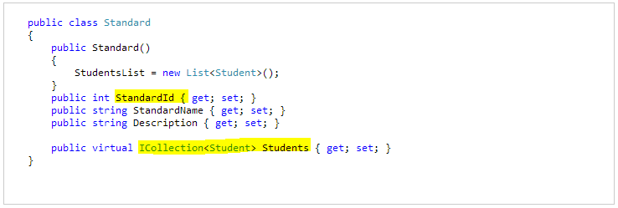
One-to-Many

Slide 20
Migration
With the existing DB initializers the data and objects are deleted and recreated, in this process we end up loosing some data or objects.
By using MigrateDatabaseToLatestVersion DB initializer it is possible for updating DB without dropping it. There are two types of migrations.
Automated
Code-based

Slide 21

Automated Migration
You have to enable automated migration by running ‘enable-migrations’ command in Package Manager Console
Once command runs successfully, it creates internal sealed Configuration class in Migration folder in your project.
You also need to set the database initializer in context class with new db initialization strategy MigrateDatabaseToLatestVersion.

Slide 22
Code-based Migration
Code based migration is useful when you want more control on migration i.e. set default value of the column etc.
Commands
Add-migration: It will scaffold the next migration for the changes you have made to your domain classes
Update-database: It will apply pending changes to the database based on latest scaffolding code file you create using "Add-Migration" command

Slide 23
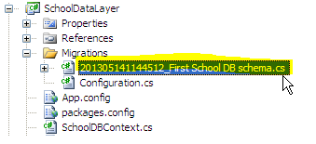
add-migration [-Name] command will create a class in your project under Migrations folder. After this, you have to update your database. You can create or update the database using “update-database” command.

Slide 24
Implementation
Add EF package to class library.
Create Entities.
Create Context.
Creating Mappings (entity configuration).
Enable Migrations - (Enable-Migrations) - creates Config.cs etc.
Add Migrations.
Update-Database –Verbose (for rollback use –TargetMigration:Name)
Add connection string -> should be context name along with name space.
In consuming application add EF package and connection string and consume.

