Slide 1
MVC
(Model View Controller)

Slide 2
What is MVC
The model-view-controller architectural pattern separates an application into three main components.
Models: Implement the logic for the application’s data domain.
Views: application’s user interface.
Controllers: handle user interaction, work with the model, and select a view to render that displays UI.

Slide 3
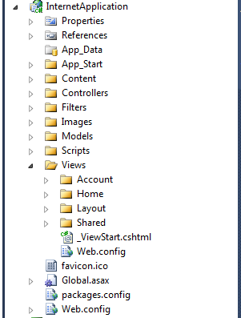
Application Structure
MVC framework maps URLs to controller classes.
MVC framework uses routing engine for mapping URLs to controller classes.

Slide 4
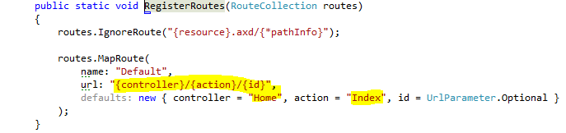
Application execution
Routes are initialized in Application_Start method of Global.asax file.
UrlRoutingModule: parses request and performs route selection.
MvcHandler: selects controller that will handle the request.

Slide 5
Routing overview
Routing is enabled in web.config (DO NOT DELETE)
System.web.httpmodules
System.web.httphandlers
System.webserver.modules
System.webserver.handlers
It is created in Global.asax (application start event) file.

Slide 6
Controllers
Locates appropriate action method to call and validating that it can be called.
Get the values to use as the action method’s arguments.
Handle errors.

Slide 7
Asynchronous Controller
Enables to write asynchronous action methods.
Can use for long running action methods.
Avoids blocking of web server from performing work while request is being processed.

Slide 8

Validation
For client-side validation you must set following flag in web.config
When you use unobtrusive validation, the validation rules are turned into HTML5 attributes. HTML5 attribute names can consist of only lowercase letters, numbers, and dashes.
Setting ClientValidationEnabled to true enables client-side validation. By setting these keys in the applicationWeb.config file, you enable client validation and unobtrusive JavaScript for the entire application. You can also enable or disable these settings in individual views or in controller methods using the following code:

Slide 9
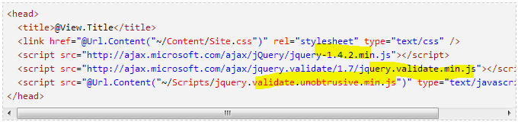
Validation….
Include the following JS files.

Slide 10
Custom Validation Attribute
First you should inherit your custom attribute from ValidationAttribute.
Define the settable properties that can be used by model.
To handle server side validation override IsValid method to execute your logic.
Implement IClientValidatable to make your validation available on client side.
Exposes GetClientValidationRules method.
Validation rules are parameters that will be provided to your JS as an array.
ModelClientValidationRule

Slide 11
Bundling and minification
These two techniques improve request load time
Improves load time by reducing the number of requests to the server and reducing the size of requested assets such as CSS and JS.
Bundling is the new feature that makes it easy to combine multiple files into a single file
Minification performs a variety of different code optimizations to scripts or css, such as removing unnecessary white space and shortening variable names to one character

Slide 12

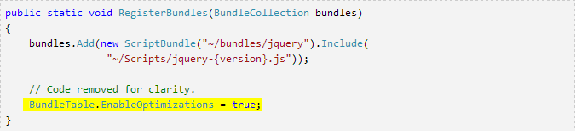
Bundling and minification….
To enable bundling and minification set debug attribute to ‘false’.

Slide 13
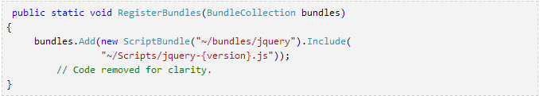
Bundling and minification….
RegisterBundles method in BundleConfig.cs class is used to create, register, and configure bundles.
The above code creates a bundle by name “~/bundles/jquery”, that includes all the files in the Scripts folder that match the wild card string “~/Scripts/jquery-{version}.js”.
Selects .min files for release and non .min files for debug.

Slide 14
Bundling and minification….
{version} wild card selects appropriate version of jquery.
Allows you to use NuGet to update to a newer jQuery version without changing the preceding bundling code or jQuery references in your view pages.
Automatically selects the full version for debug configurations and the ".min" version for release builds.
Bundles are referenced in views using “Render” method (Styles.Render for CSS and Scripts.Render for JS).

Slide 15
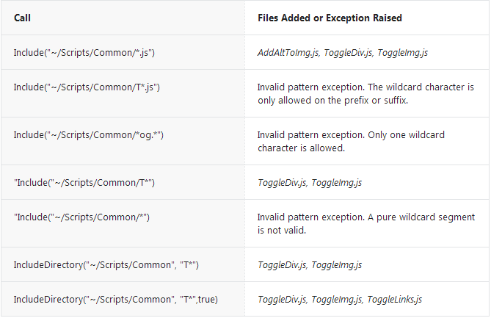
Bundling wild cards

Slide 16
Dependency Injection
Is a design pattern that allows to develop loosely coupled code.
Is a great way to reduce tight coupling between software components.
Enables us to better manage future changes and other complexity in software.
It this pattern the consumer object receives its dependencies inside constructor properties or arguments.
This pattern requires a framework component behind to deal with class constructor.

Slide 17
Filtering
Sometimes we need to preform logic either before an action method is called or after an action method runs. This can be done using filters.
Filters are custom classes that provide both a declarative and programmatic means to add pre-action and post-action behavior to controller action methods.

Slide 18
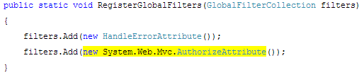
Security
You cannot use routing or web.config to secure your application
The only supported way to secure your application is to apply “Authorize” attribute to each controller.
In MVC you need to protect controllers and actions (resources).
MVC 3 introduced global fiters, to add AuthorizeAttribute to global.asax to protect every action of every controller.

Slide 19
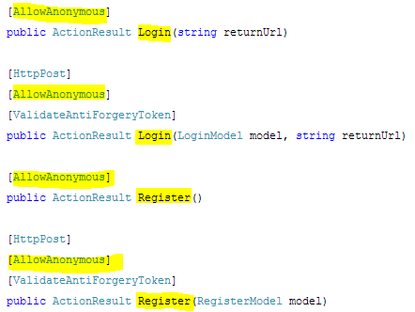
Security
Applying Authorize attribute globally introduces a problem i.e. you have to be logged on before log on or register.
To overcome this problem, you apply “AllowAnonymous” attribute to action methods to opt out of authorization.

Slide 20
Security
ASP.NET MVC does not support cookieless session and authentication.
Cookieless sessions are vulnerable to session hijacking attacks.

Slide 21
Cross-site request forgery
Cross-site request forgery (also known as XSRF or CSRF) is an attack against web-hosted applications whereby a malicious website can influence the interaction between a client browser and a website trusted by that browser.
These attacks are made possible because web browsers will send authentication tokens automatically with every request to a website.
It is different from phishing attack, phishing attack require interaction from the victim. In a phishing attack the mimic of target website is created.
In XSRF the attacker is relying on the browser automatically sending all relevant cookies to the target website.

Slide 22
Defend Cross-site request forgery
To defend against XSRF attacks a variant of “synhronizer token pattern” is used.
The synchronizer token pattern requires the generating of random "challenge" tokens that are associated with the user's current session.
These challenge tokens are then inserted within the HTML forms and links associated with sensitive server-side operations.
When the user wishes to invoke these sensitive operations, the HTTP request should include this challenge token.
Then server application should verify the existence and correctness of token.
The token consist a random 128-bit identifier.

Slide 23
Defend Cross-site request forgery
The tokens are encrypted and signed, so you can’t view the contents (username and additional information).
To generate anti-XSRF tokens, call @Html.AntiForgeryToken() method.
To validate tokens, include ValidateAntiForgeryToken attribute on action or controller.
The incoming session token and field token are read and the anti-XSRF token extracted from each.
If the current user is authenticated, username is compared with the username stored in the field token.
If an IAntiForgeryAdditionalDataProvider is configured, the runtime calls its ValidateAdditionalData method.

