Slide 1
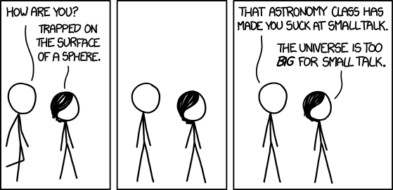
Astro Quiz

Slide 2

xkcd
1

Slide 3



Aero Spacelines
2
Bloated aircrafts, manufactured specially for NASA
Mini, pregnant, should I add guppy fish photo

Slide 4
3
It is a barrier island that separates the Pulicat Lake from the Bay of Bengal, and is home to the town of Pulicat.
The nearest town is Sullurpeta, which has the nearest railway station. It is 80 km (50 mi) from Chennai.
What is its claim to fame ? (see map)

Slide 5
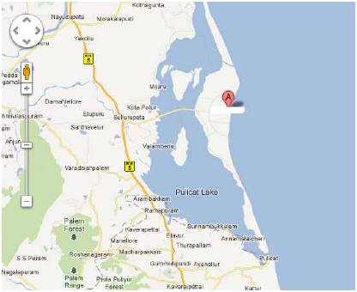

Slide 6
Answer
Sriharikota
It houses India's only satellite launch centre in the Satish Dhawan Space Centre (SHAR) and is used by the Indian Space Research Organisation ISRO to launch satellites using multi-stage rockets such as the Polar Satellite Launch Vehicle (PSLV) and the Geosynchronous Satellite Launch Vehicle (GSLV)

Slide 7
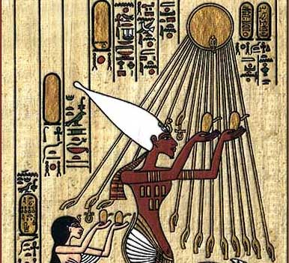
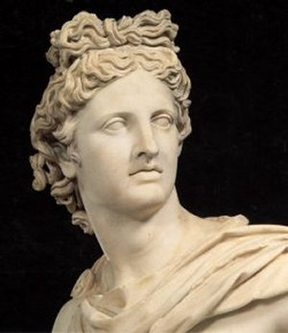
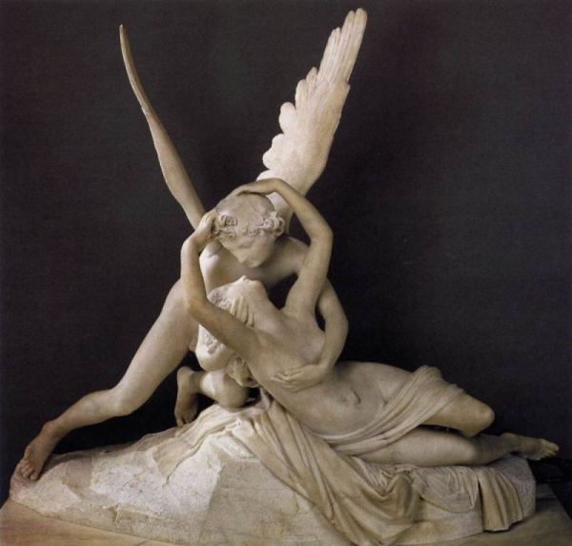
Connect
4
Aten
Apollo
Amor

Slide 8
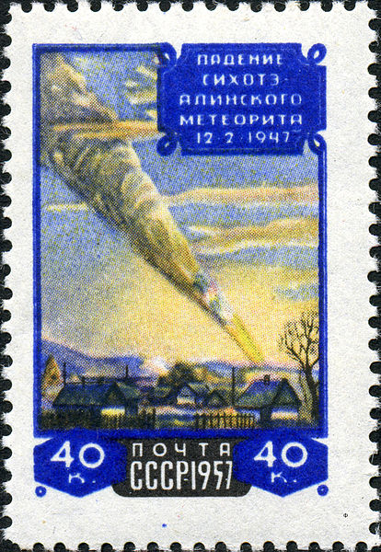
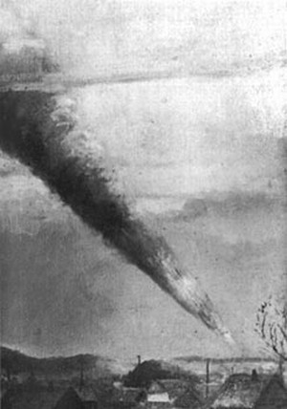
5
X is an iron meteorite that fell on 12 February 1947 in the mountains of Siberia.
X is named after the same mountain range
A smoke trail, estimated at 32 km (20 mi) long, remained in the sky for several hours.
On November 20, 1957 the Soviet Union issued a stamp for the 10th anniversary of this meteorite shower. It reproduces a painting by P. J. Medvedev, a Soviet artist who witnessed the fall.
Painting
Stamp

Slide 9
Answer
Sikhote-Alin

Slide 10
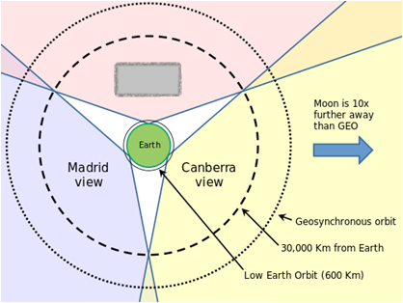
6
X is a gold-mining ghost town in California
X hosts one of the three deep-space communication facilities of NASA’s Deep Space Network
It is commonly believed that the first U.S. satellite, Explorer I, was confirmed to be in orbit by the use of the phrase “X has the bird“. However the facility was not in operation at the time of Explorer I, and like many oft-repeated quotations it is incorrect.

Slide 11
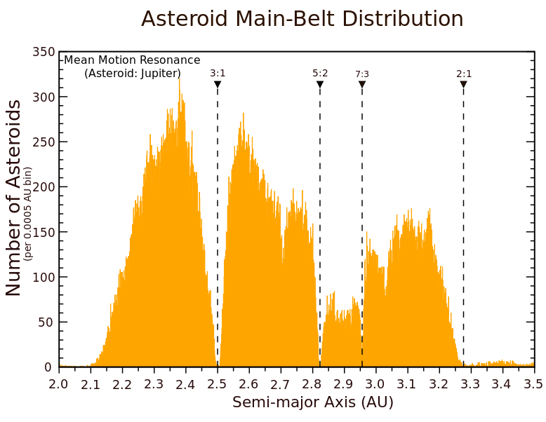
7
The American Keppler?
What are these gaps or dips in the distribution of main-belt asteroids by semi-major axis called as ? They correspond to the location of orbital resonances with Jupiter.
Saturn rings? – contributions to astronomy

Slide 12
8
X is a rock song from the band Y.
The song's lyrics are selected verses from a poem by Sandy Pearlman, the band's producer and mastermind behind their image, called "The Soft Doctrines of Immaginos".
Longtime Y fan and author Stephen King recorded a spoken narration for the video, which is as follows:
"Imaginos - A bedtime story for the children of the damned. From a dream world, paralleling our earth in time and space, the invisible ones have sent an agent who will dream the dream of history. With limitless power he becomes the greatest actor of the 19th century. Taking on many ingenious disguises, he places himself at pivotal junctures in history, continually altering its course and testing our ability to respond to the challenge of evil. His name is 'Imaginos'".
In X, the character of Imaginos comes to realize his heritage and his role as the altered human. References are made to celestial objects throughout the song: "The light that never warms" being the moon, "The Queenly flux" the constellation Cassiopeia, "My dog, fixed and consequent" being Sirius, the dog star. The "Four Winds Bar" may be a reference to the Tropic of Cancer. All in all, it has Imaginos explaining his position as part of Les Invisibles.
Id X and Y

Slide 13
9
During spring of 1982, the band X watched the launching of the Columbia Space Shuttle from Cape Kennedy, Florida.
Yis a X’s song that describes the launch of STS-1 and the Space Shuttle Columbia
The song was used as a wakeup song for astronauts during STS-109, which was the last successful flight of Space Shuttle Columbia. It was used again for astronaut Mike Fincke during STS-134, flown by Space Shuttle Endeavour on its final mission before retirement

Slide 14
Answer
Countdown – Rush

Slide 15
Connect
10
Zanya, Unity, Zveda, Destiny, Quest, Pirs, Harmony, Columbus, Kibo, Cupola, Rassvet, Leonardo, Nauka*, Uzolovoy*
Exhaustive list
I need the exact answer
What is the asterix for?

Slide 16
11
Thomas Wright, an English astronomer published “An original theory or new hypothesis of the Universe” in 1750. In it, he put forward the idea that the Milky Way is “an optical effect due to our immersion in what locally approximates to a flat layer of stars.”
In 1755, X expanded on Wright’s ideas, theorizing that the Milky Way was a disc made up of stars, formed from a cloud of gas, which was spinning. He was the first to suggest that other nebulae which had been observed could also be discs of stars, thus opening a whole new idea of astronomy beyond our solar system.
X introduced the term "island Universe" for these distant nebulae.
“Island Universe” – The idea that our Sun is just one of myriads of stars in a huge stellar system, the Milky Way, and that there may be many other stellar systems of equal rank outside the Milky Way

Slide 17
12
In 1995, Nancy Lieder, put forward an idea about disastrous encounter between the Earth and a large planetary object named Y.
She founded the website ZetaTalk.
She describes herself as a Contactee with the ability to receive messages from extra-terrestrials from the Zeta Reticuli star system through an implant in her brain.
Although Lieder originally referred to the object as "Planet X", it has become deeply associated with Y, a planet from the works of ancient astronaut proponent Zecharia Sitchin, particularly his book The 12th Planet.

Slide 18
13
Phaeton is a hypothetical planet posited to once have existed.
It was named for Phaeton, the son of the sun god Helios and Clymene in Greek mythology, who attempted to drive his father's solar chariot for a day with disastrous results and was ultimately destroyed by Zeus using a thunderbolt.
Inspired by this legend, where can we see this hypothetical heavenly body today?

Slide 19
Answer
It was supposed to exist between the orbits of Mars and Jupiter whose destruction supposedly led to the formation of the asteroid belt.
Theories regarding the formation of the asteroid belt from the destruction of a hypothetical planet are today collectively referred to as the "disruption theory" which states that there was once a major planetary member of the solar system circulating in the present gap between Mars and Jupiter, which was variously destroyed when:
it veered too close to Jupiter and was torn apart by the gas giant's powerful gravity.
it was struck by another large celestial body.
it was destroyed by a hypothetical brown dwarf, the companion star to the Sun known as Nemesis.
it was shattered by some internal catastrophe.
Today, the Phaeton hypothesis has been superseded by the accretion model.

Slide 20
Connect
14
A, a Germnan Astronmer , was first person to view the planet Neptune and know what he was looking at. He used the calculations of B to know where to look.
A always refused to be acknowledged as the discoverer of Neptune; he attributed the discovery to B
B predicted the existence of the then unknown planet Neptune, using only mathematics and astronomical observations of the known planet Uranus.
Encouraged by physicist Arago, B was intensely engaged for months in complex calculations to explain small but systematic discrepancies between Uranus's observed orbit and the one predicted from the laws of gravity of Newton. In François Arago's apt phrase, B had discovered a planet "with the point of his pen".
At the same time, but unknown to B, similar calculations were made by C in England.
The discovery of Neptune led to the discovery of its moon Triton by D just seventeen days later. D is also credited for the discovery of Hyperion (a moon of Saturn), Ariel and Umbriel (two moons of Uranus).
The names A, B, C, D, and Arago form a exhaustive list. What is it?

Slide 21
15
All The Great Constellations Live Very Long Since Stars Can't Alter Physics.^{[32]}
As The Great Cook Likes Very Little Salt, She Compensates Adding Pepper.
Really Boring Teachers Can Live Very Sadly Since Apples Give Worthless Feelings.
All That Gold Can Load Very Lazy Students Since Children Are at Play
What am I talking about?

Slide 22
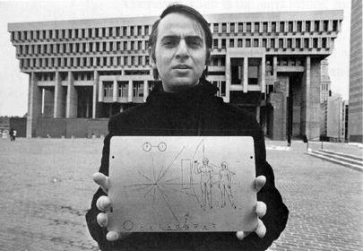
15

Slide 23
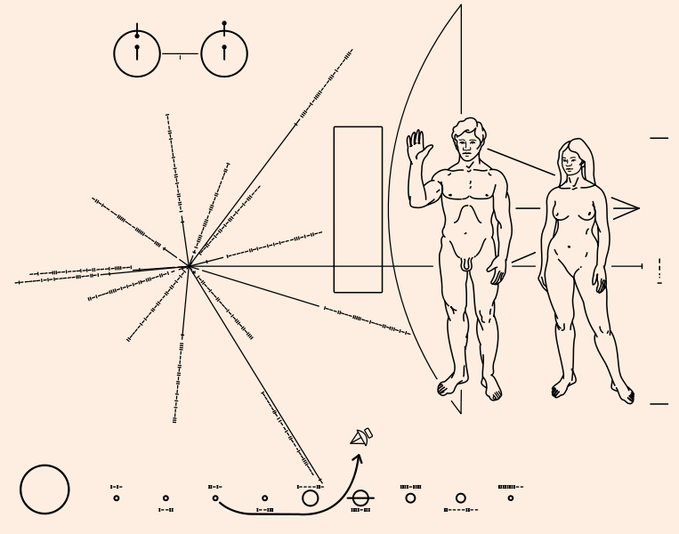

Slide 24
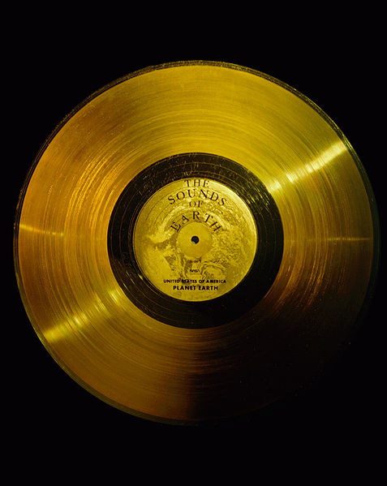
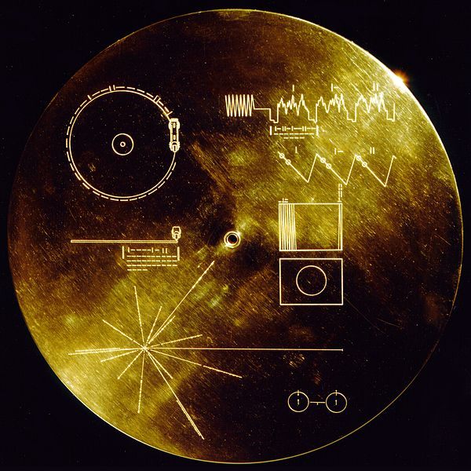

Slide 25
Bonus!
The only rock and roll song in this collection?

Slide 26
I’M 1
16
SN 1054 is a supernova that was first observed on 4 July 1054 (hence its name), and that lasted for a period of around two years.
The remnant of SN 1054, which consists of debris ejected during the explosion, is known as X. It is located in the sky near the star Zeta Tauri (ζ Tauri).

