Slide 1
Crystal Crusader
Created by: Group 4 (Elise Ambriz, Xavier Begerow, Grace Cappella, Nathan Moyer, Jacob Travis)

Slide 2
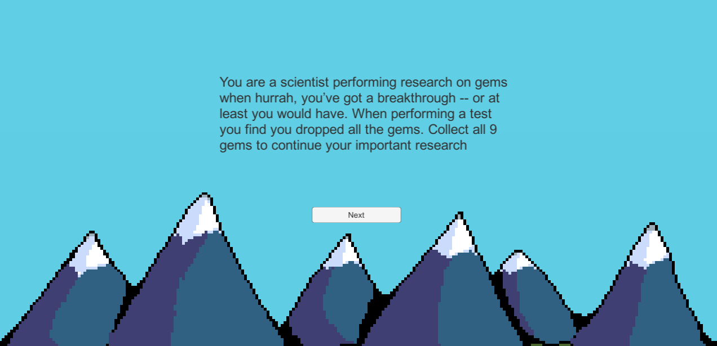
Crystal Crusader - Quick Details
Genre
A combination of platformer, puzzle, and exploration.
Game Elements
Collect gems!
Navigate through a maze of a level
Player
Single Player Game
Game level
The player is to collect 3 of each gem type to finish the level.
Level 1
Setting: Grassy field with colorful platforms
Collect red, blue, and green gems
Player’s controls
WASD to Move
Space (and W) to Jump

Slide 3
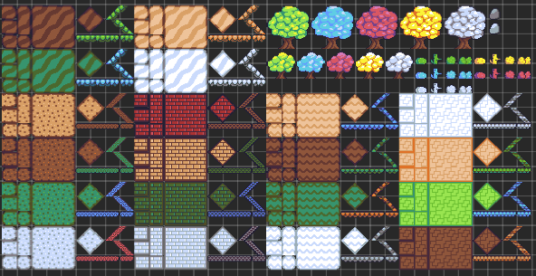
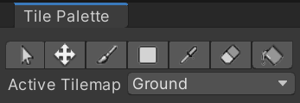
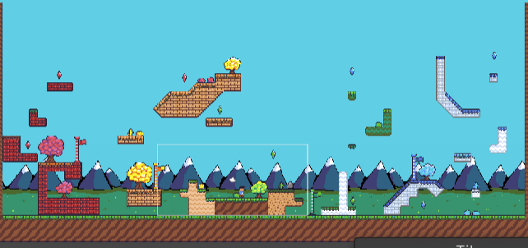
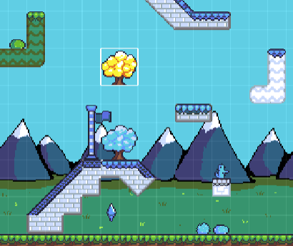
Level Design
- Tilemap - Tools

Slide 4
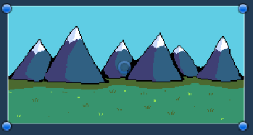
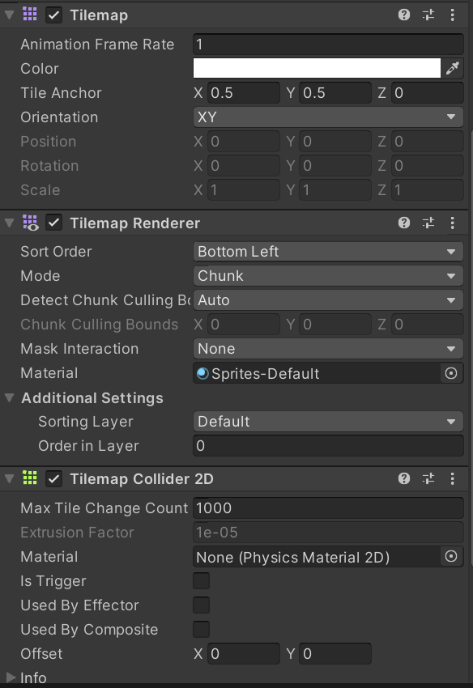
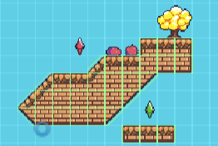
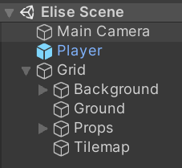
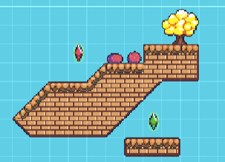
Level Design
- Sorting Layers - Separation by GameObjects

Slide 5

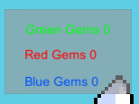
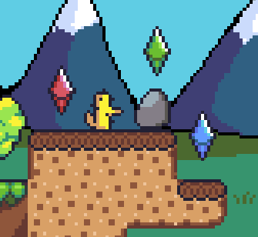
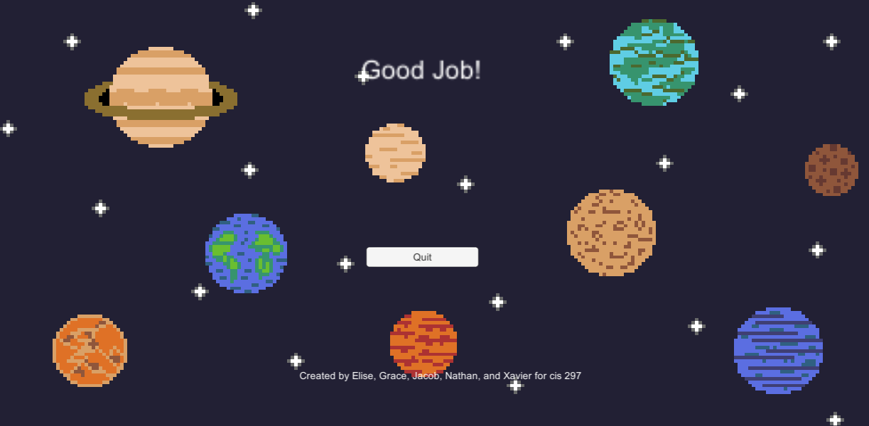
Gem Scripting
Each Gem Script
Static GameManager
GemCounter(UI)
GemHandler(Scenes)

Slide 6
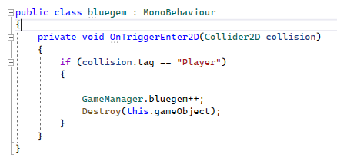
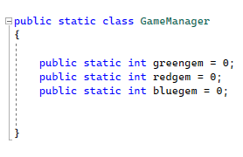
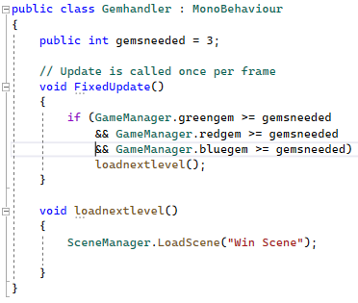
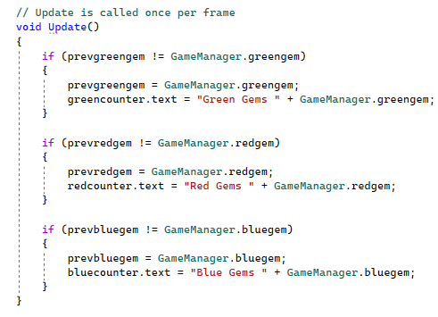
Gem Collision Static Variables
UI Updates
Load Win Scene

Slide 7
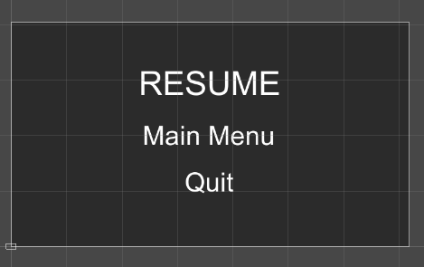
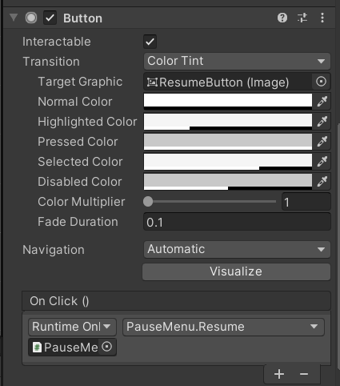
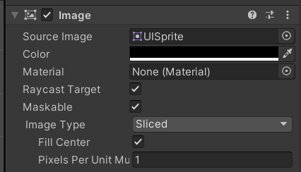
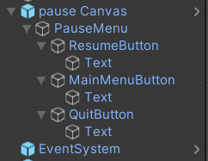
Pause Menu - Canvas
Hierarchy
Canvas
Buttons
Text formatting within Buttons

Slide 8
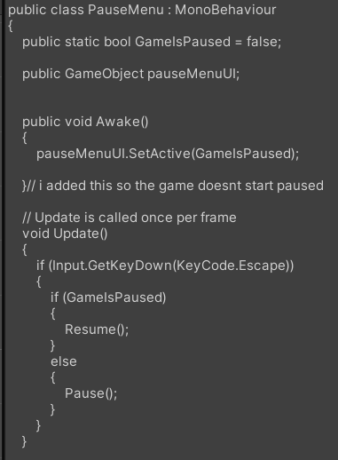
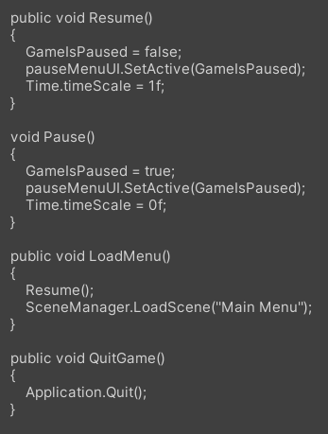
Pause Menu - Buttons Script
Awake Function
Update Function
Pause Function
Buttons
Resume
Main Menu
Quit

Slide 9
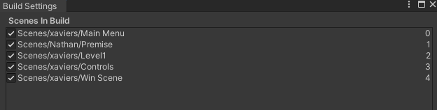
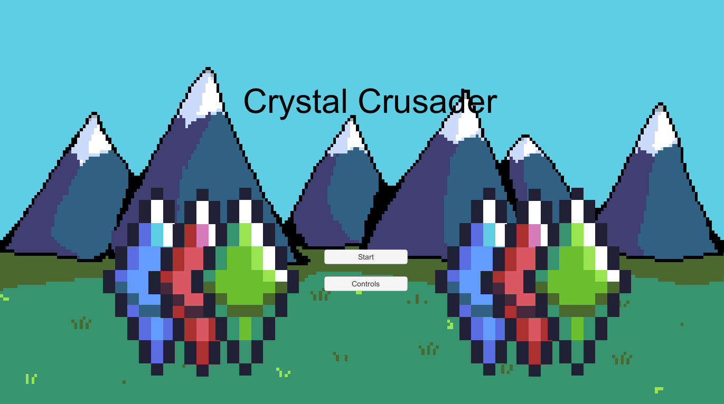
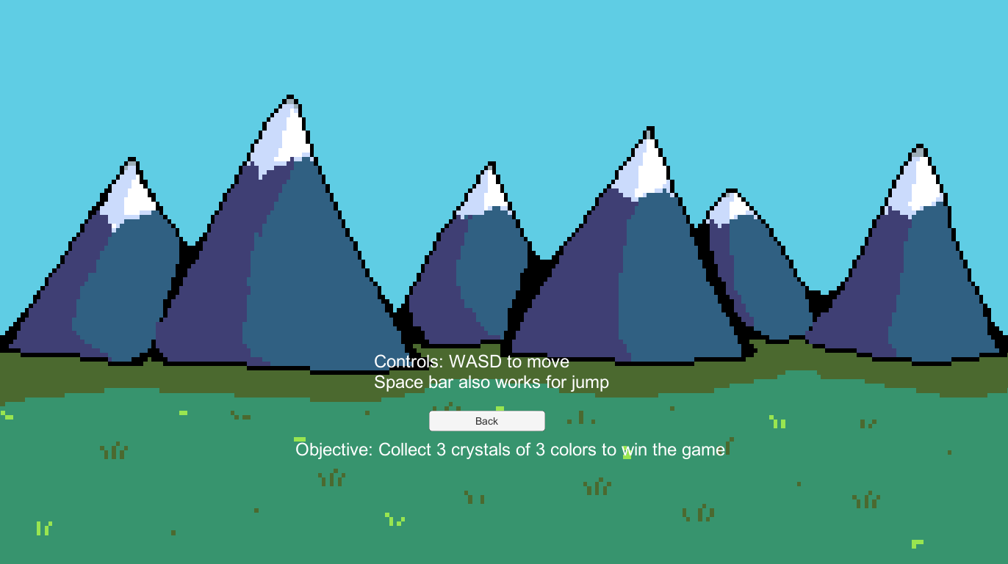
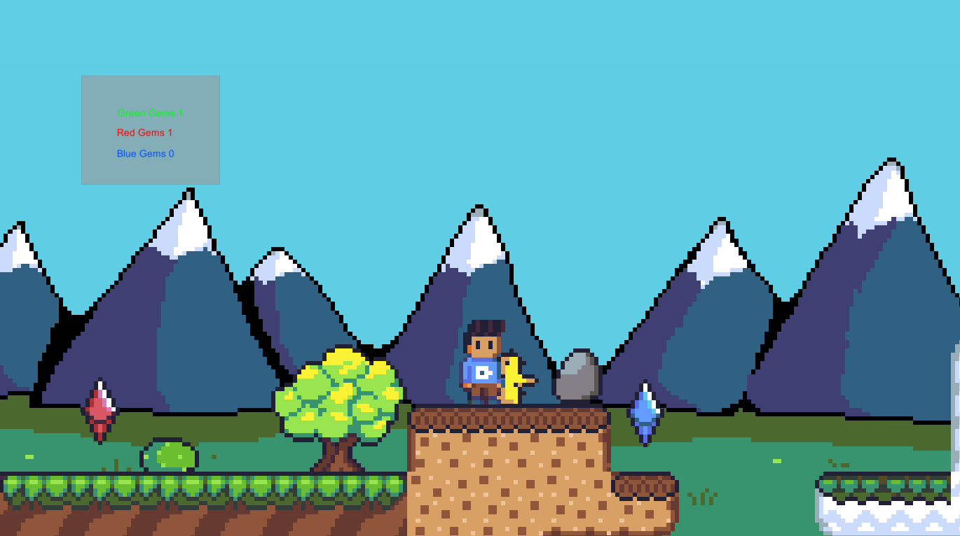
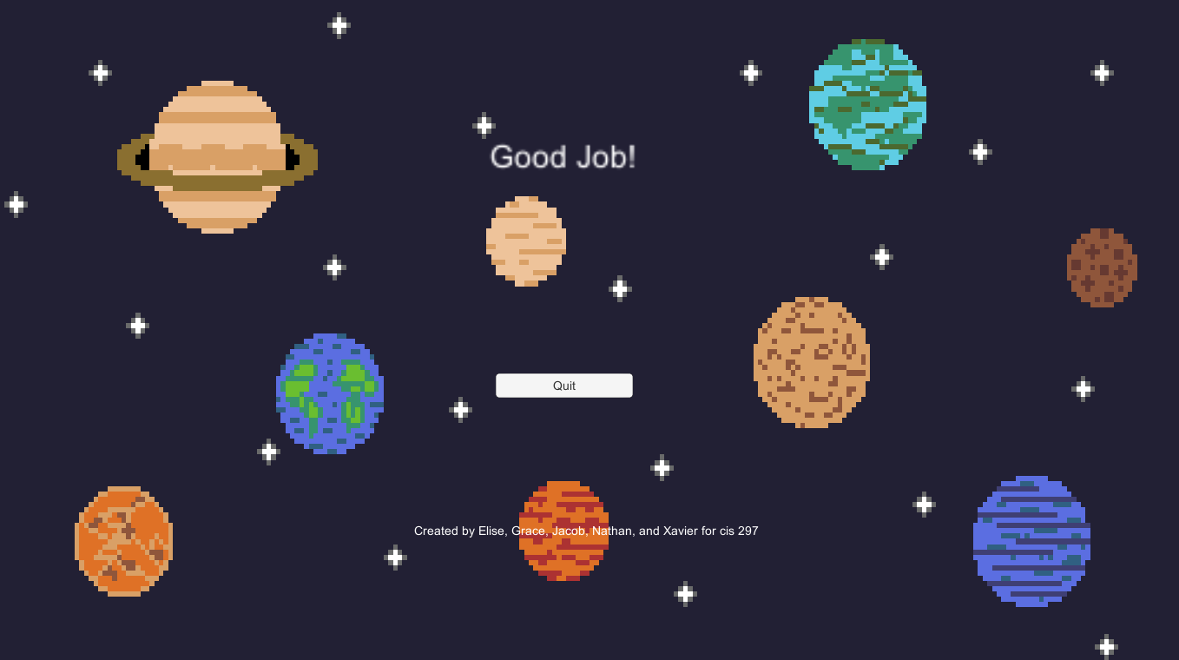
Scene and Level Transitions
Scenes
5 total

Slide 10
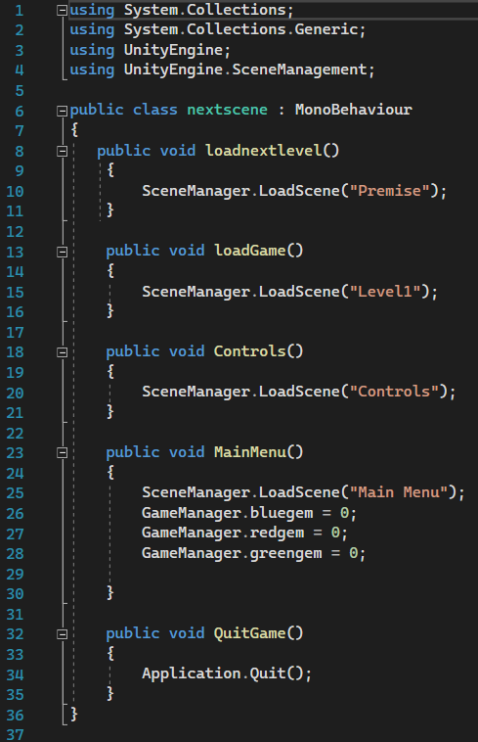
Scene and Level Transitions cont.
Script
This is called upon a specified action within each scene

Slide 11
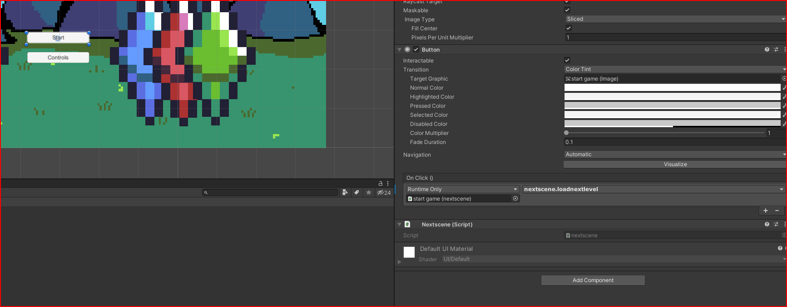
Scene and Level Transitions cont.

Slide 12
Audio
Audio was gathered through free downloads via BenSound.com
Have different royalty free sing for each level of play
Implemented as components(audio source) from imported asset in inspector window
Added as essentially invisible components to each game scene
Purpose: To better immerse the player in the gameplay and provide filler for that space.
Folder named Audio stores all downloaded audio files and imports them as assets

Slide 13
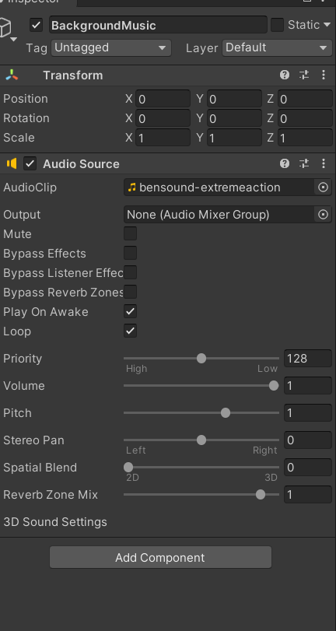
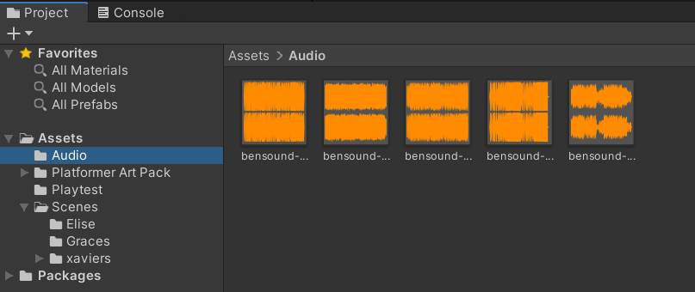
Audio In Unity

