Slide 1
Docker Containers
Marko Ambrož,
Žiga Hudolin
Ministrstvo za javno upravo
DIREKTORAT ZA INFORMATIKO

Slide 2
“Vendor lock in” with DOCKER ???
http://blog.dennybritz.com/2015/10/01/a-brief-guide-to-the-docker-ecosystem/
DOCKER CLIENT
DOCKER CLIENT
DOCKER CLIENT
DOCKER CLIENT
DOCKER CLIENT
DOCKER HUB
DOCKER ENGINE
DOCKER REGISTRY
DOCKER SWARM
DOCKER CLOUD
DOCKER COMPOSE
DOCKER UCP
Universal Control Plane
DOCKER MACHINE
DOCKER TOOLBOX

Slide 3
Supported operating systems
General purpose operating
systems:
Container optimized
operating systems:
Amazon EC2
Arch Linux
Azure Microsoft
CentOS
CRUX Linux
Debian
Fedora
FrugalWare
Gentoo
Google Cloud
Joyent
Mac OS X
Oracle Linux
Rackspace Cloud
Red Hat Enterprise Linux
SoftLayer IBM
openSUSE and SUSE Linux
Ubuntu
Windows 20+
RedHat Project Atomic
Boot2Docker
CoreOS
OSv
VMWare PhotonOS
RancherOS
Ubuntu Core 7+

Slide 4
Dockerization of applications
DOCKERHUB
(Docker Registry)
GITHUB
(GitLab)
DOCKER BUILD
DOCKERFILE
FROM ubuntu
RUN apt-get update
RUN apt-get -y install git build-essential
RUN apt-get -y install nodejs npm
RUN apt-get install -y git-core zip
RUN apt-get clean
WORKDIR /opt/coder/
RUN git clone github: googlecoder.git .
RUN ls -la && pwd
WORKDIR /opt/coder/coder-apps
RUN ./install_common.sh ../coder-base
WORKDIR /opt/coder/coder-base
RUN npm install
COPY src/config.js /opt/coder/coder-base/
\ config.js#
#EXPOSE 80 443
EXPOSE 8180 8181
CMD ["nodejs","server.js"]
DOCKER PULL
Carina, Sloppy.io,
Tutum, StackDock,
...
DOCKER RUN

Slide 5
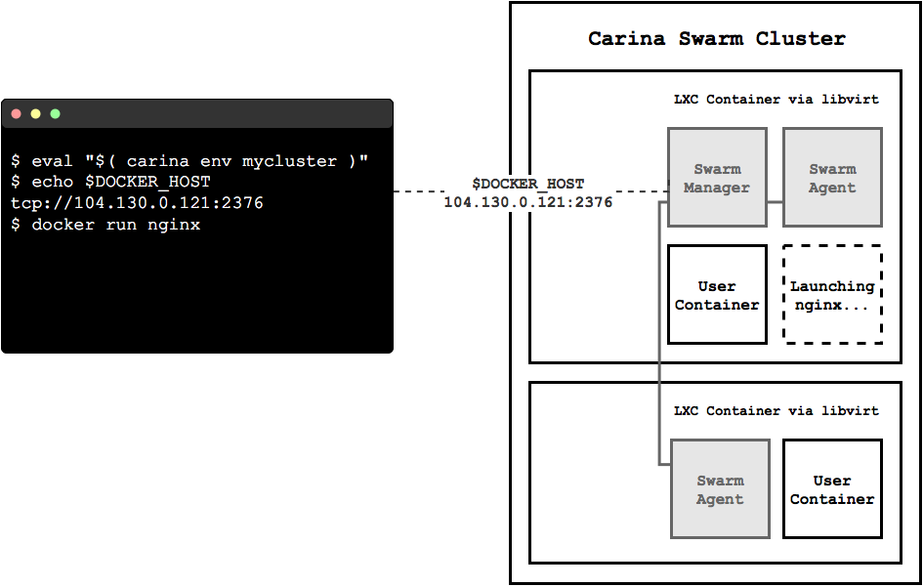
Are Docker Containers cloud neutral?
IaaS (Infrastructure as a Service)
  e.g.: DigitalOcean droplets: Ubuntu, Fedora, Debian, CoreOS, Centos
CaaS (Container as a Service)
  e.g.: RackSpace: CARINA

Slide 6
If the demo fails you can swim with:
GoogleCoder in a Container at DigitalOcean:
https://188.166.34.228:7443/
Password: SInog32016

Slide 7
Demonstration

Slide 8
Example 1
  Target: Create a container that runs as a deamon
  and a command that print Hello World on screen
  every second
  In this example we will use
    docker run; runs the container
    -d; flag runs the container in the background
    ubuntu; is the image you would like to run
    docker logs; looks inside the container
  Finally we specify a command to run:
    /bin/sh -c "while true; do echo hello world; sleep 1;
    done”

Slide 9
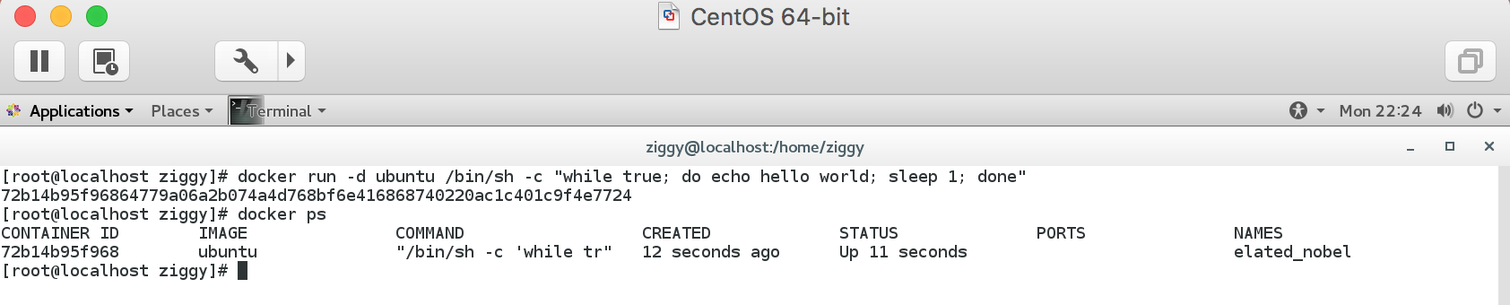
Example 1: docker run
  docker run -d ubuntu /bin/sh -c "while true;
  do echo hello world; sleep 1; done”
  This long string “72b14b95f96864779a06a2b...”
  is called a container ID
  docker ps command queries the Docker daemon
  for information about all the containers.

Slide 10
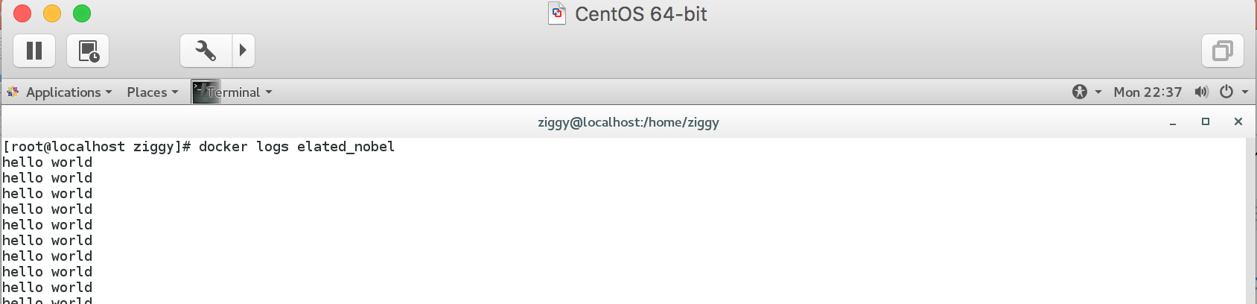
Example 1: docker logs
  To see what is going on inside the container we
  will use the docker logs command
  docker stop command tells Docker to politely
  stop the running container and returns the name
  of the container it stopped “elated_nobel”

Slide 11
Example 2
  Target: Create a container that runs as a deamon
  and a command that print Hello World every
  second and write it in a specific file
  In this example we will use next commands
    docker run; runs the container
    -d; flag runs the container in the background
    ubuntu; is the image you would like to run
    docker exec; runs a new command in a running
    container
  Finally we specify a command to run an write
  result in a file

Slide 12
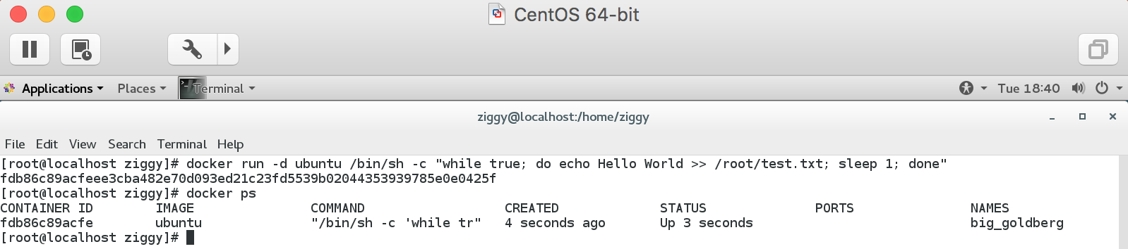
Example 2: docker run
  docker run -d ubuntu /bin/sh -c "while true;
  do echo Hello World >> /root/test.txt; sleep 1;
  done"
  This long string “fdb86c89acfeee3cba482e70…”
  is called a containerID
  docker ps command queries the Docker daemon
  for information about all the containers.

Slide 13
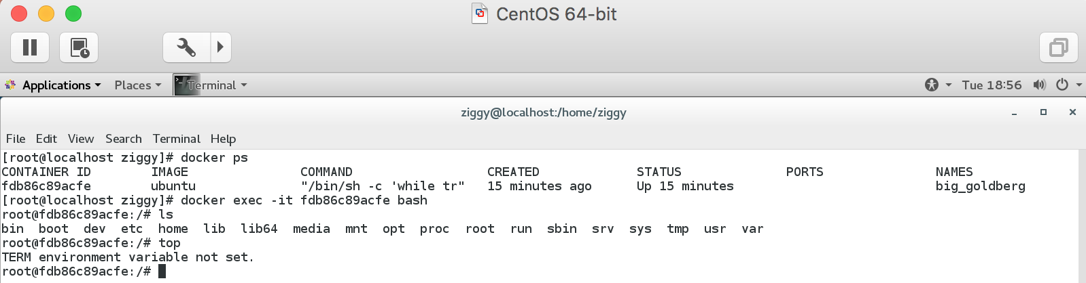
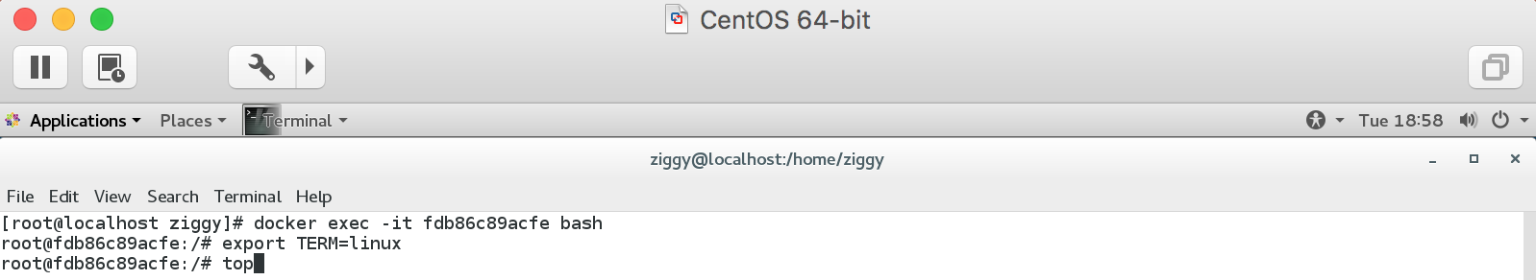
Example 2: docker exec
  With command docker exec we run a new
  command in a running container
  We set TERM environment variable in running
  container

Slide 14
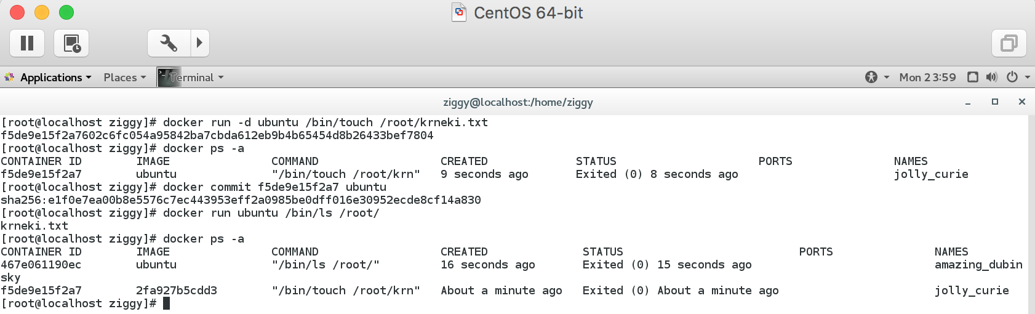
Example 3: docker commit
  Target: update a container created from an image
  with specific file and commit the results to an
  image
  In this example we will use next command
    docker commit; create a new image from a
    container's changes
    Uporaba: docker commit [OPTIONS] CONTAINER [REPOSITORY[:TAG]]

Slide 15
Example 4
  Target: Install aplication Google Coder
  In this example we will use next commands
    docker pull; pull an image or a repository from the
    registry
    docker images; list images
  Finally we check our application in browser

Slide 16
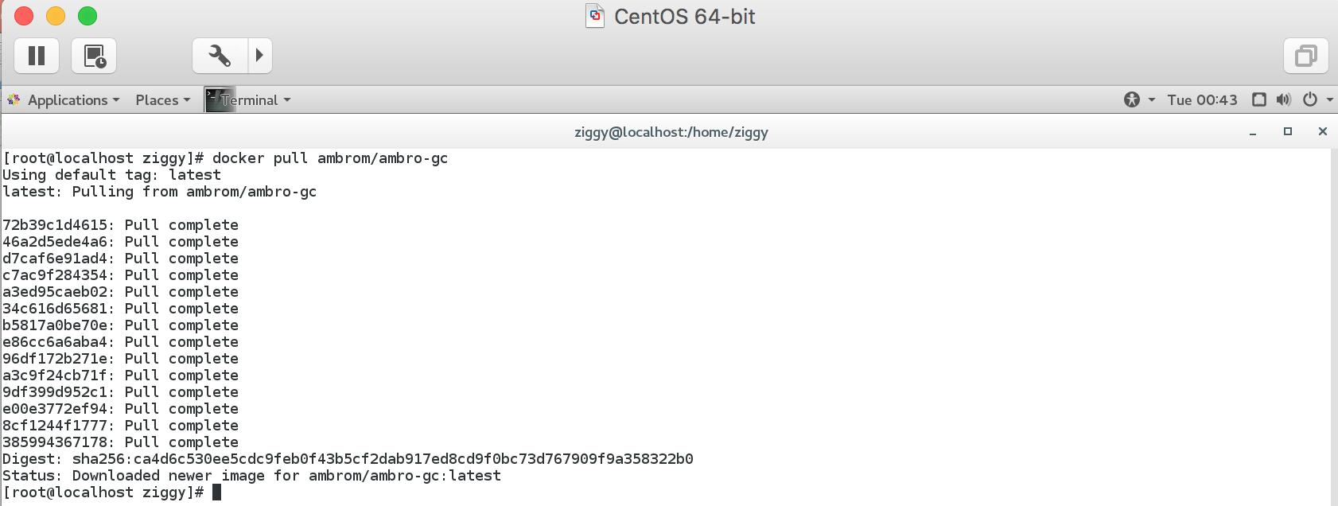
Example 4: docker pull
  We will use image from ambrom/ambro-gc
  repository on dockerhub

Slide 17
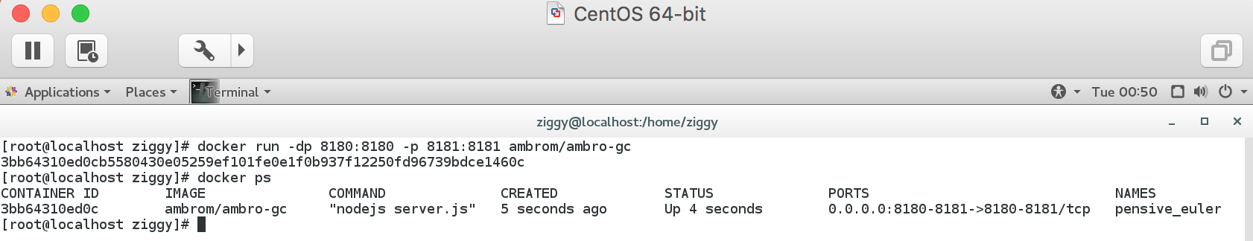
Example 4: docker run
  With command docker run we will run our
  application, but we have to specify ports “8180
  and 8181”
  We will open the browser and check if application
  is alive and responsible

Slide 18
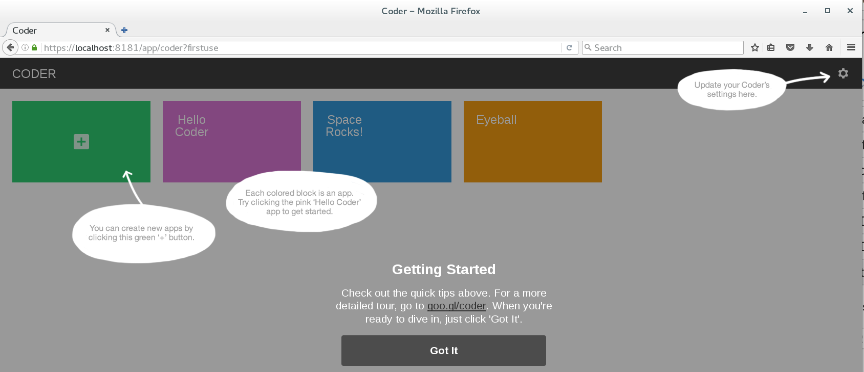
Primer 4: test aplikacije
  https://localhost:8181

