Slide 1

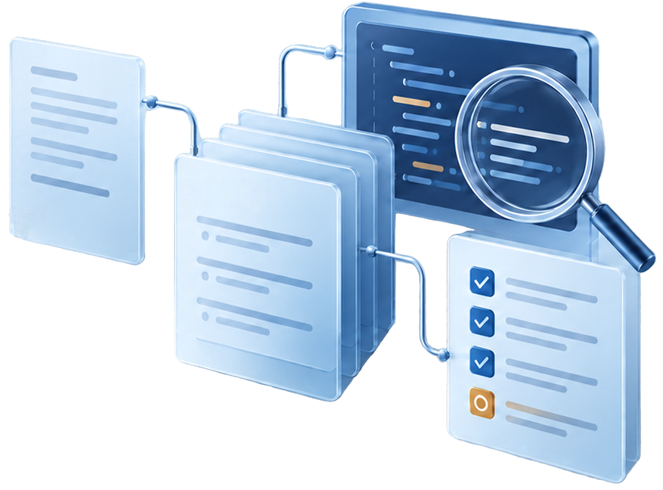

Software Engineering QA Agent
Test Case
From requirements to reviewed test evidence
Group O
Onyanga Ambrose
Angom Joyce Rita
Byali Macqueline Leya
Nuwagaba Jerome Bill
Okoth Victor
23/U/16852/EVE
23/U/06202/PS
23/U/07849/EVE
23/U/16213/PS
23/U/1315
Notes:
23/U/16852/EVE

Slide 2

Turning requirements into tests takes manual work
The problem
Developers must translate requirements into tests, investigate failures, and keep results linked to the original requirements.
Who it helps
Developers and QA engineers working on small software projects.
Why AI
It can interpret written requirements, propose candidate tests, and help explain failures. People review the tests and approve execution.

Slide 3
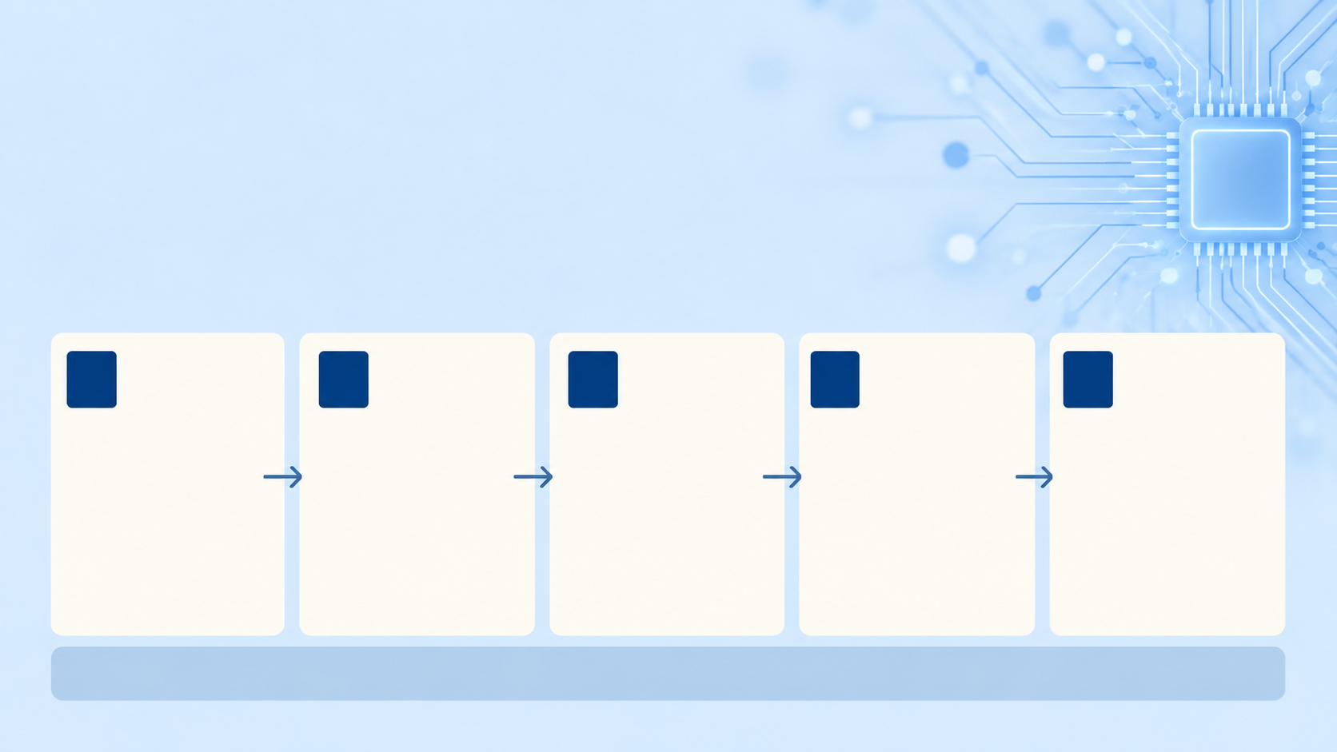
How the
QA Agent developed
Five stages to build reliable, evidence-based QA
1
2
3
4
5
Model
RAG
Tools
Bounded agent
Evaluation
Propose candidate tests from written requirements.
Retrieve relevant project evidence to support answers.
Retrieve evidence and prepare local issue drafts through approved functions.
Investigate reported failures within
fixed limits.
Check outcomes across normal, failure and adversarial scenarios.
People review generated tests and approve execution.

Slide 4
How the QA Agent works
Selected context and model responses
LOCAL COMPUTER
User interface
Flask application
Retrieve
evidence
Project RAG
Groq model
Review
Requirements
Project code
Test review
Workflow and triage
Permission checks
Project evidence
Relevant excerpts
Proposes tests
Explains failures
No host execution
Human approval
Approved code and source
Review, approve and Run
Local storage
Docker sandbox
Results and reports
Traces and history
Approved tests
Isolated, no network
Human control stays local. Groq receives selected context, not direct access to the sandbox.

Slide 5
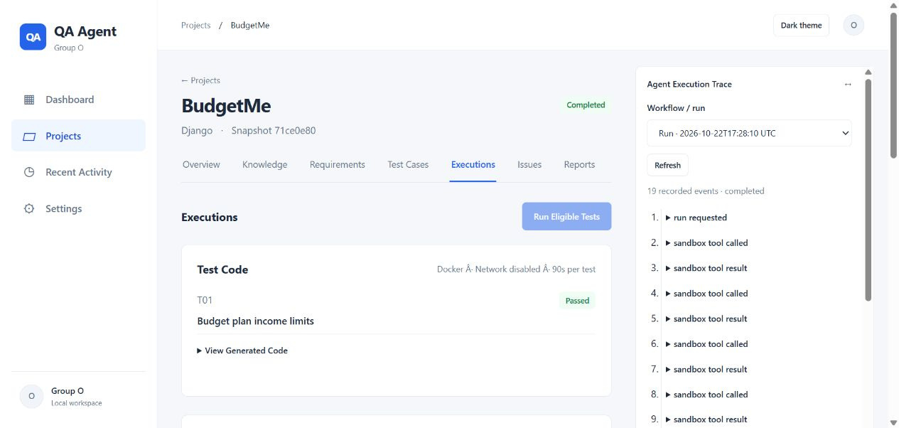
Successful end-to-end workflow
Live demo: one requirement, reviewed tests
01
Connect
Authorized BudgetMe source
02
Specify
Add the income-limit requirement
03
Review
Inspect candidate tests and code
04
Approve and run
Explicit approval, then Docker
05
Inspect
Results, trace and report
5

Slide 6

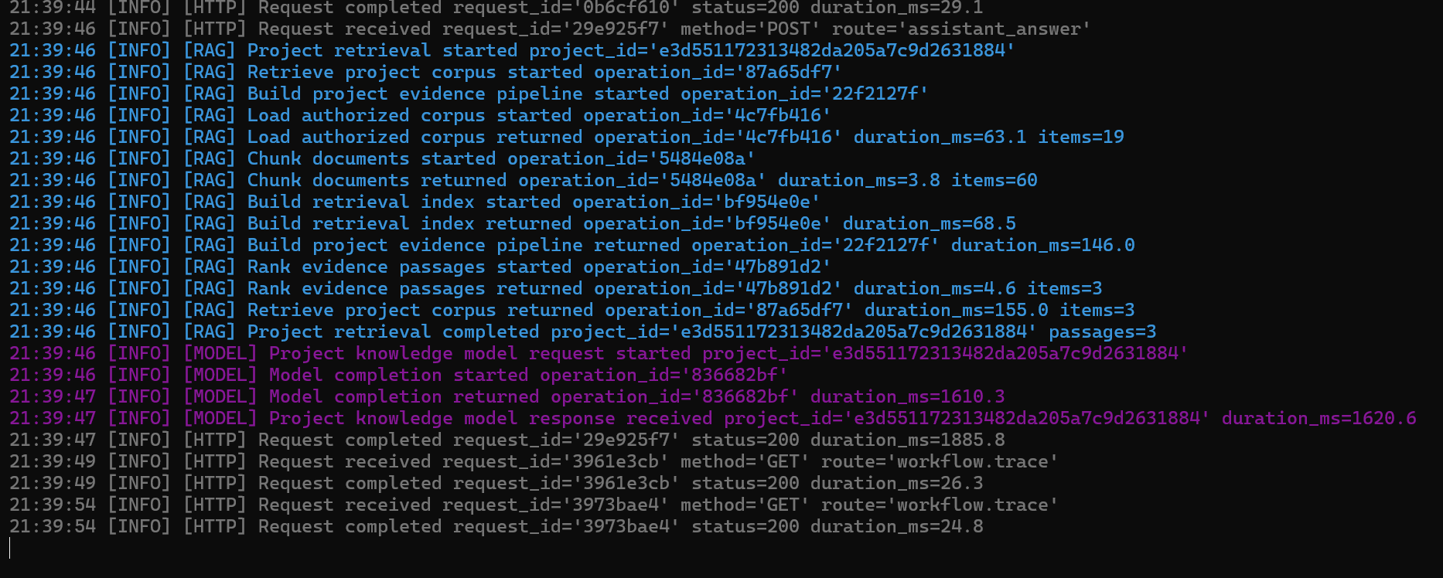
Inspect the Evidence Behind the Result
WHAT TO VERIFY
Requirement + test IDs
01
Which requirement and tests ran?
Approval
02
Was the reviewed version executed?
INSERT YOUR EXECUTION SCREENSHOT
Tool call + test output
03
Terminal logs • Docker test results • Agent trace
What did the sandbox actually return?
Result → report link
Use an actual captured run, with sensitive details hidden.
04
Can the outcome be traced later?
A proposed test becomes evidence only after an actual recorded execution.

Slide 7


A Real Limitation
Groq HTTP 413
The model provider rejected an
oversized project knowledge request.
We engineered a bounded context
src/app.py now bounds serialized project context and trims lower-priority records.
Independently verified success
RAG retrieval returned 3 passages.
Model answered in 1428.9 ms.

Slide 8







Controlled Recovery Without Unsafe Actions
A retrieval fault was injected to validate bounded recovery behavior.
Injected retrieval failure
The next retrieval returned real, project-bound evidence.
Next retrieval obtained
real project-bound evidence
A local issue draft was created and retained for review.
Local issue draft retained
for review
This is a synthetic test, not a confirmed product bug.

Slide 9






Guardrails and Human Control
BEFORE
Approve cases
BEFORE execution: approve cases and executable code; cryptographic hashes bind approved source and code.
DURING
Docker isolated · no network
DURING execution: allow-listed tools only, Docker isolation, no network access, iteration limits, safe stop and handoff.
AFTER execution: reports and issue drafts require human review. No automatic publishing or merges permitted.
AFTER
Review reports
no auto-publish

Slide 10

Lessons and Honest Limits
Three Lessons
Three Honest Limitations
Proposals are not results: model output requires human validation before any claim is made.
Project-scoped retrieval matters: bounded context improves relevance and prevents overreach.
Approvals, failures, and evidence must be inspectable: every step must leave an auditable trace.
Incomplete answers remain possible under ambiguous or underspecified requirements.
Generated test code requires developer review before execution ,it is a proposal, not a guarantee.
API quotas and prepared adapters constrain real-time use offline fallbacks are partial mitigations.

