Slide 1
GROUP O / BSE4104
Software
Engineering
QA Agent
A controlled route from requirements
to reviewed test evidence.
Notes:
25 seconds. We built the Software Engineering QA Agent as our capstone product and used BudgetMe as the target application. We focused on traceability and developer control throughout the workflow.

Slide 2
THE PROBLEM
Requirements need a clear
route into useful tests.
01
Interpretation
Expected behavior can be unclear or assumed.
02
Execution
Candidate tests need review before they run.
03
Investigation
A failure needs evidence before a defect decision.
Notes:
35 seconds. We addressed the gap between requirements and practical testing. We used the charter and user stories to define our QA Agent, while keeping BudgetMe requirements separate as the target behaviour to check.

Slide 3
THE WORKFLOW
Review stays part of the process.
01
Connect
Snapshot the authorized source folder.
02
Specify
Add requirements with identifiable records.
03
Review
Inspect proposed tests and generated code.
04
Run
Approve selected cases, then start the sandbox.
05
Explain
Inspect results and prepare a local draft.
Notes:
45 seconds. We connected the project, stored requirements and added review gates. Our workflow requires explicit approval and a separate Run action before any selected test executes.

Slide 4
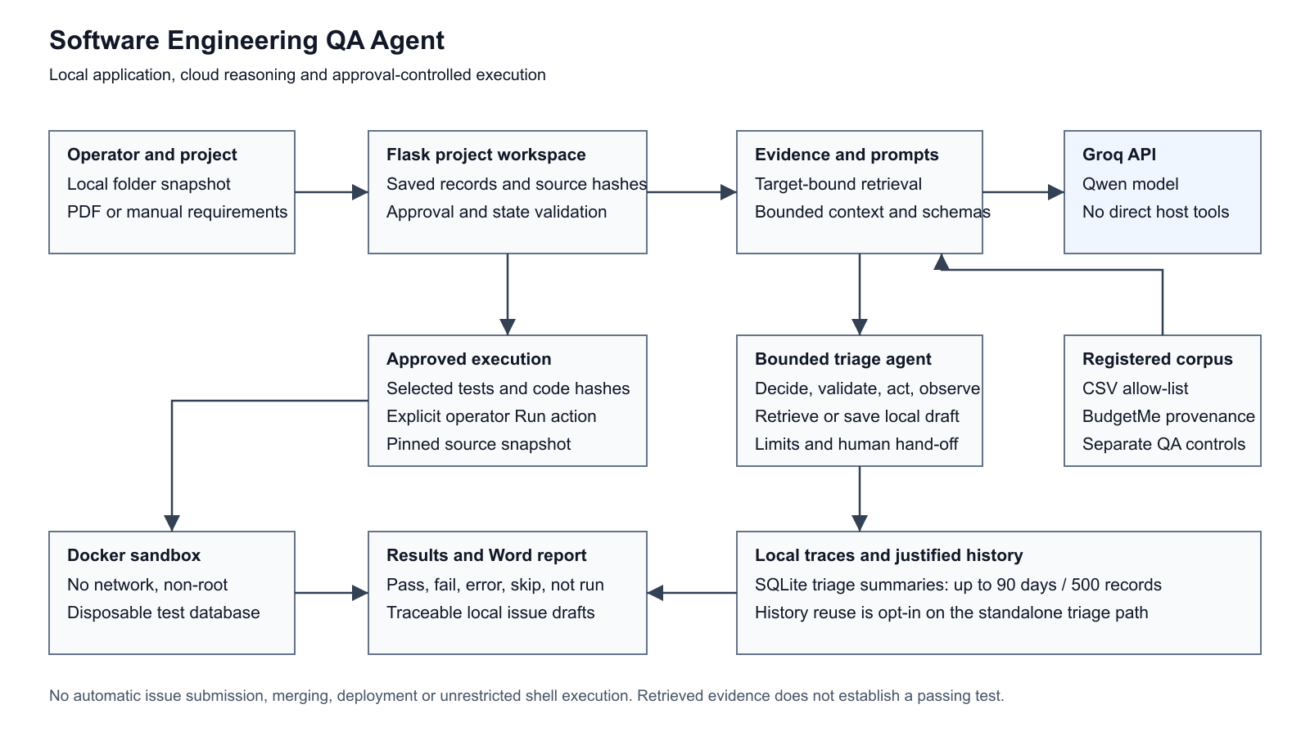
SYSTEM ARCHITECTURE
Local control. Bounded cloud reasoning.
Notes:
50 seconds. We kept local records and deterministic tool dispatch on our side of the Groq boundary. We used a separate approved Docker execution path. The supplied SVG shows these boundaries.

Slide 5
MODEL BASELINE
Prompt changes
improved grounding.
7 / 10
PASS outcomes with v1.2
Same ten requirements across
three saved prompt versions.
Week 2 requirement-to-test baseline
Notes:
35 seconds. We used this early model baseline to compare the versioned prompts against the same ten requirements. The displayed counts come from the saved prompt evaluation and describe that configuration, rather than a later workflow score.

Slide 6
BUDGETME AS THE TARGET
Knowledge grounded in the code.
100
Budget planning
Savings and transaction records
Cash, MTN and Airtel movement records
verified snapshot files
Repository version a55e0b2
Source URL, paths and retrieval date retained
Notes:
45 seconds. We recorded the target snapshot and its provenance before using it. We verified 100 supported source files. BudgetMe records movements locally; we did not verify a production payment transaction.

Slide 7
A CONCRETE SOURCE RULE
A budget must fit the pay period.
Allocations + savings
≤ pay-period income
Equality is accepted. An over-income plan receives a form error.
Notes:
35 seconds. We used FR-006 to connect a source-derived rule to normal, equality and over-limit test inputs. We checked the cap against the entered pay-period income; it does not normalise that amount to monthly income.

Slide 8
RETRIEVAL AND ANSWERS
Evidence stays attached to the answer.
15 / 15
12
answerable
1 mixed
answers met the recorded
grounding criteria in the retest.
2 unsupported
Notes:
50 seconds. We kept each answer with the excerpts used to support it. In the 22 October evaluation, R13 reports the supported minimum amount and leaves the production provider URL unresolved; R14 and R15 do not invent absent information. We used an AI-assisted rubric for this single evaluation, with independent human acceptance still pending.

Slide 9
TOOLS AND PERMISSIONS
Two explicit tools.
One enforced boundary.
Retrieve evidence
Create a draft
Authorized sources
Validated query and result
Inspectable excerpts
Local record
Expected and observed behavior
submitted = false
Publication, merging, deployment and shell access remain outside the allow-list.
Notes:
45 seconds. We recorded successful live model selection for retrieval and local draft creation. Our prohibited-action request selected no tool. We enforced the schema and allow-list in application code independently of the wording returned by the model.

Slide 10
BOUNDED AGENCY
The next step depends on the evidence.
6
3
1
iterations
retrievals
local draft
A retrieval fails. The agent retrieves again. A draft is saved.
Normal, adversarial and controlled-recovery traces retained
Notes:
55 seconds. We deliberately injected one retrieval failure, then recorded grounded retrieval and a saved draft in the selected recovery trace. We also kept normal and adversarial traces. We enforced stop limits and tool guards in deterministic code.

Slide 11
STATE AND MEMORY
History informs the next run.
1
Fresh retrieval still occurs.
Prior outcomes do not grant approval.
Deletion removed both retained summaries.
earlier report available
to the second run
Retention: up to 90 days or 500 summaries
Notes:
50 seconds. We completed two opt-in memory runs. The second trace records prior_report_count=1 and fresh retrieval. Our project failure-analysis path saves summaries with reuse off, while standalone triage supports explicit reuse.

Slide 12
VERIFICATION
Controls checked beyond the happy path.
66
Schema and permission validation
Source and approved-code hashes
State continuation and memory
Bounded project context
offline regression
checks passed
Notes:
45 seconds. We kept offline checks of deterministic behaviour separate from live model evidence. We recorded request-size errors, retrieval-scope problems, unfinished responses, provider errors and generated-test setup failures in the failure catalogue, with our responses and subsequent checks.

Slide 13
SYSTEM CHECKS
31 full passes across 36 scenarios.
5/6 Normal use
36
5/6 Edge conditions
4/6 Incorrect information
6/6 Adversarial input
scenarios completed
6/6 Tool failure
5/6 Unauthorized action
Five partial results identify the remaining improvements.
Notes:
35 seconds. We executed all 36 scenarios for the 22 October evaluation. We recorded 31 full passes and five partial results after the documented checks, giving an 86.1 percent full-pass rate with partials excluded. We found gaps in feature completeness, proposal/result attribution, conflict clarification, setup diagnosis and stop/handoff behaviour. We used live Groq for generative cases and actual services with labelled fault injection for deterministic cases.

Slide 14
LIVE DEMONSTRATION
Follow one case from source to evidence.
01 Ask and inspect sources
02 Review a candidate test
03 Approve and run in the sandbox
04 Inspect the result and recovery trace
Notes:
Allow four minutes. We will use the prepared disposable demonstration session to follow one case from source to evidence. We will ask a BudgetMe knowledge question, inspect its sources and a benign proposed case, review its code, approve it and explicitly run it. We will then inspect the recorded results and recovery trace. If a service fails, we will report the actual failure and use the retained trace as evidence.

Slide 15
SOFTWARE ENGINEERING QA AGENT
The developer retains
the final decision.
Traceable requirements.
Reviewable tests.
Bounded actions.
Notes:
25 seconds. We kept readable evidence, explicit boundaries and developer control at the centre of our project. We leave the final decision with the developer and can discuss the sources, limits and traces behind our results.

