Slide 1
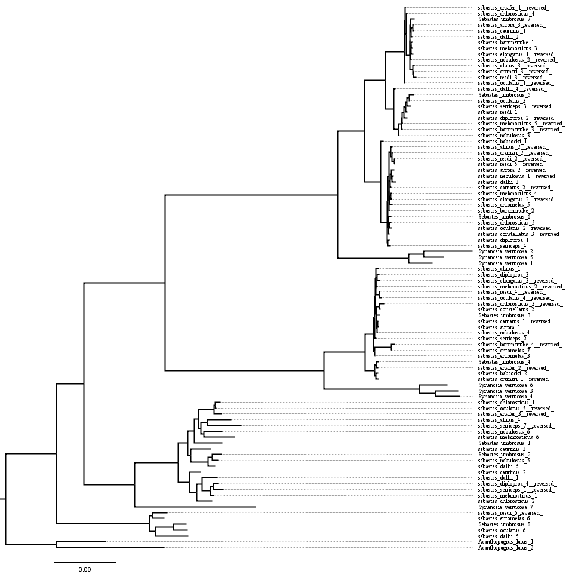
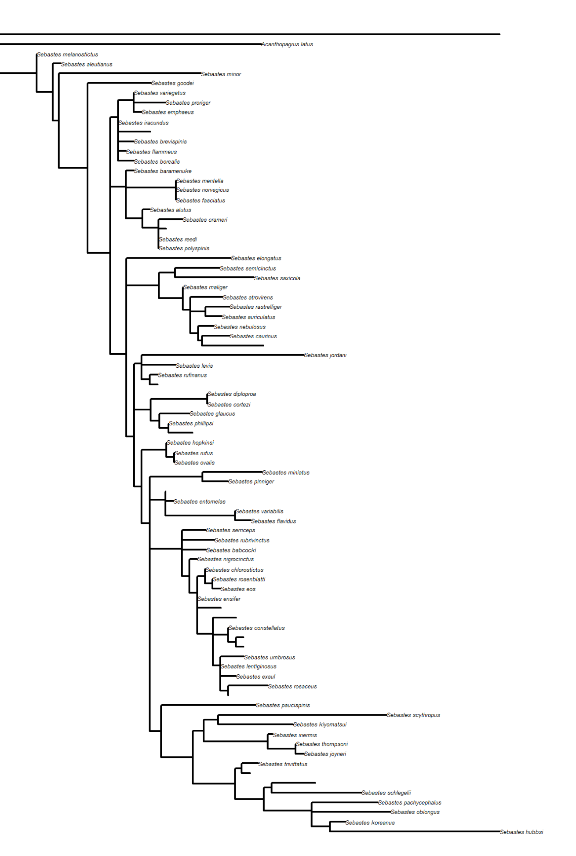

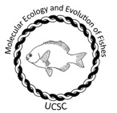


Reconstruction of the evolutionary history of the venom gene Stonustoxin in Sebastes
Author: Ambrosio Rivera, Giacomo Bernardi, Eric Witte
Abstract
Rockfish, or Sebastes, is a highly diverse genus of fish primarily located in the Eastern Pacific and is important for fisheries and coastal ecosystems. Research suggests that organisms with venom production have accelerated evolutionary rates compared to other lineages without a venom system (Yang, Siqi, et al., 2025). Sebastes is closely related to venomous species including Pterois sp., and there is a lack of data on the evolution of venom in the genes Sebastes ( Lee, Sung-Gwon, et al.,2025). This research uses the Sebastes genome collection from NCBI to extract orthologous stonustoxins, a group of venom genes that includes venom from lionfish (Pterois) and stonefish (Synanceia). We built phylogenies to understand the evolutionary history of the gene; we looked for selection signatures, and we overlaid ecological characteristics to detect associations. Studying the evolution of venom in fish is useful for understanding adaptive potential for species interactions as well as diversification of a speciose genus of fishes.
Methods
Mitochondrial DNA COI to establish species relationship
Stonustoxin alignment among several species of Rockfish Sebastes
Extract putative Stonustoxin region in all Sebastes from NCBI
Align putative Stonustoxin across Sebastes spp.
Results
Next steps
Finish extracting the Sebastes genus. Select species to extract putative Stonustoxin and conduct trna analysis to determine if the protein is expressing in those species.
References
Lee, Sung-Gwon, et al. “Complete mitogenomes of venomous fish paracentropogon rubripinnis and inimicus japonicus elucidate phylogenetic relationships in scorpaeniformes.” Scientific Reports, vol. 15, no. 1, 5 Aug. 2025, https://doi.org/10.1038/s41598-025-05085-y.
Tang, Tianle, et al. “A chromosome-level genome assembly of the Reef Stonefish (synanceia verrucosa) provides novel insights into stonustoxin (sntx) genes.” Molecular Biology and Evolution, vol. 40, no. 10, 14 Sept. 2023, https://doi.org/10.1093/molbev/msad215.
Yang, Siqi, et al. “Evolution of phospholipase A2 in bees and flies.” Ecology and Evolution, vol. 15, no. 10, Oct. 2025, https://doi.org/10.1002/ece3.72385.
Acknowledgments

