Slide 1
StatLink – community statistics website
Made by:
Erik Ambrus
Norbert Galbács
Máté Gyuricza

Slide 2

Problem
Game statistics websites - no available community
Solution
Statistics website with community-like interface

Slide 3
Functionality
Statistics on games with networking options
Main functionalities:
-Registration and login
-Home page
-Community page
-friends
-chats
-Profile page
-Esports page

Slide 4
Management
Work split based on experties
In common: Database, CSS, HTML, PHP
Ambrus Erik
-Home Page
-Registration
-Documentation
Galbács Norbert
-Profile Page
-Testing
Gyuricza Máté
-Community Page
-API

Slide 5
Tools & Services used
Softwares & Services:
-Visual Studio Code / Notepad++
-Git / Google Drive / Discord
-PhpMyAdmin, Xampp
Languages:
-HTML, CSS
-PHP, Javascript
-SQL
Frameworks:
-Bootstrap

Slide 6

Frontend
UI
-Navbar and Footer
-Responsive design
Composition
-HTML structure
-Javascript animations
-CSS
-Bootstrap

Slide 7
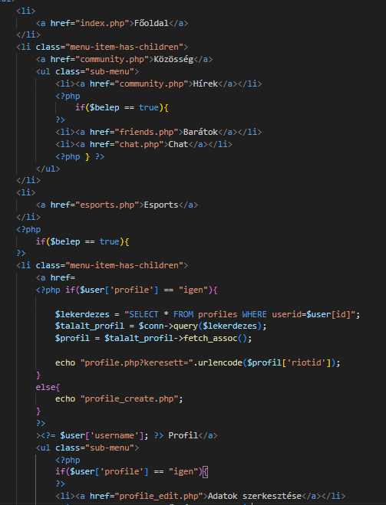
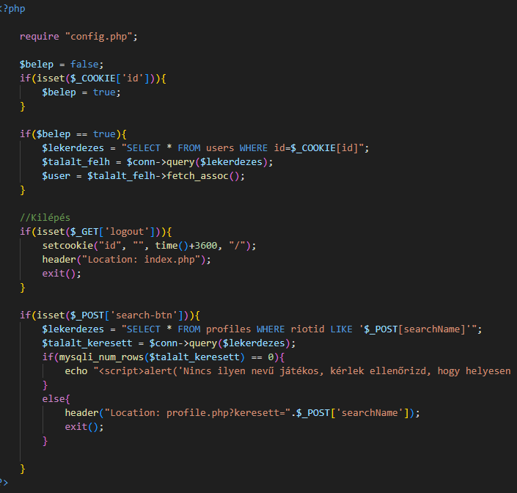
Backend
Used in coding:
-JavaScript
-PHP
-SQL
Approach and Logic:
-no major frameworks
-Separate navbar and footer

Slide 8
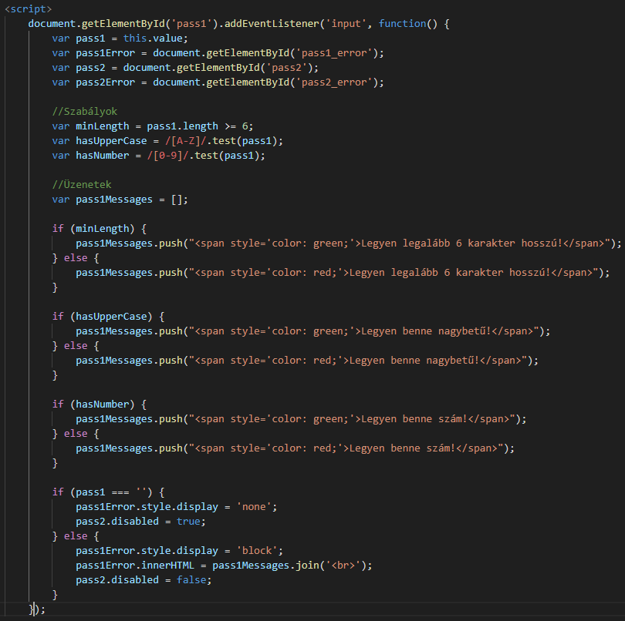
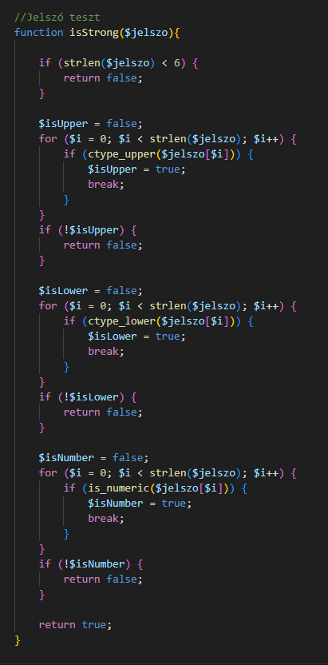
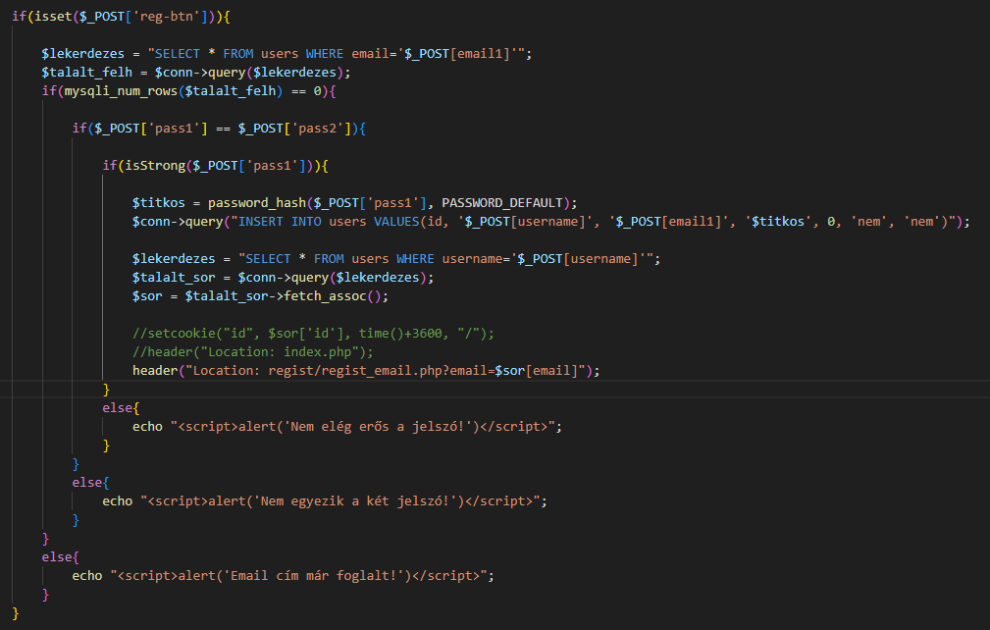
Backend
Verification:
password authentication

Slide 9
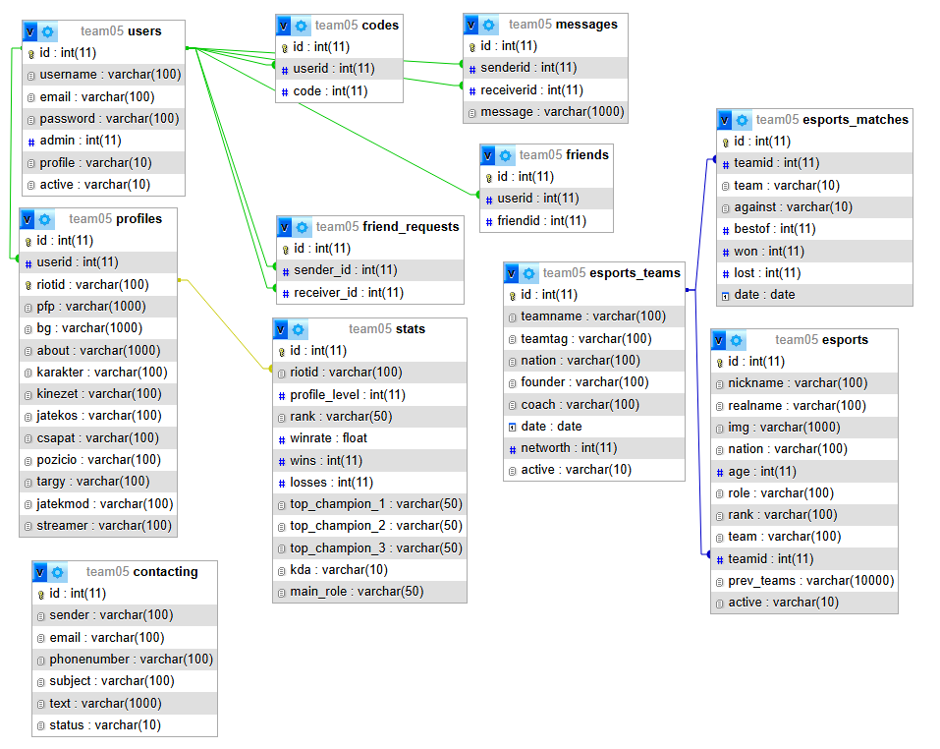
Database
Technicalities:
-Mysq
-PhpMyAdmin
Tables:
-Users
-Profiles
-Friends
-Esports

Slide 10
Testing
Manual testing
Unit testing
Security testing

Slide 11
Challenges and Future
Emerging barriers:
-PHP email sending
-API problems
Future plans:
-Include more regions
-Expand video game types
-Including more features for profile
-New languages

Slide 12
Thank you for listening!

Slide 13
TEMPLATE
temp

