Slide 1
CPE 314 · FINAL DEFENSE
DineSmart
Restaurant Ordering & Inventory Insights System
Team 5 · EDP 69323 · Option E: Restaurant Ordering & Inventory Insights
Kiro Del Rosario · Jamaica Ambuhot · Janine Ebrado
Josiela Yap · Vincent Hayag · Ben Justin Lajot
Notes:
Replace the project name, team number, section and member names. Keep this slide up while you set up the demo machine.

Slide 2
Defense plan
OVERVIEW
1
Live Demo 4 min
One realistic end-to-end task
Who speaks
Demo driver: Josiela Yap
  Vincent Hayag
Architecture: Janine Ebrado
  Jamaica Ambuhot
Justification: Kiro Del Rosario
  Ben Justin Lajot
Everyone: Q&A
2
Architecture Walkthrough 3 min
Class hierarchy, ER diagram, requirement-to-code map
3
Design Justification 2-3 min
Answer 1-2 instructor questions about a design choice
4
Individual Q&A 2-3 min each
Each member explains code they committed
Notes:
Total group time is 10-12 minutes, then individual Q&A of 2-3 minutes per member. Decide who speaks on each segment before the day.

Slide 3

Project overview
OVERVIEW
What to cover
Restaurant staff need one system to coordinate menus, orders, kitchen workflow and ingredient stock.
Restaurant owner, supervisor, kitchen staff, waiter, and cashier will be able to access and use it.
Restaurant Ordering & Inventory Insights.
API: TheMealDB
Menu, recipe, scheduling and sold-out management
Order queue, payment/service status and ingredient inventory
Reservations, sales reports and charts
Notes:
30-45 seconds. State the problem, the user, and the API your app consumes.

Slide 4
Live demo: one end-to-end task
LIVE DEMO
Scenario script (4 min)
Sign in with a staff role and open the available menu.
Place an order for a customer and submit it.
Show the order in the kitchen queue; update its preparation status.
Show the ingredient check, recursive totals and stock deduction.
Cashier marks PAID; waiter marks SERVED.
Refresh sales / best-seller charts and show saved data.
Edge cases to show
• Empty recipe search
• Order quantity of 0 or invalid input
• Insufficient ingredient stock
• TheMealDB timeout / no results
• Cancel a pending order and verify stock restoration.
Notes:
Run on the actual presentation machine. Graders check: runs start to finish without crashing and handles at least one invalid or empty input.

Slide 5
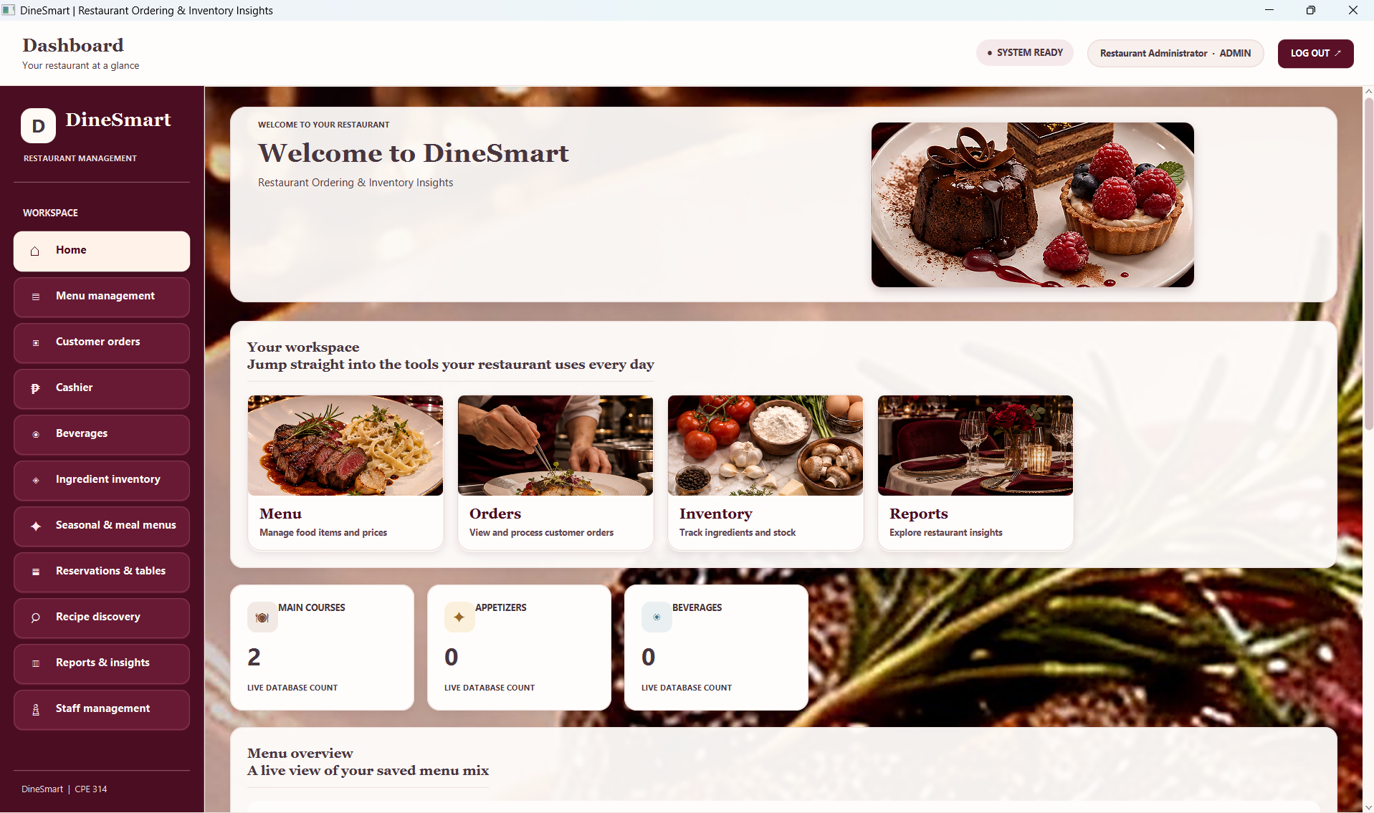
User interface: main screen
EVIDENCE: UI
Main screen
Dashboard / home navigation
Purpose
Provides a starting point for menu, orders, inventory, reservations and reports.
Visible controls
Role-based navigation, dashboard metrics, refresh actions and page controls.
Code
ui/DineSmartApp.java — start() and page-building methods; controllers enforce role actions.
Notes:
Show a real screenshot, not a mockup. Name the screen, what the user does here, and which handler runs.

Slide 6
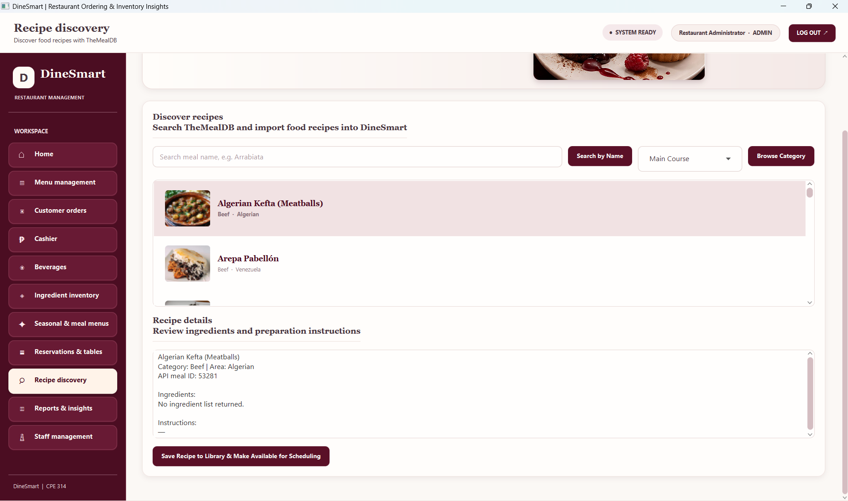
UI: second screen and controls
EVIDENCE: UI
Control | Event | Handler method
Search by Name | onAction | TheMealDbService.searchByName()
Browse Category | onAction | searchByCategory(); Main Course maps to native categories
Save Recipe | onAction | RecipeCatalogRepository + MenuPhotoStorage
Place Order / Paid / Served | onAction | OrderController.placeOrder(), markPaid(), markServed()
Notes:
Requirement: at least 3 interactive controls, each wired to a working event handler. List every control in the table.

Slide 7
Where each requirement lives
ARCHITECTURE
Requirement | Class / file | Where in demo
Object-Oriented Design | model/MenuItem.java; Appetizer, MainCourse, Beverage | Show abstract type + overridden getItemType()
Data Structure / Recursion | service/PersistentKitchenQueue.java; PendingOrderStack.java; RecursiveIngredientCalculator.java | Kitchen FIFO + calculateFrom() base/recursive case
Automated Testing (JUnit 5) | src/test/java — 15 test classes; 114 @Test methods in source | Run mvn clean test; show live result
Data Model + SQLite via JDBC | data/Database.java; OrderRepository.java; MenuItemRepository.java; IngredientRepository.java | Place order, inspect SQLite rows / foreign keys
API Consumption (REST + JSON) | service/TheMealDbService.java; MealDbMealDto.java; MealDbMealMapper.java | Search/browse/import a recipe
Event-Driven GUI (3+ controls) | ui/DineSmartApp.java; controller/*Controller.java | Search, browse, save, place order, mark paid/served
Concurrency (background thread) | ui/DineSmartApp.java — ioExecutor + CompletableFuture + Platform.runLater | Start API search and show loading state
Data Mining (aggregation) | data/OrderReportRepository.java; controller/ReportController.java | Best sellers, category counts, orders by hour
Data Visualization (chart) | ui/DineSmartApp.java — chart refresh methods | Refresh bar / line charts after data changes
Notes:
Section 3 of the project specification. Every row needs a real class or file name you can open instantly in the IDE.

Slide 8
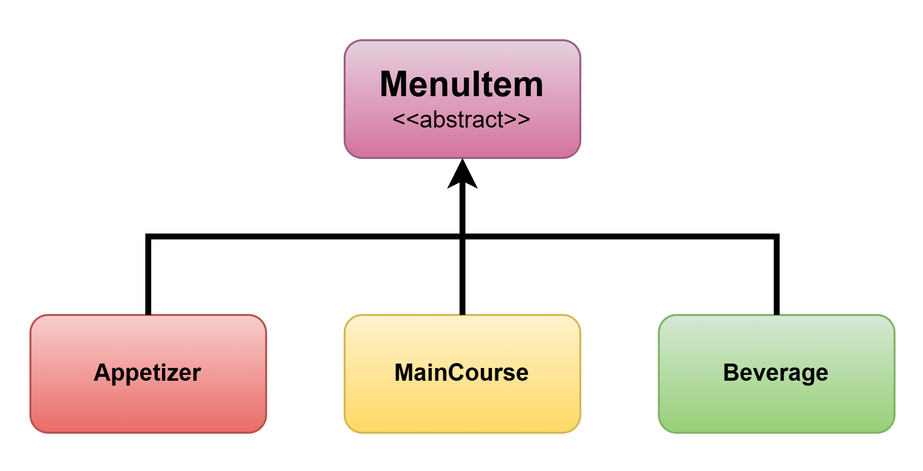
Class hierarchy
ARCHITECTURE
Point out
Abstract base class: MenuItem
Concrete subclasses
Appetizer, MainCourse, Beverage
Polymorphic method
Each subclass overrides getItemType() and returns its own category.
Single responsibility
MenuItem stores common menu data; each subclass represents one menu category.
Notes:
Requirement: at least one abstract class or interface with 2+ concrete subclasses, applying Single Responsibility. Be ready to open these in the IDE.

Slide 9
Polymorphism in action
ARCHITECTURE
List<MenuItem> menu = List.of(
new Appetizer("Bruschetta", 12900, 5),
new MainCourse("Steak", 85000, 20),
new Beverage("Lemonade", 9900, 2)
);
for (MenuItem item : menu) {
System.out.println(item.getItemType());
}
Say
Overridden method: getItemType()
Appetizer returns APPETIZER; MainCourse returns MAIN_COURSE; Beverage returns BEVERAGE.
The loop uses MenuItem references. Java dispatches to the correct subclass implementation at runtime.
No instanceof / category if-else is needed for this call.
Notes:
Show the line where a base-type reference calls an overridden method. Explain why this is better than if/else on type.

Slide 10
Data structure and recursion
ARCHITECTURE
Stack / Queue / Map
Queue — kitchen workflow
PersistentKitchenQueue stores pending SQLite order IDs in FIFO order. nextOrderId() peeks at the oldest pending order.
Why FIFO?
Kitchen orders should be handled in arrival order. The queue is rebuilt from persisted order timestamps.
Stack — pending-order utility
PendingOrderStack stores order IDs in LIFO order; popMostRecent() returns the newest pending order.
Where visible
Kitchen queue and pending-order controls in the order screen.
Recursive method
Recursive ingredient calculator
Class: RecursiveIngredientCalculator
Method: calculateFrom(items, index, totals)
Base case
index >= orderedItems.size() → return accumulated totals.
Recursive case
Aggregate this order line, then call calculateFrom(items, index + 1, totals).
Real use
OrderRepository checks and deducts each shared ingredient once. Recursion shows one order line per call and a clear stop condition; a loop could also solve it.
Notes:
Requirement: a Stack, Queue or Map used purposefully, plus a genuinely recursive method (not a one-line loop in disguise).

Slide 11
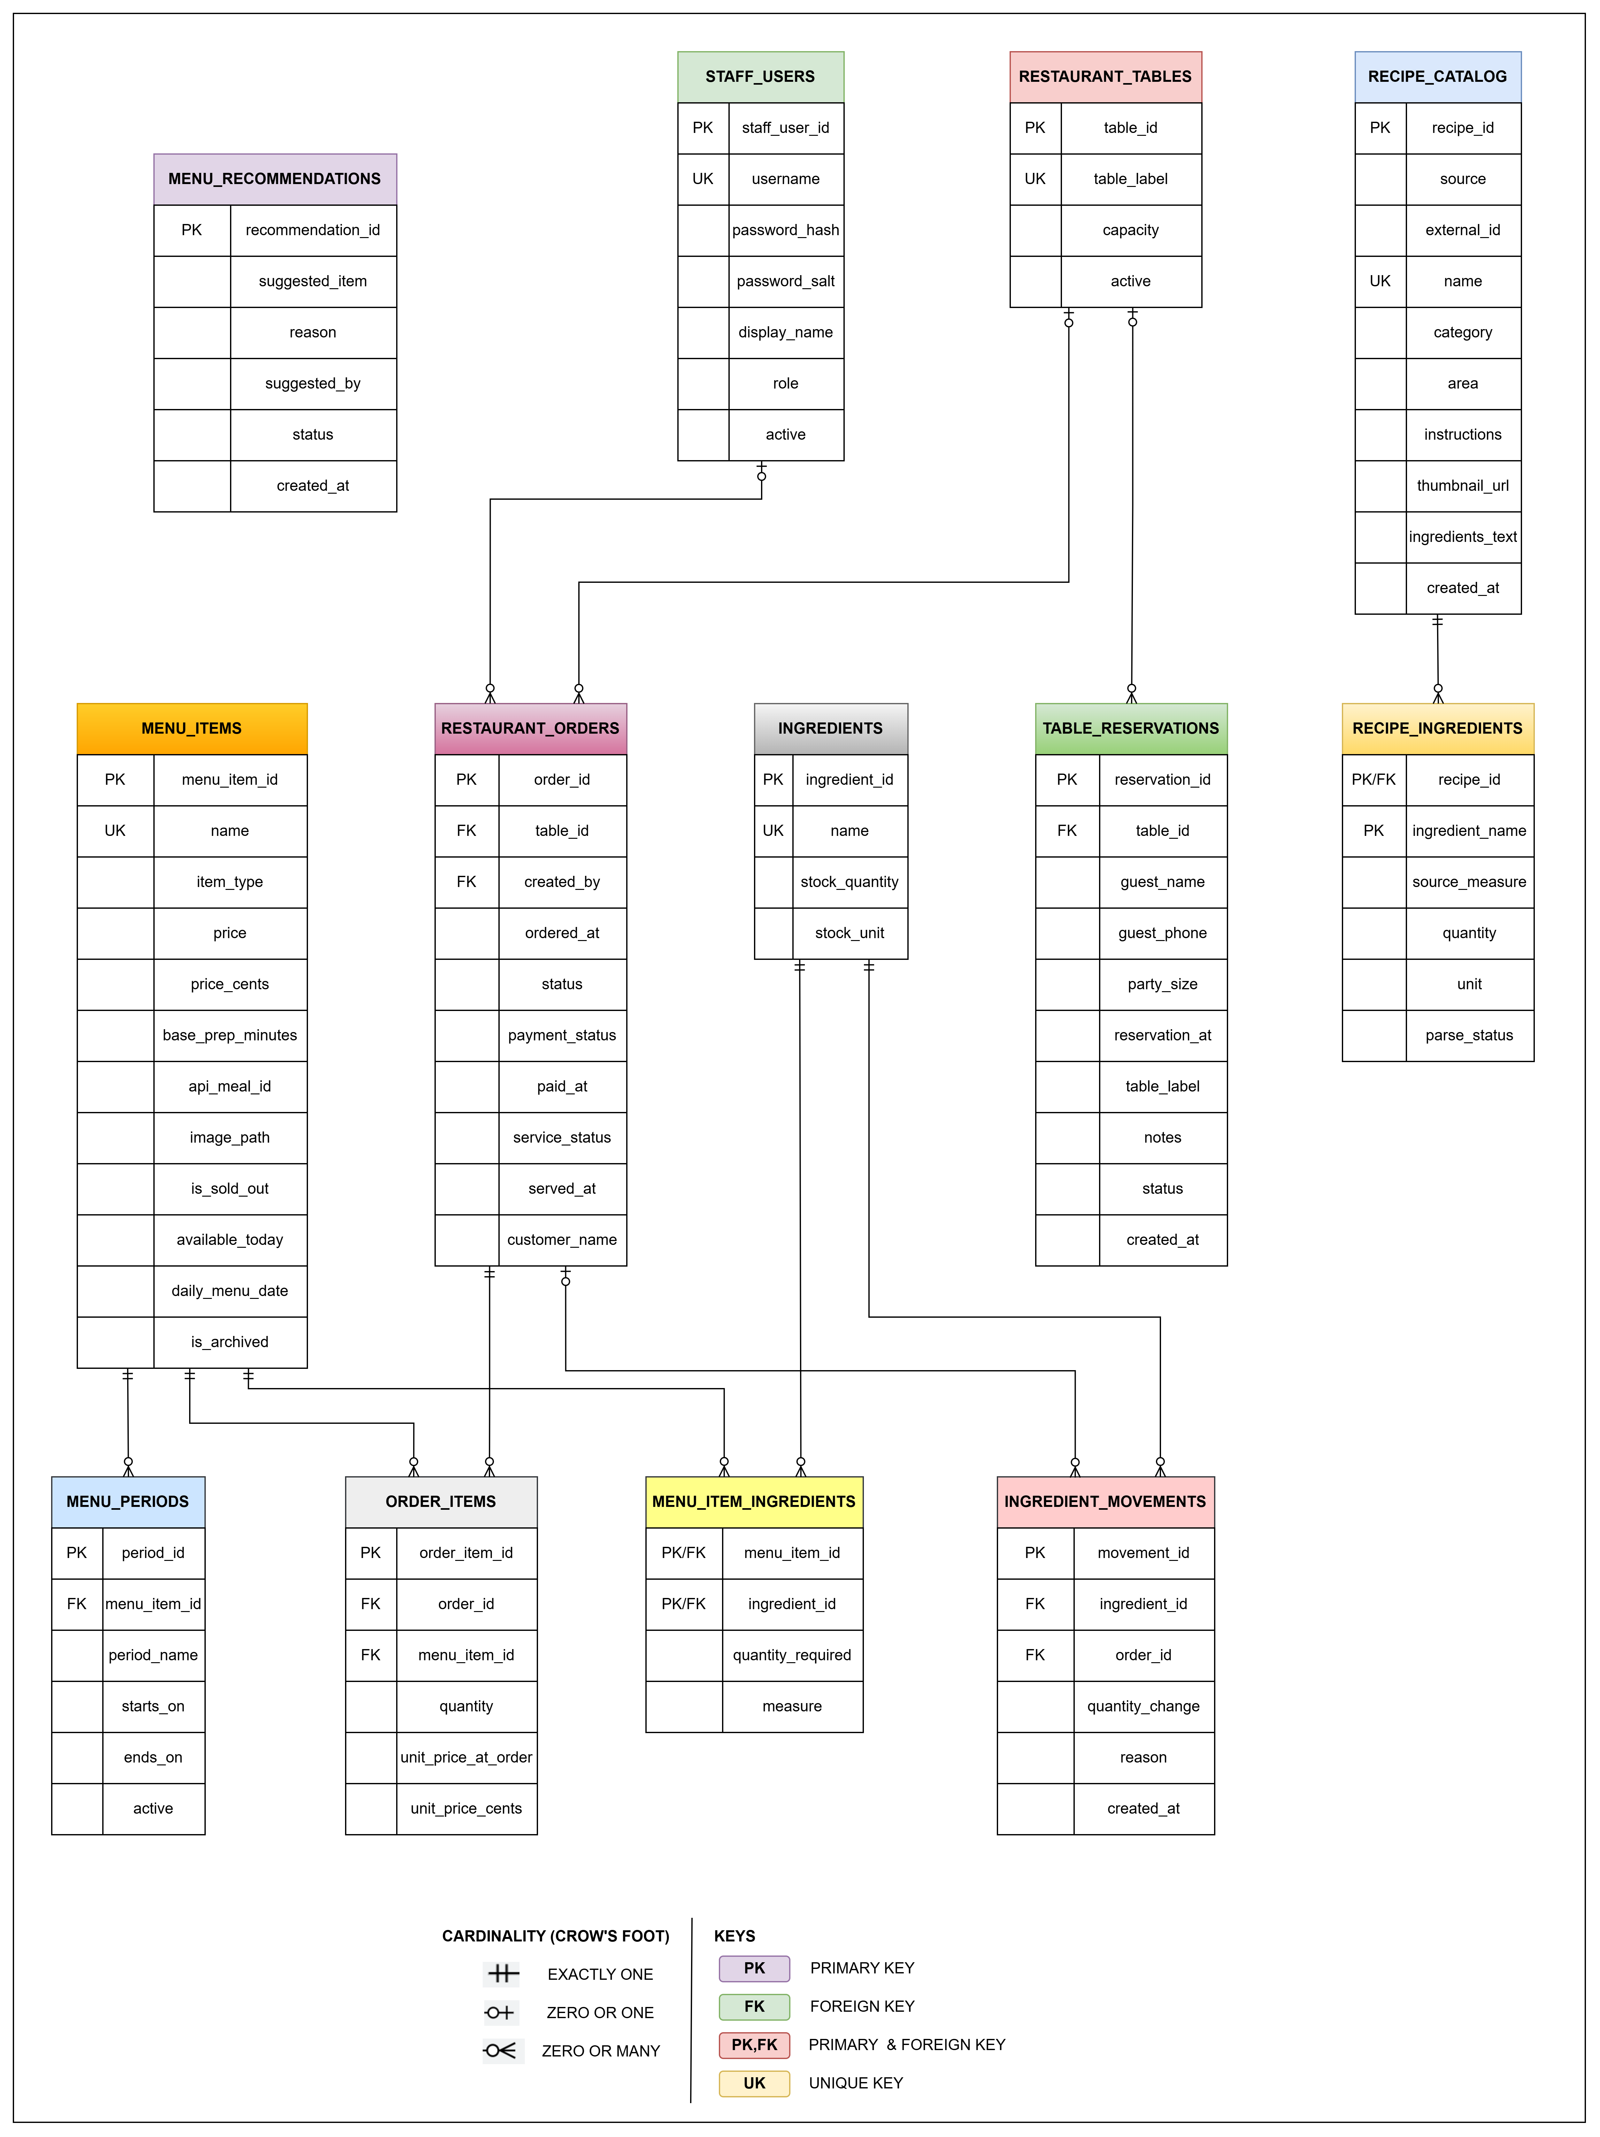
ER model and database schema
ARCHITECTURE
POINT OUT
13 Database Entities
Representing staff, menus, orders, recipes, ingredients, reservations, and inventory.
Primary and Foreign Keys
Each table uses primary keys to identify records, while foreign keys connect related database tables.
Relationships and Cardinality
One restaurant order can contain multiple order items (1:M). Menu items and ingredients have an M:N relationship through a junction table.
Verified Database Implementation
The ERD matches the actual SQLite database (`dinesmart.db`), including its tables, attributes, keys, and relationships.
Notes:
Requirement: 3+ entities, at least one relationship. The diagram must match the real .db schema; be ready to open the file.

Slide 12
JDBC and PreparedStatement
ARCHITECTURE
String addSql = """
INSERT INTO order_items
(order_id, menu_item_id, quantity,
unit_price_at_order, unit_price_cents)
VALUES (?, ?, ?, CAST(? AS REAL), ?)
""";
try (PreparedStatement add = c.prepareStatement(addSql)) {
add.setString(1, orderId);
add.setLong(2, menuId);
add.setInt(3, quantity);
add.setString(4, Money.toDatabaseDecimal(priceCents));
add.setLong(5, priceCents);
add.executeUpdate();
}
DAO / repository
data/OrderRepository.java — placeOrder()
CRUD coverage
Create/read/update/delete operations are implemented across the repositories for menu items, ingredients, orders, staff and reservations.
Notes:
No string-concatenated SQL anywhere. Show one create/read/update/delete path.

Slide 13
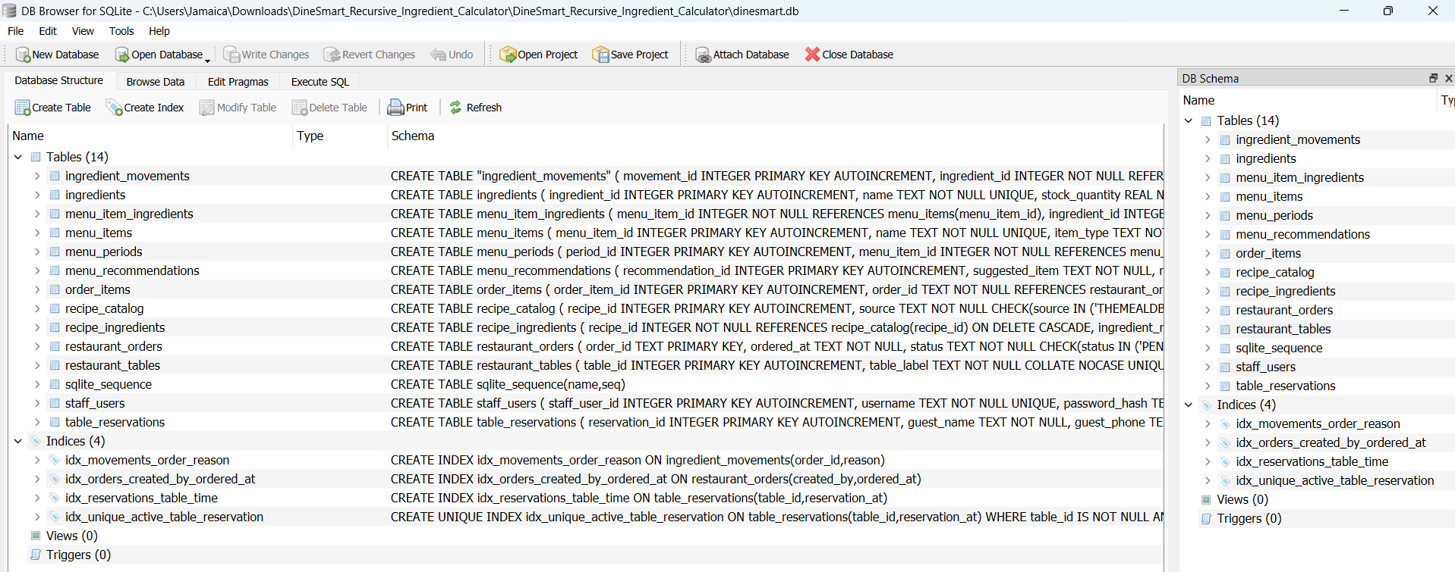
Database Tables

Slide 14
API consumption
ARCHITECTURE
Request
GET search.php?s={query}
GET filter.php?c={category}
GET lookup.php?i={mealId}
Base URL
themealdb.com/api/json/v1/1/
JSON response
MealDbMealDto.fromJson() parses:
idMeal, strMeal, strCategory, strArea, strInstructions, strMealThumb
strIngredient1–20 + strMeasure1–20
Used in app
MealDbMealMapper → MealRecipe
Recipes appear in Discover Recipes; saved to Recipe Catalog with instructions, ingredients and thumbnail URL/photo.
When the call fails
TheMealDbService applies connection/request timeouts and reports IO / interruption / empty-result outcomes. DineSmartApp runs the call off the UI thread and displays a status/error message; users can retry or search by name.
Notes:
Requirement: a real public REST call with the JSON parsed and used, not just printed. Show a log or network inspector.

Slide 15
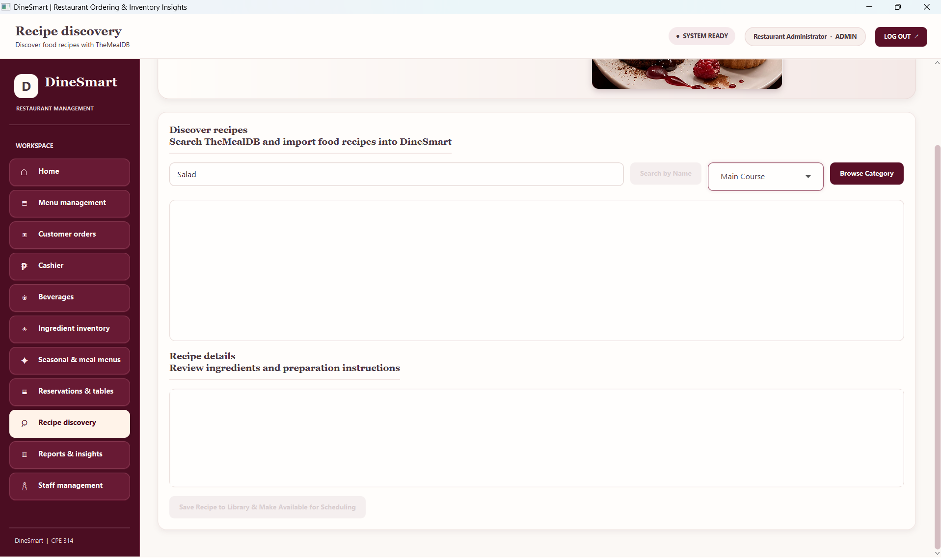
Concurrency: UI stays responsive
ARCHITECTURE
Background operation
TheMealDB name search, category browsing and recipe import / image work run outside the JavaFX Application Thread.
Executor
DineSmartApp.ioExecutor — fixed thread pool of 4 daemon threads named dinesmart-io.
Return to UI
CompletableFuture.supplyAsync(..., ioExecutor) performs work; whenComplete(...) uses Platform.runLater(...) to update controls safely.
Loading feedback
Status text changes and action buttons are disabled while the request is running.
Notes:
Requirement: a long-running operation on a background thread. Graders confirm live and may read the source. Never call the API from the UI thread.

Slide 16
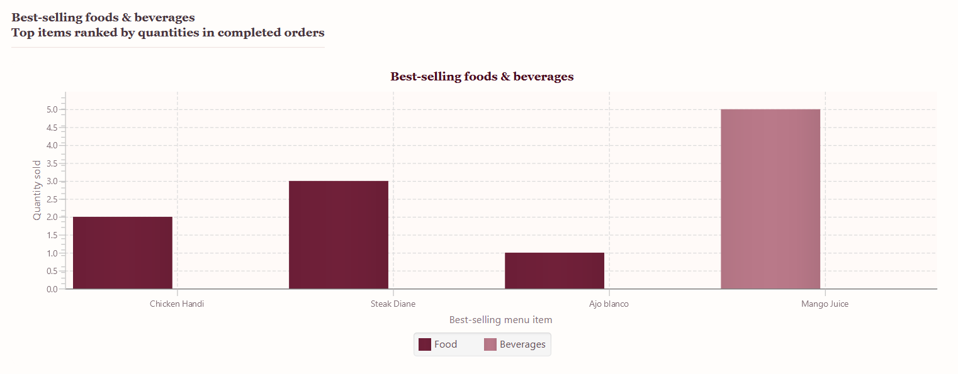
Data mining and chart
EVIDENCE: GRAPH
Mining / aggregation
Best sellers: SUM(order_items.quantity), grouped by menu item for COMPLETED orders.
Peak hour: COUNT(restaurant_orders), grouped by hour using SQLite strftime('%H', ordered_at).
Menu mix: COUNT(menu_items) grouped by item_type.
Data source
Live SQLite order and menu records via OrderReportRepository / MenuItemRepository.
Chart choices
Bar charts compare categories / best sellers. A line chart shows hourly order pattern.
Notes:
Requirements: a real aggregation or frequency analysis over app data, and a labeled chart. Graders change the input and re-run: the chart must change.

Slide 17
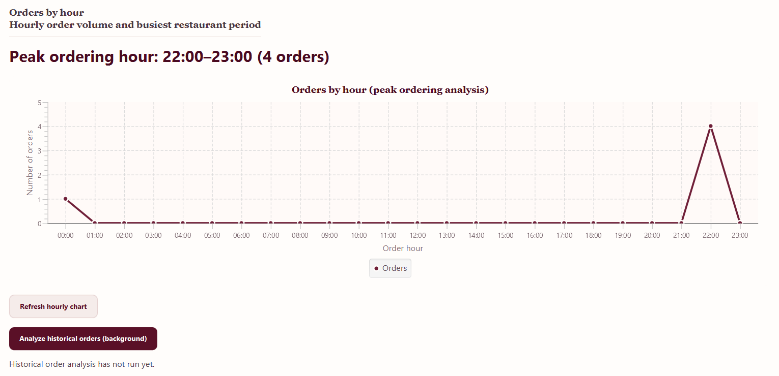
Line Chart

Slide 18
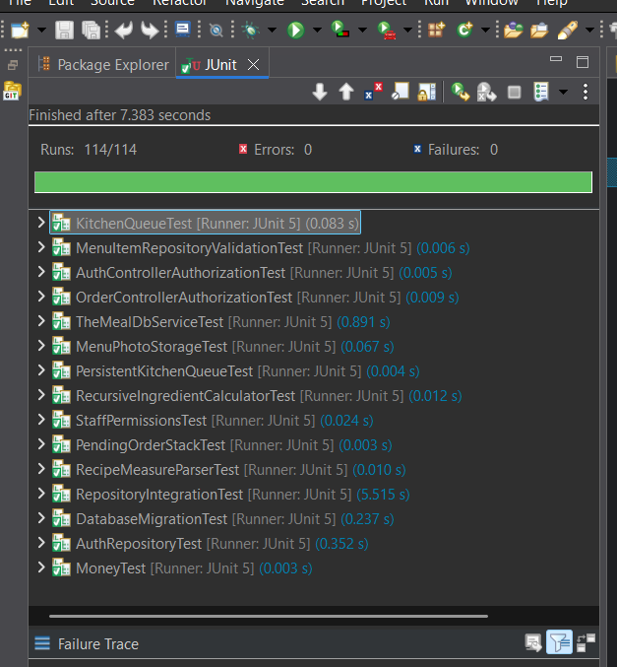
Automated tests
EVIDENCE: TESTS
Class tested | Edge case covered
RecursiveIngredientCalculatorTest | Empty order, repeated ingredients, invalid quantity, unit mismatch
TheMealDbServiceTest | Empty API response, HTTP failure, timeout, category mapping
RepositoryIntegrationTest | Order persistence, stock deduction / rollback, payment and service status
StaffPermissionsTest | Role access allowed / denied for protected operations
Notes:
Requirement: 6+ JUnit 5 tests, run live with 0 failures, and at least one edge case per tested class. Run the suite on the presentation machine.

Slide 19
Code quality and git history
EVIDENCE: CODE
Member | Commits | Lines added / removed | Main area
Kiro Del Rosario | 8 | +756 / -2,670 | Authentication, Staff Permissions, API Integration, DTO
Jamaica Ambuhot | 9 | +397 / -0 | Menu Management, Menu Models, Ingredient Calculator, Money Utility
Janine Ebrado | 14 | +7,625 / -2,507 | Database Schema, Migrations, Repositories, Orders and Reservations
Vincent Hayag | 7 | +239 / -10 | Inventory, Reservation Controllers, Kitchen Queues, Order Persistence
Josiela Yap | 3 | +5,399 / -1 | JavaFX User Interface, Menu Photo Storage, Staff Permissions
Ben Justin Lajot | 3 | +291 / -1 | Reporting Controller, Order Reports, Kitchen Queue Testing
Notes:
Run git log --author for each member beforehand. Balanced contribution and meaningful commit messages are checked.

Slide 20
Naming Conventions
Class Names: PascalCase (e.g., MenuItemRepository, DineSmartApp)
Methods and Variables: camelCase (e.g., findMenuCards, ingredientId)
Constants and Enum Values: UPPER_SNAKE_CASE (e.g., ADMIN, VIEW_MENU)
Test Classes: ClassNameTest (e.g., StaffPermissionsTest)
Package Layout
ph.uc.cpe314.dinesmart
-controller
-data
-dto
-model
-service
-ui
-util

Slide 21
Who built what
EVIDENCE: CODE
Member | Classes / files committed | Can explain
Kiro Del Rosario | AuthController.java, AuthRepository.java, MealDbMealDto.java, ApiResult.java, MealDbMealMapper.java, StaffPermissions.java, TheMealDbService.java, module-info.java | User authentication and role-based permissions, including TheMealDB API integration and the process of searching, retrieving, and mapping recipes into DineSmart.
Jamaica Ambuhot | MenuController.java, MenuRecommendationRepository.java, Appetizer.java, Beverage.java, MainCourse.java, MealRecipe.java, MenuItem.java, RecursiveIngredientCalculator.java, Money.java | Menu management and menu item classification (Appetizer, Main Course, and Beverage), including recursive ingredient calculation for combining recipe ingredient requirements.
Janine Ebrado | OrderController.java, Database.java, IngredientRepository.java, MealRecipeRepository.java, MenuItemRepository.java, MenuPeriodRepository.java, OrderRepository.java, RecipeCatalogRepository.java, RecipeMeasureParser.java, ReservationRepository.java, RestaurantOrder.java | Order processing and database operations, including ingredient validation, inventory deduction, recipe measurement parsing, and saving order records.
Notes:
Prepares the Individual Q&A: the instructor asks each member about code they personally committed, checked against git history.

Slide 22
EVIDENCE: CODE
Who built what
Member | Classes / files committed | Can explain
Vincent Hayag | InventoryController.java, ReservationController.java, KitchenQueue.java, OrderHistoryStack.java, PendingOrderStack.java, PersistentKitchenQueue.java | Inventory management, reservation processing, and FIFO/LIFO queue and stack operations for handling pending orders.
Josiela Yap | DineSmartApp.java, MenuPhotoStorage.java | Main application workflow, JavaFX navigation, role-based access, and saving and retrieving menu photos.
Ben Justin Lajot | ReportController.java, OrderReportRepository.java, KitchenQueueTest.java, MenuItemRepositoryValidationTest.java, AuthControllerAuthorizationTest.java, OrderControllerAuthorizationTest.java, AuthRepositoryTest.java, DatabaseMigrationTest.java, RecipeMeasureParserTest.java, RepositoryIntegrationTest.java, MenuPhotoStorageTest.java, PendingOrderStackTest.java, PersistentKitchenQueueTest.java, RecursiveIngredientCalculatorTest.java, StaffPermissionsTest.java, TheMealDbServiceTest.java, MoneyTest.java | Sales report generation, database queries and data aggregation, JUnit testing, and validation of system functionality.

Slide 23
Design justification
DESIGN DECISIONS
Decision 1 — One menu table with a type field
Choice
Store Appetizer, Main Course and Beverage in menu_items using item_type.
Alternative
Create a separate table for each menu category.
Why
Shared price, availability, order and sold-out behavior stays in one consistent schema; order_items references one menu_items table.
Cost
Category-specific fields need validation in application logic.
Decision 2 — TheMealDB DTO + mapper
Choice
Parse external JSON into MealDbMealDto, then map to the MealRecipe domain model.
Alternative
Use raw JSONObject fields directly inside the UI.
Why
Separates API transport format from application data and makes parsing testable.
Cost
Requires mapping code and still depends on network availability / API response shape.
Notes:
Expect 1-2 questions such as: why a Queue and not a Stack? Prepare two decisions and a rejected alternative for each.

Slide 24
Challenges and how we solved them
REFLECTION
Challenge | What we tried | How we fixed it
Main Course browse returned no recipes | TheMealDB has no literal Main Course category; aggregate supported API categories. Appetizer maps to Starter. | TheMealDbService.resolveApiCategories(); live API demo still required.
Recipe measurements are inconsistent | Keep source measures; parse numeric quantities where possible; flag unclear measurements as NEEDS_REVIEW. | RecipeMeasureParser + recipe_ingredients.parse_status.
One order may use the same ingredient in several dishes | RecursiveIngredientCalculator totals order-line requirements before stock validation and deduction. | OrderRepository.deductRecipeIngredients(); demonstrate base and recursive cases.
No known blocking issues | Completed the full Maven/JUnit test suite and resolved the identified implementation and testing issues. | All tests passed with 0 failures and 0 errors. Keep the successful Maven test report as evidence. Demonstrate API integration and system features during the final defense.
Notes:
Be honest: real problems with a real fix score better than a list of things that went smoothly.

Slide 25
Lessons learned and future work
REFLECTION
What we learned
Technical
• External APIs need DTO mapping, validation and clear failure handling.
• JDBC transactions protect order and stock consistency.
• Recursion can aggregate repeated ingredient needs across order lines.
Team
• Keep branches synchronized and review changes early.
What we would do differently
Run the complete test suite and integration demo after every major merge.
If we had more time
Improve ingredient unit conversion and review workflows for vague measures.
Add more automated end-to-end tests and continuous integration checks.
Explore customer-facing ordering and a real payment integration.
Improve reporting filters and exportable sales summaries.
Notes:
Keep to 30 seconds. Name what you would do next.

Slide 26
Questions
Individual Q&A: each member explains code they committed
https://github.com/ambuhotjam/cpe314--69323--capstone-team-05.git · Team 05
Notes:
Leave this up during individual Q&A.

