Slide 1


MULTIVARIATE TIME SERIES FORECASTING
PRESENTED BY:
Ambuj Kumar
(En No. 171230011)
Electrical and Electronics
Engineering NIT Delhi
GUIDED BY:
Dr. Varun Dutt
Associate Professor
P.I. ACS LAB
School of Computing and
Electrical Engineering
School of Humanities and Social Science IIT Mandi

Slide 2
TABLE OF CONTENTS
Introduction
Type of Time Series
Time Series Data to Supervised Data
Why Deep Learning ?
Type of Models
Observations
Results
Conclusion
Bibliography

Slide 3
INTRODUCTION
Time series forecasting is a technique for the prediction of events though a sequence of time.
This technique predict future events by analysing the trends of the past, on the assumption that future trends will hold almost similar to historical trends
It is important because there are so many prediction problems that involve a time component

Slide 4
TYPE OF TIME SERIES
Univariate Prediction
Single Step Prediction
Multi Step Prediction
Multivariate Prediction
Single Step Prediction
Multi Step Prediction
Multi Headed Prediction
Single Step Prediction
Multi Step Prediction

Slide 5
TIME SERIES TO SUPERVISED DATA
Before machine learning can be used, time series forecasting problems must be re-framed as supervised learning problems
Time Series Data : [ 1 , 2 , 3, 4, 5, 6, 7, 8, 9, 10, 11, 12 ]
Supervised Data : X1 X2 Y
1 2 3
2 3 4
3 4 5
4 5 6
5 6 7
6 7 8
7 8 9
8 9 10

Slide 6
WHY DEEP LEARNING ?
Deep learning methods offer a lot of promise for time series forecasting because of the following reasons.
Automatically learn arbitrary complex mappings from inputs to outputs
Support multiple inputs and outputs
Automatic learning of temporal dependence
Automatic identification, extraction and distillation of salient features
Native Support for Sequences

Slide 7
TYPE OF MODELS
Multivariate model
Multi-headed Model
X1
X2
X3
Model
X1
X2
X3
.
.
.
MERGE
Y
Model
Y
Model
Model
…………….

Slide 8
OBSERVATIONS
After implementing various model I found that
LSTM Model performed very well if the data does not have temporal dependency
CNN-LSTM Model performed very well if the data have temporal dependency

Slide 9
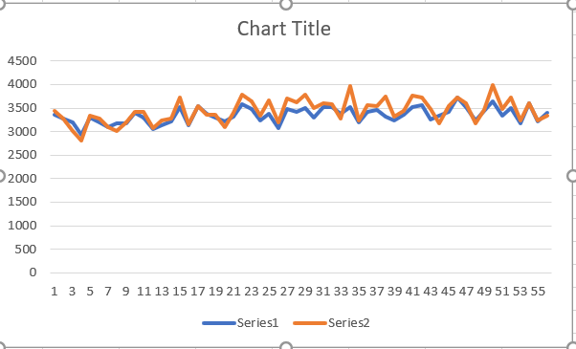
RESULTS
Lets have a look the results which I got
Medicine A LSTM Result :
Note : Here series1 is Predicted value
and series2 is True value

Slide 10
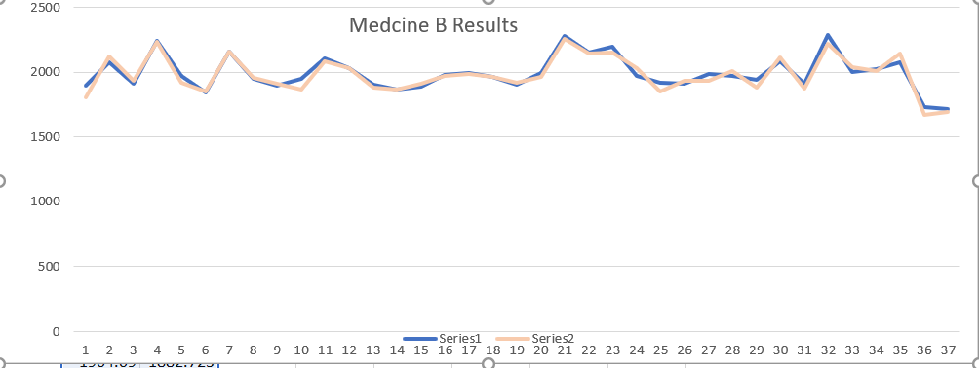
Result Continue ………………………
Medicine B CNN-LSTM Result :
Note : Here Series1 is True Values
and Series 2 is Predicted Value

Slide 11
CONCLUSION
In this project we can see that how the deep learning models can performed much better than the statistical models
Now a days Deep Learning models are frequently use to solve the problem of time series
Deep learning have ability to offer a lot of promise for time series forecasting

Slide 12
BIBLIOGRAPHY
https://robjhyndman.com/papers/ijf25.pdf
https://github.com/topics/time-series-forecasting
https://github.com/mborysiak/Time-Series-Forecasting-with-ARIMA-and-LSTM
https://stackoverflow.com/
https://www.geeksforgeeks.org/
https://machinelearningmastery.com/
https://towardsdatascience.com/
https://www.youtube.com/watch?v=e8Yw4alG16Q
https://www.youtube.com/watch?v=Aw77aMLj9uM

