Slide 1
Time Series Forecasting
Time series forecasting is a technique for the prediction of events though a sequence of time.
Data is collected at regular interval of time
This technique predict future events by analysing the trends of the past, on the assumption that future trends will hold almost similar to historical trends

Slide 2
Type of Forecasting
Univariate Prediction
Multivariate Prediction
Single Step Prediction Multi Step Prediction Single Step Prediction Multi Step Prediction

Slide 3


Type of Data in Forecasting
Univariate Data | Multivariate Data
This type of data consists of only one variable at a time. Ex : since the information deals with only one quantity that changes. It does not deal with causes or relationships | This type of data consists of more than two variable at a time. Ex: It deals with causes or relationships

Slide 4
Time Series Components
Trend:
The trend shows the general tendency of the data to increase or decrease during a long period of time. A trend is a smooth, general, long-term, average tendency
Cyclic Pattern :
A cyclic pattern exists when data exhibit rises and falls that are not of fixed period.

Slide 5
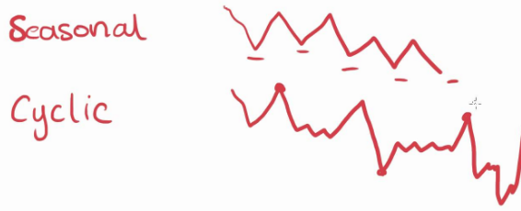
Time Series Components
Seasonal Pattern or Seasonality :A seasonal pattern exists when a series is influenced by seasonal factors (e.g., the quarter of the year, the month, or day of the week). Seasonality is always of a fixed and known period. Hence, seasonal time series are sometimes called periodic time series.

Slide 6
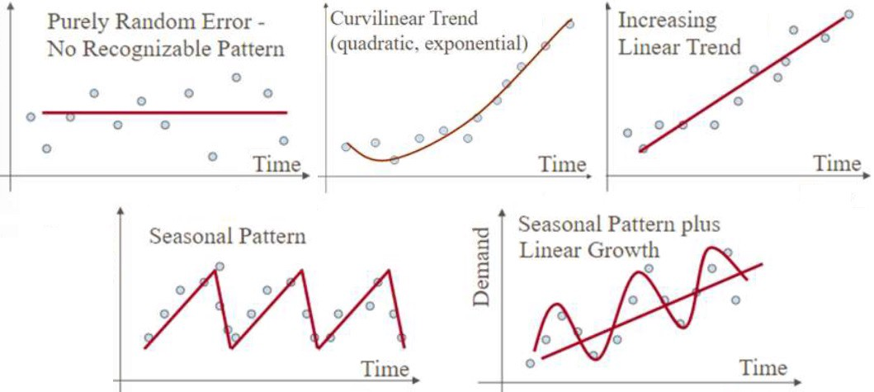
Time Series Components

Slide 7
Statistical Methods of Forecasting
These methods works only and only on univariate data
Average Method : it use mean or median of whole data
Moving Average (MA) : it use mean or median of last few data
Exponential Smoothing(ES) : Single ES can’t handle trend and seasonality , Double ES handle trends while Triple ES can handle both
Auto Regression Moving Average (ARMA) : It use two polynomials, one for the autoregression (AR) and the second for the moving average (MA)
Auto Regression Integration Moving Average (ARIMA) : Can handle trend but not seasonality
Seasonal Auto Regression Integration Moving Average (SARIMA) : Can handle trend and seasonality

Slide 8
Machine Learning Methods of Forecasting
These methods works on both type of data (i.e. Univariate and multivariate)
Time series problem is Regression type problem . Once Time-series data is converted into Supervised Data ,we can use all supervised techniques like
Multi Layer Perceptron Model (MLP), Convolutional Neural Network (CNN), Support Vector Machine etc.
Memory based Deep learning methods like LSTM (i.e. Long Sort Term Memory )and GRU (i.e. Gated Recurrent Unit) offer offer a lot of promise for time series forecasting

Slide 9
Conversion of Time Series Data into Supervised Data
Before applying the machine learning on time series forecasting problems dataset must be re-framed as supervised learning problems
Time Series Data : [ 1 , 2 , 3, 4, 5, 6, 7, 8, 9, 10, 11, 12 ]
Supervised Data : X1 X2 Y
1 2 3
2 3 4
3 4 5
4 5 6
5 6 7

Slide 10
Thank You

