Slide 1

Sprocket Central Pty Ltd
Data analytics approach
Data Analyst- Ambuj Garg

Slide 2
Agenda
Introduction
Data Exploration
Model Development
Interpretation

Slide 3
Introduction
Basic Information of the data.
In our data analysis of Sprocket Central Pty Ltd, we will be merging three tables to consolidate the data. This merged dataset will provide us with comprehensive information for further analysis. The merged dataset will encompass a total of 30 columns, allowing us to explore various aspects of the business. Among these columns, some key variables for analysis include Profit, Brand, Product Class, and Product Line. By examining these variables, we can gain insights into the company's financial performance, brand portfolio, and product categorization, which will contribute to making informed business decisions.

Slide 4
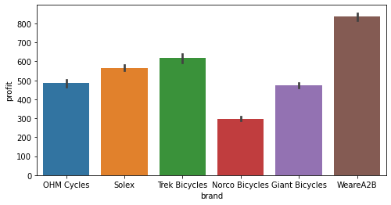
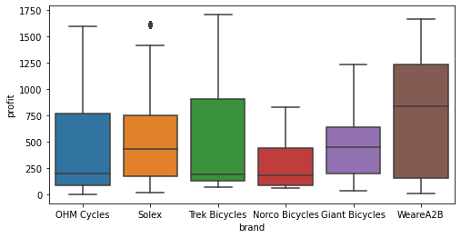
Data Exploration
Brand Analysis
In Sprocket Central Pty Ltd, there are a total of six brands. When analyzing the profit for each brand, we observe that WeareA2B has the highest profit, while Norco Bicycles has the least profit. The remaining four brands show average profits, which are calculated by taking their respective averages. This analysis helps us understand the varying levels of profitability across different brands within the company.

Slide 5
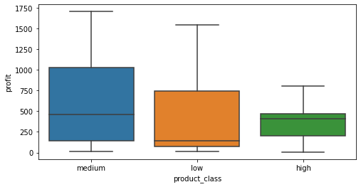
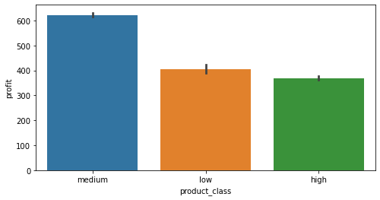
Data Exploration
Product Class
The box plot and bar plot illustrate the product class distribution of the bicycles. It is evident that the medium product class yields the highest profit, while the low product class generates an average profit. Conversely, the high product class exhibits the lowest profitability. This analysis sheds light on the relationship between product class and profit, highlighting the importance of the medium product class in driving higher profits for the company.

Slide 6
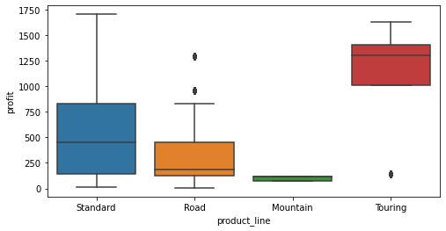
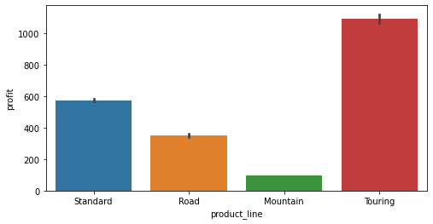
Data Exploration
Product Line
The box plot and bar plot illustrate the distribution of product lines for bicycles. It is evident that the Touring product line yields the highest profit, with the majority of profits generated from this category. The second-highest profit comes from the Standard product line, which also boasts a high price range similar to Touring. In terms of profit, the Road product line ranks third. Notably, the Mountain product line demonstrates the least profitability and exhibits some outliers. This analysis provides insights into the profit distribution across different product lines, highlighting the dominance of Touring and the relatively lower profitability of Mountain.

Slide 7
Model Development
Before proceeding with the model development, certain steps need to be taken. Firstly, necessary encodings are required due to the presence of multiple categorical variables. Categorical variables cannot be directly used in model development, so we will apply one-hot encoding, target encoding, and label encoding. Additionally, we will explore potential feature engineering opportunities to extract valuable information from the data.
After performing the encoding and feature engineering, we will apply statistical techniques to validate the columns. Furthermore, we will assess the need for any transformations or scaling of the data.
Once the above processes are completed, the data will be split into train and test sets. The base model will be built and its performance will be evaluated. Additionally, advanced AI models can be developed for enhanced performance and predictive accuracy.

Slide 8
Interpretation
From the data provided by Sprocket Central Pty Ltd, we have extracted various insights as elaborated in the above slides. Based on our analysis, we recommend targeting the top thousands customers who have contributed the most to our business, determined by their profit contribution. Additionally, focusing on younger customers may also be a viable strategy as they represent a potential target market.
Another approach is to identify the customers with the highest number of transactions by grouping them based on customer ID. Selecting the top 1000 customers with the highest transaction count can provide valuable targets for the company.
We suggest that the company records customer footfalls and tracks their purchasing behavior to identify potential target customers. Additionally, creating a database of customers who did not make a purchase and investigating the main reasons behind their decision can provide insights for improving the company's offerings and sales strategies.

