Slide 1
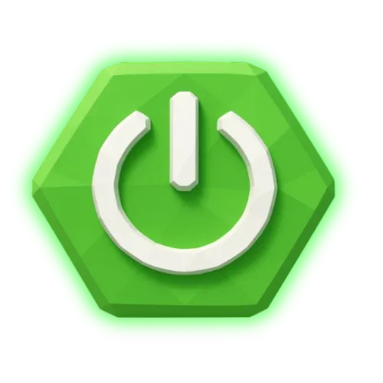
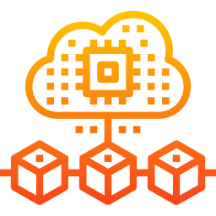

Spring Boot Microservices
with Git-Based
Version Control
+
+
Spring Boot
Microservices
Git
Presented by: Prashant Ambule
Technology: Java + Spring Boot + Microservices
Version Control: Git & GitHub

Slide 2


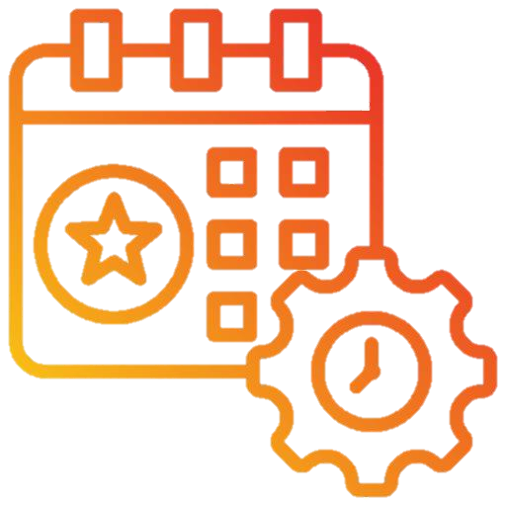

What are Microservices?
Microservices is an Architecture Where one large application into small independent services.
Example: College Event Management System
User Service
College Service
Event Service
Registration
Service

Slide 3
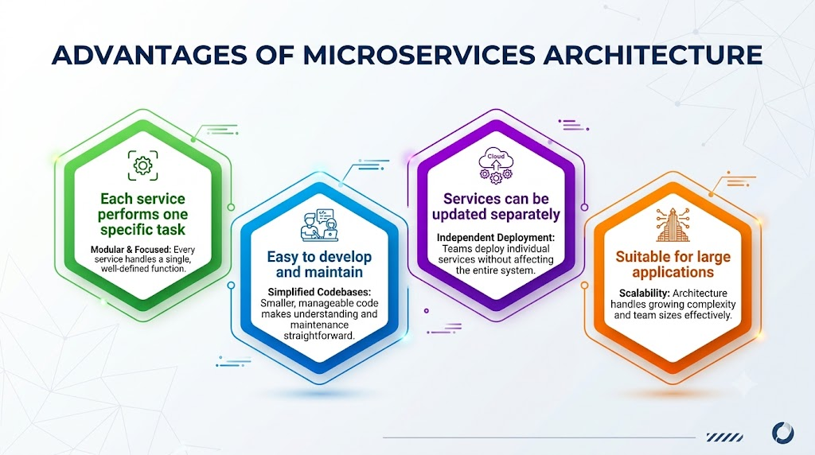

Slide 4
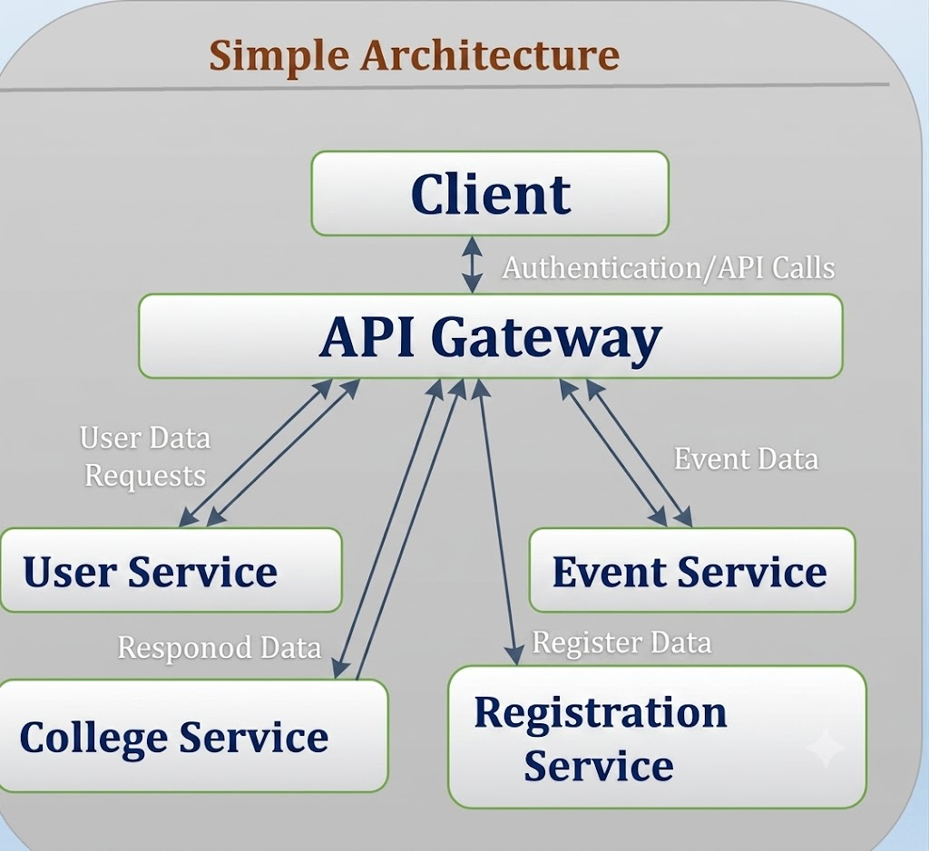
Spring Boot Microservices
Spring Boot is a Java framework used to build web applications and REST APIs easily.
Simple Architecture
Technologies I can relate to:
Java → Main programming language
Spring Boot → Backend development
Spring Web → REST APIs
Spring Data JPA → Database operations
MySQL → Store application data
Spring Security → Login and user authorization
Client
API Gateway
User Service
Event Service
College Service
Registration
Service

Slide 5
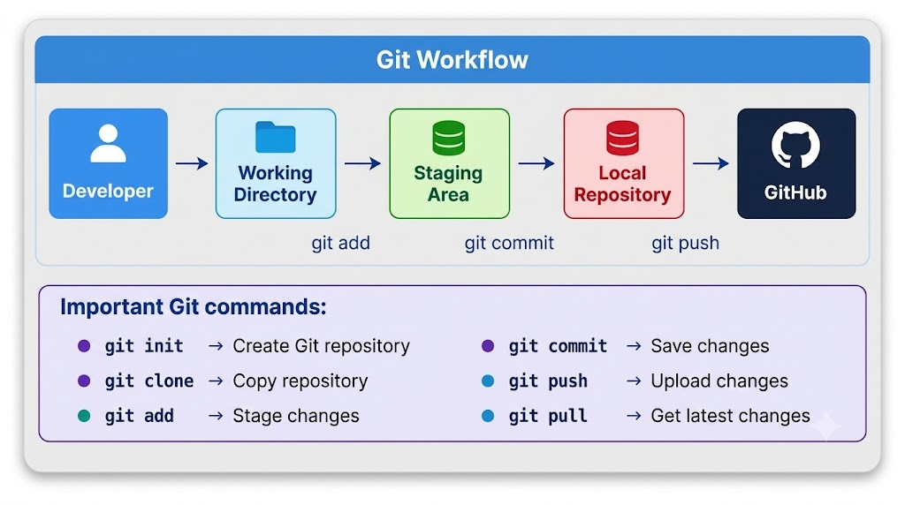
Git-Based Version Control
Git helps developers track and manage changes in them
source code.

Slide 6
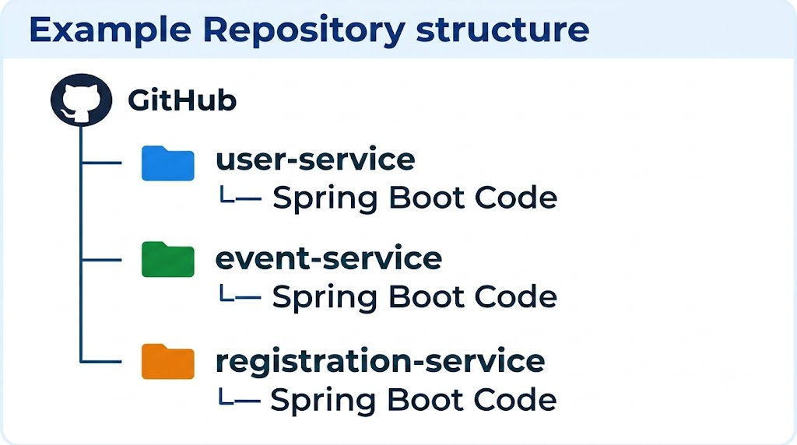
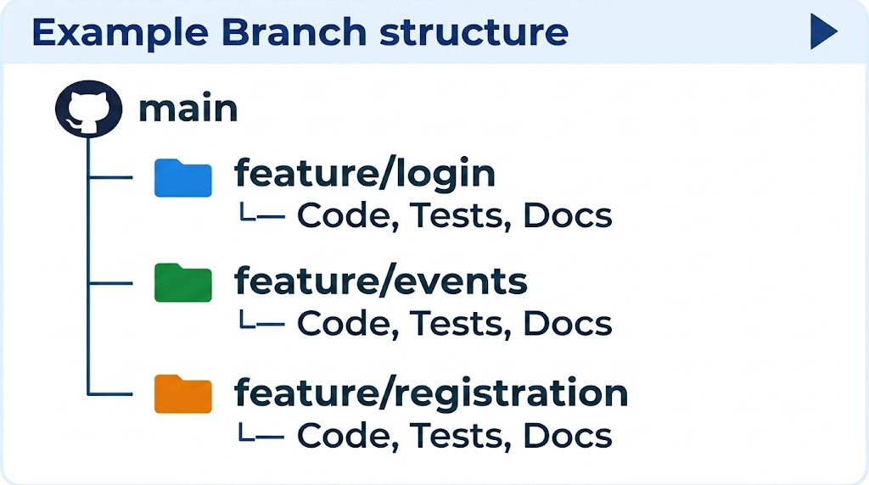
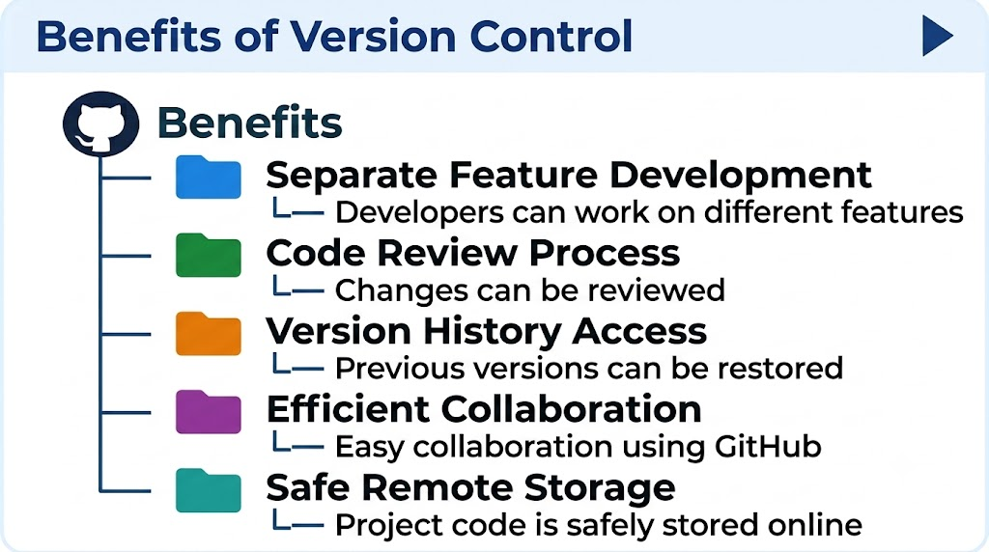
Spring Boot + GitHub

Slide 7
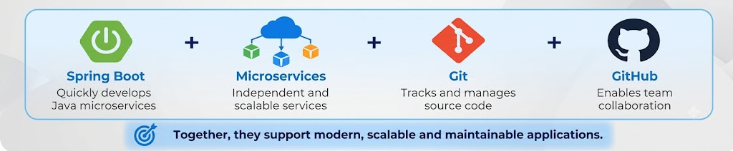
Conclusion
Thank You

