Slide 1
Energy forecasting data challenge
Kaggle challenge – Final submission 31.01.2023
https://hessian.ai/energy-forecasting/

Slide 2
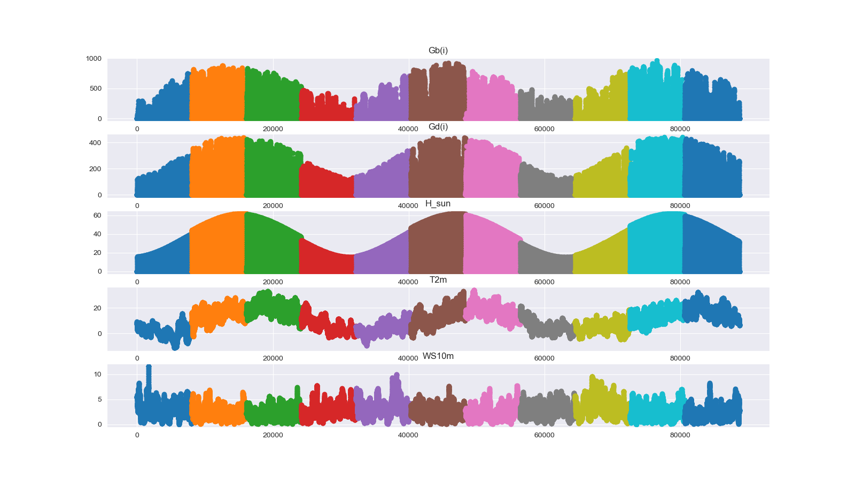
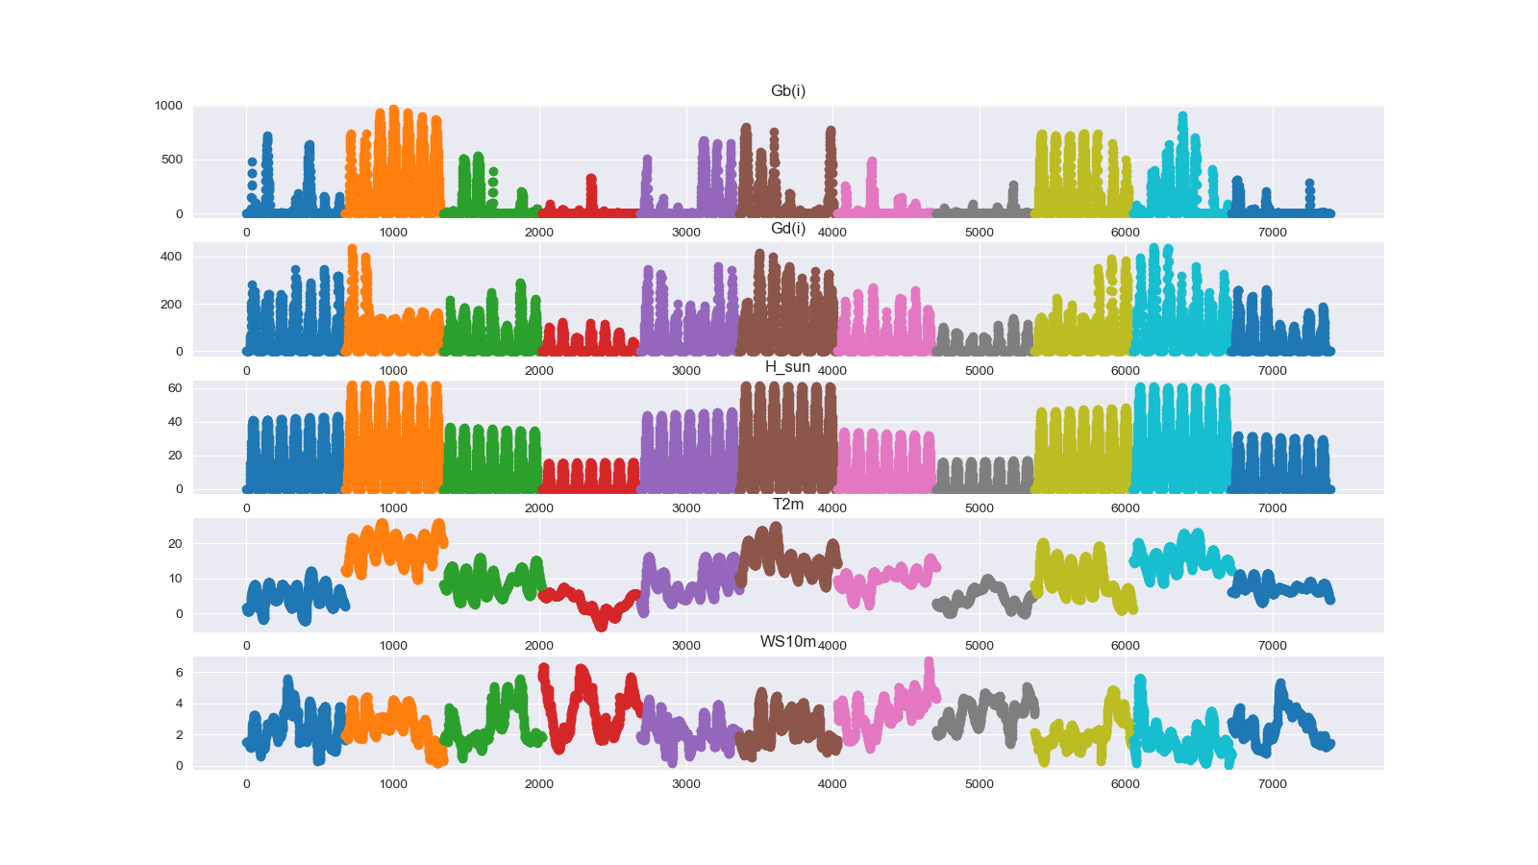
Short facts
https://www.kaggle.com/competitions/energy-forecasting-data-challenge/data
Goal: develop an (AI) algorithm that forecasts the residual loads
Residual load = load – production
Train set: 2,7 years of meteorological data + load& production, split into 11 data sets
Test set: 1 week of data at different times, also split into 11 data sets

Slide 3
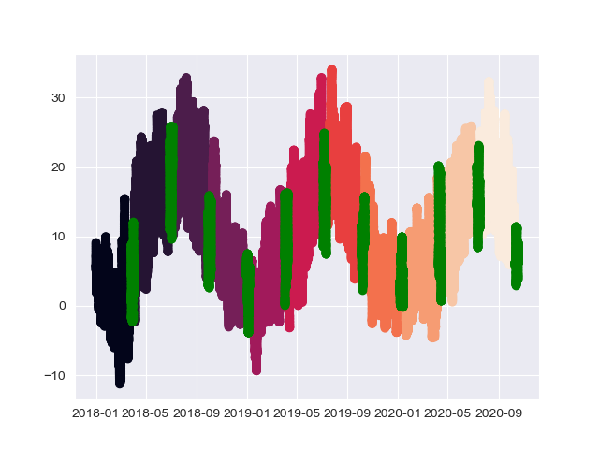
Distribution of test set
Test set has weekly segments in between the trian data sets

Slide 4
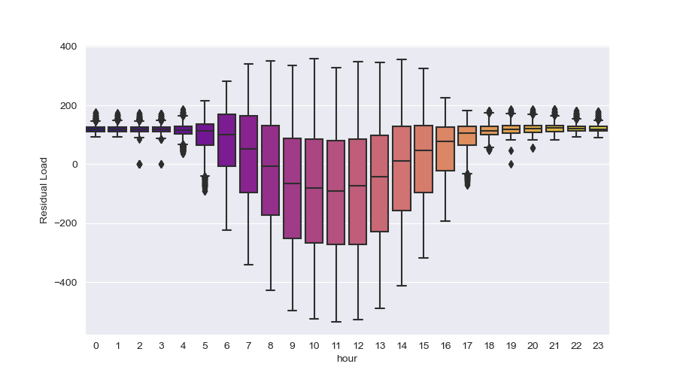
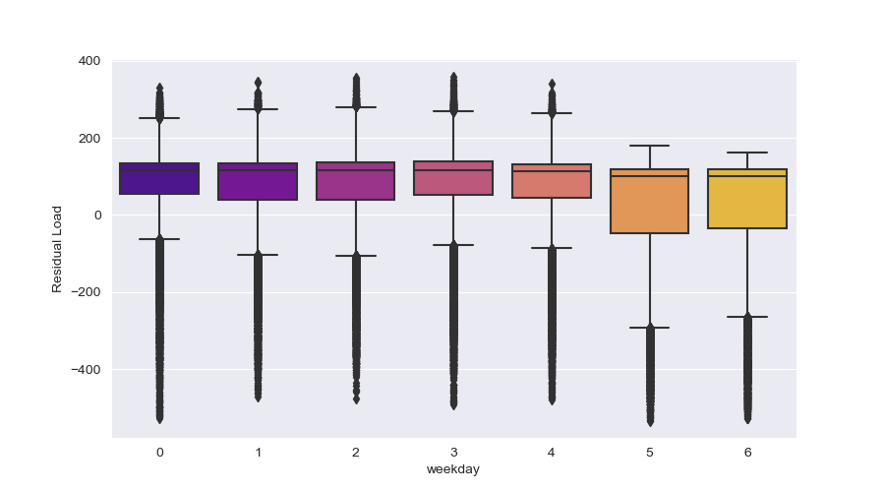
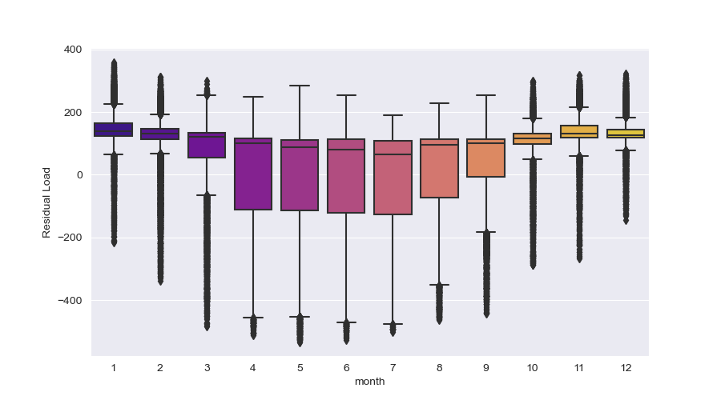
Residual load

Slide 5
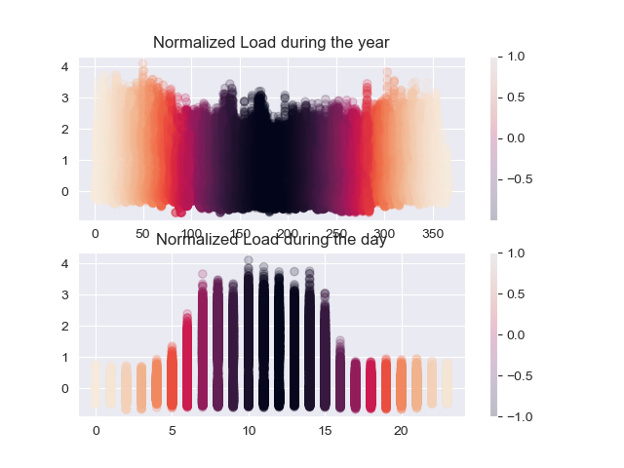
Load analysis

Slide 6
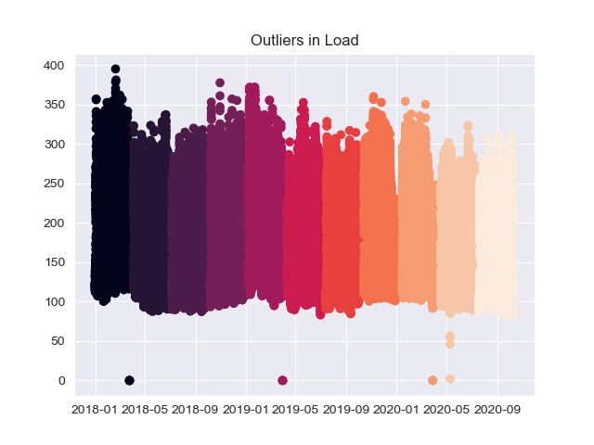
Outliers in load
Only 16 < 82
-> removed by set to min value

Slide 7
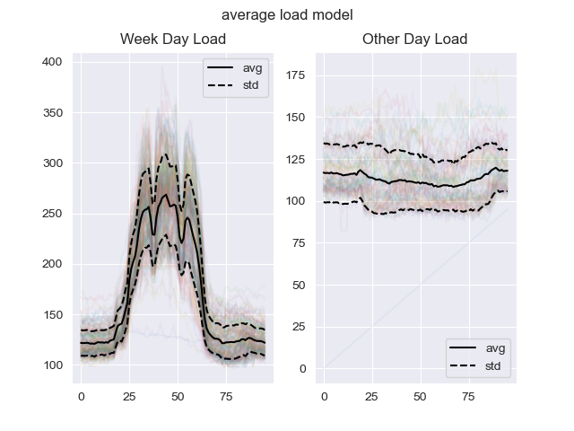
Current approach
Pre-Proc:
normalization of target variables
removed outliers in load
Predict Residual load by two fold approach:
1. predict load by 11 individually trained (GBRT) models
Implemented improvements:
added (hessian) public holidays as features
added weekday (true/fals) feature
added annual seasonality (dayofYearSinsoid)
added „average load model“
Predict of test set e.g. (dataset 1) uses average of model 1 +2
2. predict production by 1 / 11 production models
Using 11 models for production improved RMSE, but did not improve leaderboard score

Slide 8
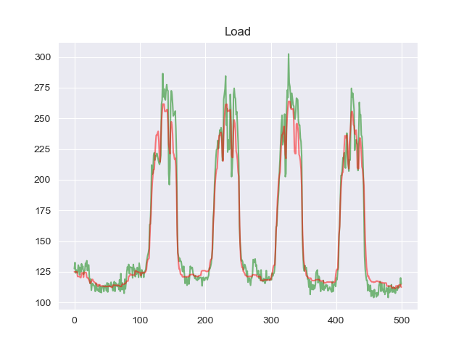
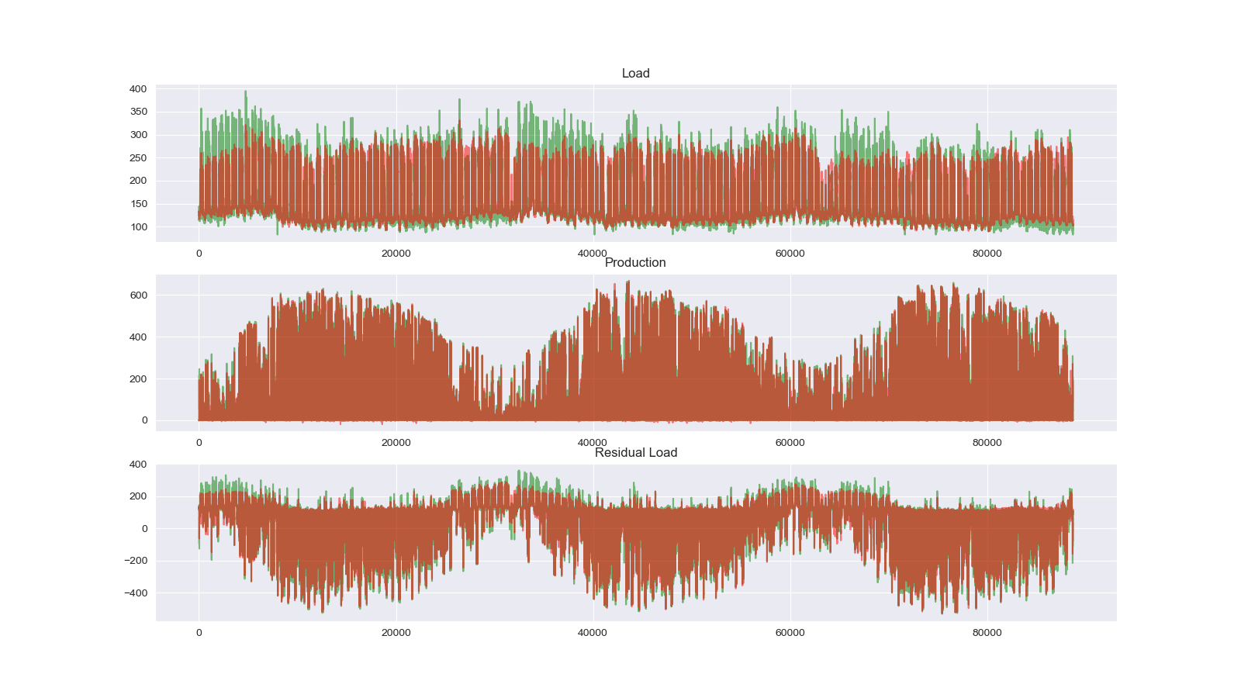
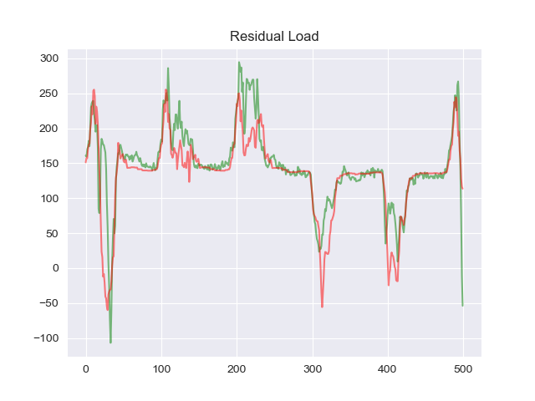
Results - train
Probably better trying to improve prediction of load

Slide 9
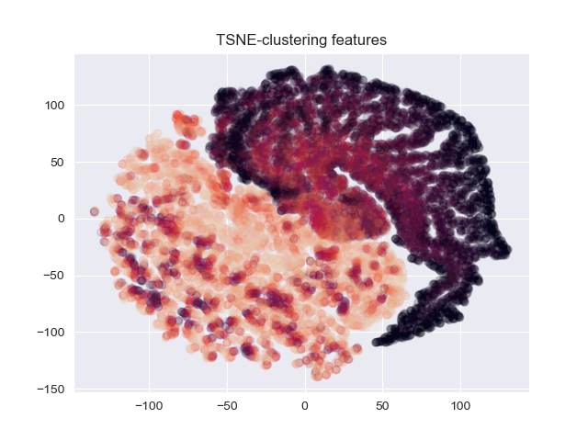
Ideas to improve
Hyperparameter tuning
n-estimators: 1000
Max depth: 5
Learning rate: 0.02
Improve prediction of production:
Improve prediction of load by:
Use different model than GBRT
Engineer more features:
Cloud index?
TSNE of meteorological vars (train+test together)
Generate more fake but similar test data?

Slide 10
Status – Team amburgerH
Currently in 11th place / 17
However: The leaderboard score which you see until the end of the challenge is only determined based on 30% of the data.
Additional credit will be given for a model:
that can adapt to up-to-date data -> continuous learning
that helps to understand the importance of features and decisions -> explainability

