Slide 1

Applied Data Science Capstone:
Battle of the Neighborhoods: Toronto Neighborhoods and its Latin American Areas
By: Alexandra Butke
Published: 8/5/2020

Slide 2
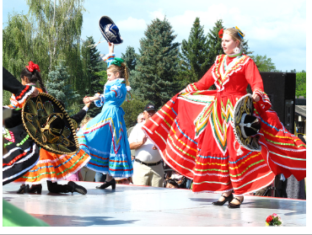
Canada’s Latin Overview
The Latin culture and people are a fast and growing population that brings beauty, knowledge and tradition to every country they are in. While the United States is the mecca for this community, the Canada Latin population is also rapidly growing.

Slide 3
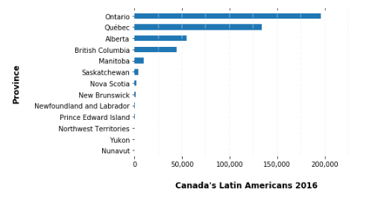
Canada’s Latin American Population
Most Latin American's reside in four Canadian Provinces: Ontario, Quebec, Alberta, and British Columbia
Ontario has the largest population at 196K

Slide 4
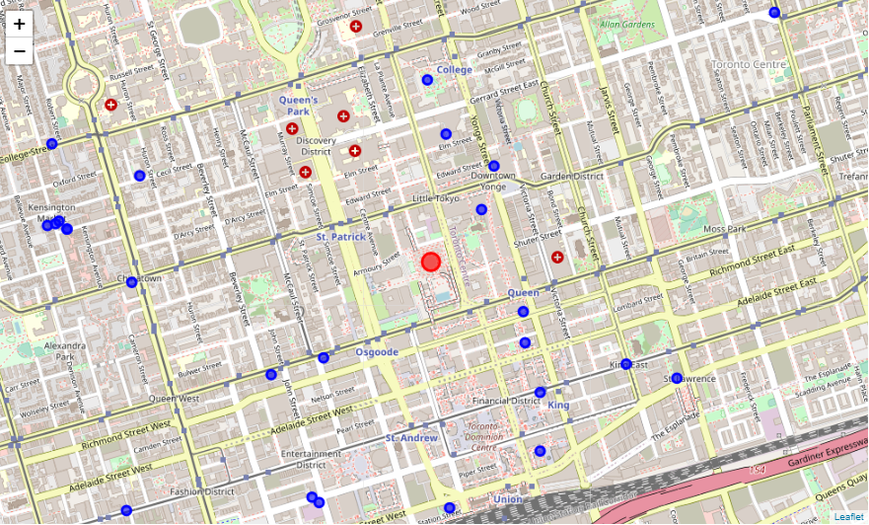
Toronto Latin Venues
Toronto is the provincial capital of Ontario and boast one of the largest Latin population at ~133K. While, Latin American’s are the minority of the population, Toronto has many venues, restaurants and localities that cater to the Latin Demographics.
Where to find Latin Venues (blue circles)
Toronto Center (red circle)

Slide 5
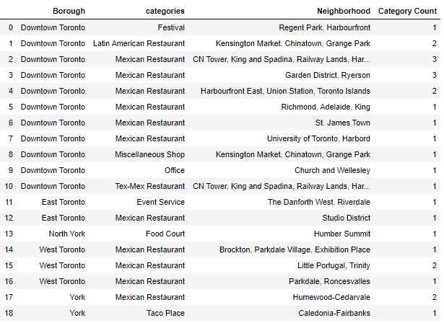
Latin Venues in Downtown Toronto
Downtown Toronto is a hotspot for those seeking to find a variety of Latin venues. The Latin Sparks Festival which started in 2012 and considered Canada’s largest block parties is held in Downtown Toronto. If you are looking for a Mexican Style Restaurant the Garden District and Kensington Market Neighborhoods, both in Downtown Toronto, are excellent and have a variety of choices for you.

Slide 6
10 Most Common Venues: slide 7 and 8 contain the data
There are many neighborhoods in Toronto
2K+ venues
275 unique categories
Using clustering approach to provide a general idea of the neighborhoods and most common areas you get 5 separate clusters
Observation:
Lots of diversity in restaurant selections
Cluster 2 and 4 show that Downtown, North York, Etobicoke, and Scarborough neighborhoods have similar interest in most common venues
Similar to foursquare search, Downtown has Mexican Restaurant as one of the most common venues in the explore search
Pubs was pretty appeared very few times as the most common venue
Parks, Playground and dog runs venues appeared frequently in most neighborhood, which could indicate that the population in the neighborhoods like the outdoors

Slide 7
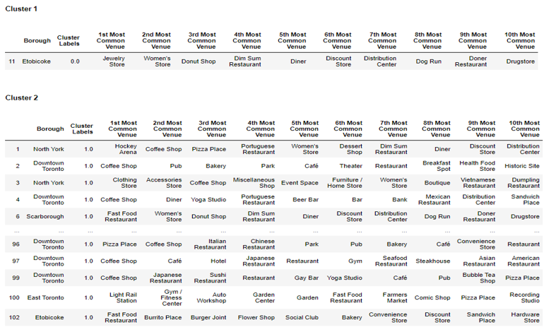
10 Most Common Venues: Cluster 1 and Cluster 2

Slide 8
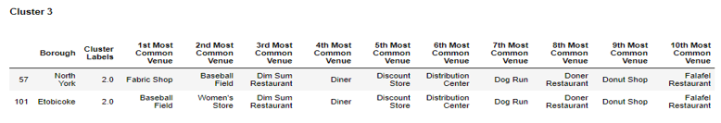
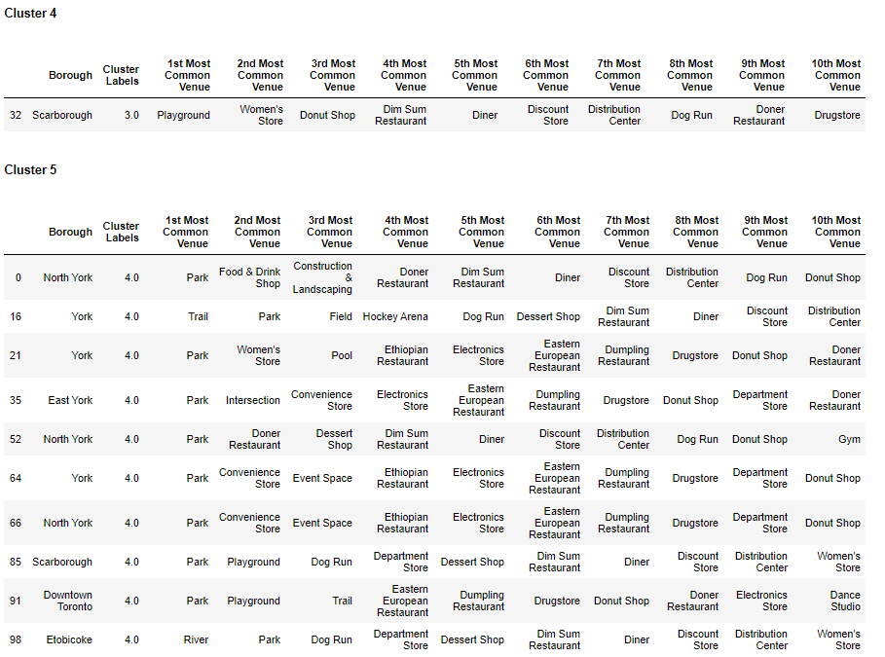
10 Most Common Venues: Cluster 3 through Cluster 5

Slide 9
Conclusion:
Ontario has the largest Latin American Population
Downtown Toronto is a hotspot for those seeking to find a variety of Latin venues
Toronto has many venues in its surrounding areas that cater to the Latin demographic
Downtown, North York, Etobicoke, and Scarborough neighborhoods are very similar and have a good variety of venues to offer
Parks
Dog Runs
Play grounds

